Slide 1

CS440/ECE448 Lecture 16: Linear Classifiers
Mark Hasegawa-Johnson, 3/2019
Including Slides by
Svetlana Lazebnik, 10/2016

Slide 2
Linear Classifiers
Naïve Bayes/BoW classifiers
Linear Classifiers in General
Perceptron
Differential Perceptron/Neural Net

Slide 3
Naïve Bayes/Bag-of-Words
Model parameters: feature likelihoods P(word | class) and priors P(class)
How do we obtain the values of these parameters?
Need training set of labeled samples from both classes
This is the maximum likelihood (ML) estimate, or estimate that maximizes the likelihood of the training data:
# of occurrences of this word in docs from this class
P(word | class) =
total # of words in docs from this class
d: index of training document, i: index of a word

Slide 4
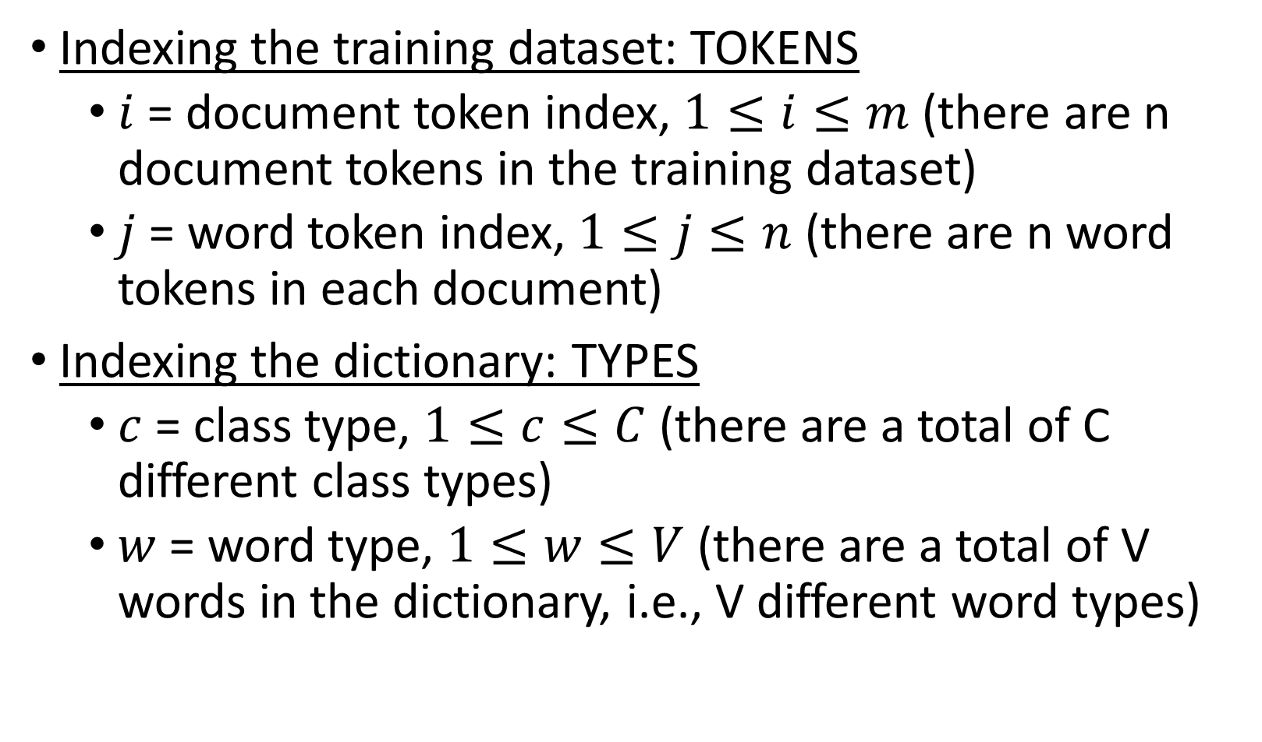
Indexing in BoW: Types vs. Tokens
Indexing the training dataset: TOKENS
$i$ = document token index, $1≤i≤m$ (there are n document tokens in the training dataset)
$j$ = word token index, $1≤j≤n$ (there are n word tokens in each document)
Indexing the dictionary: TYPES
$c$ = class type, $1≤c≤C$ (there are a total of C different class types)
$w$ = word type, $1≤w≤V$ (there are a total of V words in the dictionary, i.e., V different word types)

Slide 5
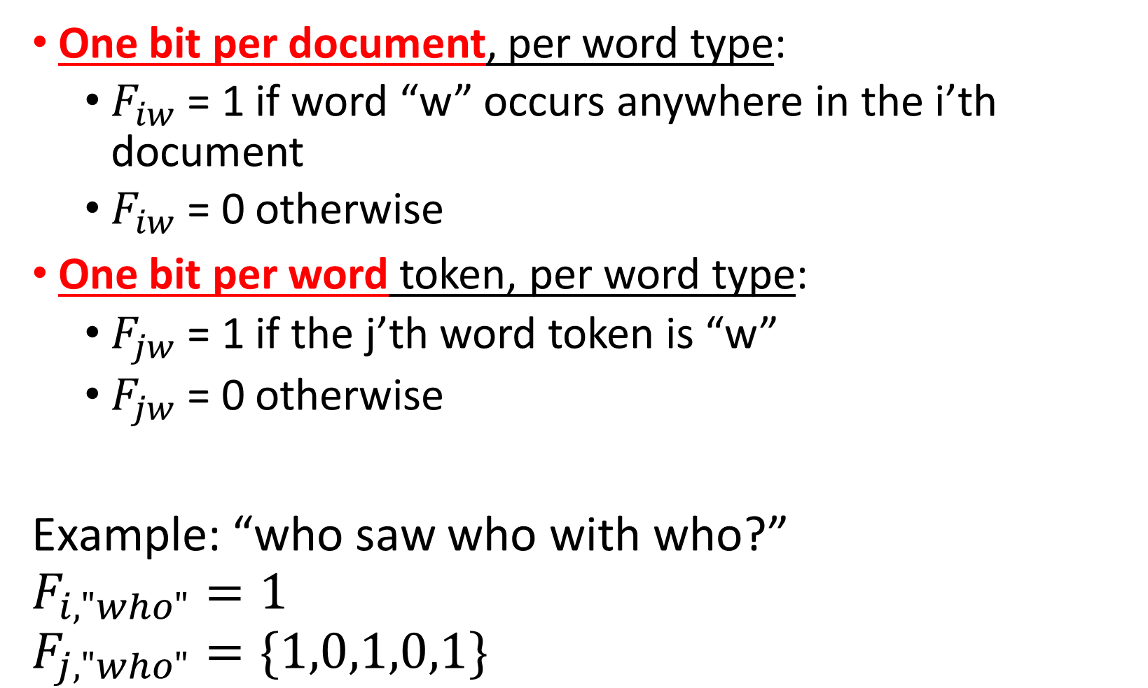
Two Different BoW Algorithms
One bit per document, per word type:
$F_{iw}$ = 1 if word “w” occurs anywhere in the i’th document
$F_{iw}$ = 0 otherwise
One bit per word token, per word type:
$F_{jw}$ = 1 if the j’th word token is “w”
$F_{jw}$ = 0 otherwise
Example: “who saw who with who?”
$$F_{i,"who"}=1$$
$$F_{j,"who"}=\{1,0,1,0,1\}$$

Slide 6
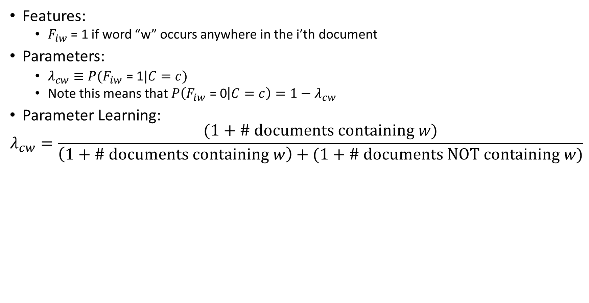
Feature = One Bit Per Document
Features:
$F_{iw}$ = 1 if word “w” occurs anywhere in the i’th document
Parameters:
$λ_{cw}≡P(F_{iw}\text{ = 1}|C=c)$
Note this means that $P\left(F_{iw}\text{ = }\text{0} | C=c\right)=1−λ_{cw}$
Parameter Learning:
$$λ_{cw}=\frac{(1+\# documents containing w)}{\left(1+\# documents containing w\right)+(1+\# documents NOT containing w)}$$

Slide 7
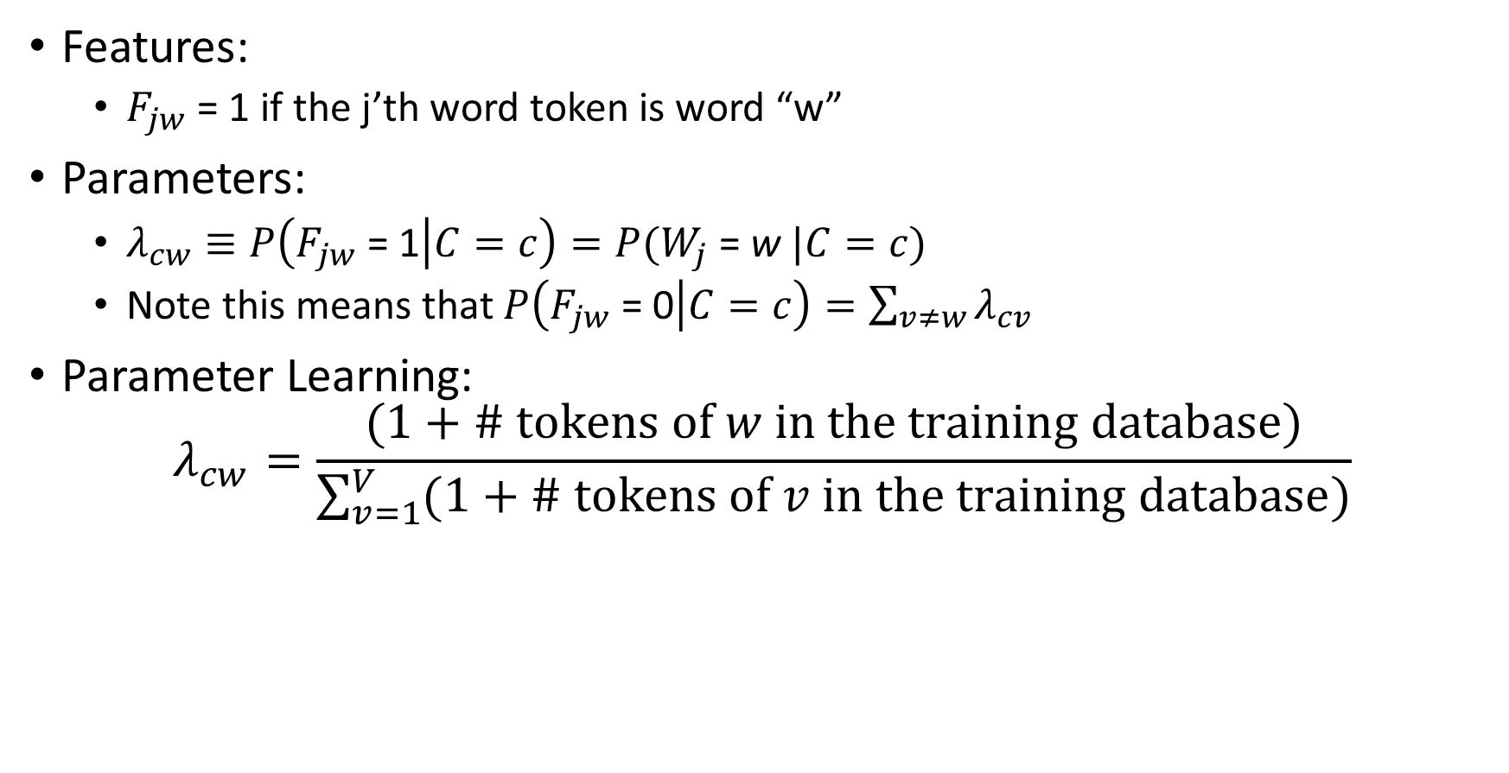
Feature = One Bit Per Word Token
Features:
$F_{jw}$ = 1 if the j’th word token is word “w”
Parameters:
$λ_{cw}≡P\left(F_{jw}\text{ = 1} | C=c\right)=P(W_{j}\text{ =} \text{w} |C=c)$
Note this means that $P\left(F_{jw}\text{ = }\text{0} | C=c\right)=\sum_{v≠w}{λ_{cv}}$
Parameter Learning:
$$λ_{cw}=\frac{(1+\# tokens of w in the training database)}{\sum_{v=1}^{V}{(1+\# tokens of v in the training database)}}$$

Slide 8

Feature = One Bit Per Document
Classification:
C* = argmax P(C=c|document)
= argmax P(C=c) P(Document|C=c)
$$=arg\max_{c}\left(π_{c}\prod_{w: f_{cw}=1}{λ_{cw}}\prod_{w: f_{cw}=0}{(1−λ_{cw})}\right)$$
P(C=c) * prod_{words that occurred}P(word ooccus|C=c) * prod_{didn’t occur} P(didn’t occur|C=c)

Slide 9

Feature = One Bit Per Word Token
Classification:
C* = argmax P(C=c|document)
= argmax P(C=c) P(Document|C=c)
$$=arg\max_{c}\left(π_{c}\prod_{j=1}^{n}{λ_{cw_{j}}}\right)$$
P(C=c) prod_{words in the document} P(get that particular word | C=c)

Slide 10
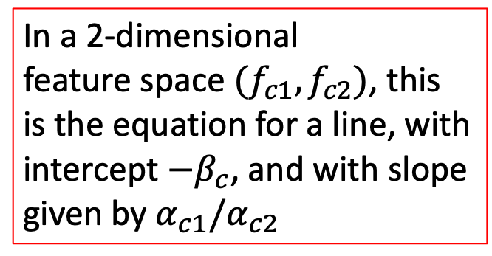

Feature = One Bit Per Document
Classification:
$$C^{∗}=arg\max_{c}\left(π_{c}\prod_{w=1}^{V}{{\left(\frac{λ_{cw}}{1−λ_{cw}}\right)}^{f_{cw}}(1−λ_{cw}) }\right)$$
$$C^{∗}=arg\max_{c}\left(β_{c}+\sum_{w=1}^{V}{α_{cw}f_{cw}}\right)$$
$$α_{cw}=\log\left(\frac{λ_{cw}}{1−λ_{cw}}\right), β_{c}=\log\left(π_{c}\prod_{w=1}^{V}{(1−λ_{cw}) }\right)$$
In a 2-dimensional
feature space $(f_{c1},f_{c2})$, this
is the equation for a line, with
intercept ${−β}_{c}$, and with slope
given by $α_{c1}/α_{c2}$

Slide 11
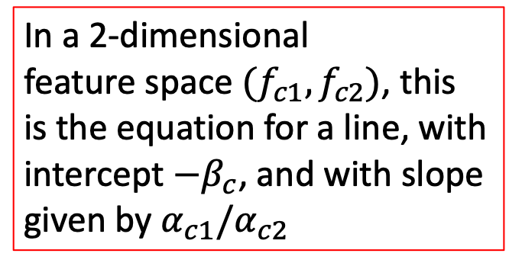

Feature = One Bit Per Word Token
Classification:
$$C^{∗}=arg\max_{c}\left(π_{c}\prod_{w=1}^{V}{{λ_{cw}}^{s_{w}} }\right)$$
Where $s_{w}=$ number of times w occurred in the document!! So…
$$C^{∗}=arg\max_{c}\left(β_{c}+\sum_{w=1}^{V}{α_{cw}s_{cw}}\right)$$
$$α_{cw}=\log{λ_{cw}}, β_{c}=\log{π_{c}}$$
In a 2-dimensional
feature space $(f_{c1},f_{c2})$, this
is the equation for a line, with
intercept ${−β}_{c}$, and with slope
given by $α_{c1}/α_{c2}$

Slide 12
Linear Classifiers
Naïve Bayes/BoW classifiers
Linear Classifiers in General
Perceptron
Differential Perceptron/Neural Net

Slide 13
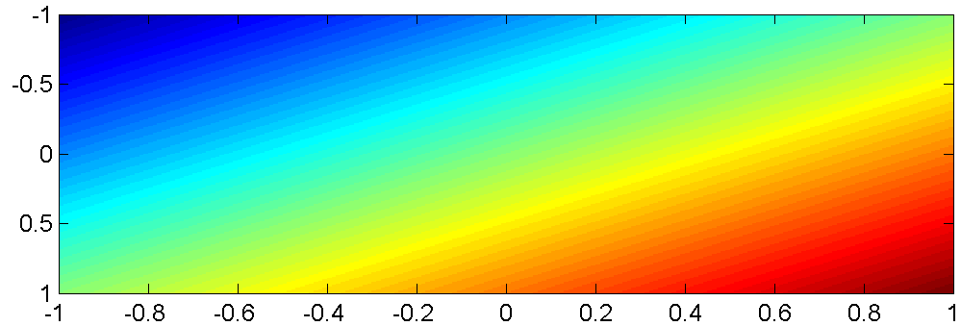
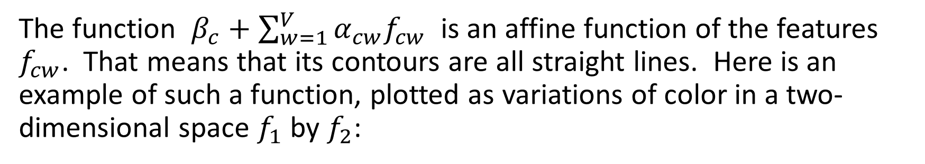


Linear Classifiers in General
The function $β_{c}+\sum_{w=1}^{V}{α_{cw}f_{cw}}$ is an affine function of the features $f_{cw}$. That means that its contours are all straight lines. Here is an example of such a function, plotted as variations of color in a two-dimensional space $f_{1}$ by $f_{2}$:
$$f_{2}$$
$$f_{1}$$

Slide 14
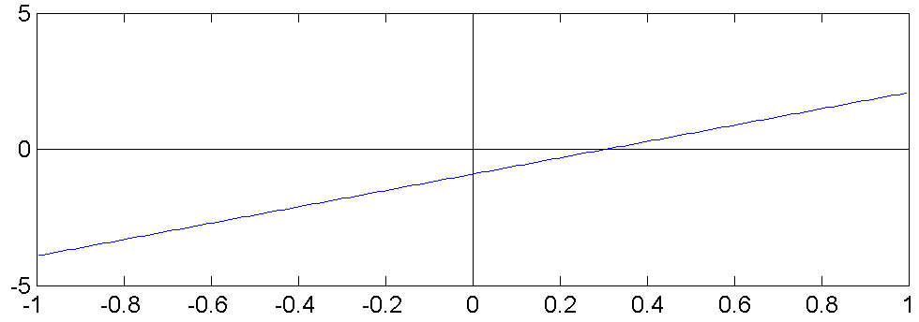
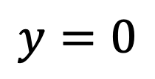
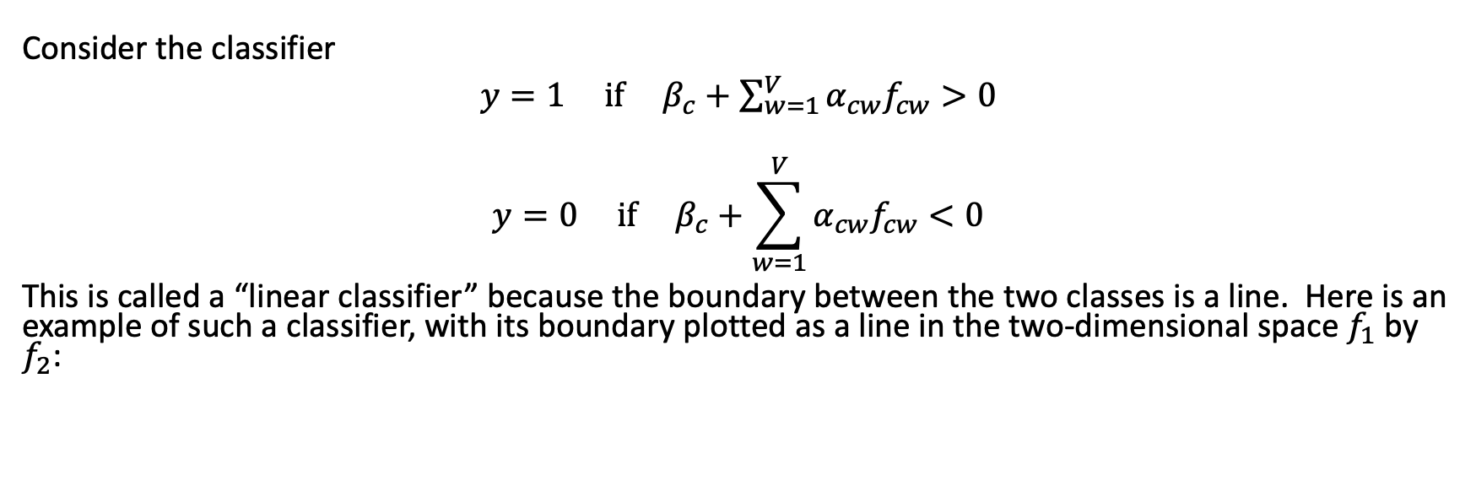
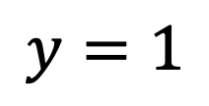


Linear Classifiers in General
Consider the classifier
${y=1 if β}_{c}+\sum_{w=1}^{V}{α_{cw}f_{cw}}>0$
$${y=0 if β}_{c}+\sum_{w=1}^{V}{α_{cw}f_{cw}}<0$$
This is called a “linear classifier” because the boundary between the two classes is a line. Here is an example of such a classifier, with its boundary plotted as a line in the two-dimensional space $f_{1}$ by $f_{2}$:
$$y=0$$
$$f_{2}$$
$$y=1$$
$$f_{1}$$

Slide 15



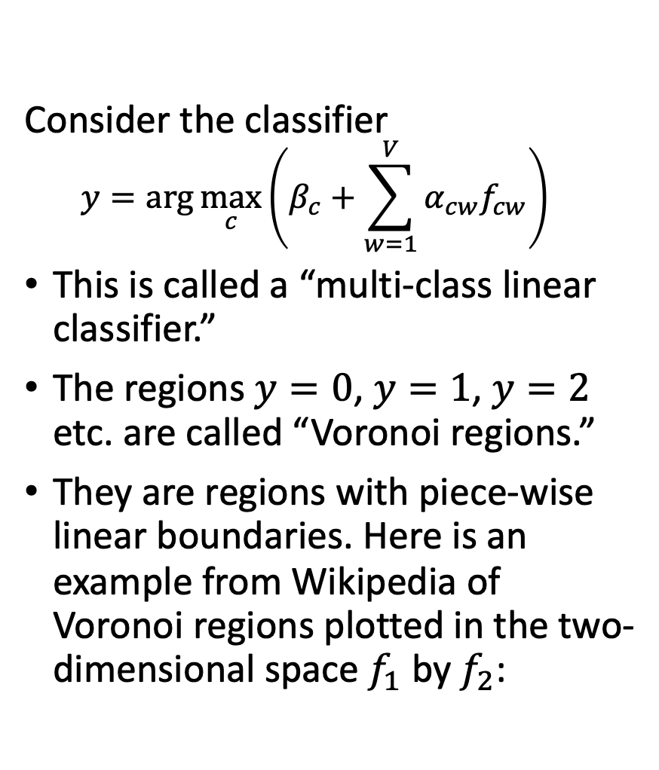








Linear Classifiers in General
$$y=1$$
$$y=2$$
$$y=3$$
Consider the classifier
$$y=arg\max_{c}\left(β_{c}+\sum_{w=1}^{V}{α_{cw}f_{cw}}\right)$$
This is called a “multi-class linear classifier.”
The regions $y=0$, $y=1$, $y=2$ etc. are called “Voronoi regions.”
They are regions with piece-wise linear boundaries. Here is an example from Wikipedia of Voronoi regions plotted in the two-dimensional space $f_{1}$ by $f_{2}$:
$$y=4$$
$$y=0$$
$$y=5$$
$$y=6$$
$$y=7$$
…
…
…
…
$$f_{2}$$
…
…
$$f_{1}$$

Slide 16


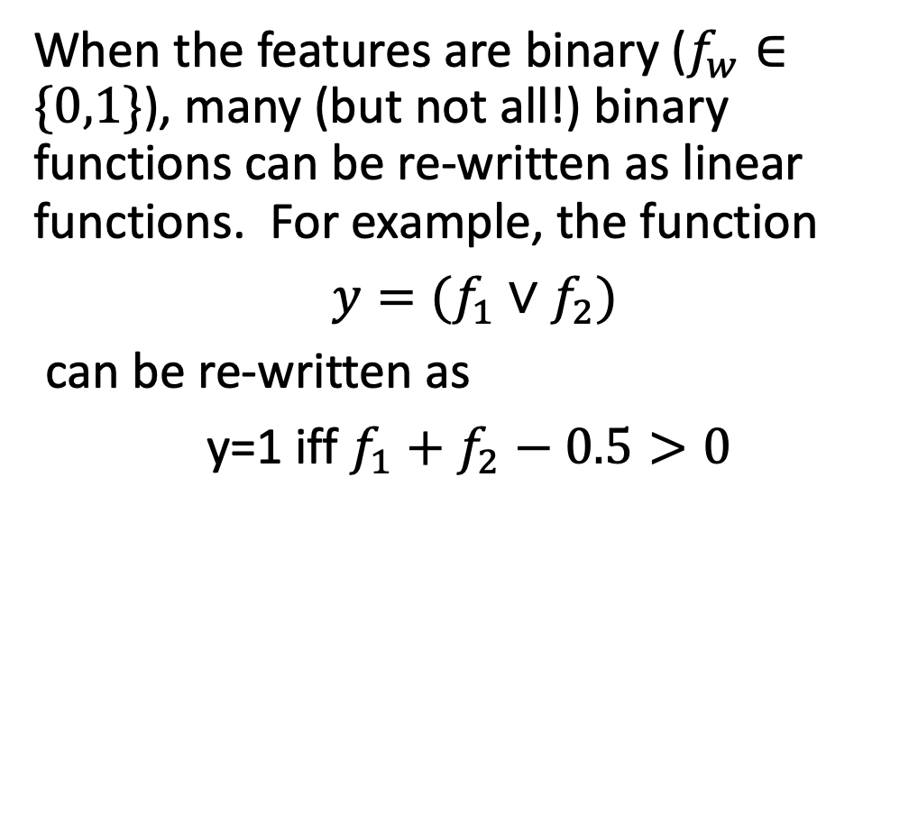



Linear Classifiers in General
When the features are binary ($f_{w}∈\{0,1\}$), many (but not all!) binary functions can be re-written as linear functions. For example, the function
$y=(f_{1}∨f_{2})$
can be re-written as
y=1 iff $f_{1}+f_{2}−0.5>0$
Similarly, the function
$y=(f_{1}∧f_{2})$
can be re-written as
y=1 iff $f_{1}+f_{2}−1.5>0$
$$f_{2}$$
$$f_{2}$$
$$f_{1}$$
$$f_{1}$$

Slide 17
Linear Classifiers in General
Not all logical functions can be written as linear classifiers!
Minsky and Papert wrote a book called Perceptrons in 1969. Although the book said many other things, the only thing most people remembered about the book was that:
“A linear classifier cannot learn an XOR function.”
Because of that statement, most people gave up working on neural networks from about 1969 to about 2006.
Minsky and Papert also proved that a two-layer neural net can learn an XOR function. But most people didn’t notice.

Slide 18
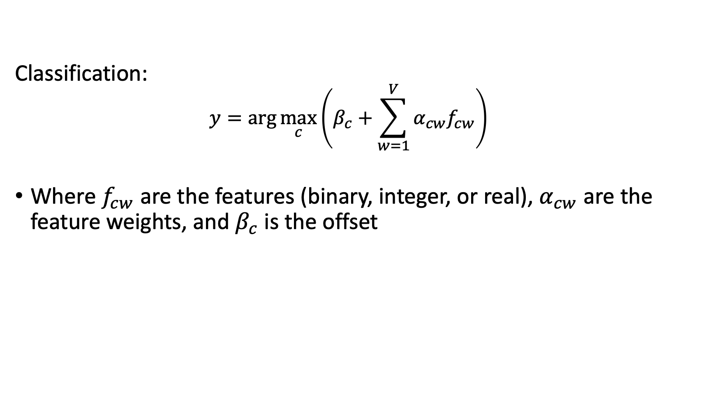
Linear Classifiers
Classification:
$$y=arg\max_{c}\left(β_{c}+\sum_{w=1}^{V}{α_{cw}f_{cw}}\right)$$
Where $f_{cw}$ are the features (binary, integer, or real), $α_{cw}$ are the feature weights, and $β_{c}$ is the offset

Slide 19
Linear Classifiers
Naïve Bayes/BoW classifiers
Linear Classifiers in General
Perceptron
Differential Perceptron/Neural Net

Slide 20
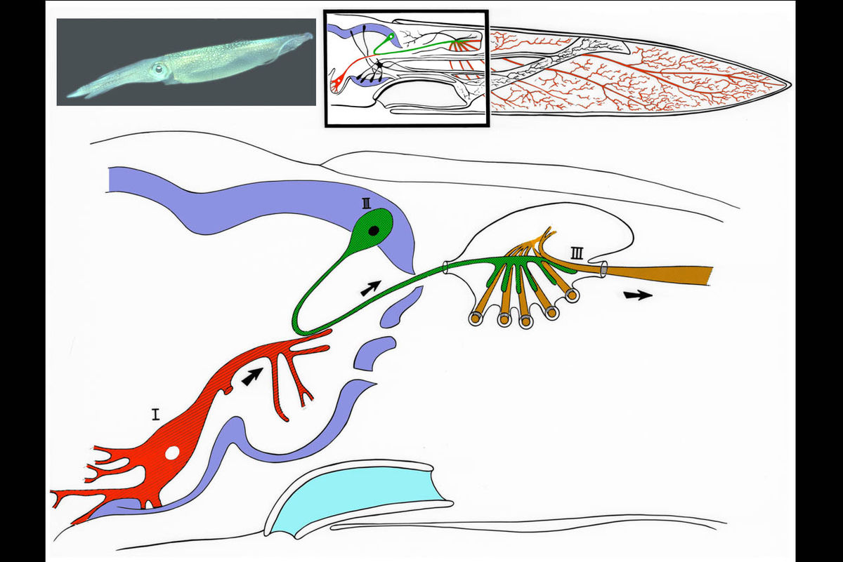
The Giant Squid Axon
1909: Williams discovers that the giant squid has a giant neuron (axon 1mm thick)
1939: Young finds a giant synapse (fig. shown: Llinás, 1999, via Wikipedia). Hodgkin & Huxley put in voltage clamps.
1952: Hodgkin & Huxley publish an electrical current model for the generation of binary action potentials from real-valued inputs.

Slide 21
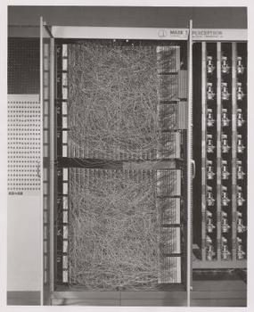
Perceptron
1959: Rosenblatt is granted a patent for the “perceptron,” an electrical circuit model of a neuron.

Slide 22
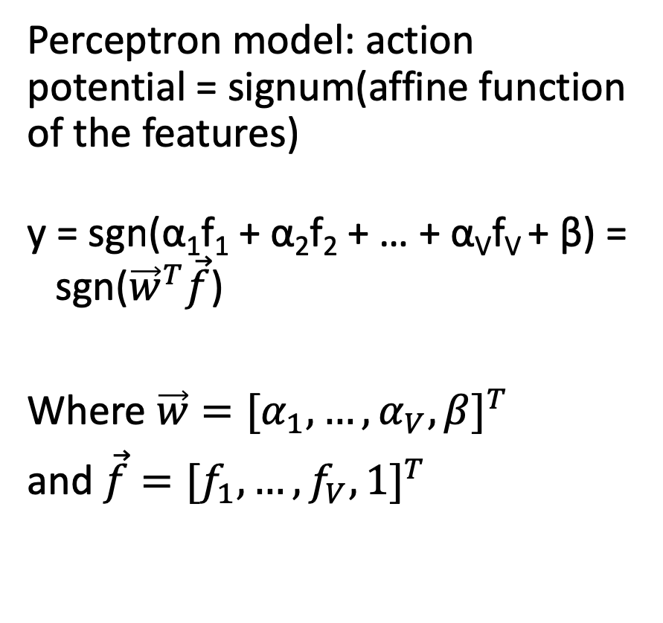
Perceptron
Perceptron model: action potential = signum(affine function of the features)
y = sgn(α₁f₁ + α₂f₂ + … + α_{V}f_{V} + β) = sgn(${\vec{w}}^{T}\vec{f}$)
Where $\vec{w}={[α_{1},…,α_{V},β]}^{T}$
and $\vec{f}={[f_{1},…,f_{V},1]}^{T}$
Input
Weights
x₁
w₁
x₂
w₂
Output: sgn(w⋅x + b)
x₃
w₃
.
.
.
w_{D}
Can incorporate bias as component of the weight vector by always including a feature with value set to 1
x_{D}

Slide 23
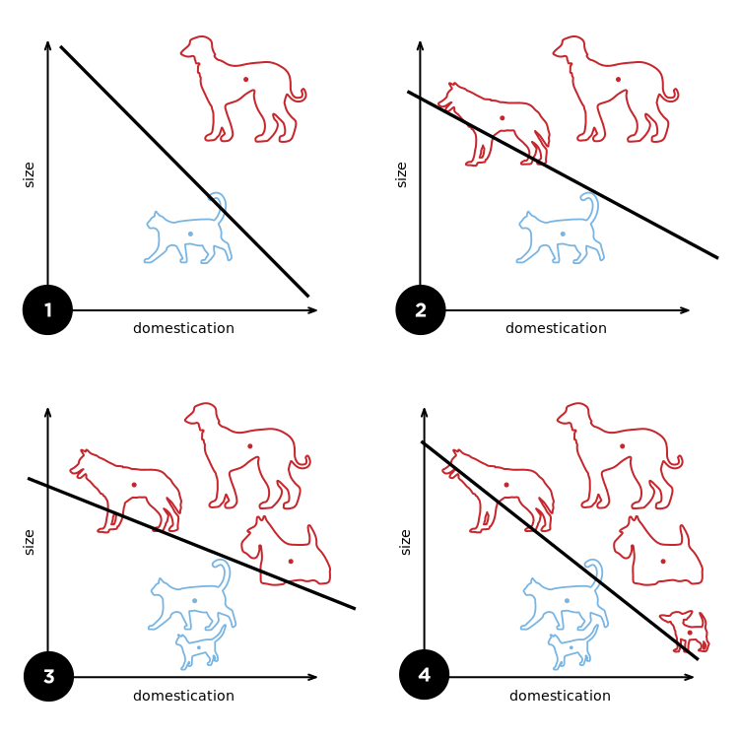
Perceptron
Rosenblatt’s big innovation: the perceptron learns from examples.
Initialize weights randomly
Cycle through training examples in multiple passes (epochs)
For each training example:
If classified correctly, do nothing
If classified incorrectly, update weights

Slide 24
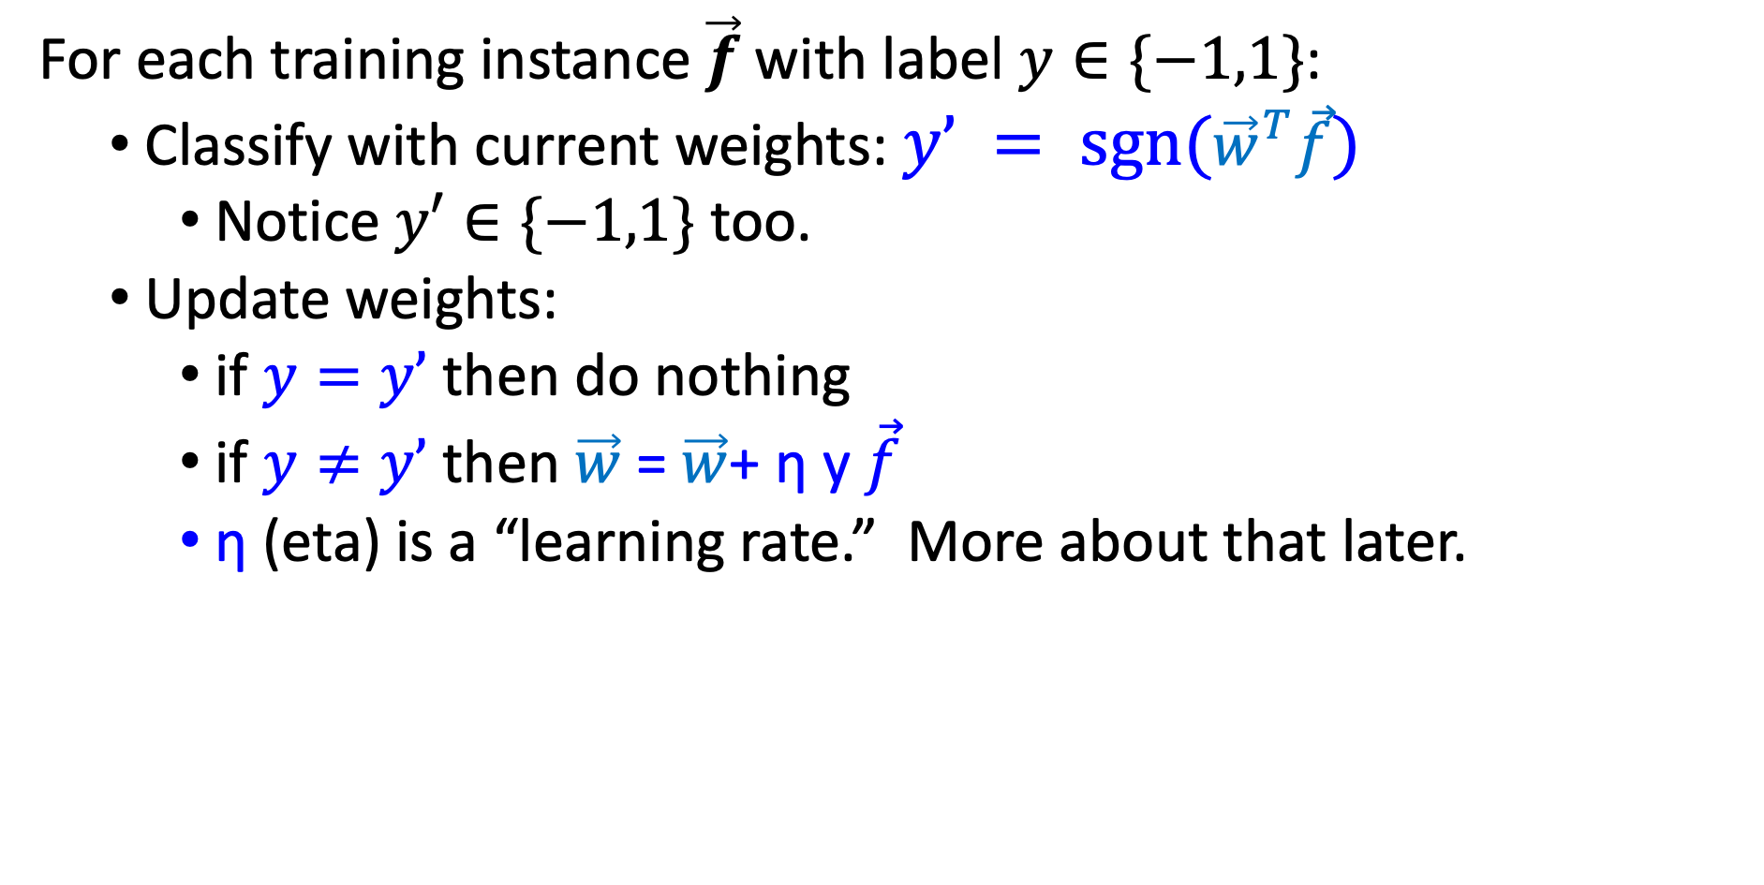
Perceptron
For each training instance $\vec{f}$ with label $y∈\{−1,1\}$:
Classify with current weights: $y’ = sgn({\vec{w}}^{T}\vec{f})$
Notice $y′∈\{−1,1\}$ too.
Update weights:
if $y=y’$ then do nothing
if $y≠y’$ then $\vec{w}$= $\vec{w}$+ η y $\vec{f}$
η (eta) is a “learning rate.” More about that later.

Slide 25
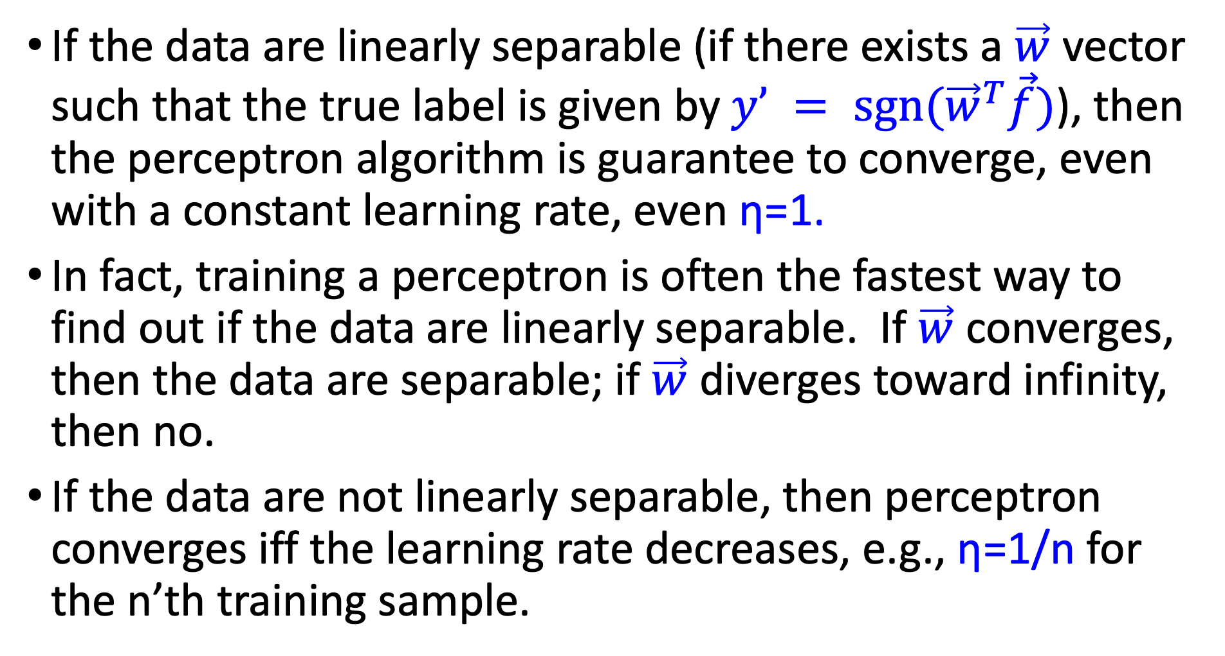
Perceptron: Proof of Convergence
If the data are linearly separable (if there exists a $\vec{w}$ vector such that the true label is given by $y’ = sgn({\vec{w}}^{T}\vec{f})$), then the perceptron algorithm is guarantee to converge, even with a constant learning rate, even η=1.
In fact, training a perceptron is often the fastest way to find out if the data are linearly separable. If $\vec{w}$ converges, then the data are separable; if $\vec{w}$ diverges toward infinity, then no.
If the data are not linearly separable, then perceptron converges iff the learning rate decreases, e.g., η=1/n for the n’th training sample.

Slide 26
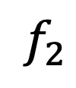

Perceptron: Proof of Convergence
Suppose the data are linearly separable. For example, suppose red dots are the class y=1, and blue dots are the class y=-1:
$$f_{2}$$
$$f_{1}$$

Slide 27
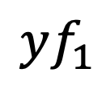
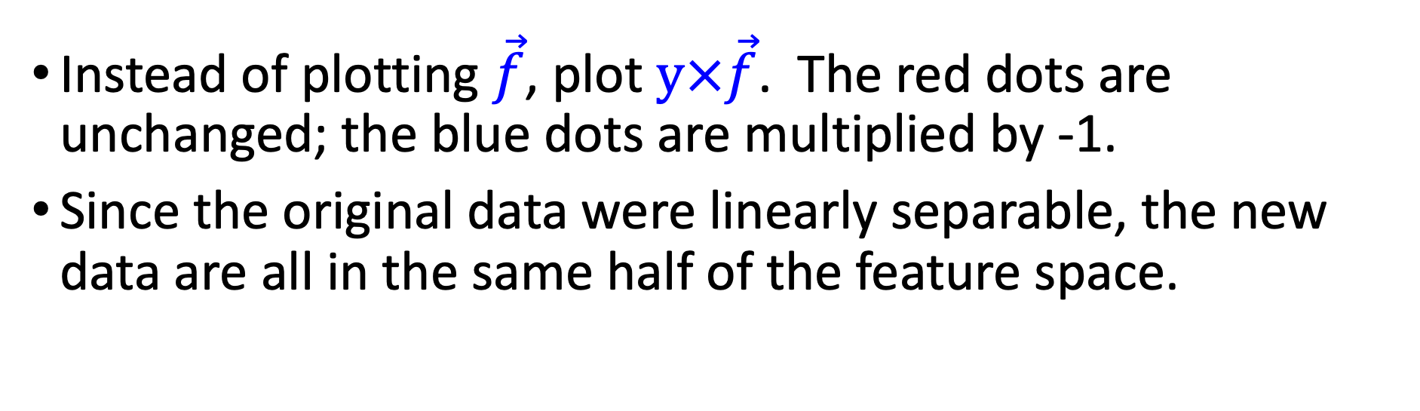
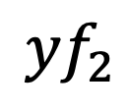
Perceptron: Proof of Convergence
Instead of plotting $\vec{f}$, plot $y×\vec{f}$. The red dots are unchanged; the blue dots are multiplied by -1.
Since the original data were linearly separable, the new data are all in the same half of the feature space.
$${yf}_{2}$$
$$yf_{1}$$

Slide 28

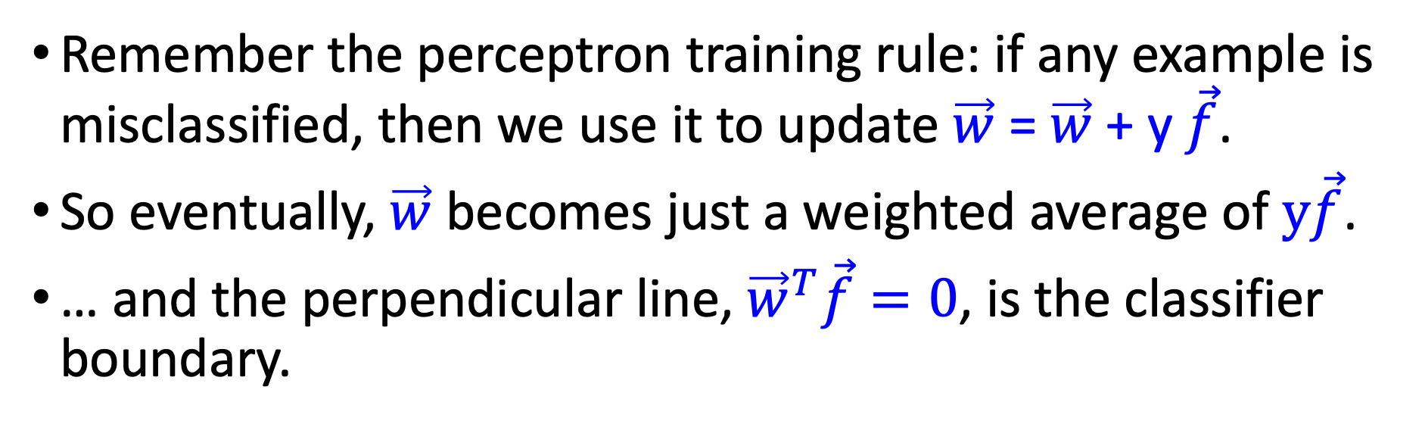


Perceptron: Proof of Convergence
Remember the perceptron training rule: if any example is misclassified, then we use it to update $\vec{w}$ = $\vec{w}$ + y $\vec{f}$.
So eventually, $\vec{w}$ becomes just a weighted average of $y\vec{f}$.
… and the perpendicular line, ${\vec{w}}^{T}\vec{f}=0$, is the classifier boundary.
$$\vec{w}$$
$${yx}_{2}$$
$$yx_{1}$$

Slide 29
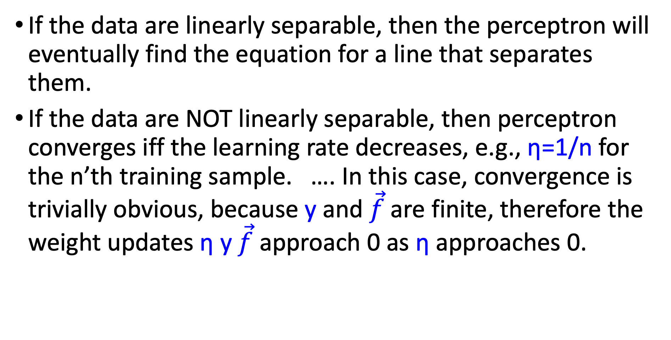
Perceptron: Proof of Convergence: Conclusion
If the data are linearly separable, then the perceptron will eventually find the equation for a line that separates them.
If the data are NOT linearly separable, then perceptron converges iff the learning rate decreases, e.g., η=1/n for the n’th training sample. …. In this case, convergence is trivially obvious, because y and $\vec{f}$are finite, therefore the weight updates η y $\vec{f}$ approach 0 as η approaches 0.

Slide 30
Implementation details
Bias (add feature dimension with value fixed to 1) vs. no bias
Initialization of weights: all zeros vs. random
Learning rate decay function
Number of epochs (passes through the training data)
Order of cycling through training examples (random)

Slide 31
Multi-class perceptrons
One-vs-others framework: Need to keep a weight vector w_{c} for each class c
Decision rule: y = argmax_{c} w_{c}⋅ f
Update rule: suppose example from class c gets misclassified as c’
Update for c: w_{c} ← w_{c} + η f
Update for c’: w_{c’} ← w_{c’} – η f
Update for all classes other than c and c’: no change

Slide 32
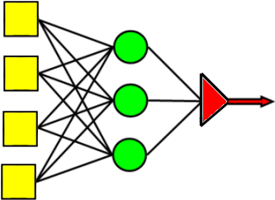
Review: Multi-class perceptrons
One-vs-others framework: Need to keep a weight vector w_{c} for each class c
Decision rule: y = argmax_{c} w_{c}⋅ f
Max
Perceptrons w/ weights w_{c}
Inputs

Slide 33
Linear Classifiers
Naïve Bayes/BoW classifiers
Linear Classifiers in General
Perceptron
Differential Perceptron/Neural Net

Slide 34
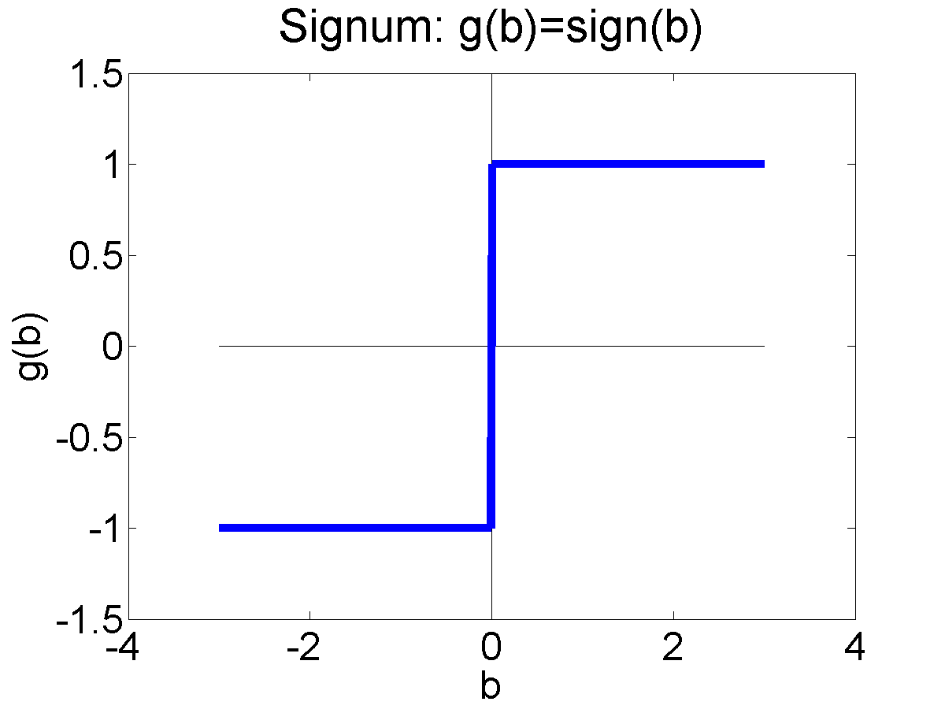
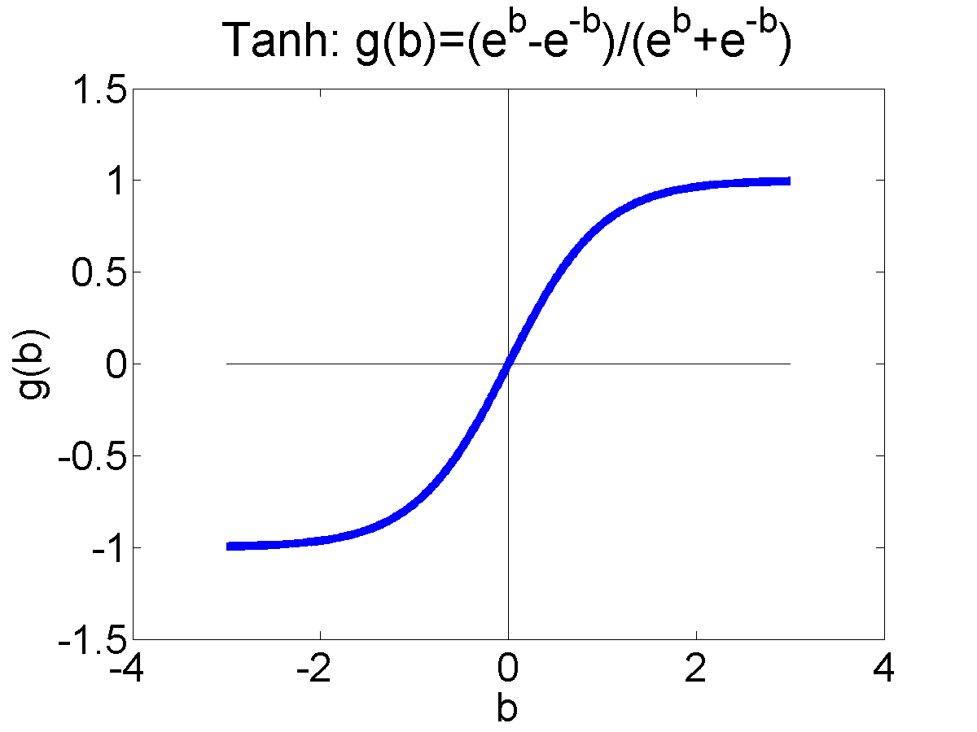
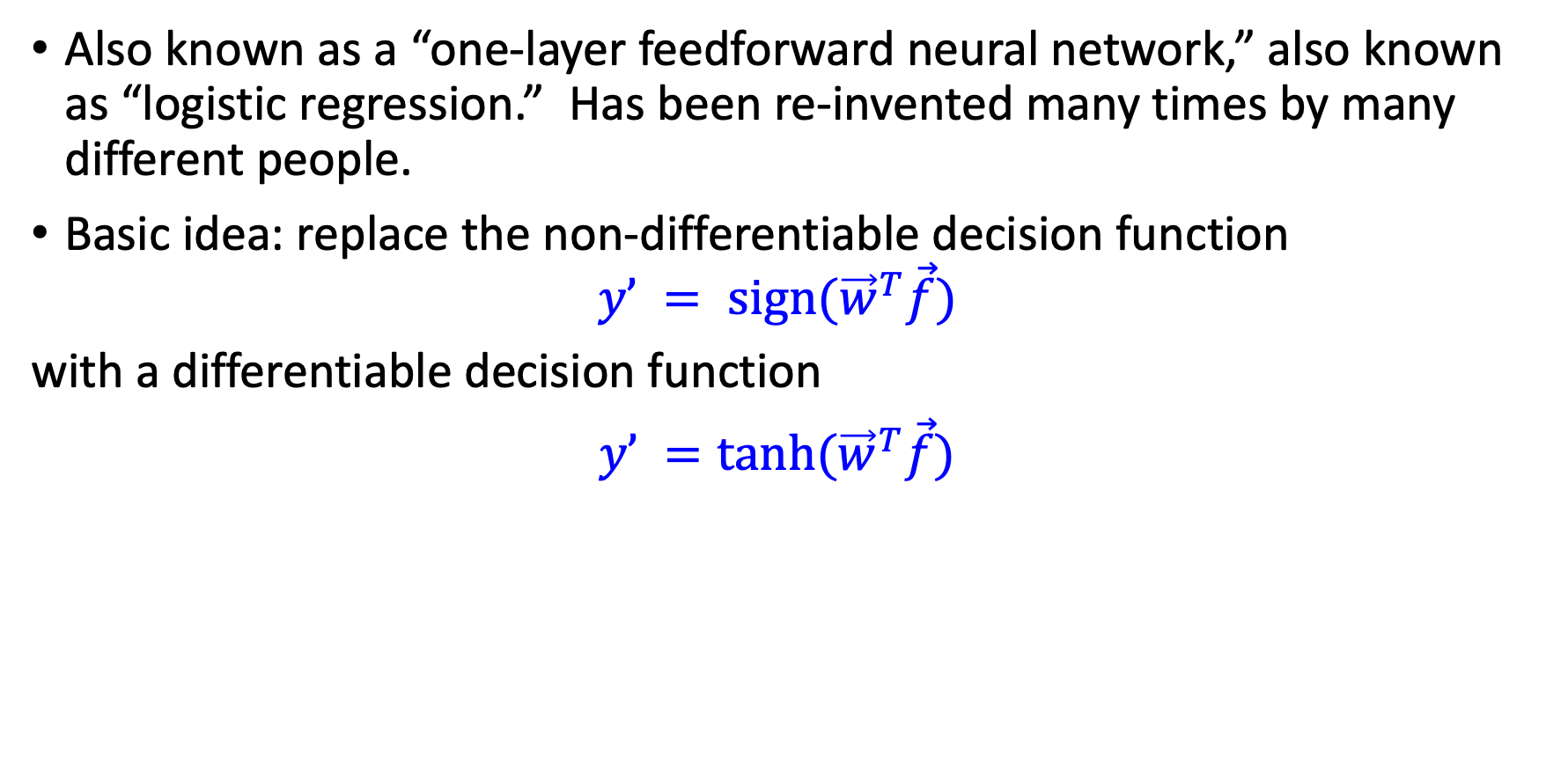
Differentiable Perceptron
Also known as a “one-layer feedforward neural network,” also known as “logistic regression.” Has been re-invented many times by many different people.
Basic idea: replace the non-differentiable decision function
$$y’ = sign({\vec{w}}^{T}\vec{f})$$
with a differentiable decision function
$y’ =tanh({\vec{w}}^{T}\vec{f})$

Slide 35
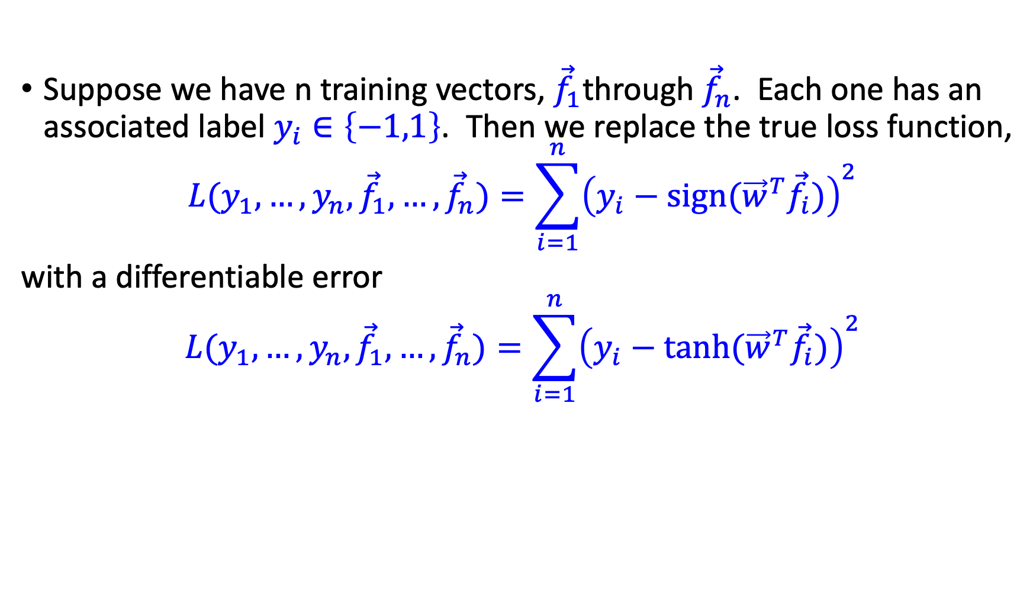
Differentiable Perceptron
Suppose we have n training vectors, ${\vec{f}}_{1}$through ${\vec{f}}_{n}$. Each one has an associated label $y_{i}∈\left\{−1,1\right\}$. Then we replace the true loss function,
$$L(y_{1},…,y_{n},{\vec{f}}_{1},…,{\vec{f}}_{n})=\sum_{i=1}^{n}{{\left(y_{i}−sign({\vec{w}}^{T}{\vec{f}}_{i})\right)}^{2}}$$
with a differentiable error
$$L(y_{1},…,y_{n},{\vec{f}}_{1},…,{\vec{f}}_{n})=\sum_{i=1}^{n}{{\left(y_{i}−tanh({\vec{w}}^{T}{\vec{f}}_{i})\right)}^{2}}$$

Slide 36
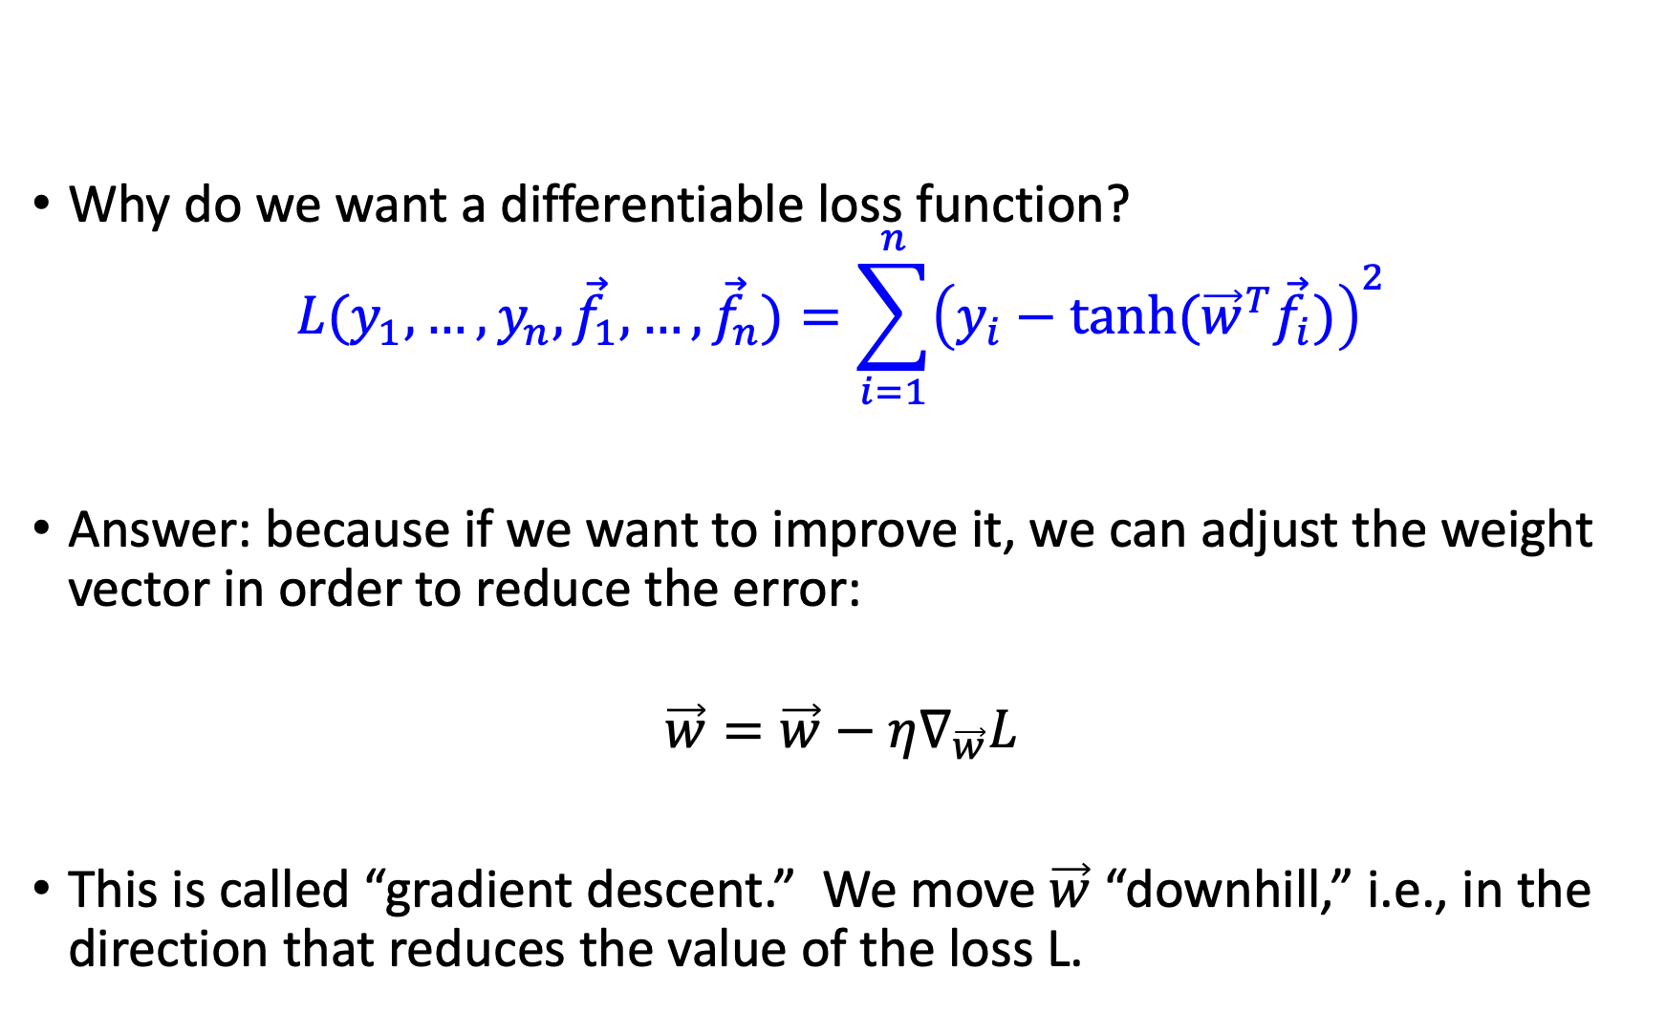
Why Differentiable?
Why do we want a differentiable loss function?
$$L(y_{1},…,y_{n},{\vec{f}}_{1},…,{\vec{f}}_{n})=\sum_{i=1}^{n}{{\left(y_{i}−tanh({\vec{w}}^{T}{\vec{f}}_{i})\right)}^{2}}$$
Answer: because if we want to improve it, we can adjust the weight vector in order to reduce the error:
$$\vec{w}=\vec{w}−η∇_{\vec{w}}L$$
This is called “gradient descent.” We move $\vec{w}$ “downhill,” i.e., in the direction that reduces the value of the loss L.

Slide 37
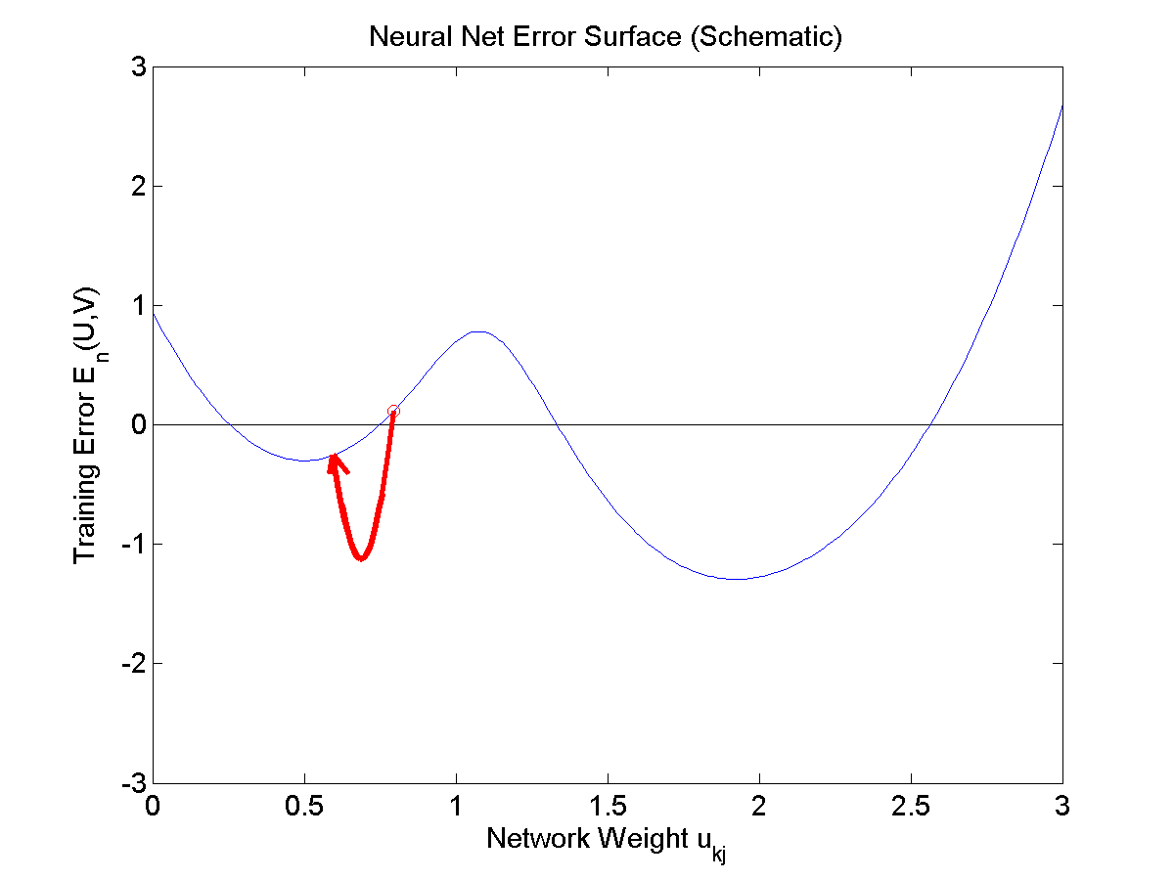

Differential Perceptron
The weights get updated according to
$$\vec{w}=\vec{w}−η∇_{\vec{w}}L$$

Slide 38
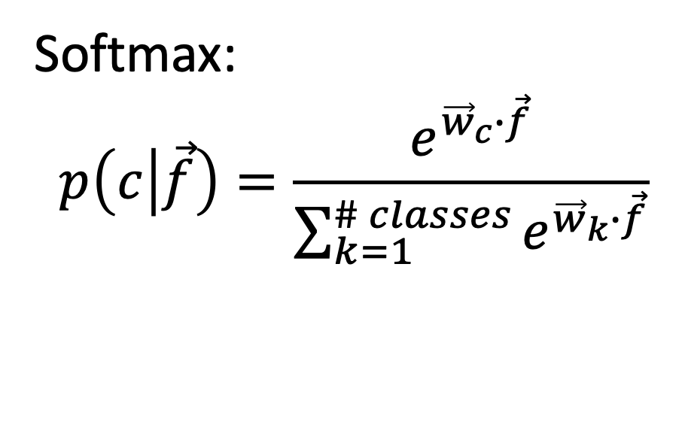
Differentiable Multi-class perceptrons
Same idea works for multi-class perceptrons. We replace the non-differentiable decision rule c = argmax_{c} w_{c}⋅ f with the differentiable decision rule c = softmax_{c} w_{c}⋅ f, where the softmax function is defined as
Softmax:
$$p\left(c | \vec{f}\right)=\frac{e^{{\vec{w}}_{c}∙\vec{f}}}{\sum_{k=1}^{\# classes}{e^{{\vec{w}}_{k}∙\vec{f}}}}$$
Softmax
Perceptrons w/ weights w_{c}
Inputs

Slide 39
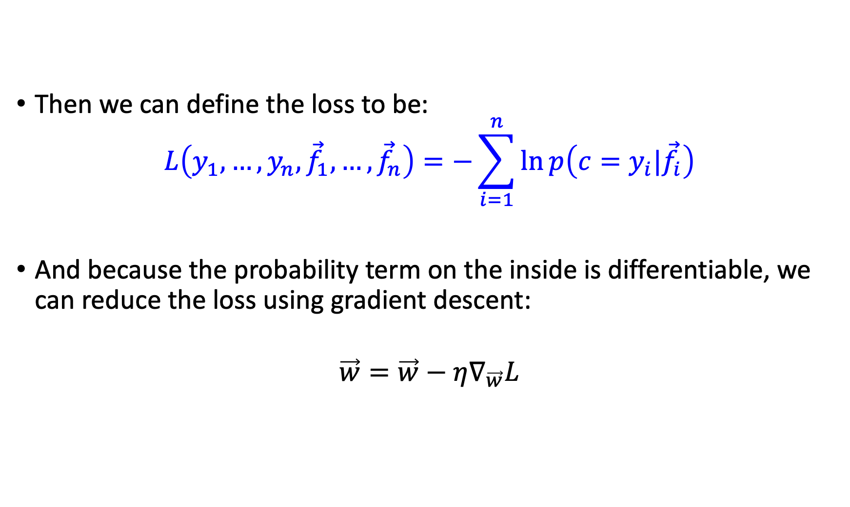
Differentiable Multi-Class Perceptron
Then we can define the loss to be:
$$L\left(y_{1},…,y_{n},{\vec{f}}_{1},…,{\vec{f}}_{n}\right)=−\sum_{i=1}^{n}{\ln{p\left(c=y_{i}|{\vec{f}}_{i}\right)}}$$
And because the probability term on the inside is differentiable, we can reduce the loss using gradient descent:
$$\vec{w}=\vec{w}−η∇_{\vec{w}}L$$

Slide 40
Summary
You now know SEVEN!! different types of linear classifiers. These 5 types are things you should completely understand already now:
One bit per document Naïve Bayes
One bit per word token Naïve Bayes
Linear classifier can implement some logical functions, like AND and OR, but not others, like XOR
Perceptron
Multi-class Perceptron
These 2 types of linear classifiers have been introduced today, and you should know the general idea, but you don’t need to understand the equations yet. We will spend lots more time talking about those equations later in the semester.
Differentiable Perceptron a.k.a. Logistic Regression
Differentiable Multi-class perceptron

