Slide 1
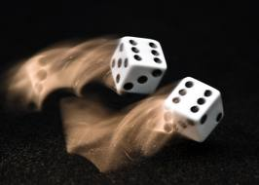
CS 440/ECE 448 Lecture 10:
Probability
Slides by Svetlana Lazebnik, 9/2016
Modified by Mark Hasegawa-Johnson, 2/2019

Slide 2
Outline
Motivation: Why use probability?
  Laziness, Ignorance, and Randomness
  Rational Bettor Theorem
Review of Key Concepts
  Outcomes, Events
  Random Variables; probability mass function (pmf)
  Jointly random variables: Joint, Marginal, and Conditional pmf
  Independent vs. Conditionally Independent events

Slide 3
Outline
Motivation: Why use probability?
  Laziness, Ignorance, and Randomness
  Rational Bettor Theorem
Review of Key Concepts
  Outcomes, Events
  Joint, Marginal, and Conditional
  Independence and Conditional Independence

Slide 4
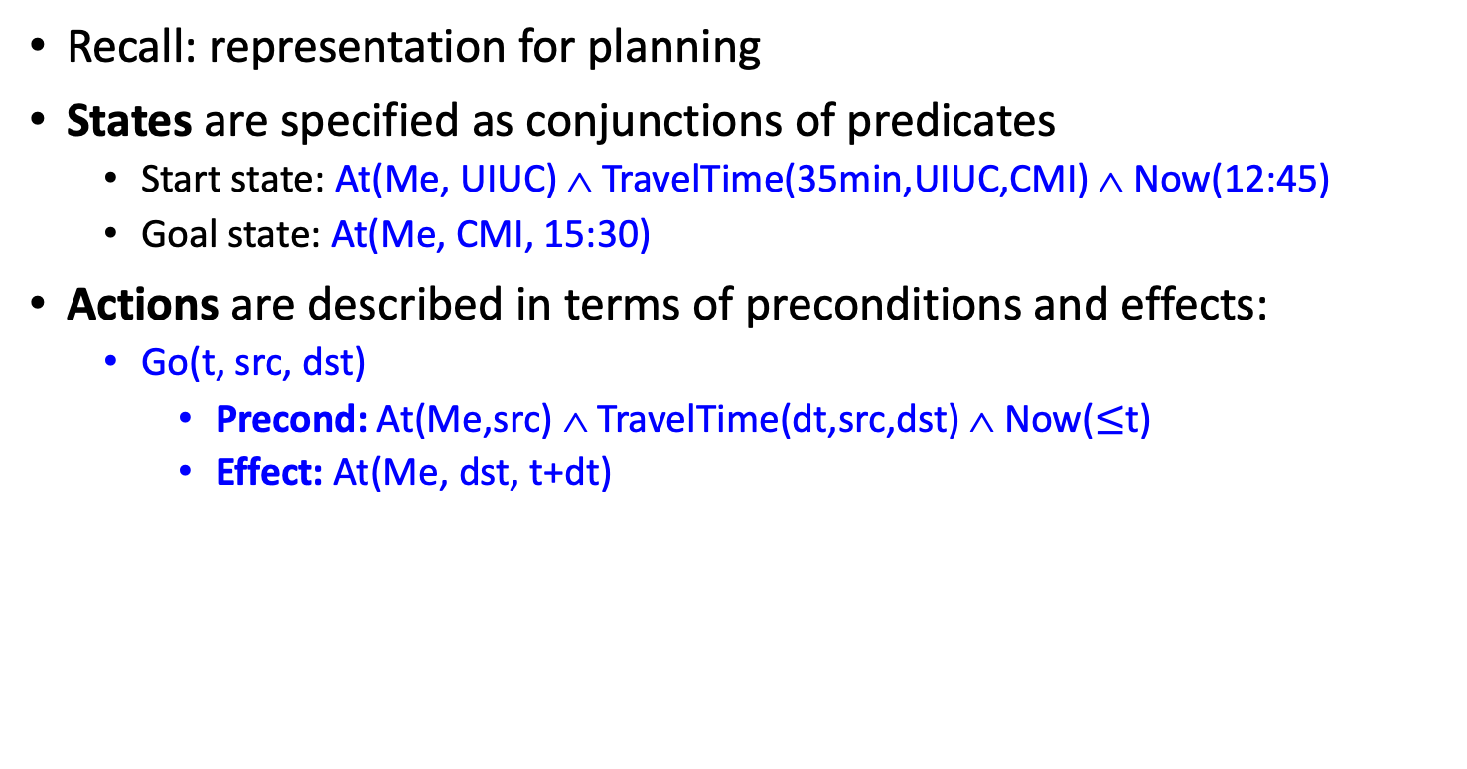
Motivation: Planning under uncertainty
Recall: representation for planning
States are specified as conjunctions of predicates
  Start state: At(Me, UIUC) ∧ TravelTime(35min,UIUC,CMI) ∧ Now(12:45)
  Goal state: At(Me, CMI, 15:30)
Actions are described in terms of preconditions and effects:
  Go(t, src, dst)
    Precond: At(Me,src) ∧ TravelTime(dt,src,dst) ∧ Now($≤$t)
    Effect: At(Me, dst, t+dt)

Slide 5
Motivation: Planning under uncertainty
Let action Go(t) = leave for airport at time t
  Will Go(t) succeed, i.e., get me to the airport in time for the flight?
Problems:
    Partial observability (road state, other drivers' plans, etc.)
    Noisy sensors (traffic reports)
    Uncertainty in action outcomes (flat tire, etc.)
    Complexity of modeling and predicting traffic
Hence a purely logical approach either
    Risks falsehood: “Go(14:30) will get me there on time,” or
    Leads to conclusions that are too weak for decision making:
    Go(14:30) will get me there on time if there's no accident, it doesn't rain, my tires remain intact, etc., etc.
    Go(04:30) will get me there on time

Slide 6
Probability
Probabilistic assertions summarize effects of
  Laziness: reluctance to enumerate exceptions, qualifications, etc. --- possibly a deterministic and known environment, but with computational complexity limitations
  Ignorance: lack of explicit theories, relevant facts, initial conditions, etc. --- environment that is unknown (we don’t know the transition function) or partially observable (we can’t measure the current state)
  Intrinsically random phenomena – environment is stochastic, i.e., given a particular (action,current state), the (next state) is drawn at random with a particular probability distribution

Slide 7
Outline
Motivation: Why use probability?
  Laziness, Ignorance, and Randomness
  Rational Bettor Theorem
Review of Key Concepts
  Outcomes, Events
  Joint, Marginal, and Conditional
  Independence and Conditional Independence

Slide 8
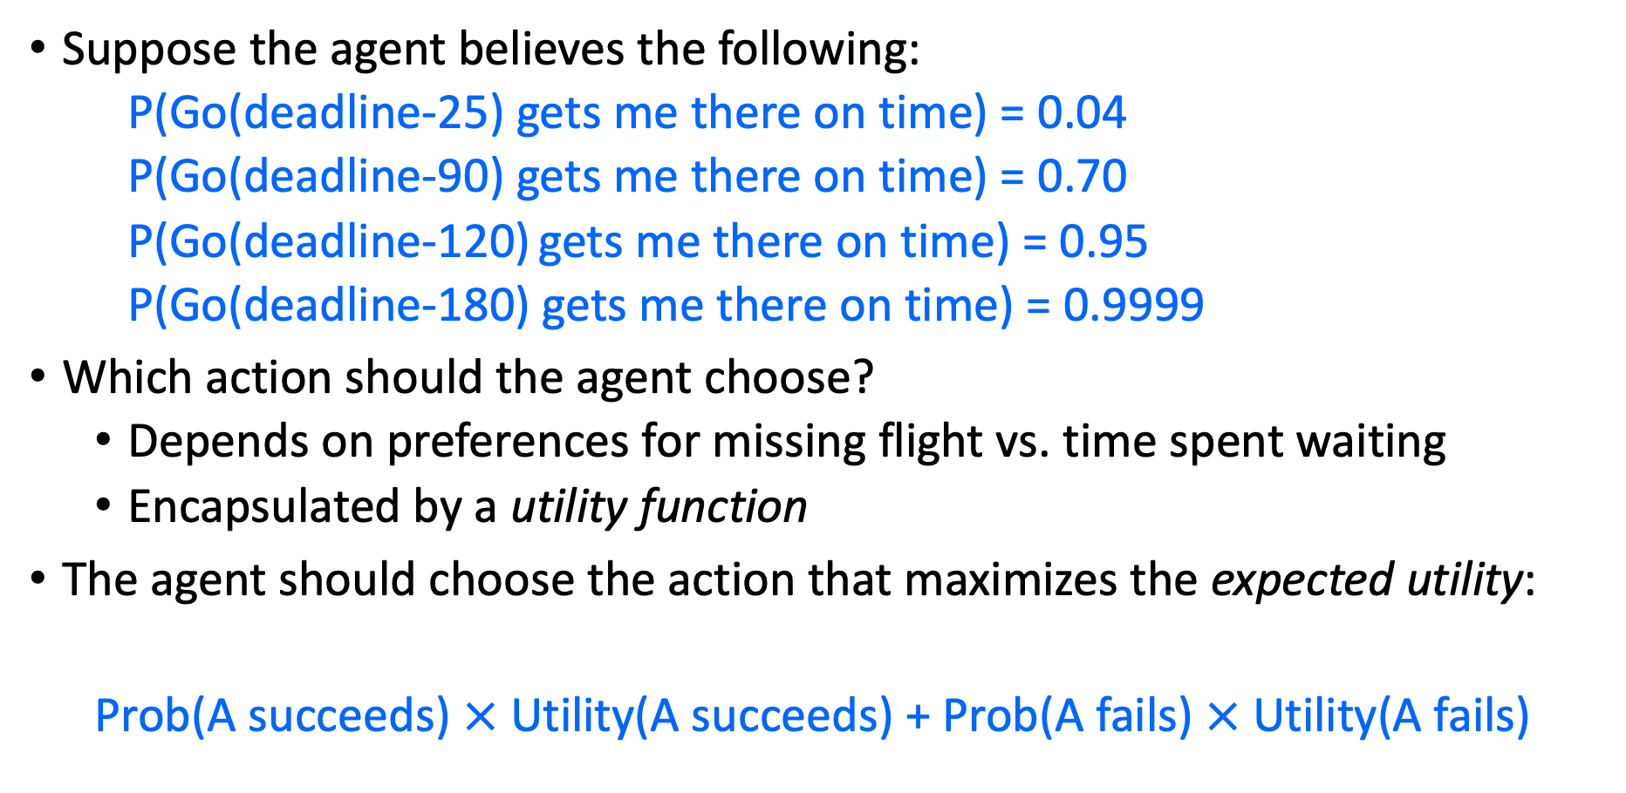
Making decisions under uncertainty
Suppose the agent believes the following:
  P(Go(deadline-25) gets me there on time) = 0.04
  P(Go(deadline-90) gets me there on time) = 0.70
  P(Go(deadline-120) gets me there on time) = 0.95
  P(Go(deadline-180) gets me there on time) = 0.9999
Which action should the agent choose?
  Depends on preferences for missing flight vs. time spent waiting
  Encapsulated by a utility function
The agent should choose the action that maximizes the expected utility:
  Prob(A succeeds) $×$ Utility(A succeeds) + Prob(A fails) $×$ Utility(A fails)

Slide 9
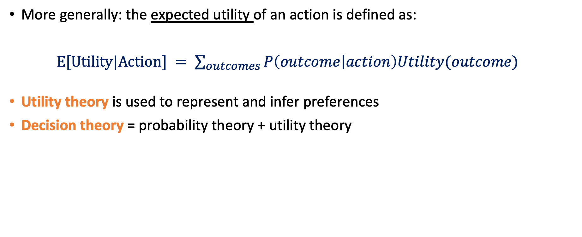
Making decisions under uncertainty
More generally: the expected utility of an action is defined as:
$E[Utility|Action] = \sum_{outcomes}{P\left(outcome | action\right)Utility(outcome)}$
Utility theory is used to represent and infer preferences
Decision theory = probability theory + utility theory

Slide 10
Where do probabilities come from?
Frequentism
  Probabilities are relative frequencies
  For example, if we toss a coin many times, P(heads) is the proportion of the time the coin will come up heads
  But what if we’re dealing with an event that has never happened before?
    What is the probability that the Earth will warm by 0.15 degrees this year?
Subjectivism
  Probabilities are degrees of belief
  But then, how do we assign belief values to statements?
  In practice: models. Represent an unknown event as a series of better-known events
A theoretical problem with Subjectivism:
Why do “beliefs” need to follow the laws of probability?

Slide 11
The Rational Bettor Theorem
Why should a rational agent hold beliefs that are consistent with axioms of probability?
  For example, P(A) + P(¬A) = 1
Suppose an agent believes that P(A)=0.7, and P(¬A)=0.7
Offer the following bet: if A occurs, agent wins $100. If A doesn’t occur, agent loses $105. Agent believes P(A)>100/(100+105), so agent accepts the bet.
Offer another bet: if ¬A occurs, agent wins $100. If ¬A doesn’t occur, agent loses $105. Agent believes P(¬A)>100/(100+105), so agent accepts the bet. Oops…
Theorem: An agent who holds beliefs inconsistent with axioms of probability can be convinced to accept a combination of bets that is guaranteed to lose them money
Notes:
If A occurs, the agent wins $6. If A does not occur, the agend loses $4. EU(bet) = 0.4 * 6 – 0.6 * 4 = 0

Slide 12
Are humans “rational bettors”?
Humans are pretty good at estimating some probabilities, and pretty bad at estimating others. What might cause humans to mis-estimate the probability of an event?
What are some of the ways in which a “rational bettor” might take advantage of humans who mis-estimate probabilities?

Slide 13
Outline
Motivation: Why use probability?
  Laziness, Ignorance, and Randomness
  Rational Bettor Theorem
Review of Key Concepts
  Outcomes, Events
  Joint, Marginal, and Conditional
  Independence and Conditional Independence

Slide 14
Events
Probabilistic statements are defined over events, or sets of world states
  A = “It is raining”
  B = “The weather is either cloudy or snowy”
  C = “I roll two dice, and the result is 11”
  D = “My car is going between 30 and 50 miles per hour”
An EVENT is a SET of OUTCOMES
  B = { outcomes : cloudy OR snowy }
  C = { outcome tuples (d1,d2) such that d1+d2 = 11 }
Notation: P(A) is the probability of the set of world states (outcomes) in which proposition A holds

Slide 15
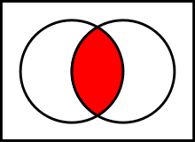
Kolmogorov’s axioms of probability
For any propositions (events) A, B
  0 ≤ P(A) ≤ 1
  P(True) = 1 and P(False) = 0
  P(A ∨ B) = P(A) + P(B) – P(A ∧ B)
    Subtraction accounts for double-counting
Based on these axioms, what is P(¬A)?
These axioms are sufficient to completely specify probability theory for discrete random variables
  For continuous variables, need density functions
A
A∧B
B

Slide 16
Outcomes = Atomic events
OUTCOME or ATOMIC EVENT: is a complete specification of the state of the world, or a complete assignment of domain values to all random variables
  Atomic events are mutually exclusive and exhaustive
E.g., if the world consists of only two Boolean variables Cavity and Toothache, then there are four outcomes:
Outcome #1: ¬Cavity ∧ ¬Toothache
Outcome #2: ¬Cavity ∧ Toothache
Outcome #3: Cavity ∧ ¬Toothache
Outcome #4: Cavity ∧ Toothache

Slide 17
Outline
Motivation: Why use probability?
  Laziness, Ignorance, and Randomness
  Rational Bettor Theorem
Review of Key Concepts
  Outcomes, Events
  Joint, Marginal, and Conditional
  Independence and Conditional Independence

Slide 18
Joint probability distributions
A joint distribution is an assignment of probabilities to every possible atomic event
  Why does it follow from the axioms of probability that the probabilities of all possible atomic events must sum to 1?
Atomic event | P
¬Cavity ∧ ¬Toothache | 0.8
¬Cavity ∧ Toothache | 0.1
Cavity ∧ ¬Toothache | 0.05
Cavity ∧ Toothache | 0.05

Slide 19
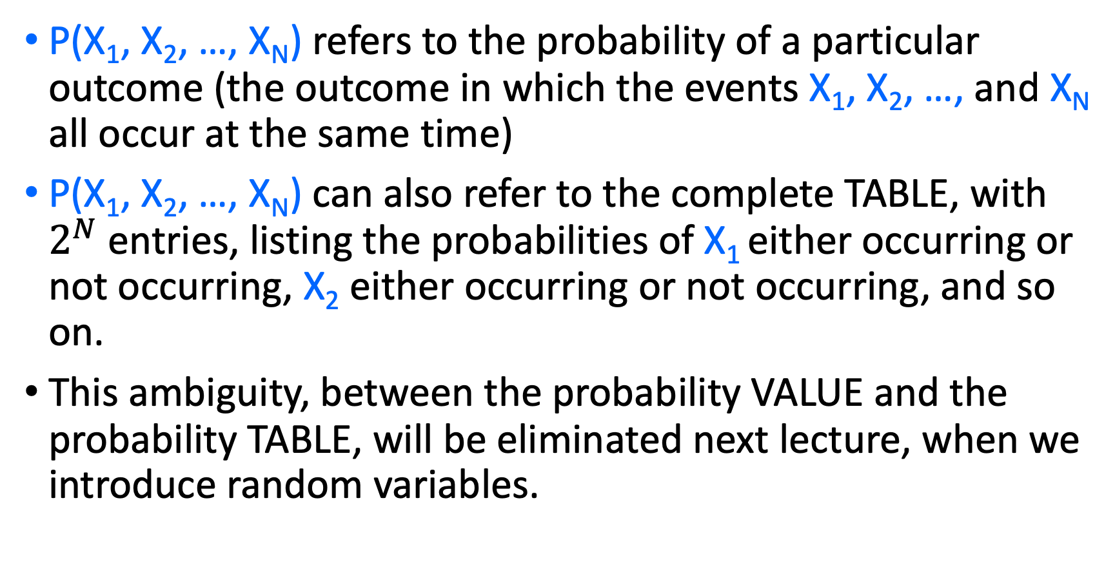
Joint probability distributions
P(X₁, X₂, …, X_{N}) refers to the probability of a particular outcome (the outcome in which the events X₁, X₂, …, and X_{N} all occur at the same time)
P(X₁, X₂, …, X_{N}) can also refer to the complete TABLE, with $2^{N}$ entries, listing the probabilities of X₁ either occurring or not occurring, X₂ either occurring or not occurring, and so on.
This ambiguity, between the probability VALUE and the probability TABLE, will be eliminated next lecture, when we introduce random variables.

Slide 20
Joint probability distributions
Suppose we have a joint distribution of N random variables, each of which takes values from a domain of size D:
  What is the size of the probability table?
  Impossible to write out completely for all but the smallest distributions

Slide 21
Marginal distributions
The marginal distribution of event X_{k} is just its probability, P(X_{k}).
To talk about marginal distributions only makes sense if you’re not given P(X_{k}). Instead, you’re given the joint distribution, P(X₁, X₂, …, X_{N}) , and from it, you need to calculate P(X_{k}).
You calculate P(X_{k}) from P(X₁, X₂, …, X_{N}) by marginalizing. P(X_{k}) is called the marginal distribution of event X_{k}.

Slide 22
Marginal probability distributions
From the joint distribution p(X,Y) we can find the marginal distributions p(X) and p(Y)
P(Cavity, Toothache)
¬Cavity ∧ ¬Toothache | 0.8
¬Cavity ∧ Toothache | 0.1
Cavity ∧ ¬Toothache | 0.05
Cavity ∧ Toothache | 0.05
P(Cavity)
¬Cavity | ?
Cavity | ?
P(Toothache)
¬Toothache | ?
Toochache | ?

Slide 23
Joint -> Marginal by adding the outcomes
From the joint distribution p(X,Y) we can find the marginal distributions p(X) and p(Y)
To find p(X = x), sum the probabilities of all atomic events where X = x:
This is called marginalization (we are marginalizing out all the variables except X)
$$P\left(X=1\right)=P\left(X=1,Y=1\right)+P\left(X=1,Y=2\right)+P\left(X=1,Y=3\right)+…$$

Slide 24
Conditional distributions
The conditional probability of event X_{k}, given event X_{j}, is the probability that X_{k} has occurred if you already know that X_{j} has occurred.
The conditional distribution is written P(X_{k}| X_{j}).
The probability that both X_{j} and X_{k} occurred was, originally, P(X_{j}, X_{k}).
But now you know that X_{j} has occurred. So all of the other events are no longer possible.
  Other events: probability used to be P(¬X_{j}), but now their probability is 0.
  Events in which X_{j} occurred: probability used to be P(X_{j}), but now their probability is 1.
So we need to renormalize: the probability that both X_{j} and X_{k} occurred, GIVEN that X_{j} has occurred, is P(X_{k}| X_{j})=P(X_{j}, X_{k})/P(X_{j}).

Slide 25
Conditional Probability: renormalize (divide)
Probability of cavity given toothache:
P(Cavity = true | Toothache = true)
For any two events A and B,
Now that we know B has occurred, the set of all possible events = the set of events in which B occurred. So we renormalize to make the area of this circle = 1.
P(A ∧ B)
The set of all possible events used to be this rectangle, so the whole rectangle used to have probability=1.
P(A)
P(B)

Slide 26
Conditional probability
P(Cavity, Toothache)
¬Cavity ∧ ¬Toothache | 0.8
¬Cavity ∧ Toothache | 0.1
Cavity ∧ ¬Toothache | 0.05
Cavity ∧ Toothache | 0.05
P(Cavity)
¬Cavity | 0.9
Cavity | 0.1
P(Toothache)
¬Toothache | 0.85
Toochache | 0.15
What is p(Cavity = true | Toothache = false)?
  p(Cavity|¬Toothache) = 0.05/0.85 = 1/17
What is p(Cavity = false | Toothache = true)?
  p(¬Cavity|Toothache) = 0.1/0.15 = 2/3

Slide 27
Conditional distributions
A conditional distribution is a distribution over the values of one variable given fixed values of other variables
P(Cavity, Toothache)
¬Cavity ∧ ¬Toothache | 0.8
¬Cavity ∧ Toothache | 0.1
Cavity ∧ ¬Toothache | 0.05
Cavity ∧ Toothache | 0.05
P(Cavity | Toothache = true)
¬Cavity | 0.667
Cavity | 0.333
P(Cavity|Toothache = false)
¬Cavity | 0.941
Cavity | 0.059
P(Toothache | Cavity = true)
¬Toothache | 0.5
Toochache | 0.5
P(Toothache | Cavity = false)
¬Toothache | 0.889
Toochache | 0.111

Slide 28
Normalization trick
To get the whole conditional distribution p(X | Y = y) at once, select all entries in the joint distribution table matching Y = y and renormalize them to sum to one
P(Cavity, Toothache)
¬Cavity ∧ ¬Toothache | 0.8
¬Cavity ∧ Toothache | 0.1
Cavity ∧ ¬Toothache | 0.05
Cavity ∧ Toothache | 0.05
Select
Toothache, Cavity = false
¬Toothache | 0.8
Toochache | 0.1
Renormalize
P(Toothache | Cavity = false)
¬Toothache | 0.889
Toochache | 0.111

Slide 29
Normalization trick
To get the whole conditional distribution p(X | Y = y) at once, select all entries in the joint distribution table matching Y = y and renormalize them to sum to one
Why does it work?
P(x|y)=
by marginalization

Slide 30
Product rule
Definition of conditional probability:
Sometimes we have the conditional probability and want to obtain the joint:

Slide 31
Product rule
Definition of conditional probability:
Sometimes we have the conditional probability and want to obtain the joint:
The chain rule:

Slide 32
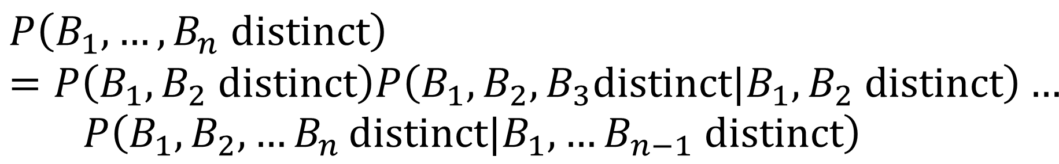
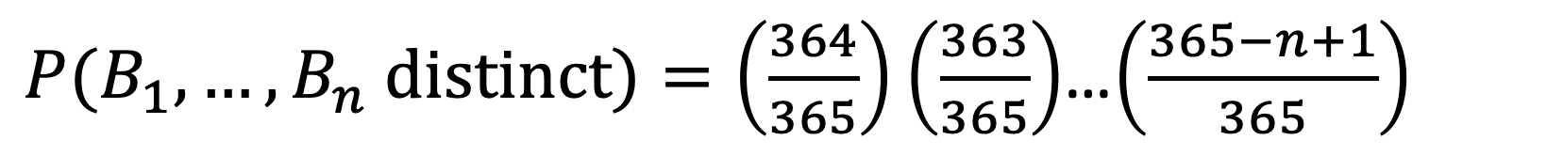
Product Rule Example: The Birthday problem
We have a set of n people. What is the probability that two of them share the same birthday?
Easier to calculate the probability that n people do not share the same birthday
$$P\left(B_{1},…,B_{n} distinct\right)=P\left(B_{1},B_{2} distinct\right)P\left(B_{1},B_{2},B_{3}distinct|B_{1},B_{2} distinct\right)…$$
$$P\left(B_{1},B_{2},{…B}_{n}distinct|B_{1},…B_{n−1} distinct\right)$$
$P(B_{1},…,B_{n} distinct)=\left(\frac{364}{365}\right)\left(\frac{363}{365}\right)$…$\left(\frac{365−n+1}{365}\right)$

Slide 33
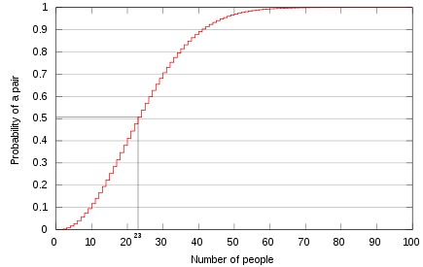
The Birthday problem
For 23 people, the probability of sharing a birthday is above 0.5!
http://en.wikipedia.org/wiki/Birthday_problem

Slide 34
Outline
Motivation: Why use probability?
  Laziness, Ignorance, and Randomness
  Rational Bettor Theorem
Review of Key Concepts
  Outcomes, Events, and Random Variables
  Joint, Marginal, and Conditional
  Independence and Conditional Independence

Slide 35
Independence ≠ Mutually Exclusive
Two events A and B are independent if and only if
p(A ∧ B) = p(A, B) = p(A) p(B)
  In other words, p(A | B) = p(A) and p(B | A) = p(B)
  This is an important simplifying assumption for modeling, e.g., Toothache and Weather can be assumed to be independent?
Are two mutually exclusive events independent?
  No! Quite the opposite! If you know A happened, then you know that B _didn’t_ happen!!
  p(A ∨ B) = p(A) + p(B)

Slide 36
Independence ≠ Conditional Independence
Two events A and B are independent if and only if
p(A ∧ B) = p(A) p(B)
  In other words, p(A | B) = p(A) and p(B | A) = p(B)
  This is an important simplifying assumption for modeling, e.g., Toothache and Weather can be assumed to be independent
Conditional independence: A and B are conditionally independent given C iff
p(A ∧ B | C) = p(A | C) p(B | C)
  Equivalent:
  p(A | B, C) = p(A | C)
  Equivalent:
  p(B | A, C) = p(B | C)

Slide 37
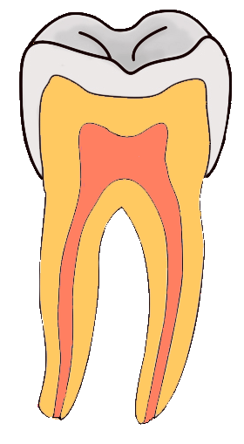
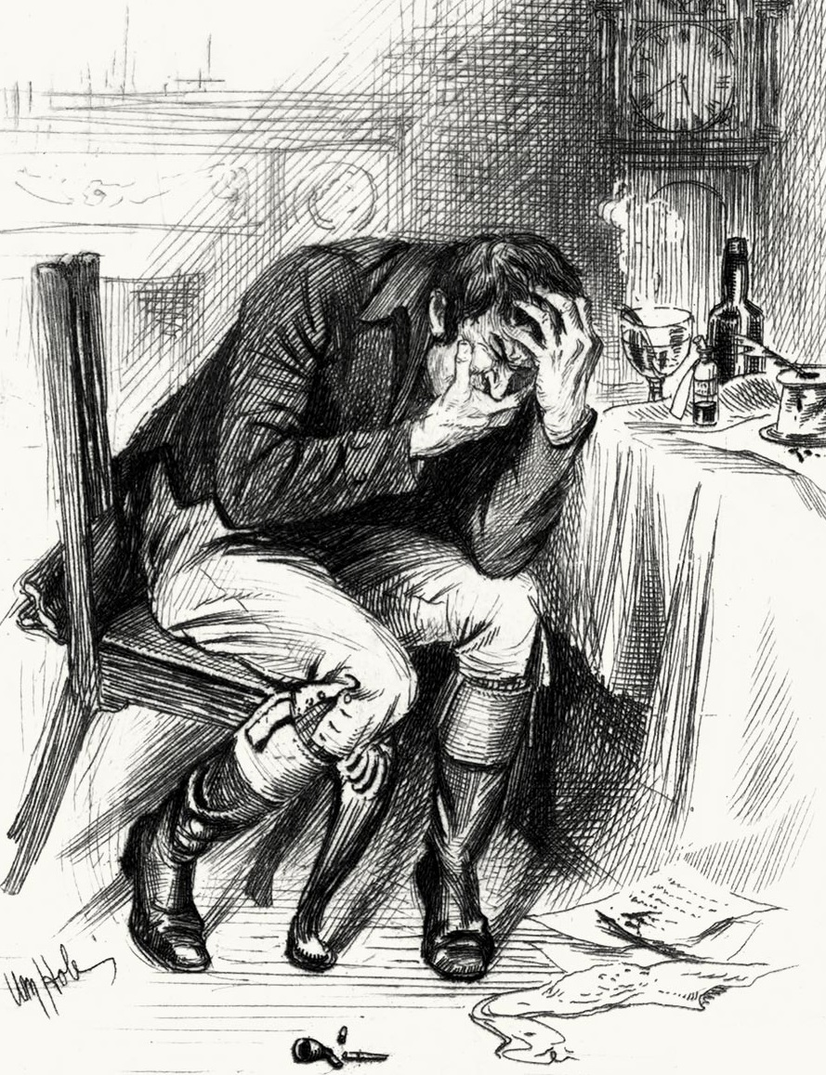

Independence ≠ Conditional Independence
Cavity: Boolean variable indicating whether the patient has a cavity
Toothache: Boolean variable indicating whether the patient has a toothache
Catch: whether the dentist’s probe catches in the cavity
By Aduran, CC-SA 3.0
By William Brassey Hole(Died:1917)
By Dozenist, CC-SA 3.0

Slide 38
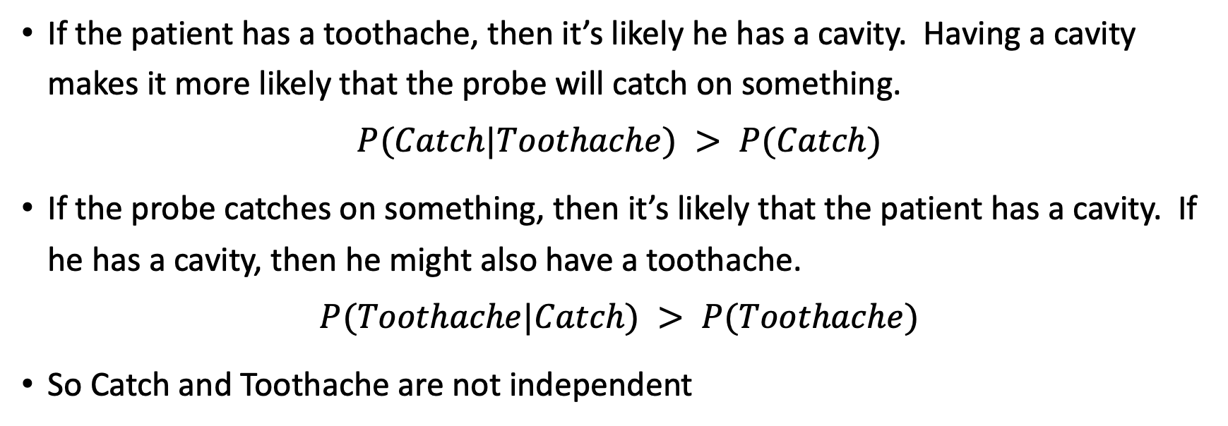
These Events are not Independent
If the patient has a toothache, then it’s likely he has a cavity. Having a cavity makes it more likely that the probe will catch on something.
$$P(Catch|Toothache) > P(Catch)$$
If the probe catches on something, then it’s likely that the patient has a cavity. If he has a cavity, then he might also have a toothache.
$$P(Toothache|Catch) > P(Toothache)$$
So Catch and Toothache are not independent

Slide 39
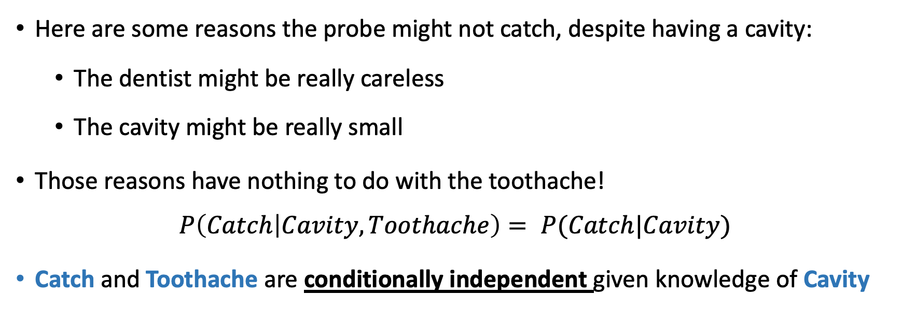
…but they are Conditionally Independent
Dependent
Dependent
Conditionally Dependent given knowledge of Cavity
Here are some reasons the probe might not catch, despite having a cavity:
  The dentist might be really careless
  The cavity might be really small
Those reasons have nothing to do with the toothache!
$$P\left(Catch | Cavity,Toothache\right)= P(Catch|Cavity)$$
Catch and Toothache are conditionally independent given knowledge of Cavity

Slide 40
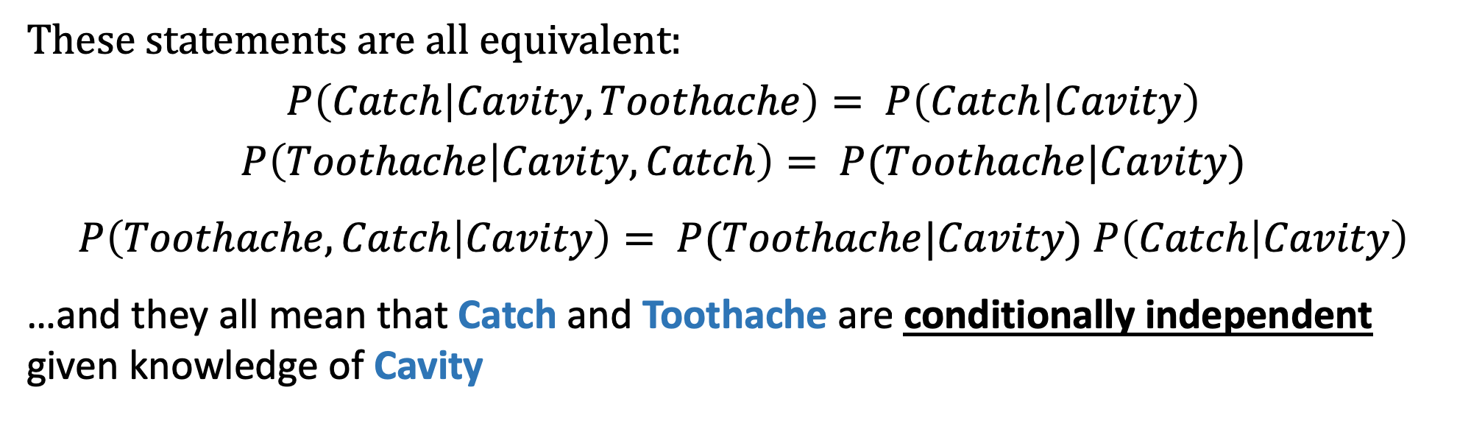
…but they are Conditionally Independent
Dependent
Dependent
Conditionally Dependent given knowledge of Cavity
These statements are all equivalent:
$$P\left(Catch | Cavity,Toothache\right)= P\left(Catch | Cavity\right)$$
$$P\left(Toothache | Cavity,Catch\right)= P(Toothache|Cavity)$$
$P\left(Toothache,Catch | Cavity\right)= P(Toothache|Cavity)$ $P\left(Catch | Cavity\right)$
…and they all mean that Catch and Toothache are conditionally independent given knowledge of Cavity

Slide 41
Outline
Motivation: Why use probability?
  Laziness, Ignorance, and Randomness
  Rational Bettor Theorem
Review of Key Concepts
  Outcomes, Events
  Random Variables; probability mass function (pmf)
  Jointly random variables: Joint, Marginal, and Conditional pmf
  Independent vs. Conditionally Independent events

