Slide 1
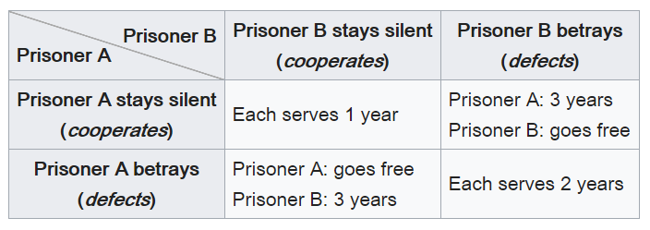
CS 440/ECE448 Lecture 9:
Game Theory
Slides by Svetlana Lazebnik, 9/2016
Modified by Mark Hasegawa-Johnson, 2/2019
https://en.wikipedia.org/wiki/Prisoner’s_dilemma

Slide 2
Game theory
Game theory deals with systems of interacting agents where the outcome for an agent depends on the actions of all the other agents
  Applied in sociology, politics, economics, biology, and, of course, AI
Agent design: determining the best strategy for a rational agent in a given game
Mechanism design: how to set the rules of the game to ensure a desirable outcome

Slide 3

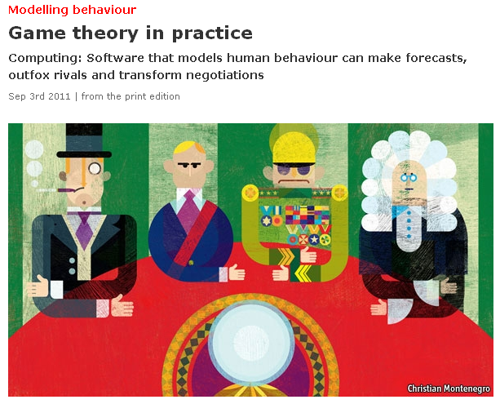
http://www.economist.com/node/21527025
Notes:
Applications: modeling auctions, negotiations, effect of regulatory schemes, military moves

Slide 4
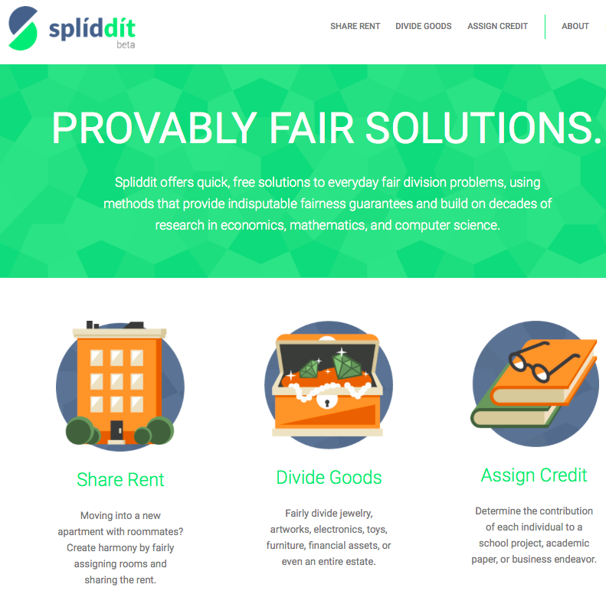
http://www.spliddit.org

Slide 5

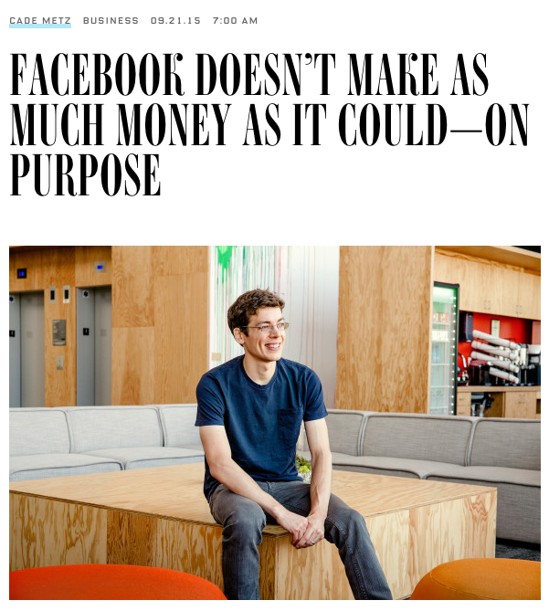
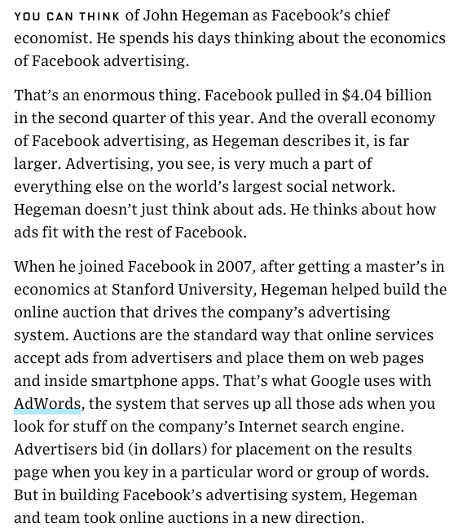
http://www.wired.com/2015/09/facebook-doesnt-make-much-money-couldon-purpose/

Slide 6
Outline of today’s lecture
Nash equilibrium, Dominant strategy, and Pareto optimality
Stag Hunt: Coordination Games
Chicken: Anti-Coordination Games, Mixed Strategies
The Ultimatum Game: Continuous and Repeated Games
Mechanism Design: Inverse Game Theory

Slide 7
Nash Equilibria, Dominant Strategies, and Pareto Optimal Solutions

Slide 8
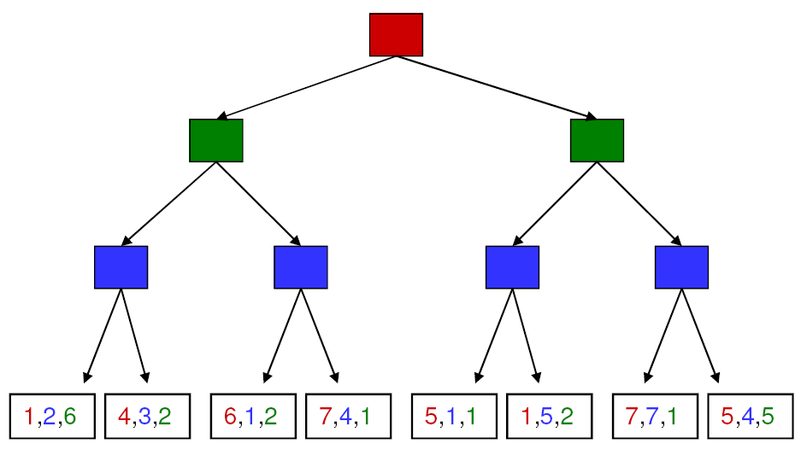
Recall: Multi-player, non-zero-sum game
Players act in sequence.
Each player makes the move that is best for them, when it’s their turn to move.
4,3,2
4,3,2
1,5,2
4,3,2
7,4,1
1,5,2
7,7,1

Slide 9
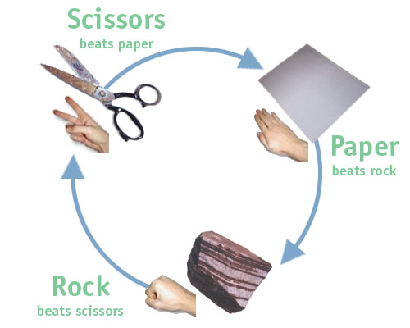




Simultaneous single-move games
Players must choose their actions at the same time, without knowing what the others will do
  Form of partial observability
Normal form representation:
Player 1
0,0 | 1,-1 | -1,1
-1,1 | 0,0 | 1,-1
1,-1 | -1,1 | 0,0
Player 2
Payoff matrix
(Player 1’s utility is listed first)
Is this a zero-sum game?

Slide 10
Prisoner’s dilemma
Two criminals have been arrested and the police visit them separately
If one player testifies against the other and the other refuses, the one who testified goes free and the one who refused gets a 10-year sentence
If both players testify against each other, they each get a
5-year sentence
If both refuse to testify, they each get a 1-year sentence
 | Alice: Testify | Alice: Refuse
Bob: Testify | -5,-5 | -10,0
Bob: Refuse | 0,-10 | -1,-1

Slide 11
Prisoner’s dilemma
Alice’s reasoning:
  Suppose Bob testifies. Then I get
  5 years if I testify and 10 years if
  I refuse. So I should testify.
  Suppose Bob refuses. Then I go free if I testify, and get 1 year if
  I refuse. So I should testify.
Nash equilibrium: A pair of strategies such that no player can get a bigger payoff by switching strategies, provided the other player sticks with the same strategy
  (Testify, Testify) is a Nash equilibrium
 | Alice: Testify | Alice: Refuse
Bob: Testify | -5,-5 | -10,0
Bob: Refuse | 0,-10 | -1,-1

Slide 12
Prisoner’s dilemma
Dominant strategy: A strategy whose outcome is better for the player regardless of the strategy chosen by the other player.
  TESTIFY!
Pareto optimal outcome: It is impossible to make one of the players better off without making another one worse off.
  (Testify, Refuse)
  (Refuse, Refuse)
  (Refuse, Testify)
Other games can be constructed in which there is no dominant strategy – we’ll see some later
 | Alice: Testify | Alice: Refuse
Bob: Testify | -5,-5 | -10,0
Bob: Refuse | 0,-10 | -1,-1

Slide 13
Prisoner’s dilemma in real life
 | Defect | Cooperate
Defect | Lose – lose | Lose big – win big
Cooperate | Win big – lose big | Win – win
Price war
Arms race
Steroid use
Diner’s dilemma
Collective action in politics
http://en.wikipedia.org/wiki/Prisoner’s_dilemma
Notes:
Diner’s dilemma [Wikipedia]: several individuals go out to eat, and prior to ordering they agree to split the check equally between all of them. Each individual must now choose whether to order the expensive or inexpensive dish. It is presupposed that the expensive dish is better than the cheaper, but not by enough to warrant paying the difference compared to eating alone. Each individual reasons that the expense they add to their bill by ordering the more expensive item is very small, and thus the improved dining experience is worth the money. However, every individual reasons this way and they all end up paying for the cost of the more expensive meal, which, by assumption, is worse for everyone than ordering and paying for the cheaper meal.

Slide 14
Is there any way to get a better answer?
Superrationality
  Assume that the answer to a symmetric problem will be the same for both players
  Maximize the payoff to each player while considering only identical strategies
  Not a conventional model in game theory
  … same thing as the Categorical Imperative?
Repeated games
  If the number of rounds is fixed and known in advance, the equilibrium strategy is still to defect
  If the number of rounds is unknown, cooperation may become an equilibrium strategy

Slide 15
The Stag Hunt: Coordination Games

Slide 16
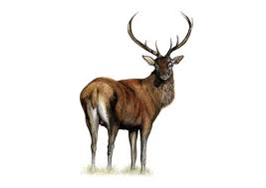
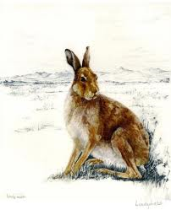
Stag hunt
 | Hunter 1: Stag | Hunter 1: Hare
Hunter 2: Stag | 2,2 | 1,0
Hunter 2: Hare | 0,1 | 1,1
Both hunters cooperate in hunting for the stag → each gets to take home half a stag
Both hunters defect, and hunt for rabbit instead → each gets to take home a rabbit
One cooperates, one defects → the defector gets a bunny, the cooperator gets nothing at all

Slide 17
Stag hunt
 | Hunter 1: Stag | Hunter 1: Hare
Hunter 2: Stag | 2,2 | 1,0
Hunter 2: Hare | 0,1 | 1,1
What is the Pareto Optimal solution?
Is there a Nash Equilibrium?
Is there a Dominant Strategy for either player?
Model for cooperative activity under conditions of incomplete information (the issue: trust)

Slide 18
Prisoner’s dilemma vs. stag hunt
Prisoner’ dilemma
Stag hunt
 | Cooperate | Defect
Cooperate | Win – win | Win big – lose big
Defect | Lose big – win big | Lose – lose
 | Cooperate | Defect
Cooperate | Win big – win big | Win – lose
Defect | Lose – win | Win – win
Players improve their winnings by defecting unilaterally
Players reduce their winnings by defecting unilaterally

Slide 19
Chicken: Anti-Coordination Games, Mixed Strategies

Slide 20

Game of Chicken
Player 1
Player 2
 | S | C
S | -10, -10 | -1, 1
C | 1, -1 | 0, 0
Chicken
Straight
Chicken
Straight
Two players each bet $1000 that the other player will chicken out
Outcomes:
  If one player chickens out, the other wins $1000
  If both players chicken out, neither wins anything
  If neither player chickens out, they both lose $10,000 (the cost of the car)
http://en.wikipedia.org/wiki/Game_of_chicken

Slide 21
Prisoner’s dilemma vs. Chicken
Prisoner’ dilemma
Chicken
 | Cooperate | Defect
Cooperate | Win – win | Win big – Lose big
Defect | Lose big – Win big | Lose – Lose
 | Chicken | Straight
Chicken | Nil – Nil | Win – Lose
Straight | Lose – Win | Lose big – Lose big
Players can’t improve their winnings by unilaterally cooperating
The best strategy is always the opposite of what the other player does

Slide 22
Game of Chicken
Player 1
Player 2
 | S | C
S | -10, -10 | -1, 1
C | 1, -1 | 0, 0
Chicken
Straight
Chicken
Straight
Is there a dominant strategy for either player?
Is there a Nash equilibrium?
  (straight, chicken) or (chicken, straight)
Anti-coordination game: it is mutually beneficial for the two players to choose different strategies
  Model of escalated conflict in humans and animals
  (hawk-dove game)
How are the players to decide what to do?
  Pre-commitment or threats
  Different roles: the “hawk” is the territory owner and the “dove” is the intruder, or vice versa
http://en.wikipedia.org/wiki/Game_of_chicken

Slide 23
Mixed strategy equilibria
Player 1
Player 2
 | S | C
S | -10, -10 | -1, 1
C | 1, -1 | 0, 0
Chicken
Straight
Chicken
Straight
Mixed strategy: a player chooses between the moves according to a probability distribution
Suppose each player chooses S with probability 1/10.
Is that a Nash equilibrium?
Consider payoffs to P1 while keeping P2’s strategy fixed
  The payoff of P1 choosing S is (1/10)(–10) + (9/10)1 = –1/10
  The payoff of P1 choosing C is (1/10)(–1) + (9/10)0 = –1/10
  Can P1 change their strategy to get a better payoff?
  Same reasoning applies to P2

Slide 24
Finding mixed strategy equilibria
 | P1: Choose S with prob. p | P1: Choose C with prob. 1-p
P2: Choose S with prob. q | -10, -10 | -1, 1
P2: Choose C with prob. 1-q | 1, -1 | 0, 0
Expected payoffs for P1 given P2’s strategy:
  P1 chooses S: q(–10) +(1–q)1 = –11q + 1
  P1 chooses C: q(–1) + (1–q)0 = –q
In order for P2’s strategy to be part of a Nash equilibrium, P1 has to be indifferent between its two actions:
  –11q + 1 = –q or q = 1/10
  Similarly, p = 1/10

Slide 25
Existence of Nash equilibria
Any game with a finite set of actions has at least one Nash equilibrium (which may be a mixed-strategy equilibrium)
If a player has a dominant strategy, there exists a Nash equilibrium in which the player plays that strategy and the other player plays the best response to that strategy
If both players have strictly dominant strategies, there exists a Nash equilibrium in which they play those strategies

Slide 26
Computing Nash equilibria
For a two-player zero-sum game, simple linear programming problem
For non-zero-sum games, the algorithm has worst-case running time that is exponential in the number of actions
For more than two players, and for sequential games, things get pretty hairy

Slide 27
Nash equilibria and rational decisions
If a game has a unique Nash equilibrium, it will be adopted if each player
  is rational and the payoff matrix is accurate
  doesn’t make mistakes in execution
  is capable of computing the Nash equilibrium
  believes that a deviation in strategy on their part will not cause the other players to deviate
  there is common knowledge that all players meet these conditions
http://en.wikipedia.org/wiki/Nash_equilibrium

Slide 28
The Ultimatum Game: Continuous and Repeated Games

Slide 29
Continuous actions:
Ultimatum game
Alice and Bob are given a sum of money S to divide
  Alice picks A, the amount she wants to keep for herself
  Bob picks B, the smallest amount of money he is willing to accept
  If S – A ≥ B, Alice gets A and Bob gets S – A
  If S – A < B, both players get nothing
What is the Nash equilibrium?
  Alice offers Bob the smallest amount of money he will accept:
  S – A = B
  Alice and Bob both want to keep the full amount: A = S, B = S
  (both players get nothing)
How would humans behave in this game?
  If Bob perceives Alice’s offer as unfair, Bob will be likely to refuse
  Is this rational?
    Maybe Bob gets some positive utility for “punishing” Alice?
http://en.wikipedia.org/wiki/Ultimatum_game

Slide 30
Sequential/repeated games and threats:
Chain store paradox
A monopolist has branches in 20 towns and faces 20 competitors successively
  Threat: respond to “in”
  with “aggressive”
Competitor
Out
In
(1, 5)
Monopolist
Aggressive
Cooperative
(0, 0)
(2, 2)
https://en.wikipedia.org/wiki/Chainstore_paradox

Slide 31
Mechanism Design: Inverse Game Theory

Slide 32
Mechanism design
(inverse game theory)
Assuming that agents pick rational strategies, how should we design the game to achieve a socially desirable outcome?
We have multiple agents and a center that collects their choices and determines the outcome

Slide 33
Auctions
Goals
  Maximize revenue to the seller
  Efficiency: make sure the buyer who values the goods the most gets them
  Minimize transaction costs for buyer and sellers

Slide 34
Ascending-bid auction
What’s the optimal strategy for a buyer?
  Bid until the current bid value exceeds your private value
Usually revenue-maximizing and efficient, unless the reserve price is set too low or too high
Disadvantages
  Collusion
  Lack of competition
  Has high communication costs

Slide 35
Sealed-bid auction
Each buyer makes a single bid and communicates it to the auctioneer, but not to the other bidders
  Simpler communication
  More complicated decision-making: the strategy of a buyer depends on what they believe about the other buyers
  Not necessarily efficient
Sealed-bid second-price auction: the winner pays the price
of the second-highest bid
  Let V be your private value and B be the highest bid by any other buyer
  If V > B, your optimal strategy is to bid above B – in particular, bid V
  If V < B, your optimal strategy is to bid below B – in particular, bid V
  Therefore, your dominant strategy is to bid V
  This is a truth revealing mechanism

Slide 36
Dollar auction
A malevolent twist on the second-price auction:
Highest bidder gets to buy the object, and pays whatever they bid
Second-highest bidder is required to pay whatever they bid, but gets nothing at all in return
Dramatization: https://www.youtube.com/watch?v=pA-SNscNADk

Slide 37
Dollar auction
A dollar bill is auctioned off to the highest bidder, but the second-highest bidder has to pay the amount of his last bid
  Player 1 bids 1 cent
  Player 2 bids 2 cents
  …
  Player 2 bids 98 cents
  Player 1 bids 99 cents
    If Player 2 passes, he loses 98 cents, if he bids $1, he might still come out even
  So Player 2 bids $1
    Now, if Player 1 passes, he loses 99 cents, if he bids $1.01, he only loses 1 cent
  …
What went wrong?
  When figuring out the expected utility of a bid, a rational player should take into account the future course of the game
What if Player 1 starts by bidding 99 cents?

Slide 38
Regulatory mechanism design: Tragedy of the commons
States want to set their policies for controlling emissions
  Each state can reduce their emissions at a cost of -10
  or continue to pollute at a cost of -5
  If a state decides to pollute, -1 is added to the utility of every other state
What is the dominant strategy for each state?
  Continue to pollute
  Each state incurs cost of -5-49 = -54
  If they all decided to deal with emissions, they would incur a cost of only -10 each
Mechanism for fixing the problem:
  Tax each state by the total amount by which they reduce the global utility (externality cost)
  This way, continuing to pollute would now cost -54

Slide 39
Review: Game theory
Normal form representation of a game
Dominant strategies
Nash equilibria
Pareto optimal outcomes
Pure strategies and mixed strategies
Examples of games
Mechanism design
  Auctions: ascending bid, sealed bid, sealed bid second-price, “dollar auction”

