Slide 1
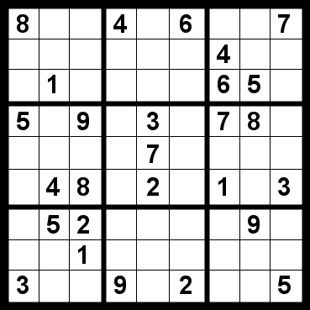
CS440/ECE 448, Lecture 6:
Constraint Satisfaction Problems
Slides by Svetlana Lazebnik, 9/2016
Modified by Mark Hasegawa-Johnson, 1/2019
8
 | 1
8
5 | 1
8
4 | 1
8
3 | 1
8 | 5
 | 1
8 | 4
 | 1
8 | 3
 | 1
8
2
5 | 1
8
5 | 1 | 9

Slide 2
Content
What is a CSP? Why is it search? Why is it special?
Examples: Map Task, N-Queens, Crytparithmetic, Classroom Assignment
Formulation as a standard search
Backtracking Search
Heuristics to improve backtracking search
Tree-structured CSPs
NP-completeness of CSP in general; the SAT problem
Local search, e.g., hill-climbing

Slide 3
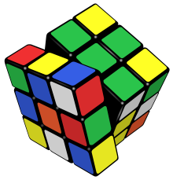
What is search for?
Assumptions: single agent, deterministic, fully observable, discrete environment
Search for planning
  The path to the goal is the important thing
  Paths have various costs, depths
Search for assignment
  Assign values to variables while respecting certain constraints
  The goal (complete, consistent assignment) is the important thing

Slide 4
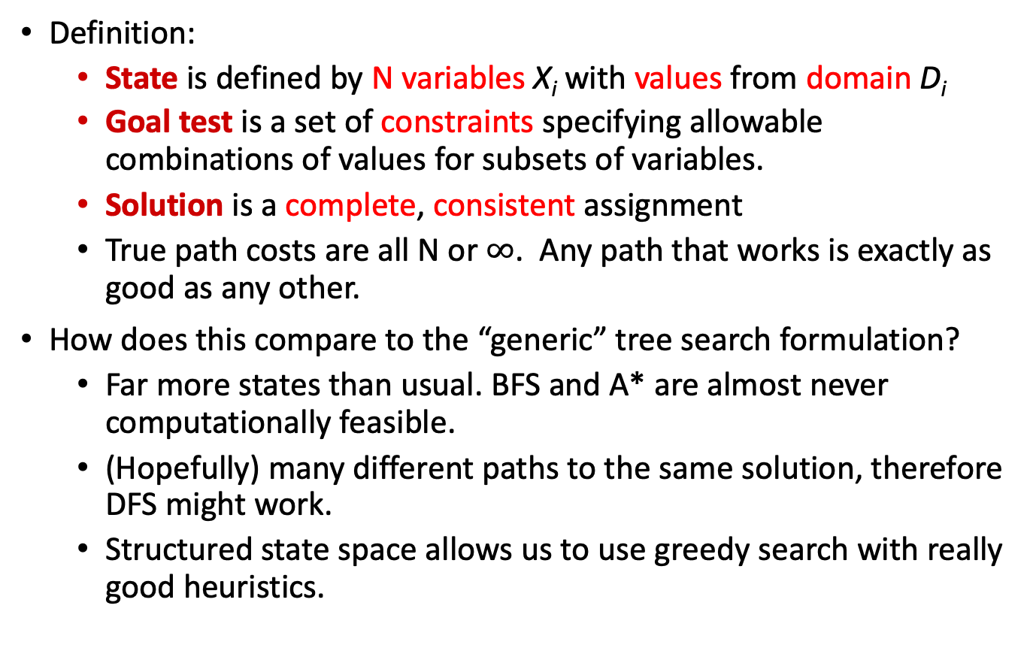
Constraint satisfaction problems (CSPs)
Definition:
  State is defined by N variables X_{i} with values from domain D_{i}
  Goal test is a set of constraints specifying allowable combinations of values for subsets of variables.
  Solution is a complete, consistent assignment
  True path costs are all N or $∞$. Any path that works is exactly as good as any other.
How does this compare to the “generic” tree search formulation?
  Far more states than usual. BFS and A* are almost never computationally feasible.
  (Hopefully) many different paths to the same solution, therefore DFS might work.
  Structured state space allows us to use greedy search with really good heuristics.

Slide 5
Examples

Slide 6
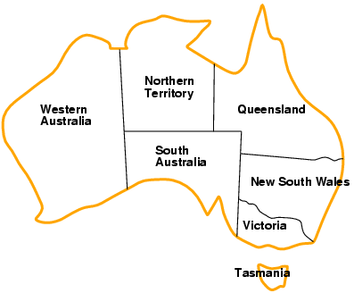
Example: Map Coloring
Variables: WA, NT, Q, NSW, V, SA, T
Domains: {red, green, blue}
Constraints: adjacent regions must have different colors
  Logical representation: WA ≠ NT
  Set representation: (WA, NT) in {(red, green), (red, blue),
  (green, red), (green, blue), (blue, red), (blue, green)}

Slide 7
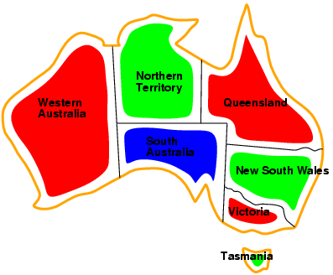
Example: Map Coloring
Solutions are complete and consistent assignments, e.g., WA = red, NT = green, Q = red, NSW = green,
V = red, SA = blue, T = green

Slide 8


Example: n-queens problem
Put n queens on an n × n board with no two queens on the same row, column, or diagonal

Slide 9

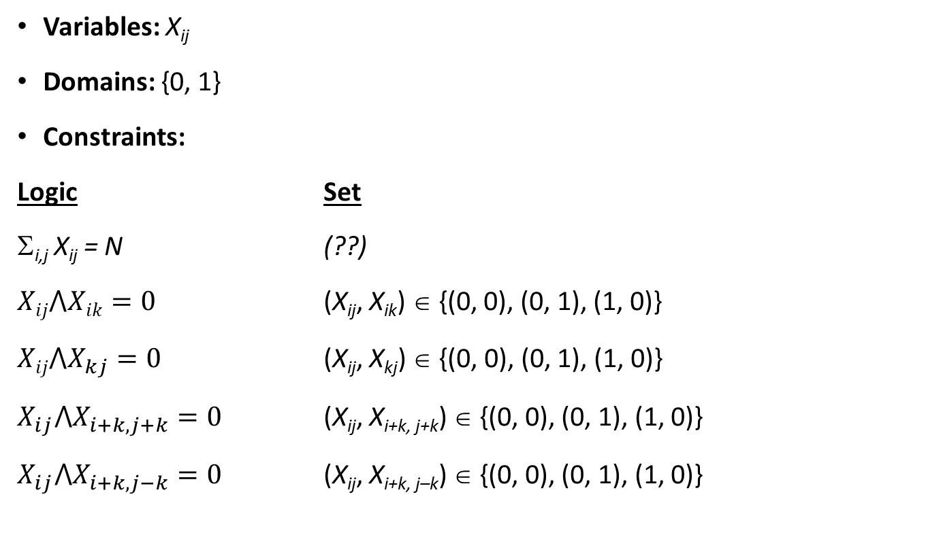
Example: N-Queens
Variables: X_{ij}
Domains: {0, 1}
Constraints:
Logic Set
Σ_{i,j} X_{ij} = N (??)
$Xij⋀Xik=0$ (X_{ij}, X_{ik}) ∈ {(0, 0), (0, 1), (1, 0)}
$Xij⋀X_{kj}=0$ (X_{ij}, X_{kj}) ∈ {(0, 0), (0, 1), (1, 0)}
$X_{ij}⋀X_{i+k,j+k}=0$ (X_{ij}, X_{i+k, j+k}) ∈ {(0, 0), (0, 1), (1, 0)}
$X_{ij}⋀X_{i+k,j−k}=0$ (X_{ij}, X_{i+k, j–k}) ∈ {(0, 0), (0, 1), (1, 0)}
X_{ij}

Slide 10
N-Queens: Alternative formulation
Variables: Q_{i}
Domains: {1, … , N}
Constraints:
  ∀ i, j non-threatening (Q_{i} , Q_{j})
Q₁
Q₂
Q₃
Q₄

Slide 11
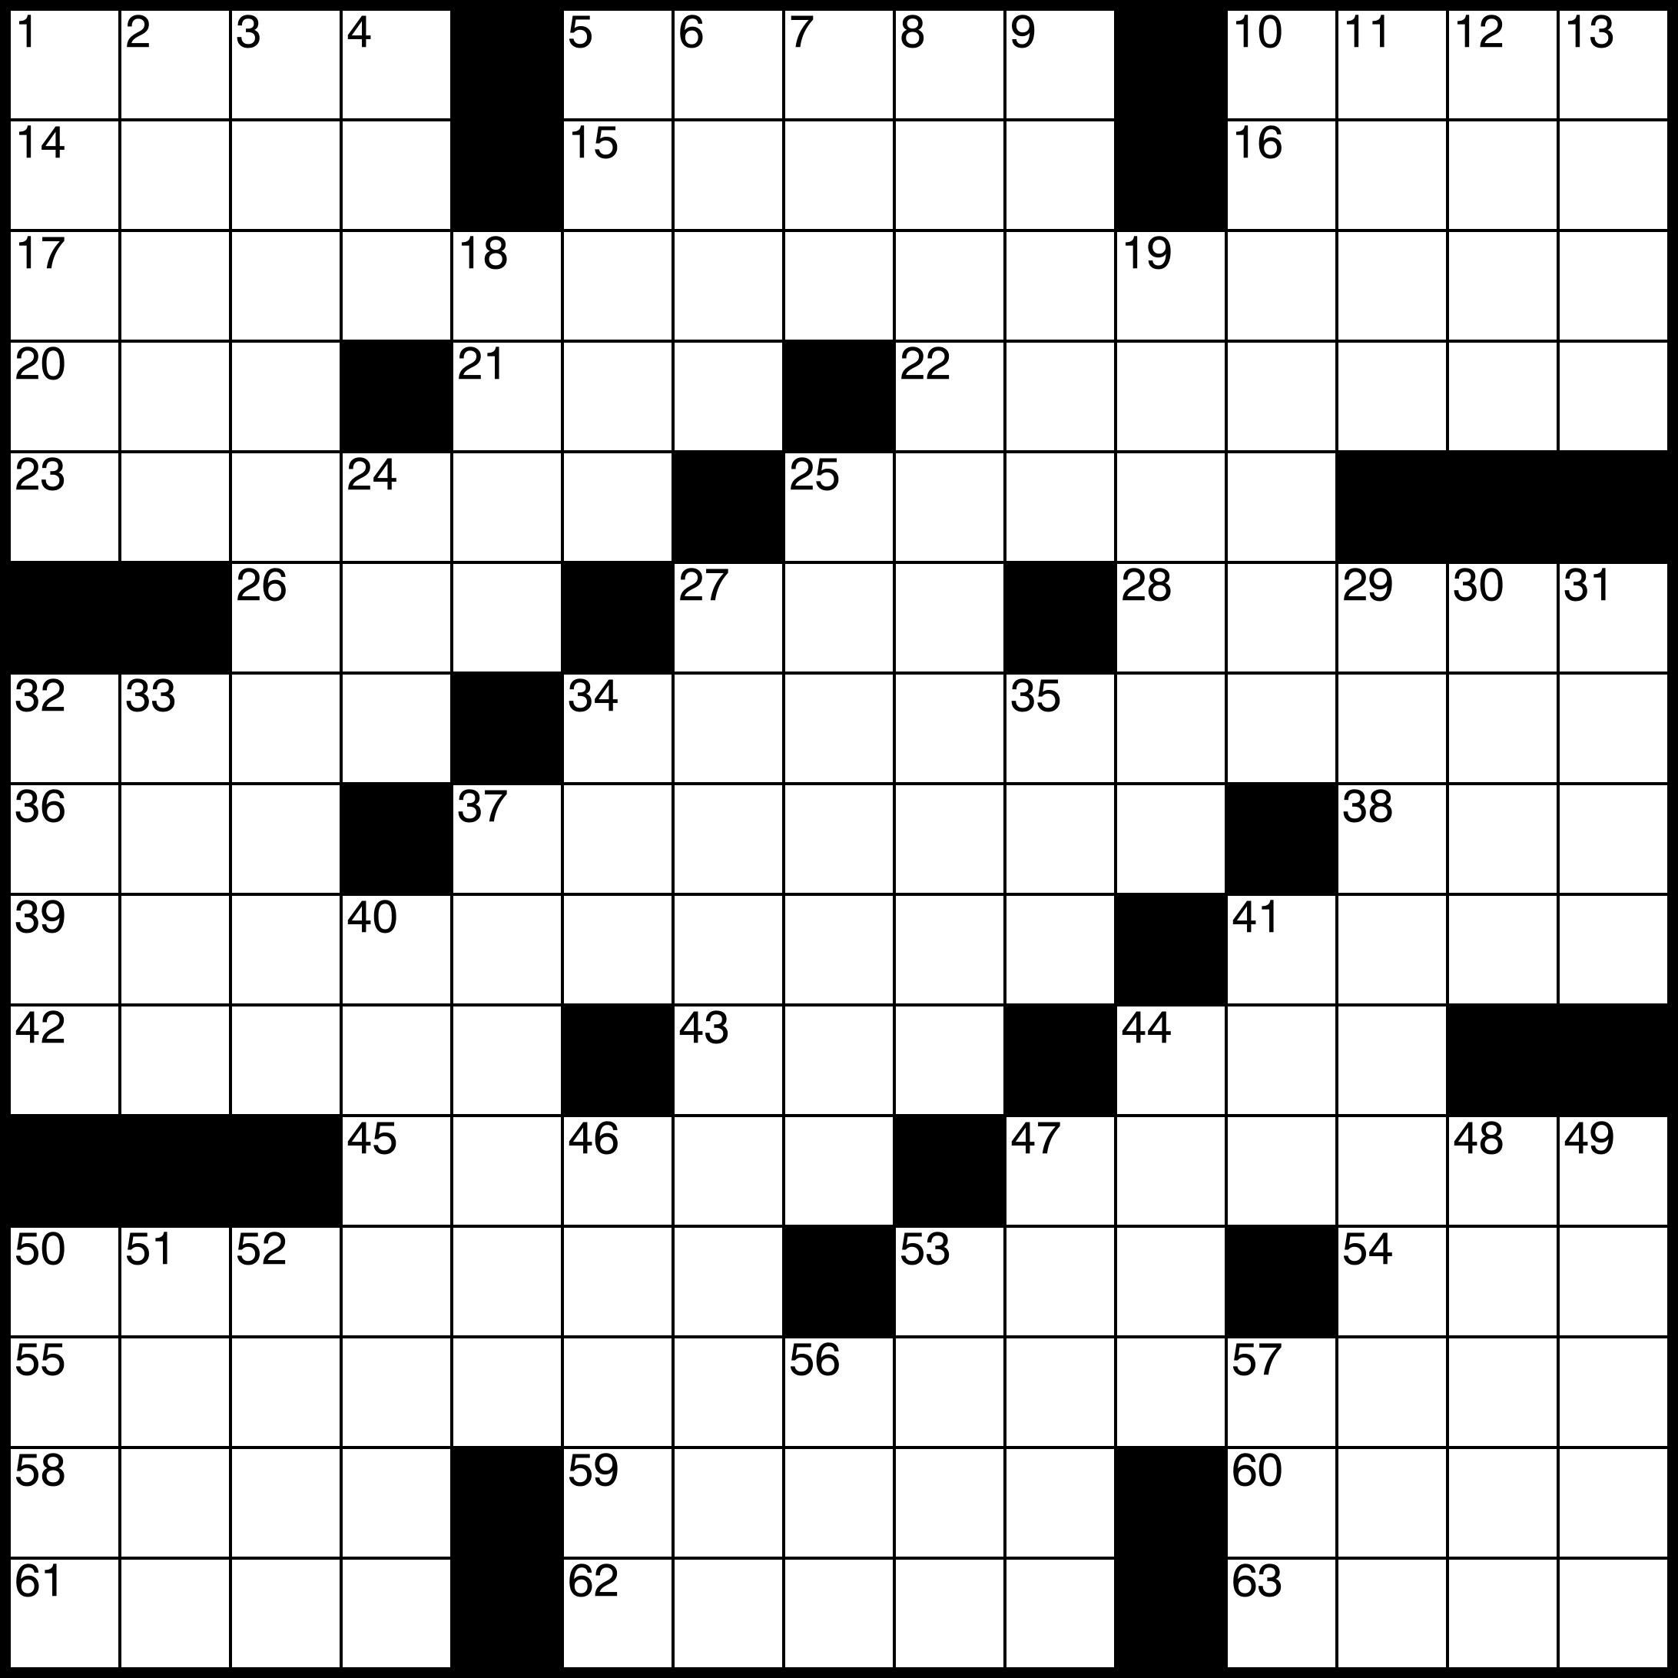
Example: Crossword Puzzle
Variables: 193 squares
Domains: {a,b,…,z}
Constraints:
  Each row-segment is a word from the dictionary.
  Each column-segment is a word from the dictionary.

Slide 12
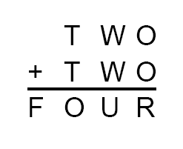
Example: Cryptarithmetic
Variables: T, W, O, F, U, R, X, Y
Domains: {0, 1, 2, …, 9}
Constraints:
  O + O = R + 10 * Y
  W + W + Y = U + 10 * X
  T + T + X = 10 * F
  Alldiff(T, W, O, F, U, R, X, Y)
  T ≠ 0, F ≠ 0, X ≠ 0
X Y

Slide 13
Real-world CSPs
Assignment problems
  e.g., who teaches what class
Timetable problems
  e.g., which class is offered when and where?
Transportation scheduling
Factory scheduling
More examples of CSPs: http://www.csplib.org/

Slide 14
Formulation as a standard search

Slide 15
Standard search formulation (incremental)
States:
  Variables and values assigned so far
Initial state:
  The empty assignment
Action:
  Choose any unassigned variable and assign to it a value that does not violate any constraints
    Fail if no legal assignments
Goal test:
  The current assignment is complete and satisfies all constraints

Slide 16
Standard search formulation (incremental)
What is the depth of any solution (assuming N variables)?
  Answer: N (this is good)
Given that there are D possible values for any variable, how many paths are there in the search tree?
  Answer: N! D^{N} (this is bad)
All paths have the same depth, so complexity of DFS and BFS are the same (both O{N! D^{N}})
Other reasons to use DFS:
  There are usually many paths to the solution (at least N!)
  Often, if a path fails, we can detect this early
Today’s goal: develop heuristics to reduce the branching factor

Slide 17
Backtracking search

Slide 18
Backtracking search
In CSP’s, variable assignments are commutative
  For example, [WA = red then NT = green] is the same as [NT = green then WA = red]
We only need to consider assignments to a single variable at each level (i.e., we fix the order of assignments)
  Then there are only D^{N} paths. We have eliminated the N! redundancy by arbitrarily choosing an order in which to assign variables.
Depth-first search for CSPs with single-variable assignments is called backtracking search

Slide 19

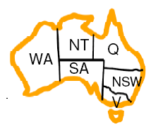
Example

Slide 20
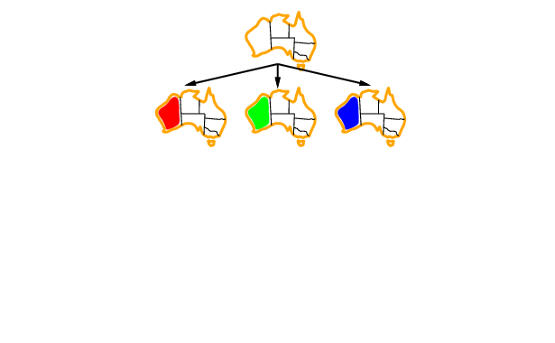
Example

Slide 21
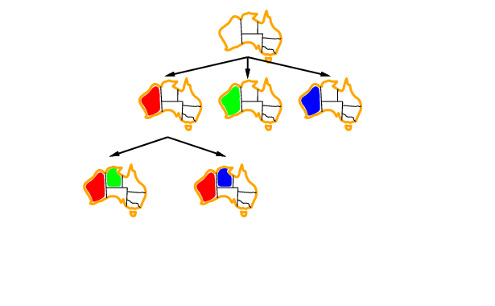
Example

Slide 22
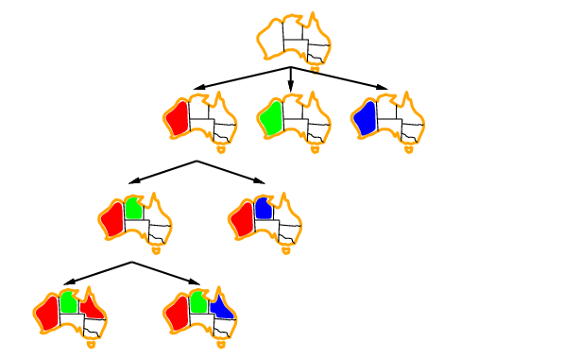
Example

Slide 23
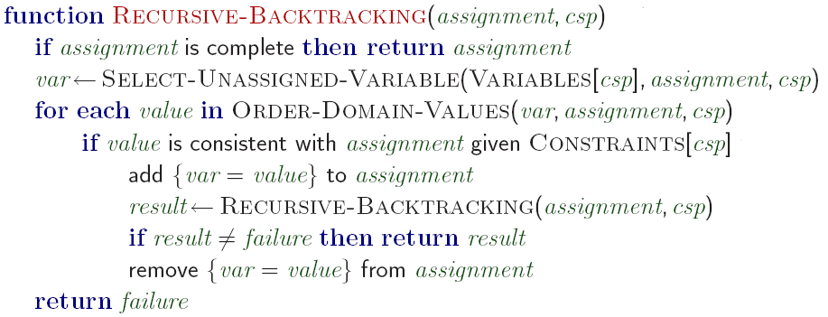
Backtracking search algorithm
Making backtracking search efficient:
  Which variable should be assigned next?
  In what order should its values be tried?
  Can we detect inevitable failure early?

Slide 24
Heuristics for making backtracking search more efficient

Slide 25
Heuristics for making backtracking search more efficient
Still DFS, but we use heuristics to decide which child to expand first. You could call it GDFS…
Heuristics that choose the next variable to assign:
  Least Remaining Values (LRV)
  Most Constraining Variable (MCV)
Heuristic that chooses a value for that variable:
  Least Constraining Assignment (LCA)
Early detection of failure:
  Forward Checking
  Arc Consistency

Slide 26
Which variable should be assigned next?
Least Remaining Values (LRV) Heuristic:
  Choose the variable with the fewest legal values

Slide 27
Which variable should be assigned next?
Least Remaining Values (LRV) Heuristic:
  Choose the variable with the fewest legal values
??

Slide 28
Which variable should be assigned next?
Most Constraining Variable (MCV) Heuristic:
  Choose the variable that imposes the most constraints on the remaining variables
  Tie-breaker among variables that have equal numbers of LRV

Slide 29
Which variable should be assigned next?
Most Constraining Variable (MCV) Heuristic:
  Choose the variable that imposes the most constraints on the remaining variables
  Tie-breaker among variables that have equal numbers of MRV
??

Slide 30
Given a variable, in which order should its values be tried?
Least Constraining Assignment (LCA) Heurstic:
  Try the following assignment first: to the variable you’re studying, the value that rules out the fewest values in the remaining variables

Slide 31
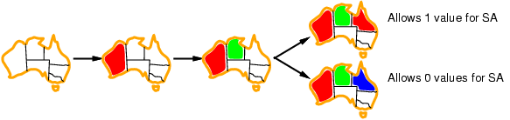
Given a variable, in which order should its values be tried?
Least Constraining Assignment (LCA) Heurstic:
  Try the following assignment first: to the variable you’re studying, the value that rules out the fewest values in the remaining variables
Which assignment for Q should we choose?

Slide 32
Early detection of failure
Apply inference to reduce the space of possible assignments and detect failure early

Slide 33
Early detection of failure: O{N} checking
Forward Checking:
  Check to make sure that every variable still has at least one possible assignment

Slide 34


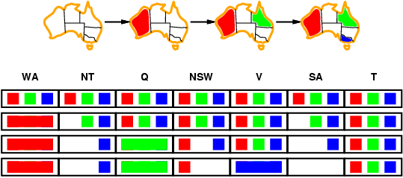
Early detection of failure: O{N} checking
Forward checking
Keep track of remaining legal values for unassigned variables
Terminate search when any variable has no legal values
WA T NT NSW Q SA V

Slide 35
Early detection of failure: O{N} checking
Forward checking
Keep track of remaining legal values for unassigned variables
Terminate search when any variable has no legal values
WA T NT NSW Q SA V

Slide 36
Early detection of failure: O{N} checking
Forward checking
Keep track of remaining legal values for unassigned variables
Terminate search when any variable has no legal values
WA T NT NSW Q SA V

Slide 37
Early detection of failure: O{N} checking
Forward checking
Keep track of remaining legal values for unassigned variables
Terminate search when any variable has no legal values
WA T NT NSW Q SA V

Slide 38
Early detection of failure: O{N^2} checking
Constraint propagation:
  Check to make sure that every PAIR of variables still has a pair-wise assignment that satisfies all constraints

Slide 39
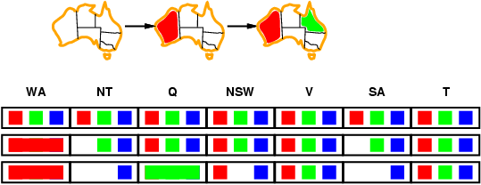
Early detection of failure: O{N^2} checking
Apply inference to reduce the space of possible assignments and detect failure early
(Reminder: there are only three colors, RGB…)

Slide 40
Constraint propagation
Forward checking propagates information from assigned to unassigned variables, but doesn't provide early detection for all failures
NT and SA cannot both be blue!
Constraint propagation repeatedly enforces constraints locally

Slide 41
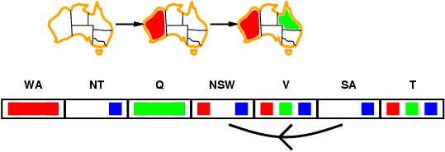
Constraint propagation algorithm: Arc consistency
Simplest form of propagation makes each pair of variables consistent:
  X →Y is consistent iff for every value of X there is some allowed value of Y
Consistent?

Slide 42
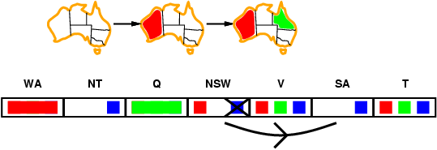
Constraint propagation algorithm: Arc consistency
Simplest form of propagation makes each pair of variables consistent:
  X →Y is consistent iff for every value of X there is some allowed value of Y
Consistent?

Slide 43
Constraint propagation algorithm: Arc consistency
Simplest form of propagation makes each pair of variables consistent:
  X →Y is consistent iff for every value of X there is some allowed value of Y
  When checking X →Y, throw out any values of X for which there isn’t an allowed value of Y

Slide 44
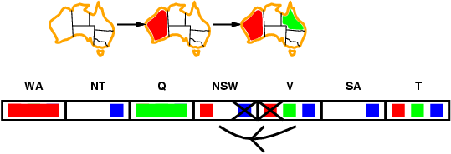
Constraint propagation algorithm: Arc consistency
Simplest form of propagation makes each pair of variables consistent:
  X →Y is consistent iff for every value of X there is some allowed value of Y
  When checking X →Y, throw out any values of X for which there isn’t an allowed value of Y
If X loses a value, all pairs Z → X need to be rechecked

Slide 45
Constraint propagation algorithm: Arc consistency
Simplest form of propagation makes each pair of variables consistent:
  X →Y is consistent iff for every value of X there is some allowed value of Y
  When checking X →Y, throw out any values of X for which there isn’t an allowed value of Y
If X loses a value, all pairs Z → X need to be rechecked

Slide 46
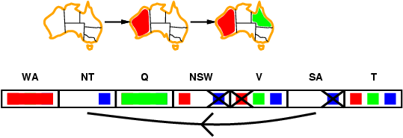
Constraint propagation algorithm: Arc consistency
Simplest form of propagation makes each pair of variables consistent:
  X →Y is consistent iff for every value of X there is some allowed value of Y
  When checking X →Y, throw out any values of X for which there isn’t an allowed value of Y
Arc consistency detects failure earlier than forward checking
Can be run before or after each assignment

Slide 47
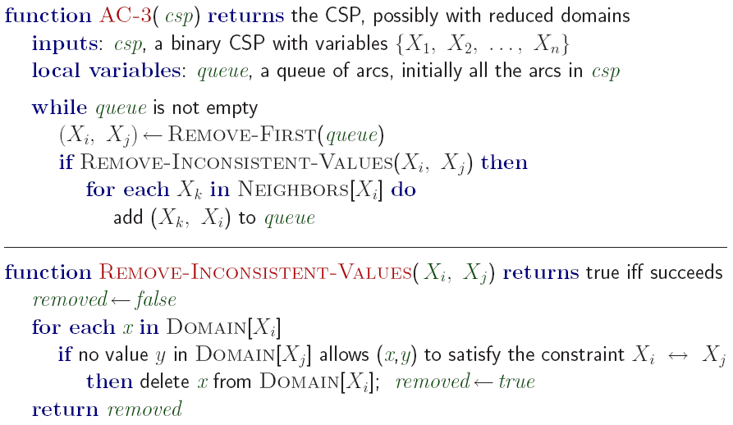
Arc consistency algorithm AC-3

Slide 48
Does arc consistency always detect the lack of a solution?
B
A
D
B
A
D
C
C
There exist stronger notions of consistency (path consistency, k-consistency), but we won’t worry about them

Slide 49
Tree-structured CSPs

Slide 50
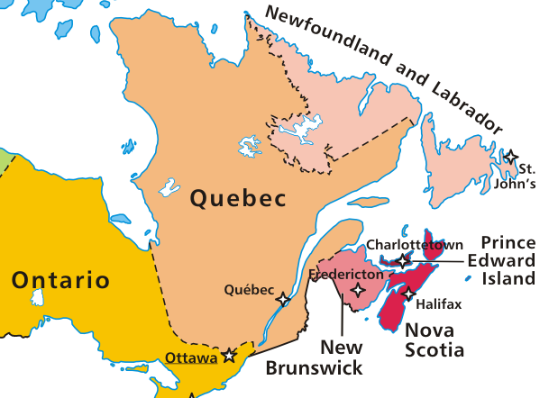
Tree-structured CSPs
Certain kinds of CSPs can be solved without resorting to backtracking search!
Tree-structured CSP: constraint graph does not have any loops
Map released to public domain by E Pluribus Anthony
Newfoundland
& Labrador
New Brunswick
Quebec
Ontario
Nova Scotia
Prince Edward Island

Slide 51
Algorithm for tree-structured CSPs
Choose one variable as root, order variables from root to leaves such that every node's parent precedes it in the ordering.
Newfoundland
& Labrador
O
Q
NL
NB
PEI
NS
New Brunswick
Quebec
Ontario
Nova Scotia
Prince Edward Island

Slide 52
Algorithm for tree-structured CSPs
Choose one variable as root, order variables from root to leaves such that every node's parent precedes it in the ordering
Create a graph listing all of the values that can be assigned to each variable
  SUPPOSE: Newfoundland wants to be green
  Quebec doesn’t want to be blue
  PEI wants to be red
Newfoundland
& Labrador
O
Q
NL
NB
PEI
NS
New Brunswick
Quebec
Ontario
Nova Scotia
Prince Edward Island

Slide 53
Algorithm for tree-structured CSPs
Choose one variable as root, order variables from root to leaves such that every node's parent precedes it in the ordering
Create a graph listing all of the values that can be assigned to each variable
BACKWARD ARC CONSISTENCY: check arc consistency starting from the rightmost node and going backwards
Newfoundland
& Labrador
O
Q
NL
NB
PEI
NS
New Brunswick
X
X
Quebec
X
Ontario
Nova Scotia
Prince Edward Island

Slide 54
Algorithm for tree-structured CSPs
Choose one variable as root, order variables from root to leaves such that every node's parent precedes it in the ordering
Create a graph listing all of the values that can be assigned to each variable
BACKWARD ARC CONSISTENCY: check arc consistency starting from the rightmost node and going backwards
FORWARD ASSIGNMENT PHASE: select an element from the domain of each variable going left to right. We are guaranteed that there will be a valid assignment because each arc is consistent
Newfoundland
& Labrador
O
Q
NL
NB
PEI
NS
New Brunswick
X
X
Quebec
X
Ontario
Nova Scotia
Prince Edward Island

Slide 55
Algorithm for tree-structured CSPs
If N is the number of variables and D is the domain size, what is the running time of this algorithm?
  O(ND²): we have to check arc consistency once for every node in the graph (every node has one parent), which involves looking at pairs of domain values

Slide 56
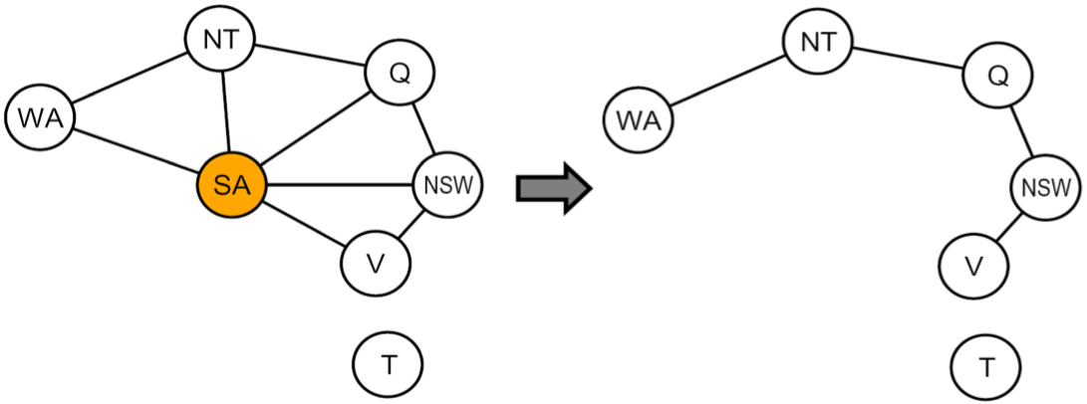
Nearly tree-structured CSPs
Cutset conditioning: find a subset of variables whose removal makes the graph a tree, instantiate that set in all possible ways, prune the domains of the remaining variables and try to solve the resulting tree-structured CSP
Cutset size c gives runtime O(D^{c} (N – c)D²)
Source: P. Abbeel, D. Klein, L. Zettlemoyer

Slide 57
NP-Completeness and the SAT Problem

Slide 58
Algorithm for tree-structured CSPs
Running time is O(ND²)
(N is the number of variables, D is the domain size)
  We have to check arc consistency once for every node in the graph (every node has one parent), which involves looking at pairs of domain values
What about backtracking search for general CSPs?
  Worst case O(D^{N})
Can we do better?

Slide 59

Computational complexity of CSPs
The satisfiability (SAT) problem:
  Given a Boolean formula, is there an assignment of the variables that makes it evaluate to true?
SAT is NP-complete
  NP: a class of decision problems for which
    the “yes” answer can be verified in polynomial time
    no known algorithm can find a “yes” answer, from scratch, in polynomial time
  An NP-complete problem is in NP and every other problem in NP can be efficiently reduced to it (Cook, 1971)
  Other NP-complete problems: graph coloring,
  n-puzzle, generalized sudoku
  It is not known whether P = NP, i.e., no efficient algorithms for solving SAT in general are known

Slide 60
Local search, e.g., hill climbing

Slide 61
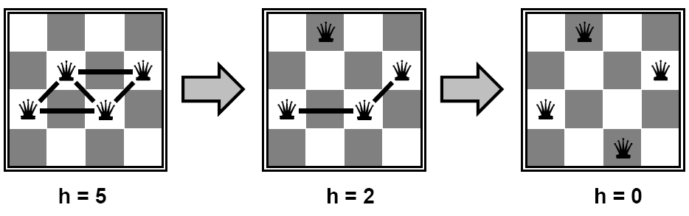
Local search for CSPs
Start with “complete” states, i.e., all variables assigned
Allow states with unsatisfied constraints
Attempt to improve states by reassigning variable values
Hill-climbing search:
  In each iteration, randomly select any conflicted variable and choose value that violates the fewest constraints
  I.e., attempt to greedily minimize total number of violated constraints
h = number of conflicts

Slide 62
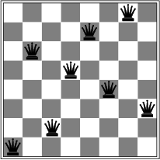
Local search for CSPs
Start with “complete” states, i.e., all variables assigned
Allow states with unsatisfied constraints
Attempt to improve states by reassigning variable values
Hill-climbing search:
  In each iteration, randomly select any conflicted variable and choose value that violates the fewest constraints
  I.e., attempt to greedily minimize total number of violated constraints
  Problem: local minima
h = 1

Slide 63
Applications that look a lot like intelligence…

Slide 64
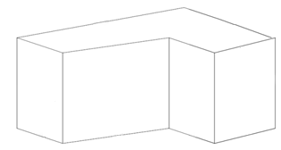
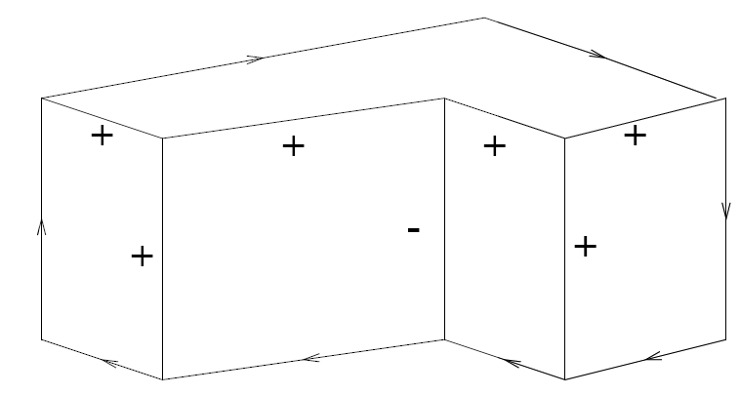
CSP in computer vision:
Line drawing interpretation
An example polyhedron:
Variables: edges
Domains: +, –, →, ←
Desired output:
David Waltz, 1975

Slide 65
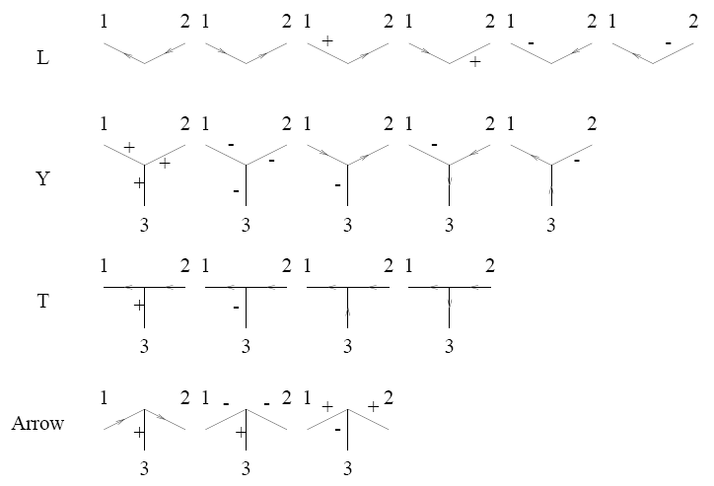
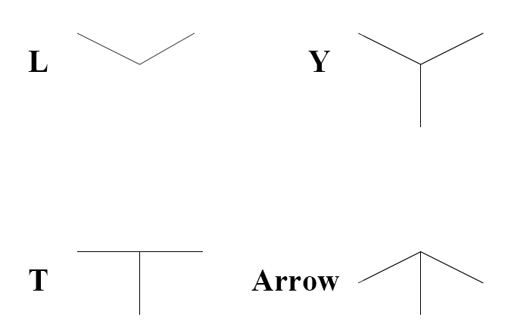
CSP in computer vision:
Line drawing interpretation
Constraints imposed by each vertex type:
Four vertex types:
David Waltz, 1975

Slide 66
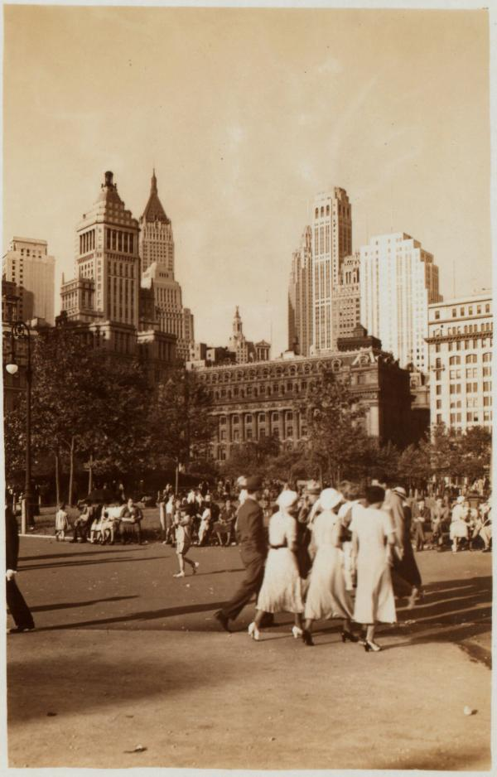




CSP in computer vision: 4D Cities
1. When was each photograph taken?
2. When did each building first appear?
3. When was each building removed?
Set of Photographs:
Set of Objects:
Buildings
G. Schindler, F. Dellaert, and S.B. Kang, Inferring Temporal Order of Images From 3D Structure, IEEE Computer Society Conference on Computer Vision and Pattern Recognition (CVPR), 2007.
http://www.cc.gatech.edu/~phlosoft/

Slide 67
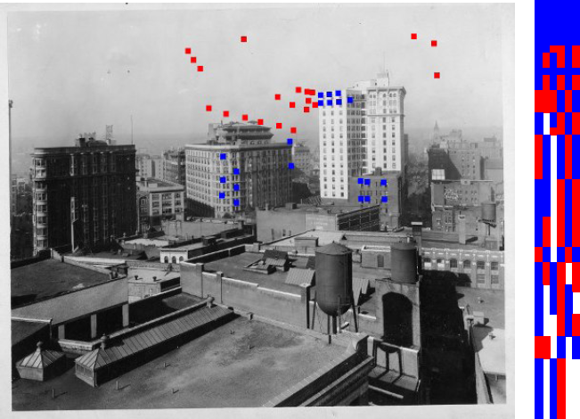
CSP in computer vision: 4D Cities
observed
missing
occluded
Columns: images
Rows: points
Satisfies constraints:
Violates constraints:
Goal: reorder images (columns) to have as few violations as possible

Slide 68

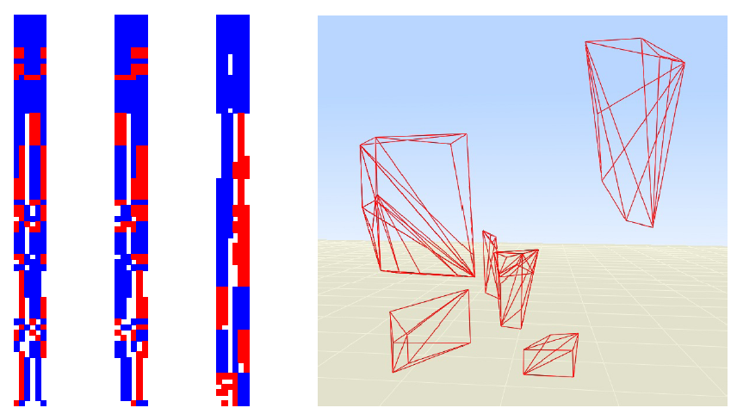
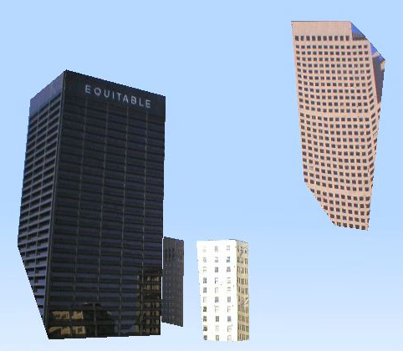
CSP in computer vision: 4D Cities
Goal: reorder images (columns) to have as few violations as possible
Local search: start with random ordering of columns, swap columns or groups of columns to reduce the number of conflicts
Can also reorder the rows to group together points that appear and disappear at the same time – that gives you buildings

Slide 69
Summary
CSPs are a special kind of search problem:
  States defined by values of a fixed set of variables
  Goal test defined by constraints on variable values
Backtracking = depth-first search where successor states are generated by considering assignments to a single variable
  Variable ordering and value selection heuristics can help significantly
  Forward checking prevents assignments that guarantee later failure
  Constraint propagation (e.g., arc consistency) does additional work to constrain values and detect inconsistencies
Complexity of CSPs
  NP-complete in general (exponential worst-case running time)
  Efficient solutions possible for special cases (e.g., tree-structured CSPs)
Alternatives to backtracking search: local search

