Slide 1
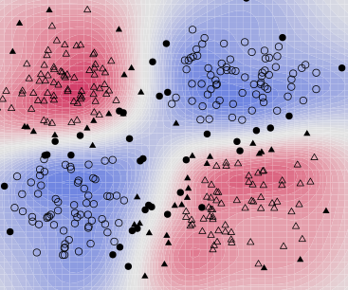
Neural networks and support vector machines

Slide 2
Outline
Neural Networks
  Perceptron review
  Differentiable perceptron
  Multilayer perceptron
  Support vector machine (SVM)
Other Machine Learning Tasks
  Structured prediction
  Clustering, quantization, density estimation
  Semi-supervised and active learning

Slide 3
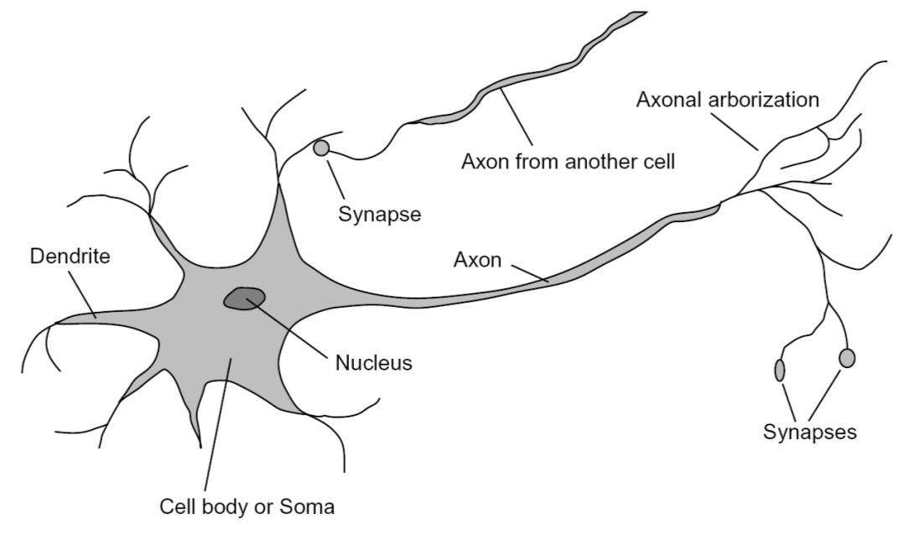
Loose inspiration: Human neurons
Notes:
From Wikipedia: At the majority of synapses, signals are sent from the axon of one neuron to a dendrite of another... All neurons are electrically excitable, maintaining voltage gradients across their membranes… If the voltage changes by a large enough amount, an all-or-none electrochemical pulse called an action potential is generated, which travels rapidly along the cell's axon, and activates synaptic connections with other cells when it arrives.

Slide 4
Perceptron
Input
Weights
x₁
w₁
x₂
w₂
Output: sgn(w⋅x + b)
x₃
w₃
.
.
.
Can incorporate bias as component of the weight vector by always including a feature with value set to 1
w_{D}
x_{D}

Slide 5
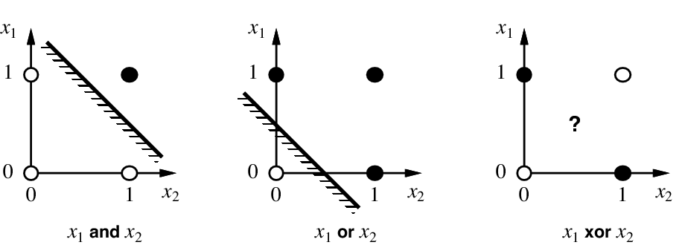
Linear separability

Slide 6
Perceptron update rule
For each training instance x with label y:
  Classify with current weights: y’ = sgn(w⋅x)
  Update weights: w ← w + α(y-y’)x
  α is a learning rate that should decay as a function of epoch t, e.g., 1000/(1000+t)
  What happens if y’ is correct?
  Otherwise, consider what happens to individual weights w_{i} ← w_{i} + α(y-y’)x_{i}
    If y = 1 and y’ = -1, w_{i} will be increased if x_{i} is positive or decreased if x_{i} is negative → w⋅x will get bigger
    If y = -1 and y’ = 1, w_{i} will be decreased if x_{i} is positive or increased if x_{i} is negative → w⋅x will get smaller

Slide 7
Outline
Neural Networks
  Perceptron review
  Differentiable perceptron
  Multilayer perceptron
  Support vector machine (SVM)
Other Machine Learning Tasks
  Structured prediction
  Clustering, quantization, density estimation
  Semi-supervised and active learning

Slide 8

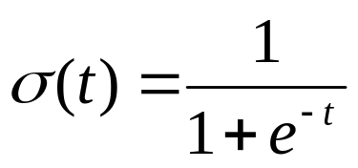
Differentiable perceptron
Input
Weights
x₁
w₁
x₂
w₂
Output: σ(w⋅x + b)
x₃
w₃
.
.
.
Sigmoid function:
w_{d}
x_{d}

Slide 9
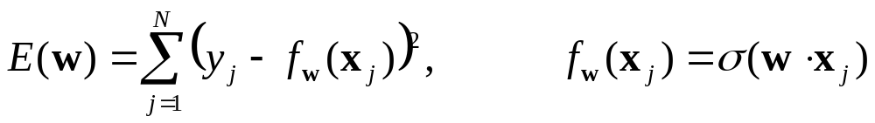
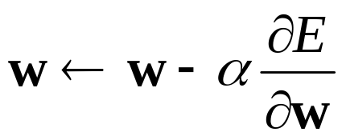
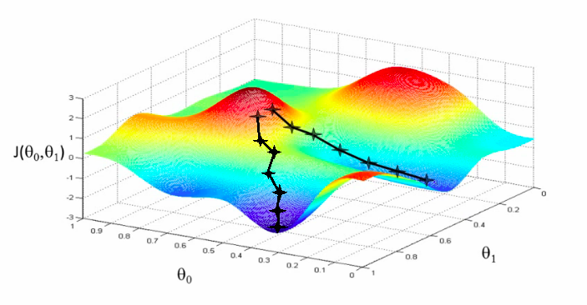
Update rule for differentiable perceptron
Define total classification error or loss on the training set:
Update weights by gradient descent:
w₂
w₁

Slide 10
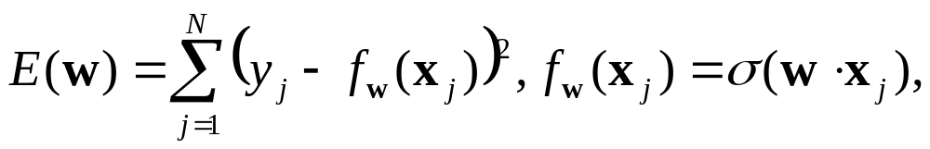
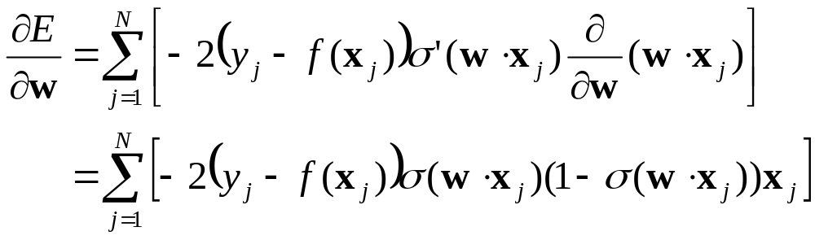
Update rule for differentiable perceptron
Define total classification error or loss on the training set:
Update weights by gradient descent:
For a single training point, the update is:

Slide 11

Update rule for differentiable perceptron
For a single training point, the update is:
Compare with update rule with non-differentiable perceptron:

Slide 12
Outline
Neural Networks
  Perceptron review
  Differentiable perceptron
  Multilayer perceptron
  Support vector machine (SVM)
Other Machine Learning Tasks
  Structured prediction
  Clustering, quantization, density estimation
  Semi-supervised and active learning

Slide 13
Linear separability

Slide 14
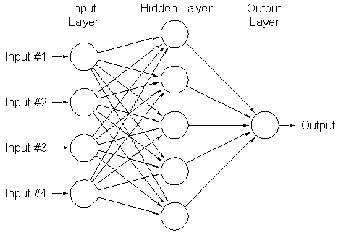
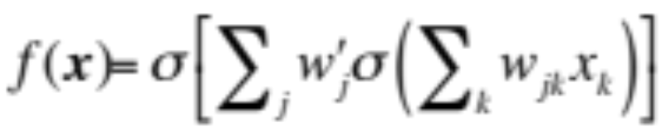
Multi-Layer Neural Network
weights w’
weights w_{j}
Can learn nonlinear functions

Slide 15
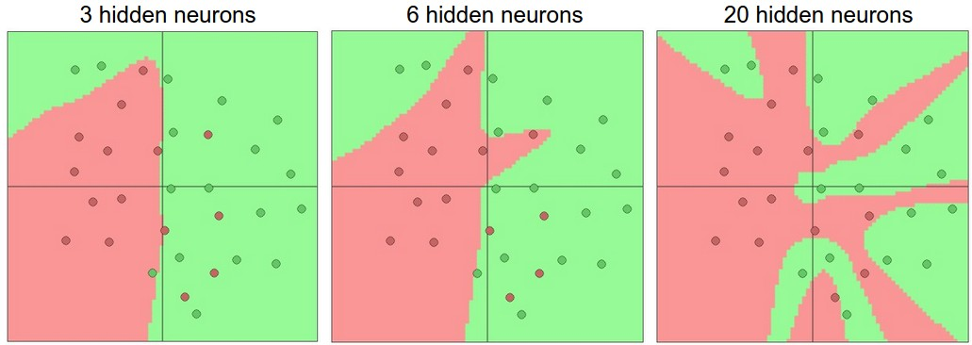
Multi-Layer Neural Network
Hidden layer size and network capacity:
Source: http://cs231n.github.io/neural-networks-1/

Slide 16
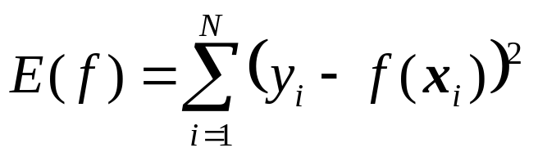
Multi-Layer Neural Network
Training: find network weights to minimize the error between true and estimated labels of training examples:
Minimization can be done by gradient descent provided f is differentiable
  This training method is called back-propagation

Slide 17
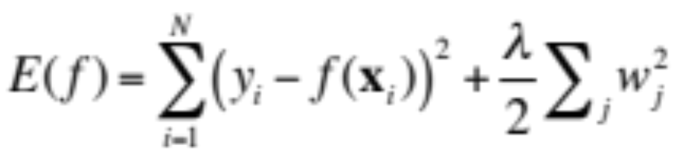
Multi-Layer Neural Network
Regularization: add a penalty on weight magnitudes to the objective function:
Discourages network weights from growing too large, encourages network to use all of its inputs “a little” rather than a few inputs “a lot”

Slide 18
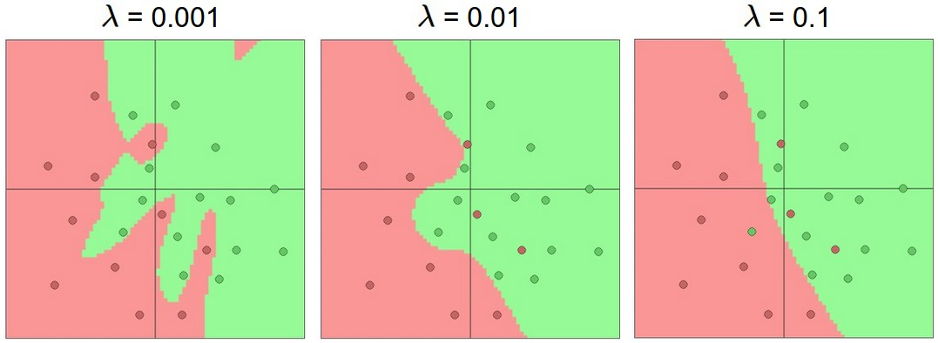
Multi-Layer Neural Network
Hidden layer size and network capacity
(each network has 20 units in hidden layer):
Source: http://cs231n.github.io/neural-networks-1/

Slide 19
Neural networks: Pros and cons
Pros
  Flexible and general function approximation framework
  Can build extremely powerful models by adding more layers
Cons
  Hard to analyze theoretically (e.g., training is prone to local optima)
  Huge amount of training data, computing power required to get good performance
  The space of implementation choices is huge (network architectures, parameters)

Slide 20
Outline
Neural Networks
  Perceptron review
  Differentiable perceptron
  Multilayer perceptron
  Support vector machine (SVM)
Other Machine Learning Tasks
  Structured prediction
  Clustering, quantization, density estimation
  Semi-supervised and active learning

Slide 21
Linear separability

Slide 22
Support vector machines
When the data are linearly separable, there may be more than one separator (hyperplane)
Which separator
is best?

Slide 23
Support vector machines
Find hyperplane that maximizes the margin between the positive and negative examples
Support vectors
Margin
C. Burges, A Tutorial on Support Vector Machines for Pattern Recognition, Data Mining and Knowledge Discovery, 1998

Slide 24
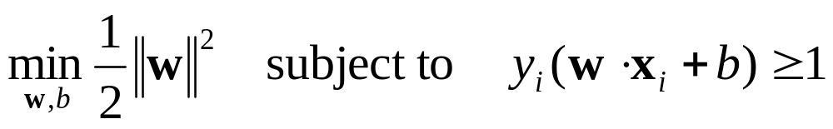
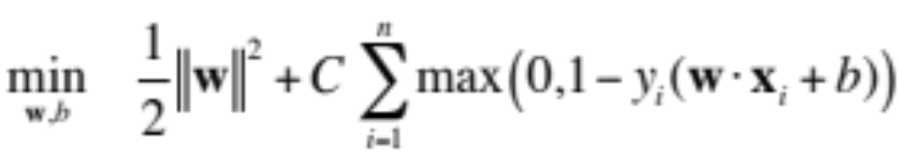
SVM parameter learning
Separable data:
Non-separable data:
Maximize margin
Classify training data correctly
Maximize margin
Minimize classification mistakes

Slide 25
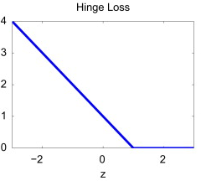
SVM parameter learning
w·x+b=+1
Margin
w·x+b=0
w·x+b=-1
Demo: http://cs.stanford.edu/people/karpathy/svmjs/demo

Slide 26
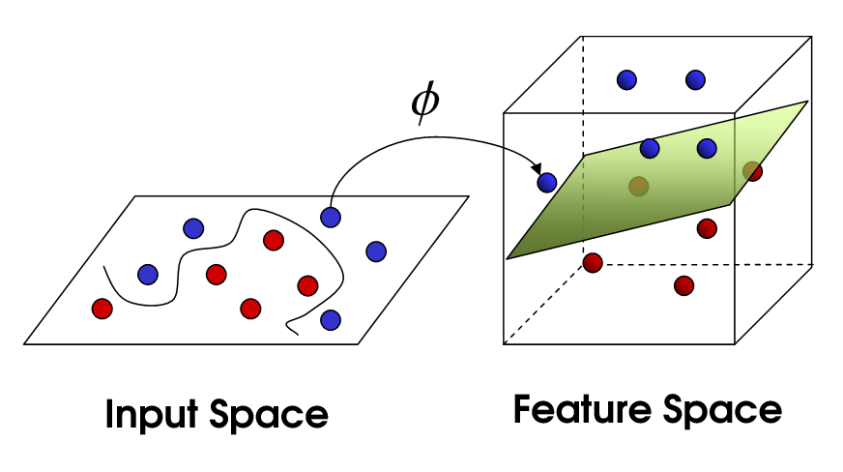
Nonlinear SVMs
General idea: the original input space can always be mapped to some higher-dimensional feature space where the training set is separable
Φ: x → φ(x)
Image source

Slide 27
Nonlinear SVMs
Linearly separable dataset in 1D:
Non-separable dataset in 1D:
We can map the data to a higher-dimensional space:
0
x
0
x
x²
0
x
Slide credit: Andrew Moore

Slide 28
The kernel trick
General idea: the original input space can always be mapped to some higher-dimensional feature space where the training set is separable
The kernel trick: instead of explicitly computing the lifting transformation φ(x), define a kernel function K such that
K(x , y) = φ(x) · φ(y)
(to be valid, the kernel function must satisfy Mercer’s condition)

Slide 29
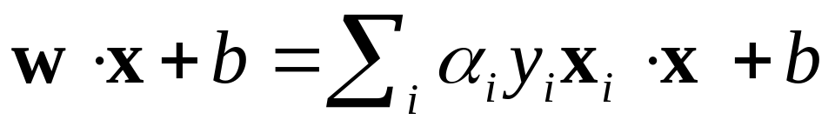
The kernel trick
Linear SVM decision function:
learned
weight
Support
vector
C. Burges, A Tutorial on Support Vector Machines for Pattern Recognition, Data Mining and Knowledge Discovery, 1998

Slide 30
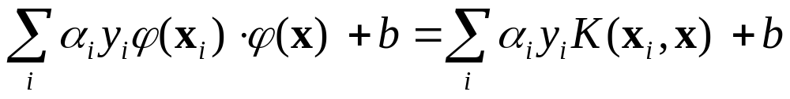
The kernel trick
Linear SVM decision function:
Kernel SVM decision function:
This gives a nonlinear decision boundary in the original feature space
C. Burges, A Tutorial on Support Vector Machines for Pattern Recognition, Data Mining and Knowledge Discovery, 1998

Slide 31
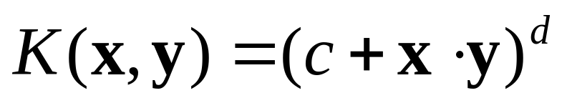
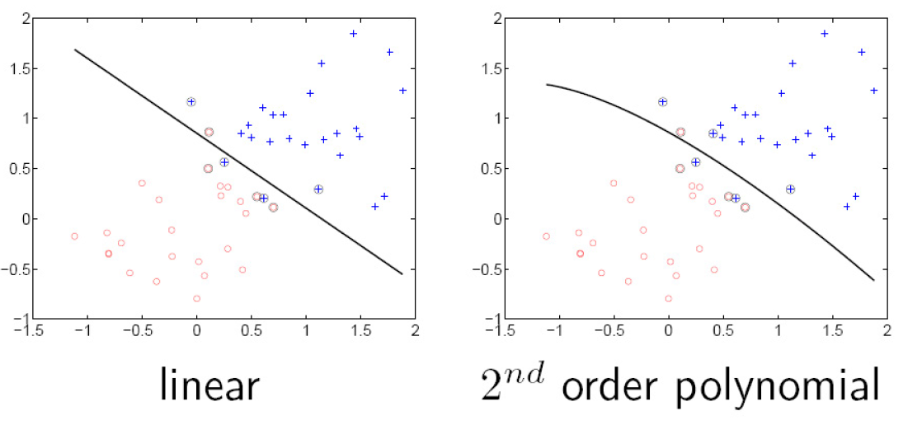
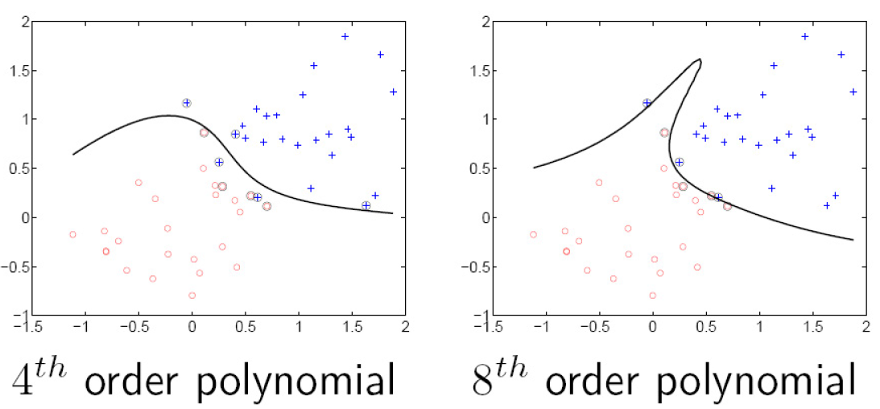
Polynomial kernel:

Slide 32
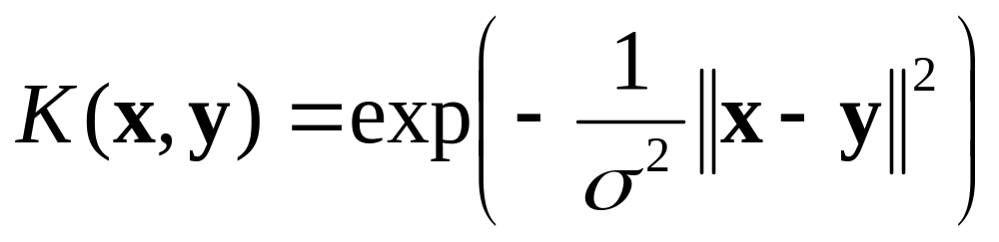
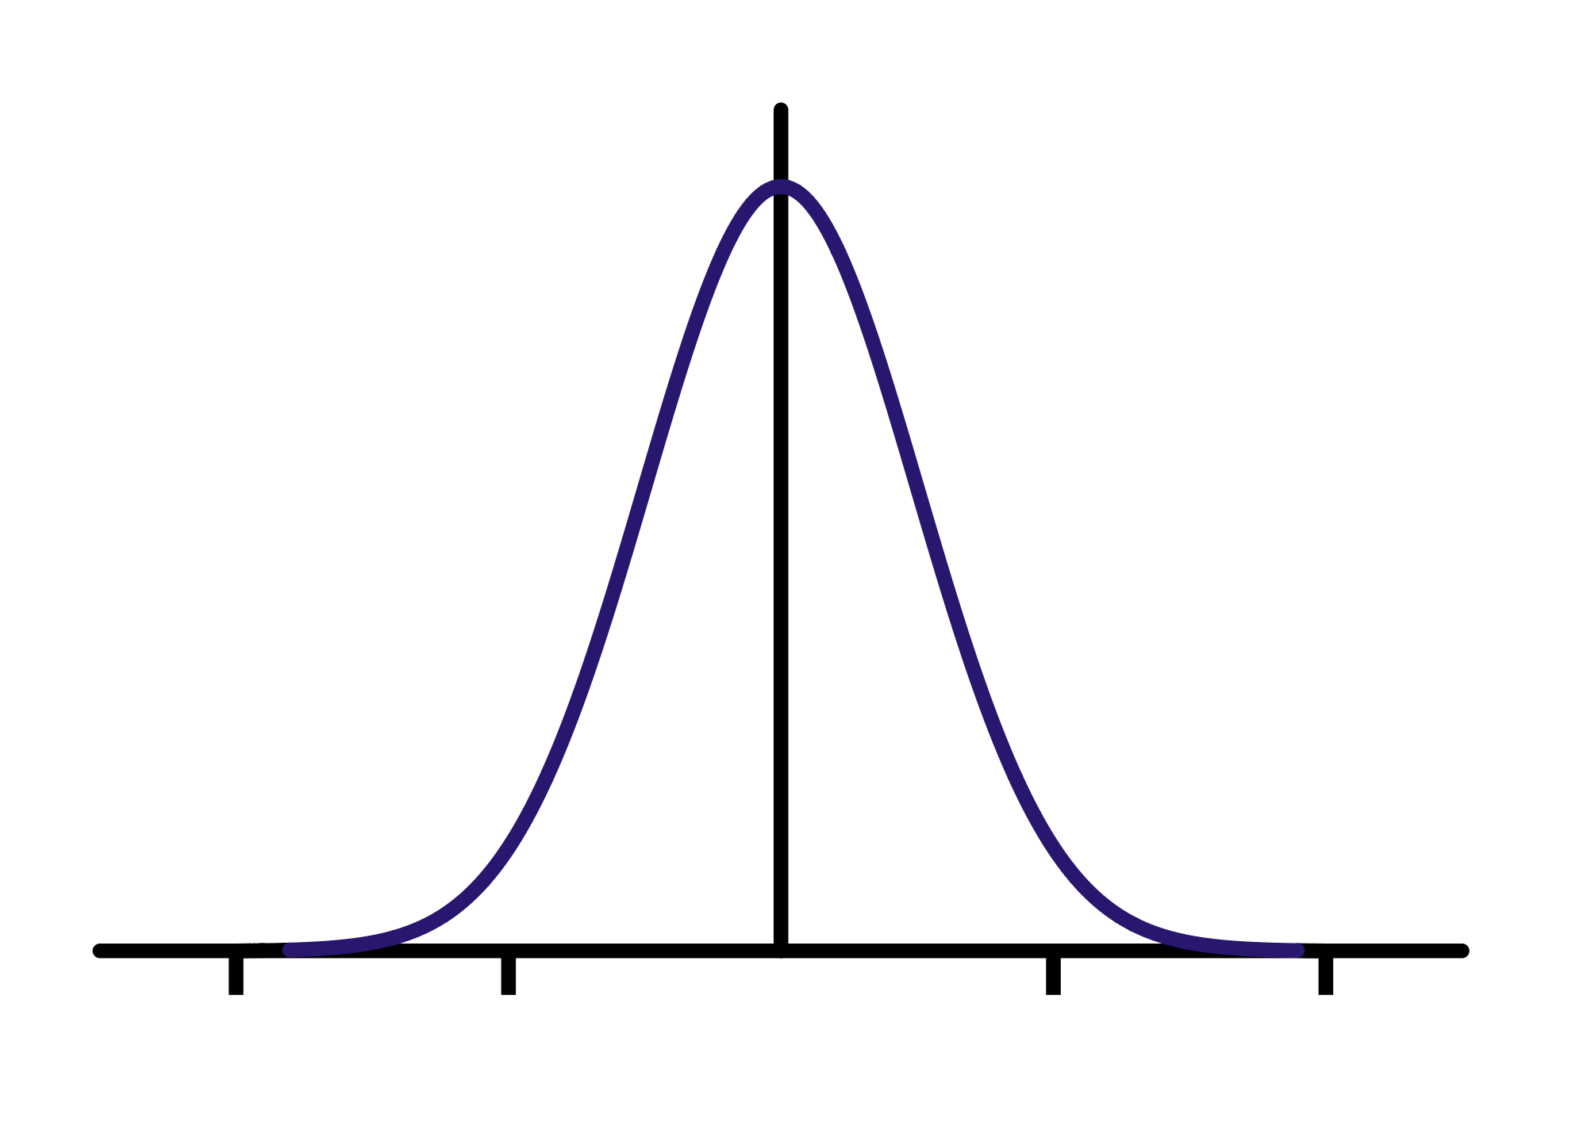
Gaussian kernel
Also known as the radial basis function (RBF) kernel:
K(x, y)
||x – y||

Slide 33
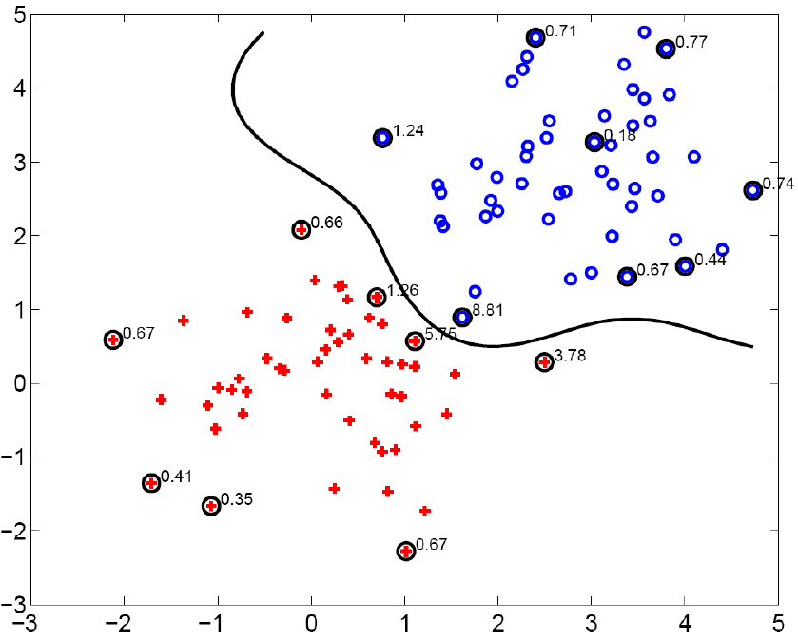
Gaussian kernel
SV’s

Slide 34
SVMs: Pros and cons
Pros
  Kernel-based framework is very powerful, flexible
  Training is convex optimization, globally optimal solution can be found
  Amenable to theoretical analysis
  SVMs work very well in practice, even with very small training sample sizes
Cons
  No “direct” multi-class SVM, must combine two-class SVMs (e.g., with one-vs-others)
  Computation, memory (esp. for nonlinear SVMs)

Slide 35
Outline
Neural Networks
  Perceptron review
  Differentiable perceptron
  Multilayer perceptron
  Support vector machine (SVM)
Other Machine Learning Tasks
  Structured prediction
  Clustering, quantization, density estimation
  Semi-supervised and active learning

Slide 36
Other machine learning scenarios
Other prediction scenarios
  Regression
  Structured prediction
Other supervision scenarios
  Unsupervised learning
  Semi-supervised learning
  Active learning
  Lifelong learning

Slide 37

Beyond simple classification: Structured prediction
Word
Image
Source: B. Taskar

Slide 38
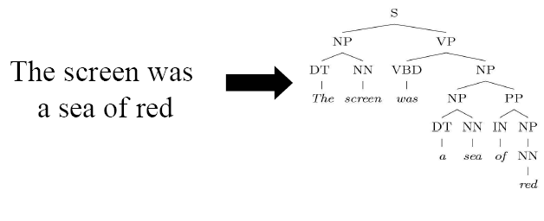
Structured Prediction
Parse tree
Sentence
Source: B. Taskar

Slide 39
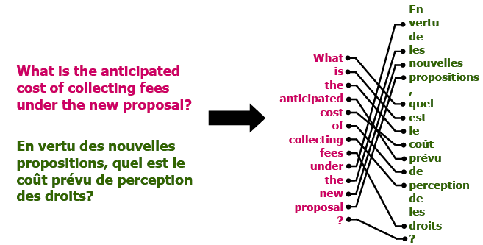
Structured Prediction
Sentence in two languages
Word alignment
Source: B. Taskar

Slide 40


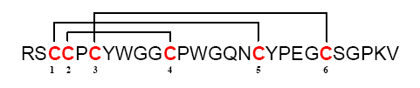
Structured Prediction
Amino-acid sequence
Bond structure
Source: B. Taskar

Slide 41
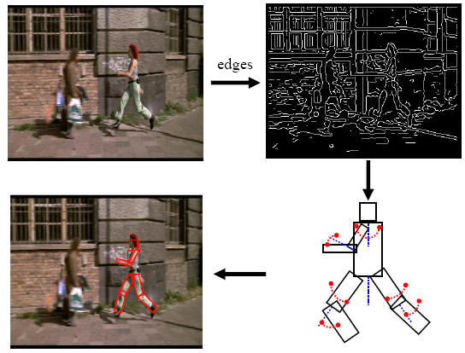
Structured Prediction
Many image-based inference tasks can loosely be thought of as “structured prediction”
model
Source: D. Ramanan

Slide 42
Outline
Neural Networks
  Perceptron review
  Differentiable perceptron
  Multilayer perceptron
  Support vector machine (SVM)
Other Machine Learning Tasks
  Structured prediction
  Clustering, quantization, density estimation
  Semi-supervised and active learning

Slide 43
Unsupervised Learning
Idea: Given only unlabeled data as input, learn some sort of structure
The objective is often more vague or subjective than in supervised learning
This is more of an exploratory/descriptive data analysis

Slide 44
Unsupervised Learning
Clustering
  Discover groups of “similar” data points

Slide 45
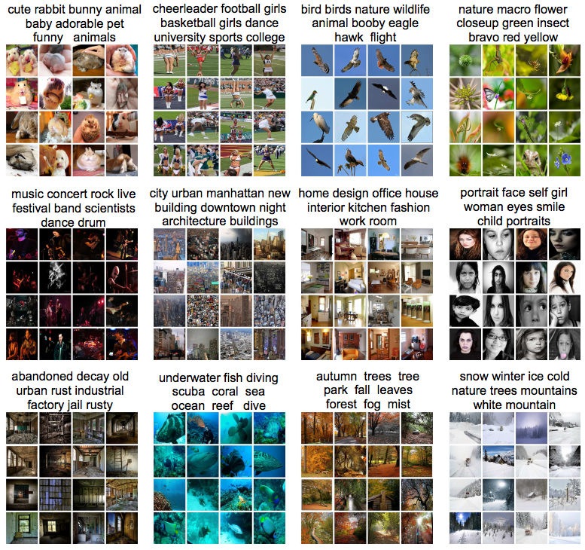

Slide 46
Unsupervised Learning
Quantization
  Map a continuous input to a discrete (more compact) output
2
1
3

Slide 47
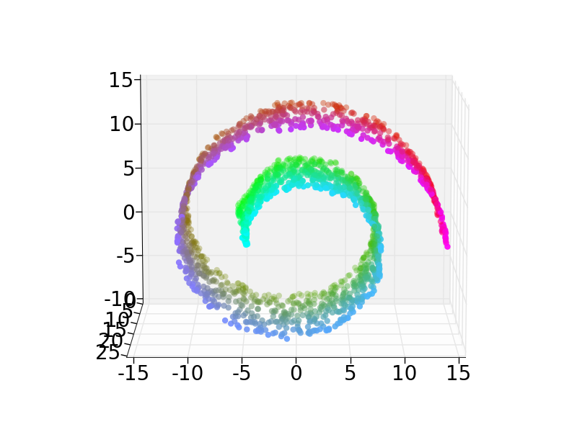
Unsupervised Learning
Dimensionality reduction, manifold learning
  Discover a lower-dimensional surface on which the data lives

Slide 48
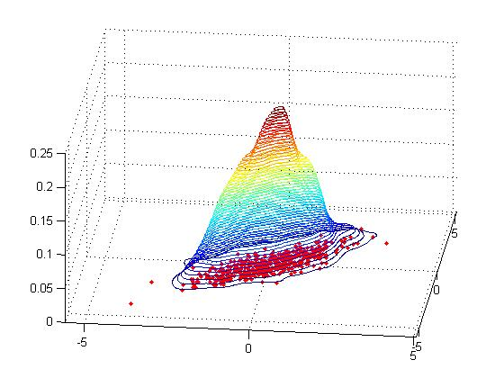
Unsupervised Learning
Density estimation
  Find a function that approximates the probability density of the data (i.e., value of the function is high for “typical” points and low for “atypical” points)
  Can be used for anomaly detection

Slide 49
Outline
Neural Networks
  Perceptron review
  Differentiable perceptron
  Multilayer perceptron
  Support vector machine (SVM)
Other Machine Learning Tasks
  Structured prediction
  Clustering, quantization, density estimation
  Semi-supervised and active learning

Slide 50
Semi-supervised learning
Lots of data are available, but only small portion is labeled (e.g. since labeling is expensive)
  Why is learning from labeled and unlabeled data better than learning from labeled data alone?
?

Slide 51
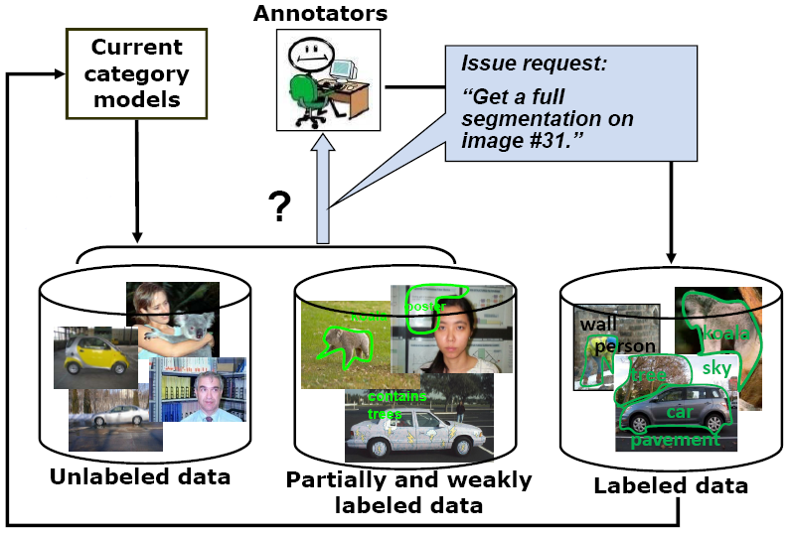
Active learning
The learning algorithm can choose its own training examples, or ask a “teacher” for an answer on selected inputs
S. Vijayanarasimhan and K. Grauman, “Cost-Sensitive Active Visual Category Learning,” 2009

Slide 52

Lifelong learning
http://rtw.ml.cmu.edu/rtw/

Slide 53

Lifelong learning
http://rtw.ml.cmu.edu/rtw/

Slide 54

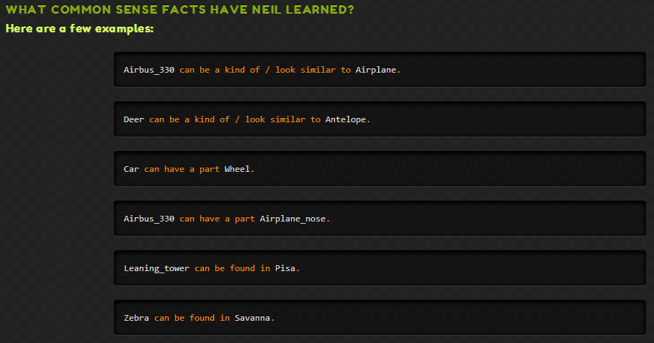
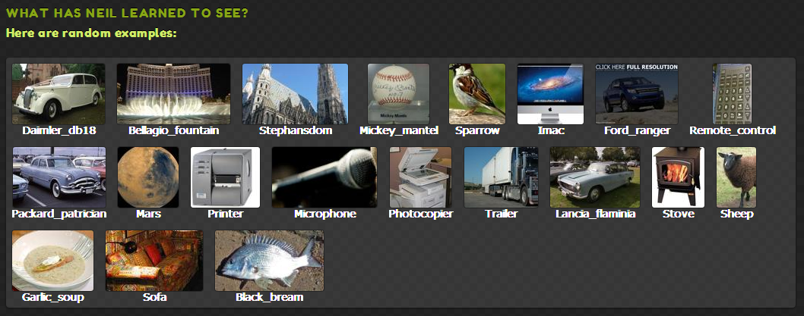
Xinlei Chen, Abhinav Shrivastava and Abhinav Gupta. NEIL: Extracting Visual Knowledge from Web Data. In ICCV 2013

Slide 55
Outline
Neural Networks
  Perceptron review
  Differentiable perceptron
  Multilayer perceptron
  Support vector machine (SVM)
Other Machine Learning Tasks
  Structured prediction
  Unsupervised learning
    Clustering, quantization, density estimation
  Semi-supervised and active learning
    Example: the Never-Ending Language Learner

