Slide 1

Machine learning
Image source: https://www.coursera.org/course/ml

Slide 2
Machine learning
Definition
  Getting a computer to do well on a task without explicitly programming it
  Improving performance on a task based on experience

Slide 3
Learning for episodic tasks
We have just looked at learning in sequential environments
Now let’s consider the “easier” problem of episodic environments
  The agent gets a series of unrelated problem instances and has to make some decision or inference about each of them
  In this case, “experience” comes in the form of training data

Slide 4

Example: Image classification
input
desired output
apple
pear
tomato
cow
dog
horse

Slide 5
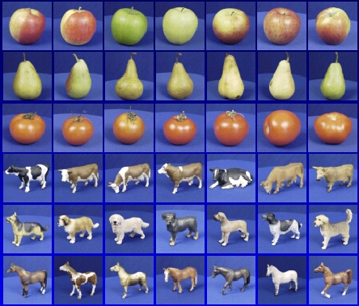
Training data
apple
pear
tomato
cow
dog
horse

Slide 6
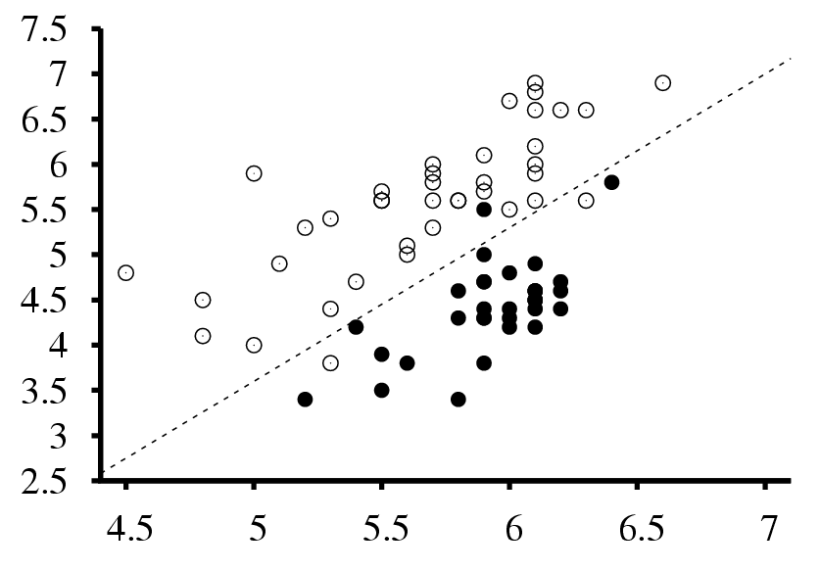
Example 2: Seismic data classification
Earthquakes
Surface wave magnitude
Nuclear explosions
Body wave magnitude

Slide 7

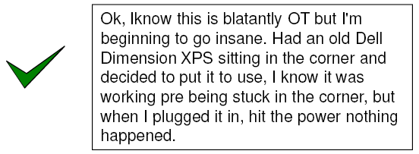
Example 3: Spam filter

Slide 8
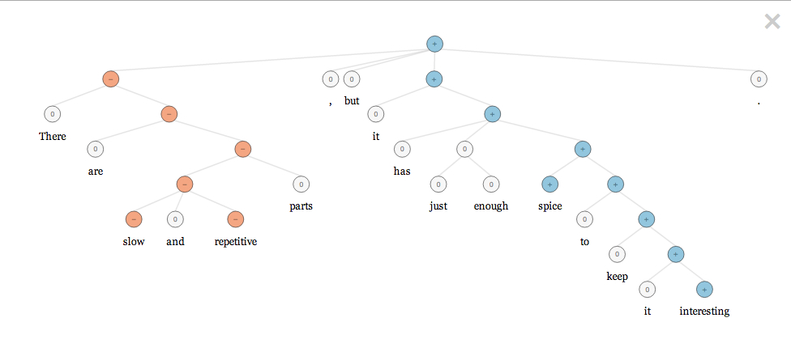
Example 4: Sentiment analysis
http://gigaom.com/2013/10/03/stanford-researchers-to-open-source-model-they-say-has-nailed-sentiment-analysis/
http://nlp.stanford.edu:8080/sentiment/rntnDemo.html

Slide 9
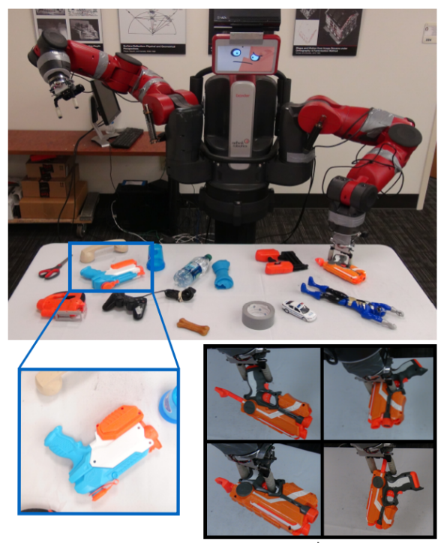
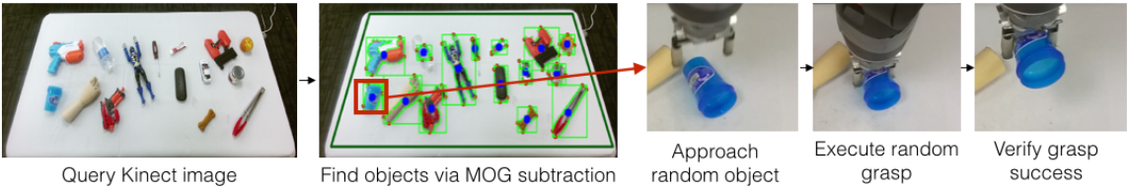
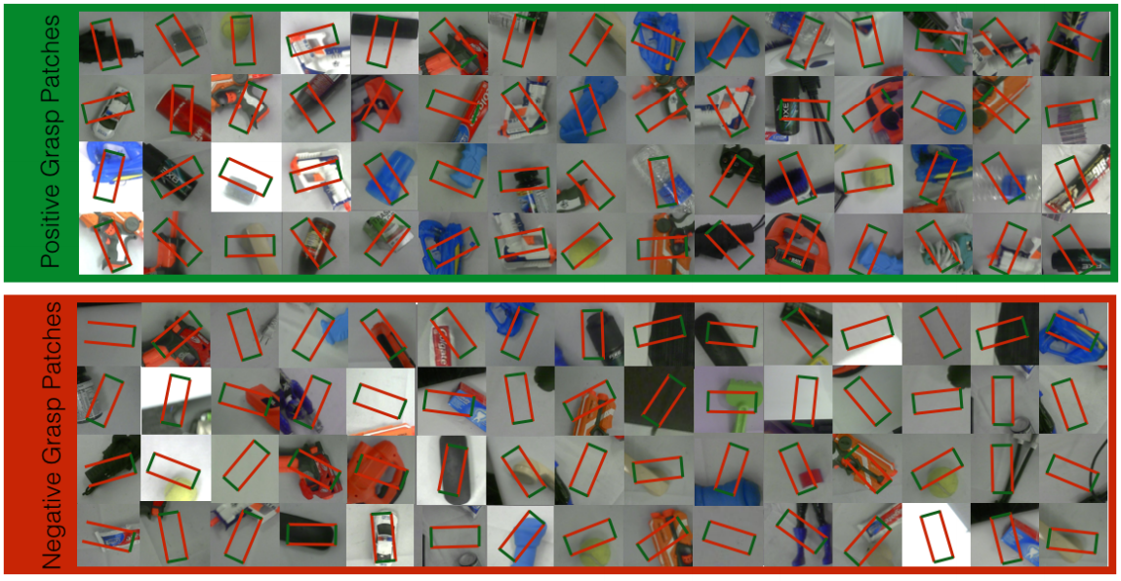
Example 5: Robot grasping
L. Pinto and A. Gupta, Supersizing self-supervision: Learning to grasp from 50K tries and 700 robot hours,” arXiv.org/abs/1509.06825
YouTube video

Slide 10
The basic supervised learning framework
y = f(x)
Learning: given a training set of labeled examples {(x₁,y₁), …, (x_{N},y_{N})}, estimate the parameters of the prediction function f
Inference: apply f to a never before seen test example x and output the predicted value y = f(x)
The key challenge is generalization
output
classification function
input

Slide 11
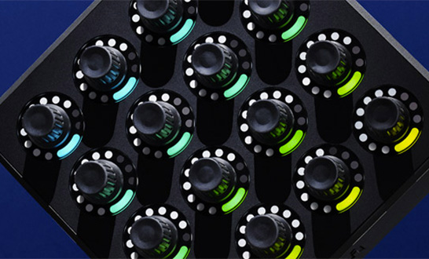

Learning and inference pipeline
Learning
Training Labels
Training Samples
Features
Training
Learned model
Learned model
Inference
Features
Prediction
Test
Label
Test Sample

Slide 12
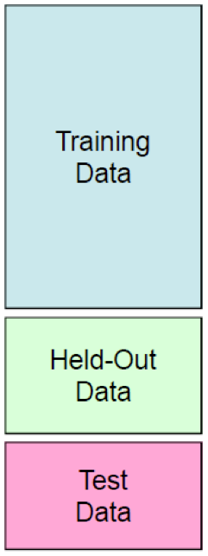
Experimentation cycle
Learn parameters on the training set
Tune hyperparameters (implementation choices) on the held out validation set
Evaluate performance on the test set
Very important: do not peek at the test set!
Generalization and overfitting
  Want classifier that does well on never before seen data
  Overfitting: good performance on the training/validation set, poor performance on test set

Slide 13



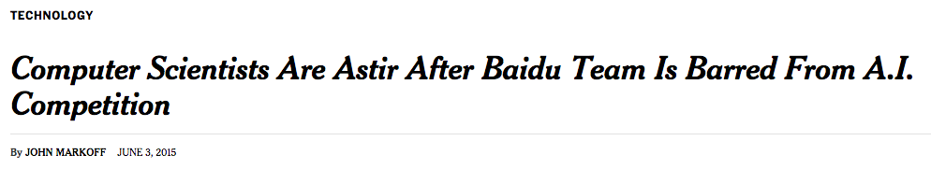

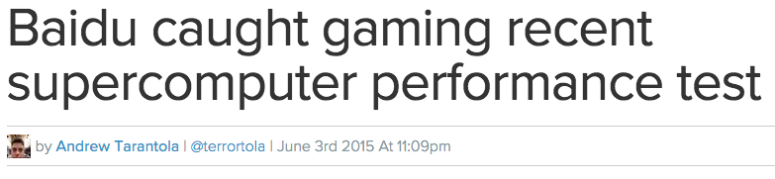

What’s the big deal?

Slide 14
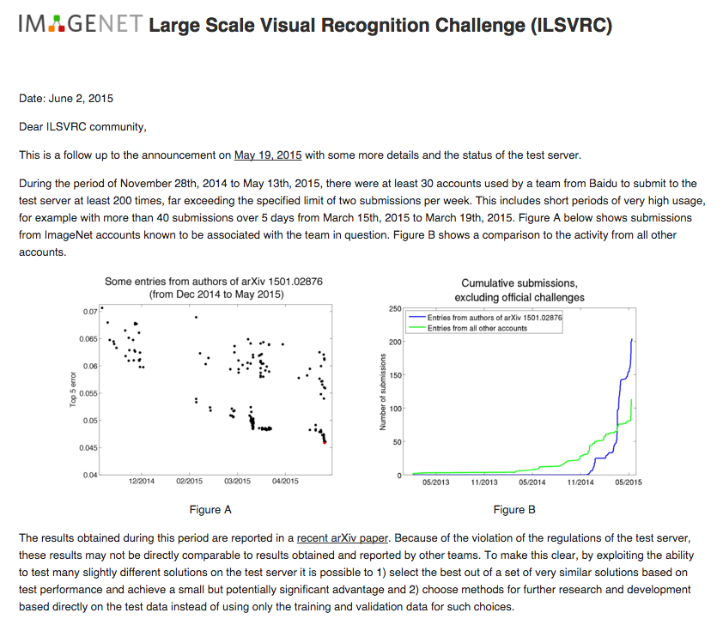
http://www.image-net.org/challenges/LSVRC/announcement-June-2-2015

Slide 15
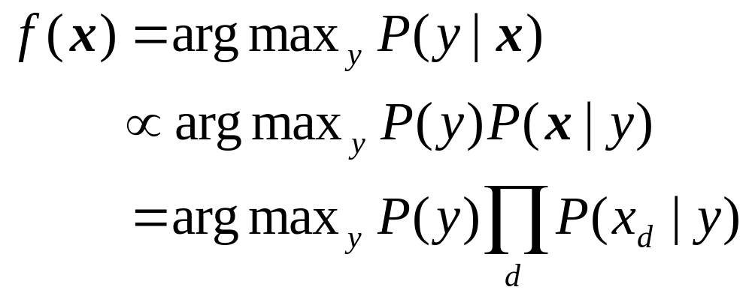
Naïve Bayes classifier
A single dimension or attribute of x

Slide 16
Decision tree classifier
Example problem: decide whether to wait for a table at a restaurant, based on the following attributes:
  Alternate: is there an alternative restaurant nearby?
  Bar: is there a comfortable bar area to wait in?
  Fri/Sat: is today Friday or Saturday?
  Hungry: are we hungry?
  Patrons: number of people in the restaurant (None, Some, Full)
  Price: price range ($, $$, $$$)
  Raining: is it raining outside?
  Reservation: have we made a reservation?
  Type: kind of restaurant (French, Italian, Thai, Burger)
  WaitEstimate: estimated waiting time (0-10, 10-30, 30-60, >60)

Slide 17
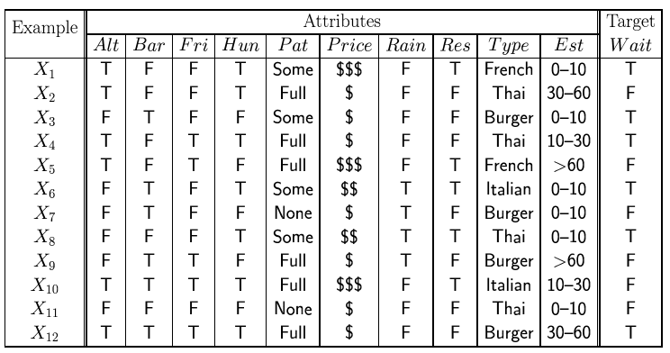
Decision tree classifier

Slide 18
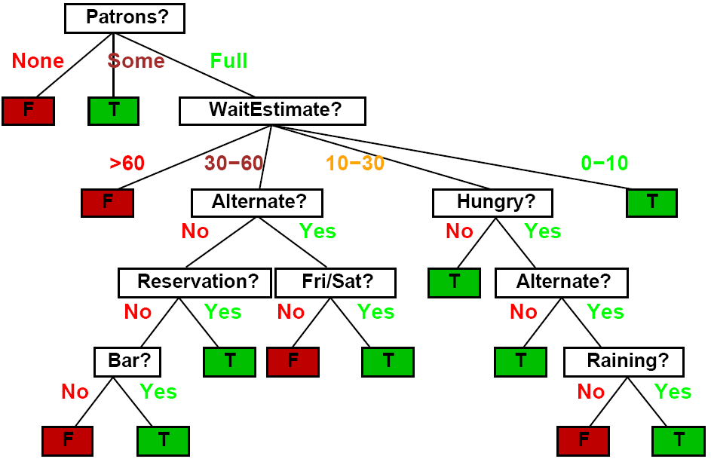
Decision tree classifier

Slide 19
Nearest neighbor classifier
Test example
Training examples from class 2
Training examples from class 1
f(x) = label of the training example nearest to x
All we need is a distance function for our inputs
No training required!

Slide 20
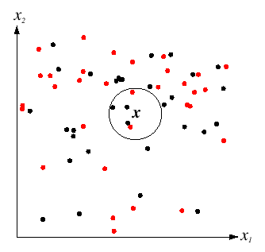
K-nearest neighbor classifier
For a new point, find the k closest points from training data
Vote for class label with labels of the k points
k = 5

Slide 21
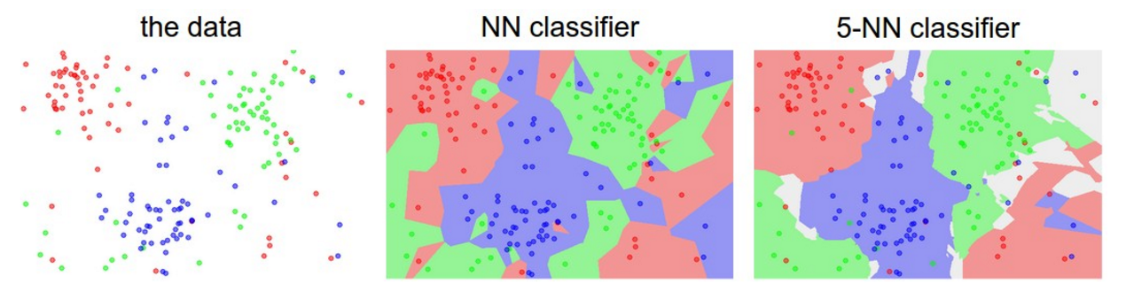
K-nearest neighbor classifier
Which classifier is more robust to outliers?
Credit: Andrej Karpathy, http://cs231n.github.io/classification/

Slide 22
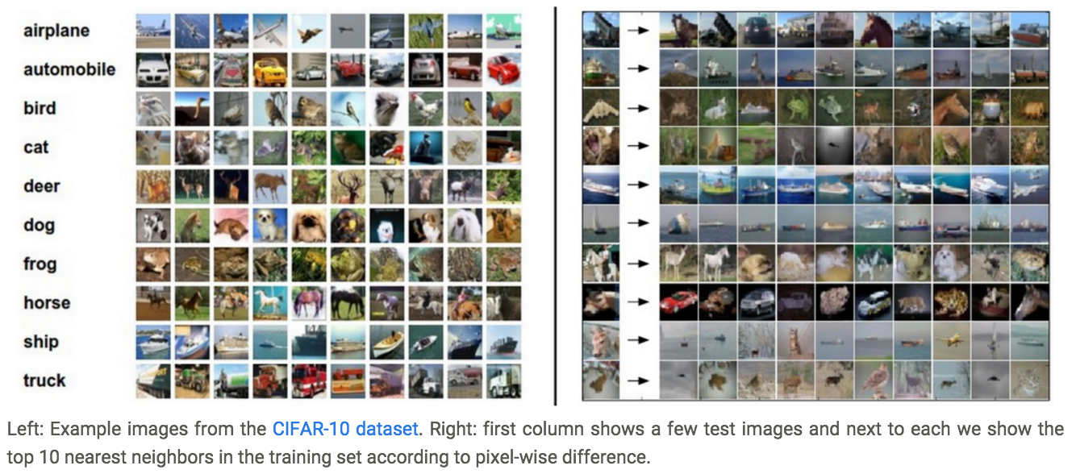
K-nearest neighbor classifier
Credit: Andrej Karpathy, http://cs231n.github.io/classification/

Slide 23
Linear classifier
Find a linear function to separate the classes
f(x) = sgn(w₁x₁ + w₂x₂ + … + w_{D}x_{D} + b) = sgn(w ⋅ x + b)

Slide 24
NN vs. linear classifiers
NN pros:
  Simple to implement
  Decision boundaries not necessarily linear
  Works for any number of classes
  Nonparametric method
NN cons:
  Need good distance function
  Slow at test time
Linear pros:
  Low-dimensional parametric representation
  Very fast at test time
Linear cons:
  How to train the linear function?
  What if data are not linearly separable?

Slide 25
Perceptron
Input
Weights
x₁
w₁
x₂
w₂
Output: sgn(w⋅x + b)
x₃
w₃
.
.
.
w_{D}
Can incorporate bias as component of the weight vector by always including a feature with value set to 1
x_{D}

Slide 26
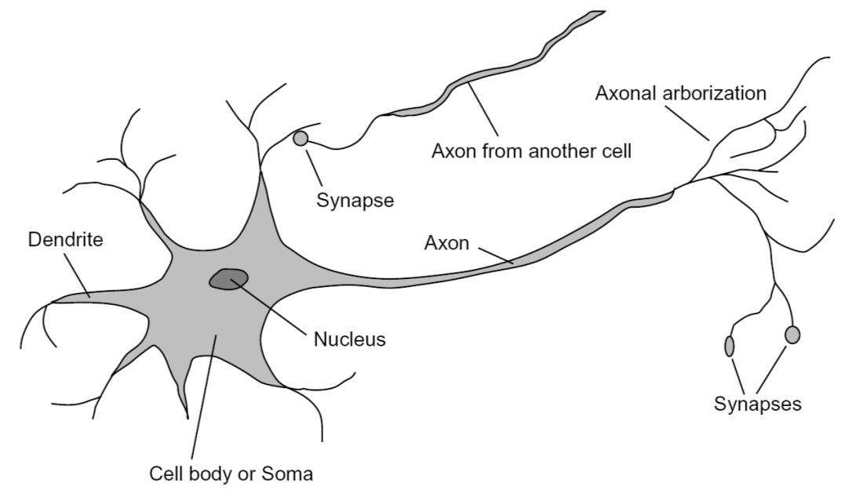
Loose inspiration: Human neurons
Notes:
From Wikipedia: At the majority of synapses, signals are sent from the axon of one neuron to a dendrite of another... All neurons are electrically excitable, maintaining voltage gradients across their membranes… If the voltage changes by a large enough amount, an all-or-none electrochemical pulse called an action potential is generated, which travels rapidly along the cell's axon, and activates synaptic connections with other cells when it arrives.

Slide 27
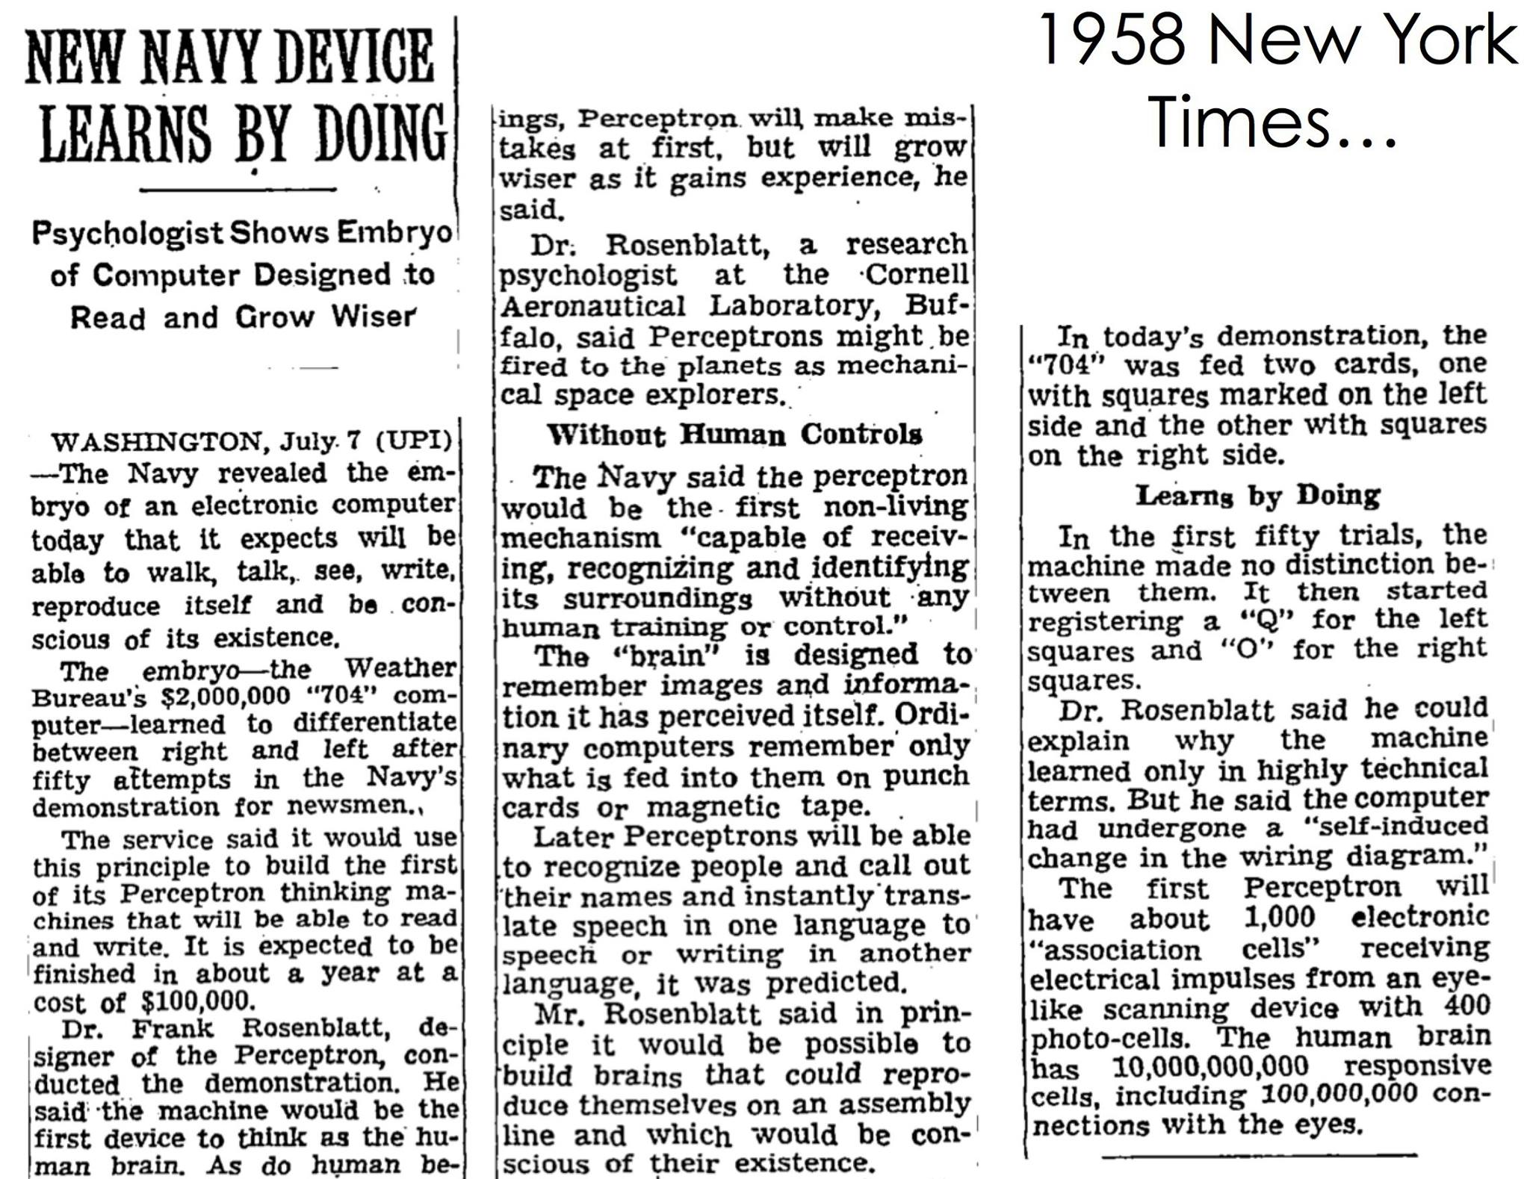

Slide 28
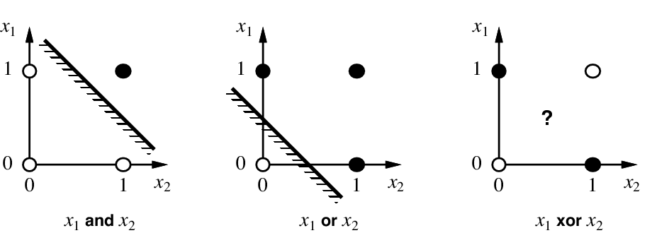
Linear separability

Slide 29
Perceptron training algorithm
Initialize weights
Cycle through training examples in multiple passes (epochs)
For each training example:
  If classified correctly, do nothing
  If classified incorrectly, update weights

Slide 30
Perceptron update rule
For each training instance x with label y:
  Classify with current weights: y’ = sgn(w⋅x)
  Update weights: w ← w + α(y-y’)x
  α is a learning rate that should decay as a function of epoch t, e.g., 1000/(1000+t)
  What happens if y’ is correct?
  Otherwise, consider what happens to individual weights w_{i} ← w_{i} + α(y-y’)x_{i}
    If y = 1 and y’ = -1, w_{i} will be increased if x_{i} is positive or decreased if x_{i} is negative → w⋅x will get bigger
    If y = -1 and y’ = 1, w_{i} will be decreased if x_{i} is positive or increased if x_{i} is negative → w⋅x will get smaller

Slide 31
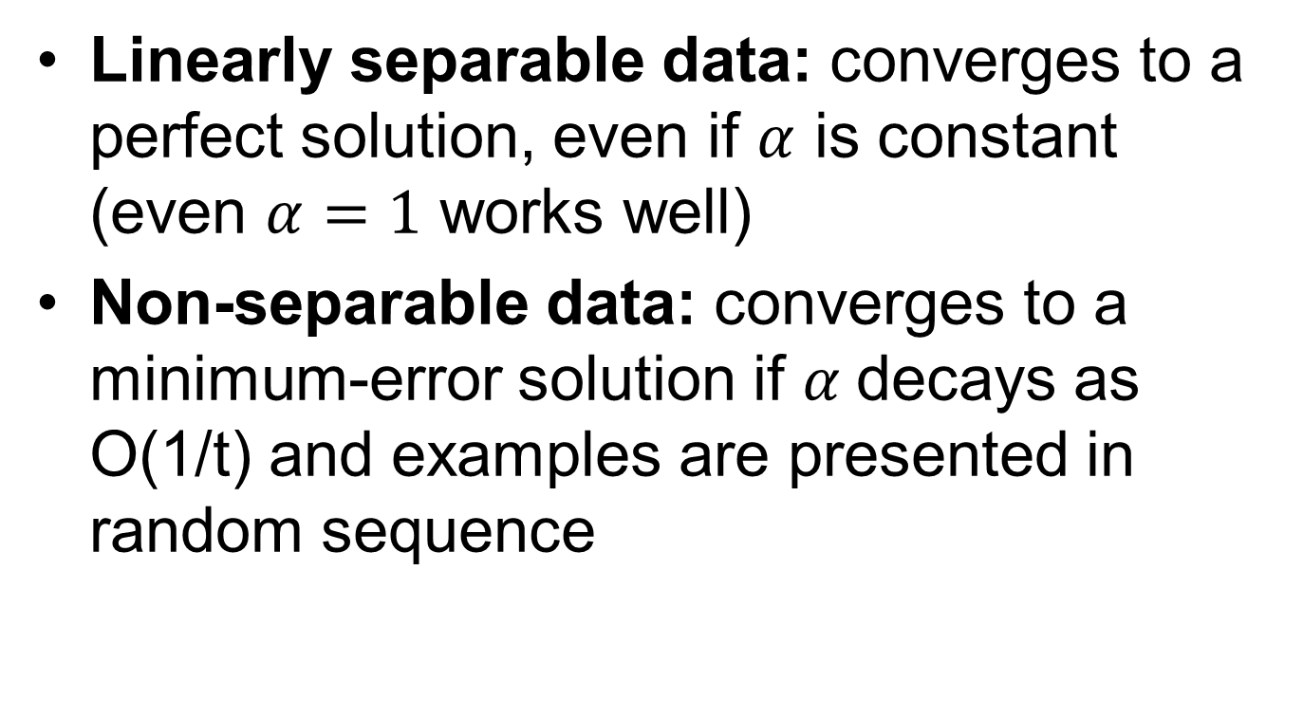
Convergence of perceptron update rule
Linearly separable data: converges to a perfect solution, even if $α$ is constant (even $α=1$ works well)
Non-separable data: converges to a minimum-error solution if $α$decays as O(1/t) and examples are presented in random sequence

Slide 32
Implementation details
Bias (add feature dimension with value fixed to 1) vs. no bias
Initialization of weights: all zeros vs. random
Learning rate decay function
Number of epochs (passes through the training data)
Order of cycling through training examples (random)

Slide 33
Multi-class perceptrons
One-vs-others framework: Need to keep a weight vector w_{c} for each class c
Decision rule: c = argmax_{c} w_{c}⋅ x
Update rule: suppose example from class c gets misclassified as c’
  Update for c: w_{c} ← w_{c} + α x
  Update for c’: w_{c’} ← w_{c’} – α x

Slide 34
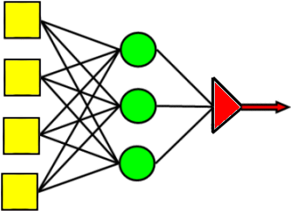
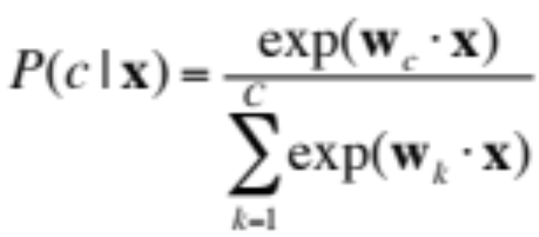
Review: Multi-class perceptrons
One-vs-others framework: Need to keep a weight vector w_{c} for each class c
Decision rule: c = argmax_{c} w_{c}⋅ x
Softmax:
Max
Perceptrons w/ weights w_{c}
Inputs

Slide 35
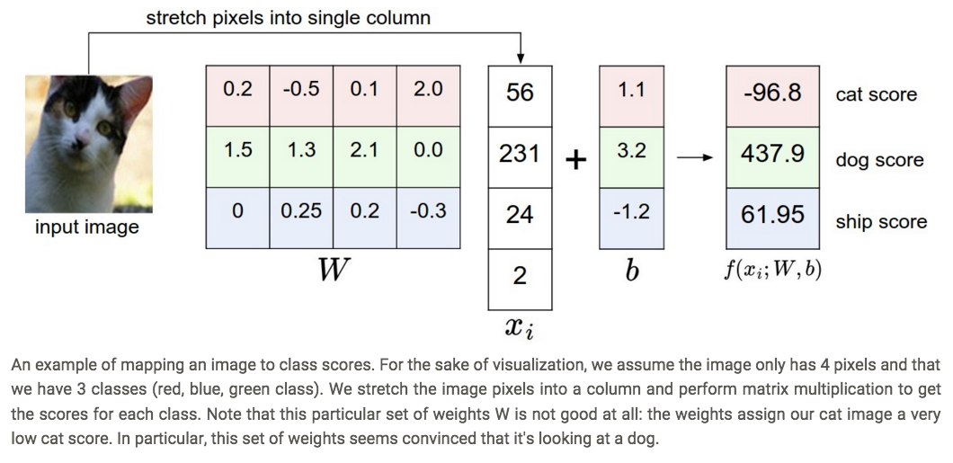
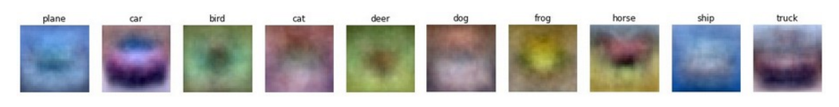
Visualizing linear classifiers
Source: Andrej Karpathy, http://cs231n.github.io/linear-classify/

