Slide 1
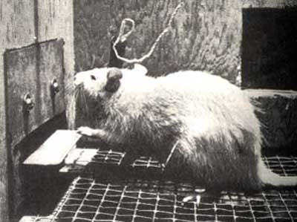
Reinforcement learning (Chapter 21)

Slide 2
Reinforcement learning
Regular MDP
  Given:
    Transition model P(s’ | s, a)
    Reward function R(s)
  Find:
    Policy π(s)
Reinforcement learning
  Transition model and reward function initially unknown
  Still need to find the right policy
  “Learn by doing”

Slide 3
Reinforcement learning:
Basic scheme
In each time step:
  Take some action
  Observe the outcome of the action: successor state and reward
  Update some internal representation of the environment and policy
  If you reach a terminal state, just start over (each pass through the environment is called a trial)
Why is this called reinforcement learning?
Notes:
See http://en.wikipedia.org/wiki/Reinforcement for discussion of reinforcement learning in psychology

Slide 4
Outline
Applications of Reinforcement Learning
Model-Based Reinforcement Learning
  Estimate P(s’|s,a) and R(s)
  Exploration vs. Exploitation
Model-Free Reinforcement Learning
  Q-learning
  Temporal Difference Learning
Function approximation; policy learning

Slide 5
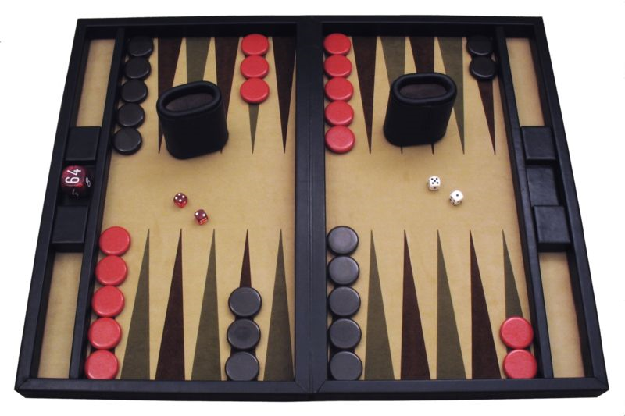
Applications of reinforcement learning
Backgammon
http://www.research.ibm.com/massive/tdl.html
http://en.wikipedia.org/wiki/TD-Gammon
Notes:
What is the state representation? What is the transition model? What is the reward function?

Slide 6
Applications of reinforcement learning
Spoken Dialog Systems (Litman et al., 2000)
Action
GreetS | Welcome to NJFun. Please say an activity name or say 'list activities' for a list of activities I know about.
GreetU | Welcome to NJFun. How may I help you?
ReAsk 1 S | I know about amusement parks, aquariums, cruises, historic sites, museums, parks, theaters, wineries, and zoos. Please say an activity name from this list.
ReAsk 1M | Please tell me the activity type.You can also tell me the location and time.

Slide 7

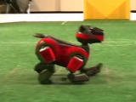
Applications of reinforcement learning
Learning a fast gait for Aibos
Initial gait
Learned gait
Policy Gradient Reinforcement Learning for Fast Quadrupedal Locomotion
Nate Kohl and Peter Stone.
IEEE International Conference on Robotics and Automation, 2004.

Slide 8
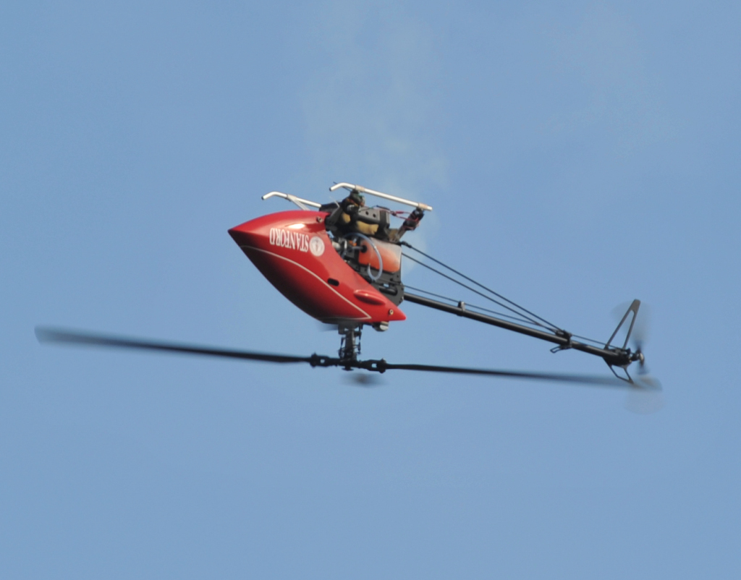
Applications of reinforcement learning
Stanford autonomous helicopter
Pieter Abbeel et al.

Slide 9
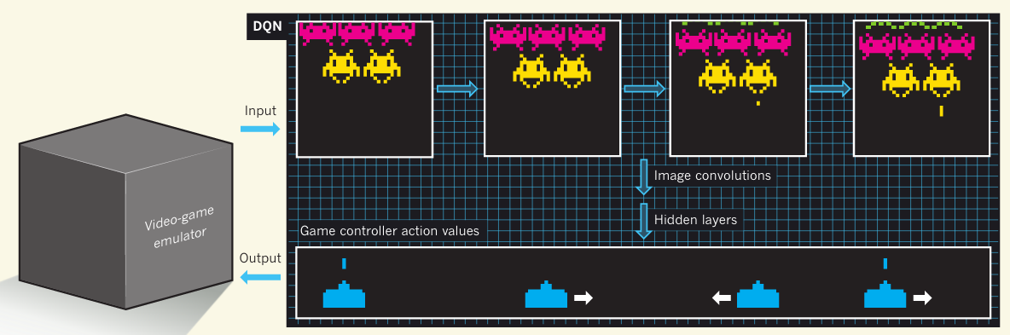
Applications of reinforcement learning
Playing Atari with deep reinforcement learning
Video
V. Mnih et al., Nature, February 2015

Slide 10
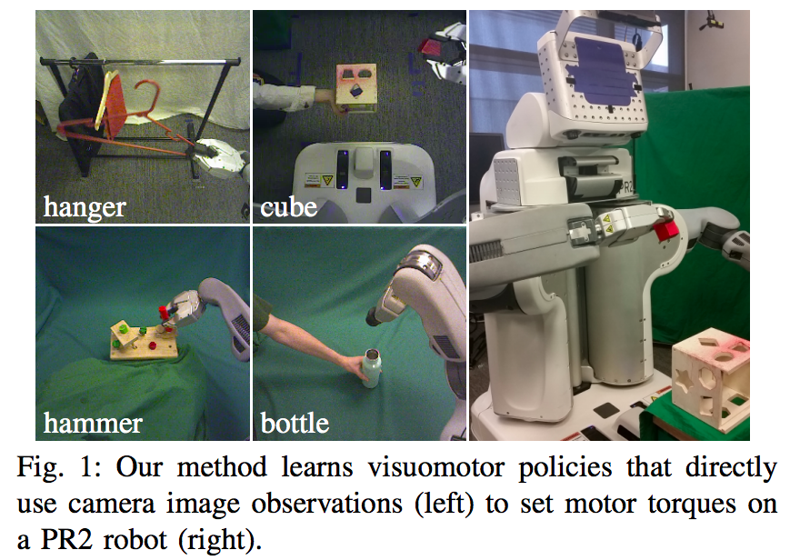
Applications of reinforcement learning
End-to-end training of deep visuomotor policies
Video
Sergey Levine et al., Berkeley

Slide 11
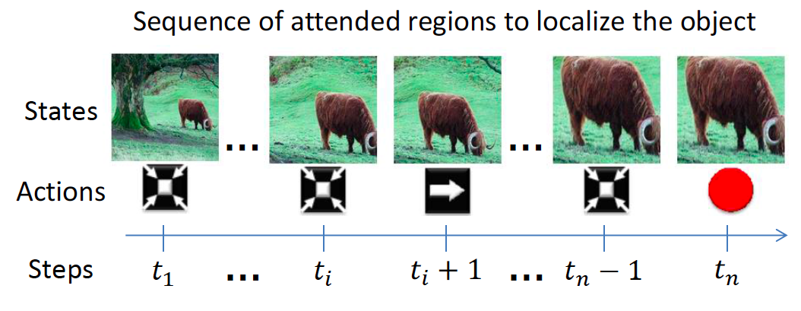
Applications of reinforcement learning
Active object localization with deep reinforcement learning
J. Caicedo and S. Lazebnik, ICCV 2015, to appear

Slide 12
Outline
Applications of Reinforcement Learning
Model-Based Reinforcement Learning
  Estimate P(s’|s,a) and R(s)
  Exploration vs. Exploitation
Model-Free Reinforcement Learning
  Q-learning
  Temporal Difference Learning
Function approximation; policy learning

Slide 13
Reinforcement learning strategies
Model-based
  Learn the model of the MDP (transition probabilities and rewards) and try to solve the MDP concurrently
Model-free
  Learn how to act without explicitly learning the transition probabilities P(s’ | s, a)
  Q-learning: learn an action-utility function Q(s,a) that tells us the value of doing action a in state s

Slide 14
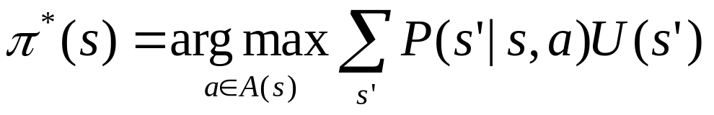
Model-based reinforcement learning
Basic idea: try to learn the model of the MDP (transition probabilities and rewards) and learn how to act (solve the MDP) simultaneously
Learning the model:
  Keep track of how many times state s’ follows state s when you take action a and update the transition probability P(s’ | s, a) according to the relative frequencies
  Keep track of the rewards R(s)
Learning how to act:
  Estimate the utilities U(s) using Bellman’s equations
  Choose the action that maximizes expected future utility:

Slide 15
Model-based reinforcement learning
Learning how to act:
  Estimate the utilities U(s) using Bellman’s equations
  Choose the action that maximizes expected future utility given the model of the environment we’ve experienced through our actions so far:
Is there any problem with this “greedy” approach?

Slide 16
Exploration vs. exploitation
Exploration: take a new action with unknown consequences
  Pros:
    Get a more accurate model of the environment
    Discover higher-reward states than the ones found so far
  Cons:
    When you’re exploring, you’re not maximizing your utility
    Something bad might happen
Exploitation: go with the best strategy found so far
  Pros:
    Maximize reward as reflected in the current utility estimates
    Avoid bad stuff
  Cons:
    Might also prevent you from discovering the true optimal strategy

Slide 17
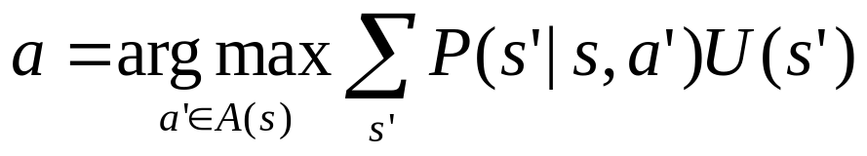
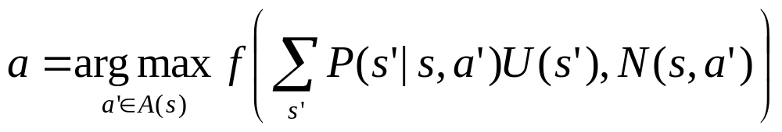
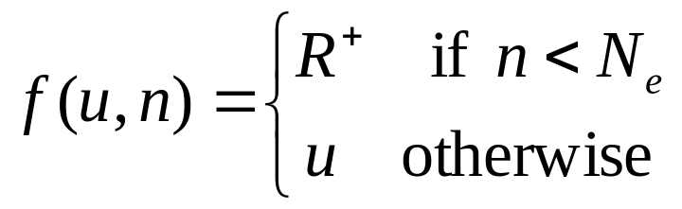
Incorporating exploration
Idea: explore more in the beginning, become more and more greedy over time
Standard (“greedy”) selection of optimal action:
Modified strategy:
exploration function
Number of times we’ve taken action a’ in state s
(optimistic reward estimate)

Slide 18
Outline
Applications of Reinforcement Learning
Model-Based Reinforcement Learning
  Estimate P(s’|s,a) and R(s)
  Exploration vs. Exploitation
Model-Free Reinforcement Learning
  Q-learning
  Temporal Difference Learning
Function approximation; policy learning

Slide 19
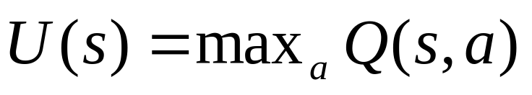
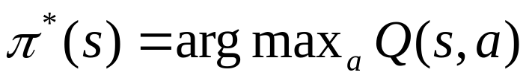
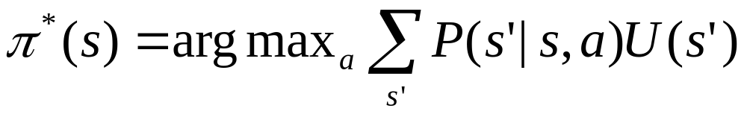
Model-free reinforcement learning
Idea: learn how to act without explicitly learning the transition probabilities P(s’ | s, a)
Q-learning: learn an action-utility function Q(s,a) that tells us the value of doing action a in state s
Relationship between Q-values and utilities:
Selecting an action:
Compare with:
  With Q-values, don’t need to know the transition model to select the next action

Slide 20
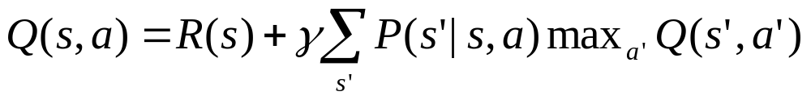
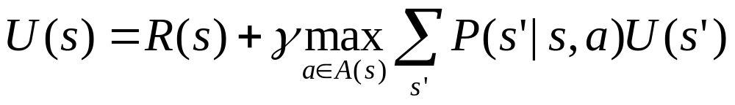
Model-free reinforcement learning
Q-learning: learn an action-utility function Q(s,a) that tells us the value of doing action a in state s
Equilibrium constraint on Q values:
What is the relationship between this constraint and the Bellman equation?
Notes:
The expression for U(s) has max_a on the right hand side because U(s) = max_a Q(s,a). In other words, to get from the expression for Q(s,a) (eq. 1) to the one for U(s) (eq. 2), add max_a to both sides of eq. 1 and replace max_a’ Q(s’,a’) in eq. 1 by U(s’) in eq. 2

Slide 21
Model-free reinforcement learning
Q-learning: learn an action-utility function Q(s,a) that tells us the value of doing action a in state s
Equilibrium constraint on Q values:
Problem: we don’t know (and don’t want to learn) P(s’ | s, a)
Notes:
What is the relationship between the constraint on the Q-values and the Bellman equation?

Slide 22
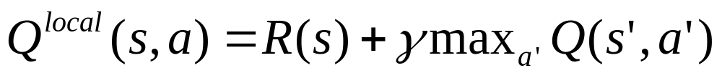
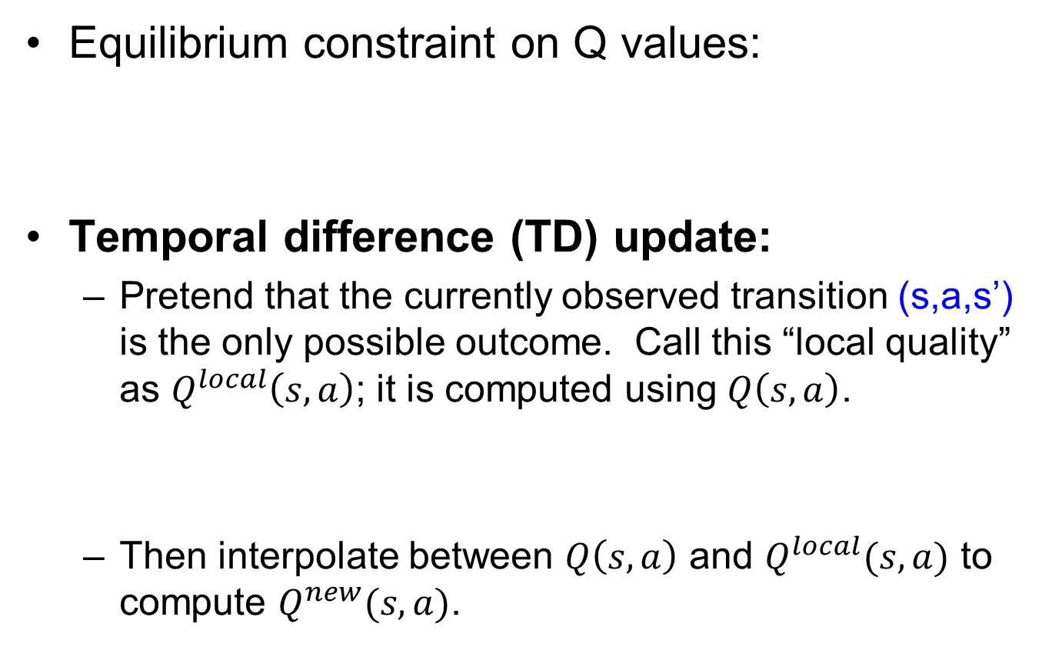
Temporal difference (TD) learning
Equilibrium constraint on Q values:
Temporal difference (TD) update:
  Pretend that the currently observed transition (s,a,s’) is the only possible outcome. Call this “local quality” as $Q^{local}\left(s,a\right)$; it is computed using $Q\left(s,a\right)$.
  Then interpolate between $Q\left(s,a\right)$ and $Q^{local}(s,a)$ to compute $Q^{new}(s,a)$.

Slide 23
Temporal difference (TD) learning
The interpolated form:
The temporal-difference form:
The computationally efficient form (all calculations rolled into one):

Slide 24
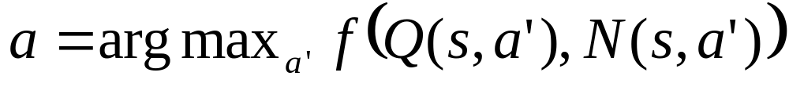
Temporal difference (TD) learning
At each time step t
  From current state s, select an action a:
  Get the successor state s’
  Perform the TD update:
Exploration function
Number of times we’ve taken action a’ from state s
Learning rate
Should start at 1 and decay as O(1/t)
e.g., α(t) = 60/(59 + t)

Slide 25
Temporal difference (TD) learning
At each time step t
  From current state s, select an action a:
  Get the successor state s’
  Perform the TD update:
Exploration function
Number of times we’ve taken action a’ from state s
Q-learning demo: http://www.cs.ubc.ca/~poole/demos/rl/q.html

Slide 26
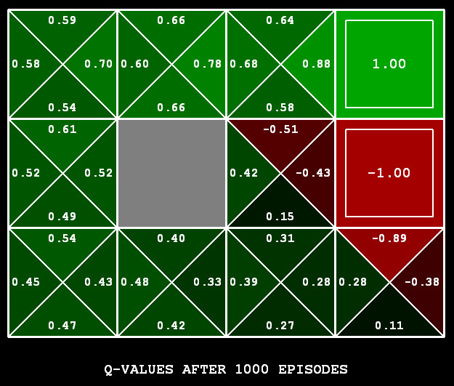
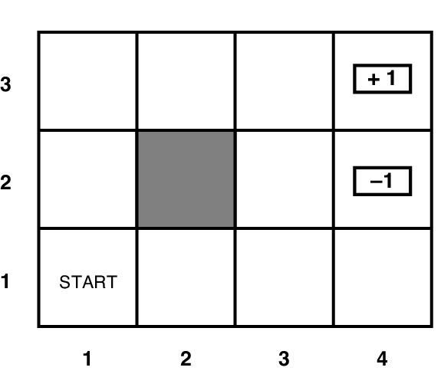
TD Q-learning result
Source: Berkeley CS188

Slide 27
Outline
Applications of Reinforcement Learning
Model-Based Reinforcement Learning
  Estimate P(s’|s,a) and R(s)
  Exploration vs. Exploitation
Model-Free Reinforcement Learning
  Q-learning
  Temporal Difference Learning
Function approximation; policy learning

Slide 28
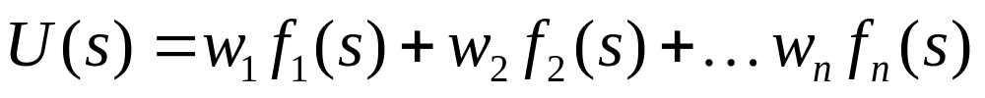
Function approximation
So far, we’ve assumed a lookup table representation for utility function U(s) or action-utility function Q(s,a)
But what if the state space is really large or continuous?
Alternative idea: approximate the utility function, e.g.,
as a weighted linear combination of features:
  RL algorithms can be modified to estimate these weights
  More generally, functions can be nonlinear (e.g., neural networks)
Recall: features for designing evaluation functions in games
Benefits:
  Can handle very large state spaces (games), continuous state spaces (robot control)
  Can generalize to previously unseen states

Slide 29
Other techniques
Policy search: instead of getting the Q-values right, you simply need to get their ordering right
  Write down the policy as a function of some parameters and adjust the parameters to improve the expected reward
Learning from imitation: instead of an explicit reward function, you have expert demonstrations of the task to learn from

