Slide 1

Markov Decision Processes
(Chapter 17)
Image source: P. Abbeel and D. Klein

Slide 2
Markov Decision Processes
In HMMs, we see a sequence of observations and try to reason about the underlying state sequence
  There are no actions involved
But what if we have to take an action at each step that, in turn, will affect the state of the world?

Slide 3
Markov Decision Processes
Components:
  States s, beginning with initial state s₀
  Actions a
    Each state s has actions A(s) available from it
  Transition model P(s’ | s, a)
    Markov assumption: the probability of going to s’ from s depends only on s and a and not on any other past actions or states
  Reward function R(s)
Policy π(s): the action that an agent takes in any given state
  The “solution” to an MDP

Slide 4
Overview
First, we will look at how to “solve” MDPs, or find the optimal policy when the transition model and the reward function are known
Second, we will consider reinforcement learning, where we don’t know the rules of the environment or the consequences of our actions

Slide 5
Game show
A series of questions with increasing level of difficulty and increasing payoff
Decision: at each step, take your earnings and quit, or go for the next question
  If you answer wrong, you lose everything
$100 question
$1,000 question
$10,000 question
$50,000 question
Correct:
$61,100
Q1
Correct
Q2
Correct
Q3
Correct
Q4
Incorrect:
$0
Incorrect:
$0
Incorrect:
$0
Incorrect:
$0
Quit:
$100
Quit:
$1,100
Quit:
$11,100

Slide 6
Game show
Consider $50,000 question
  Probability of guessing correctly: 1/10
  Quit or go for the question?
What is the expected payoff for continuing?
  0.1 * 61,100 + 0.9 * 0 = 6,110
  What is the optimal decision?
$100 question
$1,000 question
$10,000 question
$50,000 question
Correct:
$61,100
Q1
Correct
Q2
Correct
Q3
Correct
Q4
Incorrect:
$0
Incorrect:
$0
Incorrect:
$0
Incorrect:
$0
Quit:
$100
Quit:
$1,100
Quit:
$11,100

Slide 7
Game show
What should we do in Q3?
  Payoff for quitting: $1,100
  Payoff for continuing: 0.5 * $11,100 = $5,550
What about Q2?
  $100 for quitting vs. $4,162 for continuing
What about Q1?
U = $3,746
U = $4,162
U = $5,550
U = $11,100
$100 question
$1,000 question
$10,000 question
$50,000 question
1/10
1/100
3/4
1/2
Correct:
$61,100
Q1
Correct
Q2
Correct
Q3
Correct
Q4
Incorrect:
$0
Incorrect:
$0
Incorrect:
$0
Incorrect:
$0
Quit:
$100
Quit:
$1,100
Quit:
$11,100

Slide 8
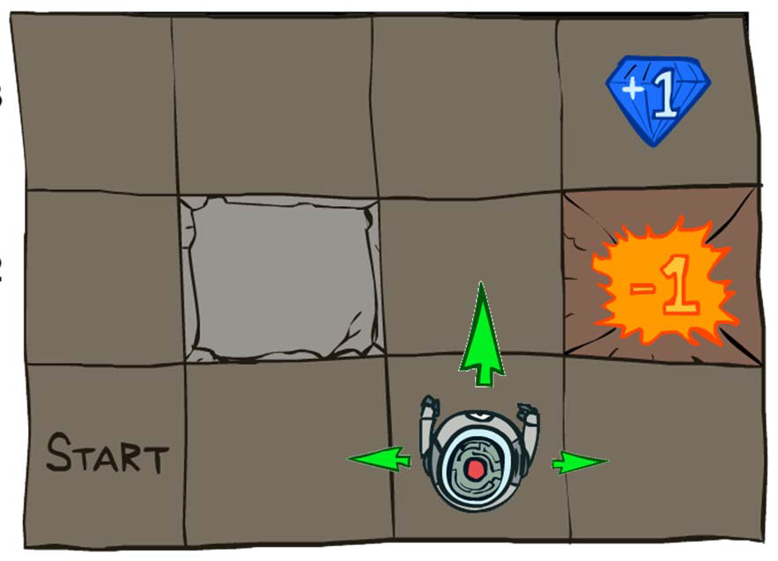
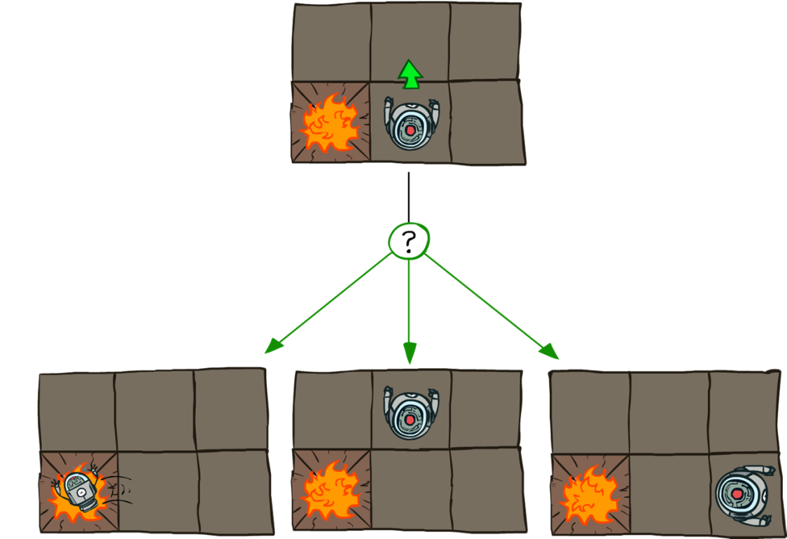
Grid world
Transition model:
0.1
0.8
0.1
R(s) = -0.04 for every non-terminal state
Source: P. Abbeel and D. Klein

Slide 9

Goal: Policy
Source: P. Abbeel and D. Klein

Slide 10
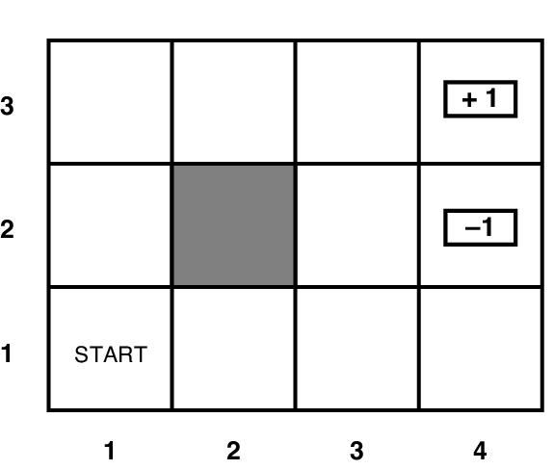
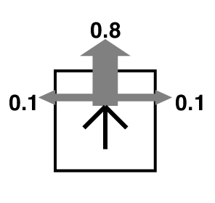
Grid world
Transition model:
R(s) = -0.04 for every non-terminal state

Slide 11
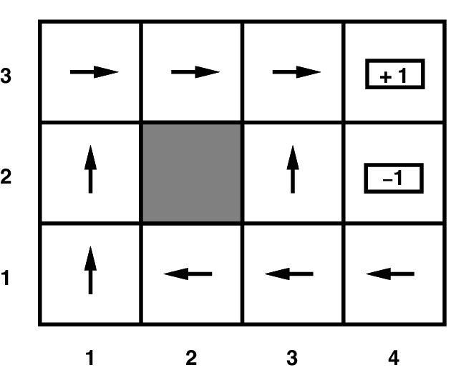
Grid world
Optimal policy when R(s) = -0.04 for every non-terminal state

Slide 12
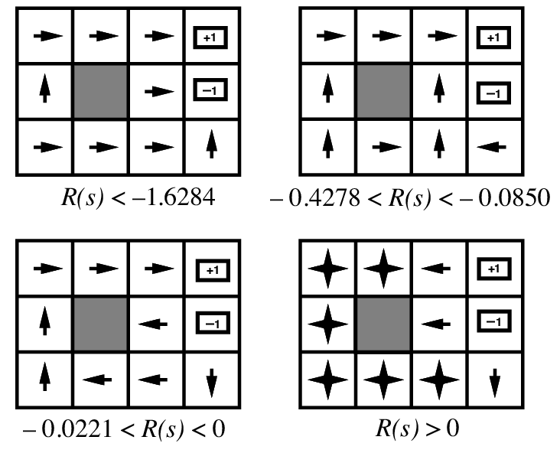
Grid world
Optimal policies for other values of R(s):

Slide 13
Solving MDPs
MDP components:
  States s
  Actions a
  Transition model P(s’ | s, a)
  Reward function R(s)
The solution:
  Policy π(s): mapping from states to actions
  How to find the optimal policy?

Slide 14
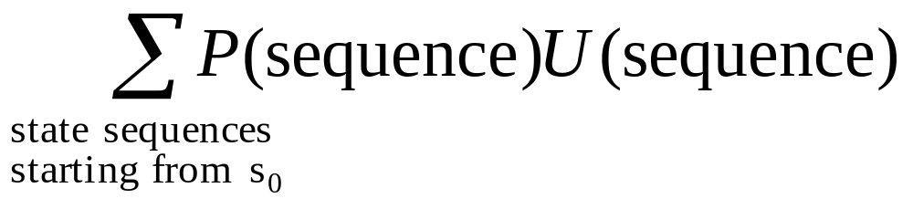
Maximizing expected utility
The optimal policy should maximize the expected utility over all possible state sequences produced by following that policy:
How to define the utility of a state sequence?
  Sum of rewards of individual states
  Problem: infinite state sequences

Slide 15
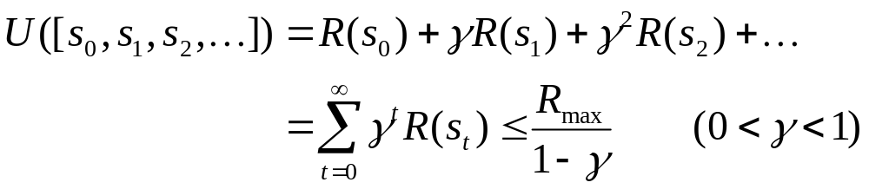
Utilities of state sequences
Normally, we would define the utility of a state sequence as the sum of the rewards of the individual states
Problem: infinite state sequences
Solution: discount the individual state rewards by a factor γ between 0 and 1:
  Sooner rewards count more than later rewards
  Makes sure the total utility stays bounded
  Helps algorithms converge

Slide 16
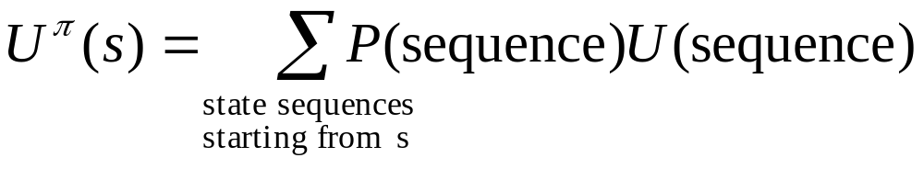
Utilities of states
Expected utility obtained by policy π starting in state s:
The “true” utility of a state, denoted U(s), is the expected sum of discounted rewards if the agent executes an optimal policy starting in state s
Reminiscent of minimax values of states…

Slide 17
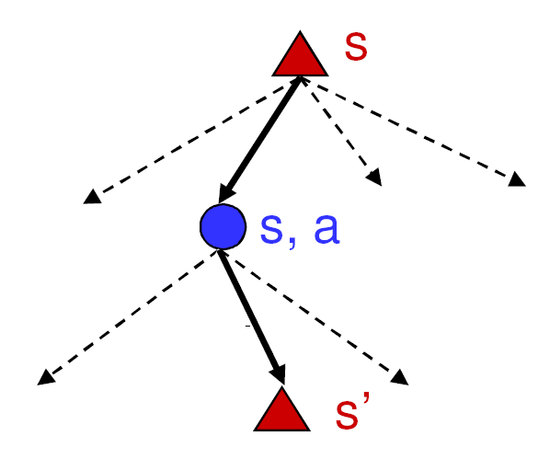
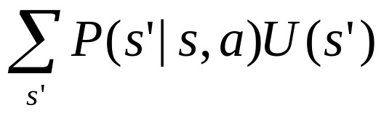
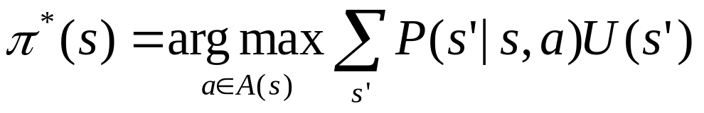
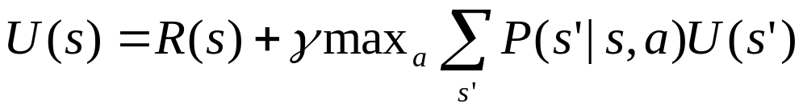
Finding the utilities of states
Max node
What is the expected utility of taking action a in state s?
How do we choose the optimal action?
Chance node
P(s’ | s, a)
U(s’)
What is the recursive expression for U(s) in terms of the utilities of its successor states?

Slide 18
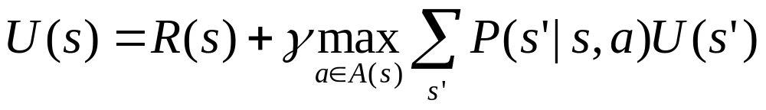
The Bellman equation
Recursive relationship between the utilities of successive states:
Receive reward R(s)
Choose optimal action a
End up here with P(s’ | s, a)
Get utility U(s’)
(discounted by γ)

Slide 19
The Bellman equation
Recursive relationship between the utilities of successive states:
For N states, we get N equations in N unknowns
  Solving them solves the MDP
  We could try to solve them through expectiminimax search, but that would run into trouble with infinite sequences
  Instead, we solve them algebraically
  Two methods: value iteration and policy iteration

Slide 20
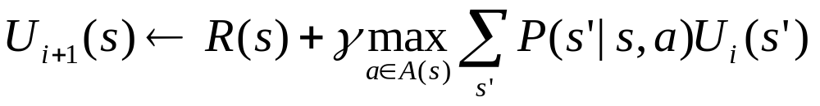
Method 1: Value iteration
Start out with every U(s) = 0
Iterate until convergence
  During the ith iteration, update the utility of each state according to this rule:
In the limit of infinitely many iterations, guaranteed to find the correct utility values
  In practice, don’t need an infinite number of iterations…

Slide 21
Value iteration
What effect does the update have?
Value iteration demo

Slide 22
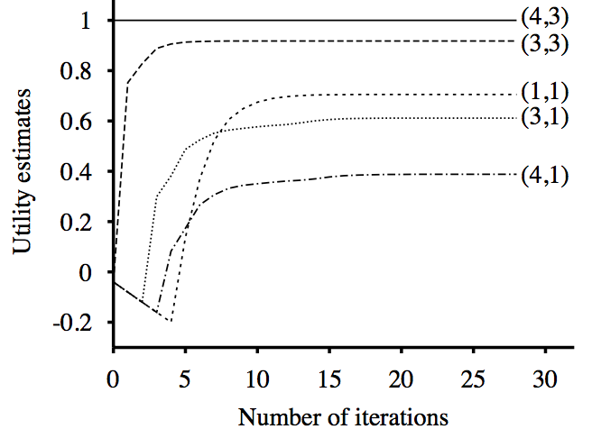
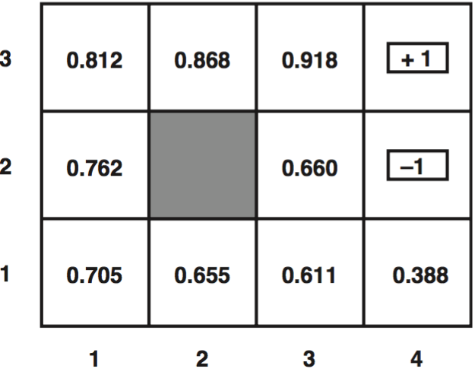
Value iteration
Input (non-terminal R=-0.04)
Utilities with discount factor 1
Final policy

Slide 23
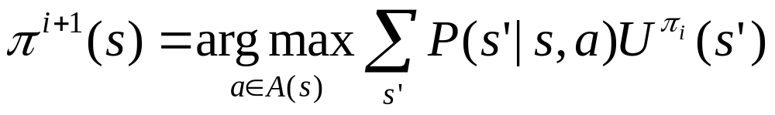
Method 2: Policy iteration
Start with some initial policy π₀ and alternate between the following steps:
  Policy evaluation: calculate U^{πi}(s) for every state s
  Policy improvement: calculate a new policy π_{i+1} based on the updated utilities

Slide 24
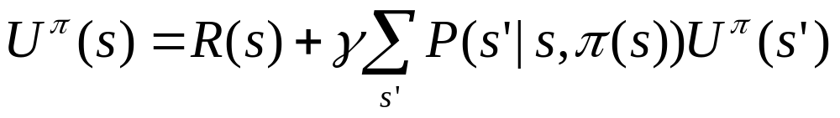
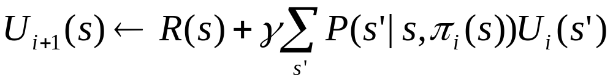
Policy evaluation
Given a fixed policy π, calculate U^{π}(s) for every state s
The Bellman equation for the optimal policy:
  How does it need to change if our policy is fixed?
  Can solve a linear system to get all the utilities!
  Alternatively, can apply the following update:

Slide 25
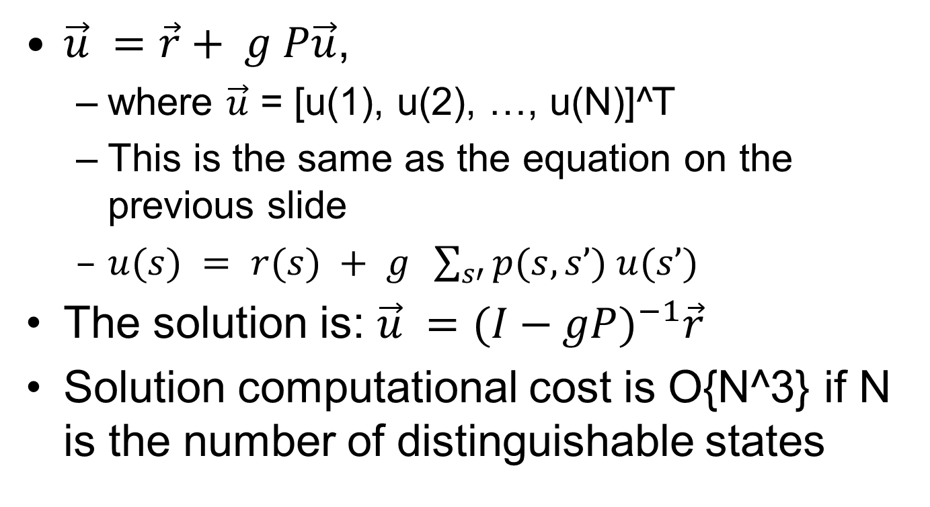
Appendix: Linear Solution to the Fixed Policy Utility Calculation
$\vec{u} =\vec{r}+ g P\vec{u}$,
  where $\vec{u}$ = [u(1), u(2), …, u(N)]^T
  This is the same as the equation on the previous slide
  $u(s) = r(s) + g \sum_{s′}{p(s,s’) u(s’)}$
The solution is: $\vec{u} ={(I−gP)}^{−1}\vec{r}$
Solution computational cost is O{N^3} if N is the number of distinguishable states

