Slide 1
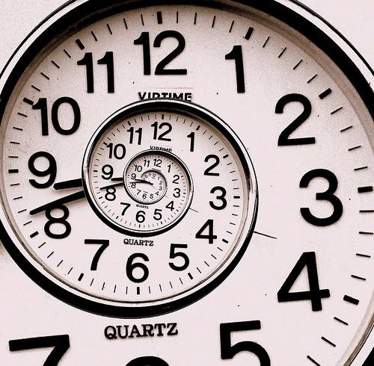
Probabilistic reasoning over time
Ch. 15, 17

Slide 2
Probabilistic reasoning over time
So far, we’ve mostly dealt with episodic environments
  Exceptions: games with multiple moves, planning
In particular, the Bayesian networks we’ve seen so far describe static situations
  Each random variable gets a single fixed value in a single problem instance
Now we consider the problem of describing probabilistic environments that evolve over time
  Examples: robot localization, tracking, speech, …

Slide 3
Hidden Markov Models
At each time slice t, the state of the world is described by an unobservable variable X_{t} and an observable evidence variable E_{t}
Transition model: distribution over the current state given the whole past history:
P(X_{t} | X₀, …, X_{t-1}) = P(X_{t} | X_{0:t-1})
Observation model: P(E_{t} | X_{0:t}, E_{1:t-1})
…
X₀
X₁
X₂
X_{t-1}
X_{t}
E₁
E₂
E_{t-1}
E_{t}

Slide 4
Hidden Markov Models
Markov assumption (first order)
  The current state is conditionally independent of all the other states given the state in the previous time step
  What does P(X_{t} | X_{0:t-1}) simplify to?
  P(X_{t} | X_{0:t-1}) = P(X_{t} | X_{t-1})
Markov assumption for observations
  The evidence at time t depends only on the state at time t
  What does P(E_{t} | X_{0:t}, E_{1:t-1}) simplify to?
  P(E_{t} | X_{0:t}, E_{1:t-1}) = P(E_{t} | X_{t})
…
X₀
X₁
X₂
X_{t-1}
X_{t}
E₁
E₂
E_{t-1}
E_{t}

Slide 5
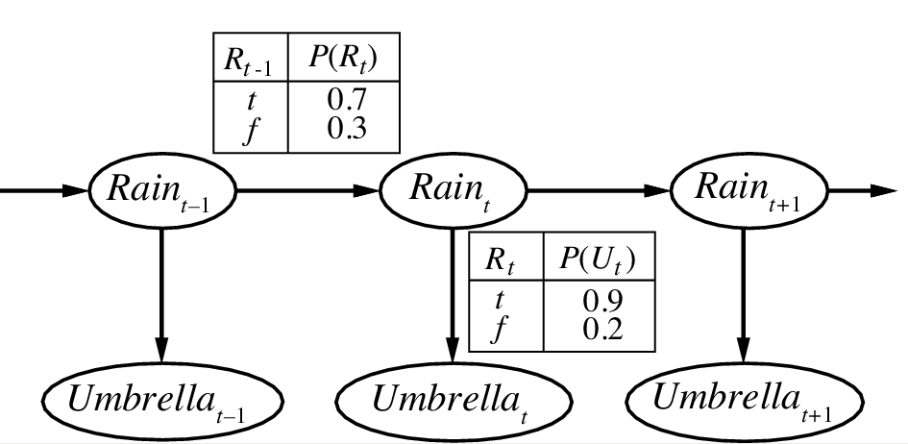
Example
state
evidence
Notes:
The example is described in Section 15.1.1

Slide 6
Example
Transition model
state
evidence
Observation model
Notes:
The example is described in Section 15.1.1

Slide 7
An alternative visualization
U=T: 0.9
U=F: 0.1
0.3
0.7
R=T
R=F
0.7
0.3
U=T: 0.2
U=F: 0.8
 | R_{t} = T | R_{t} = F
R_{t-1} = T | 0.7 | 0.3
R_{t-1} = F | 0.3 | 0.7
Observation (emission) probabilities
 | U_{t} = T | U_{t} = F
R_{t} = T | 0.9 | 0.1
R_{t} = F | 0.2 | 0.8
Transition probabilities
Notes:
The example is described in Section 15.1.1

Slide 8
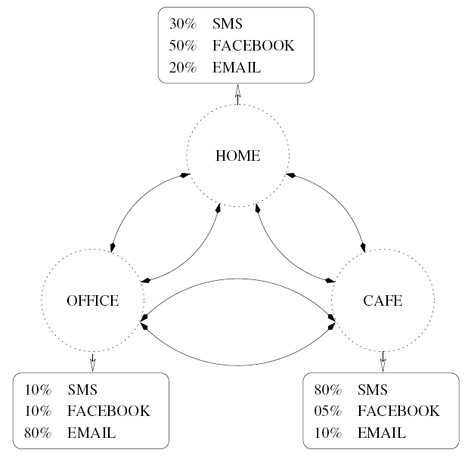
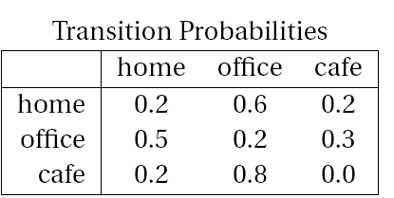
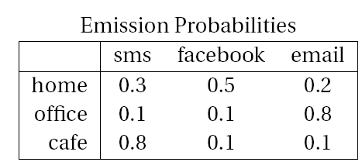
Another example
States: X = {home, office, cafe}
Observations: E = {sms, facebook, email}
Slide credit: Andy White

Slide 9
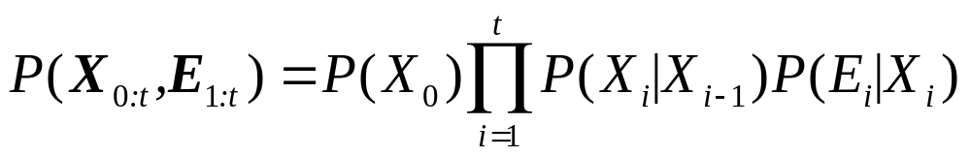
The Joint Distribution
Transition model: P(X_{t} | X_{0:t-1}) = P(X_{t} | X_{t-1})
Observation model: P(E_{t} | X_{0:t}, E_{1:t-1}) = P(E_{t} | X_{t})
How do we compute the full joint P(X_{0:t}, E_{1:t})?
…
X₀
X₁
X₂
X_{t-1}
X_{t}
E₁
E₂
E_{t-1}
E_{t}

Slide 10
Review: Bayes net inference
Computational complexity
Special cases
Parameter learning

Slide 11
Review: HMMs
Transition model: P(X_{t} | X_{0:t-1}) = P(X_{t} | X_{t-1})
Observation model: P(E_{t} | X_{0:t}, E_{1:t-1}) = P(E_{t} | X_{t})
How do we compute the full joint P(X_{0:t}, E_{1:t})?
…
X₀
X₁
X₂
X_{t-1}
X_{t}
E₁
E₂
E_{t-1}
E_{t}

Slide 12
HMM inference tasks
Filtering: what is the distribution over the current state X_{t} given all the evidence so far, e_{1:t} ?
  The forward algorithm
Query variable
…
…
X₀
X₁
X_{k}
X_{t-1}
X_{t}
E₁
E_{k}
E_{t-1}
E_{t}
Evidence variables

Slide 13
HMM inference tasks
Filtering: what is the distribution over the current state X_{t} given all the evidence so far, e_{1:t} ?
Smoothing: what is the distribution of some state X_{k} given the entire observation sequence e_{1:t}?
  The forward-backward algorithm
…
…
X₀
X₁
X_{k}
X_{t-1}
X_{t}
E₁
E_{k}
E_{t-1}
E_{t}

Slide 14
HMM inference tasks
Filtering: what is the distribution over the current state X_{t} given all the evidence so far, e_{1:t} ?
Smoothing: what is the distribution of some state X_{k} given the entire observation sequence e_{1:t}?
Evaluation: compute the probability of a given observation sequence e_{1:t}
…
…
X₀
X₁
X_{k}
X_{t-1}
X_{t}
E₁
E_{k}
E_{t-1}
E_{t}

Slide 15
HMM inference tasks
Filtering: what is the distribution over the current state X_{t} given all the evidence so far, e_{1:t}
Smoothing: what is the distribution of some state X_{k} given the entire observation sequence e_{1:t}?
Evaluation: compute the probability of a given observation sequence e_{1:t}
Decoding: what is the most likely state sequence X_{0:t} given the observation sequence e_{1:t}?
  The Viterbi algorithm
…
…
X₀
X₁
X_{k}
X_{t-1}
X_{t}
E₁
E_{k}
E_{t-1}
E_{t}

Slide 16
HMM Learning and Inference
Inference tasks
  Filtering: what is the distribution over the current state X_{t} given all the evidence so far, e_{1:t}
  Smoothing: what is the distribution of some state X_{k} given the entire observation sequence e_{1:t}?
  Evaluation: compute the probability of a given observation sequence e_{1:t}
  Decoding: what is the most likely state sequence X_{0:t} given the observation sequence e_{1:t}?
Learning
  Given a training sample of sequences, learn the model parameters (transition and emission probabilities)
    EM algorithm

Slide 17
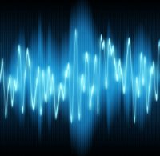

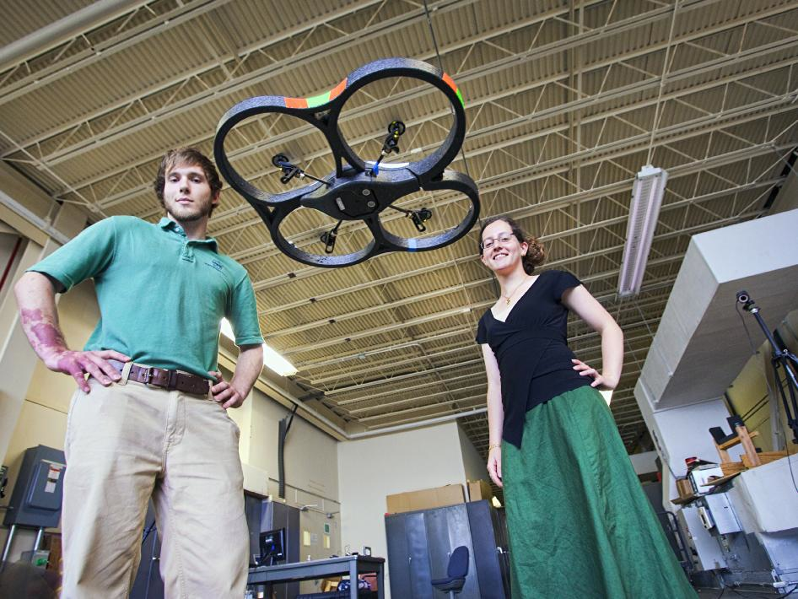
Applications of HMMs
Speech recognition HMMs:
  Observations are acoustic signals (continuous valued)
  States are specific positions in specific words (so, tens of thousands)
Machine translation HMMs:
  Observations are words (tens of thousands)
  States are translation options
Robot tracking:
  Observations are range readings (continuous)
  States are positions on a map (continuous)
Source: Tamara Berg
Notes:
HMMs are used all over the place. They’re used for speech recognition in HMMs. Here observations are acoustic signals, states are phonemes in words. HMMs are used for machine translation where observations are words and states are translation options (ie what word in german should we translate this word in english to?) in robot tracking hmm’s are used to localize where the robot is located in space. Here observations are range readings and states are positions on a map. We’ll see some of these examples in a little more depth later.

Slide 18
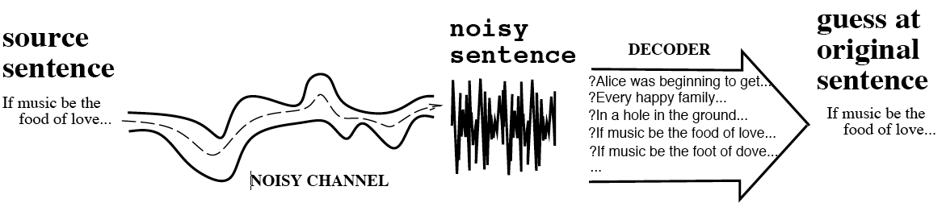
Application of HMMs: Speech recognition
“Noisy channel” model of speech

Slide 19
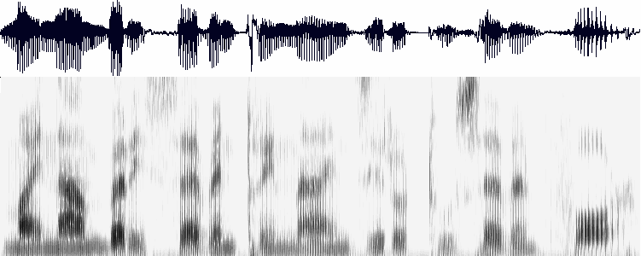
Speech feature extraction
Acoustic wave form
Sampled at 8KHz, quantized to 8-12 bits
Amplitude
Spectrogram
Frequency
Time
Frame
(10 ms or 80 samples)
Feature vector
~39 dim.

Slide 20
Speech feature extraction
Acoustic wave form
Sampled at 8KHz, quantized to 8-12 bits
Amplitude
Spectrogram
Frequency
Time
Frame
(10 ms or 80 samples)
Feature vector
~39 dim.

Slide 21
Phonetic model
Phones: speech sounds
Phonemes: groups of speech sounds that have a unique meaning/function in a language (e.g., there are several different ways to pronounce “t”)

Slide 22
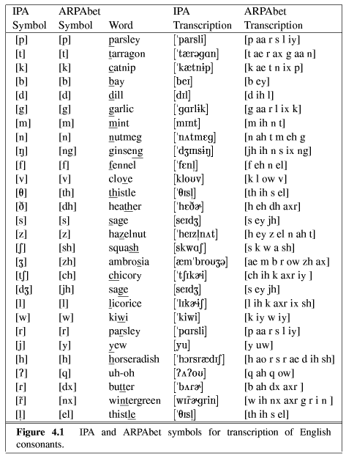
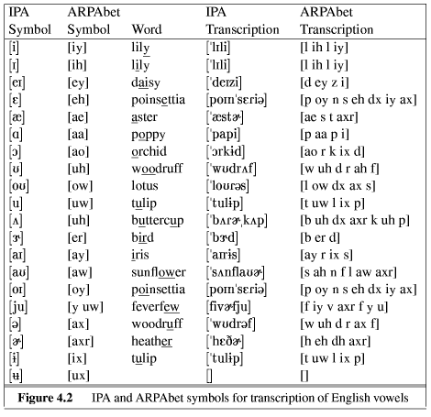
Phonetic model

Slide 23
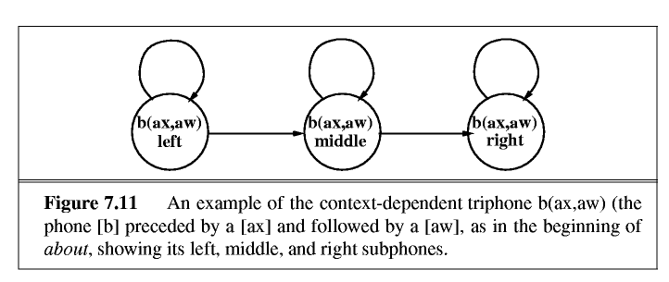
HMM models for phones
HMM states in most speech recognition systems correspond to subphones
  There are around 60 phones and as many as 60³ context-dependent triphones

Slide 24
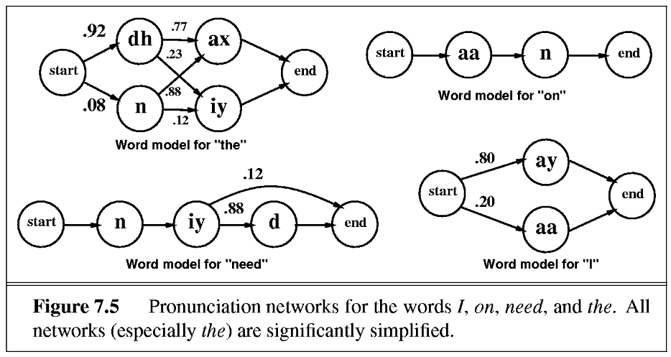
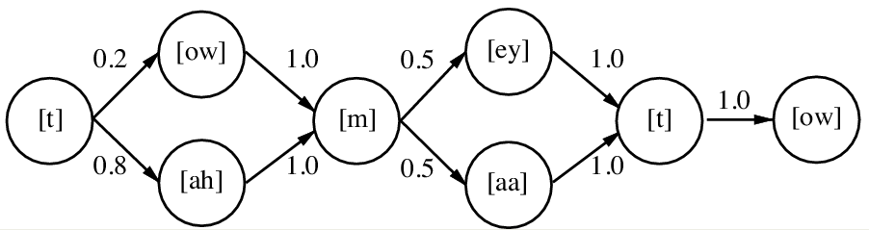
HMM models for words

Slide 25
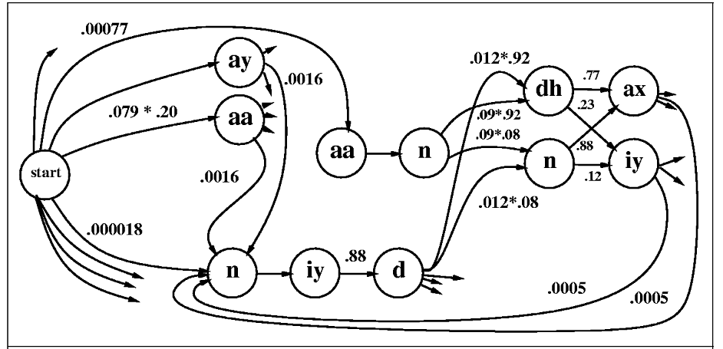
Putting words together
Given a sequence of acoustic features, how do we find the corresponding word sequence?

Slide 26
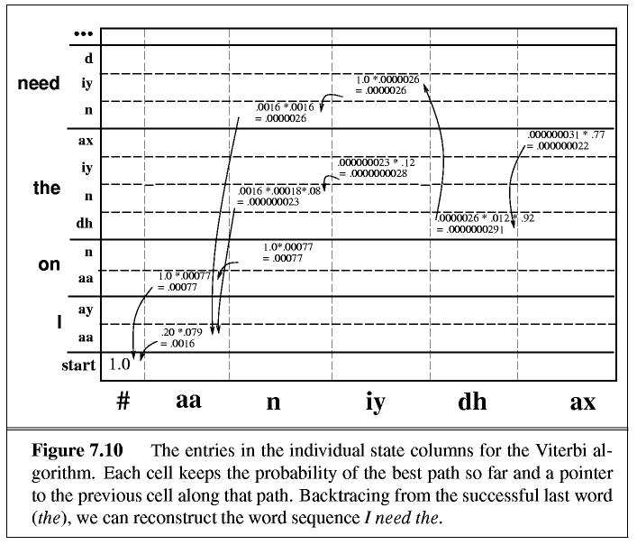
Decoding with the Viterbi algorithm

Slide 27

Reference
D. Jurafsky and J. Martin, “Speech and Language Processing,” 2nd ed., Prentice Hall, 2008

