Slide 1
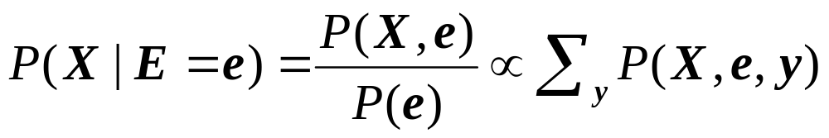
Bayes network inference
A general scenario:
  Query variables: X
  Evidence (observed) variables and their values: E = e
  Unobserved variables: Y
Inference problem: answer questions about the query variables given the evidence variables
  This can be done using the posterior distribution P(X | E = e)
  The posterior can be derived from the full joint P(X, E, Y)
Since Bayesian networks can afford exponential savings in representing joint distributions, can they afford similar savings for inference?
Notes:
1

Slide 2
Outline
Inference Examples
Inference Algorithms
  Trees: Sum-product algorithm
  Graphs: No polynomial-time algorithm
Parameter Learning
  Expectation Maximization
Structure Learning
  Regularized Maximum Likelihood

Slide 3
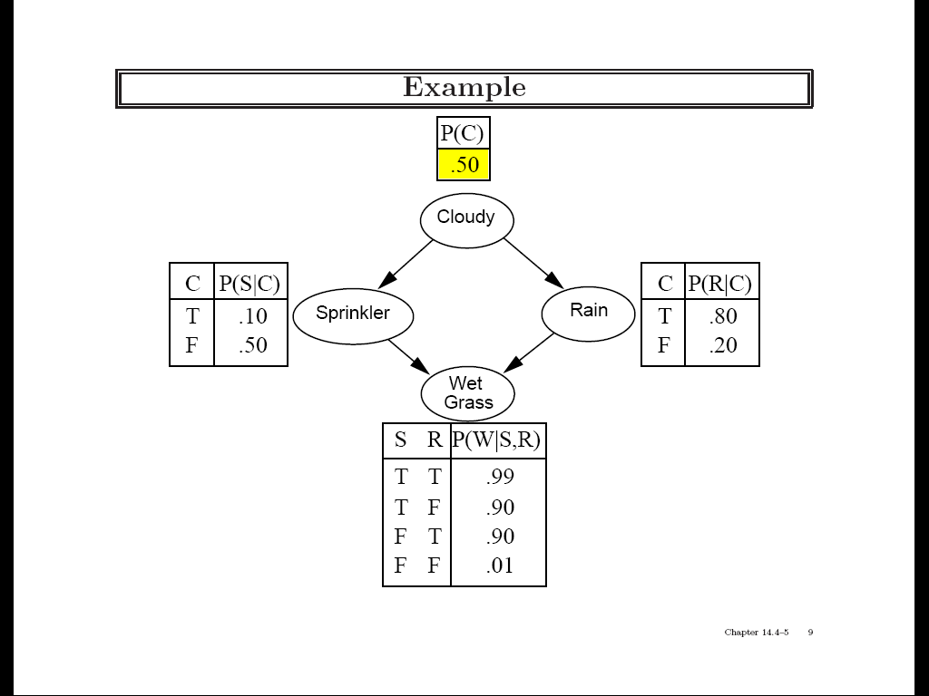
Practice example 1
Variables: Cloudy, Sprinkler, Rain, Wet Grass

Slide 4
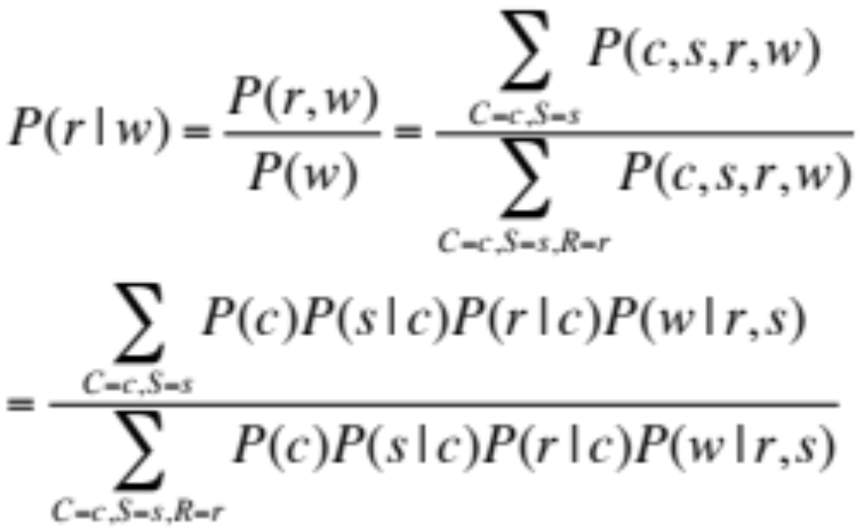
Practice example 1
Given that the grass is wet, what is the probability that it has rained?

Slide 5
Practice example 2
What determines whether you will pass the exam?
  A: Do you attend class?
  S: Do you study?
  Pr: Are you prepared
  for the exam?
  F: Is the grading fair?
  Pa: Do you get a passing
  grade on the exam?
A
S
F
Pr
Pa
Source: UMBC CMSC 671, Tamara Berg

Slide 6
Practice example 2
P(A=T) = 0.8
P(S=T) = 0.6
A
S
P(F=T) = 0.9
F
Pr
A | S | P(Pr|A,S)
T | T | 0.9
T | F | 0.5
F | T | 0.7
F | F | 0.1
Pa
Pr | A | F | P(Pa|A,Pr,F)
T | T | T | 0.9
T | T | F | 0.6
T | F | T | 0.2
T | F | F | 0.1
F | T | T | 0.4
F | T | F | 0.2
F | F | T | 0.1
F | F | F | 0.2
Source: UMBC CMSC 671, Tamara Berg

Slide 7
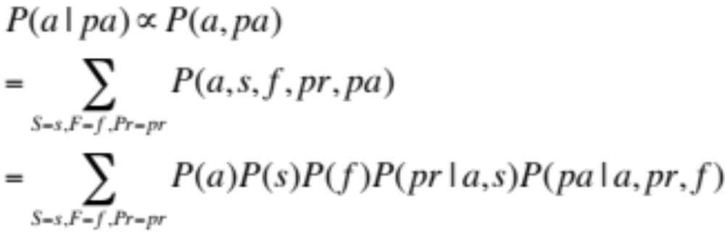
Practice example 2
Query: What is the probability that a student attended class, given that they passed the exam?
A
S
F
Pr
Pa
Source: UMBC CMSC 671, Tamara Berg

Slide 8
Outline
Inference Examples
Inference Algorithms
  Trees: Sum-product algorithm
  Graphs: No polynomial-time algorithm
Parameter Learning
  Expectation Maximization
Structure Learning
  Regularized Maximum Likelihood

Slide 9
Efficient exact inference
Key idea: compute the results of
sub-expressions in a bottom-up way and cache them for later use
  Form of dynamic programming
  Polynomial time and space complexity for polytrees: networks at most one undirected path between any two nodes

Slide 10
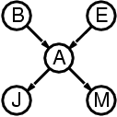
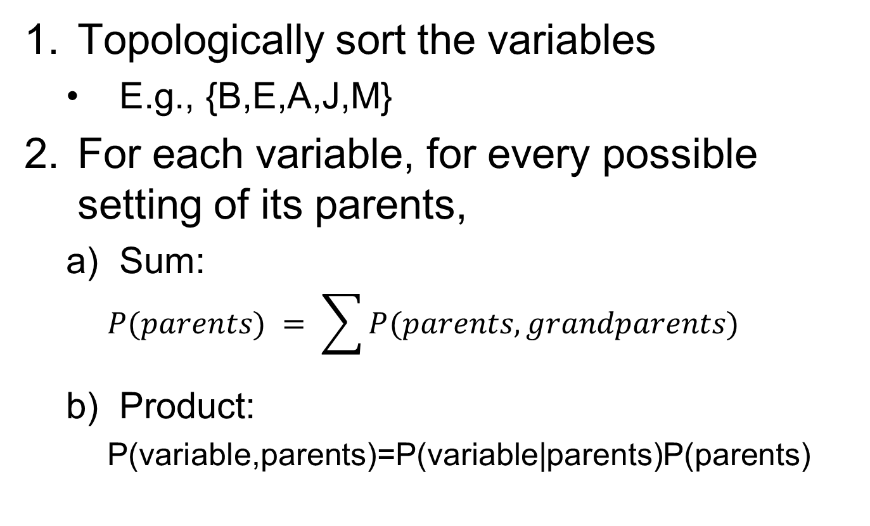
Sum-Product Algorithm for Trees
Topologically sort the variables
  E.g., {B,E,A,J,M}
For each variable, for every possible setting of its parents,
  Sum:
    $$P(parents) = \sum{P(parents,grandparents)}$$
  Product:
    P(variable,parents)=P(variable|parents)P(parents)

Slide 11
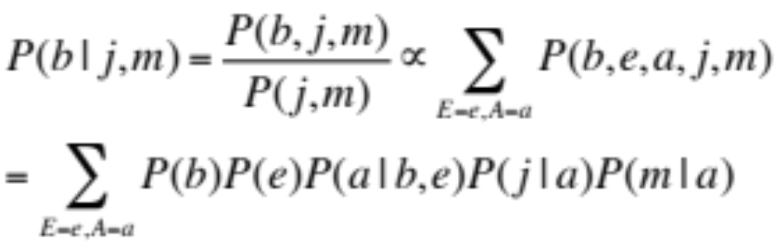
Practice example 3
Query: P(b | j, m)
Can we compute this sum efficiently?

Slide 12
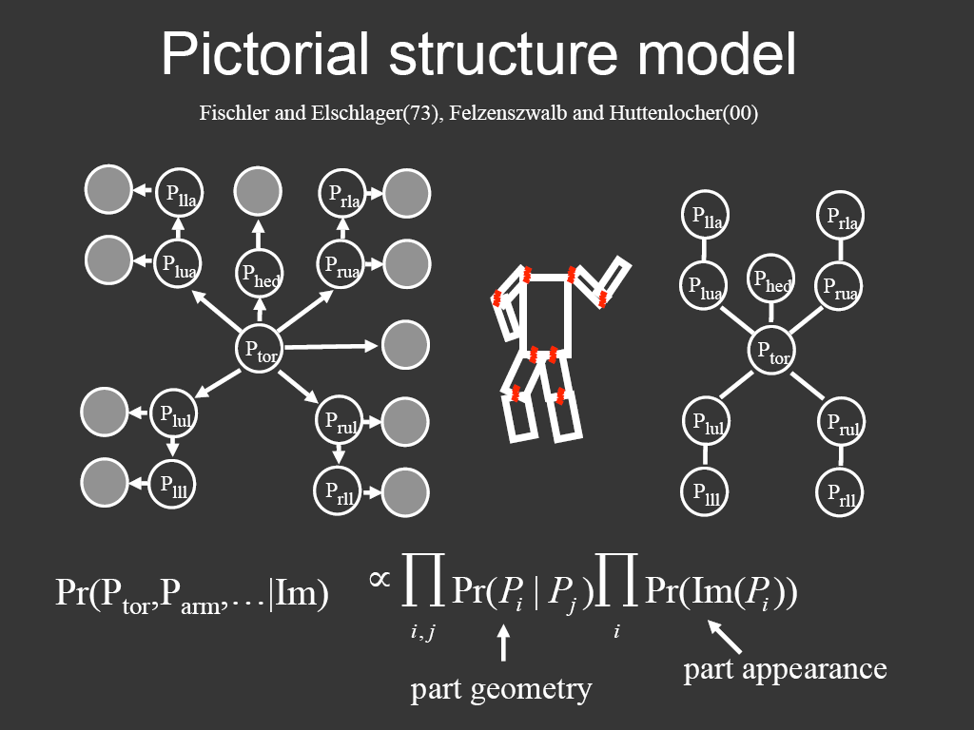
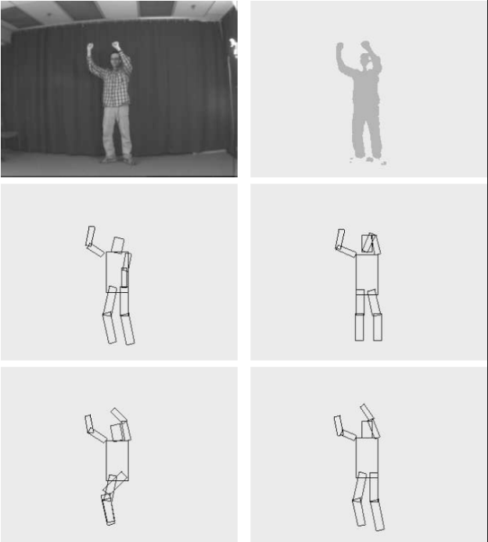
Representing people

Slide 13
Outline
Inference Examples
Inference Algorithms
  Trees: Sum-product algorithm
  Graphs: No polynomial-time algorithm
Parameter Learning
  Expectation Maximization
Structure Learning
  Regularized Maximum Likelihood

Slide 14
Bayesian network inference
In full generality, NP-hard
  More precisely, #P-hard: equivalent to counting satisfying assignments
We can reduce satisfiability to Bayesian network inference
  Decision problem: is P(Y) > 0?

Slide 15
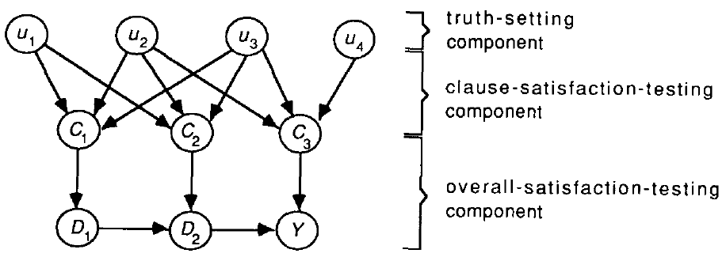
Bayesian network inference
In full generality, NP-hard
  More precisely, #P-hard: equivalent to counting satisfying assignments
We can reduce satisfiability to Bayesian network inference
  Decision problem: is P(Y) > 0?
C₁
C₂
C₃
G. Cooper, 1990

Slide 16
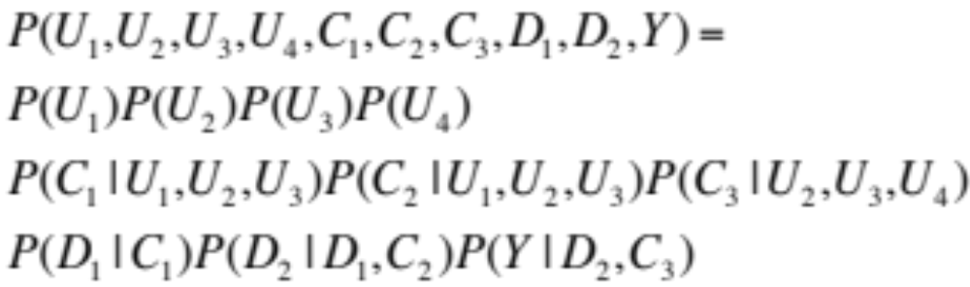
Bayesian network inference

Slide 17
Bayesian network inference:
Big picture
Exact inference is intractable
  There exist techniques to speed up computations, but worst-case complexity is still exponential except in some classes of networks (polytrees)
Approximate inference (not covered)
  Sampling, variational methods, message passing / belief propagation…
Notes:
Start here

Slide 18
Outline
Inference Examples
Inference Algorithms
  Trees: Sum-product algorithm
  Graphs: No polynomial-time algorithm
Parameter Learning
  Expectation Maximization
Structure Learning
  Regularized Maximum Likelihood

Slide 19
Parameter learning
  Inference problem: given values of evidence variables E = e, answer questions about query variables X using the posterior P(X | E = e)
Learning problem: estimate the parameters of the probabilistic model P(X | E) given a training sample {(x₁,e₁), …, (x_{n},e_{n})}
Notes:
19

Slide 20
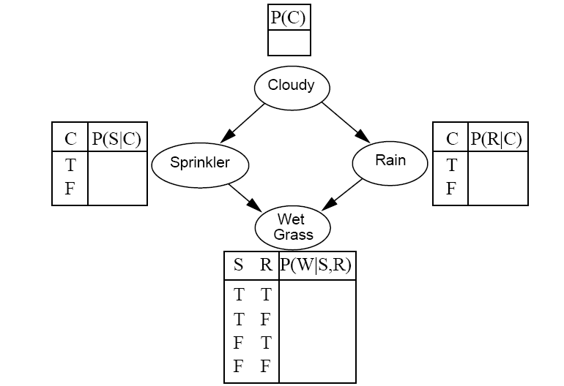
Parameter learning
Suppose we know the network structure (but not the parameters), and have a training set of complete observations
Training set
?
Sample | C | S | R | W
1 | T | F | T | T
2 | F | T | F | T
3 | T | F | F | F
4 | T | T | T | T
5 | F | T | F | T
6 | T | F | T | F
… | … | … | …. | …
?
?
?
?
?
?
?
?

Slide 21
Parameter learning
Suppose we know the network structure (but not the parameters), and have a training set of complete observations
  P(X | Parents(X)) is given by the observed frequencies of the different values of X for each combination of parent values

Slide 22
Parameter learning
Incomplete observations
Expectation maximization (EM) algorithm for dealing with missing data
?
Training set
Sample | C | S | R | W
1 | ? | F | T | T
2 | ? | T | F | T
3 | ? | F | F | F
4 | ? | T | T | T
5 | ? | T | F | T
6 | ? | F | T | F
… | … | … | …. | …
?
?
?
?
?
?
?
?
Notes:
Roughly speaking, alternate between doing inference on the missing data (“filling in” the missing data) and re-estimating the parameters of the model given the estimated missing data

Slide 23
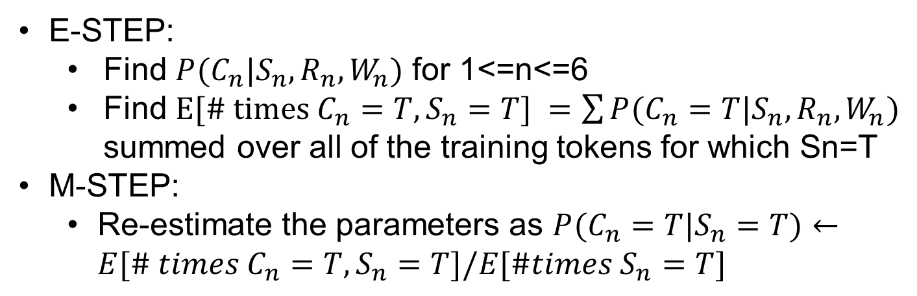
Parameter learning: EM
Sample | C | S | R | W
1 | ? | F | T | T
2 | ? | T | F | T
3 | ? | F | F | F
4 | ? | T | T | T
5 | ? | T | F | T
6 | ? | F | T | F
… | … | … | …. | …
E-STEP:
  Find $P(C_{n}|S_{n},R_{n},W_{n})$ for 1<=n<=6
  Find $E[\# times C_{n}=T,S_{n}=T] =\sum{P(C_{n}=T|S_{n},R_{n},W_{n})}$ summed over all of the training tokens for which Sn=T
M-STEP:
  Re-estimate the parameters as $P(C_{n}=T|S_{n}=T)←E[\# times C_{n}=T,S_{n}=T]/E[\#times S_{n}=T]$
Notes:
Roughly speaking, alternate between doing inference on the missing data (“filling in” the missing data) and re-estimating the parameters of the model given the estimated missing data

Slide 24
Outline
Inference Examples
Inference Algorithms
  Trees: Sum-product algorithm
  Graphs: No polynomial-time algorithm
Parameter Learning
  Expectation Maximization
Structure Learning
  Regularized Maximum Likelihood

Slide 25
Structure learning
What if the network structure is unknown?
Training set
C
Sample | C | S | R | W
1 | T | F | T | T
2 | F | T | F | T
3 | T | F | F | F
4 | T | T | T | T
5 | F | T | F | T
6 | T | F | T | F
… | … | … | …. | …
?
S
R
W

Slide 26
Structure learning
For every possible set of edges:
  Compute the data likelihood given this structure
  Penalize complexity (e.g., subtract # edges)
Find the structure with highest penalized likelihood
Sample | C | S | R | W
1 | T | F | T | T
2 | F | T | F | T
3 | T | F | F | F
4 | T | T | T | T
5 | F | T | F | T
6 | T | F | T | F
… | … | … | …. | …
?
S
R
W

Slide 27
Summary: Bayesian networks
Structure
Parameters
Inference
Learning

