Slide 1
Review: Bayesian inference
A general scenario:
  Query variables: X
  Evidence (observed) variables and their values: E = e
Inference problem: answer questions about the query variables given the evidence variables
This can be done using the posterior distribution P(X | E = e)
Example of a useful question: Which X is true?
  More formally: what value of X has the least probability of being wrong?
  Answer: MPE = MAP (argmin P(error) = argmax P(X=x|E=e))
Notes:
1

Slide 2
Today: What if P(X,E) is complicated?
Very, very common problem: P(X,E) is complicated because both X and E depend on some hidden variable Y
SOLUTION:
  Draw a bunch of circles and arrows that represent the dependence
  When your algorithm performs inference, make sure it does so in the order of the graph
FORMALISM: Bayesian Network

Slide 3
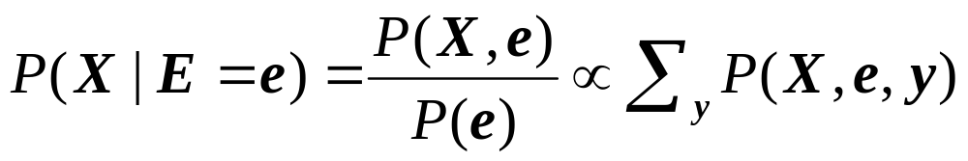
Hidden Variables
A general scenario:
  Query variables: X
  Evidence (observed) variables and their values: E = e
  Unobserved variables: Y
Inference problem: answer questions about the query variables given the evidence variables
  This can be done using the posterior distribution P(X | E = e)
  In turn, the posterior needs to be derived from the full joint P(X, E, Y)
Bayesian networks are a tool for representing joint probability distributions efficiently
Notes:
3

Slide 4


Bayesian networks
More commonly called graphical models
A way to depict conditional independence relationships between random variables
A compact specification of full joint distributions

Slide 5
Outline
Review: Bayesian inference
Bayesian network: graph semantics
The Los Angeles burglar alarm example
Key concepts
  Conditional independence ≠ Independence
  Number of parameters you have to learn
Constructing a Bayesian network
Real-world examples

Slide 6
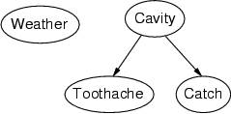
Bayesian networks: Structure
Nodes: random variables
Arcs: interactions
  An arrow from one variable to another indicates
  direct influence
  Must form a directed, acyclic graph

Slide 7
Example: N independent coin flips
Complete independence: no interactions
…
X₁
X₂
X_{n}

Slide 8
Example: Naïve Bayes document model
Random variables:
  X: document class
  W₁, …, W_{n}: words in the document
X
…
W₁
W₂
W_{n}

Slide 9
Outline
Review: Bayesian inference
Bayesian network: graph semantics
The Los Angeles burglar alarm example
Key concepts
  Conditional independence ≠ Independence
  Number of parameters you have to learn
Constructing a Bayesian network
Real-world examples

Slide 10
Example: Burglar Alarm
I have a burglar alarm that is sometimes set off by minor earthquakes. My two neighbors, John and Mary, promised to call me at work if they hear the alarm
  Example inference task: suppose Mary calls and John doesn’t call. What is the probability of a burglary?
What are the random variables?
  Burglary, Earthquake, Alarm, JohnCalls, MaryCalls
What are the direct influence relationships?
  A burglar can set the alarm off
  An earthquake can set the alarm off
  The alarm can cause Mary to call
  The alarm can cause John to call

Slide 11
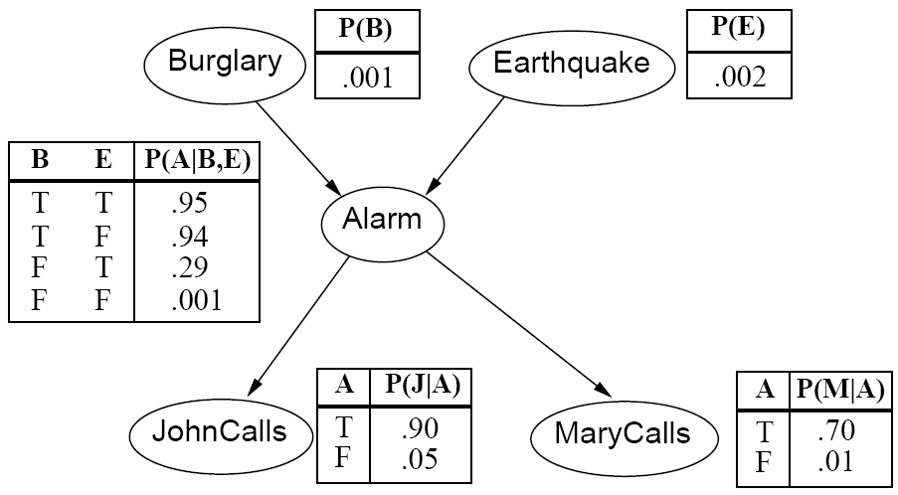
Example: Burglar Alarm

Slide 12
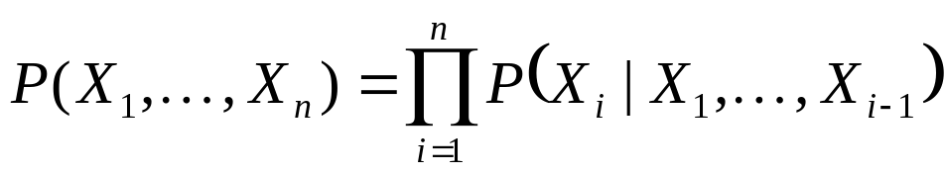
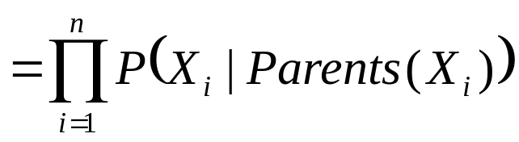
Conditional independence and the joint distribution
Key property: each node is conditionally independent of its non-descendants given its parents
Suppose the nodes X₁, …, X_{n} are sorted in topological order
To get the joint distribution P(X₁, …, X_{n}),
use chain rule:

Slide 13
Conditional probability distributions
To specify the full joint distribution, we need to specify a conditional distribution for each node given its parents:
P (X | Parents(X))
…
Z₁
Z₂
Z_{n}
X
  P (X | Z₁, …, Z_{n})

Slide 14
Example: Burglar Alarm
The conditional probability tables are the model parameters

Slide 15
Outline
Review: Bayesian inference
Bayesian network: graph semantics
The Los Angeles burglar alarm example
Key concepts
  Conditional independence ≠ Independence
  Number of parameters you have to learn
Constructing a Bayesian network
Real-world examples

Slide 16
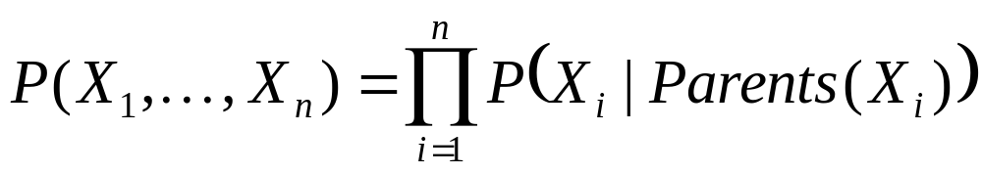
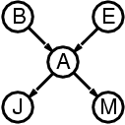
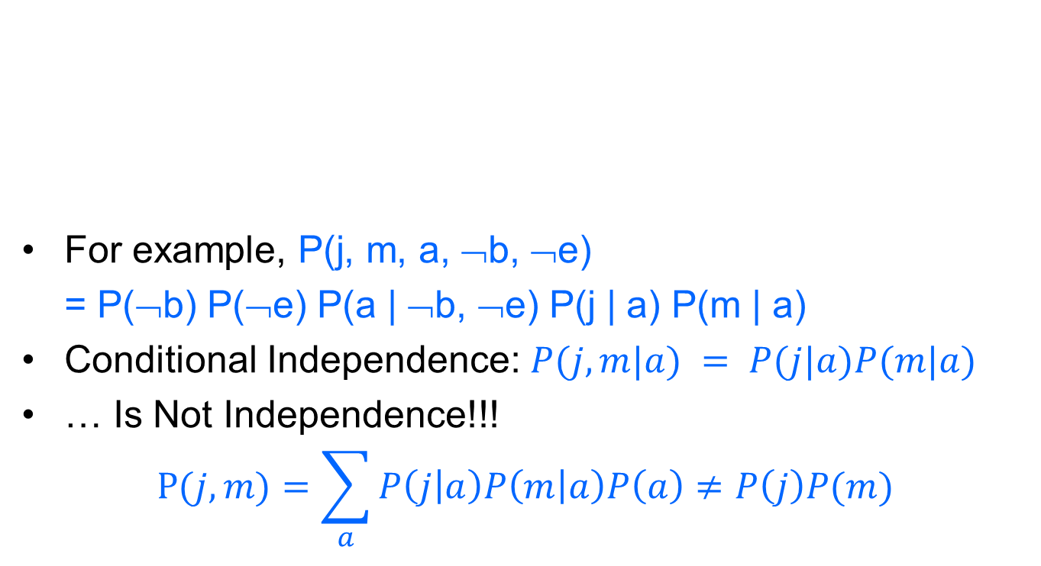
The joint probability distribution
For example, P(j, m, a, ¬b, ¬e)
= P(¬b) P(¬e) P(a | ¬b, ¬e) P(j | a) P(m | a)
Conditional Independence: $P(j,m|a) = P(j|a)P(m|a)$
… Is Not Independence!!!
$$P(j,m)=\sum_{a}{P\left(j | a\right)P\left(m | a\right)P\left(a\right)≠P\left(j\right)P(m)}$$

Slide 17
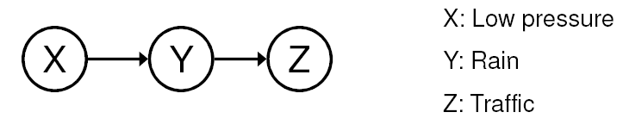
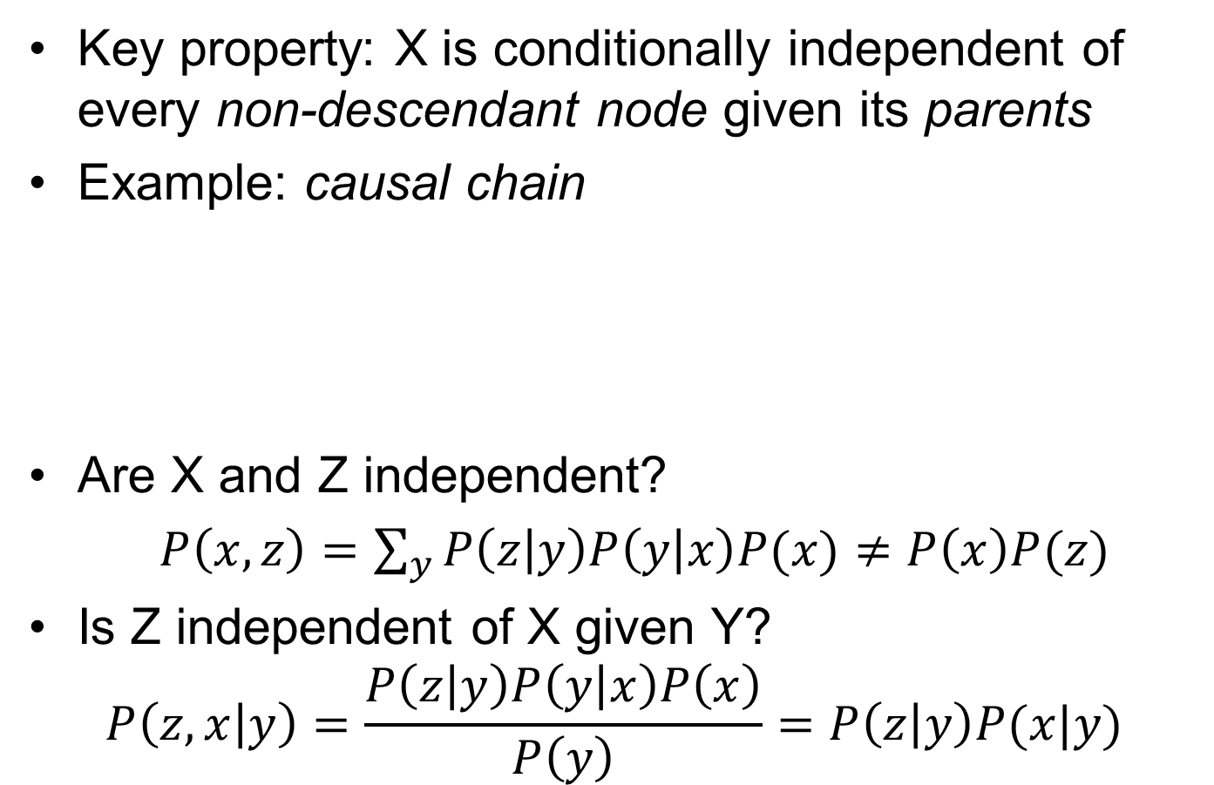
Conditional independence
Key property: X is conditionally independent of every non-descendant node given its parents
Example: causal chain
Are X and Z independent?
$P\left(x,z\right)=\sum_{y}{P\left(z | y\right)P\left(y | x\right)P(x)≠P\left(x\right)P(z)}$
Is Z independent of X given Y?
$$P\left(z,x | y\right)=\frac{P\left(z | y\right)P\left(y | x\right)P\left(x\right)}{P\left(y\right)}=P\left(z | y\right)P(x|y)$$

Slide 18
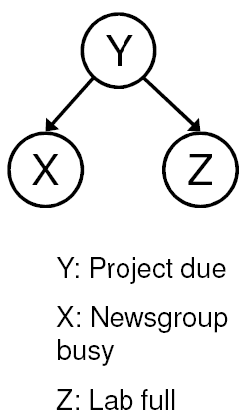
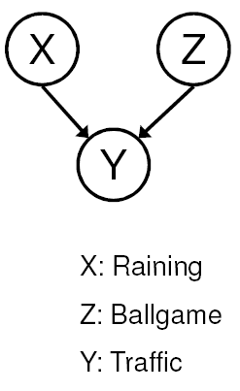
Conditional independence
Common cause
Are X and Z independent?
  No
Are they conditionally independent given Y?
  Yes
Common effect
Are X and Z independent?
  Yes
Are they conditionally independent given Y?
  No
Notes:
Is P(Raining | Traffic) the same as P(Raining | Traffic, Ballgame)?

Slide 19
Compactness
Suppose we have a Boolean variable X_{i} with k Boolean parents. How many rows does its conditional probability table have?
  2^{k} rows for all the combinations of parent values
  Each row requires one number for P(X_{i} = true | parent values)
If each variable has no more than k parents, how many numbers does the complete network require?
  O(n · 2^{k}) numbers – vs. O(2^{n}) for the full joint distribution
How many nodes for the burglary network?
  1 + 1 + 4 + 2 + 2 = 10 numbers (vs. 2⁵-1 = 31)

Slide 20
Outline
Review: Bayesian inference
Bayesian network: graph semantics
The Los Angeles burglar alarm example
Key concepts
  Conditional independence ≠ Independence
  Number of parameters you have to learn
Constructing a Bayesian network
Real-world examples

Slide 21
Constructing Bayesian networks
Choose an ordering of variables X₁, … , X_{n}
For i = 1 to n
  add X_{i} to the network
  select parents from X₁, … ,X_{i-1} such that
  P(X_{i} | Parents(X_{i})) = P(X_{i} | X₁, ... X_{i-1})

Slide 22
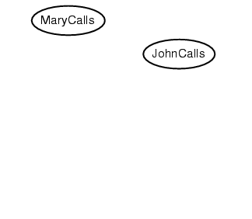
Example
Suppose we choose the ordering M, J, A, B, E

Slide 23
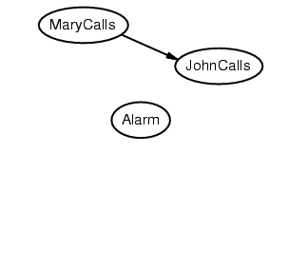
Example
Suppose we choose the ordering M, J, A, B, E

Slide 24
Example
Suppose we choose the ordering M, J, A, B, E

Slide 25
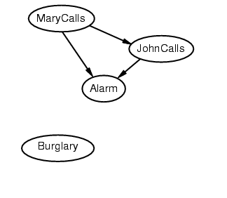
Example
Suppose we choose the ordering M, J, A, B, E

Slide 26
Example
Suppose we choose the ordering M, J, A, B, E

Slide 27
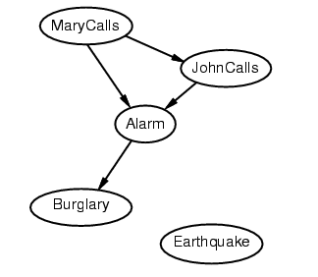
Example
Suppose we choose the ordering M, J, A, B, E

Slide 28
Example
Suppose we choose the ordering M, J, A, B, E

Slide 29
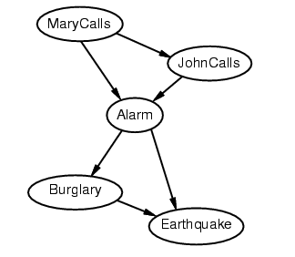
Example
Suppose we choose the ordering M, J, A, B, E

Slide 30
Example contd.
Deciding conditional independence is hard in noncausal directions
  The causal direction seems much more natural
Network is less compact: 1 + 2 + 4 + 2 + 4 = 13 numbers needed (vs. 10 for the causal ordering)

Slide 31
Outline
Review: Bayesian inference
Bayesian network: graph semantics
The Los Angeles burglar alarm example
Key concepts
  Conditional independence ≠ Independence
  Number of parameters you have to learn
Constructing a Bayesian network
Real-world examples

Slide 32
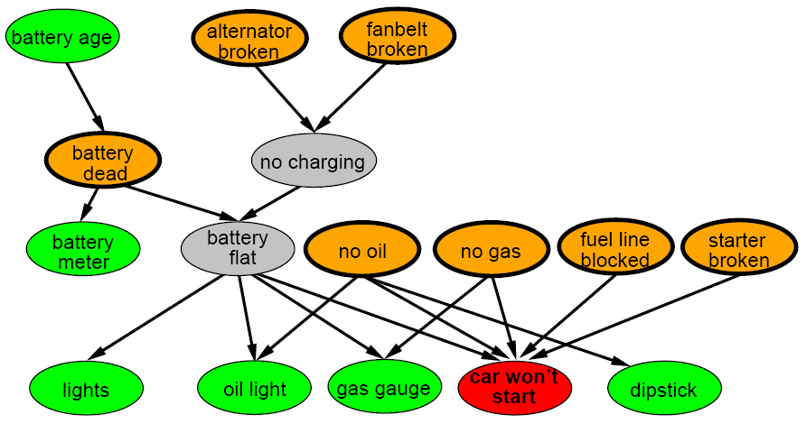
A more realistic Bayes Network:
Car diagnosis
Initial observation: car won’t start
Orange: “broken, so fix it” nodes
Green: testable evidence
Gray: “hidden variables” to ensure sparse structure, reduce parameters

Slide 33
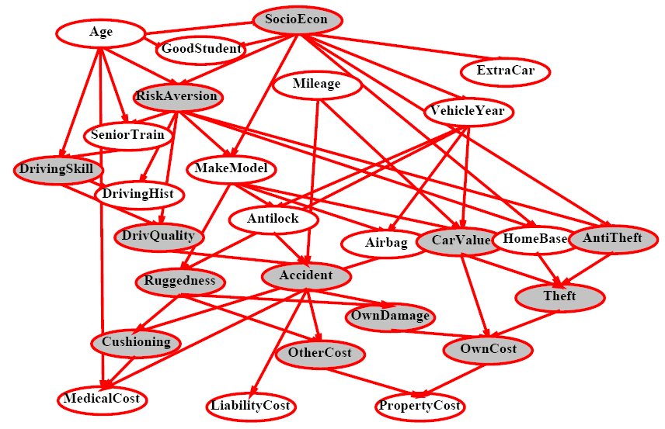
Car insurance

Slide 34
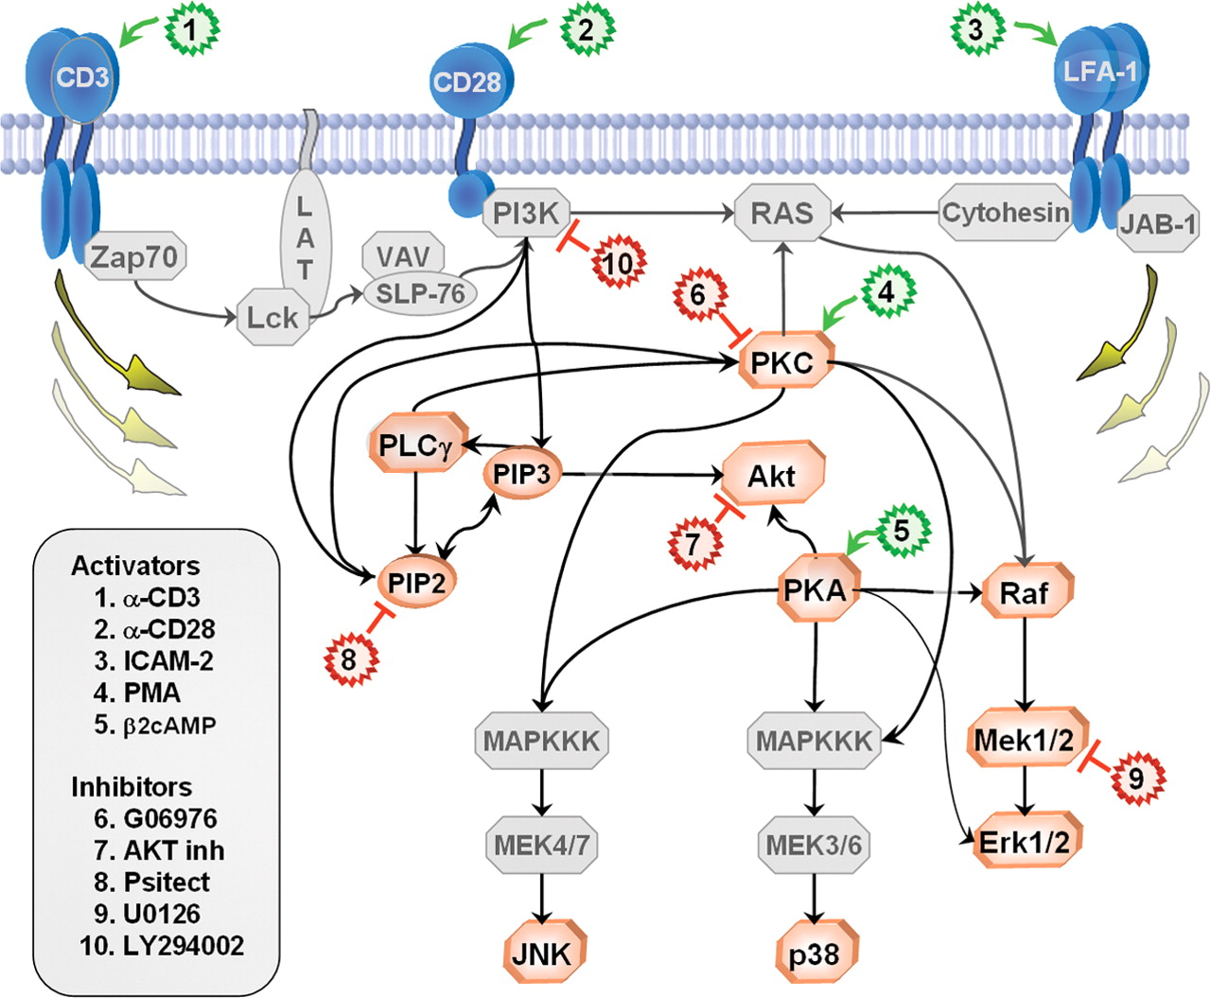
In research literature…
Causal Protein-Signaling Networks Derived from Multiparameter Single-Cell Data
Karen Sachs, Omar Perez, Dana Pe'er, Douglas A. Lauffenburger, and Garry P. Nolan
(22 April 2005) Science 308 (5721), 523.

Slide 35
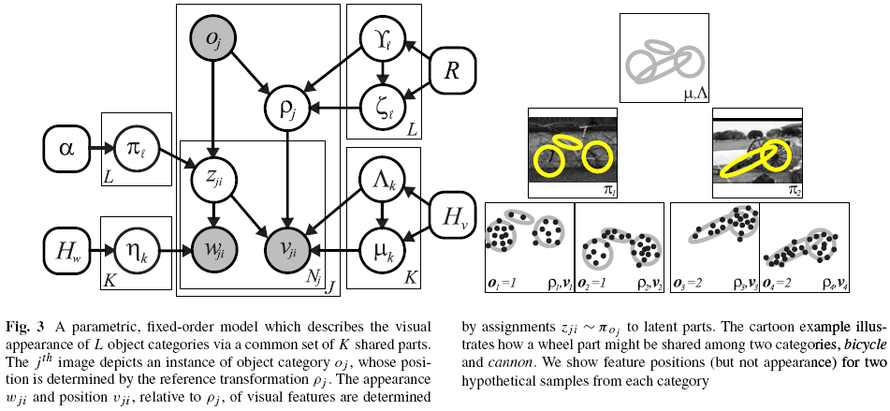
In research literature…
Describing Visual Scenes Using Transformed Objects and Parts
E. Sudderth, A. Torralba, W. T. Freeman, and A. Willsky.
International Journal of Computer Vision, No. 1-3, May 2008, pp. 291-330.

Slide 36
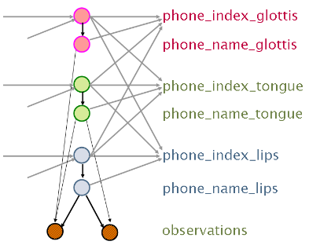
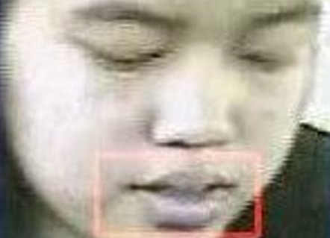
In research literature…
Audiovisual Speech Recognition with Articulator Positions as Hidden Variables
Mark Hasegawa-Johnson, Karen Livescu, Partha Lal and Kate Saenko
International Congress on Phonetic Sciences 1719:299-302, 2007

Slide 37
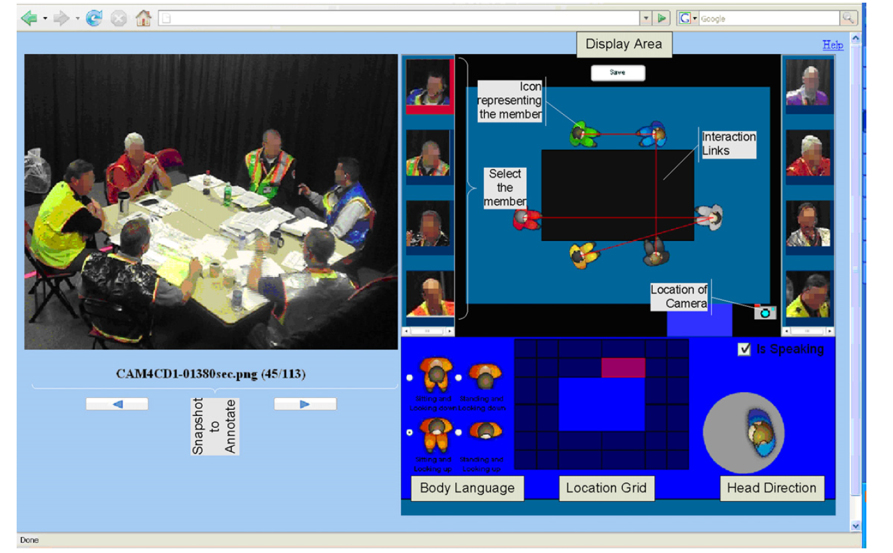
In research literature…
Detecting interaction links in a collaborating group using manually annotated data
S. Mathur, M.S. Poole, F. Pena-Mora, M. Hasegawa-Johnson, N. Contractor
Social Networks 10.1016/j.socnet.2012.04.002

Slide 38
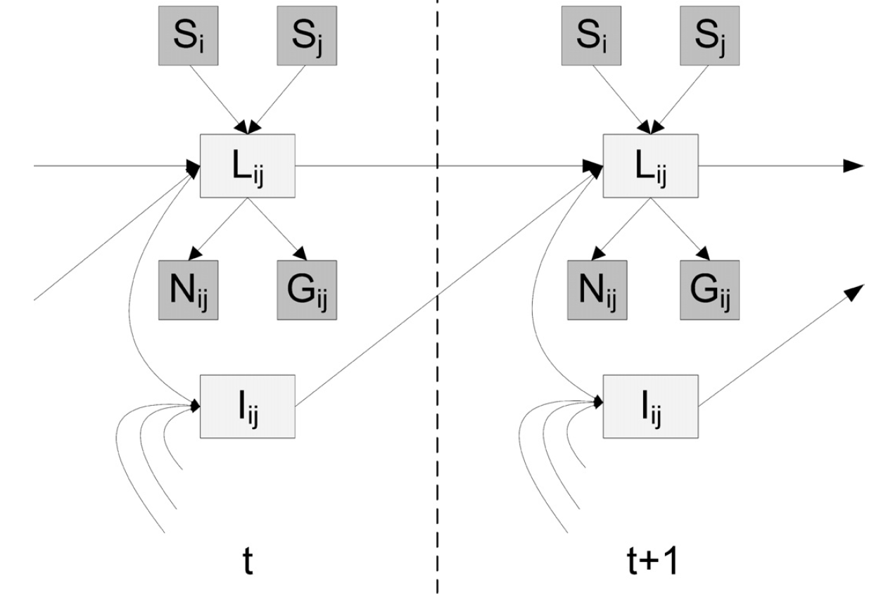
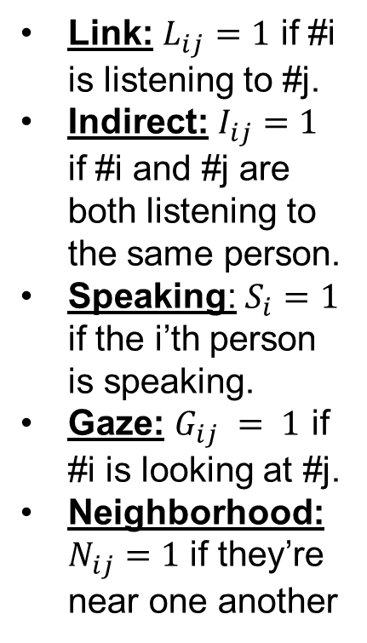
In research literature…
Link: $L_{ij}=1$ if #i is listening to #j.
Indirect: $I_{ij}=1$ if #i and #j are both listening to the same person.
Speaking: $S_{i}=1$ if the i’th person is speaking.
Gaze: $G_{ij} = 1$ if #i is looking at #j.
Neighborhood: $N_{ij}=1$ if they’re near one another
Detecting interaction links in a collaborating group using manually annotated data
S. Mathur, M.S. Poole, F. Pena-Mora, M. Hasegawa-Johnson, N. Contractor
Social Networks 10.1016/j.socnet.2012.04.002

Slide 39
Summary
Bayesian networks provide a natural representation for (causally induced) conditional independence
Topology + conditional probability tables
Generally easy for domain experts to construct

