Slide 1
Bayesian Inference &
Naïve Bayes
10/17/2016

Slide 2
Review: Probability
Random variables, events
Axioms of probability
Atomic events
Joint and marginal probability distributions
Conditional probability distributions
Product rule, chain rule
Independence and conditional independence

Slide 3
Outline: Bayesian Inference
Bayes Rule
Law of Total Probability
Misdiagnosis
MAP = MPE
The “Naïve Bayesian” Assumption
Spam Filter

Slide 4
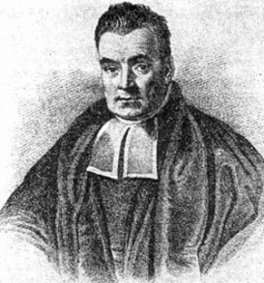
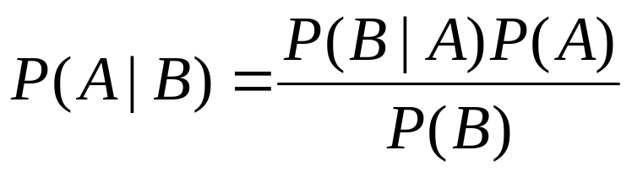
Bayes Rule
Rev. Thomas Bayes
(1702-1761)
The product rule gives us two ways to factor
a joint probability:
Therefore,
Why is this useful?
  Can update our beliefs about A based on evidence B
    P(A) is the prior and P(A|B) is the posterior
  Key tool for probabilistic inference: can get diagnostic probability from causal probability
    E.g., P(Cavity = true | Toothache = true) from
    P(Toothache = true | Cavity = true)
Notes:
A: some unobservable aspect of the world that we are trying to predict (query variable)
B: observable evidence

Slide 5
Bayes Rule example
Marie is getting married tomorrow, at an outdoor ceremony in the desert. In recent years, it has rained only 5 days each year (5/365 = 0.014). Unfortunately, the weatherman has predicted rain for tomorrow. When it actually rains, the weatherman correctly forecasts rain 90% of the time. When it doesn't rain, he incorrectly forecasts rain 10% of the time. What is the probability that it will rain on Marie's wedding?

Slide 6
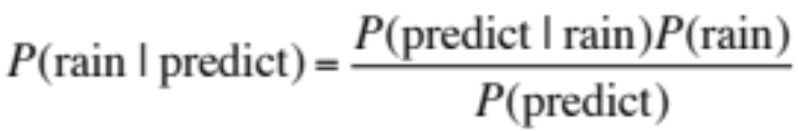
Bayes Rule example
Marie is getting married tomorrow, at an outdoor ceremony in the desert. In recent years, it has rained only 5 days each year (5/365 = 0.014). Unfortunately, the weatherman has predicted rain for tomorrow. When it actually rains, the weatherman correctly forecasts rain 90% of the time. When it doesn't rain, he incorrectly forecasts rain 10% of the time. What is the probability that it will rain on Marie's wedding?

Slide 7
Outline: Bayesian Inference
Bayes Rule
Law of Total Probability
Misdiagnosis
MAP = MPE
The “Naïve Bayesian” Assumption
Spam Filter

Slide 8
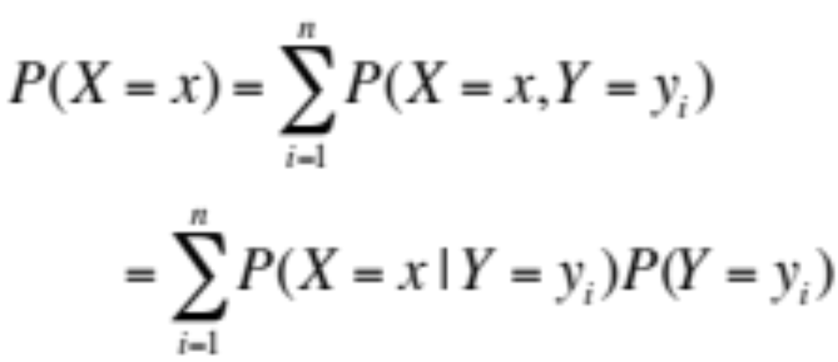
Law of total probability

Slide 9
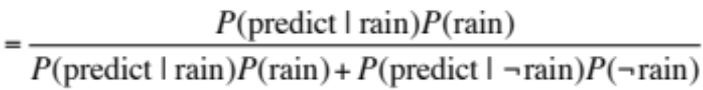
Bayes Rule example
Marie is getting married tomorrow, at an outdoor ceremony in the desert. In recent years, it has rained only 5 days each year (5/365 = 0.014). Unfortunately, the weatherman has predicted rain for tomorrow. When it actually rains, the weatherman correctly forecasts rain 90% of the time. When it doesn't rain, he incorrectly forecasts rain 10% of the time. What is the probability that it will rain on Marie's wedding?

Slide 10
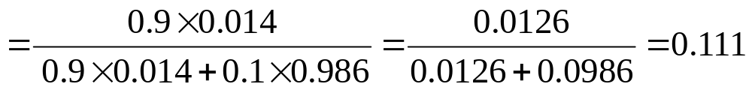
Bayes Rule example
Marie is getting married tomorrow, at an outdoor ceremony in the desert. In recent years, it has rained only 5 days each year (5/365 = 0.014). Unfortunately, the weatherman has predicted rain for tomorrow. When it actually rains, the weatherman correctly forecasts rain 90% of the time. When it doesn't rain, he incorrectly forecasts rain 10% of the time. What is the probability that it will rain on Marie's wedding?

Slide 11
Outline: Bayesian Inference
Bayes Rule
Law of Total Probability
Misdiagnosis
MAP = MPE
The “Naïve Bayesian” Assumption
Spam Filter

Slide 12
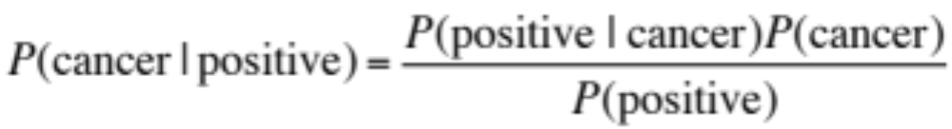
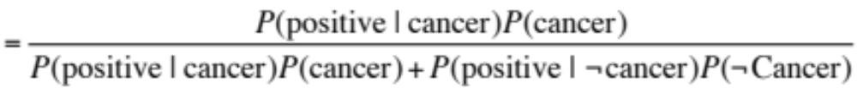
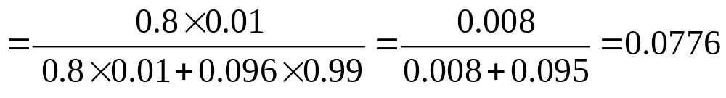
Bayes rule: Example
1% of women at age forty who participate in routine screening have breast cancer. 80% of women with breast cancer will get positive mammographies. 9.6% of women without breast cancer will also get positive mammographies. A woman in this age group had a positive mammography in a routine screening. What is the probability that she actually has breast cancer?
https://www.youtube.com/watch?v=BcvLAw-JRss

Slide 13
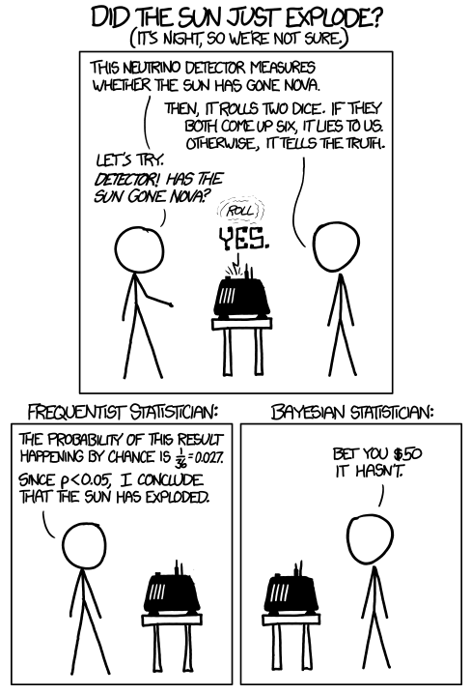
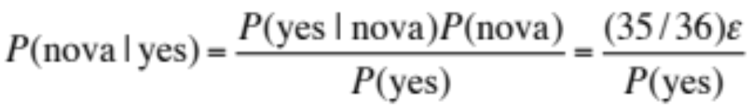
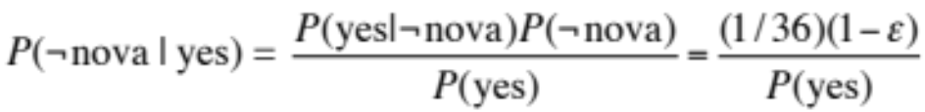
https://xkcd.com/1132/
See also: https://xkcd.com/882/
Notes:
P(Nova|Yes) = P(Yes|Nova)P(Nova)/P(Yes) = (35/36)(eps)/P(Yes)
P(not Nova|Yes) = P(Yes|Not Nova)P(Not Nova)/P(Yes) = (1/36)(1-eps)/P(Yes)
P(Not Nova|Yes) / P(Nova|Yes) = (1/36)(1-eps) / ((35/36) eps) = (1 – eps)/(35 eps)

Slide 14

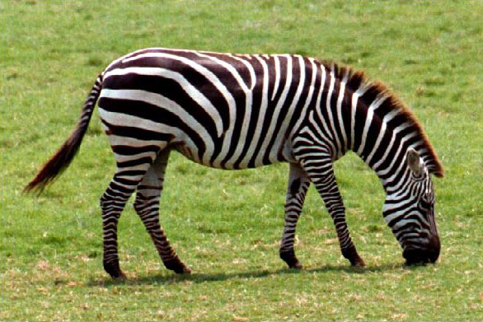
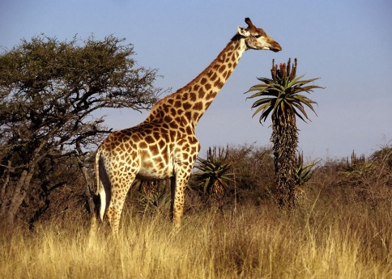
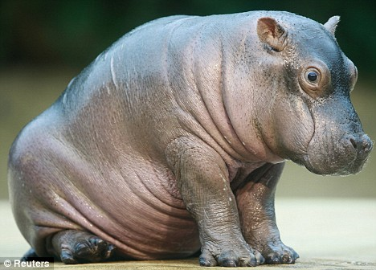
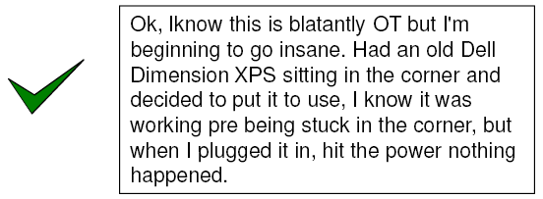
Probabilistic inference
Suppose the agent has to make a decision about the value of an unobserved query variable X given some observed evidence variable(s) E = e
  Partially observable, stochastic, episodic environment
  Examples: X = {spam, not spam}, e = email message
  X = {zebra, giraffe, hippo}, e = image features
Notes:
Expected loss of a decision: P(decision is correct) * 0 + P(decision is wrong) * 1

Slide 15
Outline: Bayesian Inference
Bayes Rule
Law of Total Probability
Misdiagnosis
MAP = MPE
The “Naïve Bayesian” Assumption
Spam Filter

Slide 16
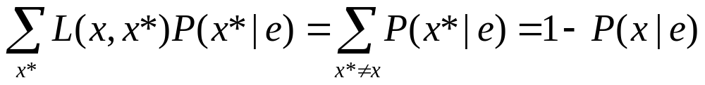
Bayesian decision theory
Let x be the value predicted by the agent and x* be the true value of X.
The agent has a loss function, which is 0 if x = x* and 1 otherwise
Expected loss for predicting x:
What is the estimate of X that minimizes the expected loss?
  The one that has the greatest posterior probability P(x|e)
  This is called the Maximum a Posteriori (MAP) decision
Notes:
Expected loss of a decision: P(decision is correct) * 0 + P(decision is wrong) * 1

Slide 17
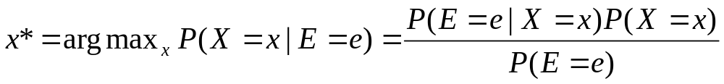
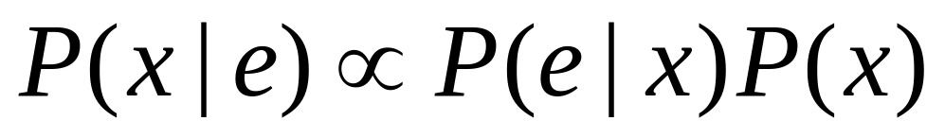
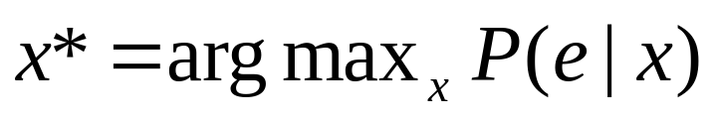
MAP decision
Value x of X that has the highest posterior probability given the evidence E = e:
Maximum likelihood (ML) decision:
posterior
likelihood
prior

Slide 18
Outline: Bayesian Inference
Bayes Rule
Law of Total Probability
Misdiagnosis
MAP = MPE
The “Naïve Bayesian” Assumption
Spam Filter

Slide 19
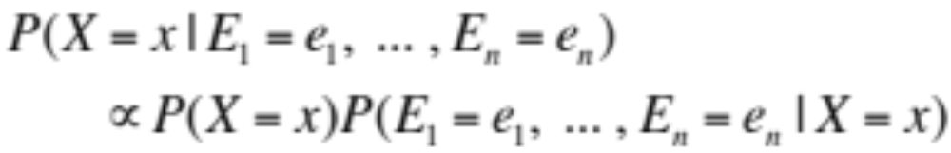
Naïve Bayes model
Suppose we have many different types of observations (symptoms, features) E₁, …, E_{n} that we want to use to obtain evidence about an underlying hypothesis X
MAP decision:
  If each feature E_{i} can take on k values, how many entries are in the (conditional) joint probability table P(E₁, …, E_{n} |X = x)?

Slide 20
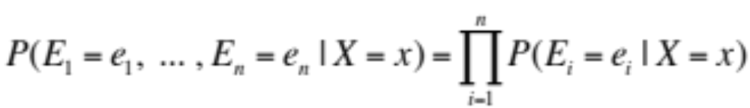
Naïve Bayes model
Suppose we have many different types of observations (symptoms, features) E₁, …, E_{n} that we want to use to obtain evidence about an underlying hypothesis X
MAP decision:
We can make the simplifying assumption that the different features are conditionally independent
given the hypothesis:
  If each feature can take on k values, what is the complexity of storing the resulting distributions?

Slide 21
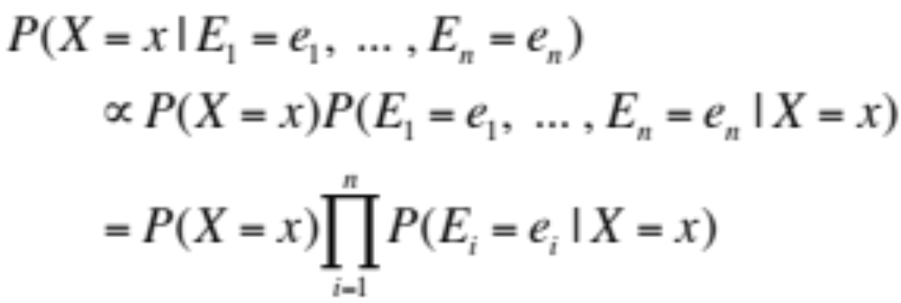
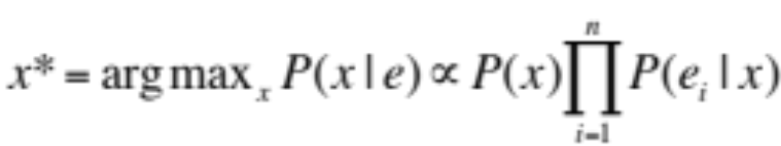
Naïve Bayes model
Posterior:
MAP decision:
posterior
prior
likelihood

Slide 22
Outline: Bayesian Inference
Bayes Rule
Law of Total Probability
Misdiagnosis
MAP = MPE
The “Naïve Bayesian” Assumption
Spam Filter

Slide 23
Case study:
Text document classification
MAP decision: assign a document to the class with the highest posterior P(class | document)
Example: spam classification
  Classify a message as spam if P(spam | message) > P(¬spam | message)

Slide 24
Case study:
Text document classification
MAP decision: assign a document to the class with the highest posterior P(class | document)
We have P(class | document) ∝ P(document | class)P(class)
To enable classification, we need to be able to estimate the likelihoods P(document | class) for all classes and
priors P(class)

Slide 25
Naïve Bayes Representation
Goal: estimate likelihoods P(document | class)
and priors P(class)
Likelihood: bag of words representation
  The document is a sequence of words (w₁, …, w_{n})
  The order of the words in the document is not important
  Each word is conditionally independent of the others given document class

Slide 26
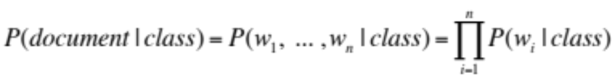
Naïve Bayes Representation
Goal: estimate likelihoods P(document | class)
and priors P(class)
Likelihood: bag of words representation
  The document is a sequence of words (w₁, …, w_{n})
  The order of the words in the document is not important
  Each word is conditionally independent of the others given document class

Slide 27

Bag of words illustration
US Presidential Speeches Tag Cloud
http://chir.ag/projects/preztags/

Slide 28

Bag of words illustration
US Presidential Speeches Tag Cloud
http://chir.ag/projects/preztags/

Slide 29

Bag of words illustration
US Presidential Speeches Tag Cloud
http://chir.ag/projects/preztags/

Slide 30
Naïve Bayes Representation
Goal: estimate likelihoods P(document | class) and P(class)
Likelihood: bag of words representation
  The document is a sequence of words (w₁, … , w_{n})
  The order of the words in the document is not important
  Each word is conditionally independent of the others given document class
  Thus, the problem is reduced to estimating marginal likelihoods of individual words P(w_{i} | class)

Slide 31
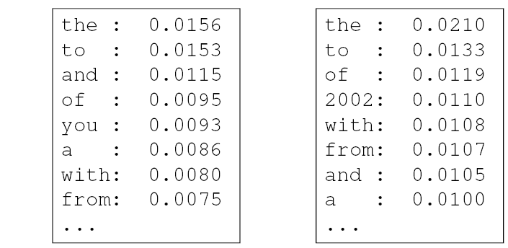
Parameter estimation
Model parameters: feature likelihoods P(word | class) and priors P(class)
  How do we obtain the values of these parameters?
prior
P(word | spam)
P(word | ¬spam)
spam: 0.33
¬spam: 0.67

Slide 32
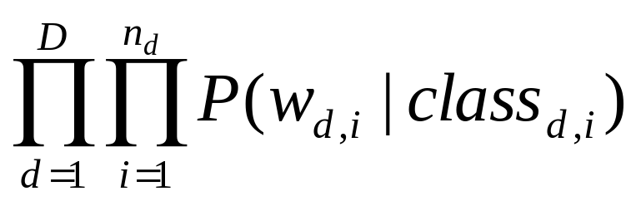
Parameter estimation
Model parameters: feature likelihoods P(word | class) and priors P(class)
  How do we obtain the values of these parameters?
  Need training set of labeled samples from both classes
  This is the maximum likelihood (ML) estimate, or estimate that maximizes the likelihood of the training data:
# of occurrences of this word in docs from this class
P(word | class) =
total # of words in docs from this class
d: index of training document, i: index of a word

Slide 33
Parameter estimation
Parameter estimate:
Parameter smoothing: dealing with words that were never seen or seen too few times
  Laplacian smoothing: pretend you have seen every vocabulary word one more time than you actually did
# of occurrences of this word in docs from this class
P(word | class) =
total # of words in docs from this class
# of occurrences of this word in docs from this class + 1
P(word | class) =
total # of words in docs from this class + V
(V: total number of unique words)

Slide 34
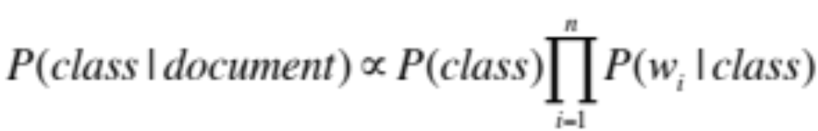
Summary: Naïve Bayes for Document Classification
Naïve Bayes model: assign the document to the class with the highest posterior
Model parameters:
Likelihood
of class 1
Likelihood
of class K
prior
P(w₁ | class₁)
P(w₂ | class₁)
…
P(w_{n} | class₁)
P(w₁ | class_{K})
P(w₂ | class_{K})
…
P(w_{n} | class_{K})
P(class₁)
…
P(class_{K})
…

Slide 35
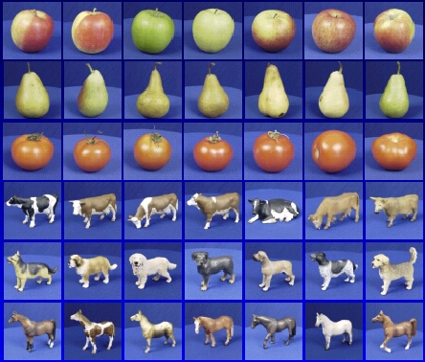

Learning and inference pipeline
Learning
Training Labels
Training Samples
Features
Training
Learned model
Learned model
Inference
Features
Prediction
Test Sample

Slide 36
Review: Bayesian decision making
Suppose the agent has to make decisions about the value of an unobserved query variable X based on the values of an observed evidence variable E
Inference problem: given some evidence E = e, what is P(X | e)?
Learning problem: estimate the parameters of the probabilistic model P(X | E) given a training sample {(x₁,e₁), …, (x_{n},e_{n})}

