Slide 1

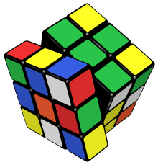
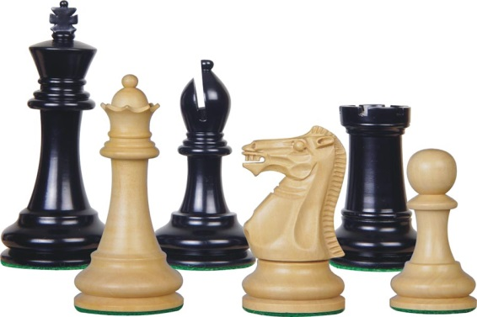
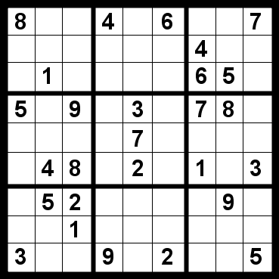
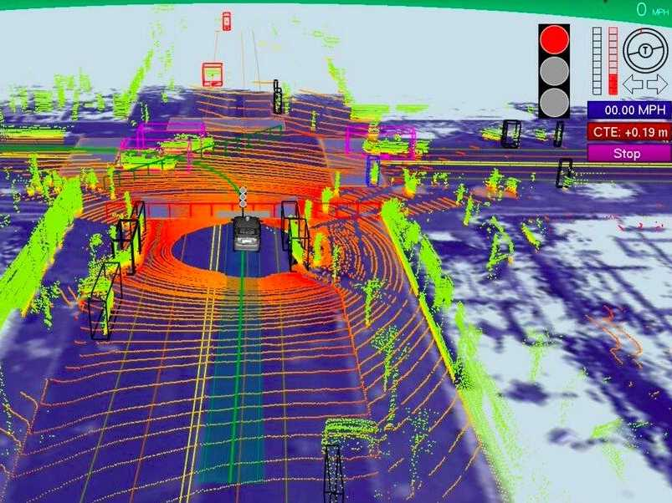
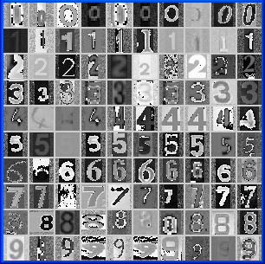
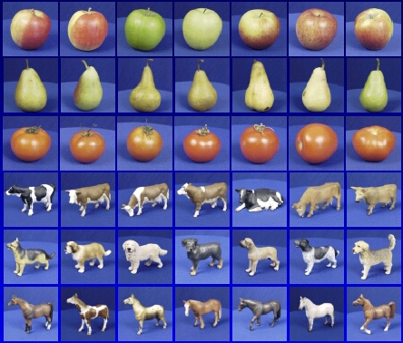

Where are we in CS 440?
Now leaving: sequential, deterministic reasoning
Entering: probabilistic reasoning and machine learning

Slide 2
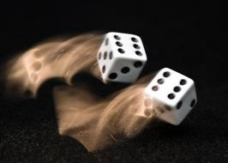
Probability: Review of main concepts (Chapter 13)

Slide 3
Outline
Motivation: Why use probability?
  Laziness, Ignorance, and Randomness
  Rational Bettor Theorem
Review of Key Concepts
  Outcomes, Events, and Random Variables
  Joint, Marginal, and Conditional
  Independent Events

Slide 4
Outline
Motivation: Why use probability?
  Laziness, Ignorance, and Randomness
  Rational Bettor Theorem
Review of Key Concepts
  Outcomes, Events, and Random Variables
  Joint, Marginal, and Conditional
  Independence and Conditional Independence

Slide 5
Motivation: Planning under uncertainty
Recall: representation for planning
States are specified as conjunctions of predicates
  Start state: At(P1, CMI) ∧ Plane(P1) ∧ Airport(CMI) ∧ Airport(ORD)
  Goal state: At(P1, ORD)
Actions are described in terms of preconditions and effects:
  Fly(p, source, dest)
    Precond: At(p, source) ∧ Plane(p) ∧ Airport(source) ∧ Airport(dest)
    Effect: ¬At(p, source) ∧ At(p, dest)

Slide 6
Motivation: Planning under uncertainty
Let action A_{t} = leave for airport t minutes before flight
  Will A_{t} succeed, i.e., get me to the airport in time for the flight?
Problems:
    Partial observability (road state, other drivers' plans, etc.)
    Noisy sensors (traffic reports)
    Uncertainty in action outcomes (flat tire, etc.)
    Complexity of modeling and predicting traffic
Hence a purely logical approach either
    Risks falsehood: “A₂₅ will get me there on time,” or
    Leads to conclusions that are too weak for decision making:
    A₂₅ will get me there on time if there's no accident on the bridge and it doesn't rain and my tires remain intact, etc., etc.
    A₁₄₄₀ will get me there on time but I’ll have to stay overnight in the airport

Slide 7
Probability
Probabilistic assertions summarize effects of
  Laziness: reluctance to enumerate exceptions, qualifications, etc.
  Ignorance: lack of explicit theories, relevant facts, initial conditions, etc.
  Intrinsically random phenomena

Slide 8
Outline
Motivation: Why use probability?
  Laziness, Ignorance, and Randomness
  Rational Bettor Theorem
Review of Key Concepts
  Outcomes, Events, and Random Variables
  Joint, Marginal, and Conditional
  Independence and Conditional Independence

Slide 9
Making decisions under uncertainty
Suppose the agent believes the following:
  P(A₂₅ gets me there on time) = 0.04
  P(A₉₀ gets me there on time) = 0.70
  P(A₁₂₀ gets me there on time) = 0.95
  P(A₁₄₄₀ gets me there on time) = 0.9999
Which action should the agent choose?
  Depends on preferences for missing flight vs. time spent waiting
  Encapsulated by a utility function
The agent should choose the action that maximizes the expected utility:
  P(A_{t} succeeds) * U(A_{t} succeeds) + P(A_{t} fails) * U(A_{t} fails)

Slide 10
Making decisions under uncertainty
More generally: the expected utility of an action is defined as:
EU(a) = Σ_{outcomes of a} P(outcome | a) U(outcome)
Utility theory is used to represent and infer preferences
Decision theory = probability theory + utility theory

Slide 11
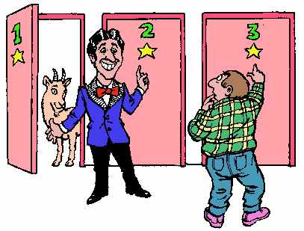
Monty Hall problem
You’re a contestant on a game show. You see three closed doors, and behind one of them is a prize. You choose one door, and the host opens one of the other doors and reveals that there is no prize behind it. Then he offers you a chance to switch to the remaining door. Should you take it?
http://en.wikipedia.org/wiki/Monty_Hall_problem

Slide 12
Monty Hall problem
With probability 1/3, you picked the correct door, and with probability 2/3, picked the wrong door. If you picked the correct door and then you switch, you lose. If you picked the wrong door and then you switch, you win the prize.
Expected utility of switching:
EU(Switch) = (1/3) * 0 + (2/3) * Prize
Expected utility of not switching:
EU(Not switch) = (1/3) * Prize + (2/3) * 0

Slide 13
Where do probabilities come from?
Frequentism
  Probabilities are relative frequencies
  For example, if we toss a coin many times, P(heads) is the proportion of the time the coin will come up heads
  But what if we’re dealing with events that only happen once?
    E.g., what is the probability that Team X will win the Superbowl this year?
    “Reference class” problem
Subjectivism
  Probabilities are degrees of belief
  But then, how do we assign belief values to statements?
  What would constrain agents to hold consistent beliefs?

Slide 14
The Rational Bettor Theorem
Why should a rational agent hold beliefs that are consistent with axioms of probability?
  For example, P(A) + P(¬A) = 1
If an agent has some degree of belief in proposition A,
he/she should be able to decide whether or not to accept
a bet for/against A (De Finetti, 1931):
  If the agent believes that P(A) = 0.4, should he/she agree to bet $4 that A will occur against $6 that A will not occur?
Theorem: An agent who holds beliefs inconsistent with axioms of probability can be convinced to accept a combination of bets that is guaranteed to lose them money
Notes:
If A occurs, the agent wins $6. If A does not occur, the agend loses $4. EU(bet) = 0.4 * 6 – 0.6 * 4 = 0

Slide 15
Outline
Motivation: Why use probability?
  Laziness, Ignorance, and Randomness
  Rational Bettor Theorem
Review of Key Concepts
  Outcomes, Events, and Random Variables
  Joint, Marginal, and Conditional
  Independence and Conditional Independence

Slide 16
Outcomes of an Experiment
The SET OF POSSIBLE OUTCOMES (a.k.a. the “sample space”) is a listing of all of the things that might happen:
Mutually exclusive. It’s not possible that two different outcomes might both happen.
Collectively exhaustive. Every outcome that could possibly happen is one of the items in the list.
Finest grain. After the experiment occurs, somebody tells you the outcome, and there is nothing else you need to know.
Example experiment: Alice, Bob, Carol and Duane run a 10km race to decide who will buy pizza tonight.
Outcome = a listing of the exact finishing times of each participant.

Slide 17
Events
Probabilistic statements are defined over events, or sets of world states
  A = “It is raining”
  B = “The weather is either cloudy or snowy”
  C = “The sum of the two dice rolls is 11”
  D = “My car is going between 30 and 50 miles per hour”
An EVENT is a SET of OUTCOMES
  B = { outcomes : cloudy OR snowy }
  C = { outcomes : d1+d2 = 11 }
Notation: P(A) is the probability of the set of world states (outcomes) in which proposition A holds

Slide 18
Kolmogorov’s axioms of probability
For any propositions (events) A, B
  0 ≤ P(A) ≤ 1
  P(True) = 1 and P(False) = 0
  P(A ∨ B) = P(A) + P(B) – P(A ∧ B)
    Subtraction accounts for double-counting
Based on these axioms, what is P(¬A)?
These axioms are sufficient to completely specify probability theory for discrete random variables
  For continuous variables, need density functions

Slide 19
Outcomes = Atomic events
OUTCOME or ATOMIC EVENT: is a complete specification of the state of the world, or a complete assignment of domain values to all random variables
  Atomic events are mutually exclusive and exhaustive
E.g., if the world consists of only two Boolean variables Cavity and Toothache, then there are four outcomes:
¬Cavity ∧ ¬Toothache
¬Cavity ∧ Toothache
Cavity ∧ ¬Toothache
Cavity ∧ Toothache

Slide 20
Random variables
We describe the (uncertain) state of the world using random variables
  Denoted by capital letters
  R: Is it raining?
  W: What’s the weather?
  D: What is the outcome of rolling two dice?
  S: What is the speed of my car (in MPH)?
Just like variables in CSPs, random variables take on values in a domain
  Domain values must be mutually exclusive and exhaustive
  R in {True, False}
  W in {Sunny, Cloudy, Rainy, Snow}
  D in {(1,1), (1,2), … (6,6)}
  S in [0, 200]

Slide 21
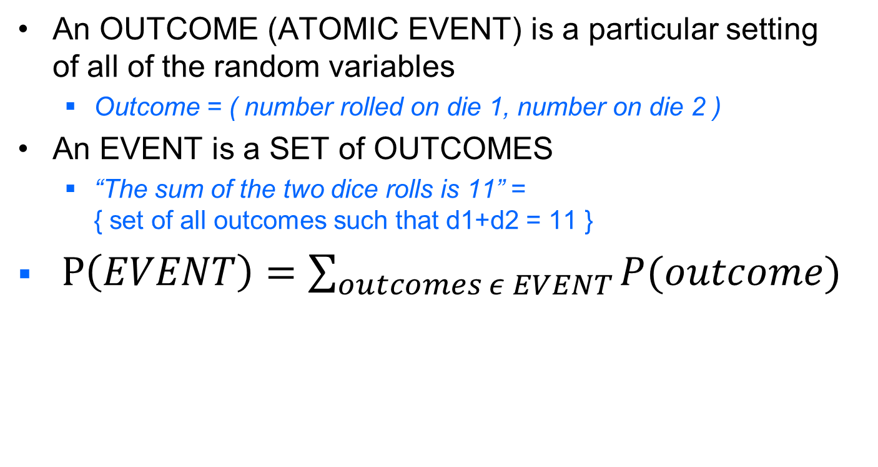
Events and Outcomes
An OUTCOME (ATOMIC EVENT) is a particular setting of all of the random variables
  Outcome = ( number rolled on die 1, number on die 2 )
An EVENT is a SET of OUTCOMES
  “The sum of the two dice rolls is 11” = { set of all outcomes such that d1+d2 = 11 }
$P\left(EVENT\right)=\sum_{outcomes ε EVENT}{P(outcome)}$

Slide 22
Outline
Motivation: Why use probability?
  Laziness, Ignorance, and Randomness
  Rational Bettor Theorem
Review of Key Concepts
  Outcomes, Events, and Random Variables
  Joint, Marginal, and Conditional
  Independence and Conditional Independence

Slide 23
Joint probability distributions
A joint distribution is an assignment of probabilities to every possible atomic event
  Why does it follow from the axioms of probability that the probabilities of all possible atomic events must sum to 1?
Atomic event | P
¬Cavity ∧ ¬Toothache | 0.8
¬Cavity ∧ Toothache | 0.1
Cavity ∧ ¬Toothache | 0.05
Cavity ∧ Toothache | 0.05

Slide 24
Joint probability distributions
A joint distribution is an assignment of probabilities to every possible atomic event
Suppose we have a joint distribution of n random variables with domain sizes d
  What is the size of the probability table?
  Impossible to write out completely for all but the smallest distributions

Slide 25
Notation
P(X₁ = x₁, X₂ = x₂, …, X_{n} = x_{n}) refers to a single entry (atomic event) in the joint probability distribution table
  Shorthand: P(x₁, x₂, …, x_{n})
P(X₁, X₂, …, X_{n}) refers to the entire joint probability distribution table
P(A) can also refer to the probability of an event
  E.g., X₁ = x₁ is an event

Slide 26
Marginal probability distributions
From the joint distribution P(X,Y) we can find the marginal distributions P(X) and P(Y)
P(Cavity, Toothache)
¬Cavity ∧ ¬Toothache | 0.8
¬Cavity ∧ Toothache | 0.1
Cavity ∧ ¬Toothache | 0.05
Cavity ∧ Toothache | 0.05
P(Cavity)
¬Cavity | ?
Cavity | ?
P(Toothache)
¬Toothache | ?
Toochache | ?

Slide 27
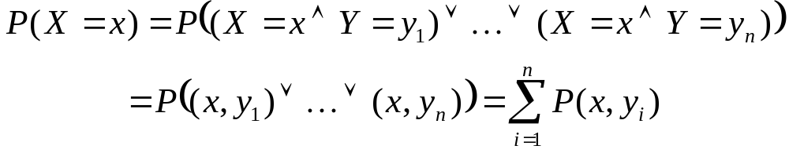
Marginal probability distributions
From the joint distribution P(X,Y) we can find the marginal distributions P(X) and P(Y)
To find P(X = x), sum the probabilities of all atomic events where X = x:
This is called marginalization (we are marginalizing out all the variables except X)

Slide 28
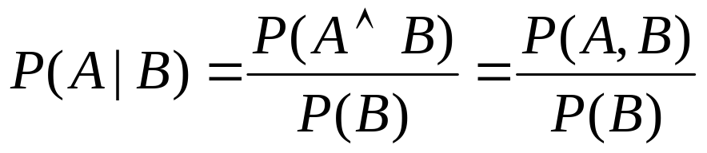
Conditional probability
Probability of cavity given toothache:
P(Cavity = true | Toothache = true)
For any two events A and B,
P(A ∧ B)
P(A)
P(B)

Slide 29
Conditional probability
P(Cavity, Toothache)
¬Cavity ∧ ¬Toothache | 0.8
¬Cavity ∧ Toothache | 0.1
Cavity ∧ ¬Toothache | 0.05
Cavity ∧ Toothache | 0.05
P(Cavity)
¬Cavity | 0.9
Cavity | 0.1
P(Toothache)
¬Toothache | 0.85
Toochache | 0.15
What is P(Cavity = true | Toothache = false)?
  0.05 / 0.85 = 0.059
What is P(Cavity = false | Toothache = true)?
  0.1 / 0.15 = 0.667

Slide 30
Conditional distributions
A conditional distribution is a distribution over the values of one variable given fixed values of other variables
P(Cavity, Toothache)
¬Cavity ∧ ¬Toothache | 0.8
¬Cavity ∧ Toothache | 0.1
Cavity ∧ ¬Toothache | 0.05
Cavity ∧ Toothache | 0.05
P(Cavity | Toothache = true)
¬Cavity | 0.667
Cavity | 0.333
P(Cavity|Toothache = false)
¬Cavity | 0.941
Cavity | 0.059
P(Toothache | Cavity = true)
¬Toothache | 0.5
Toochache | 0.5
P(Toothache | Cavity = false)
¬Toothache | 0.889
Toochache | 0.111

Slide 31
Normalization trick
To get the whole conditional distribution P(X | Y = y) at once, select all entries in the joint distribution table matching Y = y and renormalize them to sum to one
P(Cavity, Toothache)
¬Cavity ∧ ¬Toothache | 0.8
¬Cavity ∧ Toothache | 0.1
Cavity ∧ ¬Toothache | 0.05
Cavity ∧ Toothache | 0.05
Select
Toothache, Cavity = false
¬Toothache | 0.8
Toochache | 0.1
Renormalize
P(Toothache | Cavity = false)
¬Toothache | 0.889
Toochache | 0.111

Slide 32
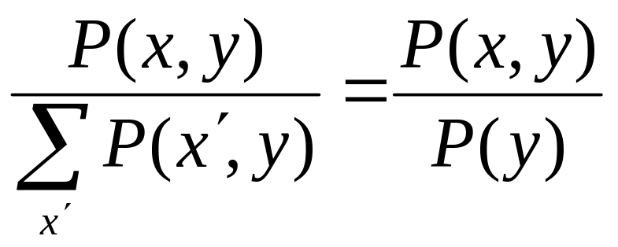
Normalization trick
To get the whole conditional distribution P(X | Y = y) at once, select all entries in the joint distribution table matching Y = y and renormalize them to sum to one
Why does it work?
by marginalization

Slide 33
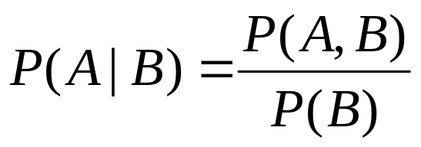
Product rule
Definition of conditional probability:
Sometimes we have the conditional probability and want to obtain the joint:

Slide 34
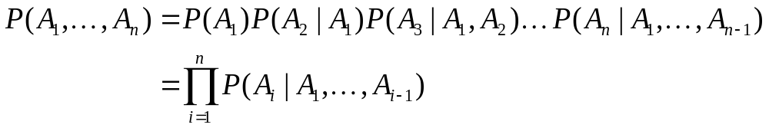
Product rule
Definition of conditional probability:
Sometimes we have the conditional probability and want to obtain the joint:
The chain rule:

Slide 35
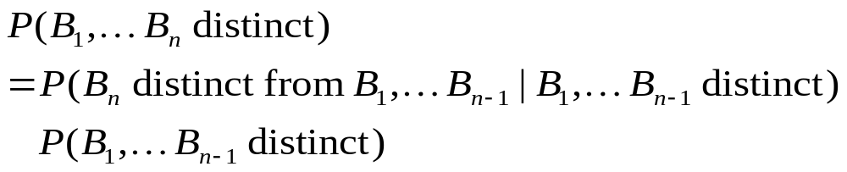
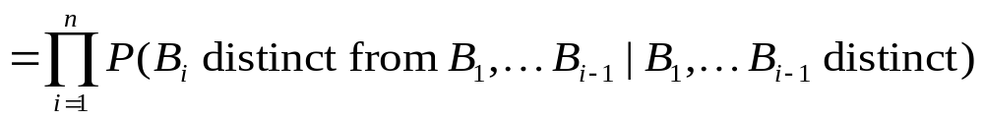
The Birthday problem
We have a set of n people. What is the probability that two of them share the same birthday?
Easier to calculate the probability that n people do not share the same birthday

Slide 36
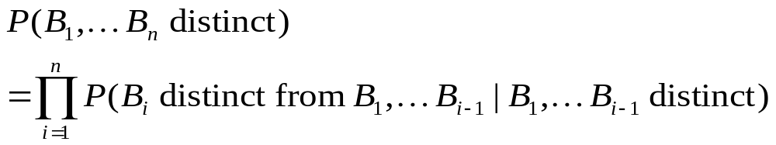
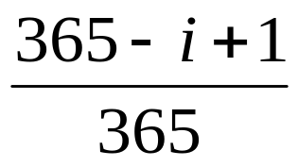
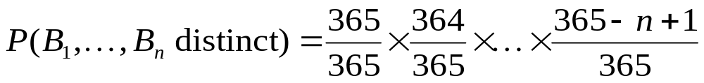
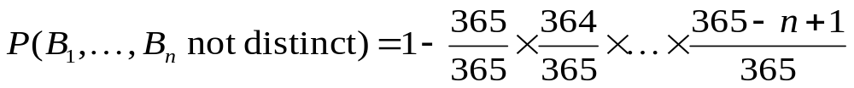
The Birthday problem

Slide 37
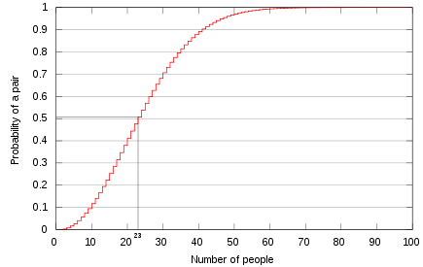
The Birthday problem
For 23 people, the probability of sharing a birthday is above 0.5!
http://en.wikipedia.org/wiki/Birthday_problem

Slide 38
Outline
Motivation: Why use probability?
  Laziness, Ignorance, and Randomness
  Rational Bettor Theorem
Review of Key Concepts
  Outcomes, Events, and Random Variables
  Joint, Marginal, and Conditional
  Independence and Conditional Independence

Slide 39
Independence
Two events A and B are independent if and only if
P(A ∧ B) = P(A, B) = P(A) P(B)
  In other words, P(A | B) = P(A) and P(B | A) = P(B)
  This is an important simplifying assumption for modeling, e.g., Toothache and Weather can be assumed to be independent
Are two mutually exclusive events independent?
  No, but for mutually exclusive events we have
  P(A ∨ B) = P(A) + P(B)

Slide 40
Independence
Two events A and B are independent if and only if
P(A ∧ B) = P(A) P(B)
  In other words, P(A | B) = P(A) and P(B | A) = P(B)
  This is an important simplifying assumption for modeling, e.g., Toothache and Weather can be assumed to be independent
Conditional independence: A and B are conditionally independent given C iff
P(A ∧ B | C) = P(A | C) P(B | C)
  Equivalently:
  P(A | B, C) = P(A | C) or P(B | A, C) = P(B | C)

Slide 41
Conditional independence: Example
Toothache: boolean variable indicating whether the patient has a toothache
Cavity: boolean variable indicating whether the patient has a cavity
Catch: whether the dentist’s probe catches in the cavity
If the patient has a cavity, the probability that the probe catches in it doesn't depend on whether he/she has a toothache
  P(Catch | Toothache, Cavity) = P(Catch | Cavity)
Therefore, Catch is conditionally independent of Toothache given Cavity
Likewise, Toothache is conditionally independent of Catch given Cavity
P(Toothache | Catch, Cavity) = P(Toothache | Cavity)
Equivalent statement:
  P(Toothache, Catch | Cavity) = P(Toothache | Cavity) P(Catch | Cavity)

Slide 42
Conditional independence: Example
How many numbers do we need to represent the joint probability table P(Toothache, Cavity, Catch)?
  2³ – 1 = 7 independent entries
Write out the joint distribution using chain rule:
P(Toothache, Catch, Cavity)
  = P(Cavity) P(Catch | Cavity) P(Toothache | Catch, Cavity)
  = P(Cavity) P(Catch | Cavity) P(Toothache | Cavity)
How many numbers do we need to represent these distributions?
  1 + 2 + 2 = 5 independent numbers
In most cases, the use of conditional independence reduces the size of the representation of the joint distribution from exponential in n to linear in n

