Slide 1
Ethernet
CS/ECE 438: Spring 2014
Instructor: Matthew Caesar
http://courses.engr.illinois.edu/cs438/

Slide 2
Some History
Ethernet was invented as a broadcast technology
  Each packet received by all attached hosts
Easy to set up, cheap to build
  But hosts had to share channel (multiple access)
Current Ethernets are “switched”
  No sharing
But need spanning tree to route on switches
  Everyone hates spanning tree, trying to eliminate it

Slide 3
Today
Study two algorithms that are “endangered”
  But both important conceptually!
Spanning Tree
  Still used, but alternatives being developed
Multiple Access in wired media (largely extinct)
  Rarely used, but useful background for wireless

Slide 4
Ethernet: Key Concepts

Slide 5
Overview of Ethernet
Dominant wired LAN technology
  Pretty much obsoleted token ring, optical LANs, ATM
Defines a spectrum of techniques
  Physical wiring, contention resolution (CSMA/CD), framing, encoding, devices (hubs/switches/bridges), forwarding, addressing

Slide 6
Overview of Ethernet
Ethernet uses CSMA/CD
  Carrier sense, collision detection, random access
Limitations on Ethernet length
  Need to ensure collisions are detected before sender is done transmitting a packet
Frame structure
  Preamble for synchronization

Slide 7
Overview of Ethernet
Device types
  Hubs: physical layer repeaters (obsolete?)
  Switch: store and forward, breaks subnet into isolated LAN segments, learning
Semantics: Unreliable, Connectionless
Benefits: easy to administer and maintain, plug-and-play
Downsides: scaling, security

Slide 8

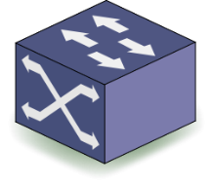

Ethernet Forwarding
Cable
End Host
0D:73:CA:F3
Switch
F0:4D:A2:3A
Hosts assigned 48-bit MAC addresses
Forwarding by “flooding”
Notes:
- Two hosts, hwo do they reach each other? Classic problem, IP and ethernet solve this differnet ways, and there are tradeoffs
Assign hosts “mac addresses” – 48 bit numbers
How can these hosts send data to each other?
But how do you know the mac address in the first place?
Trunk ports can carry multiple vlans accepss ports carry 1

Slide 9
Ethernet Forwarding
Cable
End Host
0D:73:CA:F3
Switch
How to flood with stateless switches?
F0:4D:A2:3A
Notes:
- Two hosts, hwo do they reach each other? Classic problem, IP and ethernet solve this differnet ways, and there are tradeoffs
Assign hosts “mac addresses” – 48 bit numbers
How can these hosts send data to each other?
But how do you know the mac address in the first place?
Trunk ports can carry multiple vlans accepss ports carry 1

Slide 10
Ethernet Forwarding
Root Switch
Cable
End Host
0D:73:CA:F3
Switch
Solution: Construct a Spanning Tree
  Elect a “root” switch
  Root-facing ports are active, others disabled
F0:4D:A2:3A
Notes:
- Two hosts, hwo do they reach each other? Classic problem, IP and ethernet solve this differnet ways, and there are tradeoffs
Assign hosts “mac addresses” – 48 bit numbers
How can these hosts send data to each other?
But how do you know the mac address in the first place?
Trunk ports can carry multiple vlans accepss ports carry 1

Slide 11
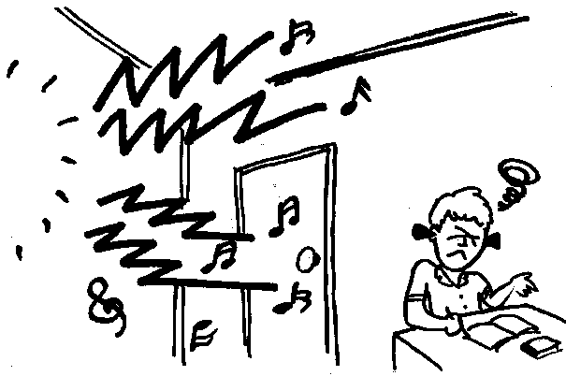
Avoiding Flooding
Flooding packets throughout network introduces problems
  Scalability, privacy, resource isolation, lack of access control
Scalability requirement is growing very fast
  Large enterprises: 50k end hosts
  Data centers: 100k servers, 5k switches
  Metro-area Ethernet: over 1M subscribers

Slide 12
Avoiding Flooding
Suppose source sends a frame to a destination
  Which LANs should a frame be forwarded on?
Trivial algorithm
  Forward all frames on all (other) LAN’s
  Potentially heavy traffic and processing overhead
Optimize by using address information
  “Learn” which hosts live on which LAN
  Maintain forwarding table
  Only forward when necessary
  Reduces bridge workload
dest
A
B
source

Slide 13
Learning Bridges
Bridge learns table entries based on source address
  When receive frame from A on port 1
  add A to list of hosts on port 1
  Time out entries to allow movement of hosts
Table is an “optimization”, meaning it helps performance but is not mandatory
Always forward broadcast frames
Host | Port
A | 1
B | 1
C | 1
X | 2
Y | 2
Z | 2
Port 1
A
B
C
Bridge
Port 2
X
Y
Z

Slide 14
Scaling Ethernet with VLANs
Student printers
Faculty printer
Faculty
VLAN
Faculty
fileserver
Divide up hosts into logical groups called VLANs
  Like virtual machines, but for LANs (creates “virtual networks”)
  VLANs isolate traffic at layer 2
Each VLAN corresponds to IP subnet, single broadcast domain
Ethernet packet headers have VLAN tag
Bridges forward packet only on subnets on corresponding VLAN
B1
Faculty
workstation
Student VLAN
Student workstations

Slide 15
Virtual LANs
Downsides of VLANs
  Are manually configured, complicates network management
  Hard to seamlessly migrate across VLAN boundaries due to addressing restrictions
Upsides of VLANs
  Limits scope of broadcasts
  Logical separation improves isolation, security
  Can change virtual topology without changing physical topology
    E.g., used in data centers for VM migration

Slide 16
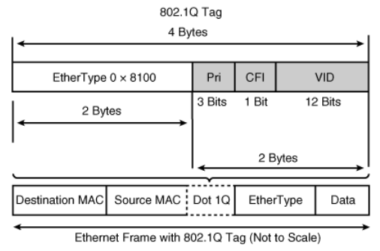
How VLANs are implemented
Access ports
VLAN 2
Trunk ports
VLAN 1
Packets are annotated with 12-bit VLAN tags
  Up to 4096 VLANs can be encapsulated within a single VLAN ID
LAN switches can configure ports as access ports or trunk ports
  Access ports append tags on packets
  VLAN membership almost always statically encoded in access switch’s configuration file
  Trunk ports can multiplex several VLANs
Notes:
For ethernet, canonical bit is always zero
Todo: add fig showing access ports and trunk

Slide 17
How VLANs are implemented
Access ports
VLAN 2
Trunk ports
VLAN 1
802.1Q (VLAN spec) defines a few other fields too
  Ethertype of 0x8100 instructs switch to decode next 2 bytes as VLAN header
  3 bits of priority (like IP ToS)
  1 bit for compatibility with token ring
What if 4096 VLANs isn’t enough?
  QinQ (802.1ad) – can encapsulate VLANs within VLANs by stacking VLAN tags
  Up to 4096 VLANs can be multiplexed within a single VLAN ID→ 4096^2 combinations
Notes:
For ethernet, canonical bit is always zero
Todo: add fig showing access ports and trunk

Slide 18
How VLANs are implemented
Access ports
VLAN 2
Trunk ports
VLAN 1
Native mode
  IEEE likes to make specs that are backwards compatible
  802.1Q allows trunk ports to carry both tagged and untagged frames
  Frames with no tags are said to be part of the switch’s native VLAN
Notes:
For ethernet, canonical bit is always zero
Todo: add fig showing access ports and trunk

Slide 19

Dynamic Trunking Protocol (DTP)
Can we create VLAN 7?
Ok.
desirable
auto
VLAN 7
auto
Protocol to automate certain aspects of VLAN configuration
  Determines whether two connected switches want to create a trunk
  Automatically sets parameters such as encapsulation and VLAN range
DTP transitions port through a set of states
  Auto (port is willing to be trunked), On/Off (permanently forces link into/from trunking, even if neighbor disagrees), Desirable (attempts to make port a trunk; pursues agreement with neighbor)
Notes:
Todo: animate http://en.wikipedia.org/wiki/Dynamic_Trunking_Protocol

Slide 20
Medium Access Control Address
MAC address
  Numerical address associated with an adapted
  Flat name space of 48 bits (e.g., 00-15-C5-49-04-A9 in HEX)
  Unique, hard-coded in the adapter when it is built
Hierarchical Allocation
  Blocks: assigned to vendors (e.g., Dell) by the IEEE
    First 24 bits (e.g., 00-15-C5-**-**-**)
  Adapter: assigned by the vendor from its block
    Last 24 bits
Broadcast address (FF-FF-FF-FF-FF-FF)
  Send the frame to all adapters

Slide 21
MAC Address vs. IP Address
MAC addresses (used in link-layer)
  Hard-coded in read-only memory when adapter is built
  Like a social security number
  Flat name space of 48 bits (e.g., 00-0E-9B-6E-49-76)
  Portable, and can stay the same as the host moves
  Used to get packet between interfaces on same network
IP addresses
  Configured, or learned dynamically
  Like a postal mailing address
  Hierarchical name space of 32 bits (e.g., 12.178.66.9)
  Not portable, and depends on where the host is attached
  Used to get a packet to destination IP subnet

Slide 22
Naming
Application layer: URLs and domain names
  names “resources” -- hosts, content, program
  (recall: mixes the what and where of an object)
Network layer: IP addresses
  host’s network location
Link layer: MAC addresses
  host identifier
Use all three for end-to-end communication!

Slide 23
Discovery
A host is “born” knowing only its MAC address
Must discover lots of information before it can communicate with a remote host B
  what is my IP address?
  what is B’s IP address? (remote)
  what is B’s MAC address? (if B is local)
  what is my first-hop router’s address? (if B is not local)
  …

Slide 24
ARP and DHCP
Link layer discovery protocols
  “Address Resolution Protocol”, “Dynamic Host Configuration Protocol”
  confined to a single local-area network (LAN)
  rely on broadcast capability of a LAN
Hosts
Router

Slide 25
ARP and DHCP
Link layer discovery protocols
Serve two functions
  Discovery of local end-hosts
    for communication between hosts on the same LAN

Slide 26
ARP and DHCP
Link layer discovery protocols
Serve two functions
  Discovery of local end-hosts
  Bootstrap communication with remote hosts
    what’s my IP address?
    who/where is my local DNS server?
    who/where is my first hop router?

Slide 27
Dynamic Host Configuration Protocol (DHCP)
Automatically configure hosts
  Assign IP addresses, DNS server, default gateway, etc.
  Client listen on UDP port 68, servers on 67
Very common LAN protocol
  Rare to find a device that doesn’t support it
Address is assigned for a lease time

Slide 28

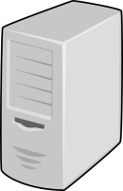

Dynamic Host Configuration Protocol (DHCP)
Client
DHCP
Server
“Can anyone give me an IP address*?” (bcast)
DHCP DISCOVER
“Sure, you can use 10.0.0.3”
DHCP OFFER
(multiple offers can arrive)
DHCP REQUEST
“Ok, I would like to use 10.0.0.3”
“Ok, you can use 10.0.0.3”
DHCP ACK
10.0.0.3 acquired
DHCP RELEASE
Returns 10.0.0.3 to available pool
“I am done with 10.0.0.3”
*and other config information
Notes:
Todo: dhcp fig anim 5-1
(removes 10.003 from pool)
Graceful leave
Request is bcast so other dhcp servers know their ip address allocations got turned down

Slide 29
DHCP
“Dynamic Host Configuration Protocol”
  defined in RFC 2131
A host uses DHCP to discover
  its own IP address
  its netmask
  IP address(es) for its DNS name server(s)
  IP address(es) for its first-hop “default” router(s)

Slide 30
DHCP: operation
One or more local DHCP servers maintain required information
  IP address pool, netmask, DNS servers, etc.
  application that listens on UDP port 67

Slide 31
DHCP: operation
One or more local DHCP servers maintain required information
Client broadcasts a DHCP discovery message
  L2 broadcast, to MAC address FF:FF:FF:FF:FF:FF

Slide 32
DHCP: operation
One or more local DHCP servers maintain required information
Client broadcasts a DHCP discovery message
One or more DHCP servers responds with a DHCP “offer” message
  proposed IP address for client, lease time
  other parameters

Slide 33
DHCP: operation
One or more local DHCP servers maintain required information
Client broadcasts a DHCP discovery message
One or more DHCP servers responds with a DHCP “offer” message
Client broadcasts a DHCP request message
  specifies which offer it wants
  echoes accepted parameters
  other DHCP servers learn they were not chosen

Slide 34
DHCP: operation
One or more local DHCP servers maintain required information
Client broadcasts a DHCP discovery message
One or more DHCP servers responds with a DHCP “offer” message
Client broadcasts a DHCP request message
Selected DHCP server responds with an ACK
(DHCP “relay agents” used when the DHCP server isn’t on the same broadcast domain -- see text)

Slide 35
DHCP uses “soft state”
  Soft state: if not refreshed, state is forgotten
  hard state: allocation is deliberately returned/withdrawn
  used to track address allocation in DHCP
Implementation
  address allocations are associated with a lease period
  server: sets a timer associated with the record of allocation
  client: must request a refresh before lease period expires
  server: resets timer when a refresh arrives; sends ACK
  server: reclaims allocated address when timer expires
Simple, yet robust under failure
  state always fixes itself in (small constant of) lease time

Slide 36
Soft state under failure
a.b.c.d is mine from (now’, now’+lease)
a.b.c.d is XYZ’s from (now, now+c.lease)
DHCP
Server
XYZ
Router
What happens when host XYZ fails?
  refreshes from XYZ stop
  server reclaims a.b.c.d after O(lease period)

Slide 37
Soft state under failure
a.b.c.d is mine from (now, now+lease)
a.b.c.d is XYZ’s from (now, now+c.lease)
DHCP
Server
XYZ
Router
What happens when server fails?
  ACKs from server stop
  XYZ releases address after O(lease period); send new request
  A new DHCP server can come up from a `cold start’ and
  we’re back on track in ~lease time

Slide 38
Soft state under failure
a.b.c.d is mine from (now, now+lease)
a.b.c.d is XYZ’s from (now, now+c.lease)
DHCP
Server
XYZ
Router
What happens if the network fails?
  refreshes and ACKs don’t get through
  XYZ release address; DHCP server reclaims it

Slide 39
Are we there yet?
What I learnt from DHCP
my IP: 1.2.3.48
netmask: 1.2.3.0/24 (255.255.255.0)
DNS: 1.2.3.156
router: 1.2.3.19
DHCP
Server
DNS
Server
Host
Host
Host
Host
Router

Slide 40
Sending Packets Over Link-Layer
1.2.3.48
1.2.3.156
Host
Host
Host
Host
DNS
IP packet
90-E2-A1-09-66-1B
58-23-D7-FA-20-B0
1.2.3.53
1.2.3.156
Router
Link layer only understands MAC addresses
  Translate the destination IP address to MAC address
  Encapsulate the IP packet inside a link-level frame

Slide 41
ARP: Address Resolution Protocol
Every host maintains an ARP table
  list of (IP address → MAC address) pairs
Consult the table when sending a packet
  Map destination IP address to destination MAC address
  Encapsulate the (IP) data packet with MAC header; transmit
But: what if IP address not in the table?
  Sender broadcasts: “Who has IP address 1.2.3.156?”
  Receiver responds: “MAC address 58-23-D7-FA-20-B0”
  Sender caches result in its ARP table

Slide 42
Address Resolution Protocol (ARP)
Networked applications are programmed to deal with IP addresses
But Ethernet forwards to MAC address
How can OS know the MAC address corresponding to a given IP address?
Solution: Address Resolution Protocol
  Broadcasts ARP request for MAC address owning a given IP address

Slide 43

Broadcast ARP reply:
“I own 4.4.4.4, and my MAC address is CC:CC:CC:CC:CC”
IP | MAC
4.4.4.4 | CC:CC:CC:CC:CC
Broadcast ARP request:
“Who owns IP address 4.4.4.4?”
5.5.5.5
DD:DD:DD:DD:DD
IP=2.2.2.2
MAC=AA:AA:AA:AA:AA
IP=4.4.4.4
MAC=CC:CC:CC:CC:CC
Broadcast Gratuitous ARP reply:
“I own 5.5.5.5, and my MAC address is DD:DD:DD:DD:DD”
IP=5.5.5.5
MAC=DD:DD:DD:DD:DD
IP=3.3.3.3
MAC=BB:BB:BB:BB:BB
ARP: determine mapping from IP to MAC address
What if IP address not on subnet?
  Each host configured with “default gateway”, use ARP to resolve its IP address
Gratuitous ARP: tell network your IP to MAC mapping
  Used to detect IP conflicts, IP address changes; update other machines’ ARP tables, update bridges’ learned information

Slide 44
What if the destination is remote?
Look up the MAC address of the first hop router
  1.2.3.48 uses ARP to find MAC address for first-hop router 1.2.3.19 rather than ultimate destination IP address
How does the red host know the destination is not local?
  Uses netmask (discovered via DHCP)
How does the red host know about 1.2.3.19?
  Also DHCP (assigned as the “gateway”)
1.2.3.0/24 (255.255.255.0)
1.2.3.48
1.2.3.156
5.6.7.0/24
host
host
...
DNS
host
host
...
host
1.2.3.19
router
router
router

Slide 45
Security Analysis of ARP
Impersonation
  Any node that hears request can answer …
  … and can say whatever they want
Actual legit receiver never sees a problem
  Because even though later packets carry its IP address, its NIC doesn’t capture them since not its MAC address

Slide 46
Steps in Sending a Packet
What do hosts need to know?
And how do they find out?

Slide 47
Steps in reaching a Host
First look up destination’s IP address
Need to know where local DNS server is
  DHCP
Also needs to know its own IP address
  DHCP

Slide 48
Sending a Packet
On same subnet:
  Use MAC address of destination.
  ARP
On some other subnet:
  Use MAC address of first-hop router.
  DHCP + ARP
And how can a host tell whether destination is on same or other subnet?
  Use the netmask
  DHCP

Slide 49
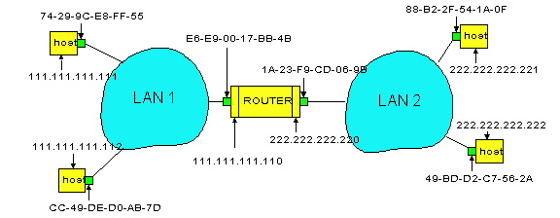
Example: A Sending a Packet to B
A
R
B
How does host A send an IP packet to host B?

Slide 50
Example: A Sending a Packet to B
A
R
B
1. A sends packet to R.
2. R sends packet to B.

Slide 51
Host A Decides to Send Through R
Host A constructs an IP packet to send to B
  Source 111.111.111.111, destination 222.222.222.222
Host A has a gateway router R
  Used to reach destinations outside of 111.111.111.0/24
  Address 111.111.111.110 for R learned via DHCP
A
R
B

Slide 52
Host A Sends Packet Through R
Host A learns the MAC address of R’s interface
  ARP request: broadcast request for 111.111.111.110
  ARP response: R responds with E6-E9-00-17-BB-4B
Host A encapsulates the packet and sends to R
A
R
B

Slide 53
R Decides how to Forward Packet
Two points:
  Routing table points to this port
  Destination address is within
  mask of port’s address (i.e., local)
Router R’s adapter receives the packet
  R extracts the IP packet from the Ethernet frame
  R sees the IP packet is destined to 222.222.222.222
Router R consults its forwarding table
  Packet matches 222.222.222.0/24 via other adapter (port)
A
R
B

Slide 54
R Sends Packet to B
Router R learns the MAC address of host B
  ARP request: broadcast request for 222.222.222.222
  ARP response: B responds with 49-BD-D2-C7-56-2A
Router R encapsulates the packet and sends to B
A
R
B

Slide 55
Key Ideas in Both ARP and DHCP
Broadcasting: used for initial bootstrap
Caching: remember the past for a while
  Store the information you learn to reduce overhead
  Remember your own address & other host’s addresses
  Key optimization for performance
Soft state: eventually forget the past
  Associate a time-to-live field with the information
  … and either refresh or discard the information
  Key for robustness

Slide 56
Discovery mechanisms
We’ve seen two broad approaches
  Broadcast (ARP, DHCP)
    flooding doesn’t scale
    no centralized point of failure
    zero configuration
  Directory service (DNS)
    no flooding
    root of the directory is vulnerable (caching is key)
    needs configuration to bootstrap (local, root servers, etc.)
Can we get the best of both?
  Internet-scale yet zero config?

Slide 57
Ethernet

Slide 58
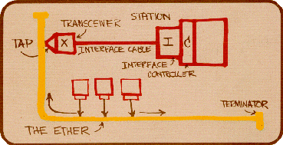
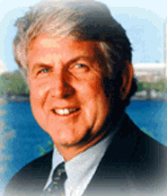
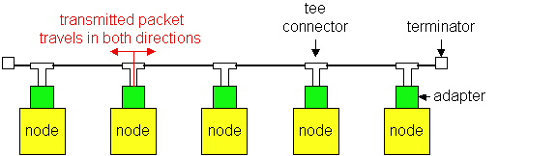
Ethernet
Bob Metcalfe, Xerox PARC, reads a paper from UHawaii and gets an idea!
Shared wired medium
  coax cable

Slide 59
Evolution
Ethernet was invented as a broadcast technology
  Hosts share channel
  Each packet received by all attached hosts
  CSMA/CD for media access control
Current Ethernets are “switched”
  Point-to-point links between switches; between a host and switch
  No sharing, no CSMA/CD
  (Next lecture) uses “self learning” and “spanning tree” algorithms for routing

Slide 60
Ethernet: CSMA/CD Protocol
Carrier sense: wait for link to be idle
Collision detection: listen while transmitting
  No collision: transmission is complete
  Collision: abort transmission & send jam signal
Random access: binary exponential back-off
  After collision, wait a random time before trying again
  After m^{th} collision, choose K randomly from {0, …, 2^{m}-1}
  … and wait for K*512 bit times before trying again
    If transmission occurring when ready to send, wait until end of transmission (CSMA)

Slide 61

Ethernet Frame Structure
Encapsulates IP datagram
Preamble: 7 bytes with a particular pattern used to synchronize receiver, sender clock rates
Addresses: 6 bytes: frame is received by all adapters on a LAN and dropped if address does not match
Type: 2 bytes, indicating higher-layer protocol (e.g., IP, Appletalk)
CRC: 4 bytes for error detection
Data payload: maximum 1500 bytes, minimum 46 bytes

Slide 62
Routing with Switches

Slide 63
Shuttling Data at Different Layers
Different devices switch different things
  Physical layer: electrical signals or bits (hubs)
  Link layer: frames (switches)
  Network layer: packets (routers)
Transport gateway
Application gateway
Router
Frame
header
Packet
header
TCP
header
User
data
Switch
Hub

Slide 64
Switches Enable Concurrent Communication
Host A can talk to C, while B talks to D
B
A
C
switch
D
Completely avoids collisions (if hosts directly attached)
  No need for all material we discuss later in lecture
  Change in nature of multiple access, but same framing
    Key to the success of ethernet!

Slide 65
Self Learning
Maps destination MAC to outgoing interface
Construct switch table automatically
Floods when does not have entry in table
B
A
C
switch
D

Slide 66
Flooding Can Lead to Loops
Flooding can lead to forwarding loops
  E.g., if the network contains a cycle of switches
  “Broadcast storm”

Slide 67
Solution: Spanning Trees
Ensure the forwarding topology has no loops
  Avoid using some of the links when flooding
  … to prevent loop from forming
Spanning tree
  Sub-graph that covers all vertices but contains no cycles
  Links not in the spanning tree do not forward frames
Graph Has Cycles!
Graph Has
No Cycles!

Slide 68
You: Design a Spanning Tree Algorithm
Distributed
No global information
Neighbors can exchange information
Must adapt when failures occur
  But don’t worry about that on first try…
Take 5 minutes, break into groups, report back

Slide 69
What Do We Know?
Shortest paths to (or from) a node form a tree
  No shortest path can have a cycle
But we must limit each node to one outgoing port towards destination
  Why?
Because this is not a directed graph!

Slide 70
Two Shortest Paths Create Cycle!

Slide 71
Must only choose one

Slide 72
Algorithm Has Two Aspects
Pick a root:
  This will be the destination to which all shortest paths go
  Pick the one with the smallest identifier (MAC add.)
Compute shortest paths to the root
  Only keep the links on shortest-paths
  Break ties in some way, so only keep one shortest path from each node

Slide 73
Breaking Ties
When there are multiple shortest paths to the root, choose the path that uses the neighbor switch with the lower ID.
One could use any tiebreaking system, but this is an easy one to remember and implement
In homeworks and test, remember this.

Slide 74
Constructing a Spanning Tree
Switches need to elect a root
  The switch w/ smallest identifier (MAC addr)
Each switch determines if each interface
is on the shortest path from the root
  Excludes it from the tree if not
Messages (Y, d, X)
  From node X
  Proposing Y as the root
  And the distance is d
root
One hop
Three hops

Slide 75
Steps in Spanning Tree Algorithm
Initially, each switch proposes itself as the root
  Switch sends a message out every interface
  … proposing itself as the root with distance 0
  Example: switch X announces (X, 0, X)
Switches update their view of the root
  Upon receiving message (Y, d, Z) from Z, check Y’s id
  If new id smaller, start viewing that switch as root
Switches compute their distance from the root
  Add 1 to the distance received from a neighbor
  Identify interfaces not on shortest path to the root
  … and exclude them from the spanning tree
If root or shortest distance to it changed, “flood” updated message (Y, d+1, X)

Slide 76
Example From Switch #4’s Viewpoint
Switch #4 thinks it is the root
  Sends (4, 0, 4) message to 2 and 7
Then, switch #4 hears from #2
  Receives (2, 0, 2) message from 2
  … and thinks that #2 is the root
  And realizes it is just one hop away
Then, switch #4 hears from #7
  Receives (2, 1, 7) from 7
  And realizes this is a longer path
  So, prefers its own one-hop path
  And removes 4-7 link from the tree
1
3
5
2
4
6
7

Slide 77
Example From Switch #4’s Viewpoint
Switch #2 hears about switch #1
  Switch 2 hears (1, 1, 3) from 3
  Switch 2 starts treating 1 as root
  And sends (1, 2, 2) to neighbors
Switch #4 hears from switch #2
  Switch 4 starts treating 1 as root
  And sends (1, 3, 4) to neighbors
Switch #4 hears from switch #7
  Switch 4 receives (1, 3, 7) from 7
  And realizes this is a longer path
  So, prefers its own three-hop path
  And removes 4-7 Iink from the tree
1
3
5
2
4
6
7

Slide 78
Which links are on spanning tree?
Take a few minutes, work this out
3-1?
5-1?
6-1?
2-6?
2-3?
1
3
5
2
4
6
7

Slide 79
Links on spanning tree
3-1
5-1
6-1
2-3
4-2
7-2
1
3
5
2
4
6
7

Slide 80
Now which ones are on the spanning tree?
2 is new root
3-2
6-2
4-2
7-2
5-6
3
5
2
4
6
7

Slide 81
Robust Spanning Tree Algorithm
Algorithm must react to failures
  Failure of the root node
    Need to elect a new root, with the next lowest identifier
  Failure of other switches and links
    Need to recompute the spanning tree
Root switch continues sending messages
  Periodically reannouncing itself as the root (1, 0, 1)
  Other switches continue forwarding messages
Detecting failures through timeout (soft state)
  If no word from root, time out and claim to be the root!

Slide 82
Why do people hate spanning tree?
Delay in reestablishing spanning tree
  Network is “down” until spanning tree rebuilt
  Work on rapid spanning tree algorithms…
    And multiple spanning trees
Much of the network bandwidth goes unused
  Forwarding is only over the spanning tree
  Why did you bother with all those other links?

Slide 83
Broadcast vs Point-to-Point

Slide 84
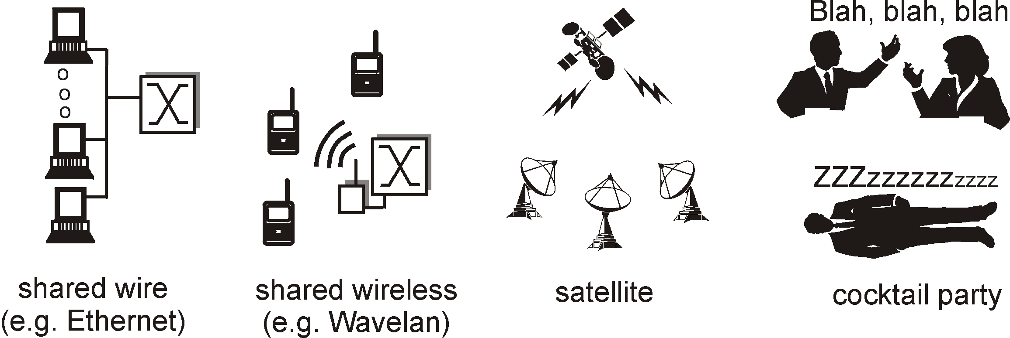

Point-to-Point vs. Broadcast Media
Point-to-point: dedicated pairwise communication
  Long-distance fiber link
  Point-to-point link between Ethernet switch and host
Broadcast: shared wire or medium
  Traditional Ethernet
  802.11 wireless LAN

Slide 85
Multiple Access Algorithm
Single shared broadcast channel
  Must avoid having multiple nodes speaking at once
  Otherwise, collisions lead to garbled data
  Need distributed algorithm for sharing the channel
  Algorithm determines which node can transmit
Classes of techniques
  Channel partitioning: divide channel into pieces
  Taking turns: scheme for trading off who gets to transmit
  Random access: allow collisions, and then recover

Slide 86
Channel Partitioning: TDMA
TDMA: Time Division Multiple Access
Access to channel in "rounds"
  Each station gets fixed length slot in each round
Time-slot length is packet transmission time
  Unused slots go idle
Example: 6-station LAN with slots 0, 3, and 4
Rounds
Slots =
0
1
2
3
4
5
0
1
2
3
4
5

Slide 87
Channel Partitioning: FDMA
FDMA: Frequency Division Multiple Access
Channel spectrum divided into frequency bands
Each station assigned fixed frequency band
Unused transmission time in frequency bands go idle
Example: 6-station LAN, 1,3,4 have pkt, frequency bands 2,5,6 idle
time
frequency bands
FDM cable

Slide 88
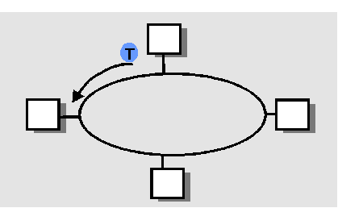
“Taking Turns” MAC protocols
Polling
Master node “invites” slave nodes to transmit in turn
Concerns:
  Polling overhead
  Latency
  Single point of failure (master)
Token passing
Control token passed from one node to next sequentially
Node must have token to send
Concerns:
  Token overhead
  Latency
  At mercy of any node
data
poll
master
data
slaves

Slide 89
None of these are the “Internet way”…
Why not?
What’s wrong with
  TDMA
  FDMA
  Polling
  Token passing
Turn to random access
  Optimize for the common case (no collision)
  Don’t avoid collisions, just recover from them….
  Sound familiar?

Slide 90
Random Access MAC Protocols

Slide 91
Random Access MAC Protocols
When node has packet to send
  Transmit at full channel data rate
  No a priori coordination among nodes
Two or more transmitting nodes ⇒ collision
  Data lost
Random access MAC protocol specifies:
  How to detect collisions
  How to recover from collisions
Examples
  ALOHA and Slotted ALOHA
  CSMA, CSMA/CD, CSMA/CA (wireless, covered later)

Slide 92
Key Ideas of Random Access
Carrier sense
  Listen before speaking, and don’t interrupt
  Checking if someone else is already sending data
  … and waiting till the other node is done
Collision detection
  If someone else starts talking at the same time, stop
    But make sure everyone knows there was a collision!
  Realizing when two nodes are transmitting at once
  …by detecting that the data on the wire is garbled
Randomness
  Don’t start talking again right away
  Waiting for a random time before trying again

Slide 93

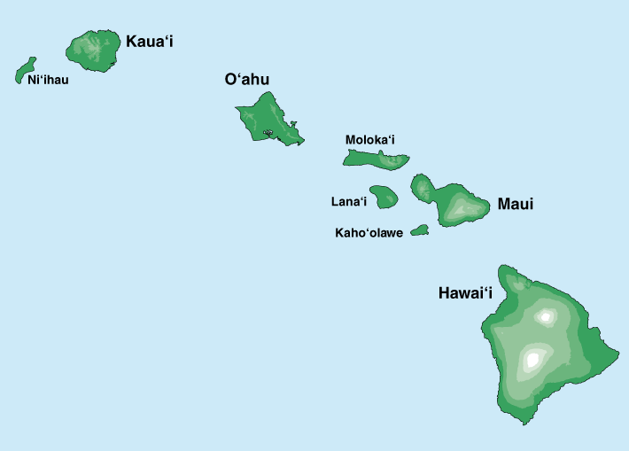
Where it all Started: AlohaNet
Norm Abramson left Stanford in 1970
So he could surf!
Set up first data communication system for Hawaiian islands
Hub at U. Hawaii, Oahu
Had two radio channels:
  Random access:
    Sites sending data
  Broadcast:
    Hub rebroadcasting data
Notes:
Who is he, and why is he my hero?

Slide 94
Aloha Signaling
Two channels: random access, broadcast
Sites send packets to hub (random)
  If received, hub sends ACK (random)
  If not received (due to collision), site resends
Hub sends packets to all sites (broadcast)
  Sites can receive even if they are also sending
Questions:
  When do you resend? Resend with probability p
  How does this perform? Need a clean model….

Slide 95
Slotted ALOHA
Operation
When node gets fresh data, transmits in next slot
No collision: success!
Collision: node retransmits with probability p until success
Assumptions
All frames same size
Time divided into equal slots (time to transmit a frame)
Nodes are synchronized
Nodes begin to transmit frames only at start of slots
If multiple nodes transmit, nodes detect collision

Slide 96
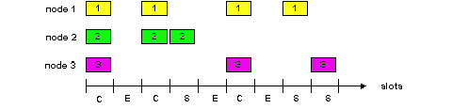
Slot-by-Slot Example

Slide 97
Efficiency of Slotted Aloha
Suppose N stations have packets to send
  Each transmits in slot with probability p
Probability of successful transmission:
by a particular node i: S_{i} = p (1-p)^{(N-1)}
by any of N nodes: S= N p (1-p)^{(N-1)}
What value of p maximizes prob. of success:
  For fixed p, S ➔ 0 as N increases
  But if p = 1/N, then S ➔ 1/e = 0.37 as N increases
Max efficiency is only slightly greater than 1/3!

Slide 98
Pros and Cons of Slotted Aloha
Pros
Single active node can continuously transmit at full rate of channel
Highly decentralized: only need slot synchronization
Simple
Cons
Wasted slots:
  Idle
  Collisions
Collisions consume entire slot
Clock synchronization
Notes:
Why is clock synchonization necessary?
It isn’t, but if we get rid of it, efficiency goes down…

Slide 99
Improving on Slotted Aloha
Fewer wasted slots
  Need to decrease collisions and empty slots
Don’t waste full slots on collisions
  Need to decrease time to detect collisions
Avoid need for synchronization
  Synchronization is hard to achieve
  And Aloha performance drops if you don’t have slots
Notes:
Which of these are the most important!

Slide 100
CSMA (Carrier Sense Multiple Access)
CSMA: listen before transmit
  If channel sensed idle: transmit entire frame
  If channel sensed busy, defer transmission
Human analogy: don’t interrupt others!
Does this eliminate all collisions?
  No, because of nonzero propagation delay

Slide 101
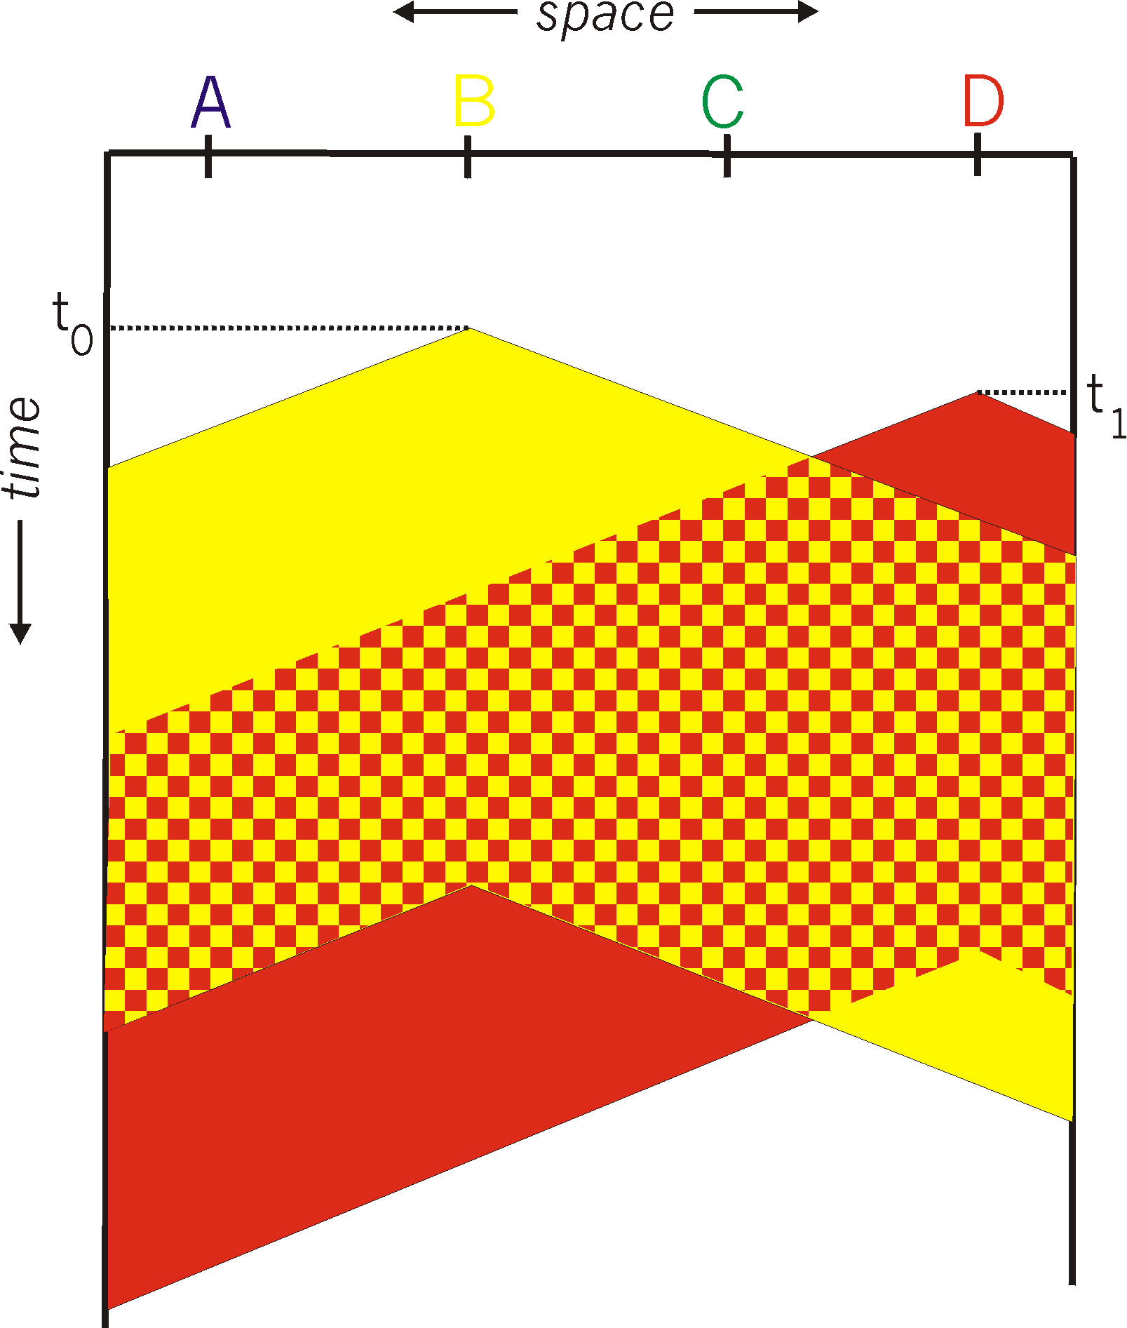
CSMA Collisions
Propagation delay: two nodes may not hear each other’s before sending.
Would slots hurt or help?
CSMA reduces but does not eliminate collisions
Biggest remaining problem?
Collisions still take full slot!
How do you fix that?
Notes:
Ask: who knows? (from knowing ethernet)?
Someone who doesn’t, how to do this?
Listen before sending to detect possible collision
Why not listen to detect current collision!

Slide 102
CSMA/CD (Collision Detection)
CSMA/CD: carrier sensing, deferral as in CSMA
  Collisions detected within short time
  Colliding transmissions aborted, reducing wastage
Collision detection easy in wired LANs:
  Compare transmitted, received signals
Collision detection difficult in wireless LANs:
  Reception shut off while transmitting (well, perhaps not)
  Not perfect broadcast (limited range) so collisions local
  Leads to use of collision avoidance instead
    Will discuss in wireless lecture

Slide 103
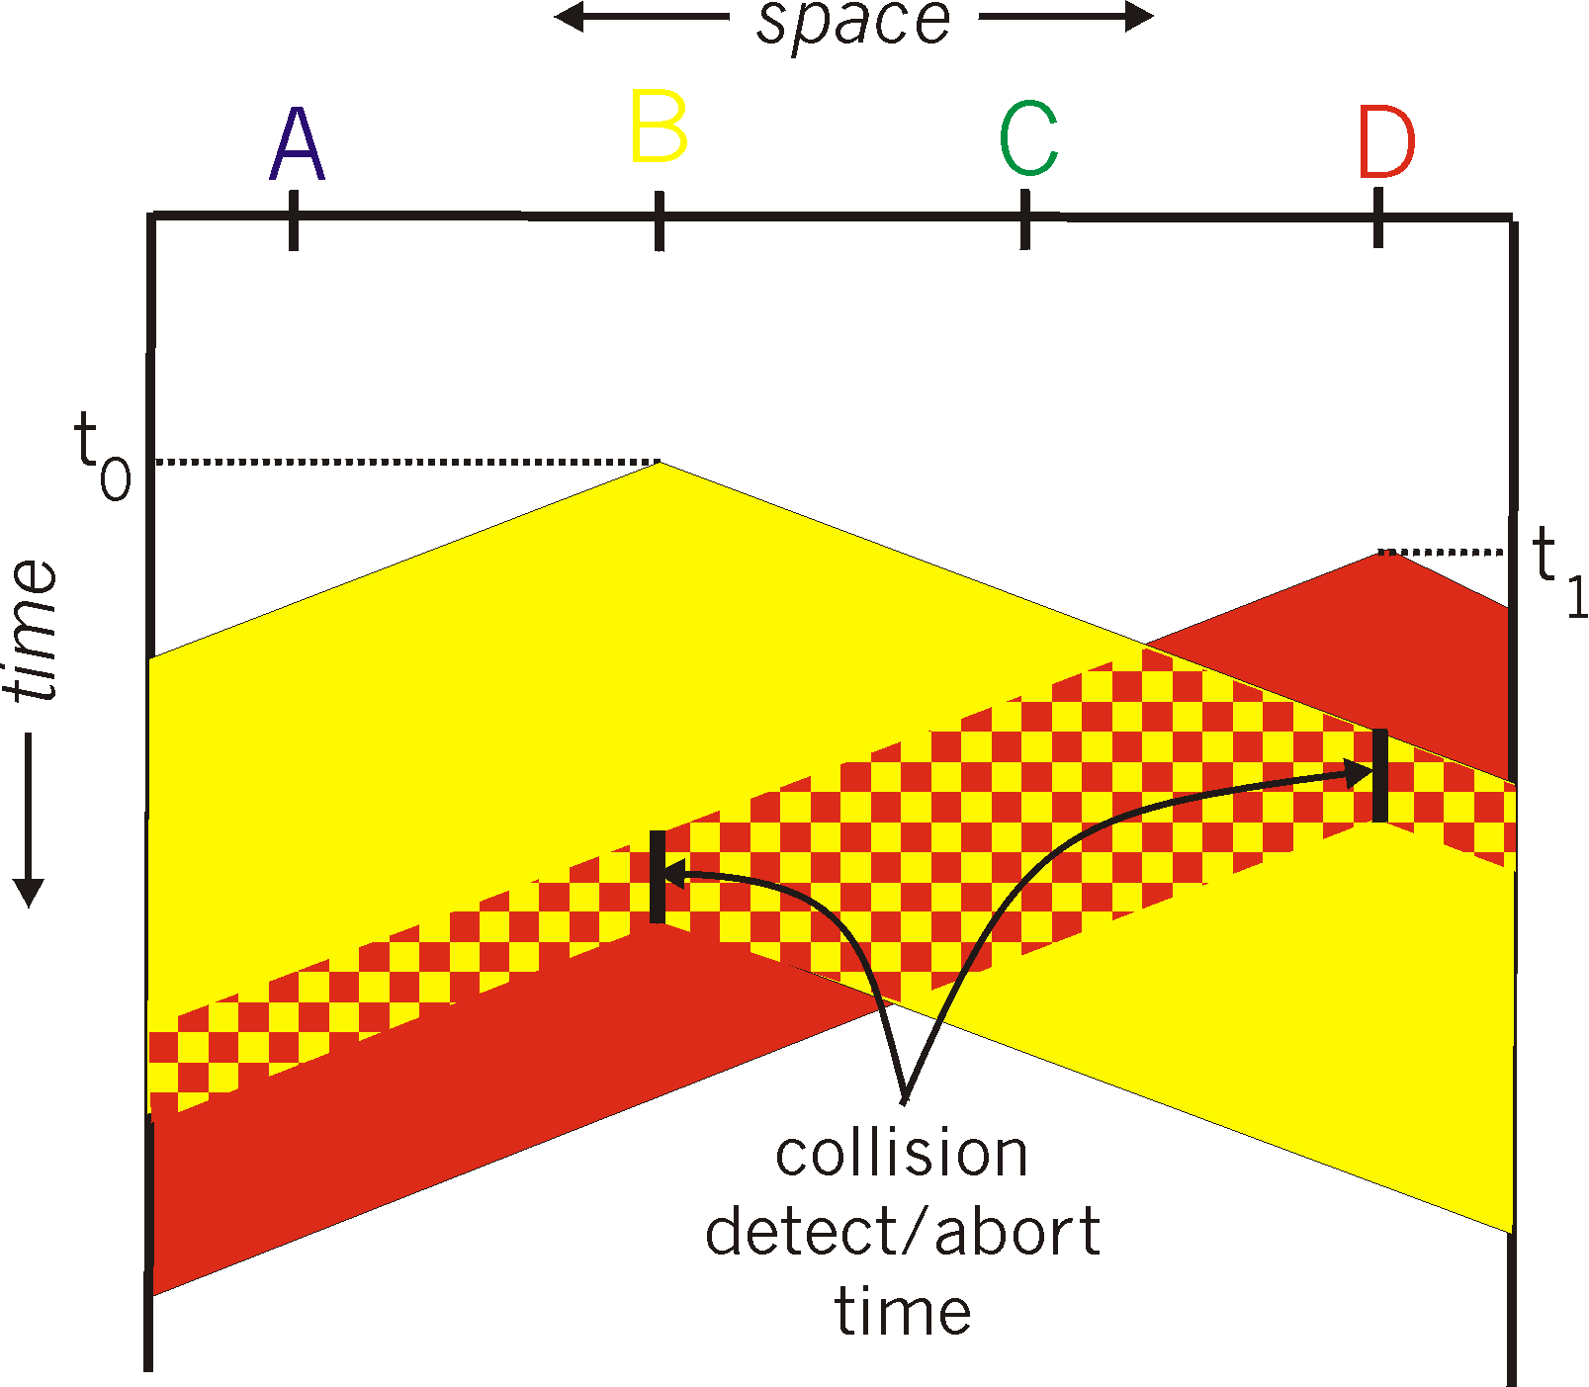
CSMA/CD Collision Detection
B and D can tell that collision occurred.
Note: for this to work, need restrictions on minimum frame size and maximum distance.
Why?
Notes:
Draw failed collision detection….

Slide 104
Limits on CSMA/CD Network Length
A
B
latency d
Latency depends on physical length of link
  Time to propagate a packet from one end to the other
Suppose A sends a packet at time t
  And B sees an idle line at a time just before t+d
  … so B happily starts transmitting a packet
B detects a collision, and sends jamming signal
  But A can’t see collision until t+2d

Slide 105
Limits on CSMA/CD Network Length
A
B
latency d
A needs to wait for time 2d to detect collision
  So, A should keep transmitting during this period
  … and keep an eye out for a possible collision
Imposes restrictions. E.g., for 10 Mbps Ethernet:
  Maximum length of the wire: 2,500 meters
  Minimum length of a frame: 512 bits (64 bytes)
    512 bits = 51.2 μsec (at 10 Mbit/sec)
    For light in vacuum, 51.2 μsec ≈ 15,000 meters
    vs. 5,000 meters “round trip” to wait for collision
  What about 10Gbps Ethernet?
Notes:
10Gbps is switched, doesn’t have this problem!!!

Slide 106

Performance of CSMA/CD
Time wasted in collisions
  Proportional to distance d
Time spend transmitting a packet
  Packet length p divided by bandwidth b
Rough estimate for efficiency (K some constant)
Note:
  For large packets, small distances, E ~ 1
  As bandwidth increases, E decreases
  That is why high-speed LANs are all switched
Notes:
K represents number of collisions per transmission….

Slide 107
Ethernet Multiple Access
First widely deployed multiple access

Slide 108
Benefits of Ethernet
Easy to administer and maintain
Inexpensive
Increasingly higher speed
Evolvable!

Slide 109
Evolution of Ethernet
Changed everything except the frame format
  From single coaxial cable to hub-based star
  From shared media to switches
  From electrical signaling to optical
Lesson #1
  The right interface can accommodate many changes
  Implementation is hidden behind interface
Lesson #2
  Really hard to displace the dominant technology
  Slight performance improvements are not enough

Slide 110
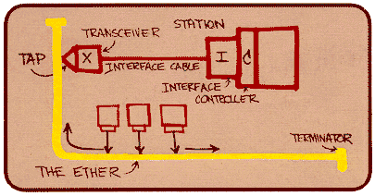
Ethernet: CSMA/CD Protocol
Carrier sense: wait for link to be idle
Collision detection: listen while transmitting
  No collision: transmission is complete
  Collision: abort transmission & send jam signal
Random access: binary exponential back-off
  After collision, wait a random time before trying again
  After m^{th} collision, choose K randomly from {0, …, 2^{m}-1}
  … and wait for K*512 bit times before trying again
    Using min packet size as “slot”
    If transmission occurring when ready to send, wait until end of transmission (CSMA)

Slide 111
Binary Exponential Backoff (BEB)
Think of time as divided in slots
After each collision, pick a slot randomly within next 2^{m} slots
  Where m is the number of collisions since last successful transmission
Questions:
  Why backoff?
  Why random?
  Why 2^{m}?
  Why not listen while waiting?
Notes:
How would listening help?

Slide 112
Behavior of BEB Under Light Load
Look at collisions between two nodes
First collision: pick one of the next two slots
  Chance of success after first collision: 50%
  Average delay 1.5 slots
Second collision: pick one of the next four slots
  Chance of success after second collision: 75%
  Average delay 2.5 slots
In general: after m^{th} collision
  Chance of success: 1-2^{-m}
  Average delay (in slots): ½ + 2^{(m-1)}

Slide 113
BEB: Theory vs Reality
In theory, there is no difference between theory and practice. But, in practice, there is.

Slide 114
BEB Reality
Performs well (far from optimal, but no one cares)
  Large packets are ~23 times as large as minimal slot
Is mostly irrelevant
  Almost all current ethernets are switched

Slide 115
BEB Theory
A very interesting algorithm
Stability for finite N only proved in 1985
  Ethernet can handle nonzero traffic load without collapse
    Greenberg et al. (AT&T)
All backoff algorithms unstable for infinite N (1985)
  Poisson model: infinite user pool, total demand is finite
    David Aldous (UCB Statistics)
Not of practical interest, but gives important insight
  Multiple access should be in your “bag of tricks”
Notes:
e.g., know most important way to spread a rumor…

Slide 116
Question
Two hosts, each with infinite packets to send
What happens under BEB?
Throughput high or low?
Bandwidth shared equally or not?

Slide 117
MAC “Channel Capture” in BEB
Finite chance that first one to have a successful transmission will never relinquish the channel
  The other host will never send a packet
Therefore, asymptotically channel is fully utilized and completely allocated to one host

Slide 118
Example
Two hosts, each with infinite packets to send
  Slot 1: collision
  Slot 2: each resends with prob ½
    Assume host A sends, host B does not
  Slot 3: A and B both send (collision)
  Slot 4: A sends with probability ½, B with prob. ¼
    Assume A sends, B does not
  Slot 5: A definitely sends, B sends with prob. ¼
    Assume collision
  Slot 6: A sends with probability ½, B with prob. 1/8
Conclusion: if A gets through first, the prob. of B sending successfully halves with each collision

Slide 119
Another Question
Hosts now have large but finite # packets to send
What happens under BEB?
Throughput high or low?

Slide 120
Answer
Efficiency less than one, no matter how many packets
Time you wait for loser to start is proportional to time winner was sending….

Slide 121
Different Backoff Functions
Exponential: backoff ~ a^{i}
  Channel capture?
  Efficiency?
Superlinear polynomial: backoff ~ i^{p} p>1
  Channel capture?
  Efficiency?
Sublinear polynomial: backoff ~ i^{p} p≤1
  Channel capture?
  Efficiency?

Slide 122
Different Backoff Functions
Exponential: backoff ~ a^{i}
  Channel capture (loser might not send until winner idle)
  Efficiency less than 1 (time wasted waiting for loser to start)
Superlinear polynomial: backoff ~ i^{p} p>1
  Channel capture
  Efficiency is 1 (for any finite # of hosts N)
Sublinear polynomial: backoff ~ i^{p} p≤1
  No channel capture (loser not shut out)
  Efficiency is less than 1 (and goes to zero for large N)
    Time wasted resolving collisions

Slide 123
Why Do We Care?
Until this work was done, no one knew about capture, or what properties of the backoff enabled it.
You don’t understand something until you’ve played with it. Just getting it to work isn’t enough.
Notes:
E.g., knowing how to spread rumor

