Slide 1
Course Overview
CS 438: Spring 2014
Matthew Caesar
http://courses.engr.illinois.edu/cs438/

Slide 2
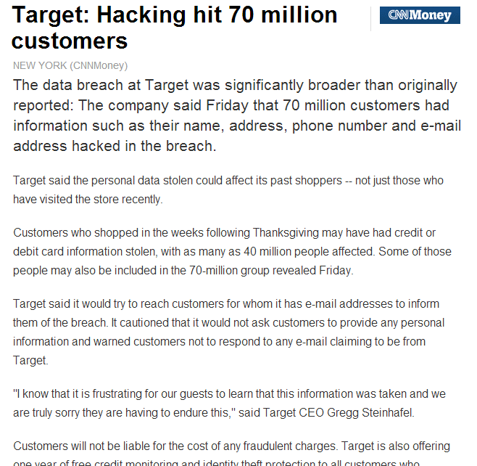
Notes:
On December 19, 2013, Target Corporation released a statement that 40 million credit and debit cards used by shoppers in its stores had been compromised. Caused by a data breach of its networking systems, the event led to an immediate \$65 million devaluation of the company's stocks, and an investigation by the United States Secret Service, with substantial lawsuits and loss of brand image on the horizon. The hackers have not yet been caught, and the scale of the financial risk to consumers makes it difficult to estimate.

Slide 3
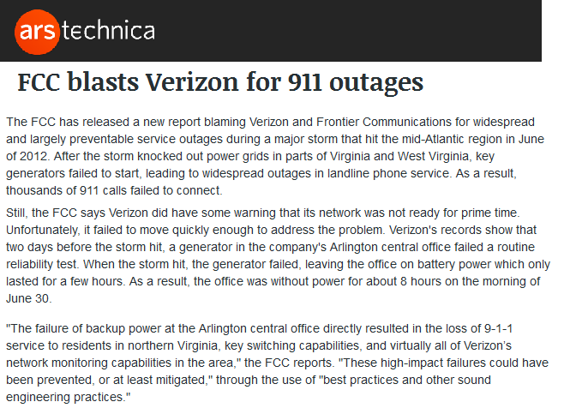
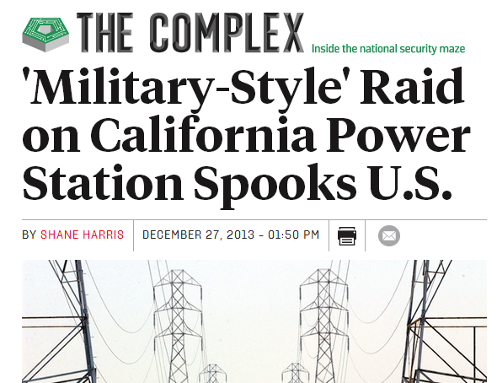
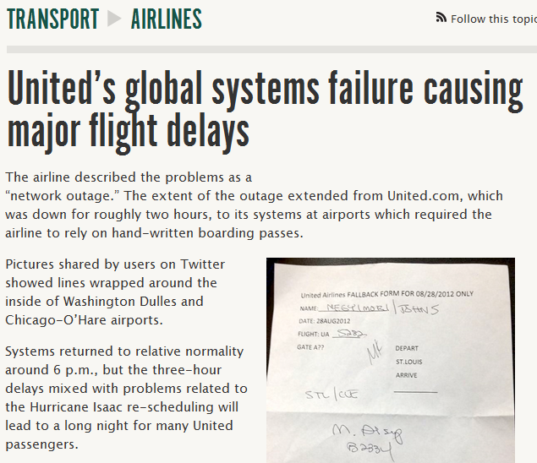
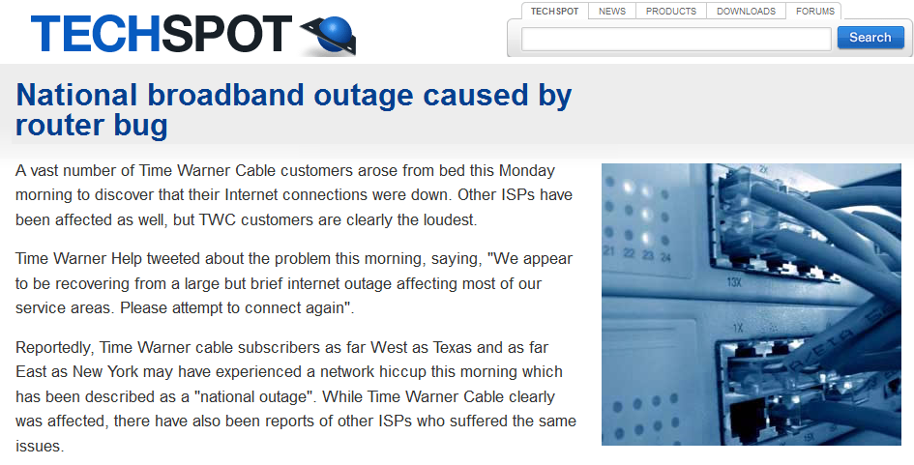
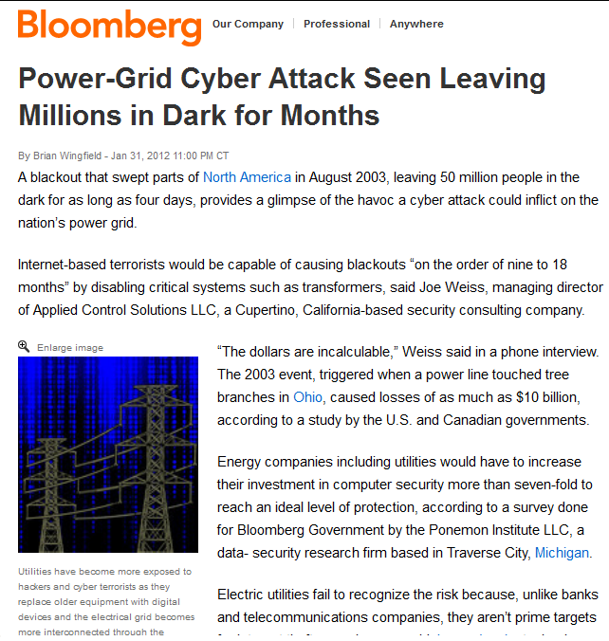
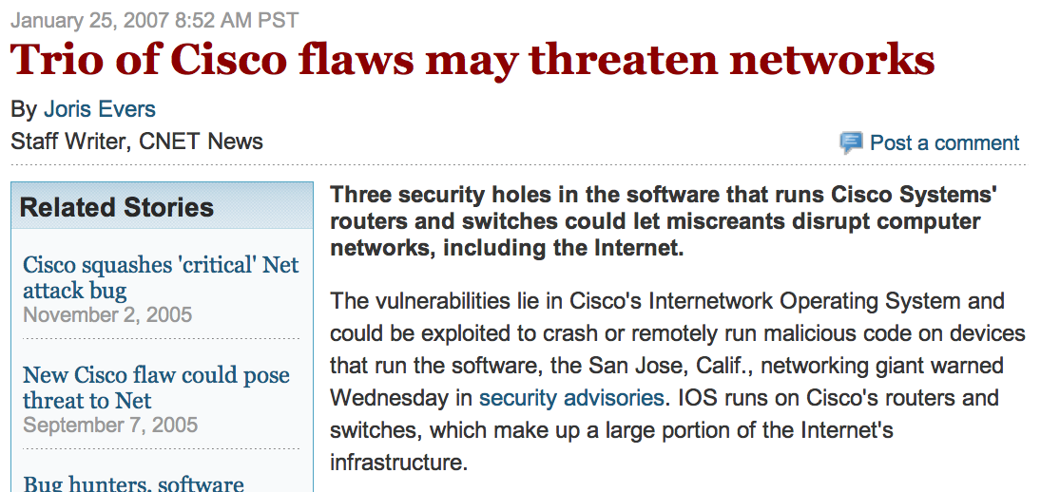
Notes:
This was not an isolated incident. Our daily news is rife with stories of major leaks of private/sensitive data [xx,xx,xx] compromise and damage of critical systems [xx,xx,xx], and infiltration and scanning/probing attacks [xx,xx,xx], on an array of governmental, commercial, and personal systems and data. These companies not naïve-- they are Fortune-500 companies, and elite government agencies, with access to extremely talented and educated engineers, and the most sophisticated in network analysis tools and auditing practice.

Slide 4
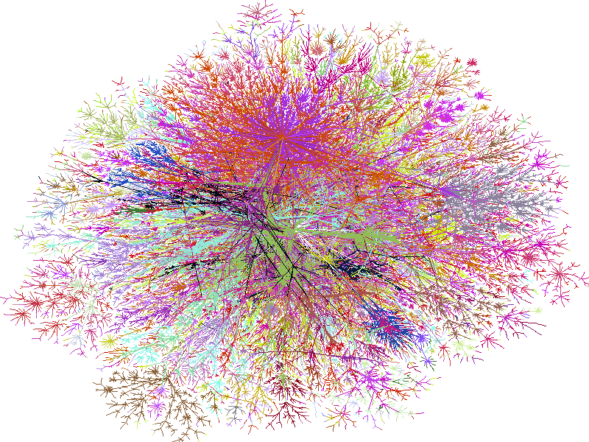
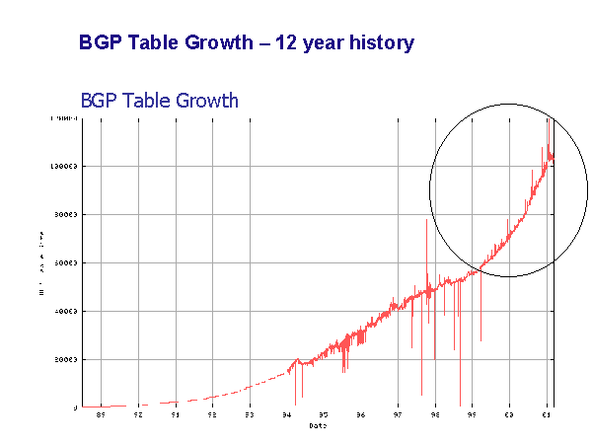
Building Networks is Challenging
Networks are large and complex
Tremendous scale
  2.4 Billion users (34% of world population)
  1 Trillion objects
  2 Million routers, 20,000 ISPs
  Routers that switch 10TB/second
Incessant rapid growth
Run by parties with competing interests
Notes:
Networks are big, complex
Distributed over global scales
Undergoing continuous failure
Run by parties with competing interests
Under continuous attack
Hard to introduce fixes, changes
Incessant rapid growth
Reason 1: Networks are Big
Internet probably largest, most complex thing ever built
2.4B users, 1T unique objects, 2B Youtube videos watched per day, 2M routers, 20,000 ISPs
Complex
Intertwining of millions of systems+protocols distributed over global scales
Distributed over global scales
Latency orders of magnitude higher than CPU proc times
Communication is inherently asynchronous, dated
Undergoing continuous failure
Run by parties with competing interests
Under continuous attack
Incessant rapid growth
The problem is that building networks is hard -- modern networks are tremendously large and complex.
[talk through slide]
--. They are also under continuous attack
Lacking tools capable of addressing this challenge, network operators often fall back to manual effort, making networks prone to oversights, mistakes, misconfigurations and vulnerabilities
2.4 Billion users (34% of world population)
1 Trillion unique URLs
294 Billion emails sent per day
1 Billion smartphones
937 Million Facebook users
2 Billion YouTube videos watched per day
Routers that switch 10Terabits/second
Links that carry 100Gigabits/second

Slide 5
Building Networks is Challenging
Networks are hard to change
Complex intertwinings, dependencies across protocols/systems, networks
But you cannot reboot the Internet
Akin to changing engine of a plane while you are flying it
Notes:
Networks are big, complex
Distributed over global scales
Undergoing continuous failure
Run by parties with competing interests
Under continuous attack
Hard to introduce fixes, changes
Incessant rapid growth
Reason 1: Networks are Big
Internet probably largest, most complex thing ever built
2.4B users, 1T unique objects, 2B Youtube videos watched per day, 2M routers, 20,000 ISPs
Complex
Intertwining of millions of systems+protocols distributed over global scales
Distributed over global scales
Latency orders of magnitude higher than CPU proc times
Communication is inherently asynchronous, dated
Undergoing continuous failure
Run by parties with competing interests
Under continuous attack
Incessant rapid growth
The problem is that building networks is hard -- modern networks are tremendously large and complex.
[talk through slide]
--. They are also under continuous attack
Lacking tools capable of addressing this challenge, network operators often fall back to manual effort, making networks prone to oversights, mistakes, misconfigurations and vulnerabilities
2.4 Billion users (34% of world population)
1 Trillion unique URLs
294 Billion emails sent per day
1 Billion smartphones
937 Million Facebook users
2 Billion YouTube videos watched per day
Routers that switch 10Terabits/second
Links that carry 100Gigabits/second

Slide 6
Building Networks is Challenging
Networks are under continuous attack
As network population grows in size so does number of
  Vandals
  Crazies
Size makes it attractive target to crooks, spies, and militaries
  Network crime is a $114B industry
Continuous flood of DoS, sniffing, compromise, phishing, extortion,…
Notes:
Reason 1: Networks are Big
Internet probably largest, most complex thing ever built
2.4B users, 1T unique objects, 2B Youtube videos watched per day, 2M routers, 20,000 ISPs
Complex
Intertwining of millions of systems+protocols distributed over global scales
Distributed over global scales
Latency orders of magnitude higher than CPU proc times
Communication is inherently asynchronous, dated
Undergoing continuous failure
Run by parties with competing interests
Under continuous attack
Incessant rapid growth
The problem is that building networks is hard -- modern networks are tremendously large and complex.
[talk through slide]
--. They are also under continuous attack
Lacking tools capable of addressing this challenge, network operators often fall back to manual effort, making networks prone to oversights, mistakes, misconfigurations and vulnerabilities
2.4 Billion users (34% of world population)
1 Trillion unique URLs
294 Billion emails sent per day
1 Billion smartphones
937 Million Facebook users
2 Billion YouTube videos watched per day
Routers that switch 10Terabits/second
Links that carry 100Gigabits/second

Slide 7
Building Networks is Challenging
Networks are big, complex
Distributed over global scales
Undergoing continuous failure
Run by parties with competing interests
Under continuous attack
Hard to introduce fixes, changes
Incessant rapid growth
Notes:
Reason 1: Networks are Big
Internet probably largest, most complex thing ever built
2.4B users, 1T unique objects, 2B Youtube videos watched per day, 2M routers, 20,000 ISPs
Complex
Intertwining of millions of systems+protocols distributed over global scales
Distributed over global scales
Latency orders of magnitude higher than CPU proc times
Communication is inherently asynchronous, dated
Undergoing continuous failure
Run by parties with competing interests
Under continuous attack
Incessant rapid growth
The problem is that building networks is hard -- modern networks are tremendously large and complex.
[talk through slide]
--. They are also under continuous attack
Lacking tools capable of addressing this challenge, network operators often fall back to manual effort, making networks prone to oversights, mistakes, misconfigurations and vulnerabilities
2.4 Billion users (34% of world population)
1 Trillion unique URLs
294 Billion emails sent per day
1 Billion smartphones
937 Million Facebook users
2 Billion YouTube videos watched per day
Routers that switch 10Terabits/second
Links that carry 100Gigabits/second

Slide 8









Networks are Important
Networks are changing…
The way we do business
E-Commerce
Marketing
Cloud Computing
Notes:
So building networks is hard
But unfortunately, computer networks are becoming increasingly critical to our daily lives
You know all the standard uses of computers…
Social networking
Gaming
But there’s a lot you may not thinki about
Financial sector – trillions of dollars –
Critical infrastructures – power grid, water delibvery systems – now all managed and operated with IP networks
911 communication services
…
Remote medicine
Brakes of your car
Power grid and critical infrastructure
Financial and trading networks – move billions of dollars per day over computer netowrks
Computer networks are no longer just for fun and games
People’s lives every day depend on the availability and functioning of computer netowrks
Makign it very important that we build them well, and protect them from adversaries,

Slide 9

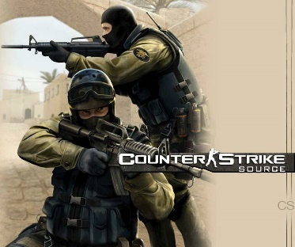






Networks are Important
Networks are changing…
The way we have relationships
Social Networking
Virtual Worlds
Matchmaking
Notes:
So building networks is hard
But unfortunately, computer networks are becoming increasingly critical to our daily lives
You know all the standard uses of computers…
Social networking
Gaming
But there’s a lot you may not thinki about
Financial sector – trillions of dollars –
Critical infrastructures – power grid, water delibvery systems – now all managed and operated with IP networks
911 communication services
…
Remote medicine
Brakes of your car
Power grid and critical infrastructure
Financial and trading networks – move billions of dollars per day over computer netowrks
Computer networks are no longer just for fun and games
People’s lives every day depend on the availability and functioning of computer netowrks
Makign it very important that we build them well, and protect them from adversaries,

Slide 10
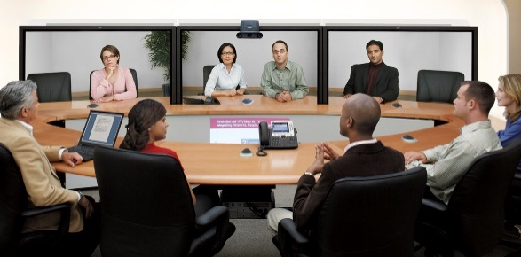




Networks are Important
Networks are changing…
The way we interact
Communication
Augmented reality
Remote presence
Notes:
So building networks is hard
But unfortunately, computer networks are becoming increasingly critical to our daily lives
You know all the standard uses of computers…
Social networking
Gaming
But there’s a lot you may not thinki about
Financial sector – trillions of dollars –
Critical infrastructures – power grid, water delibvery systems – now all managed and operated with IP networks
911 communication services
…
Remote medicine
Brakes of your car
Power grid and critical infrastructure
Financial and trading networks – move billions of dollars per day over computer netowrks
Computer networks are no longer just for fun and games
People’s lives every day depend on the availability and functioning of computer netowrks
Makign it very important that we build them well, and protect them from adversaries,

Slide 11







Networks are Important
Networks are changing…
The way we learn
Online Learning
Online Content
Search Engines
MOOCs
Online Content
Search Engines
Notes:
So building networks is hard
But unfortunately, computer networks are becoming increasingly critical to our daily lives
You know all the standard uses of computers…
Social networking
Gaming
But there’s a lot you may not thinki about
Financial sector – trillions of dollars –
Critical infrastructures – power grid, water delibvery systems – now all managed and operated with IP networks
911 communication services
…
Remote medicine
Brakes of your car
Power grid and critical infrastructure
Financial and trading networks – move billions of dollars per day over computer netowrks
Computer networks are no longer just for fun and games
People’s lives every day depend on the availability and functioning of computer netowrks
Makign it very important that we build them well, and protect them from adversaries,

Slide 12
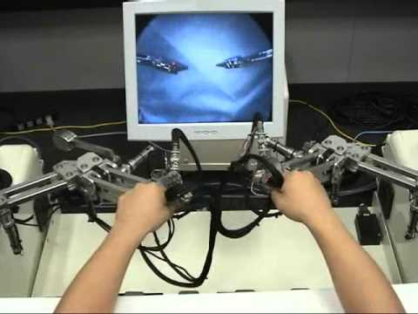
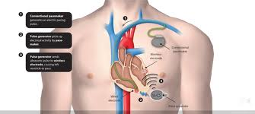

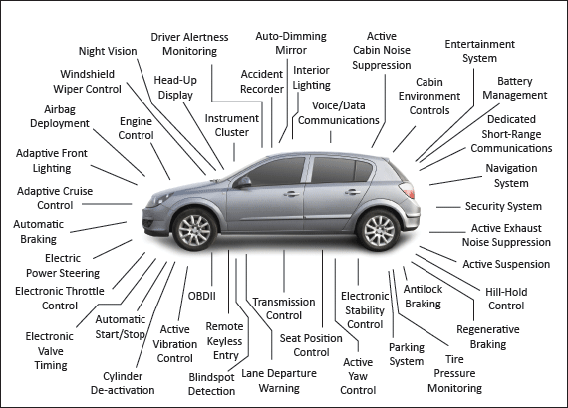
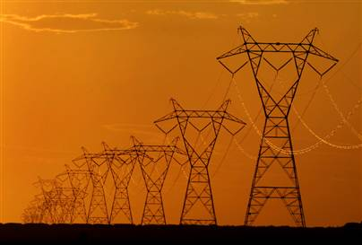
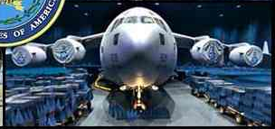
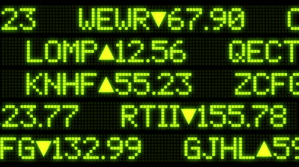

Networked Medical Devices
Emergency Response
Telesurgery
Cyber Physical Networks
Military Networks
Finance/trading Networks
Critical Infrastructures
Notes:
So building networks is hard
But unfortunately, computer networks are becoming increasingly critical to our daily lives
You know all the standard uses of computers…
Social networking
Gaming
But there’s a lot you may not thinki about
Financial sector – trillions of dollars –
Critical infrastructures – power grid, water delibvery systems – now all managed and operated with IP networks
911 communication services
…
Remote medicine
Brakes of your car
Power grid and critical infrastructure
Financial and trading networks – move billions of dollars per day over computer netowrks
Computer networks are no longer just for fun and games
People’s lives every day depend on the availability and functioning of computer netowrks
Makign it very important that we build them well, and protect them from adversaries,

Slide 13
This class
Goal: teach tools and techniques to build, operate, manage, and deploy application services for modern computer network
This class is a first step towards exciting careers
  An operator of a large ISP network
  Architect at a major network device manufacturer
  Designer of a next-generation Internet protocol
  Founder of the next hot network tech startup
  Builder of a major datacenter network
  And much more!...
Notes:
This class will teach you the tools you need to build networks, and to build networks well
[give overview of topics]
This class will not be easy. But the challenges you will face in the real world will not be easy. To learn, we need to expose you to the real challenges

Slide 14
This class
Key concepts:
  History and overall “architecture” of the Internet
  Routing and addressing
  Data packetization and transport
  Network services
  Security
  Network application programming
  Recent trends (datacenters, SDN, …)
Notes:
This class will teach you the tools you need to build networks, and to build networks well
[give overview of topics]
This class will not be easy. But the challenges you will face in the real world will not be easy. To learn, we need to expose you to the real challenges

Slide 15



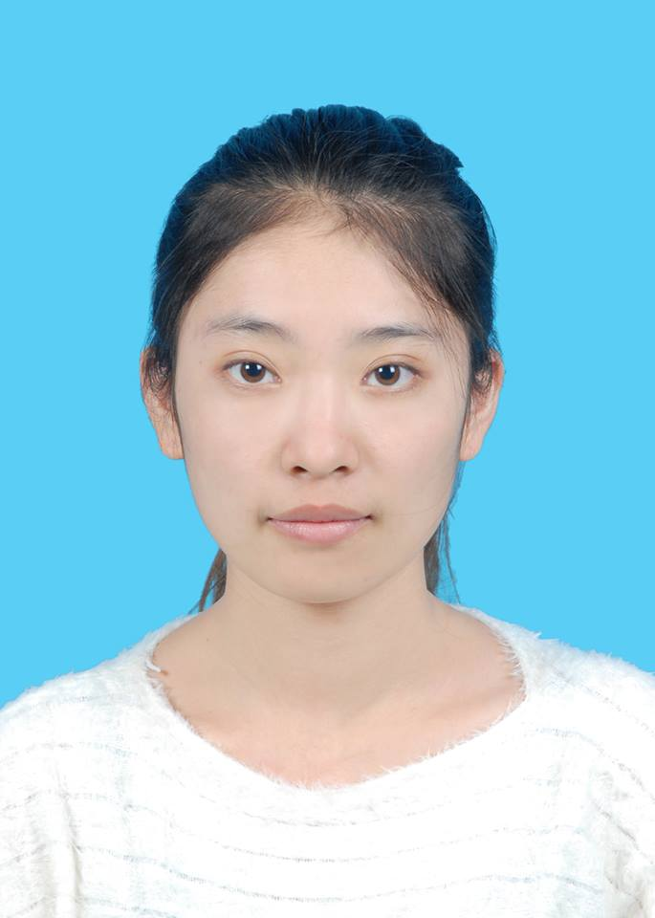
The Team
Notes:
Times are tight for all of us
I and the university have fought to bring you a strong team of

Slide 16
Instructor: Matthew Caesar
CS Faculty at Univ. Illinois
PhD from UC Berkeley, 2007
Over 10+ years experience working in computer networks/systems
NSF CAREER Award, AT&T VURI award, PI in DARPA MRC and CSSG programs, over 50 academic pubs
I like to build things that people use
  Industrial experience at AT&T Labs, Microsoft Research, HP, Nokia DSL; helped found two startups on core networking/security systems; partnerships/tech transfer with Cisco, AT&T, Microsoft
Notes:
I serve as President of Veriflow Systems, a company commercializing
I decided that I like to build things people use. Now I like to lead teams that do.

Slide 17
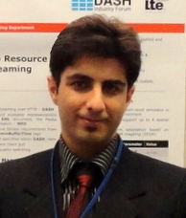
TA: Siting Chang
Brings expertise in data traffic (monitoring, prediction), vehicle networks
BE+MS in transportation engineering; PhD student at UIUC
Research on Sustainable and Resilient Infrastructure systems
Illinois Traffic Engineering Student Chapter Host
Notes:
I serve as President of Veriflow Systems, a company commercializing
I decided that I like to build things people use. Now I like to lead teams that do.

Slide 18
TA: Fred Douglas
Brings expertise in network theory and data center networking
BA (Math+CS, Case Western), PhD student at UIUC
Awards: 1st place MAA math competition, NSF REU
Currently building proposed technical infrastructure to power HP’s cloud computing offerings
Previous focus “secure multi-party computation”
Notes:
I serve as President of Veriflow Systems, a company commercializing
I decided that I like to build things people use. Now I like to lead teams that do.

Slide 19
TA: Lingyu (Ivory) Xu
Brings expertise in network security, privacy, and mobile devices
MS student at UIUC, BE in CS from Beijing Univ.
Developed several real-world security solutions: cross-site scripting vulnerability detection tool, privacy platform for Android OS, time-interleaved allocation alg for data centers
Notes:
I serve as President of Veriflow Systems, a company commercializing
I decided that I like to build things people use. Now I like to lead teams that do.

Slide 20
How can we build networks?

Slide 21
There’s a lot we don’t know about how to build networks
No consensus on what constitutes the “correct” or “best” network design
No consensus on “top problems”
No consensus on the right prioritization of goals
Not even a well-developed theory to draw from

Slide 22
What we do know
The early Internet pioneers came up with a solution that was successful beyond all imagining
Several enduring architectural principles and practices emerged from their work

Slide 23
Some key principles
Statistical multiplexing [lecture 2]
Packets [lecture 2]
The network is “application neutral” [lecture 3]
Best effort service [lecture 3]
A layered protocol architecture [lectures: all]
A “narrow API” at the network layer [lecture 8]
The “end to end” design principle [lecture 8]
Decentralization [lecture: 2, 3, 6, 8, 9, 21]
Notes:
analogy for each

Slide 24
What we do know
The early Internet pioneers came up with a solution that was successful beyond all imagining
Several enduring architectural principles and practices emerged from their work
But it is just one design
And numerous cracks have emerged over time
  want to diagnose problems but IP hides federation
  want to block unwanted traffic but the network doesn’t authenticate
  can’t optimize for different applications or customers
  complex and buggy protocols
  upgrading protocols is deeply painful

Slide 25
What we do know
The early Internet pioneers came up with a solution that was successful beyond all imagining
Several enduring architectural principles and practices emerged from their work
But it is just one design
And numerous cracks have emerged over time
As have new requirements
  Mobility, reliability, data centers, sensors, …

Slide 26
Hence, networking today is still debating the big questions...
Packets
Statistical multiplexing
Protocol layers
A “narrow waist” at the network layer
Best-effort service
The “end to end” design principle
Decentralization
→“circuits”
→ “reservations”
→multi-service”
→ “middleboxes”
→ “centralize”

Slide 27
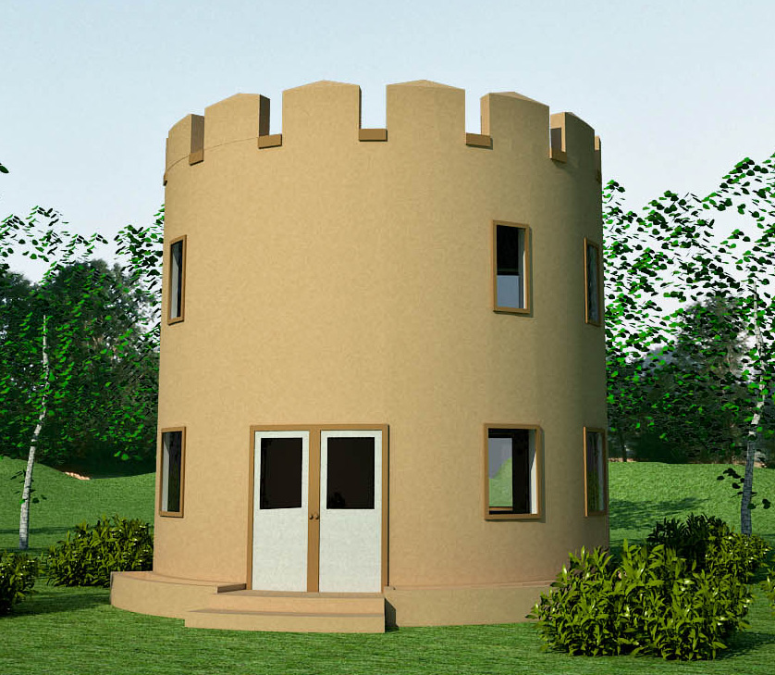
Backing up a level
The Internet offers us a lesson in how to reason through the design of a very complex system
  What are our goals and constraints?
  What’s the right prioritization of goals?
  How do we decompose a problem?
  Who does what? How?
  What are the interfaces between components?
  What are the tradeoffs between design options?
In short: a lesson in how to architect a system
Notes:
common sense and rigorous thinking taken to the extreme

Slide 28
Network “Architecture”
More about thinking rigorously than doing rigorous math
More about understanding tradeoffs than running benchmarks
More about practicality than optimality

Slide 29
What CS 438 Will Teach You
How the Internet works
Why it works the way it does
How to think through a complicated (networking) design problem

Slide 30
Administrative Details

Slide 31
Prerequisites
Operating Systems Concepts
  CS 241 or equivalent
C or C++ Programming
  Preferably Unix
Probability and Statistics

Slide 32
Grading Policy
7 Homeworks | 15%
3 MPs | 35% (10+10+15)
Midterm exam | 25%
“High-level” exam | 2% (extra credit)
Final exam | 25%

Slide 33
Homework and Projects
Homework: Due Wednesdays at start of class.
Projects: Due Fridays at 9:00pm.
  2% off per hour late
  MP1 is solo
  MP2 and MP3 are 2 person teams
  TAs will handle all project-related questions

Slide 34
Academic Honesty
Your work in this class must be your own.
All infractions reported to the department
If students are found to have collaborated excessively or to have blatantly cheated (e.g., by copying or sharing answers during an examination or sharing code for the project), all involved will at a minimum receive grades of 0 for the first infraction.
  We will run a similarity-checking system on code and binaries
Further infractions will result in failure in the course and/or recommendation for dismissal from the university.

Slide 35
Graduate Students
Graduate students MAY take an extra one hour project in conjunction with this class
Undergraduates may not take this project course
  However, if you are interested in networking research, please contact me or another faculty here at UIUC

Slide 36
Class Communications
Web site: http://courses.engr.illinois.edu/cs438
  Assignments, lecture slides, announcements
Use your instructional account to hand in homework and projects
Email list:
  Make sure you are on cs438-sp14@illinois.edu
Use Piazza for all other intra-class communication
  You should all be signed up by now
Cc our staff (cs438-staff@illinois.edu) on any non-private emails sent directly to me (caesar@illinois.edu)

Slide 37
Class Participation
Ask and answer questions!!
  it helps you understand
  it helps others understand
  it helps you stay awake
  it helps me stay awake
  it’s just more fun for all of us
Sit towards the front
Limit electronic access for < 90 minutes
Notes:
Numerous studies have shown…

Slide 38
Thanks to
Slide decks include content developed at UC Berkeley (Scott Shenker, Ion Stoica, Sylvia Ratnasamy), Princeton University (Jennifer Rexford), University of Massachusetts (Jim Kurose), Stanford (Nick McKeown), and others

Slide 39
Any questions?

