Slide 1
Internet QoS
CS/ECE 438: Communication Networks
Syed Faisal Hasan, PhD
(Research Scholar
Information Trust Institute)
Visiting Lecturer
ECE

Slide 2
Introduction
The Internet only provides a ‘best effort’ service model
It does not provide any guarantee in terms of delay and/or bandwidth.
This service model is not suitable for many applications
Interactive sessions like live audio/video conferencing, real-time applications require strict delay and bandwidth guarantee

Slide 3
Quality of Service (QoS)
QoS is all about providing different class of services in IP networks
Each class may support different subclasses
Applications and/or users will specify the service they require from the network and the network will provide that.
QoS is a superset of ‘best effort’ service model
It requires additional features/mechanisms on the end host and routing devices

Slide 4
QoS Architechtures
There are two prominent architectures for QoS:
Integrated Services (IntServ)
Differentiated Services (DiffServ)
They differ in their granularity of service
IntServ provides per flow guarantees
DiffServ provides aggregated service classes
DiffServ is more popular than IntServ
IntServ is not scalable and incremental deployment is not possible

Slide 5
Integrated Services (IntServ)
Packets with same source, destination IP address, port number and protocol number are identified as flows
Two level of service class for each flow:
Controlled load service: as good as an unloaded network
Guaranteed service: provides firm guarantees
Makes use of Resource Reservation Protocol (RSVP)
RSVP reserves resources for a particular flow in all the routers in a particular path between a source and destination
All the in-path routers must store per flow resource reservation information
IntServ has scalability and deployment problem
This is an end-to-end model
All in-path routers must also classify packets into flows

Slide 6
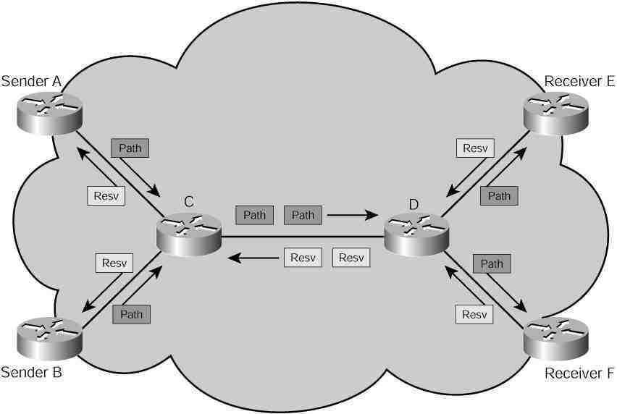
IntServ: Mechanism
Signaling and/or admission control: A signaling protocol RSVP is required for reservation of resources. Admission control blocks incoming traffic if the desired QoS cannot be met.

Slide 7
Differentiated Services (DiffServ)
Provides per hop behavior instead of end-to-end
No signaling/reservation needed.
No need to classify packets into flows
Support a small number of forwarding classes at each router
Service models to be accomplished through provisioning
Edge routers map packets into forwarding classes based on service level agreement (SLA).
Forwarding class is encoded in the packet header.
Six bits in the TOS file in the IP packet is used in DiffServ:
Examples of forwarding classes:
101 110 - Expedited Forwarding
010 010 - Assured forwarding
Problems with DiffServ:
end-to-end service guaranteed is hard to

Slide 8
DiffServ Code Point (DSCP)

Slide 9
Mechanisms for QoS
The mechanisms need to be in place to augment the network with QoS capabilities:
Signaling and/or admission control: A signaling protocol is required for reservation of resources. Admission control blocks incoming traffic if the desired QoS cannot be met.
Packet classification/marking: Packet classifiers select packets in a traffic stream based on the content of some portion of the packet header
traffic conditioning. Traffic conditioning performs metering, shaping, policing and/or re-marking to ensure that the traffic entering the DS domain conforms to the rules

Slide 10
Mechanisms Contnd..
.
Marking: the process of setting the DS codepoint in a packet based on defined rules; pre-marking, re-marking.
Metering: the process of measuring the temporal properties (e.g., rate) of a traffic stream selected by a classifier
Shaping: the process of delaying packets within a traffic stream to cause it to conform to some defined traffic profile.

Slide 11
Assure Forwarding (AF)
A general use DiffServ Per-Hop-Behavior (PHB) Group defined by RFC 2597
The AF PHB group provides delivery of IP packets in four independently forwarded AF classes
Within each AF class IP packets are marked with one of three possible drop precedence values
In a DS node, the level of forwarding assurance of an IP packet thus depends on
how much forwarding resources has been allocated to the AF class that the packet belongs to
what is the current load of the AF class, and, in case of congestion within the class
what is the drop precedence of the packet.

Slide 12
AF Example
Recommended values of AF DS code points (DSCP)
AF11 = '001010', AF12 = '001100', AF13 = '001110', AF21 = '010010', AF22 = '010100', AF23 = '010110', AF31 = '011010', AF32 = '011100', AF33 = '011110', AF41 = '100010', AF42 = '100100', AF43 = '100110'.

Slide 13
Example AF configuration
The drop precedence level of a packet could be assigned, for example, by using a token bucket /leaky bucket traffic policer, which has as its parameters a rate and a size, which is the sum of two burst values: a committed information rate (CIR) and Peak Information Rate (PIR)
Token Bucket Animation

Slide 14
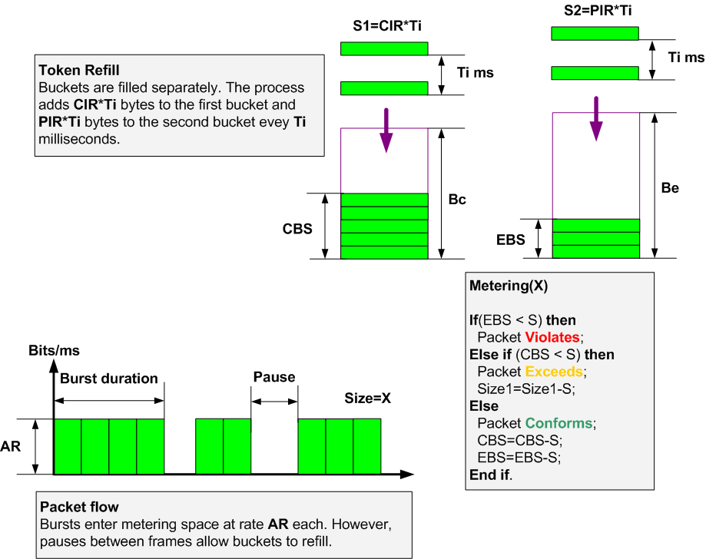
Token Bucket Usage

Slide 15
Expedited Forwarding (EF) PHB
The EF PHB (RFC 2475) can be used to build a low loss, low latency, low jitter, assured bandwidth, end-to-end service through DS domains.
Codepoint 101110 is recommended for the EF PHB.
Creating such a service has two parts:
Configuring nodes so that the aggregate has a well-defined minimum departure rate. ("Well-defined" means independent of the dynamic state of the node. In particular, independent of the intensity of other traffic at the node.)
Conditioning the aggregate (via policing and shaping) so that its arrival rate at any node is always less than that node's configured minimum departure rate.

Slide 16
AF/EF Queuing Mechanism
Several types of queue scheduling mechanisms may be employed to deliver the forwarding behavior:
Class Based Queue (CBQ)
Token Bucket Flow (TBF)
Clark-Shenker-Zhang (CSZ)
First In First Out (FIFO)
Priority Traffic Equalizer (TEQL)
Stochastic Fair Queuing (SFQ)
Asynchronous Transfer Mode (ATM)
Random Early Detection (RED)
Generalized RED (GRED)

Slide 17
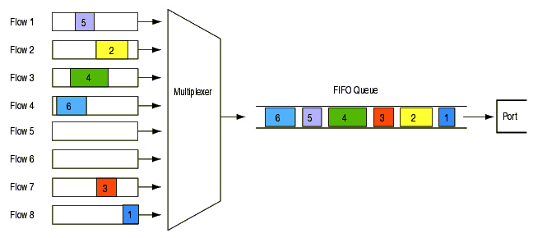
FIFO Queuing

Slide 18
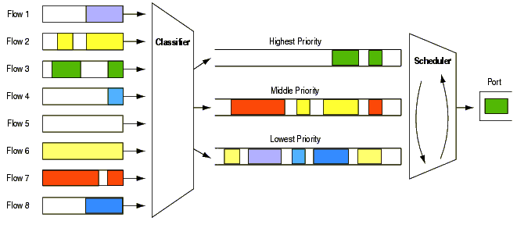
Priority Queuing

Slide 19
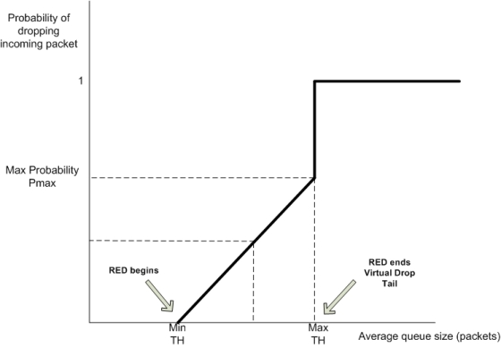
Random Early Drop (RED) Queuing

Slide 20
Other approaches to QoS
Multi Protocol Label Switching (MPLS)
Traffic Engineering
Constraint Based Routing
Software Defined Networking

Slide 21
Critics of QoS
QoS is a highly debated issue
Its unlikely that Internet wide QoS will ever be deployed
On the other hand, QoS has been hugely successful in private/enterprise networks
Net-neutrality vs QoS is an ongoing issue.

Slide 22
Questions?
Syed Faisal Hasan
hasansf@illinois.edu

