Slide 1
Chapter 3: Transport Layer
Our goals:
understand principles behind transport layer services:
multiplexing/demultiplexing
reliable data transfer
flow control
congestion control
learn about transport layer protocols in the Internet:
UDP: connectionless transport
TCP: connection-oriented transport
TCP congestion control

Slide 2
Chapter 3 outline
3.1 Transport-layer services
3.2 Multiplexing and demultiplexing
3.3 Connectionless transport: UDP
3.4 Principles of reliable data transfer
3.5 Connection-oriented transport: TCP
segment structure
reliable data transfer
flow control
connection management
3.6 Principles of congestion control
3.7 TCP congestion control

Slide 3
Transport services and protocols
provide logical communication between app processes running on different hosts
transport protocols run in end systems
sender: breaks app messages into segments, passes to network layer
receiver: reassembles segments into messages, passes to app layer
more than one transport protocol available to apps
Internet: TCP and UDP
application
transport
network
data link
physical
network
data link
physical
network
data link
physical
network
data link
physical
logical end-end transport
network
data link
physical
network
data link
physical
application
transport
network
data link
physical

Slide 4
Transport vs. network layer
network layer: logical communication between hosts
transport layer: logical communication between processes
relies on, enhances, network layer services
Household analogy:
12 kids sending letters to 12 kids
processes = kids
app messages = letters in envelopes
hosts = houses
transport protocol = Ann to Bill
network-layer protocol = postal service

Slide 5
Internet transport-layer protocols
reliable, in-order delivery (TCP)
congestion control
flow control
connection setup
unreliable, unordered delivery: UDP
no-frills extension of “best-effort” IP
services not available:
delay guarantees
bandwidth guarantees
application
transport
network
data link
physical
network
data link
physical
network
data link
physical
network
data link
physical
logical end-end transport
network
data link
physical
network
data link
physical
application
transport
network
data link
physical

Slide 6
Chapter 3 outline
3.1 Transport-layer services
3.2 Multiplexing and demultiplexing
3.3 Connectionless transport: UDP
3.4 Principles of reliable data transfer
3.5 Connection-oriented transport: TCP
segment structure
reliable data transfer
flow control
connection management
3.6 Principles of congestion control
3.7 TCP congestion control

Slide 7
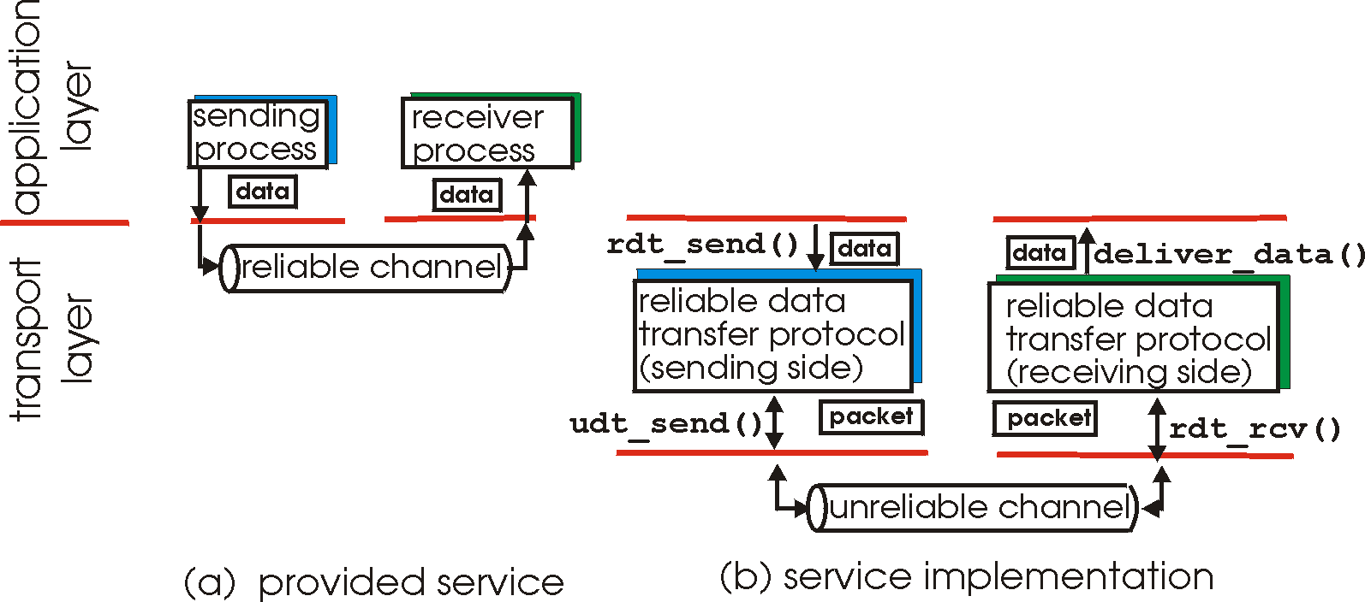
Principles of Reliable data transfer
important in app., transport, link layers
top-10 list of important networking topics!
characteristics of unreliable channel will determine complexity of reliable data transfer protocol (rdt)

Slide 8
Principles of Reliable data transfer
important in app., transport, link layers
top-10 list of important networking topics!
characteristics of unreliable channel will determine complexity of reliable data transfer protocol (rdt)

Slide 9
Principles of Reliable data transfer
important in app., transport, link layers
top-10 list of important networking topics!
characteristics of unreliable channel will determine complexity of reliable data transfer protocol (rdt)

Slide 10
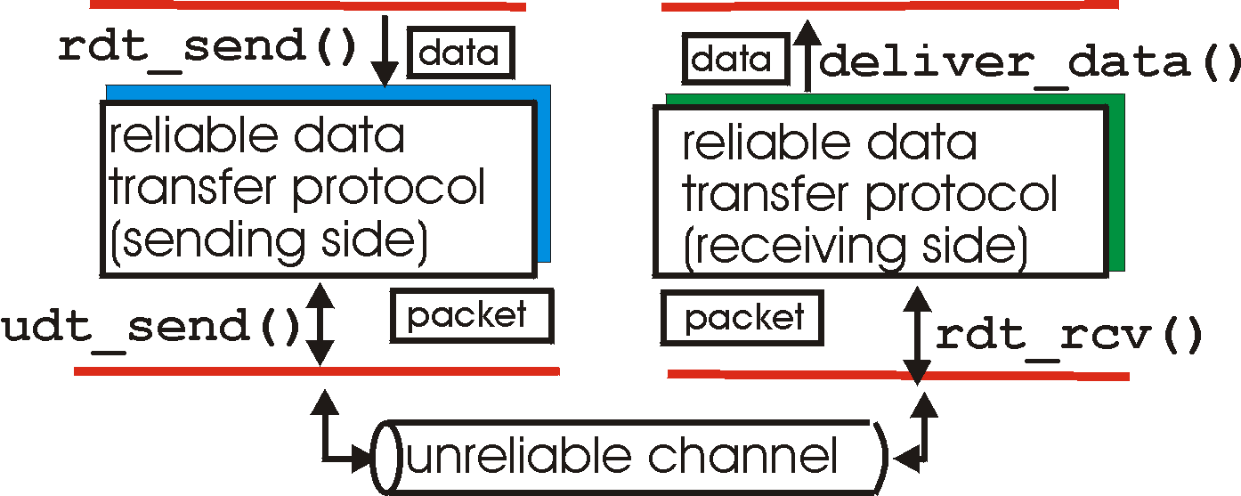
Reliable data transfer: getting started
rdt_send(): called from above, (e.g., by app.). Passed data to
deliver to receiver upper layer
deliver_data(): called by rdt to deliver data to upper
send
side
receive
side
udt_send(): called by rdt,
to transfer packet over
unreliable channel to receiver
rdt_rcv(): called when packet arrives on rcv-side of channel

Slide 11
Reliable data transfer: getting started
We’ll:
incrementally develop sender, receiver sides of reliable data transfer protocol (rdt)
consider only unidirectional data transfer
but control info will flow on both directions!
use finite state machines (FSM) to specify sender, receiver
event causing state transition
actions taken on state transition
state: when in this “state” next state uniquely determined by next event
state
1
state
2
event
actions

Slide 12
Rdt1.0: reliable transfer over a reliable channel
underlying channel perfectly reliable
no bit errors
no loss of packets
separate FSMs for sender, receiver:
sender sends data into underlying channel
receiver read data from underlying channel
Wait for call from above
rdt_send(data)
Wait for call from below
rdt_rcv(packet)
extract (packet,data)
deliver_data(data)
packet = make_pkt(data)
udt_send(packet)
sender
receiver

Slide 13
Rdt2.0: channel with bit errors
underlying channel may flip bits in packet
checksum to detect bit errors
the question: how to recover from errors:
acknowledgements (ACKs): receiver explicitly tells sender that pkt received OK
negative acknowledgements (NAKs): receiver explicitly tells sender that pkt had errors
sender retransmits pkt on receipt of NAK
new mechanisms in rdt2.0 (beyond rdt1.0):
error detection
receiver feedback: control msgs (ACK,NAK) rcvr->sender
Why Send ACK (incurs control overhead)?
Why not send a NACK only when packet is corrupted?

Slide 14
rdt2.0: FSM specification
rdt_send(data)
snkpkt = make_pkt(data, checksum)
udt_send(sndpkt)
receiver
rdt_rcv(rcvpkt) &&
isNAK(rcvpkt)
Wait for call from above
Wait for ACK or NAK
rdt_rcv(rcvpkt) &&
corrupt(rcvpkt)
udt_send(sndpkt)
udt_send(NAK)
rdt_rcv(rcvpkt) && isACK(rcvpkt)
Λ
Wait for call from below
sender
rdt_rcv(rcvpkt) &&
notcorrupt(rcvpkt)
extract(rcvpkt,data)
deliver_data(data)
udt_send(ACK)

Slide 15
rdt2.0: operation with no errors
rdt_send(data)
snkpkt = make_pkt(data, checksum)
udt_send(sndpkt)
rdt_rcv(rcvpkt) &&
isNAK(rcvpkt)
Wait for call from above
Wait for ACK or NAK
rdt_rcv(rcvpkt) &&
corrupt(rcvpkt)
udt_send(sndpkt)
udt_send(NAK)
rdt_rcv(rcvpkt) && isACK(rcvpkt)
Wait for call from below
Λ
rdt_rcv(rcvpkt) &&
notcorrupt(rcvpkt)
extract(rcvpkt,data)
deliver_data(data)
udt_send(ACK)

Slide 16
rdt2.0: error scenario
rdt_send(data)
snkpkt = make_pkt(data, checksum)
udt_send(sndpkt)
rdt_rcv(rcvpkt) &&
isNAK(rcvpkt)
Wait for call from above
Wait for ACK or NAK
rdt_rcv(rcvpkt) &&
corrupt(rcvpkt)
udt_send(sndpkt)
udt_send(NAK)
rdt_rcv(rcvpkt) && isACK(rcvpkt)
Wait for call from below
Λ
rdt_rcv(rcvpkt) &&
notcorrupt(rcvpkt)
A major flaw.
What is it?
extract(rcvpkt,data)
deliver_data(data)
udt_send(ACK)

Slide 17
rdt2.0 has a fatal flaw!
What happens if ACK/NAK corrupted?
sender doesn’t know what happened at receiver!
can’t just retransmit: possible duplicate
Handling duplicates:
sender retransmits current pkt if ACK/NAK garbled
sender adds sequence number to each pkt
receiver discards (doesn’t deliver up) duplicate pkt
stop and wait
Sender sends one packet,
then waits for receiver
response

Slide 18
rdt2.1: sender, handles garbled ACK/NAKs
rdt_send(data)
sndpkt = make_pkt(0, data, checksum)
udt_send(sndpkt)
rdt_rcv(rcvpkt) &&
( corrupt(rcvpkt) ||
isNAK(rcvpkt) )
Wait for call 0 from above
Wait for ACK or NAK 0
udt_send(sndpkt)
rdt_rcv(rcvpkt)
&& notcorrupt(rcvpkt)
&& isACK(rcvpkt)
rdt_rcv(rcvpkt)
&& notcorrupt(rcvpkt)
&& isACK(rcvpkt)
Λ
Λ
Wait for ACK or NAK 1
Wait for
call 1 from above
rdt_rcv(rcvpkt) &&
( corrupt(rcvpkt) ||
isNAK(rcvpkt) )
rdt_send(data)
udt_send(sndpkt)
sndpkt = make_pkt(1, data, checksum)
udt_send(sndpkt)

Slide 19
rdt2.1: receiver, handles garbled ACK/NAKs
rdt_rcv(rcvpkt) && notcorrupt(rcvpkt)
&& has_seq0(rcvpkt)
extract(rcvpkt,data)
deliver_data(data)
sndpkt = make_pkt(ACK, chksum)
udt_send(sndpkt)
rdt_rcv(rcvpkt) && (corrupt(rcvpkt)
rdt_rcv(rcvpkt) && (corrupt(rcvpkt)
sndpkt = make_pkt(NAK, chksum)
udt_send(sndpkt)
sndpkt = make_pkt(NAK, chksum)
udt_send(sndpkt)
Wait for
0 from below
Wait for
1 from below
rdt_rcv(rcvpkt) &&
not corrupt(rcvpkt) &&
has_seq1(rcvpkt)
rdt_rcv(rcvpkt) &&
not corrupt(rcvpkt) &&
has_seq0(rcvpkt)
sndpkt = make_pkt(ACK, chksum)
udt_send(sndpkt)
sndpkt = make_pkt(ACK, chksum)
udt_send(sndpkt)
rdt_rcv(rcvpkt) && notcorrupt(rcvpkt)
&& has_seq1(rcvpkt)
extract(rcvpkt,data)
deliver_data(data)
sndpkt = make_pkt(ACK, chksum)
udt_send(sndpkt)
Why?

Slide 20
rdt2.1: discussion
Sender:
seq # added to pkt
two seq. #’s (0,1) will suffice. Why?
must check if received ACK/NAK corrupted
twice as many states
state must “remember” whether “current” pkt has 0 or 1 seq. #
Receiver:
must check if received packet is duplicate
state indicates whether 0 or 1 is expected pkt seq #
note: receiver can not know if its last ACK/NAK received OK at sender

Slide 21
rdt2.2: a NAK-free protocol
same functionality as rdt2.1, using ACKs only
instead of NAK, receiver sends ACK for last pkt received
receiver must explicitly include seq # of pkt being ACKed
duplicate ACK at sender results in same action as NAK: retransmit current pkt

Slide 22
rdt2.2: sender, receiver fragments
rdt_send(data)
sndpkt = make_pkt(0, data, checksum)
udt_send(sndpkt)
rdt_rcv(rcvpkt) &&
( corrupt(rcvpkt) ||
isACK(rcvpkt,1) )
Wait for call 0 from above
Wait for ACK
0
udt_send(sndpkt)
sender FSM
fragment
rdt_rcv(rcvpkt)
&& notcorrupt(rcvpkt)
&& isACK(rcvpkt,0)
rdt_rcv(rcvpkt) &&
(corrupt(rcvpkt) ||
has_seq1(rcvpkt))
Λ
Wait for
0 from below
receiver FSM
fragment
udt_send(sndpkt)
rdt_rcv(rcvpkt) && notcorrupt(rcvpkt)
&& has_seq1(rcvpkt)
extract(rcvpkt,data)
deliver_data(data)
sndpkt = make_pkt(ACK1, chksum)
udt_send(sndpkt)

Slide 23
rdt3.0: channels with errors and loss
New assumption: underlying channel can also lose packets (data or ACKs)
checksum, seq. #, ACKs, retransmissions will be of help, but not enough
Approach: sender waits “reasonable” amount of time for ACK
retransmits if no ACK received in this time
if pkt (or ACK) just delayed (not lost):
retransmission will be duplicate, but use of seq. #’s already handles this
receiver must specify seq # of pkt being ACKed
requires countdown timer
WHY?

Slide 24
rdt3.0: channels with errors and loss
New assumption: underlying channel can also lose packets (data or ACKs)
checksum, seq. #, ACKs, retransmissions will be of help, but not enough
Approach: sender waits “reasonable” amount of time for ACK (timeout)
retransmits if no ACK received in this time
if pkt (or ACK) just delayed (not lost):
retransmission will be duplicate, but use of seq. #’s already handles this
receiver must specify seq # of pkt being ACKed
requires countdown timer
WHY?

Slide 25
rdt3.0 sender
rdt_send(data)
rdt_rcv(rcvpkt) &&
( corrupt(rcvpkt) ||
isACK(rcvpkt,1) )
sndpkt = make_pkt(0, data, checksum)
udt_send(sndpkt)
start_timer
rdt_rcv(rcvpkt)
Λ
Λ
Wait for
call 0from above
Wait for ACK0
timeout
udt_send(sndpkt)
start_timer
rdt_rcv(rcvpkt)
&& notcorrupt(rcvpkt)
&& isACK(rcvpkt,1)
rdt_rcv(rcvpkt)
&& notcorrupt(rcvpkt)
&& isACK(rcvpkt,0)
stop_timer
stop_timer
Wait for ACK1
Wait for
call 1 from above
timeout
udt_send(sndpkt)
start_timer
rdt_rcv(rcvpkt)
rdt_send(data)
Λ
rdt_rcv(rcvpkt) &&
( corrupt(rcvpkt) ||
isACK(rcvpkt,0) )
sndpkt = make_pkt(1, data, checksum)
udt_send(sndpkt)
start_timer
Λ

Slide 26
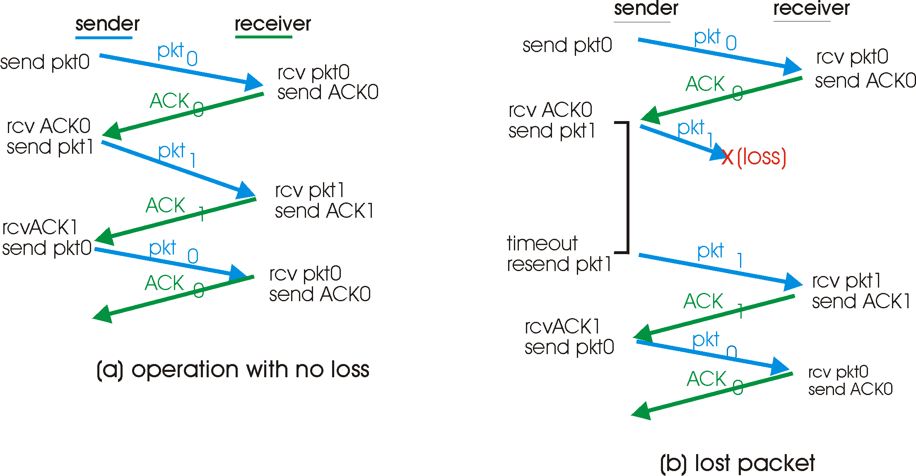
rdt3.0 in action

Slide 27
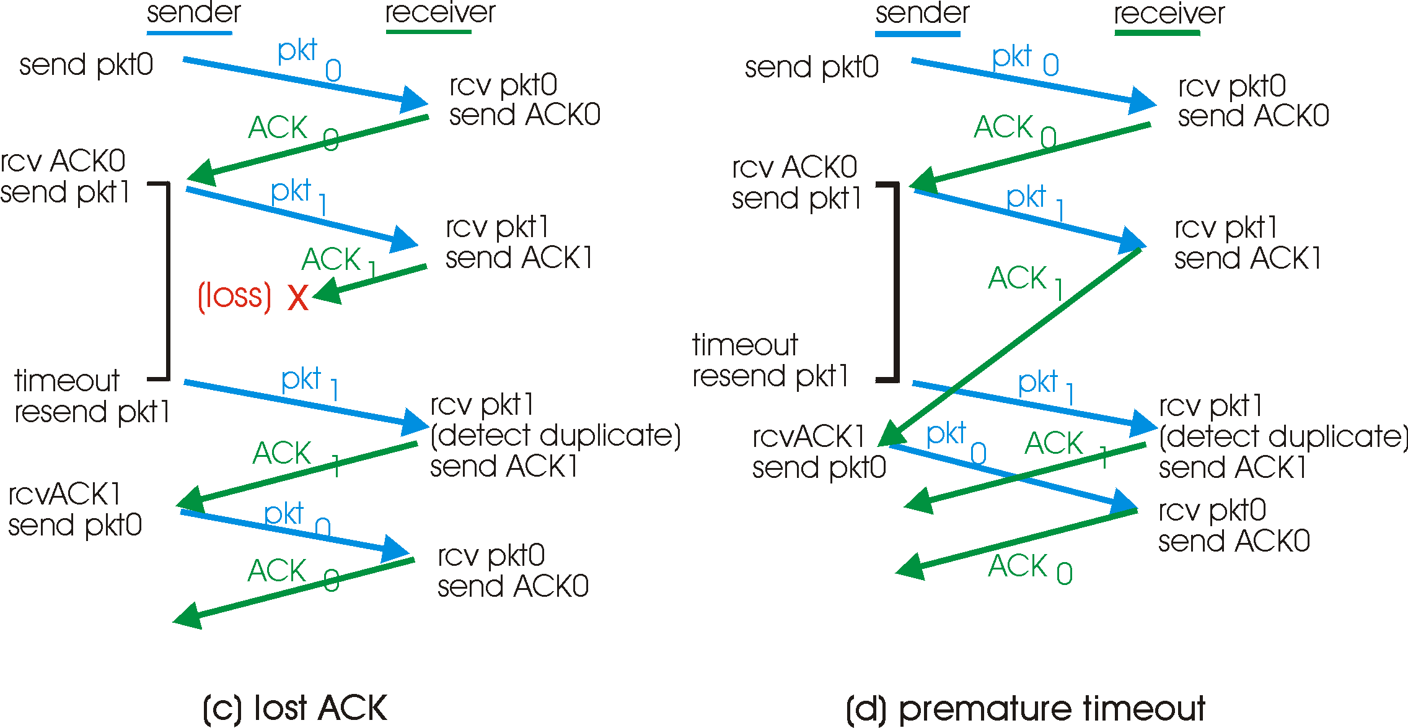
rdt3.0 in action

Slide 28
Performance of rdt3.0
rdt3.0 works, but performance stinks
example: 1 Gbps link, 15 ms e-e prop. delay, 1KB packet:
T
=
L (packet length in bits)
8kb/pkt
transmit
=
= 8 microsec
R (transmission rate, bps)
10**9 b/sec
U _{sender}: utilization – fraction of time sender busy sending
1KB pkt every 30 msec -> 33kB/sec thruput over 1 Gbps link
network protocol limits use of physical resources!

Slide 29
rdt3.0: stop-and-wait operation
sender
receiver
first packet bit transmitted, t = 0
last packet bit transmitted, t = L / R
first packet bit arrives
RTT
last packet bit arrives, send ACK
ACK arrives, send next
packet, t = RTT + L / R

Slide 30
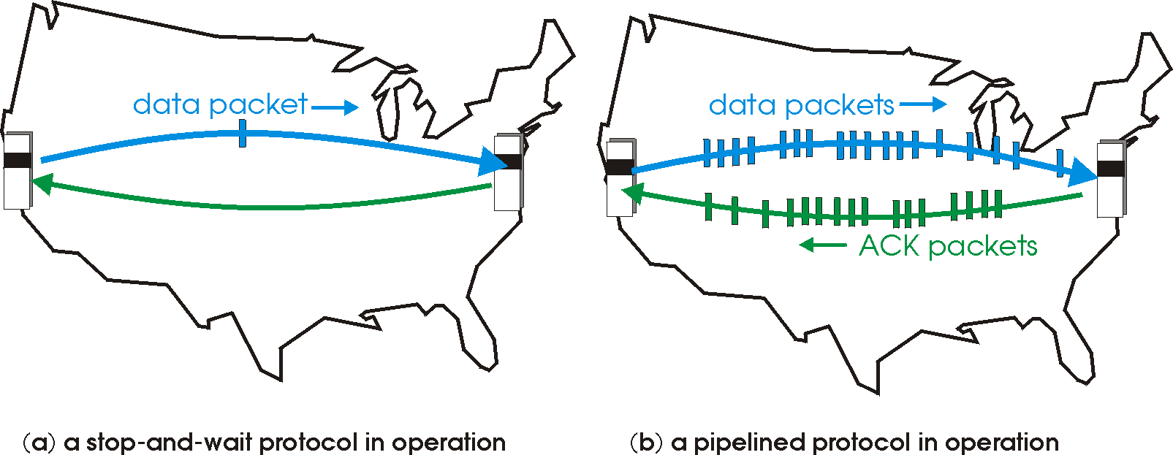
Pipelined protocols
Pipelining: sender allows multiple, “in-flight”, yet-to-be-acknowledged pkts
range of sequence numbers must be increased
buffering at sender and/or receiver
Two generic forms of pipelined protocols: go-Back-N, selective repeat

Slide 31
Pipelining: increased utilization
sender
receiver
first packet bit transmitted, t = 0
last bit transmitted, t = L / R
first packet bit arrives
RTT
last packet bit arrives, send ACK
last bit of 2nd packet arrives, send ACK
last bit of 3rd packet arrives, send ACK
ACK arrives, send next
packet, t = RTT + L / R
Increase utilization
by a factor of 3!

Slide 32
Go-Back-N
Sender:
k-bit seq # in pkt header
“window” of up to N, consecutive unack’ed pkts allowed
ACK(n): ACKs all pkts up to, including seq # n - “cumulative ACK”
may receive duplicate ACKs (see receiver)
timer for each in-flight pkt
timeout(n): retransmit pkt n and all higher seq # pkts in window

Slide 33
GBN: sender extended FSM
rdt_send(data)
if (nextseqnum < base+N) {
sndpkt[nextseqnum] = make_pkt(nextseqnum,data,chksum)
udt_send(sndpkt[nextseqnum])
if (base == nextseqnum)
start_timer
nextseqnum++
}
else
refuse_data(data)
Λ
base=1
nextseqnum=1
timeout
Wait
start_timer
udt_send(sndpkt[base])
udt_send(sndpkt[base+1])
…
udt_send(sndpkt[nextseqnum-1])
rdt_rcv(rcvpkt)
&& corrupt(rcvpkt)
rdt_rcv(rcvpkt) &&
notcorrupt(rcvpkt)
base = getacknum(rcvpkt)+1
If (base == nextseqnum)
stop_timer
else
start_timer

Slide 34
GBN: receiver extended FSM
default
udt_send(sndpkt)
rdt_rcv(rcvpkt)
&& notcurrupt(rcvpkt)
&& hasseqnum(rcvpkt,expectedseqnum)
Λ
Wait
extract(rcvpkt,data)
deliver_data(data)
sndpkt = make_pkt(expectedseqnum,ACK,chksum)
udt_send(sndpkt)
expectedseqnum++
expectedseqnum=1
sndpkt =
make_pkt(expectedseqnum,ACK,chksum)
ACK-only: always send ACK for correctly-received pkt with highest in-order seq #
may generate duplicate ACKs
need only remember expectedseqnum
out-of-order pkt:
discard (don’t buffer) -> no receiver buffering!
Re-ACK pkt with highest in-order seq #

Slide 35
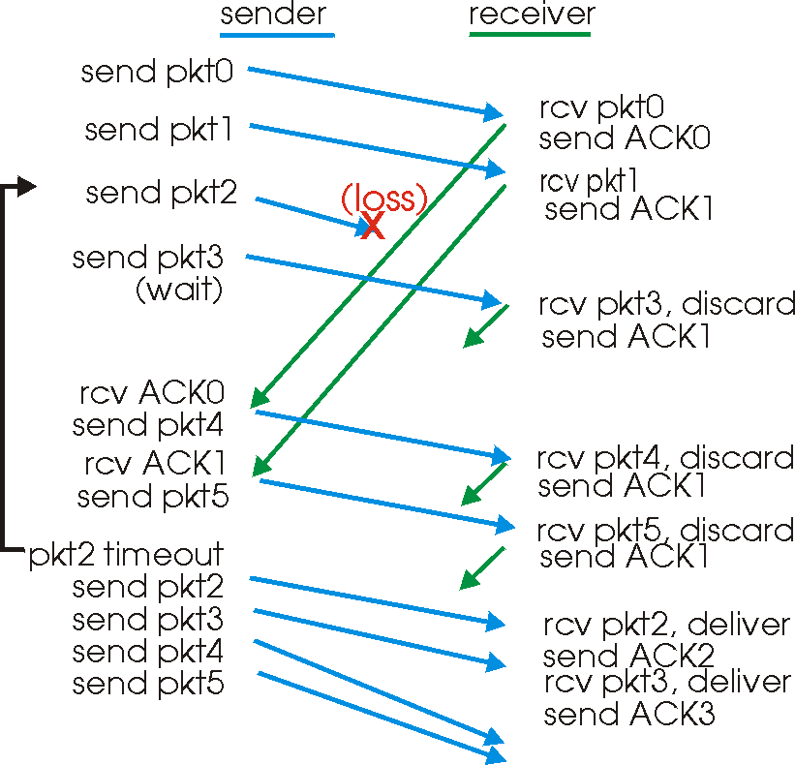
GBN in action

Slide 36
Selective Repeat
receiver individually acknowledges all correctly received pkts
buffers pkts, as needed, for eventual in-order delivery to upper layer
sender only resends pkts for which ACK not received
sender timer for each unACKed pkt
sender window
N consecutive seq #’s
again limits seq #s of sent, unACKed pkts

Slide 37
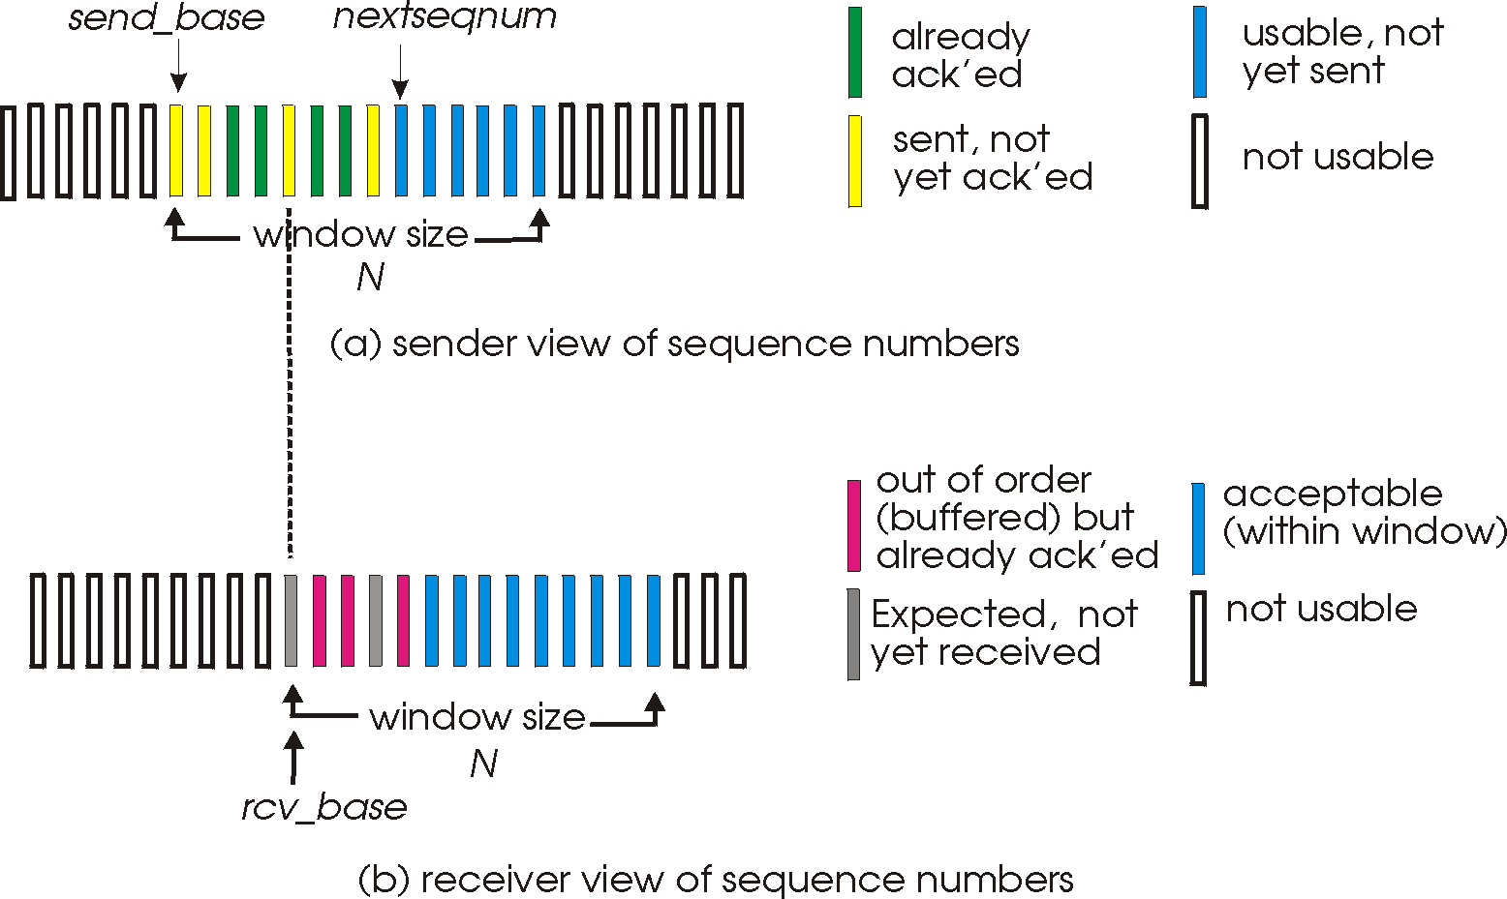
Selective repeat: sender, receiver windows

Slide 38
Selective repeat
sender
receiver
data from above :
if next available seq # in window, send pkt
timeout(n):
resend pkt n, restart timer
ACK(n) in [sendbase,sendbase+N]:
mark pkt n as received
if n smallest unACKed pkt, advance window base to next unACKed seq #
pkt n in [rcvbase, rcvbase+N-1]
send ACK(n)
out-of-order: buffer
in-order: deliver (also deliver buffered, in-order pkts), advance window to next not-yet-received pkt
pkt n in [rcvbase-N,rcvbase-1]
ACK(n)
otherwise:
ignore

Slide 39
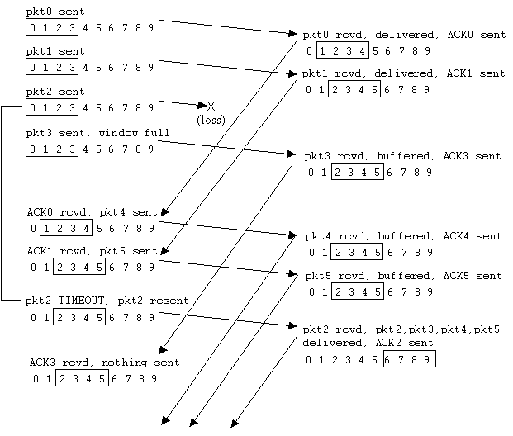
Selective repeat in action

Slide 40
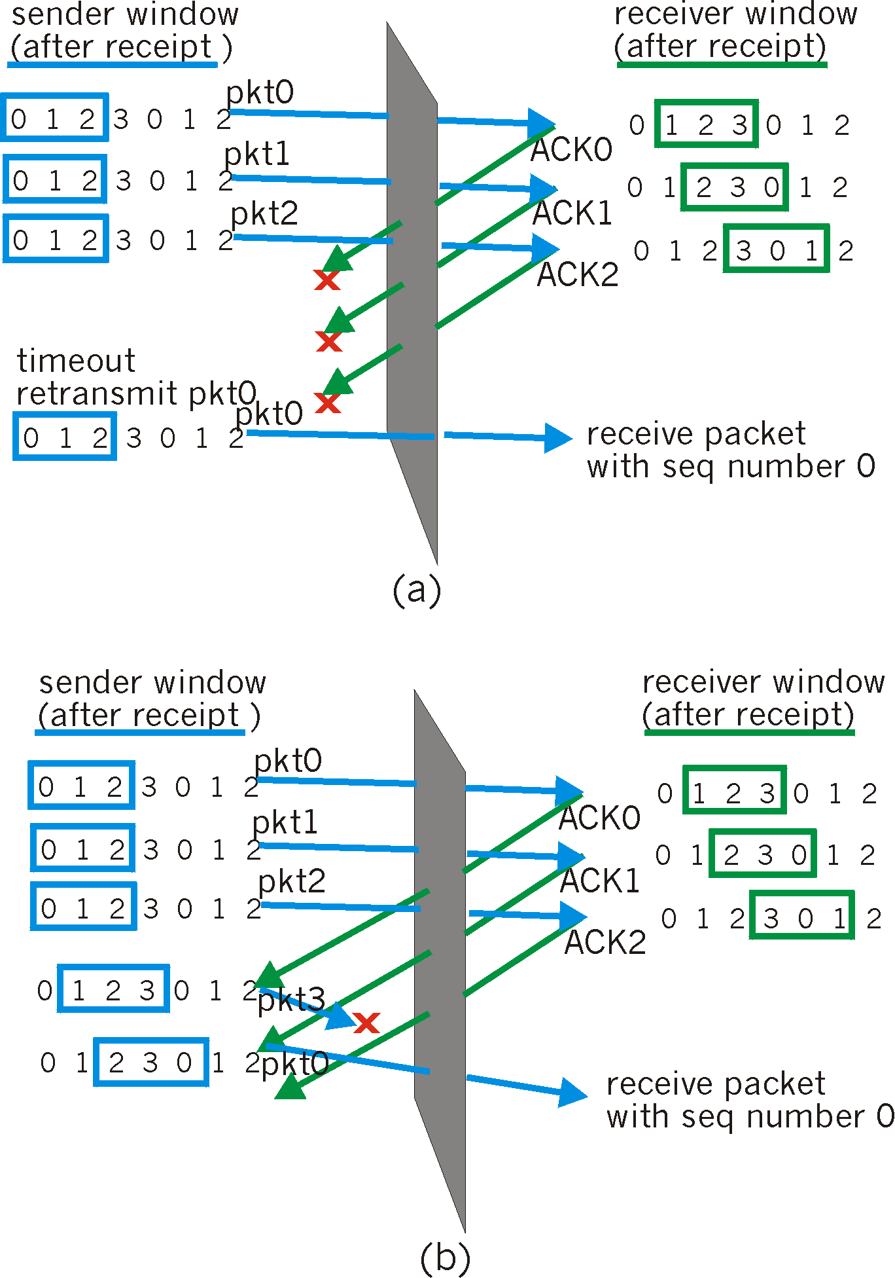
Selective repeat: dilemma
Example:
seq #’s: 0, 1, 2, 3
window size=3
receiver sees no difference in two scenarios!
incorrectly passes duplicate data as new in (a)
Q: what relationship
between seq # size and
window size is safe?

Slide 41
Agenda
Transport Layer
Multiplexing / Demultiplexing
Reliable Transport
Stop-and-go
Pipelined
Go back N
Selective Request
TCP
Congestion Control
Flow Control

Slide 42
TCP: Connection-Oriented Transport
TCP has 3 main components
Reliable transmission
Congestion Control
Flow Control

Slide 43
Reliable Transmission
TCP is connection-oriented
Sender sends control packets (SYN) and receiver replies (ACK)
Receiver also opens a similar connection
Sender sends a small burst of packets
Receiver ACKs: ACK contains the next expected packet (actually byte)
Sender receives ACK, and sends a bigger burst
Called “Self-clocking” behavior

Slide 44
Reliable Transmission
If train of packets lost
Sender will not get any ACKs
Will timeout (gets alarmed)
Retransmit from first un-ACK-ed packet,
Drastically reduces window size
If packet n lost, but (n+1) successful
Receiver will send Duplicate ACK
If many DupACKs, then receiver not alarmed
Resends (n+1)
Cuts window size by half

Slide 45
Congstion Control

Slide 46
TCP Congestion Control
Problem Definition
How much data should I pump into the network to ensure
Intermediate router queues not filling up
Fairness achieved among multiple TCP flows
Why is this problem difficult?
TCP cannot have information about the network
Only TCP receiver can give some feedbacks

Slide 47
The TCP Intuition
Pour
water
Collect
water

Slide 48
The TCP Protocol (in a nutshell)
T transmits few packets, waits for ACK
Called slow start
R acknowledges all packet till seq #i by ACK i (optimizations possible)
ACK sent out only on receiving a packet
Can be Duplicate ACK if expected packet not received
ACK reaches T → indicator of more capacity
T transmits larger burst of packets (self clocking) … so on
Burst size increased until packet drops (i.e., DupACK or timeout)
When T gets DupACK or waits for longer than RTO
Assumes congestion → reduces burst size (congestion window)

Slide 49
TCP Timeline
Host A
Host B
one segment
Think of a blind
person trying to
stand up in a low
ceiling room
Objective:
Don’t bang your
head, but stand
up quickly
RTT
two segments
four segments
time

Slide 50
When waited for > RTO
After RTO timeout
cwnd = 20
ssthresh = 8
ssthresh = 10
double CongWin every RTT
done by incrementing CongWin
for every ACK received

Slide 51
The TCP Protocol (in a nutshell)
DupACK not necessarily indicator of congestion
Can happen due to out of order (OOO) delivery of packets
If 3 OOO pkts, then CW need not be cut drastically
The DupACK packet retransmitted
Continue with same pace of transmission as before
(fast recovery)
R advertizes its receiver window in ACKs
If filling up, T reduces congestion window
Why ?

Slide 52
Fast Recovery on 3 OOO DupACKs
After fast recovery
Receiver’s advertized window

Slide 53
TCP sender congestion control
State | Event | TCP Sender Action | Commentary
Slow Start (SS) | ACK receipt for previously unacked data | CongWin = CongWin + MSS, If (CongWin > Threshold) set state to “Congestion Avoidance” | Resulting in a doubling of CongWin every RTT
Congestion Avoidance (CA) | ACK receipt for previously unacked data | CongWin = CongWin+MSS * (MSS/CongWin) | Additive increase, resulting in increase of CongWin by 1 MSS every RTT
SS or CA | Loss event detected by triple duplicate ACK | Threshold = CongWin/2, CongWin = Threshold, Set state to “Congestion Avoidance” | Fast recovery, implementing multiplicative decrease. CongWin will not drop below 1 MSS.
SS or CA | Timeout | Threshold = CongWin/2, CongWin = 1 MSS, Set state to “Slow Start” | Enter slow start
SS or CA | Duplicate ACK | Increment duplicate ACK count for segment being acked | CongWin and Threshold not changed

Slide 54
TCP Round Trip Time and Timeout
Q: how to set TCP timeout value?
longer than RTT
but RTT varies
too short: premature timeout
unnecessary retransmissions
too long: slow reaction to segment loss
RTO = Estimated-RTT + guard-factor

Slide 55
TCP Round Trip Time and Timeout
RTO = Estimated-RTT + guard-factor
Q: how to estimate RTT?
SampleRTT: measured time from segment transmission until ACK receipt
ignore retransmissions
SampleRTT will vary, want estimated RTT “smoother”
average several recent measurements, not just current SampleRTT

Slide 56
TCP Round Trip Time and Timeout
RTO = Estimated-RTT + guard-factor
EstimatedRTT = (1- α)*EstimatedRTT + α*SampleRTT
Exponential weighted moving average
influence of past sample decreases exponentially fast
typical value: α = 0.125

Slide 57
Example RTT estimation:

Slide 58
TCP Round Trip Time and Timeout
RTO = Estimated-RTT + guard-factor
Setting the timeout
EstimtedRTT plus “safety margin”
large variation in EstimatedRTT -> larger safety margin
first estimate of how much SampleRTT deviates from EstimatedRTT:
DevRTT = (1-β)*DevRTT +
β*|SampleRTT-EstimatedRTT|
(typically, β = 0.25)
Then set timeout interval:
TimeoutInterval = EstimatedRTT + 4*DevRTT

Slide 59
TCP Flow Control
Problem Definition
The receiver has limits on buffer
If many nodes transmitting to same receiver
Losses may happen at receiver
Need to avoid such losses
Solution
Receiver tells transmitter how much space left
Transmitter chooses its congestion window accordingly

Slide 60
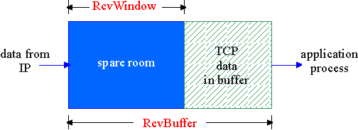
TCP Flow control: how it works
Rcvr advertises spare room by including value of RcvWindow in segments
Sender limits unACKed data to RcvWindow
guarantees receive buffer doesn’t overflow
(Suppose TCP receiver discards out-of-order segments)
spare room in buffer
= RcvWindow
= RcvBuffer-[LastByteRcvd - LastByteRead]

Slide 61
Why is TCP fair?
Two competing sessions:
Additive increase gives slope of 1, as throughout increases
multiplicative decrease decreases throughput proportionally
R
equal bandwidth share
loss: decrease window by factor of 2
congestion avoidance: additive increase
Connection 2 throughput
loss: decrease window by factor of 2
congestion avoidance: additive increase
Connection 1 throughput
R

Slide 62
Why is it different in Wireless?

Slide 63
Questions?
…

