Slide 1
Chapter 6: Wireless and Mobile Networks
Background:
# wireless (mobile) phone subscribers now exceeds # wired phone subscribers!
computer nets: laptops, palmtops, PDAs, Internet-enabled phone promise anytime untethered Internet access
two important (but different) challenges
communication over wireless link
handling mobile user who changes point of attachment to network

Slide 2
Chapter 6 outline
6.1 Introduction
Wireless
6.2 Wireless links, characteristics
CDMA
6.3 IEEE 802.11 wireless LANs (“wi-fi”)
6.4 Cellular Internet Access
architecture
standards (e.g., GSM)
Mobility
6.5 Principles: addressing and routing to mobile users
6.6 Mobile IP
6.7 Handling mobility in cellular networks
6.8 Mobility and higher-layer protocols
6.9 Summary

Slide 3
Elements of a wireless network
wireless hosts
laptop, PDA, IP phone
run applications
may be stationary (non-mobile) or mobile
wireless does not always mean mobility
network
infrastructure

Slide 4
Elements of a wireless network
base station
typically connected to wired network
relay - responsible for sending packets between wired network and wireless host(s) in its “area”
e.g., cell towers 802.11 access points
network
infrastructure

Slide 5
Elements of a wireless network
wireless link
typically used to connect mobile(s) to base station
also used as backbone link
multiple access protocol coordinates link access
various data rates, transmission distance
network
infrastructure

Slide 6
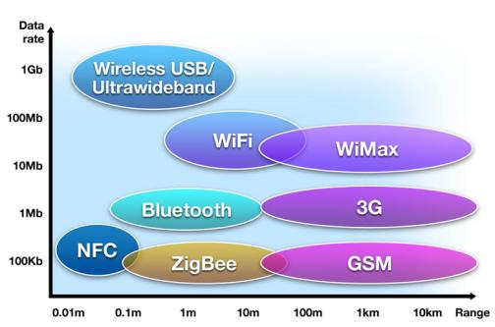

Slide 7
Characteristics of selected wireless link standards
54 Mbps
802.11{a,g}
5-11 Mbps
.11 p-to-p link
802.11b
1 Mbps
802.15
3G
384 Kbps
UMTS/WCDMA, CDMA2000
2G
56 Kbps
IS-95 CDMA, GSM
Indoor
10 – 30m
Outdoor
50 – 200m
Mid range
outdoor
200m – 4Km
Long range
outdoor
5Km – 20Km

Slide 8
Elements of a wireless network
infrastructure mode
base station connects mobiles into wired network
handoff: mobile changes base station providing connection into wired network
network
infrastructure

Slide 9
Elements of a wireless network
Ad hoc mode
no base stations
nodes can only transmit to other nodes within link coverage
nodes organize themselves into a network: route among themselves

Slide 10
Wireless Link Characteristics
Differences from wired link ….
decreased signal strength: radio signal attenuates as it propagates through matter (path loss)
interference from other sources: standardized wireless network frequencies (e.g., 2.4 GHz) shared by other devices (e.g., phone); devices (motors) interfere as well
multipath propagation: radio signal reflects off objects ground, arriving ad destination at slightly different times
…. make communication across (even a point to point) wireless link much more “difficult”

Slide 11
Wireless network characteristics
Multiple wireless senders and receivers create additional problems (beyond multiple access):
A
B
C
C
A’s signal
strength
C’s signal
strength
B
A
Hidden terminal problem
B, A hear each other
B, C hear each other
A, C can not hear each other
means A, C unaware of their interference at B
space
Signal fading:
B, A hear each other
B, C hear each other
A, C can not hear each other interferring at B

Slide 12
Code Division Multiple Access (CDMA)
used in several wireless broadcast channels (cellular, satellite, etc) standards
unique “code” assigned to each user; i.e., code set partitioning
all users share same frequency, but each user has own “chipping” sequence (i.e., code) to encode data
encoded signal = (original data) X (chipping sequence)
decoding: inner-product of encoded signal and chipping sequence
allows multiple users to “coexist” and transmit simultaneously with minimal interference (if codes are “orthogonal”)

Slide 13
CDMA Encode/Decode
channel output Z_{i,m}
Z_{i,m}= d_{i}.c_{m}
data
bits
d₀ = 1
1
1
1
1
1
d₁ = -1
1
1
1
-
-
-
-
1
-
-
-
1
-
1
1
1
1
1
sender
1
1
slot 1
channel
output
slot 0
channel
output
1
1
1
1
1
code
1
1
-
-
-
1
-
1
1
1
-
-
-
1
-
1
1
1
slot 1
slot 0
M
D_{i} = Σ Z_{i,m}.c_{m}
m=1
M
received
input
1
1
1
1
1
1
1
1
d₀ = 1
-
-
-
-
1
-
-
-
1
-
1
1
1
1
1
1
d₁ = -1
1
slot 1
channel
output
slot 0
channel
output
1
1
1
1
1
code
1
1
-
-
-
1
-
1
1
1
-
-
-
1
-
1
1
1
receiver
slot 1
slot 0

Slide 14
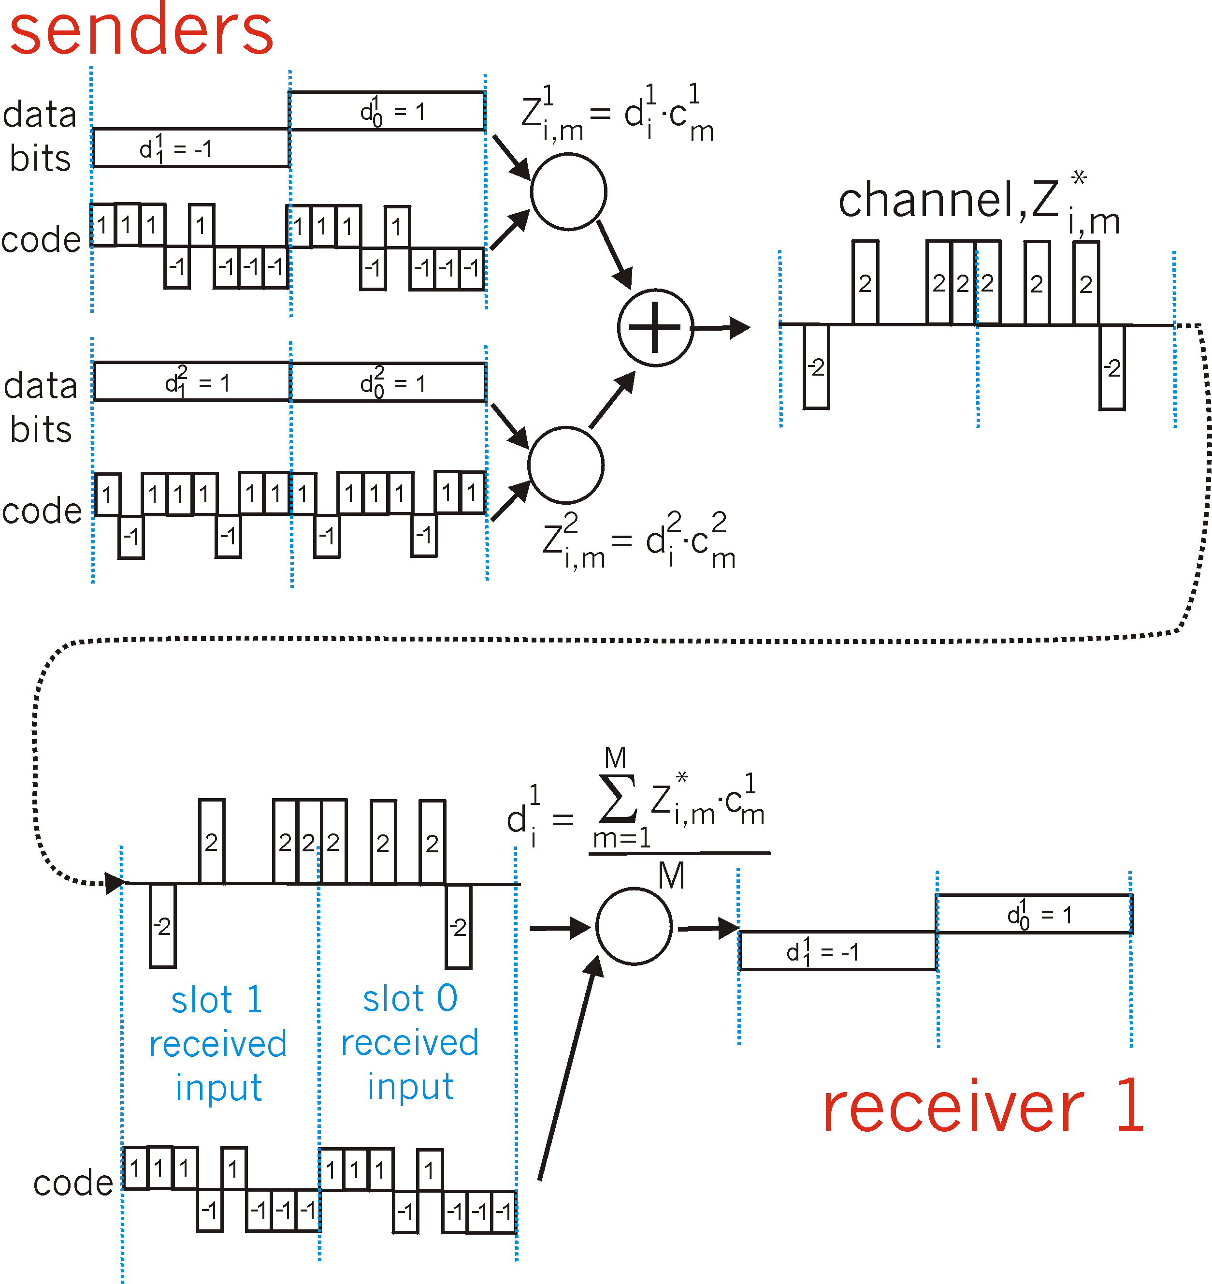
CDMA: two-sender interference

Slide 15
Chapter 6 outline
6.1 Introduction
Wireless
6.2 Wireless links, characteristics
CDMA
6.3 IEEE 802.11 wireless LANs (“wi-fi”)
6.4 Cellular Internet Access
architecture
standards (e.g., GSM)
Mobility
6.5 Principles: addressing and routing to mobile users
6.6 Mobile IP
6.7 Handling mobility in cellular networks
6.8 Mobility and higher-layer protocols
6.9 Summary

Slide 16
IEEE 802.11 Wireless LAN
802.11b
2.4-5 GHz unlicensed radio spectrum
up to 11 Mbps
direct sequence spread spectrum (DSSS) in physical layer
all hosts use same chipping code
widely deployed, using base stations
802.11a
5-6 GHz range
up to 54 Mbps
802.11g
2.4-5 GHz range
up to 54 Mbps
All use CSMA/CA for multiple access
All have base-station and ad-hoc network versions

Slide 17
802.11 LAN architecture
wireless host communicates with base station
base station = access point (AP)
Basic Service Set (BSS) (aka “cell”) in infrastructure mode contains:
wireless hosts
access point (AP): base station
ad hoc mode: hosts only
Internet
hub, switch
or router
AP
BSS 1
AP
BSS 2

Slide 18
802.11: Channels, association
802.11b: 2.4GHz-2.485GHz spectrum divided into 11 channels at different frequencies
AP admin chooses frequency for AP
interference possible: channel can be same as that chosen by neighboring AP!
host: must associate with an AP
scans channels, listening for beacon frames containing AP’s name (SSID) and MAC address
selects AP to associate with
may perform authentication [Chapter 8]
will typically run DHCP to get IP address in AP’s subnet

Slide 19
IEEE 802.11: multiple access
avoid collisions: 2⁺ nodes transmitting at same time
802.11: CSMA - sense before transmitting
don’t collide with ongoing transmission by other node
802.11: no collision detection!
difficult to receive (sense collisions) when transmitting due to weak received signals (fading)
can’t sense all collisions in any case: hidden terminal, fading
goal: avoid collisions: CSMA/C(ollision)A(voidance)
A
B
C
C
A’s signal
strength
C’s signal
strength
B
A
space

Slide 20
IEEE 802.11 MAC Protocol: CSMA/CA
802.11 sender
1 if sense channel idle for DIFS then
transmit entire frame (no CD)
2 if sense channel busy then
start random backoff time
timer counts down while channel idle
transmit when timer expires
if no ACK, increase random backoff interval, repeat 2
802.11 receiver
- if frame received OK
return ACK after SIFS (ACK needed due to hidden terminal problem)
sender
receiver
DIFS
data
SIFS
ACK

Slide 21
Avoiding collisions (more)
idea: allow sender to “reserve” channel rather than random access of data frames: avoid collisions of long data frames
sender first transmits small request-to-send (RTS) packets to BS using CSMA
RTSs may still collide with each other (but they’re short)
BS broadcasts clear-to-send CTS in response to RTS
RTS heard by all nodes
sender transmits data frame
other stations defer transmissions
Avoid data frame collisions completely
using small reservation packets!

Slide 22
Collision Avoidance: RTS-CTS exchange
A
B
AP
RTS(B)
RTS(A)
reservation collision
RTS(A)
CTS(A)
CTS(A)
DATA (A)
defer
time
ACK(A)
ACK(A)

Slide 23
802.11 frame: addressing
2
2
6
6
6
2
6
0 - 2312
4
frame
control
duration
address
1
address
2
address
3
seq
control
address
4
payload
CRC
Address 4: used only in ad hoc mode
Address 1: MAC address
of wireless host or AP
to receive this frame
Address 3: MAC address
of router interface to which AP is attached
Address 2: MAC address
of wireless host or AP
transmitting this frame

Slide 24
802.11 frame: addressing
Internet
H1
R1
router
AP
R1 MAC addr AP MAC addr
dest. address
source address
802.3 frame
AP MAC addr H1 MAC addr R1 MAC addr
address 1
address 2
address 3
802.11 frame

Slide 25
802.11 frame: more
frame seq #
(for reliable ARQ)
duration of reserved
transmission time (RTS/CTS)
2
2
6
6
6
2
6
0 - 2312
4
frame
control
duration
address
1
address
2
address
3
seq
control
address
4
payload
CRC
2
2
4
1
1
1
1
1
1
1
1
Protocol
version
Type
Subtype
To
AP
From
AP
More
frag
Retry
Power
mgt
More
data
WEP
Rsvd
frame type
(RTS, CTS, ACK, data)

Slide 26
802.11: mobility within same subnet
H1 remains in same IP subnet: IP address can remain same
switch: which AP is associated with H1?
self-learning (Ch. 5): switch will see frame from H1 and “remember” which switch port can be used to reach H1
router
hub or
switch
BBS 1
AP 1
AP 2
H1
BBS 2

Slide 27
802.15: personal area network
less than 10 m diameter
replacement for cables (mouse, keyboard, headphones)
ad hoc: no infrastructure
master/slaves:
slaves request permission to send (to master)
master grants requests
802.15: evolved from Bluetooth specification
2.4-2.5 GHz radio band
up to 721 kbps
S
P
P
radius of
coverage
M
S
S
P
P
M
Master device
Slave device
Parked device (inactive)
S
P

Slide 28
Chapter 6 outline
6.1 Introduction
Wireless
6.2 Wireless links, characteristics
6.3 IEEE 802.11 wireless LANs (“wi-fi”)
6.4 Cellular Internet Access
architecture
standards (e.g., GSM)
Mobility
6.5 Principles: addressing and routing to mobile users
6.6 Mobile IP
6.7 Handling mobility in cellular networks
6.8 Mobility and higher-layer protocols
6.9 Summary

Slide 29
Components of cellular network architecture
MSC
connects cells to wide area net
manages call setup (more later!)
handles mobility (more later!)
cell
covers geographical region
base station (BS) analogous to 802.11 AP
mobile users attach to network through BS
air-interface: physical and link layer protocol between mobile and BS
Mobile
Switching
Center
Public telephone
network, and
Internet
Mobile
Switching
Center
wired network

Slide 30
Cellular networks: the first hop
Two techniques for sharing mobile-to-BS radio spectrum
combined FDMA/TDMA: divide spectrum in frequency channels, divide each channel into time slots
CDMA: code division multiple access
time slots
frequency
bands

Slide 31
Cellular standards: brief survey
2G systems: voice channels
IS-136 TDMA: combined FDMA/TDMA (north america)
GSM (global system for mobile communications): combined FDMA/TDMA
most widely deployed
IS-95 CDMA: code division multiple access
CDMA-2000
TDMA/FDMA
GPRS
EDGE
UMTS
Don’t drown in a bowl
of alphabet soup
IS-136
GSM
IS-95

Slide 32
Cellular standards: brief survey
2.5 G systems: voice and data channels
for those who can’t wait for 3G service: 2G extensions
general packet radio service (GPRS)
evolved from GSM
data sent on multiple channels (if available)
enhanced data rates for global evolution (EDGE)
also evolved from GSM, using enhanced modulation
Date rates up to 384K
CDMA-2000 (phase 1)
data rates up to 144K
evolved from IS-95

Slide 33
Cellular standards: brief survey
3G systems: voice/data
Universal Mobile Telecommunications Service (UMTS)
CDMA-2000
….. more (and more interesting) cellular topics due to mobility (stay tuned for details)

Slide 34
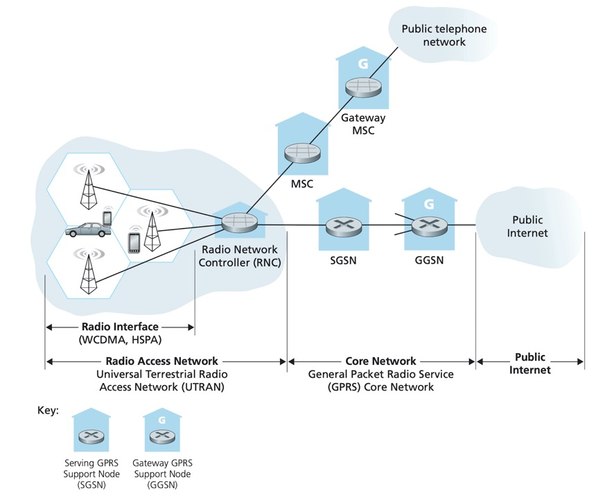

Slide 35
Chapter 6 outline
6.1 Introduction
Wireless
6.2 Wireless links, characteristics
CDMA
6.3 IEEE 802.11 wireless LANs (“wi-fi”)
6.4 Cellular Internet Access
architecture
standards (e.g., GSM)
Mobility
6.5 Principles: addressing and routing to mobile users
6.6 Mobile IP
6.7 Handling mobility in cellular networks
6.8 Mobility and higher-layer protocols
6.9 Summary

Slide 36
What is mobility?
spectrum of mobility, from the network perspective:
no mobility
high mobility
mobile wireless user,
using same access
point
mobile user, connecting/ disconnecting from network using DHCP.
mobile user, passing through multiple access point while maintaining ongoing connections (like cell phone)

Slide 37
Mobility: Vocabulary
home network: permanent “home” of mobile
(e.g., 128.119.40/24)
home agent: entity that will perform mobility functions on behalf of mobile, when mobile is remote
wide area network
Permanent address: address in home network, can always be used to reach mobile
e.g., 128.119.40.186
correspondent

Slide 38
Mobility: more vocabulary
visited network: network in which mobile currently resides (e.g., 79.129.13/24)
Permanent address: remains constant (e.g., 128.119.40.186)
Care-of-address: address in visited network.
(e.g., 79,129.13.2)
wide area network
foreign agent: entity in visited network that performs mobility functions on behalf of mobile.
correspondent: wants to communicate with mobile

Slide 39
How do you contact a mobile friend:
Consider friend frequently changing addresses, how do you find her?
I wonder where Alice moved to?
search all phone books?
call her parents?
expect her to let you know where he/she is?

Slide 40
Mobility: approaches
Let routing handle it: routers advertise permanent address of mobile-nodes-in-residence via usual routing table exchange.
routing tables indicate where each mobile located
no changes to end-systems
Let end-systems handle it:
indirect routing: communication from correspondent to mobile goes through home agent, then forwarded to remote
direct routing: correspondent gets foreign address of mobile, sends directly to mobile

Slide 41
Mobility: approaches
Let routing handle it: routers advertise permanent address of mobile-nodes-in-residence via usual routing table exchange.
routing tables indicate where each mobile located
no changes to end-systems
let end-systems handle it:
indirect routing: communication from correspondent to mobile goes through home agent, then forwarded to remote
direct routing: correspondent gets foreign address of mobile, sends directly to mobile
not
scalable
to millions of
mobiles

Slide 42
Mobility: registration
visited network
home network
1
2
wide area network
mobile contacts foreign agent on entering visited network
foreign agent contacts home agent home: “this mobile is resident in my network”
End result:
Foreign agent knows about mobile
Home agent knows location of mobile

Slide 43
Mobility via Indirect Routing
foreign agent receives packets, forwards to mobile
home agent intercepts packets, forwards to foreign agent
visited
network
home
network
3
wide area network
2
1
correspondent addresses packets using home address of mobile
4
mobile replies directly to correspondent

Slide 44
Indirect Routing: comments
Mobile uses two addresses:
permanent address: used by correspondent (hence mobile location is transparent to correspondent)
care-of-address: used by home agent to forward datagrams to mobile
triangle routing: correspondent-home-network-mobile
inefficient when
correspondent, mobile
are in same network

Slide 45
Indirect Routing: moving between networks
suppose mobile user moves to another network
registers with new foreign agent
new foreign agent registers with home agent
home agent update care-of-address for mobile
packets continue to be forwarded to mobile (but with new care-of-address)
mobility, changing foreign networks transparent: on going connections can be maintained!

Slide 46
Mobility via Direct Routing
foreign agent receives packets, forwards to mobile
correspondent forwards to foreign agent
visited
network
home
network
4
wide area network
2
3
correspondent requests, receives foreign address of mobile
1
4
mobile replies directly to correspondent

Slide 47
Mobility via Direct Routing: comments
overcome triangle routing problem
non-transparent to correspondent: correspondent must get care-of-address from home agent
what if mobile changes visited network?

Slide 48
Accommodating mobility with direct routing
anchor foreign agent: FA in first visited network
data always routed first to anchor FA
when mobile moves: new FA arranges to have data forwarded from old FA (chaining)
foreign net visited
at session start
anchor
foreign
agent
wide area network
2
1
4
5
3
new
foreign
network
correspondent
agent
new foreign
agent
correspondent

Slide 49
Chapter 6 outline
6.1 Introduction
Wireless
6.2 Wireless links, characteristics
CDMA
6.3 IEEE 802.11 wireless LANs (“wi-fi”)
6.4 Cellular Internet Access
architecture
standards (e.g., GSM)
Mobility
6.5 Principles: addressing and routing to mobile users
6.6 Mobile IP
6.7 Handling mobility in cellular networks
6.8 Mobility and higher-layer protocols
6.9 Summary

Slide 50
Mobile IP
RFC 3220
has many features we’ve seen:
home agents, foreign agents, foreign-agent registration, care-of-addresses, encapsulation (packet-within-a-packet)
three components to standard:
indirect routing of datagrams
agent discovery
registration with home agent

Slide 51
Mobile IP: indirect routing
foreign-agent-to-mobile packet
packet sent by home agent to foreign agent: a packet within a packet
dest: 128.119.40.186
dest: 79.129.13.2
dest: 128.119.40.186
Permanent address: 128.119.40.186
Care-of address: 79.129.13.2
dest: 128.119.40.186
packet sent by correspondent

Slide 52
Mobile IP: agent discovery
agent advertisement: foreign/home agents advertise service by broadcasting ICMP messages (typefield = 9)
H,F bits: home and/or foreign agent
R bit: registration required

Slide 53
Mobile IP: registration example

Slide 54
Components of cellular network architecture
recall:
correspondent
wired public telephone
network
MSC
MSC
MSC
MSC
MSC
different cellular networks,
operated by different providers

Slide 55
Handling mobility in cellular networks
home network: network of cellular provider you subscribe to (e.g., Sprint PCS, Verizon)
home location register (HLR): database in home network containing permanent cell phone #, profile information (services, preferences, billing), information about current location (could be in another network)
visited network: network in which mobile currently resides
visitor location register (VLR): database with entry for each user currently in network
could be home network

Slide 56
GSM: indirect routing to mobile
HLR
home
network
2
correspondent
home
Mobile
Switching
Center
home MSC consults HLR,
gets roaming number of
mobile in visited network
1
call routed
to home network
3
Public switched
telephone
network
VLR
Mobile
Switching
Center
4
home MSC sets up 2nd leg of call
to MSC in visited network
mobile
user
MSC in visited network completes
call through base station to mobile
visited
network

Slide 57
GSM: handoff with common MSC
Handoff goal: route call via new base station (without interruption)
reasons for handoff:
stronger signal to/from new BSS (continuing connectivity, less battery drain)
load balance: free up channel in current BSS
GSM doesn’t mandate why to perform handoff (policy), only how (mechanism)
handoff initiated by old BSS
VLR
Mobile
Switching
Center
old
routing
new
routing
old BSS
new BSS

Slide 58
GSM: handoff with common MSC
1. old BSS informs MSC of impending handoff, provides list of 1⁺ new BSSs
2. MSC sets up path (allocates resources) to new BSS
3. new BSS allocates radio channel for use by mobile
4. new BSS signals MSC, old BSS: ready
5. old BSS tells mobile: perform handoff to new BSS
6. mobile, new BSS signal to activate new channel
7. mobile signals via new BSS to MSC: handoff complete. MSC reroutes call
8 MSC-old-BSS resources released
VLR
Mobile
Switching
Center
4
2
1
8
7
3
old BSS
5
6
new BSS

Slide 59
GSM: handoff between MSCs
anchor MSC: first MSC visited during call
call remains routed through anchor MSC
new MSCs add on to end of MSC chain as mobile moves to new MSC
IS-41 allows optional path minimization step to shorten multi-MSC chain
home network
correspondent
Home MSC
anchor MSC
PSTN
MSC
MSC
MSC
(a) before handoff

Slide 60
GSM: handoff between MSCs
anchor MSC: first MSC visited during cal
call remains routed through anchor MSC
new MSCs add on to end of MSC chain as mobile moves to new MSC
IS-41 allows optional path minimization step to shorten multi-MSC chain
home network
correspondent
Home MSC
anchor MSC
PSTN
MSC
MSC
MSC
(b) after handoff

Slide 61
Chapter 6 Summary
Wireless
wireless links:
capacity, distance
channel impairments
CDMA
IEEE 802.11 (“wi-fi”)
CSMA/CA reflects wireless channel characteristics
cellular access
architecture
standards (e.g., GSM, CDMA-2000, UMTS)
Mobility
principles: addressing, routing to mobile users
home, visited networks
direct, indirect routing
care-of-addresses
case studies
mobile IP
mobility in GSM

Slide 62
Questions?

Slide 63
Mobility: GSM versus Mobile IP
GSM element |  | Comment on GSM element | Mobile IP element
Home system | Network to which the mobile user’s permanent phone number belongs |  |  | Home network
Gateway Mobile Switching Center, or “home MSC”. Home Location Register (HLR) | Home MSC: point of contact to obtain routable address of mobile user. HLR: database in home system containing permanent phone number, profile information, current location of mobile user, subscription information |  |  | Home agent
Visited System | Network other than home system where mobile user is currently residing |  |  | Visited network
Visited Mobile services Switching Center. Visitor Location Record (VLR) | Visited MSC: responsible for setting up calls to/from mobile nodes in cells associated with MSC. VLR: temporary database entry in visited system, containing subscription information for each visiting mobile user |  |  | Foreign agent
Mobile Station Roaming Number (MSRN), or “roaming number” | Routable address for telephone call segment between home MSC and visited MSC, visible to neither the mobile nor the correspondent. |  |  | Care-of-address

Slide 64
Wireless, mobility: impact on higher layer protocols
logically, impact should be minimal …
best effort service model remains unchanged
TCP and UDP can (and do) run over wireless, mobile
… but performance-wise:
packet loss/delay due to bit-errors (discarded packets, delays for link-layer retransmissions), and handoff
TCP interprets loss as congestion, will decrease congestion window un-necessarily
delay impairments for real-time traffic
limited bandwidth of wireless links

