Slide 1
Mobile Computing and Applications
ECE 434
Spring 2021
Romit Roy Choudhury
Dept. of ECE and CS

Slide 2
Course Logistics Course Theme Course Structure Assorted Thoughts

Slide 3
Course Logistics Course Theme Assorted Thoughts

Slide 4
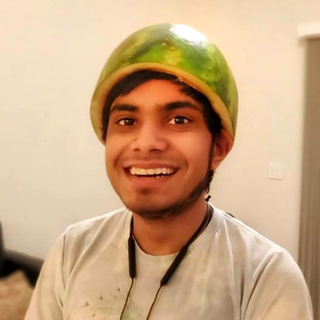
Welcome to ECE 434
Timings: M/W 10am
Location: Zoom
Course TAs: Liz Li
ziyueli3@illinois.edu
Shreyas Kishore
kishore4@illinois.edu
Insructor: Romit Roy Choudhury
PhD from UIUC, 2006
Faculty at Duke University, 2006-2013
Research in Wireless Networks, Mobile Computing
Email me at croy@illinois.edu
Visit me at 263 Coordinated Science Lab

Slide 5
Welcome to ECE 434
Prerequisite: Basic math (linear alg., prob.)
Some programming (Python, MATLAB)
Basically, UG junior, senior, or grad students
Any of you low on prerequisites?
How many CS, how many ECE?

Slide 6
Welcome to ECE 434
Grading:
Homework (2-3): 20%
Paper reviews (5-8): 10%
Machine problems (5-6): 40%
Midterm (April 21): 25%
For 3 credit students only:
Best of (N-1) MP
For 4 credit students only:
All N MPs

Slide 7
Welcome to ECE 434
Course Website:
Most course related information will be posted at:
https://courses.grainger.illinois.edu/cs434/sp2021/
Please check course website frequently

Slide 8
Course Logistics Course Theme (big picture) Assorted Thoughts

Slide 9
1970s to early 2000:
Consistent innovation in wireless/mobile communication

Slide 10
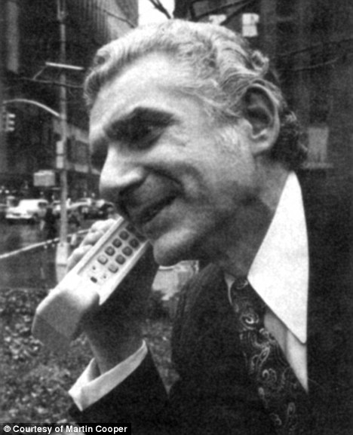
First mobile phone - 1973

Slide 11
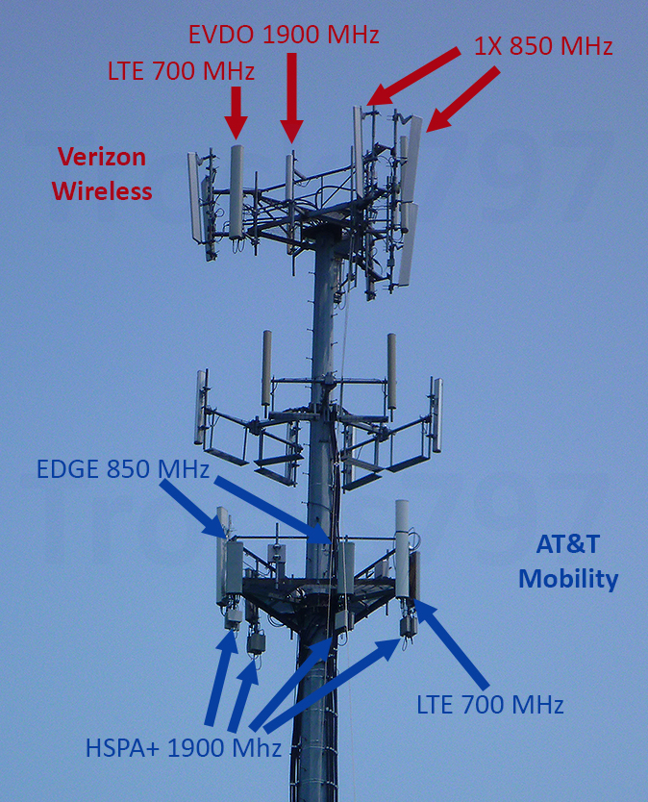
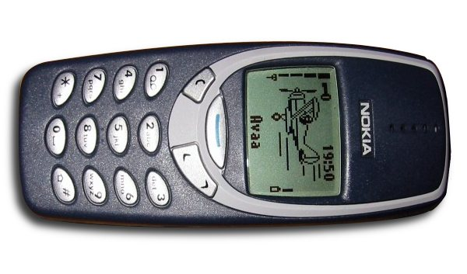
Ubiquitous voice (GSM, CDMA)
Data connectivity coming soon
(2G, 3G, LTE, WiMax, …)

Slide 12
Technological innovation was great from
a consumer standpoint
But, what about the company’s
business perspective …

Slide 13
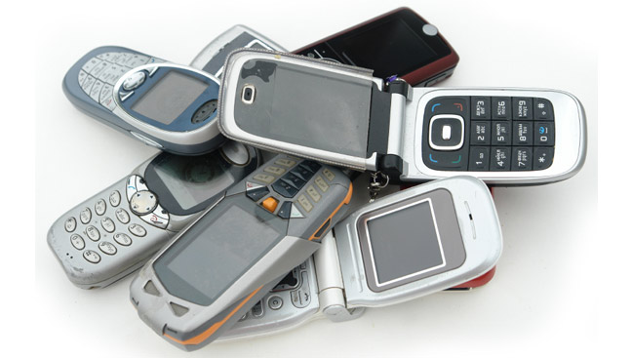
But technology/device easily commoditized
All companies can make them
Long term revenue stream unclear …
Especially big companies with high overheads/cost

Slide 14
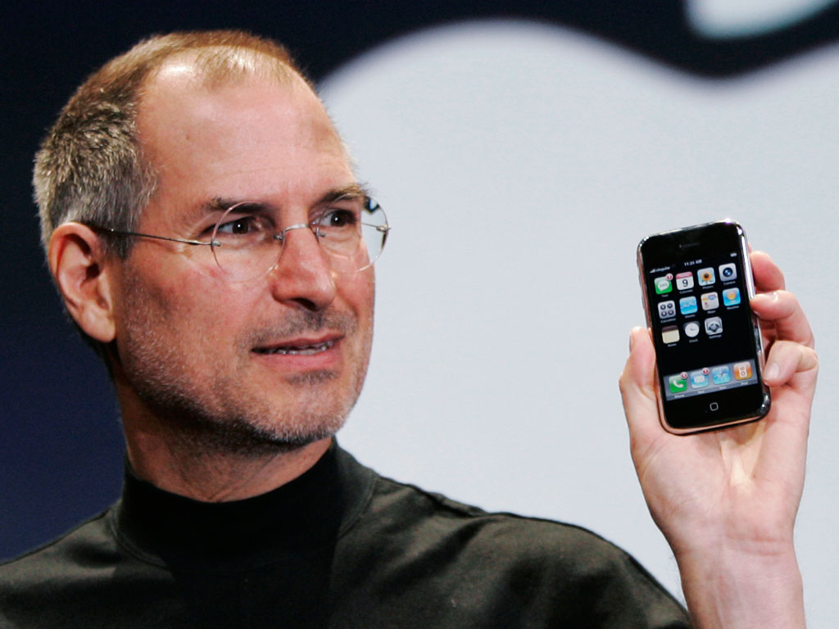
Realization:
Hard to commoditize creativity …
Eco-system of apps and services will always
keep you ahead …

Slide 15
But, you need app developers to attract users …
You need users to attract app developers

Slide 16
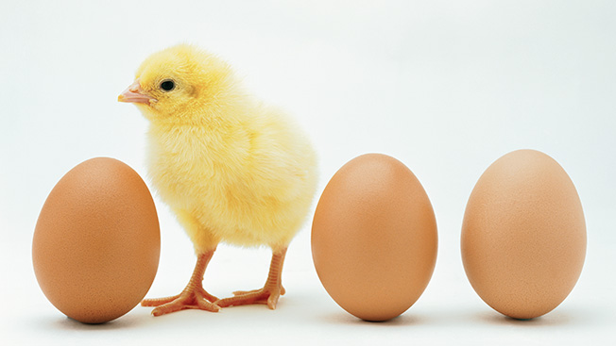
A chicken & egg problem at bootstrap
Developers will not join until profitable …
will not be profitable unless many developers join

Slide 17
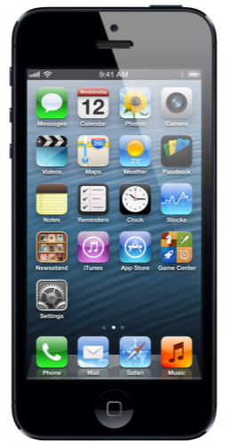
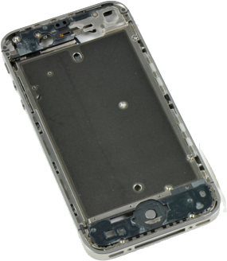
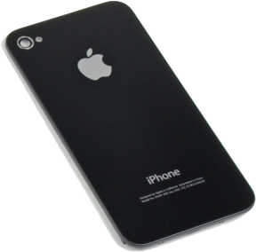
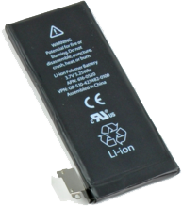
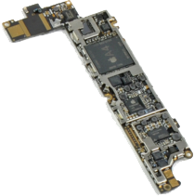
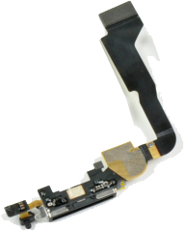
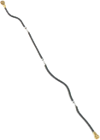
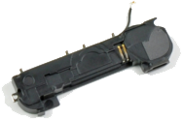
Offer something irresistable
Hardware + CPU + sensors + interface + aesthetics …
To win over app developers and customers

Slide 18
And very importantly, the channel for app development
and delivery – the app store

Slide 19
It worked!

Slide 20
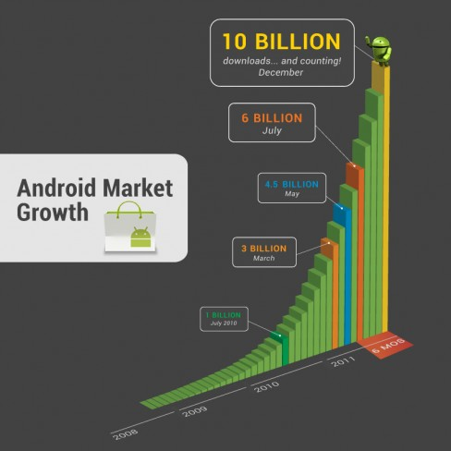
And Google
caught up !

Slide 21
But…

Slide 22
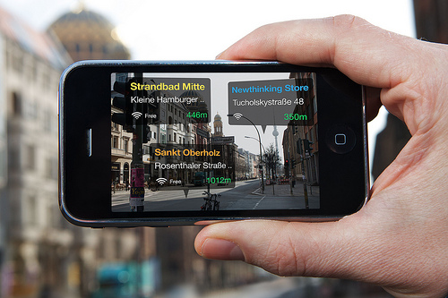
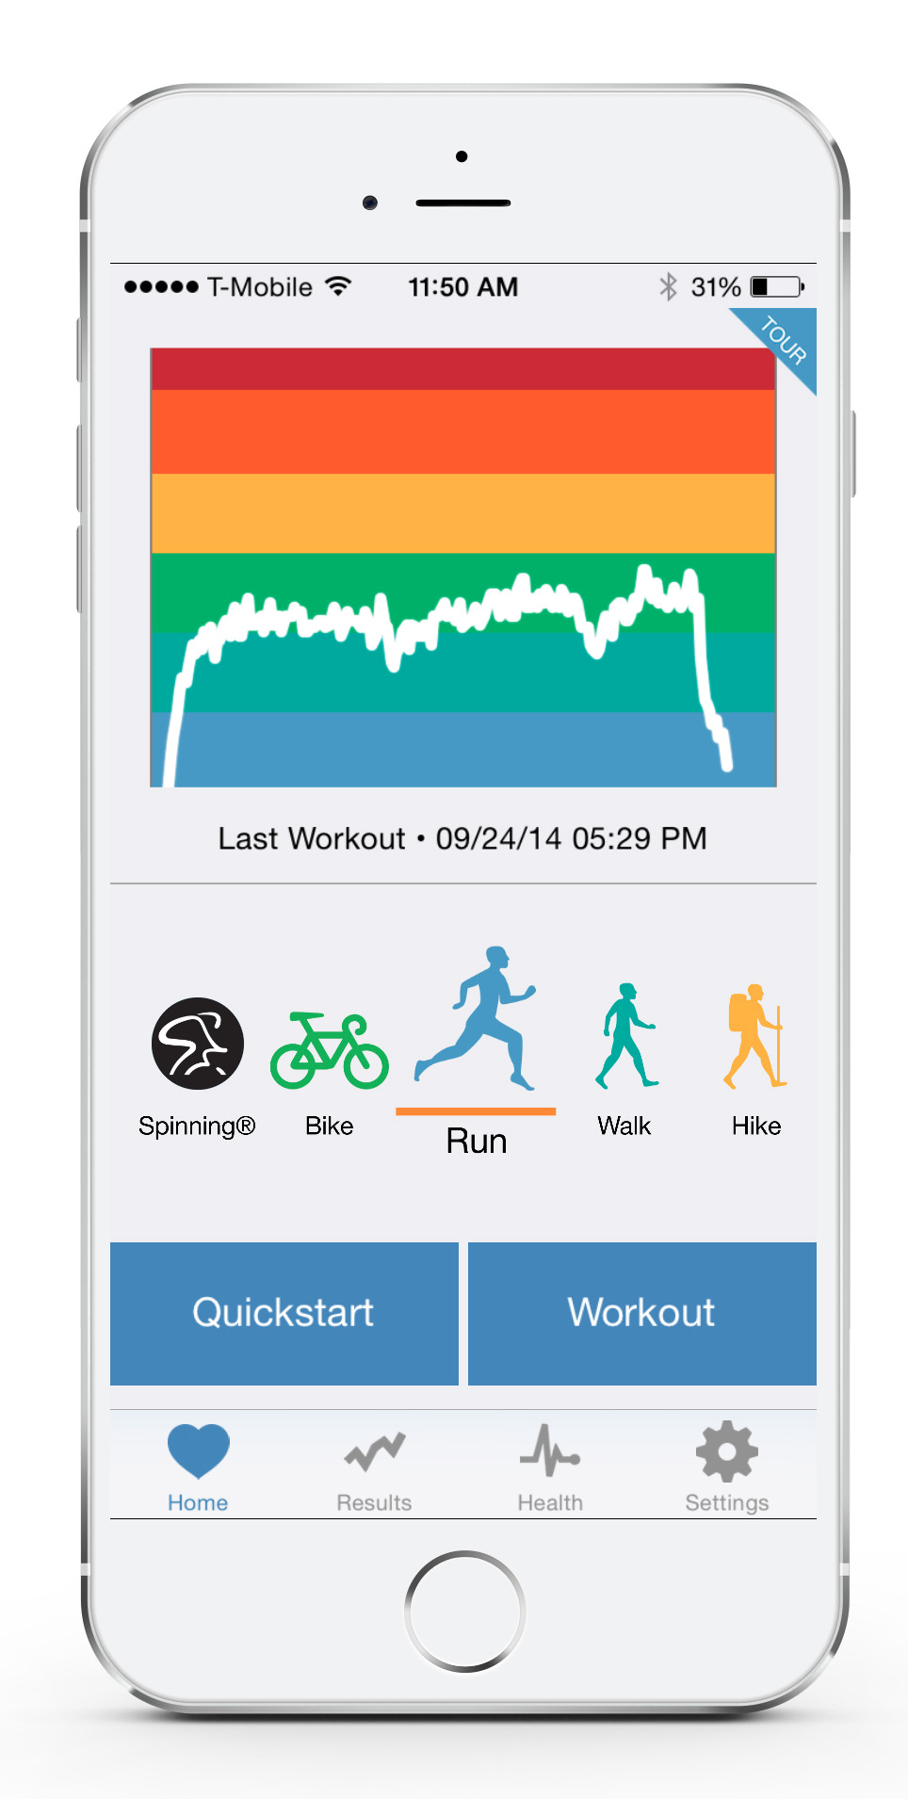
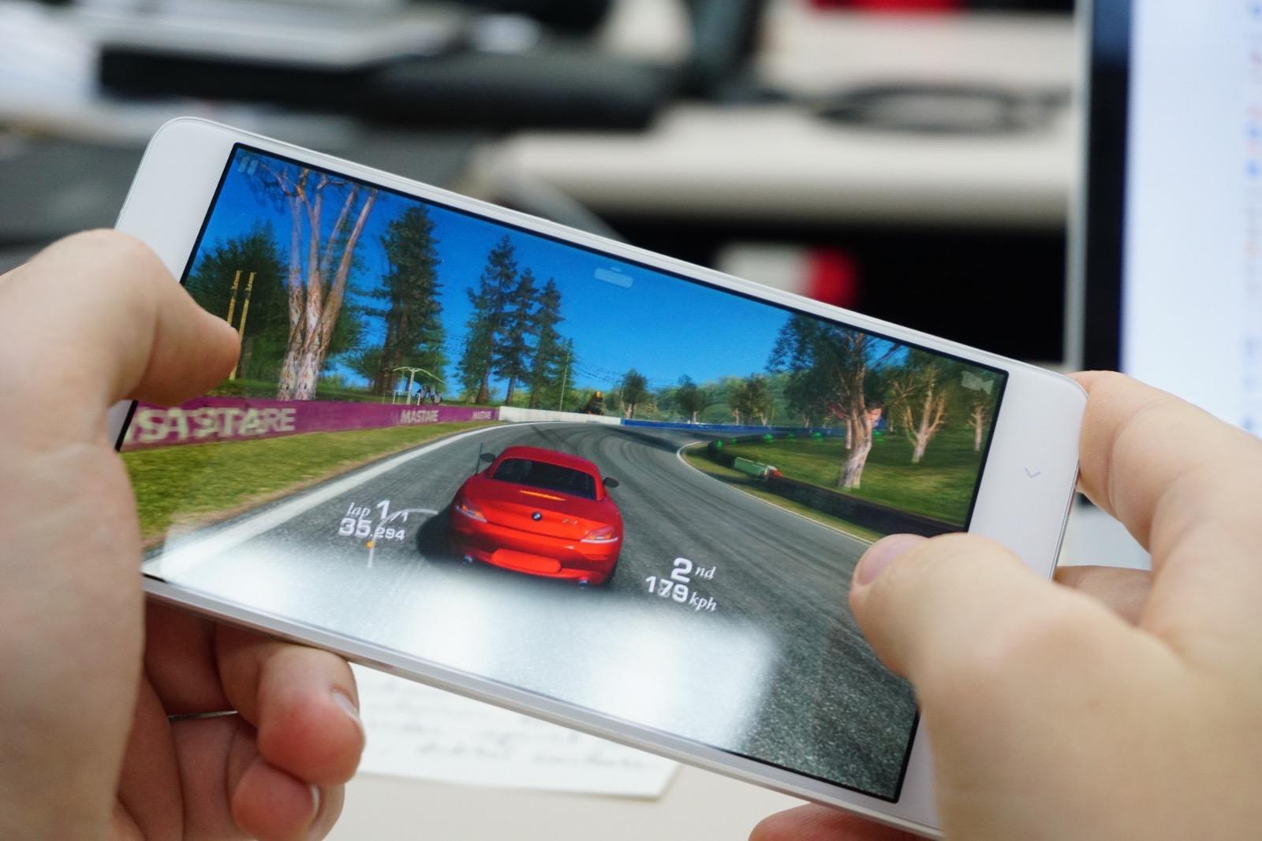
Most Apps = Low Hanging Fruit
Recycling the Same Building Blocks

Slide 23
Getting harder to make money off apps
Startups heavily leveraging business innovation
Technological underpins not arriving fast
Cannot sustain for long …
New technology building blocks, ideas, crucial

Slide 24
Need you to take it to the next level …
Through novel ideas, better research, and execution.

Slide 25
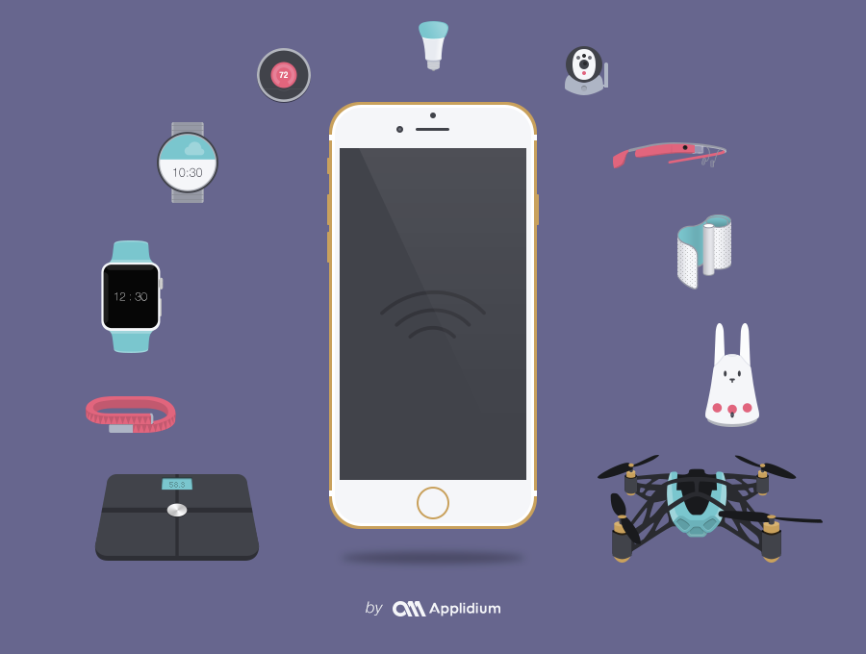
Not just smartphones, but
the whole IoT spectrum

Slide 26
This Course – A First Step Towards …
Developing future-facing sensor-centric technologies

Slide 27
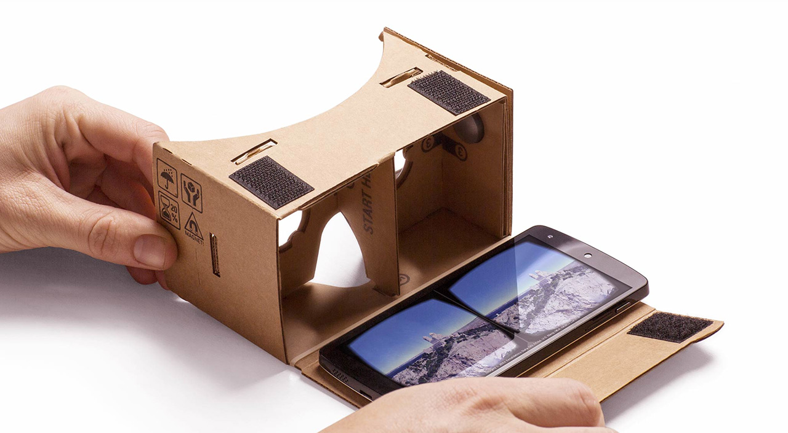
This Course – A First Step Towards …
Developing future-facing sensor-centric technologies
Will take a practical approach:
Build systems (top-down) with some mathematical framework (bottom-up)

Slide 28
Not a course on
programming
or app design
This ECE 434
Programming
and apps
Math
foundations
Not a course on
linear algebra,
probability, DSP
Algorithms and
Techniques
Not a course on
Algorithms

Slide 29
For Example …

Slide 30
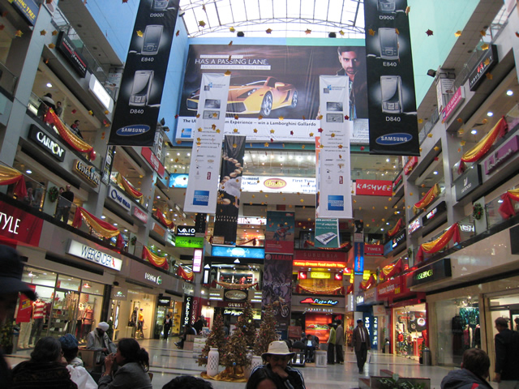
Indoor Localization

Slide 31
Smartwatch Gesture Tracking

Slide 32
Smartwatch Gesture Tracking

Slide 33
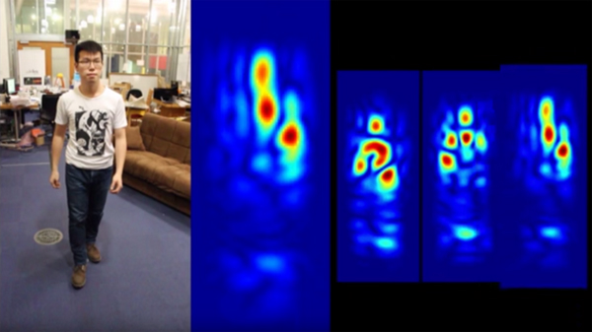
Wireless Gesture Tracking

Slide 34
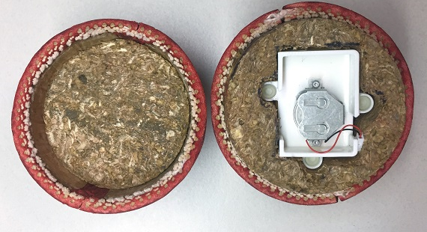
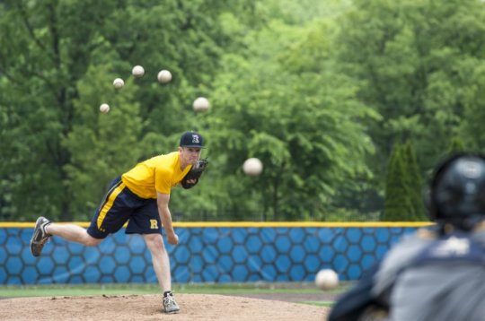
Sports Analytics
Motion sensors

Slide 35
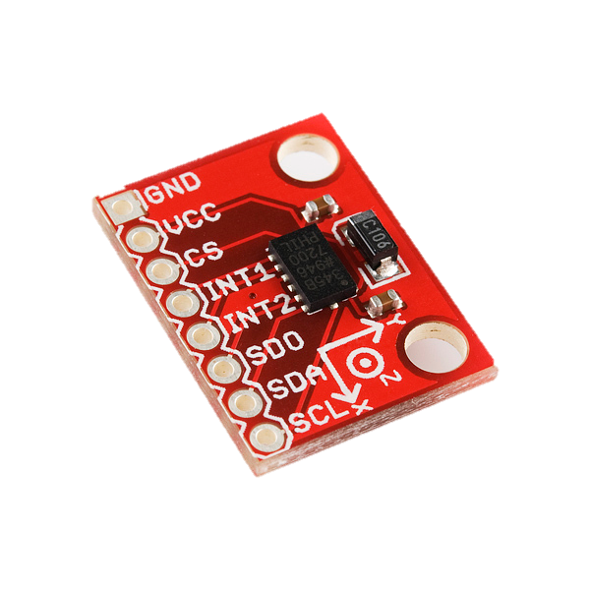
Vibration Motors & Sensors
Accelerometer
Vibration Motor

Slide 36
Vibration Motors & Sensors
Accelerometer
Vibration Motor

Slide 37
Security and Privacy
Inaudible to humans
Audible malicious commands to Alexa

Slide 38
Inaudible Acoustics

Slide 39
Earphones and Acoustics
2005
2015
2018
2023

Slide 40
Spatial Acoustics
Different propagation
delays at two ears

Slide 41
Spatial Acoustics
Different propagation
delays at two ears
Inject artificial delays as if sounds coming from a specific direction

Slide 42
Spatial Acoustics
Different propagation
delays at two ears
Inject artificial delays as if sounds coming from a specific direction
But delays are not unique along hyperbola

Slide 43
Spatial Acoustics
Different propagation
delays at two ears
Inject artificial delays as if sounds coming from a specific direction
But delays are not unique along hyperbola
Personal Transfer Function

Slide 44
Spatial Acoustics
Different propagation
delays at two ears
Inject artificial delays as if sounds coming from a specific direction
But delays are not unique along hyperbola
Personal Transfer Function
3D Gazing
Direction

Slide 45
Spatial Acoustics
Voice Escort
Acoustic Augmented
Reality (AAR)
Follow
Me
Starbucks
here

Slide 46
Idea
Augmented Reality
Last year’s tax statements
Allow random indoor object tagging
Others should be able to retrieve
Faulty Monitor
Wish mom birthday
Return CDs
Notes:
This animation shows the vision of this talk. We would like to enabling simultaneous tagging and retrieval in natural environment. The tagging should be done in such a way that tags can be retrieved from different location, orientations, and time. I have been working on this project for a while now and I have prototype ready. I have two phones and have tagged many objects in this room. You may scan the environment and see those tags.

Slide 47
Obviously, this course cannot teach you all of that …
Instead, 434 will give you
Foundations to understand and dive deeper
Exposure to many sub-areas of mobile computing
Taste and and eye to identify good ideas/problems

Slide 48
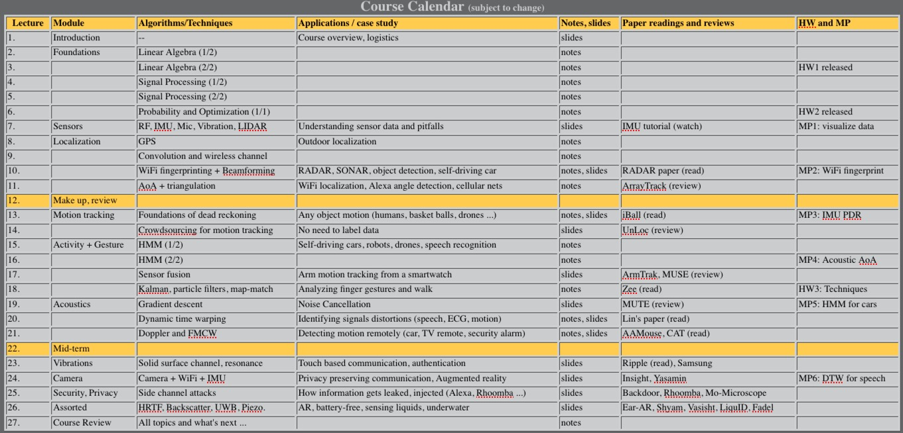
Course Content (see webpage)

Slide 49
Some Math
We will need some math …
But we will start from absolute scratch ... no, I mean it
And the math should be useful in many other contexts
This course will also connect math to apps ...
If you still don’t like it, its my fault.
But all I ask is … give it an earnest shot

Slide 50
Balancing Act
Teaching how to build systems is challenging
There is no set of prerequisite that’s adequate
Takes good foundation + creativity + systematic execution
Will try to balance these multiple angles
Please bear with me if sometimes materials are
too easy/ too difficult for YOU

Slide 51
Course Logistics Course Theme Assorted Thoughts

Slide 52
Assorted Thoughts
This class is about exciting topics
Be active, ask questions, debate, and disagree

Slide 53
Assorted Thoughts
This class is about exciting topics
Be active, ask questions, debate, and disagree
Don’t worry about grades
It does not matter as much as you think it does

Slide 54
Assorted Thoughts
This class is about exciting topics
Be active, ask questions, debate, and disagree
Don’t worry about grades
It does not matter as much as you think it does
Read a lot – this is a hot research area
If you are hunting for MS/PhD area, or passionate on start-ups, read even more

Slide 55
Assorted Thoughts
This class is about exciting topics
Be active, ask questions, debate, and disagree
Don’t worry about grades
It does not matter as much as you think it does
Read a lot – this is a hot research area
If you are hunting for MS/PhD area, or passionate on start-ups, read even more
Interact with me
Even if you have ZERO clue of what’s going on

Slide 56
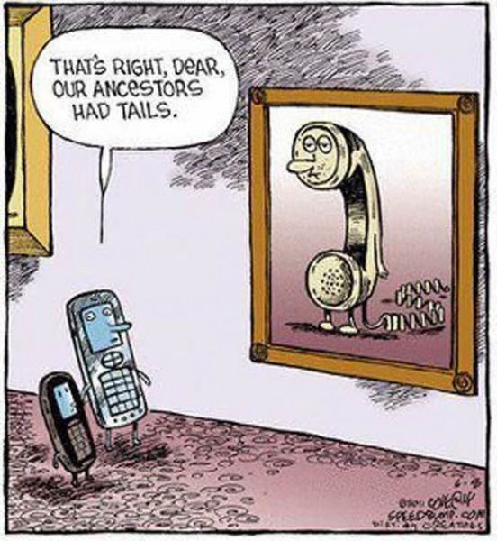
Questions?

Slide 57
Questions ?

