Slide 1
1. Vibratory Sensing and Communication

Slide 2
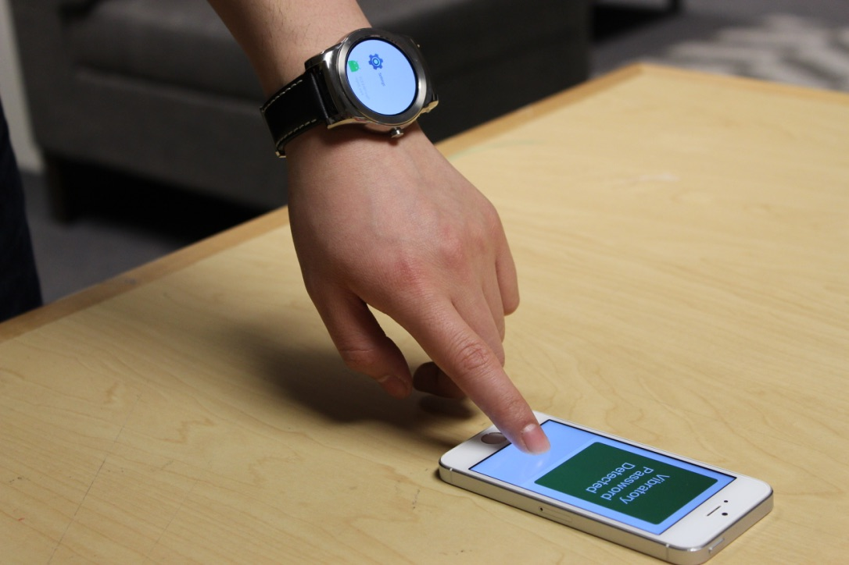
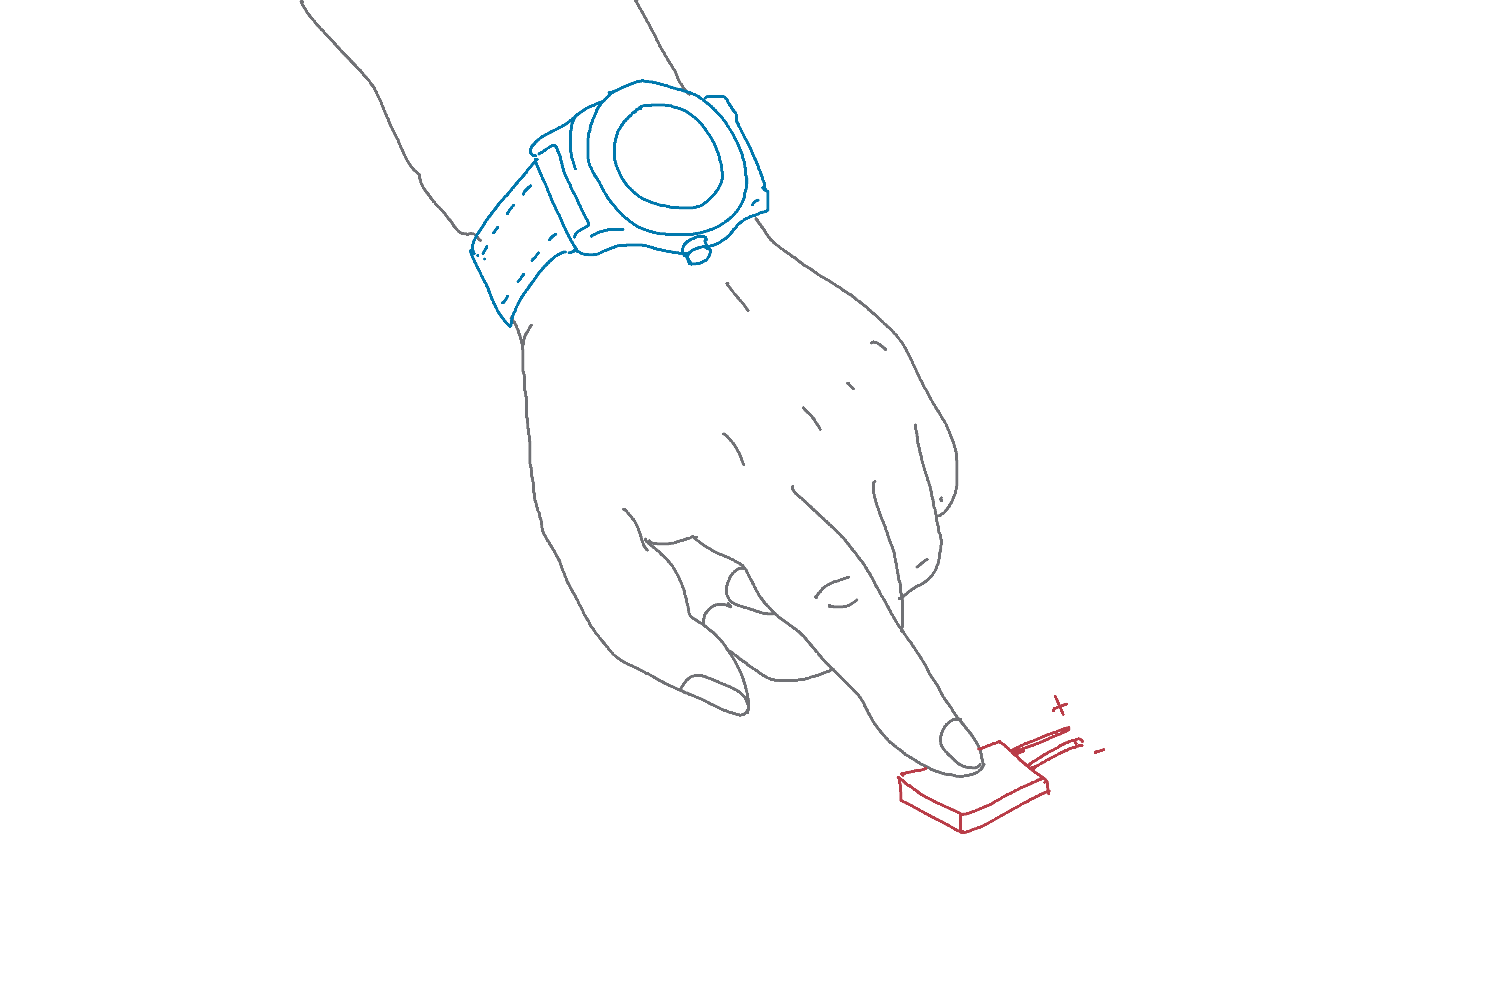

Slide 3
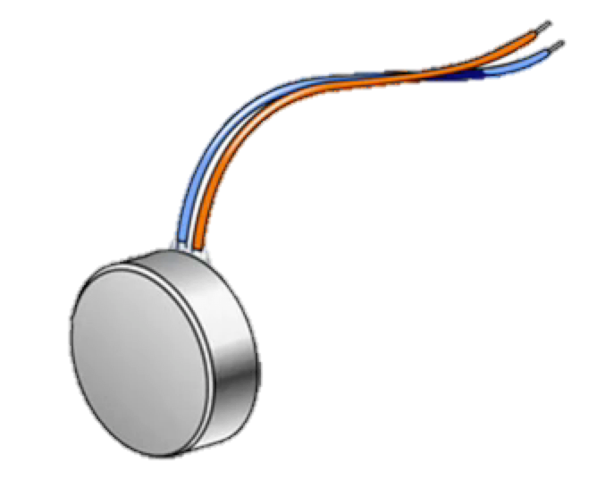
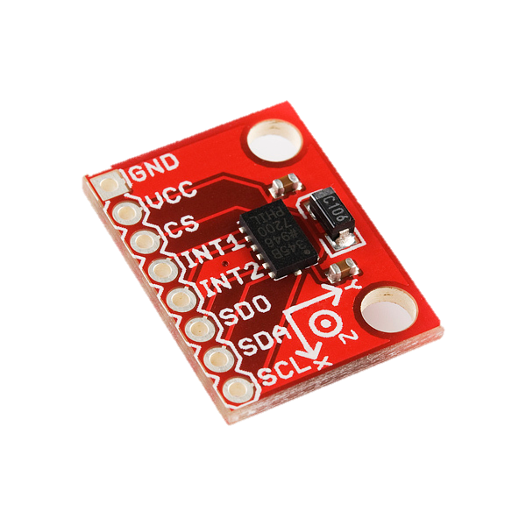
Vibration motor
1001110010101
Motion sensor
(e.g., accelerometer, microphone)
Notes:
Now, what could be the “RECEIVER” for such vibrations?
Observe that almost all mobile devices today have a motion sensor called … ACCELEROMETERS

Slide 4
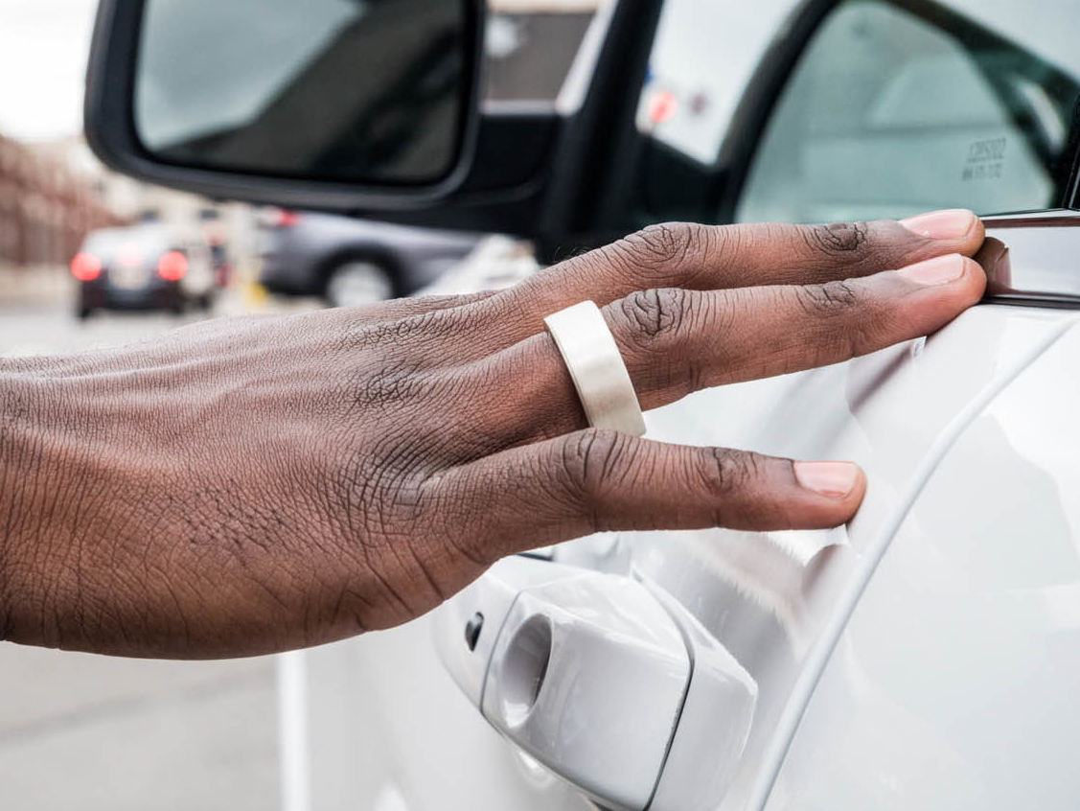
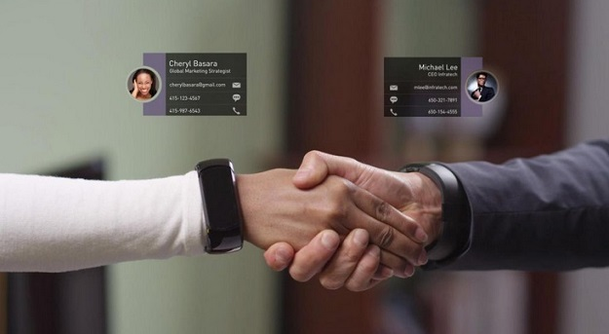


Slide 5
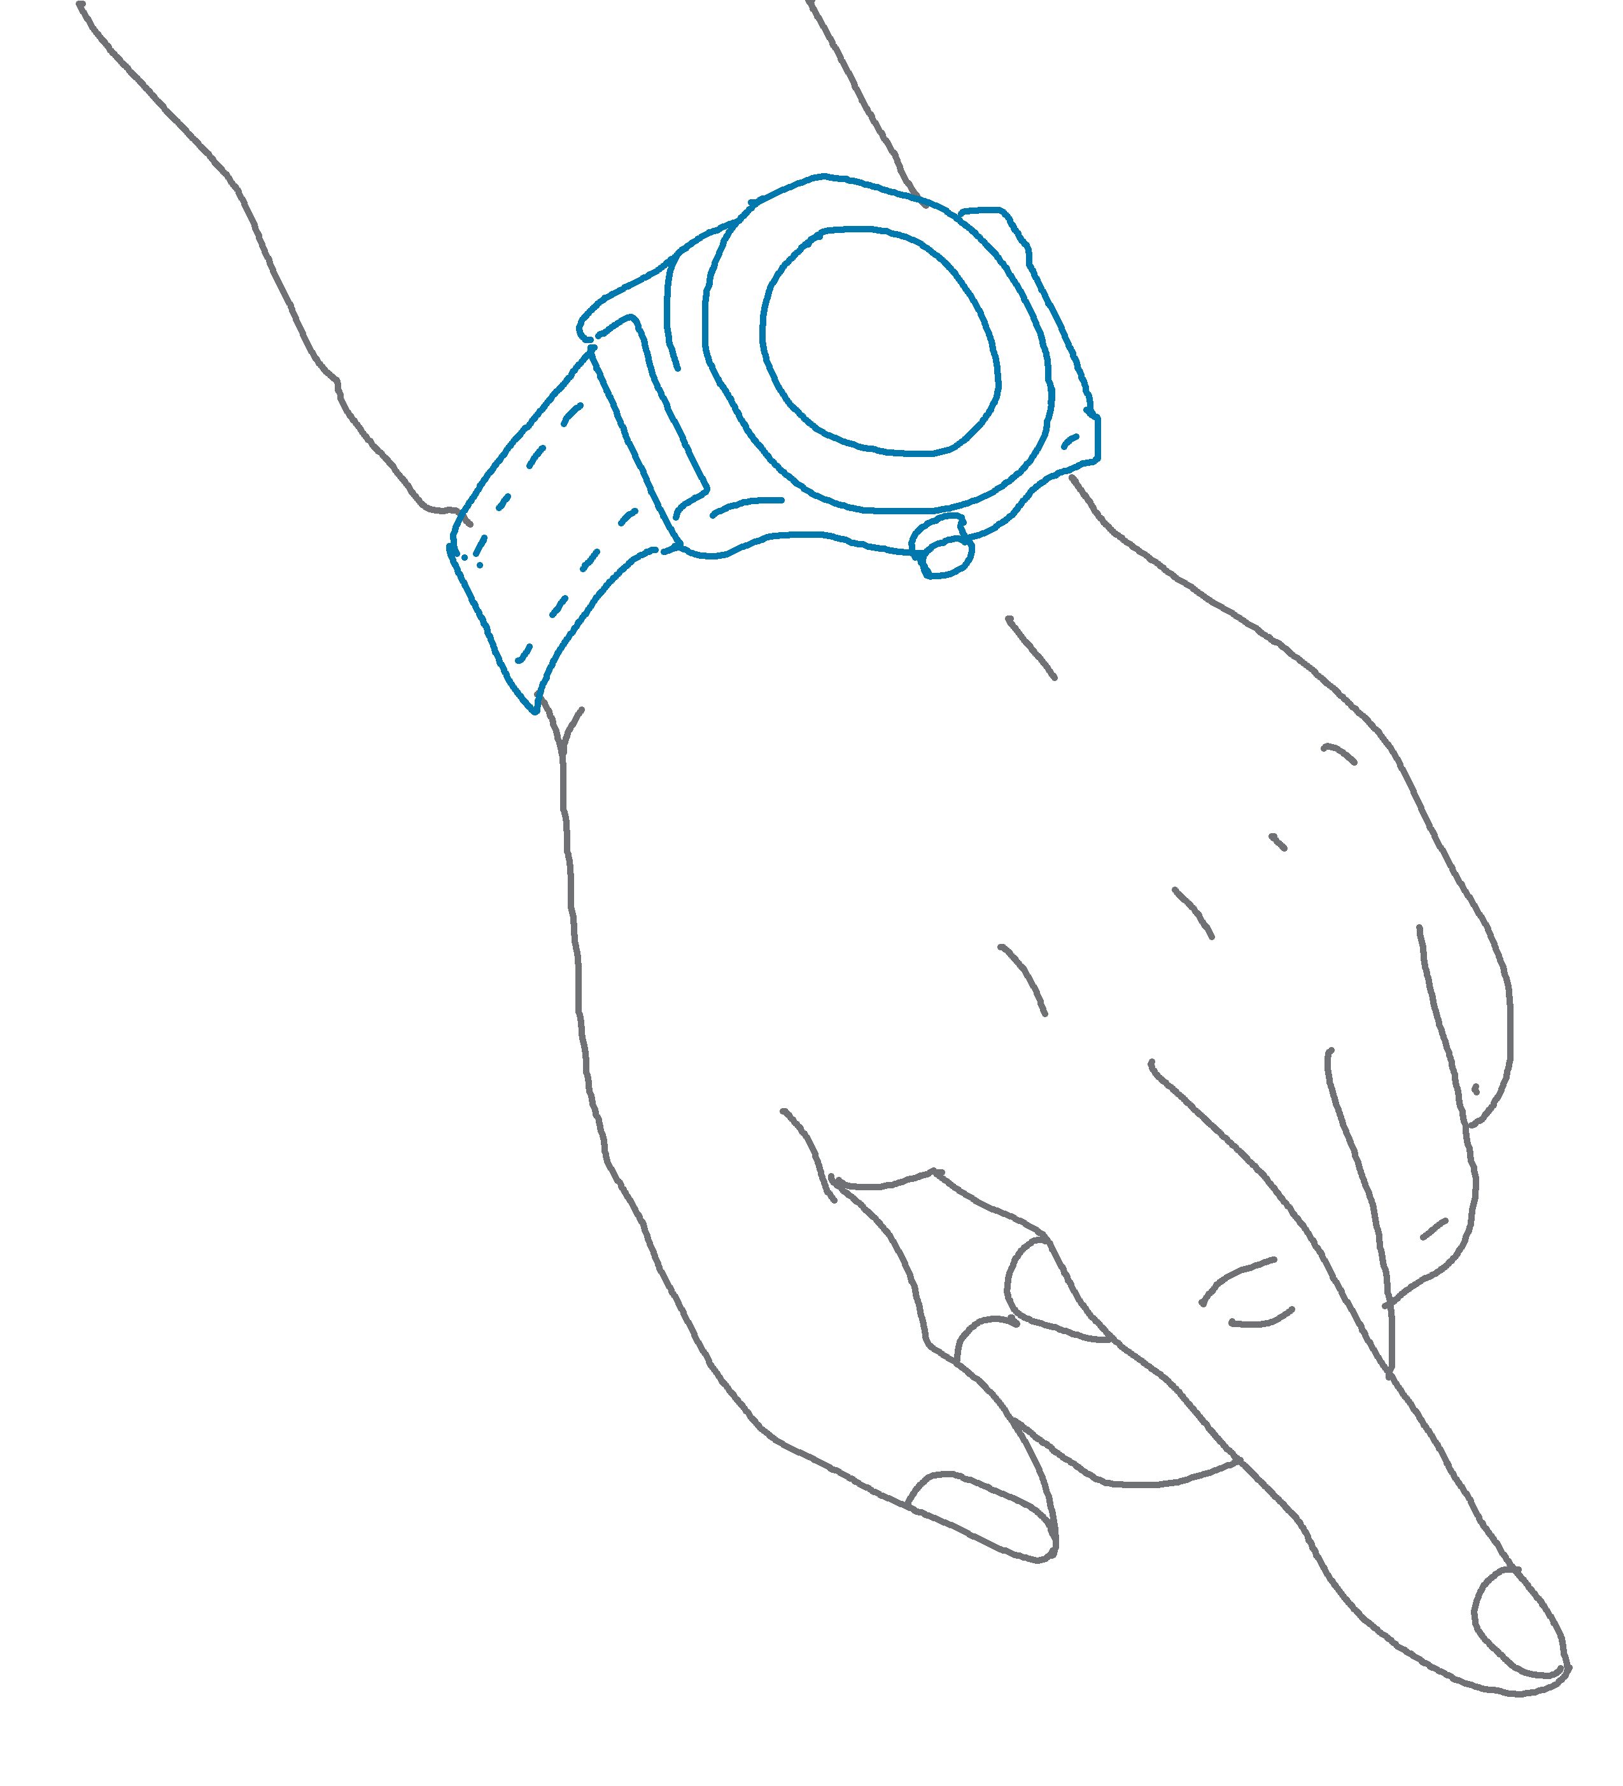
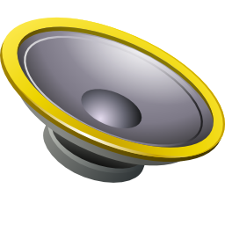





Opportunity:
$$S$$
$$V$$
$$hbone$$
$$V+S$$
Notes:
Of course, simple subtraction does not work … since the sound arrives over different channels to each of the microphones.
However, adaptive filtering can be used to constantly equalize and cancel the effects of the ambient sound.

Slide 6

Opportunity:
$$S$$
$$V$$
$$hbone$$
$$V+S$$
$$S$$
Notes:
Of course, simple subtraction does not work … since the sound arrives over different channels to each of the microphones.
However, adaptive filtering can be used to constantly equalize and cancel the effects of the ambient sound.

Slide 7
Opportunity:
$$S$$
$$V$$
$$hbone$$
$$V+S$$
$$S$$
Cancel
Notes:
Of course, simple subtraction does not work … since the sound arrives over different channels to each of the microphones.
However, adaptive filtering can be used to constantly equalize and cancel the effects of the ambient sound.

Slide 8




Opportunity:
$$S$$
$$V$$
$$h1$$
$$hbone$$
$$h2$$
$$V1+S1$$
$$S2$$
Cancel
Notes:
Of course, simple subtraction does not work … since the sound arrives over different channels to each of the microphones.
However, adaptive filtering can be used to constantly equalize and cancel the effects of the ambient sound.

Slide 9
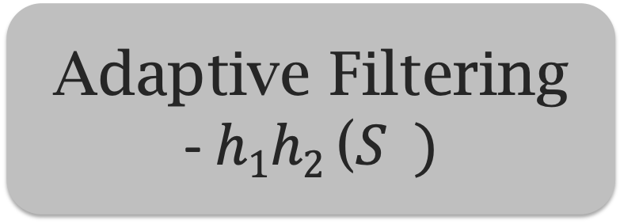
Opportunity:
$$S$$
$$V$$
$$h1$$
$$hbone$$
$$h2$$
$$V1+S1$$
$$S2$$
Adaptive Filtering
- $h1h2$ ($S )$
-1
2
Notes:
Of course, simple subtraction does not work … since the sound arrives over different channels to each of the microphones.
However, adaptive filtering can be used to constantly equalize and cancel the effects of the ambient sound.

Slide 10

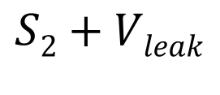

Opportunity:
$$S$$
$$V$$
$$h1$$
$$hbone$$
$$h2$$
$$Vleak$$
$$V1+S1$$
$$S2+Vleak$$
Correlation derails
adaptive filter
Notes:
Unfortunately … even this did not work well … and upon carefully analysis … we realized that vibration was LEAKING from one microphone to another … making the two inputs to the adaptive filter CORRELATED.
Well, why was it leaking?
Because … the two microphones are always on the same PCB … and this creates a solid surface channel for vibrations to propagate from the first microphone to the second.
The stronger the leakage … the worse was the cancellation through adaptive filtering.

Slide 11
Opportunity:
$$S$$
$$V$$
$$h1$$
$$hbone$$
$$h2$$
$$Vleak$$
$$V1+S1$$
$$S2+Vleak$$
Correlation derails
adaptive filter
400 bps with accelerometer … 8 kbps with microphone
Notes:
Unfortunately … even this did not work well … and upon carefully analysis … we realized that vibration was LEAKING from one microphone to another … making the two inputs to the adaptive filter CORRELATED.
Well, why was it leaking?
Because … the two microphones are always on the same PCB … and this creates a solid surface channel for vibrations to propagate from the first microphone to the second.
The stronger the leakage … the worse was the cancellation through adaptive filtering.

Slide 12
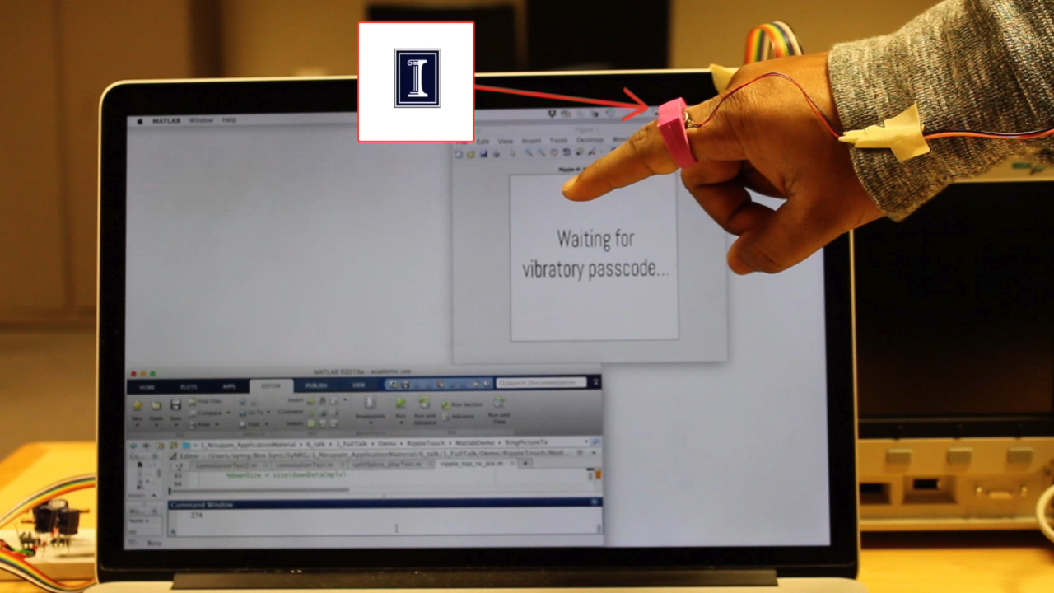
Demo
Notes:
Here is a demo of our vibratory ring … which contains an image that needs to be transmitted to the receiver …
==========
We use an image to demonstrate the 10 kbps bandwidth achieved …
Of course, in general the data could be credit card information … or authentication passwords … that would take MUCH LESS TIME for transmission.

Slide 13
1. Vibratory Sensing and Communication
2. Inaudible Acoustics

Slide 14


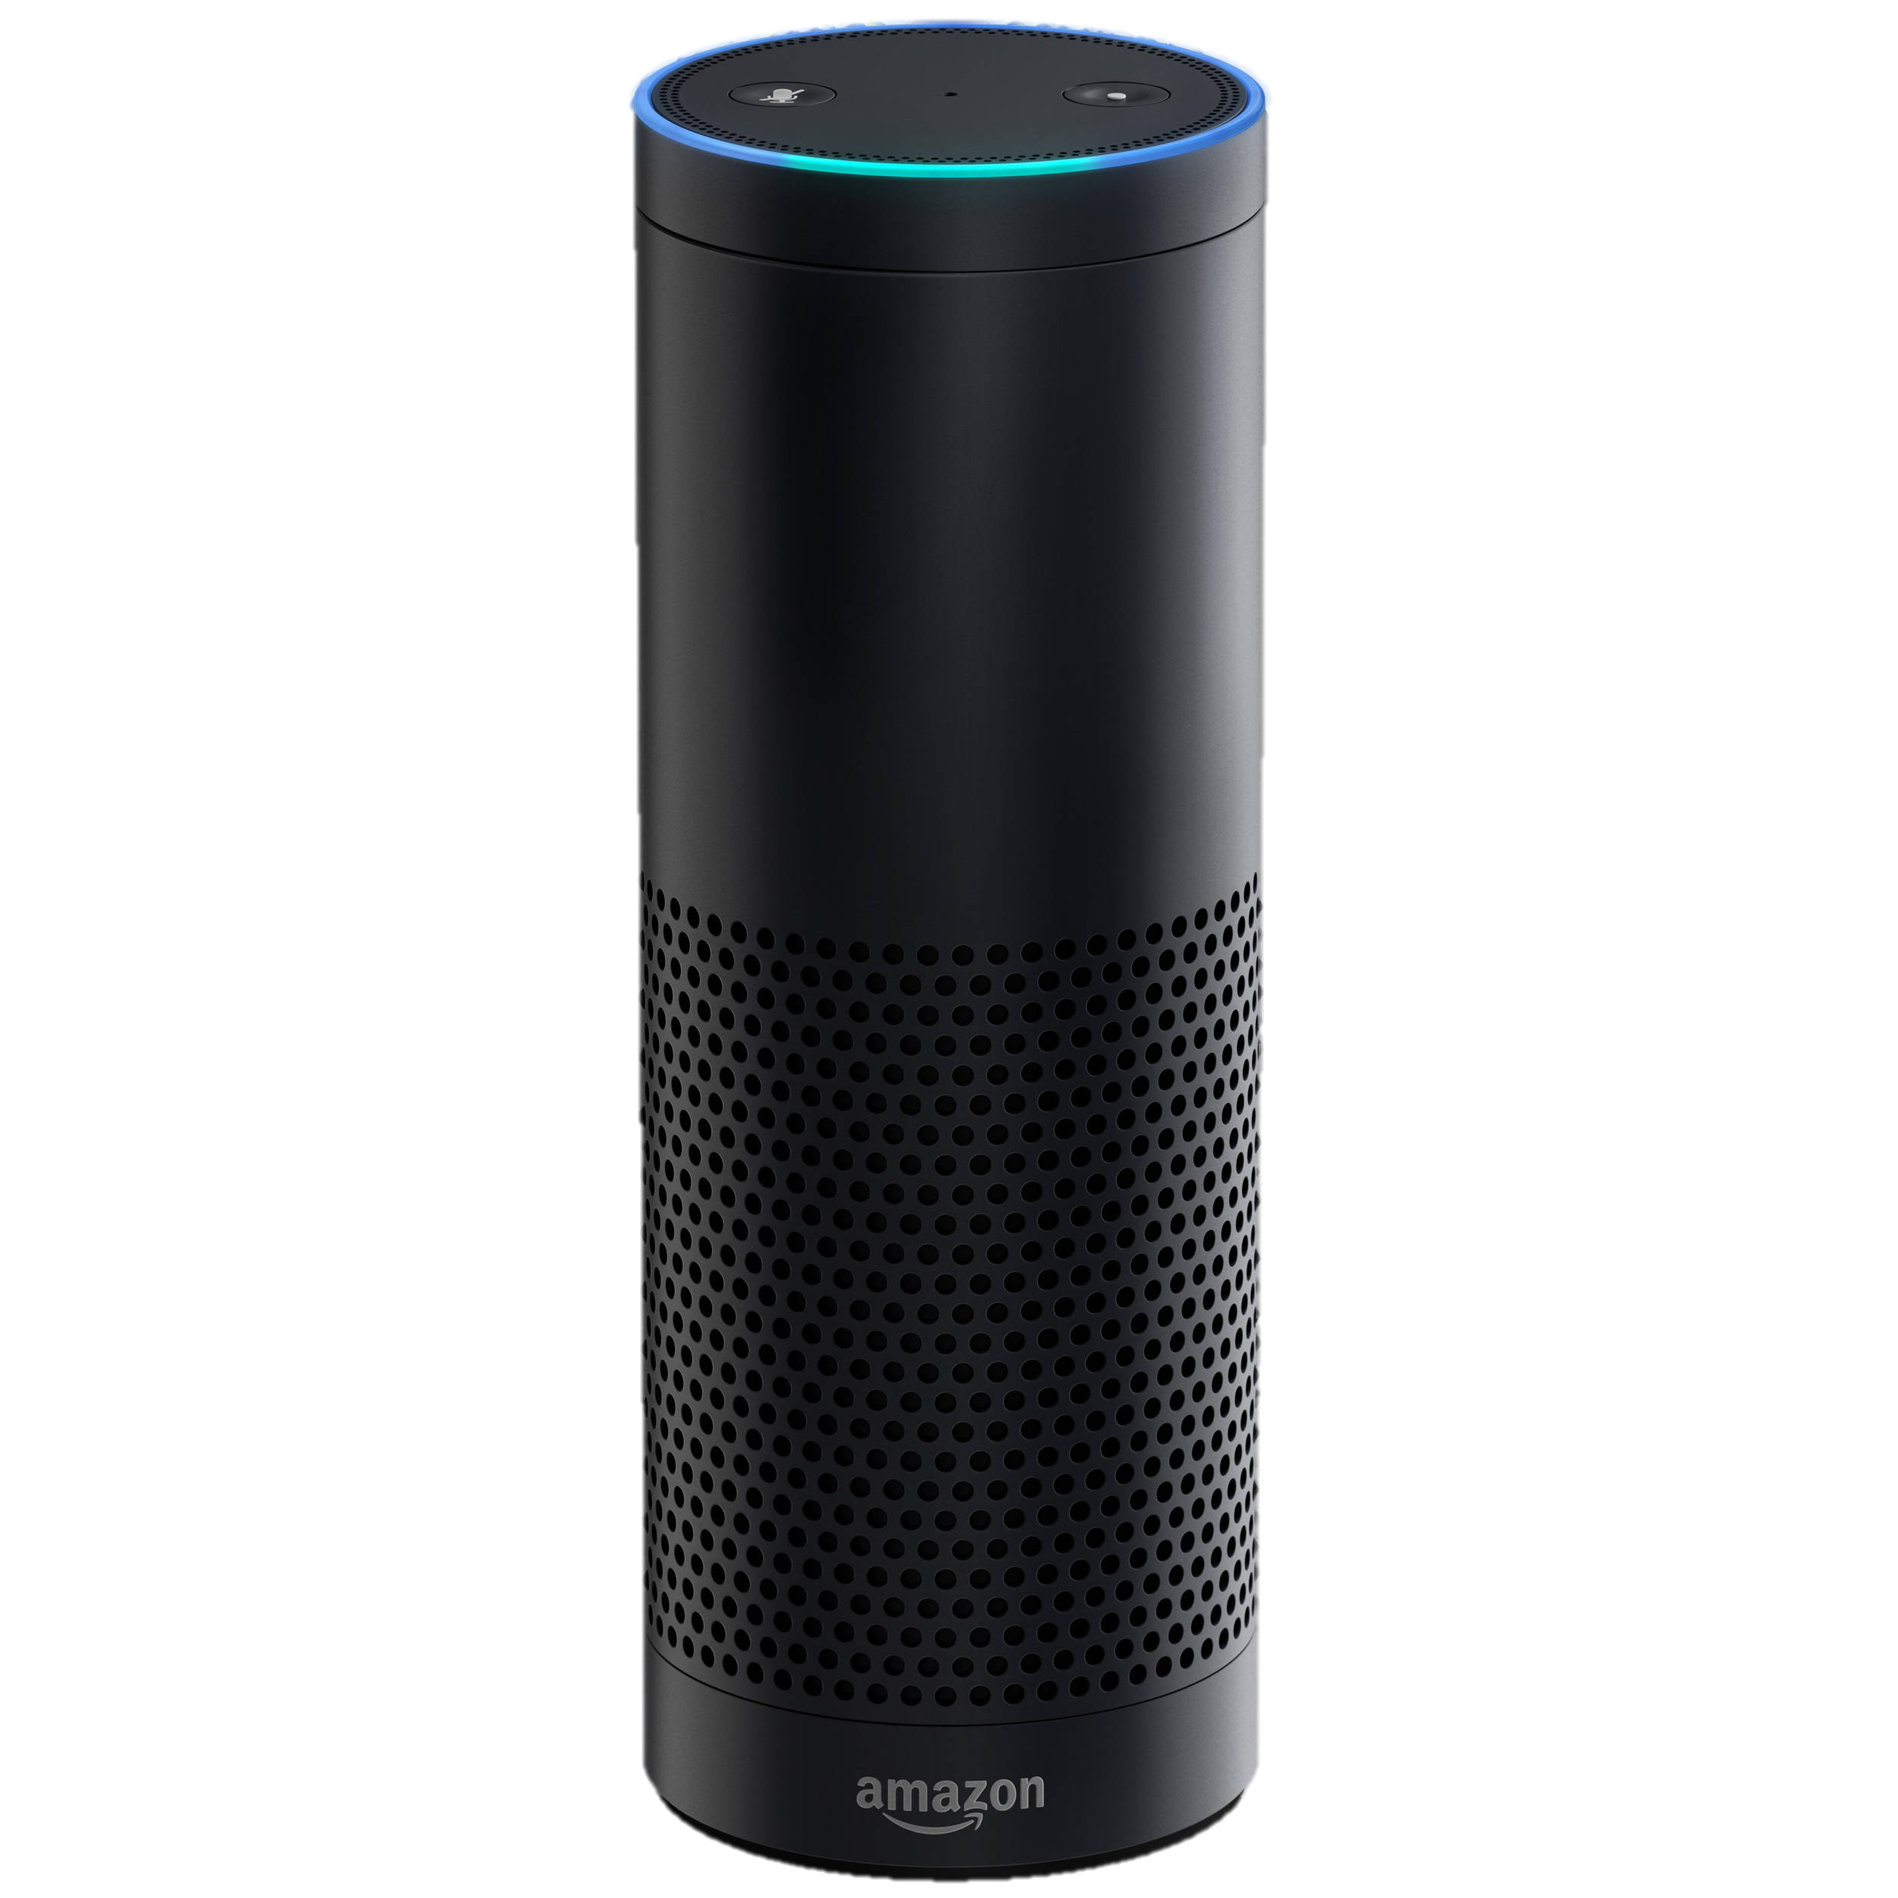


Normal Sound
(< 24 kHz)
Ultrasound
(> 25 kHz)
This project
(> 25 kHz)
Ok
“Alexa, open the garage door!”

Slide 15
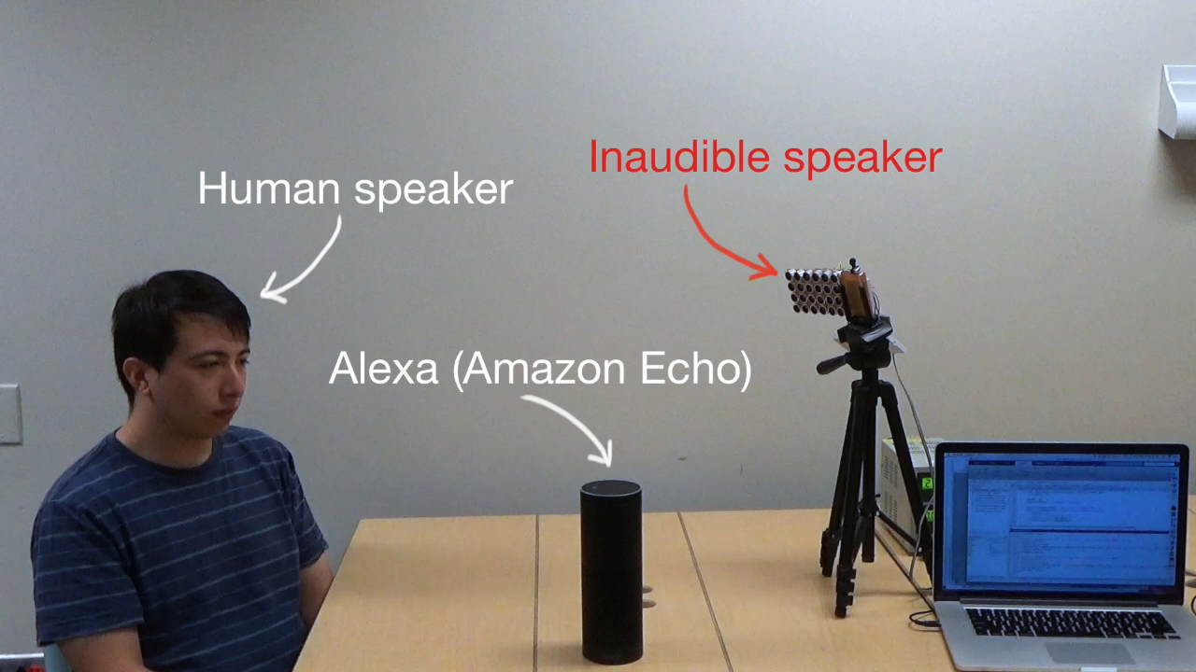
Demo

Slide 16
Other Applications
Notes:
Microphones in today’s devices sense air vibrations and process them in 4 main stages.

Slide 17


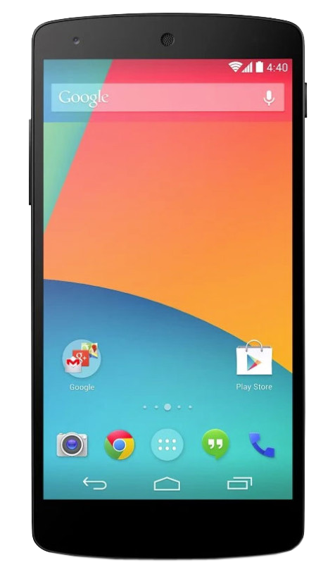


Inaudible Acoustic Communication
$ 5.00
Notes:
A completely different use-case is in acoustic communication … … where data can be TRANSMITTED over high ultrasound frequencies but RECEIVED through regular microphones …
Thus … a shopping mall or museum can offer location based information from acoustic beacons … without making it audible to users.
Note that Near ultrasound can be used in this context…but it has a very limited bandwidth … around 2KHz … while backdoor can use the entire bandwidth of the microphone.

Slide 18
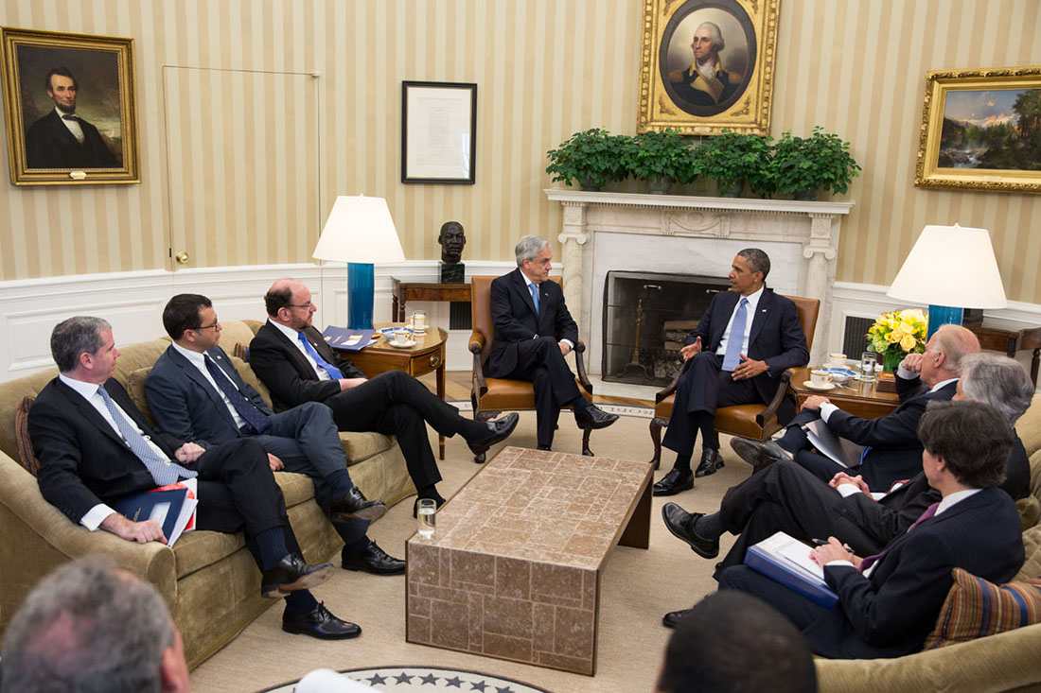

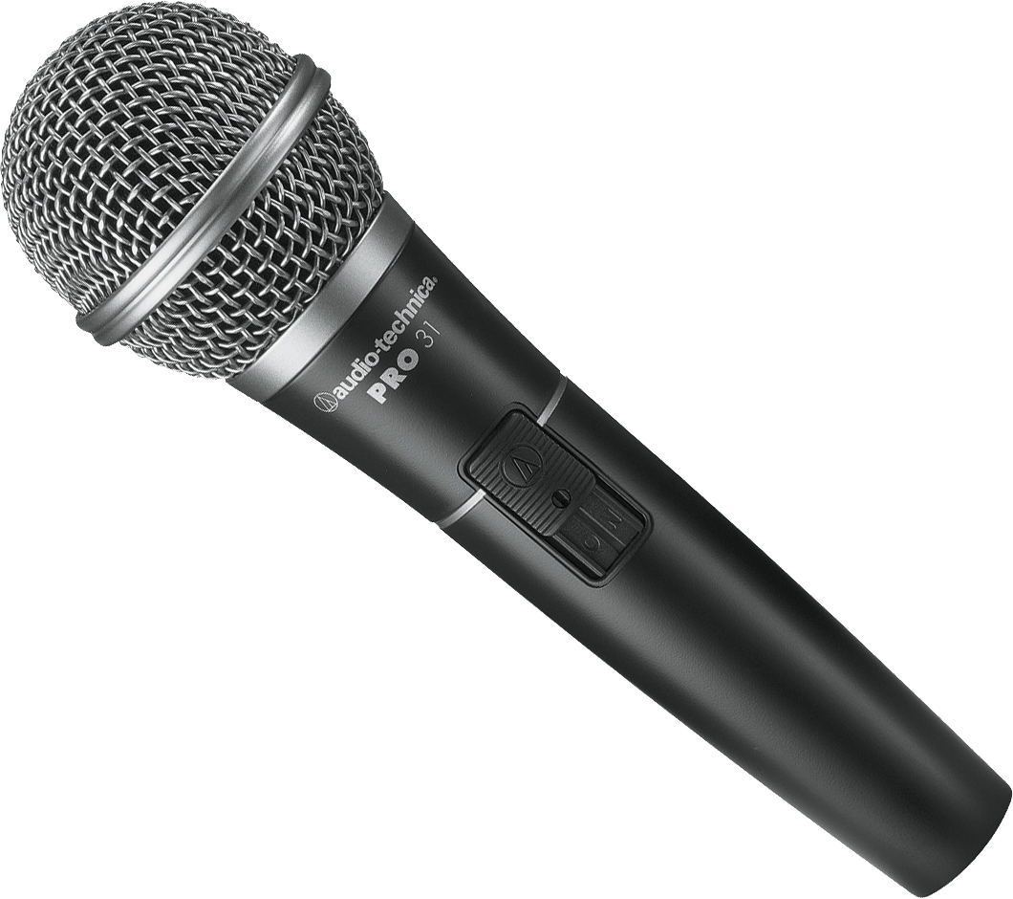
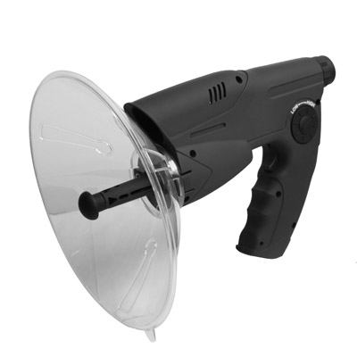
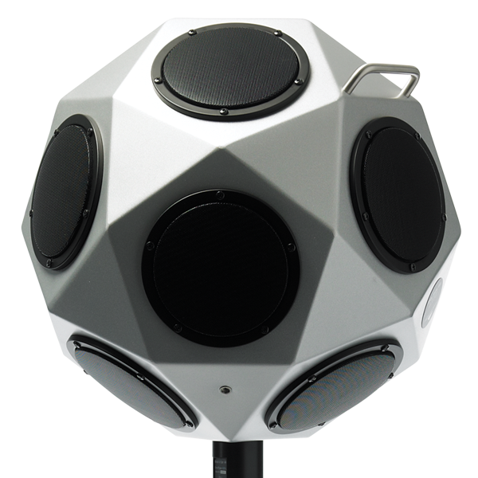

Protecting Privacy (Inaudible Jammer)
Inaudible
jamming
signal
Notes:
Imagine an important meeting is going on and someone is sneakily recording it …
As of now, its not easy to prevent it ...
With BACKDOOR we can build an inaudible jammer that can block all the microphones ... doesn’t interfere the meeting at all.

Slide 19


Threats: Inaudible Acoustic Attack
Ok
Jamming
911 calls
Inaudible
Voice Commands
Notes:
Or can even jam all the 911 phone calls before a bank robbery.
While various applications are possible … this paper focuses on enabling the core capability … and understanding what is, or is not, possible …

Slide 20
How?
Notes:
Microphones in today’s devices sense air vibrations and process them in 4 main stages.

Slide 21
Air vibrations
Digital
samples
Diaphragm
Amplifier
Filter
ADC
Notes:
Microphones in today’s devices sense air vibrations and process them in 4 main stages.

Slide 22
Air vibrations
Digital
samples
Diaphragm
Amplifier
Filter
ADC
Notes:
The first stage is a diaphragm that converts the sound vibration into electrical voltage

Slide 23
Inaudible
Amplitude
10k
20k
30k
40k
50k
60k
70k
80k
90k
100k
Microphone frequency spectrum
Diaphragm
Amplifier
Filter
ADC
Notes:
…This voltage, contain all the information of the sound … however, is too weak for further processing … and so …

Slide 24
Amplitude
10k
20k
30k
40k
50k
60k
70k
80k
90k
100k
Microphone frequency spectrum
Diaphragm
Amplifier
Filter
ADC
Notes:
to amplify the signal power …
Now, this signal typically contains many more frequencies than the sampling system can handle …

Slide 25
Amplitude
10k
20k
30k
40k
50k
60k
70k
80k
90k
100k
Microphone frequency spectrum
Diaphragm
Amplifier
Filter
ADC
Notes:
Hence, a low pass filter…

Slide 26
Microphone
filter
Amplitude
10k
20k
30k
40k
50k
60k
70k
80k
90k
100k
Microphone frequency spectrum
Diaphragm
Amplifier
Filter
ADC
Notes:
removes the unwanted frequencies above 24 kHz …
And ultimately, this filtered signal is sampled by an ADC to generate digital sound samples

Slide 27
Microphone
filter
Amplitude
10k
20k
30k
40k
50k
60k
70k
80k
90k
100k
Microphone frequency spectrum
Diaphragm
Amplifier
Filter
ADC
Notes:
Now … let’s focus a bit more on the amplifier

Slide 28
V_{out}
Output
Input
Output
V_{in}
Input
Nonlinear
V_{out} = a₁V_{in}
V_{out} = a₁V_{in}+ a₂V_{in}²+
a₃V_{in}³+…
Frequency
10k
20k
30k
40k
50k
60k
70k
80k
90k
100k
Diaphragm
Amplifier
Notes:
The INPUT OUTPUT relation of an amplifier can be modeled by a straight line … that is … … if the INPUT signal is Vin … after passing through the amplifier it will be multiplied by a constant gain A1 … to produce the amplified OUTPUT signal Vout.
This simple equation captures this behavior … … HOWEVER …this behavior is frequency dependent and this is linear equation is true ONLY when Vin is in the low audible frequency regime …
If the same amplifier is fed with a high frequency Vin … … the input output relation becomes non-linear … as shown by a curve.
So now … Vout is a higher order polynomial of Vin … that is … a1 Vin + a2 Vin squared + a3 Vin cubed and so on … Now, since the third and higher order coefficients are weak

Slide 29
V_{out}
Output
Input
Output
V_{in}
Input
Nonlinear
V_{out} = a₁V_{in}
V_{out} = a₁V_{in}+ a₂V_{in}²
Frequency
10k
20k
30k
40k
50k
60k
70k
80k
90k
100k
Diaphragm
Amplifier
Notes:
… they can be ignored for practical purposes …
BUT … … the second order term is reasonably strong … and more IMPORTANTLY … it is fundamental to all amplifiers …
A far more expensive amplifier may be linear over a larger frequency range … but it will always exhibit non-linearity above some frequency threshold

Slide 30
V_{out}
Output
Input
Output
V_{in}
Input
Nonlinear
V_{out} = a₁V_{in}
V_{out} = a₁V_{in}+ a₂V_{in}²
Frequency
10k
20k
30k
40k
50k
60k
70k
80k
90k
100k
Nonlinearity is fundamental to all microphones
Diaphragm
Amplifier

Slide 31
V_{in} = sin F₁ + sin F₂
Notes:
Consider the simple case where we are playing two high frequencies … F1 = 50kHz … and F2 = 40kHz … through a speaker …
These frequencies will appear in the received spectrum ...

Slide 32
V_{in} = sin F₁ + sin F₂
Audible
Inaudible
Amplitude
Microphone
filter
10k
20k
30k
40k
50k
60k
70k
80k
90k
100k
Frequency
Notes:
Consider the simple case where we are playing two high frequencies … F1 = 50kHz … and F2 = 40kHz … through a speaker …
These frequencies will appear in the received spectrum ...

Slide 33
V_{in} = sin F₁ + sin F₂
Audible
Inaudible
F₂
F₁
Amplitude
Microphone
filter
10k
20k
30k
40k
50k
60k
70k
80k
90k
100k
Frequency
Notes:
Consider the simple case where we are playing two high frequencies … F1 = 50kHz … and F2 = 40kHz … through a speaker …
These frequencies will appear in the received spectrum ...

Slide 34
V_{in} = sin F₁ + sin F₂
Audible
Inaudible
F₂
F₁
Amplitude
Microphone
filter
10k
20k
30k
40k
50k
60k
70k
80k
90k
100k
Frequency
V_{out} = a₁V_{in}+ a₂V_{in}²
( sin F₁ + sin F₂ )²
= cos 2F₁
cos 2F₂
cos (F₁+F₂)
cos (F₁- F₂)
-
--
+
Notes:
and then will pass through the amplifier … meaning that the signals will get SQUARED … due to the non-linearity
From simple trigonometry … sin F1 + sin F2 SQUARED will result in a signal with 4 frequency components … namely 2F1 … 2F2 … F1+F2 … and F1—F2.

Slide 35
V_{in} = sin F₁ + sin F₂
Audible
Inaudible
F₂
F₁
2F₂
(F₁+F₂)
2F₁
Amplitude
Microphone
filter
10k
20k
30k
40k
50k
60k
70k
80k
90k
100k
Frequency
V_{out} = a₁V_{in}+ a₂V_{in}²
( sin F₁ + sin F₂ )²
= cos 2F₁
cos 2F₂
cos (F₁+F₂)
cos (F₁- F₂)
-
--
+
Notes:
Observe that the first 3 components are at EVEN HIGHER frequencies … …

Slide 36
V_{in} = sin F₁ + sin F₂
Audible
Inaudible
F₂
F₁
2F₂
(F₁+F₂)
2F₁
Amplitude
Microphone
filter
10k
20k
30k
40k
50k
60k
70k
80k
90k
100k
Frequency
V_{out} = a₁V_{in}+ a₂V_{in}²
( sin F₁ + sin F₂ )²
= cos 2F₁
cos 2F₂
cos (F₁+F₂)
cos (F₁- F₂)
-
--
+
Notes:
and will all be removed by the low pass filter.

Slide 37
V_{in} = sin F₁ + sin F₂
Audible
Inaudible
(F₁-F₂)
F₂
F₁
2F₂
(F₁+F₂)
2F₁
Amplitude
Microphone
filter
10k
20k
30k
40k
50k
60k
70k
80k
90k
100k
Frequency
V_{out} = a₁V_{in}+ a₂V_{in}²
( sin F₁ + sin F₂ )²
= cos 2F₁
cos 2F₂
cos (F₁+F₂)
cos (F₁- F₂)
-
--
+
Notes:
However, the fourth component is much lower … since it is the DIFFERENCE of the 2 frequencies …
If F1 and F2 are chosen correctly … this 4th component can survive the filter … and actually get recorded by the microphone.

Slide 38
V_{in} = sin F₁ + sin F₂
Audible
Inaudible
(F₁-F₂)
F₂
F₁
Amplitude
Microphone
filter
10k
20k
30k
40k
50k
60k
70k
80k
90k
100k
Frequency
Notes:
As a generalization … a whole set of frequencies can be TRANSLATED into the lower frequency band by using an appropriate frequency F2 … at a slightly lower value.

Slide 39
Audible
Inaudible
F₂
Amplitude
Microphone
filter
10k
20k
30k
40k
50k
60k
70k
80k
90k
100k
Frequency

Slide 40



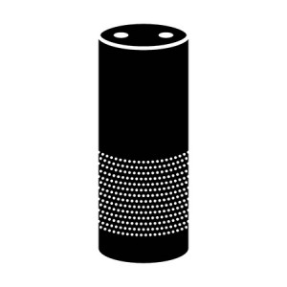
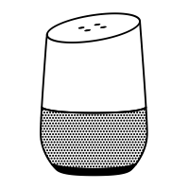

Audible
Inaudible
F₂
Amplitude
Microphone
filter
10k
20k
30k
40k
50k
60k
70k
80k
90k
100k
Frequency
0 1 1 0 0 1 0 1 0 1 0 1 0 1 1
Notes:
This signal can be used for data communication to microphone enabled devices…

Slide 41

Audible
Inaudible
F₂
Amplitude
Microphone
filter
10k
20k
30k
40k
50k
60k
70k
80k
90k
100k
Frequency
Notes:
We can use it for designing an inaudible jammer, that can block un-authorised recording of private converstion…

Slide 42
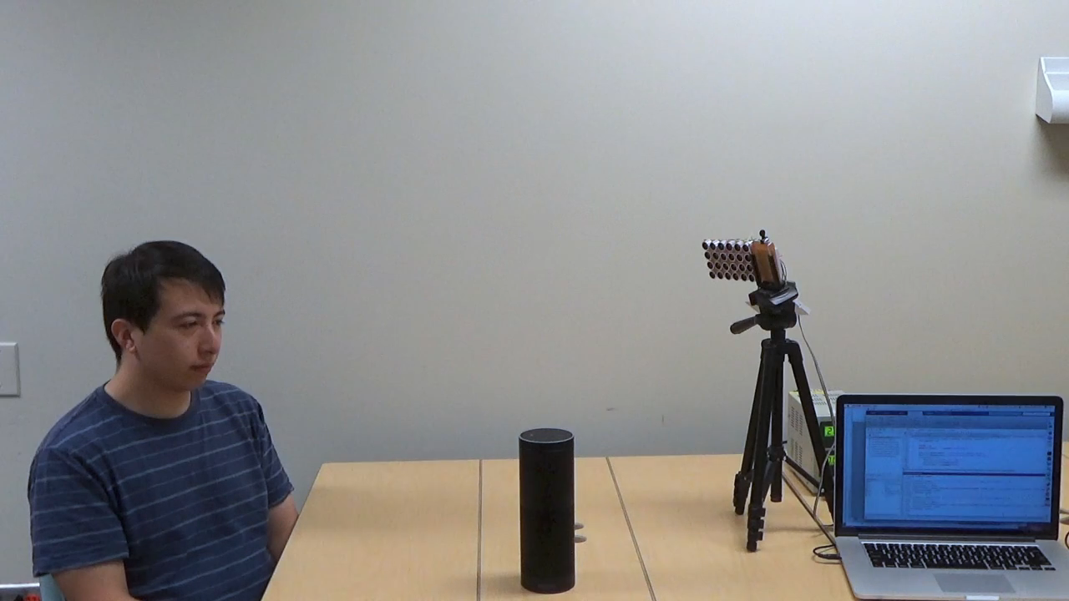
Audible
Inaudible
F₂
Amplitude
Microphone
filter
10k
20k
30k
40k
50k
60k
70k
80k
90k
100k
Frequency

Slide 43
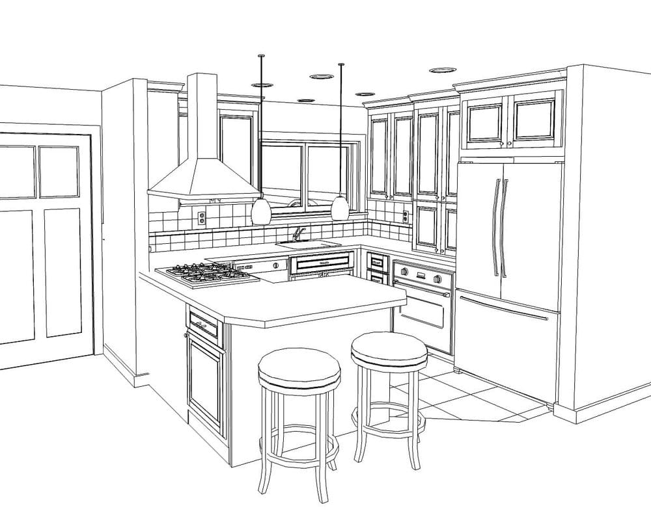
3-5 ft
Notes:
We asked the question…can someone use this technique to launch attack from the outside of the house…and trigger alexa.

Slide 44
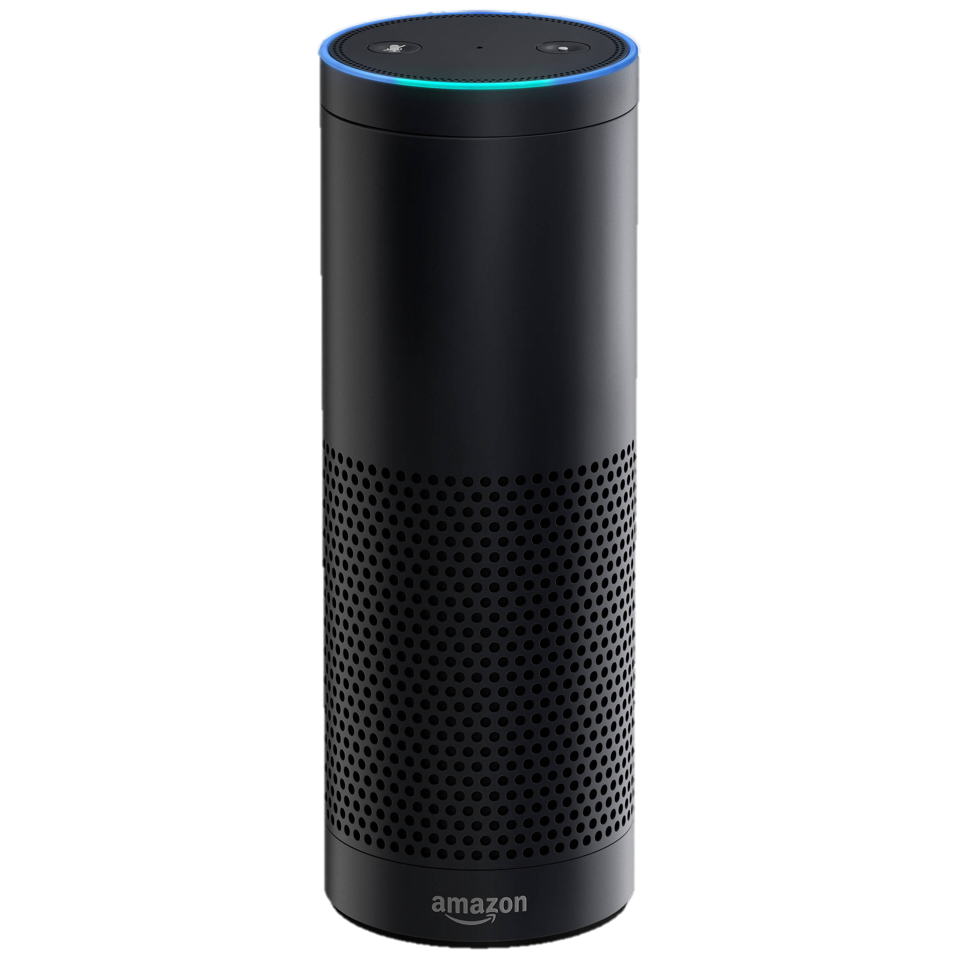

Can someone attack from a longer range?

Slide 45





Can someone attack from a longer range?

Slide 46
Can someone attack from a longer range?
High power makes ultrasonic speakers audible

Slide 47

Speakers have nonlinearity too!

Slide 48
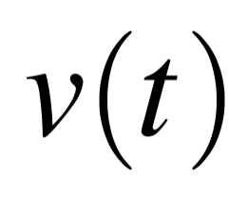
Voice Command:
Amplitude
Frequency
10k
20k
30k
40k
50k
60k
70k
80k
90k

Slide 49
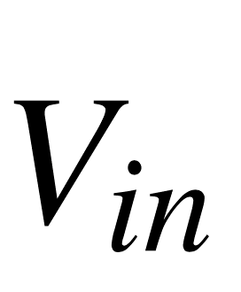
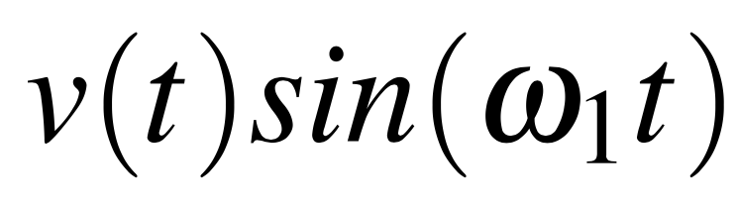
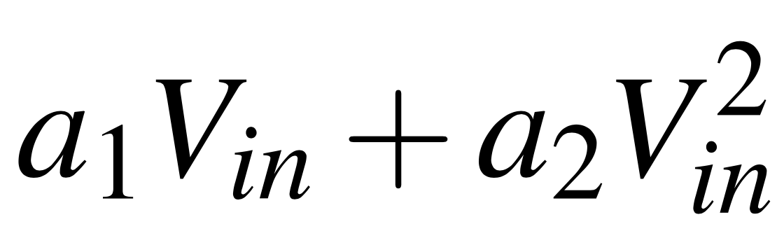
=
Amplitude
Frequency
10k
20k
30k
40k
50k
60k
70k
80k
90k
Speaker Nonlinearity

Slide 50
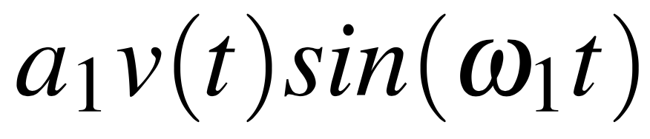
=
Amplitude
Frequency
10k
20k
30k
40k
50k
60k
70k
80k
90k
Speaker Nonlinearity
Amplitude
10k
20k
30k
40k
50k
60k
70k
80k
90k

Slide 51
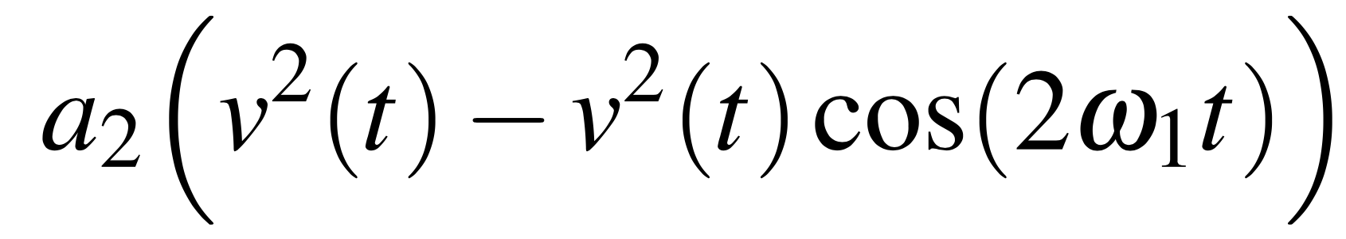
=
Amplitude
Frequency
10k
20k
30k
40k
50k
60k
70k
80k
90k
Speaker Nonlinearity
+
Amplitude
10k
20k
30k
40k
50k
60k
70k
80k
90k

Slide 52
=
Amplitude
Frequency
10k
20k
30k
40k
50k
60k
70k
80k
90k
Speaker Nonlinearity
General to all speakers!
Audible
Inaudible
Amplitude
10k
20k
30k
40k
50k
60k
70k
80k
90k

Slide 53
Speaker leakage is unavoidable…
… motivating “Leakage Optimization”
[1] Advanced Digital Signal Processing and Noise Reduction – S. Vaseghi
[2] Deconvolution and Nonlinear Inverse Filtering Using a Neural Network – Filson Glanz et. al.
[3] Adaptive Cancellation of Nonlinear Intersymbol Interference for Voiceband … – Ezio Biglieri et. al.
Notes:
http://ieeexplore.ieee.org/stamp/stamp.jsp?tp=&arnumber=1146107

Slide 54
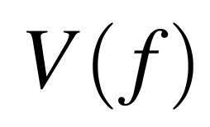

Speaker Nonlinearity → Audible Leakage
Speaker input
Amplitude
Bandwidth: B
Frequency
10k
20k
30k
40k
50k
60k
70k
80k
90k
100k
Speaker output
$$V\left(−f\right)∗V(f)$$
Amplitude
Bandwidth: B
Frequency
10k
20k
30k
40k
50k
60k
70k
80k
90k
100k

Slide 55

Speaker Nonlinearity → Audible Leakage
Speaker input
Amplitude
Frequency
10k
20k
30k
40k
50k
60k
70k
80k
90k
100k
Speaker output
Amplitude
Frequency
10k
20k
30k
40k
50k
60k
70k
80k
90k
100k

Slide 56
Speaker Nonlinearity → Audible Leakage
Speaker input
Amplitude
Frequency
10k
20k
30k
40k
50k
60k
70k
80k
90k
100k
Speaker output
Amplitude
Frequency
10k
20k
30k
40k
50k
60k
70k
80k
90k
100k

Slide 57
Speaker Nonlinearity → Audible Leakage
Speaker input
Amplitude
Frequency
10k
20k
30k
40k
50k
60k
70k
80k
90k
100k
Speaker output
Amplitude
Frequency
10k
20k
30k
40k
50k
60k
70k
80k
90k
100k

Slide 58
Speaker Nonlinearity → Audible Leakage
Speaker input
Amplitude
Frequency
10k
20k
30k
40k
50k
60k
70k
80k
90k
100k
Chopping compresses the leakage band
Speaker output
Amplitude
Frequency
10k
20k
30k
40k
50k
60k
70k
80k
90k
100k

Slide 59
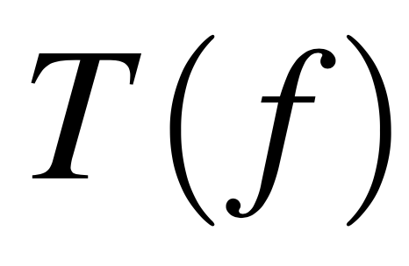



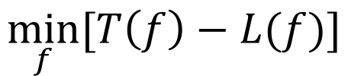
Leakage from Speaker
Speaker input
Human Hearing Threshold
$$T\left(f\right)$$
Amplitude
Audible
Inaudible
Minimum Gap
Frequency
10k
20k
30k
40k
50k
60k
70k
80k
90k
100k
$$L\left(f\right)$$
Speaker output
$$Maximize$$
$$\min_{f}{[T\left(f\right)−L(f)]}$$
Amplitude
$subject to f0≤$ $f1≤f2≤ …≤fN$
Frequency
10k
20k
30k
40k
50k
60k
70k
80k
90k
100k

Slide 60
Speaker input
Amplitude
Frequency
10k
20k
30k
40k
50k
60k
70k
80k
90k
100k
Speaker output
Amplitude
Frequency
10k
20k
30k
40k
50k
60k
70k
80k
90k
100k

Slide 61
Speaker input
Amplitude
Frequency
10k
20k
30k
40k
50k
60k
70k
80k
90k
100k
Speaker output
Inaudible
Amplitude
Frequency
10k
20k
30k
40k
50k
60k
70k
80k
90k
100k

Slide 62
Speaker input
F₂
Amplitude
Frequency
10k
20k
30k
40k
50k
60k
70k
80k
90k
100k
Speaker output
F₂
Inaudible
Amplitude
Frequency
10k
20k
30k
40k
50k
60k
70k
80k
90k
100k
Microphone output
Microphone
filter
F₂
Amplitude
Frequency
10k
20k
30k
40k
50k
60k
70k
80k
90k
100k

Slide 63
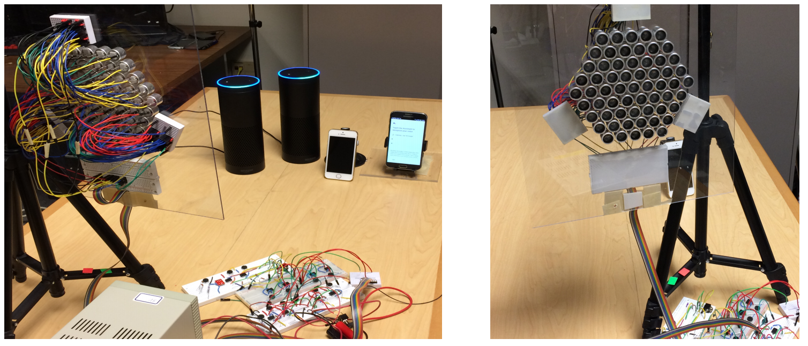
Evaluation

Slide 64
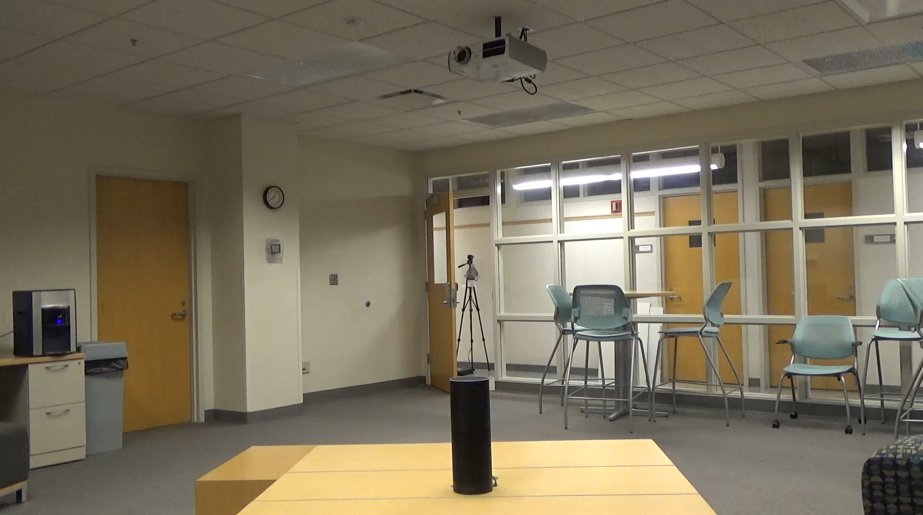
Inaudible voice commands: Long range
Inaudible voice command: Long range
Speaker array running leakage optimization
25 feet

Slide 65

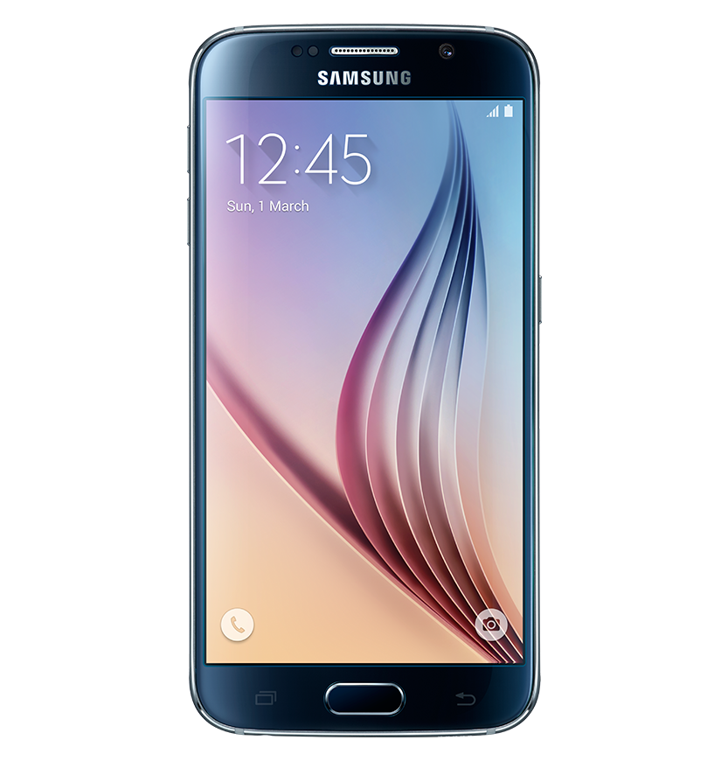
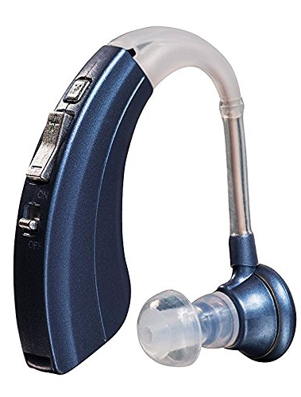
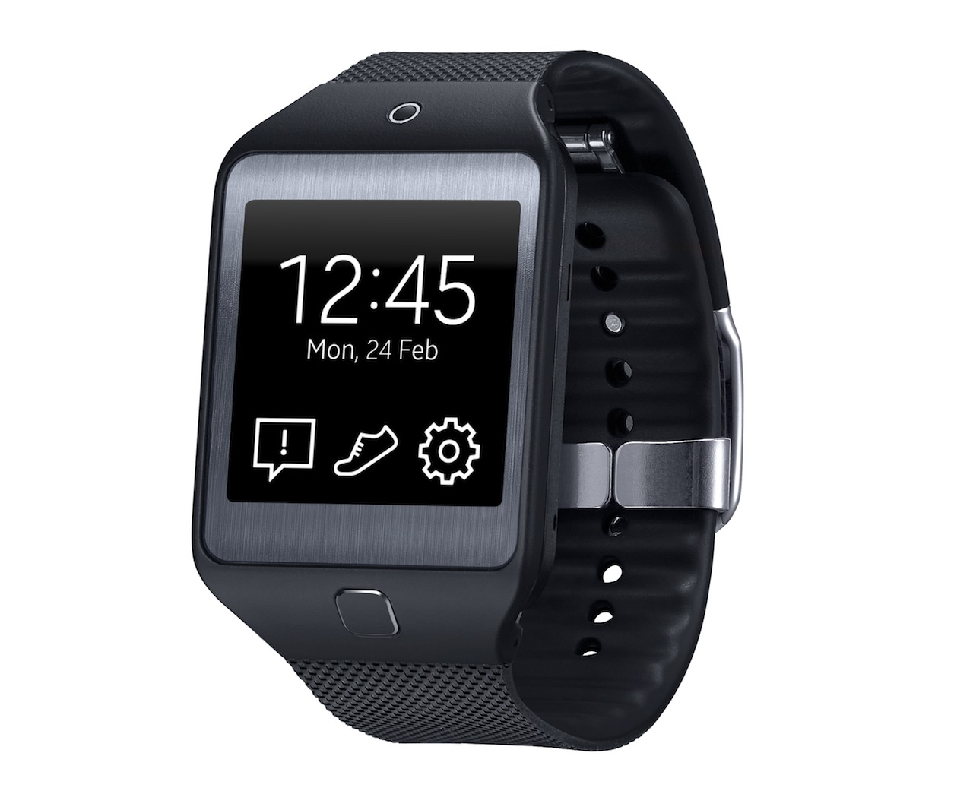

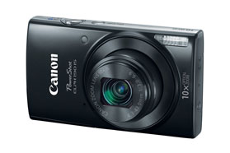
Applies to all microphone-enabled devices
80
60
Inaudible sound SNR (dB)
40
iPhone
Android phone
Laptop
Hearing aids
Smart-watch
20
Camera
0

Slide 66
How to defend against these attacks?

Slide 67
How to defend against these attacks?
Needs research

