Slide 1
Mid Term Review

Slide 2
Mid Term
Wed, Apr 15
Online “Zoom” exam
Duration 1 hour
Require you to keep laptop camera on so we can see you
Exam level
Not hard
1 cheat sheet allowed (front and back)

Slide 3
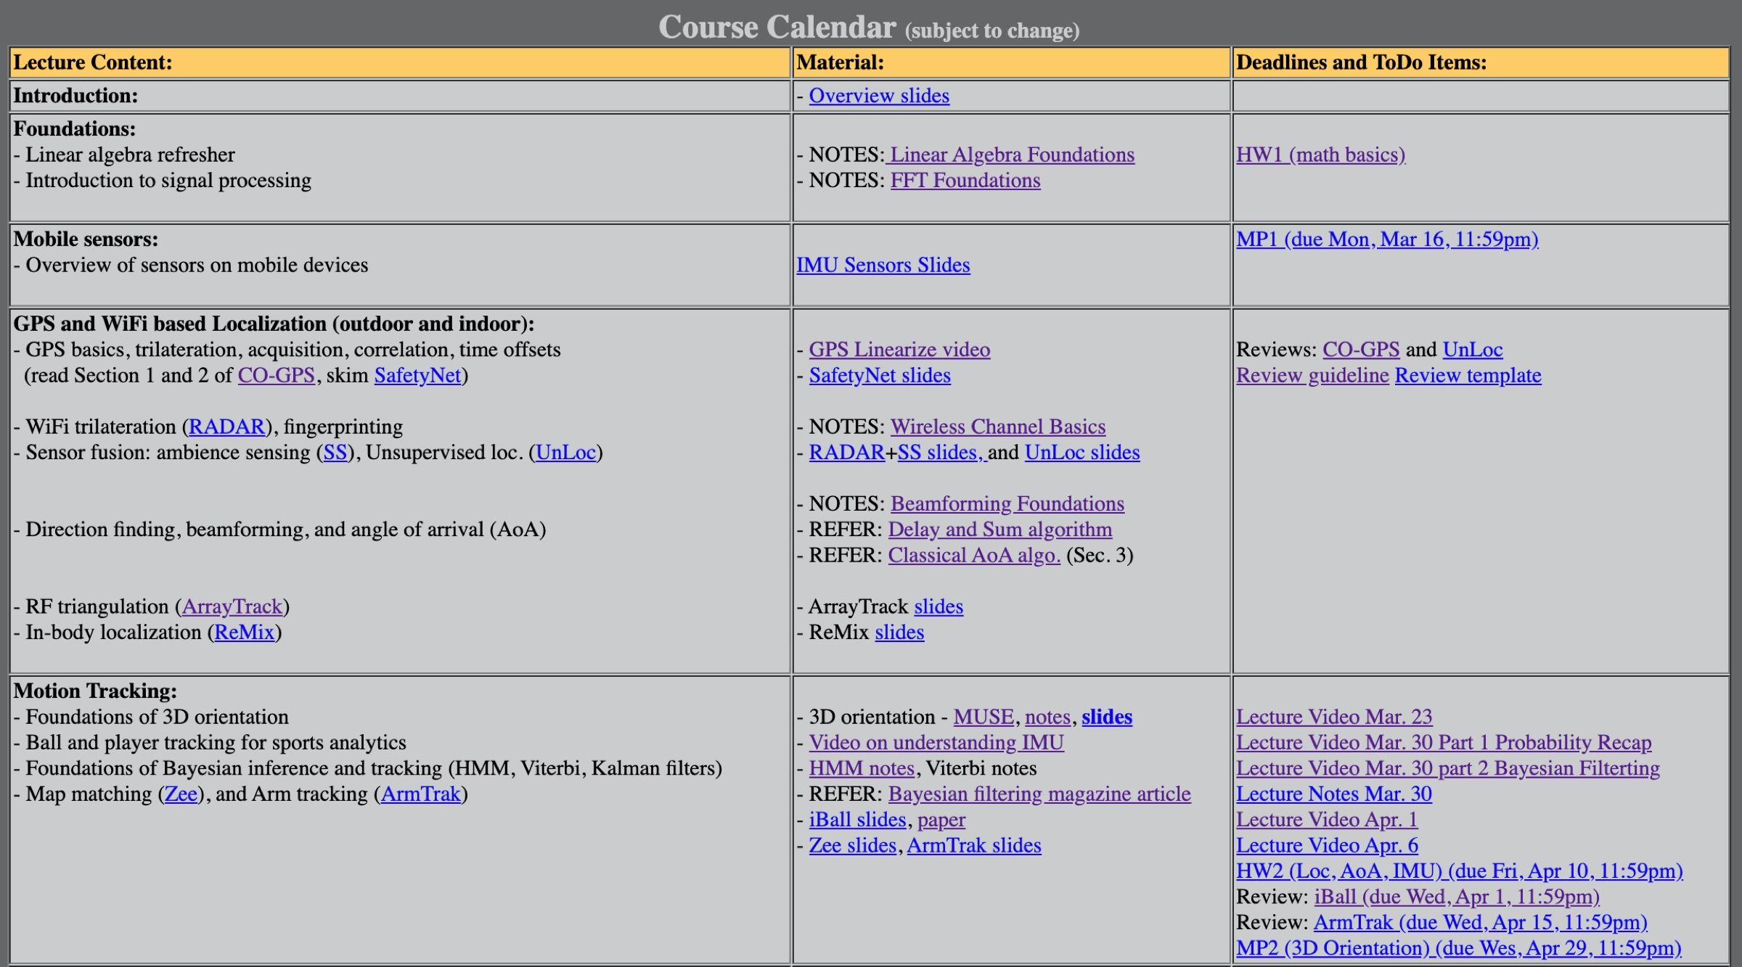
Syllabus: Everything covered till today

Slide 4
Approximate Exam Format
Around 4 questions
Q1. to Q2. -- Set of true/false statements
You will need to justify your answer in one sentence
Q3 -- Topic question with sub-parts
You may need to work out small problems
You may need to argue and/or identify flaws
You may need to give examples/counter-examples
Q4. -- Design or Solve
You may need to sketch the design of a system
Or solve a problem

Slide 5
Approximate Exam Format
Questions should NOT require you to learn details and facts
No need to know what packets are sent in RADAR,
Or what is the exact equation for arm motion kinectics
Or how much accuracy does UnLoc achieve …
Questions are ALL conceptual
Very similar to homework problems

Slide 6
Focus on …
Understanding math foundations
Understanding the ideas, intuitions, and tradeoffs in each of the applications discussed
Think about the generalization of the idea discussed … how it connects to other things that face the same problem
Revise your basic probability

Slide 7
Consider a thin matrix A with dimension m*n (m>n). Can Ax=b have infinite solutions?
Assume signal a(t) has frequencies f1 and f2, and b(t) has frequencies f2 and f3. What frequencies are in a signal that is formed by convolving a(t) with b(t)?
For a single frequency signal s sampled at sub Nyquist frequency f1, the outcome shows frequency f2. Sampled with sub Nyquist frequency f3, the outcome shows frequency f4. What can one of the original s be?
Assume there is only one source X(t), the incoming angle for this source is theta. Derive the signal received Y(t) at the antenna array and write it in matrix form (and show which is the steering matrix).
Now if you don’t know theta, how to solve for theta from received signal Y(t) – write a pseudo code.
Given a bunch of shapes of displacement, velocity, and acceleration, I might ask: which of these shapes are valid?
Assume a ball of radius R is rolling on the ground in a straight line with a constant speed v along global x axis. Assume at the initial moment, the local frame is aligned with global frame. What is the reading of accelerometer a(t) and gyroscope w(t) in its local frame? (Assume the IMU is at the center of the ball)

Slide 8
Complete the sentence: In RADAR, the calibration phase measures the fingerprints for 4 distinct orientation because …
Explain: In UnLoc, landmarks need to be estimated in a specific order. What determines this order?
Turns out that all possible trajectories (or paths) in the HMM result in equal probability. What can you tell about the transition probability matrix? What can you tell about the conditional distribution P(m | s)?

Slide 9
Any Questions?

