Slide 1
Google TPU
Keshav Bachu (sbachu2)
Nirupam K N (nirupam2@illinois.edu)
Sam Grayson (grayson5@illinois.edu)
University of Illinois, Urbana-Champaign

Slide 2
Topic List (this slide is just for us)
What is Deep Learning ? (Sam)
Just a basic gist of NN/CNN/LSTM/RNN. (Sam)
Differences between CPU/GPU/TPU/Accelerators (Nirupam)
What is the need of Deep Learning accelerators? (Nirupam)
TPU - how it came into existence
TPU architecture (Keshav)
Integration
Systolic array
Pipeline
Instruction set
Generational changes (1 slide)
Software Stack (Sam + Keshav)
CUDA (Keshav)
TensorFlow (Keshav)
XLA (Sam)
TPU comparison with other DL accelerators (MIT EYERISS, NVIDIA TESLA V100 etc.) - (Nirupam)
Conclusion
Q&A

Slide 3
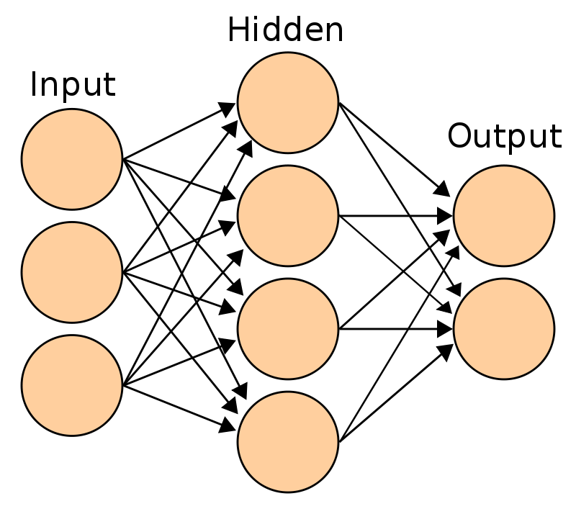
Neural Nets in brief
Neuron := (inputs, function, output)
Neural Network := digraph of neurons
Computes some complex function (e.g. is_dog: image -> bool)
Tweak the parameters to better match observed data (“training”)
f

Slide 4
Neural Nets in brief
Neural Nets are old idea
Recent advances in hardware allowed huge number of layers in neural net (deep NN)
Important for image classification, speech recognition
Takes days to train, but computation can be batched and parallelized
ith input feature
of kth input
ith weight
of jth neuron
ith input feature
ith weight
of jth neuron
ith input feature
ith weight

Slide 5
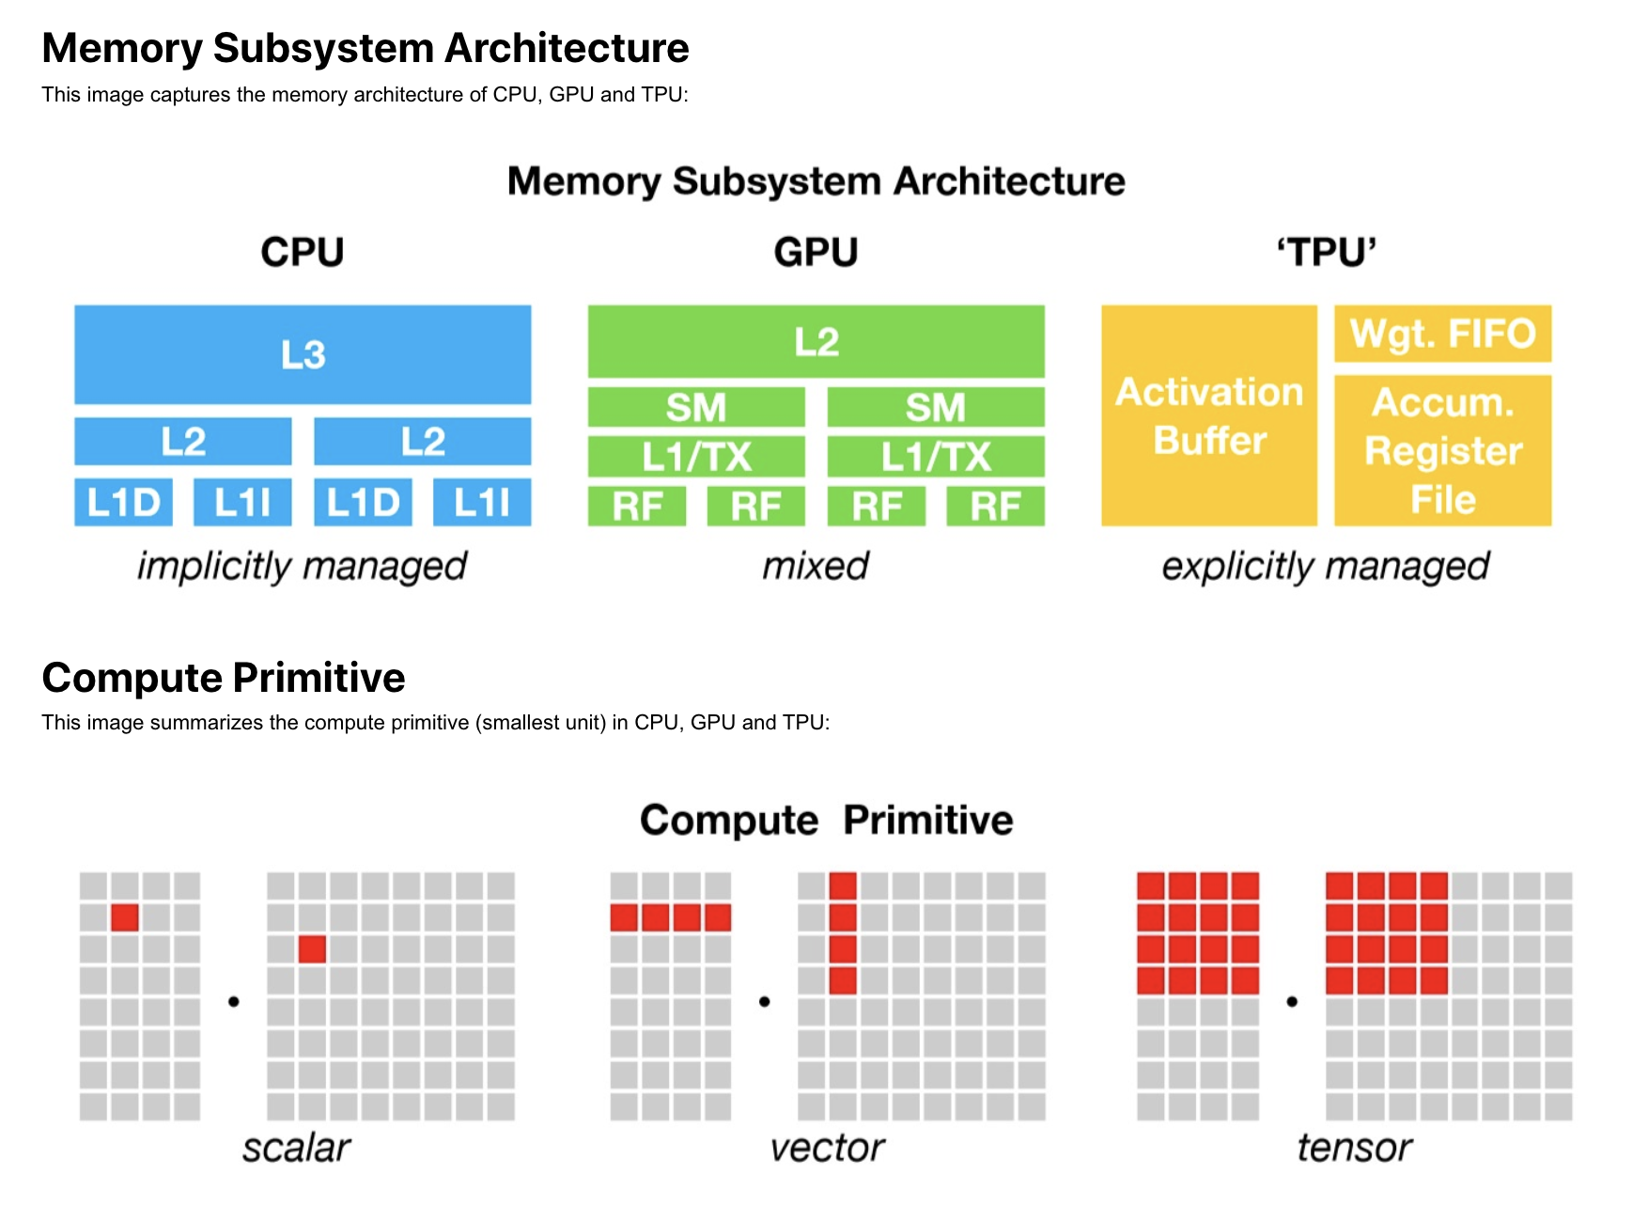
CPU vs GPU vs TPU
Notes:
CPU:
1 X 1 data unit (Dimensions)
Low latency
Arithmetic operations - sequential order ([1,2,3] * [4,5,6] = [4,10,18]) ⇒ This will take 2ns+2ns+2ns = 6ns
CPU can handle tens of operation per cycle (Performance)
A processor designed to solve every computational problem in a general fashion. The cache and memory design is designed to be optimal for any general programming problem. (Purpose)
General purpose programming problem (Usage)
GPU:
1 X N data unit
High throughput
Arithmetic operations - sequential order ([1,2,3] * [4,5,6] = [4,10,18]) => This will take 2ns only = as the 3 multiplication happens at the same time parallely
GPU can handle tens of thousands of operation per cycle
A processor designed to accelerate the rendering of graphics.
Graphics rendering, Machine Learning model training and inference, efficient for programming problem with parallelization scope, General purpose programming problem
(RF - Register File, SM - Streaming Multiprocessor, L1 cache )
TPU:
N X N data unit
TPU can handle upto 128000 operations per cycle
A co-processor designed to accelerate deep learning tasks develop using TensorFlow (a programming framework); Compilers have not been developed for TPU which could be used for general purpose programming; hence, it requires significant effort to do general programming on TPU
Machine Learning model (only in TensorFlow model) training and inference
https://www.youtube.com/watch?v=-P28LKWTzrI

Slide 6
Why DL accelerator?
To perform compute intensive operations like matrix multiplication, convolution, Fast Fourier Transforms etc.
Data size - in GBs/PBs
Energy-efficiency - Consumption can be minimized with some specialized chipsets
CPU’s, in general, are used for general purposes, whereas we need ASIC hardware to do above mentioned.
Deep learning does not have flow control logics, whereas CPU has optimized flow control and speculation.
A large amount of computation over massive amounts of data
Notes:
Flow control logics = Branch predictors, speculation

Slide 7
Tensor Processing Unit
Developed by Google
Purpose: To accelerate the Neural Network computation
Production-ready ASIC
Connected to Host via PCIe
GPUs to TPUs? Why?
- Latency requirements while performing inference
- small batch size
- To some extent, GPUs are still general purpose
TPU does not fetch the data from the register for every operation instead host sends instructions to TPU

Slide 8
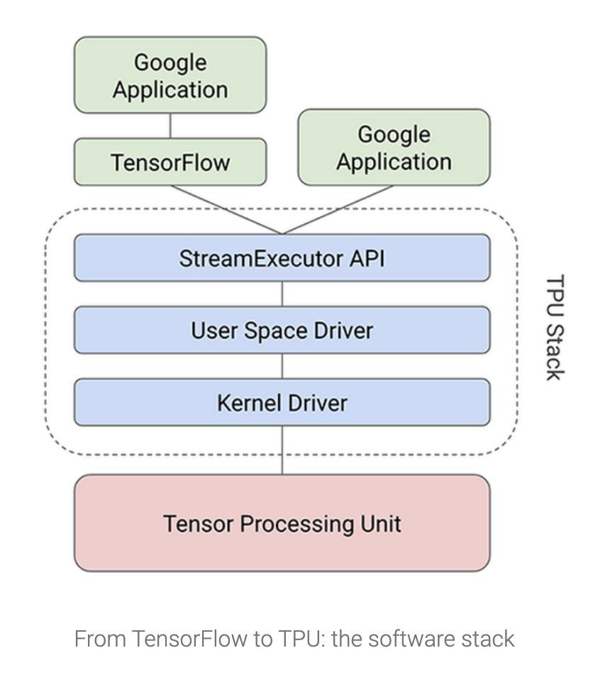
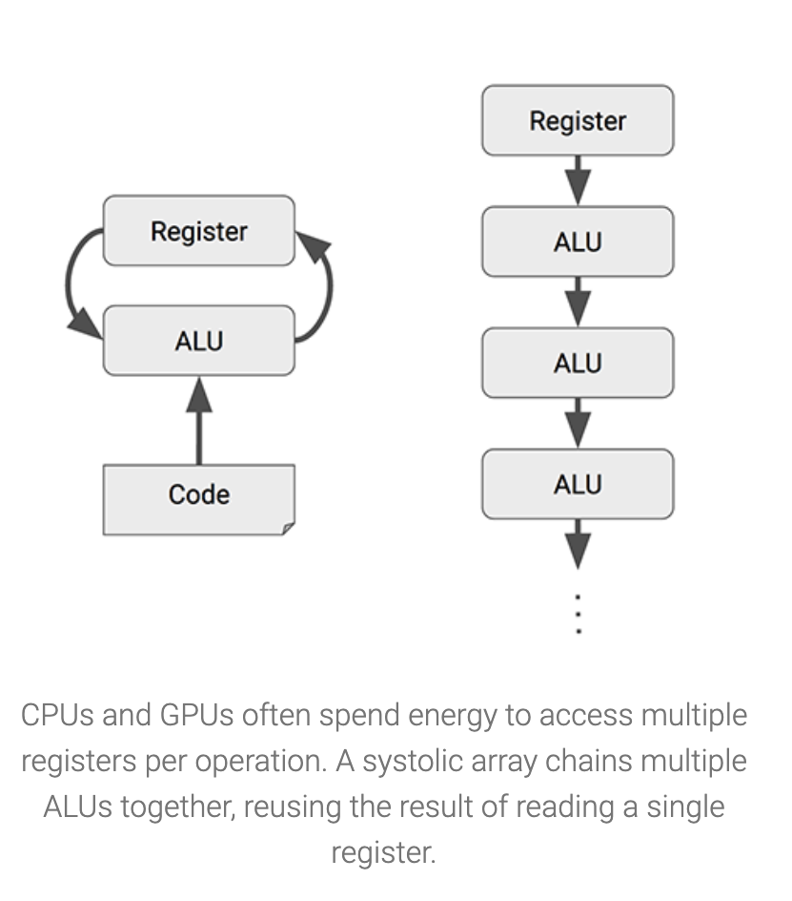
Notes:
These are generalized for all neural networks - not just for one specific neural network
Compiler and software stack to convert the APIs(from Tensorflow) to TPU instruction set
Only for us

Slide 9
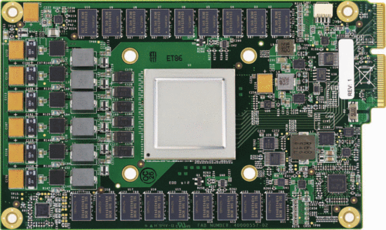
Overview
4 stage pipeline with CISC instruction set
Placed on a PCIe port
Interacts with CPU as a controller, where CPU sends instructions
Used in data centers for heavy compute workloads
Notes:
“It uses a 4-stage pipeline for these CISC instructions, where each instruction executes in a separate stage.”
“Rather than be tightly integrated with a CPU, to reduce the chances of delaying deployment, the TPU was designed to be a coprocessor on the PCIe I/O bus, allowing it to plug into existing servers just as a GPU does.”
“Moreover, to simplify hardware design and debugging, the host server sends TPU instructions for it to execute rather than the TPU fetching them itself.”

Slide 10
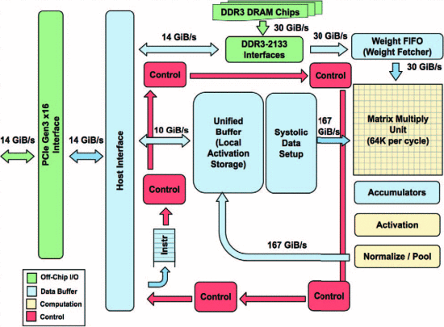
Hardware
Notes:
TPU - CISC architecture
Reads in 256 values per clock cycle (Cycle time changes based on 8 bit or 16 bit entries?)
Weights and Activations loaded in to Weight FIFO, reads from off chip RAM
Matrix Unit: 64 KiB tile for weights (and another 64Kib for double buffering)
Unified Local Buffer: Stores the outputs from matrix multiply, can be fed into matrix multiply unit again
Activation Unit: Hardwired activation functions

Slide 11
Instruction Set
5 Main Instructions:
Read_Host_Memory
Read_Weights
Mat.Mul./Conv.
Activate
Write_Host_Memory
Notes:
1,2,5 are simple as the name implies
3 Uses 256 * 256 matrix multiplixations, so it works well for larger matrix multiplications; Takes B * 256 inputs and takes B cycles to output
4 Activation layer function in NN, also has inbuilt functions like RELU and pooling (more dedicated hardware so depends on build) for NN and ConvNet respectively

Slide 12
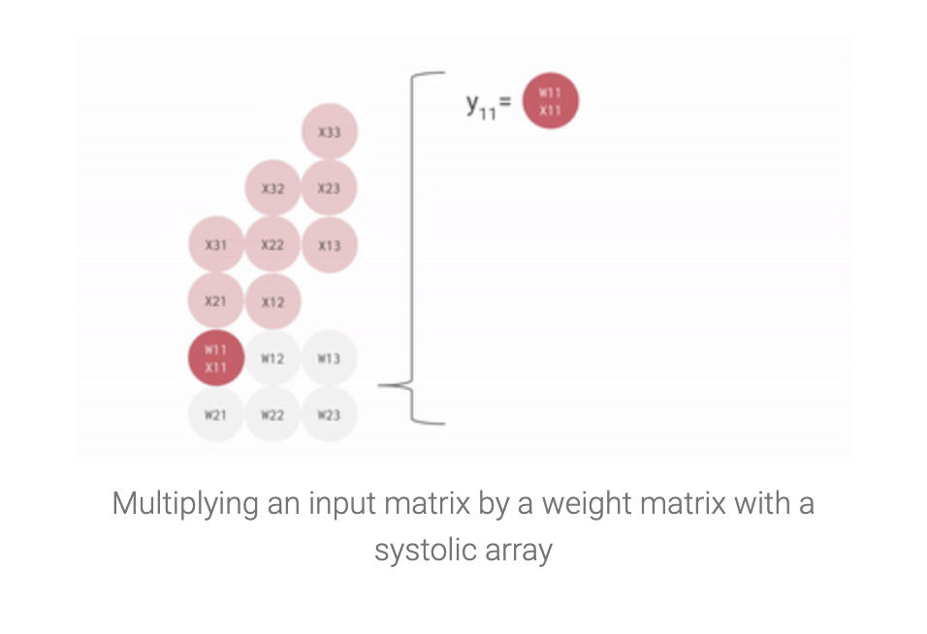
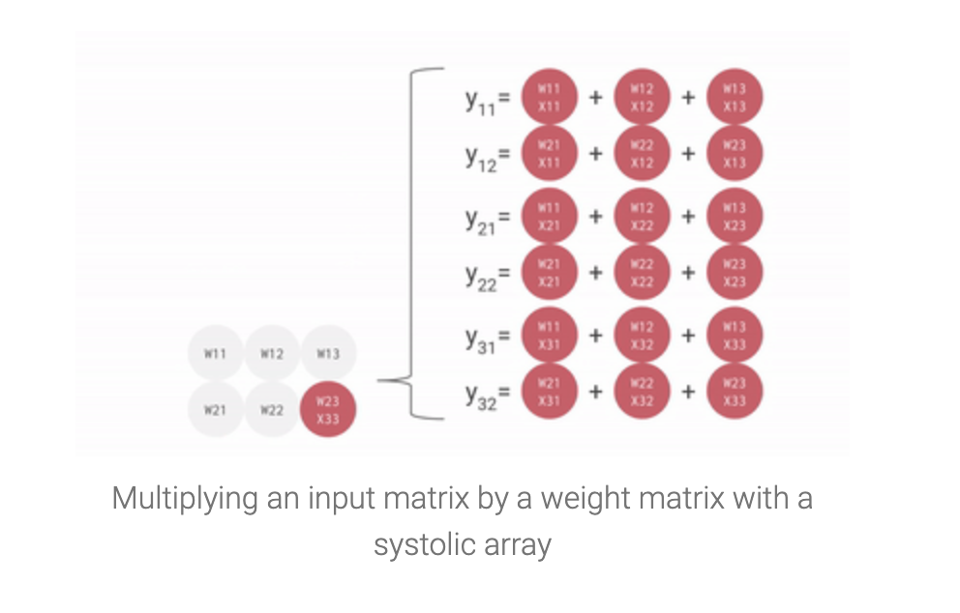
SYSTOLIC ARRAY IMPLEMENTATION
Notes:
The heart of the TPU: A systolic array
A systolic array is a network of processors that rhythmically compute and pass data through the system. They derived their name from drawing an analogy to how blood rhythmically flows through a biological heart as the data flows from memory in a rhythmic fashion passing through many elements before it returns to memory.
optimized for power and area efficiency wrt matrix multiplication
Engineering trade off: limiting registers, control and operational flexibility in exchange for efficiency and much higher operation density.
A major benefit of systolic arrays is that all operand data and partial results are stored within (passing through) the processor array. There is no need to access external buses, main memory or internal caches during each operation as is the case with Von Neumann or Harvard sequential machines.

Slide 13
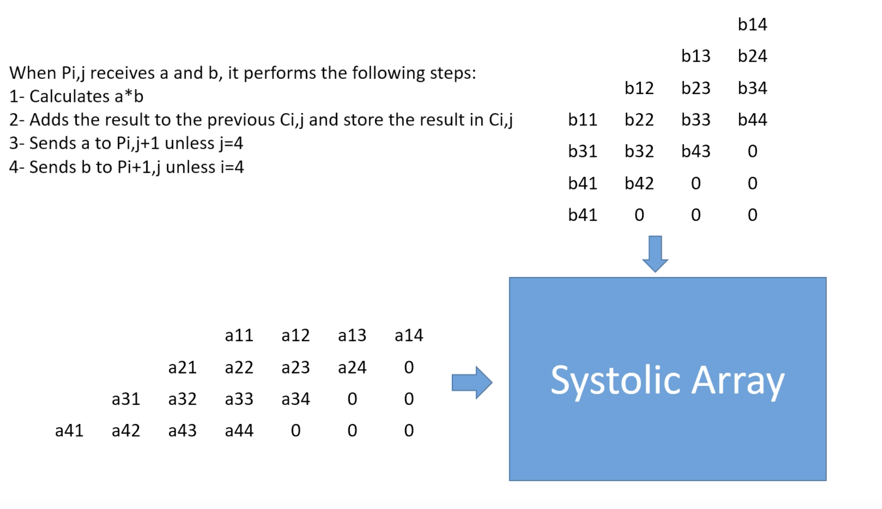
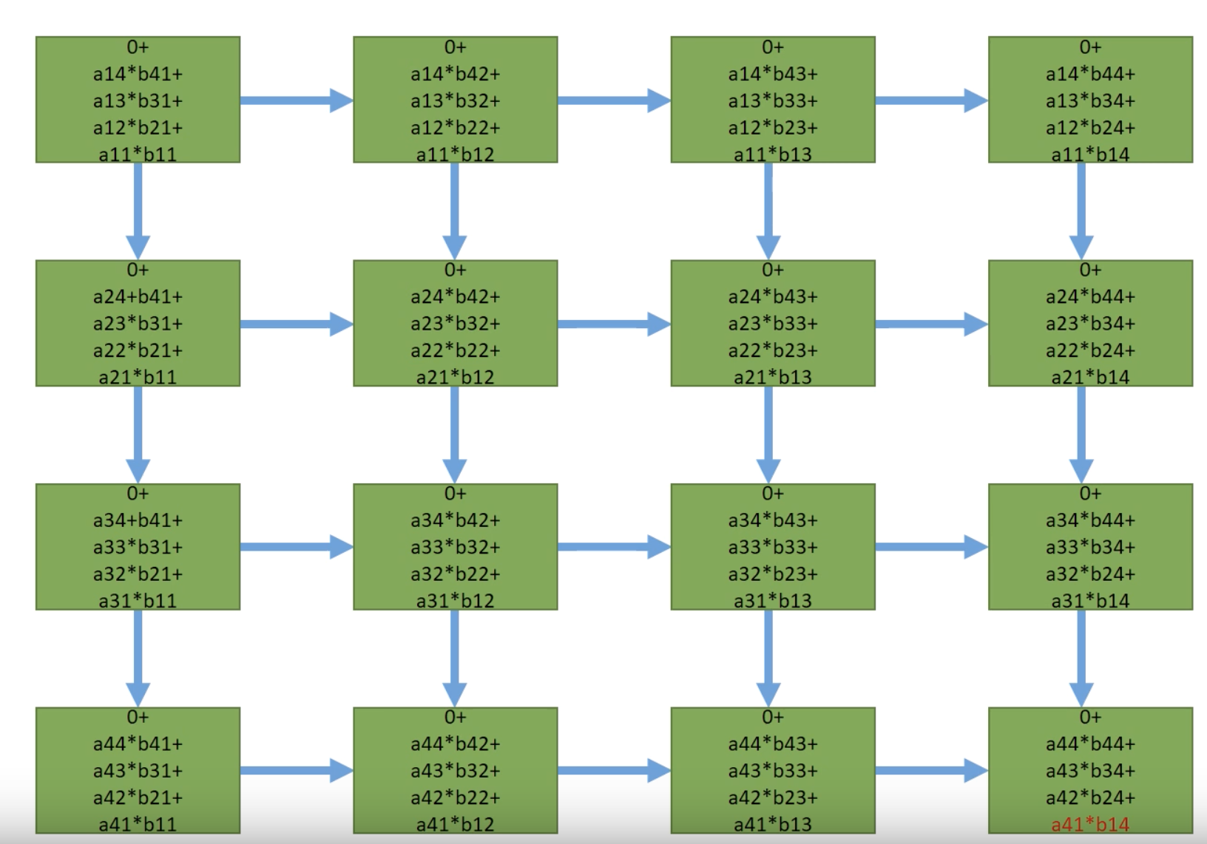
Notes:
https://www.youtube.com/watch?v=cmy7LBaWuZ8
During the execution of this massive matrix multiply, all intermediate results are passed directly between 64K ALUs without any memory access, significantly reducing power consumption and increasing throughput.
256 × 256 = total 65,536 ALUs. That means a TPU can process 65,536 multiply-and-adds for 8-bit integers every cycle. Because a TPU runs at 700MHz, a TPU can compute 65,536 × 700,000,000 = 46 × 1012 multiply-and-add operations or 92 Teraops per second (92 × 1012) in the matrix unit.

Slide 14
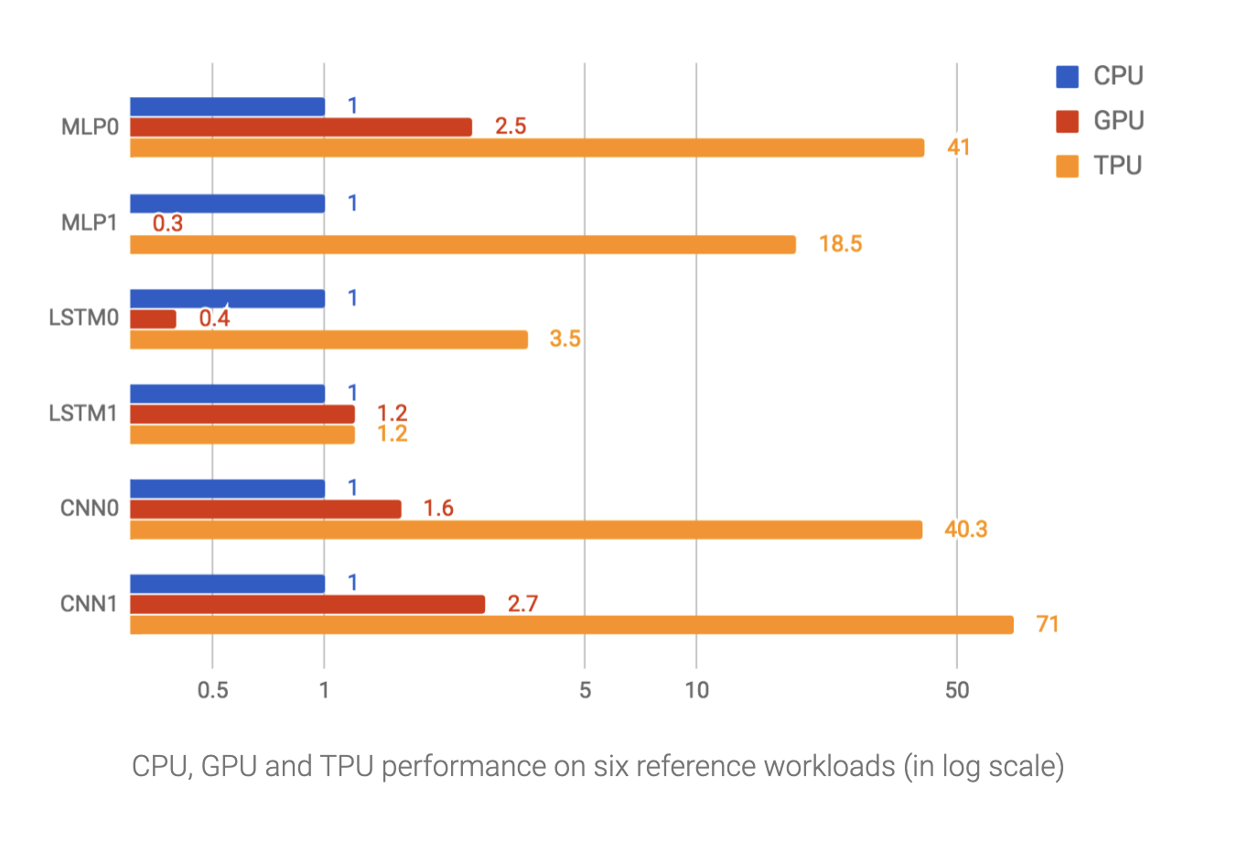
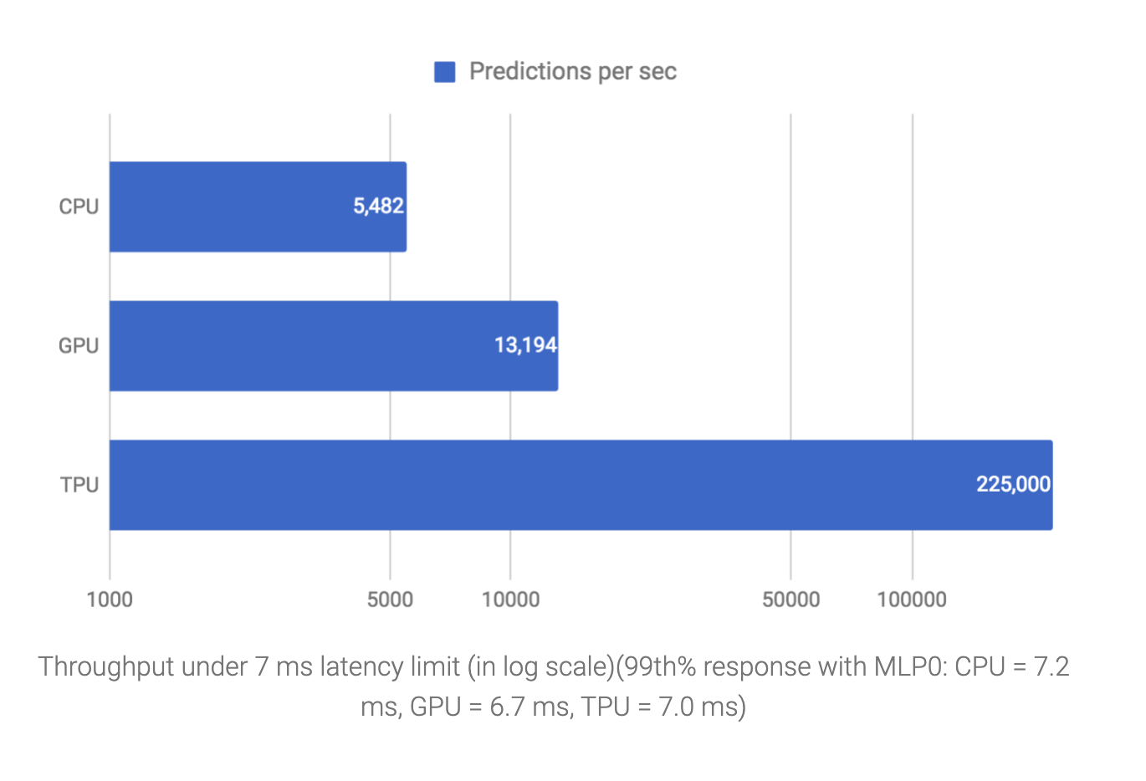
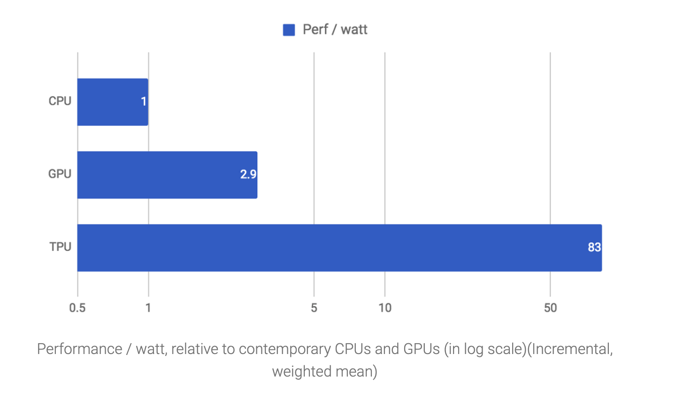
Performance
Notes:
an overall performance (predictions per second) comparison between the TPU and a contemporary CPU and GPU across six neural network applications under a latency limit.
WRT prediction’s per second - TPU outperforms (Number speaks everything)
WRT CNN’s TPU’s outperform GPU’s
performs reasonably well than GPUs for MLPs
WRT LSTM1 almost similar to GPU
PROS - a) Programmability b)Production Ready
CONS - a) No direct support for sparsity b)Converts CNN to Matmul which may not be optimal
(MLP: Multi Layer Perceptron, LSTM: Long Short-Term Memory, CNN: Convolutional Neural Network)
With the TPU, we can easily estimate exactly how much time is required to run a neural network and make a prediction. (DO NOT CONFUSE PREDICTION WITH BRANCH PREDICTION)
As a result, the CISC-based matrix processor design delivers an outstanding performance-per-watt ratio: TPU provides a 83X better ratio compared with contemporary CPUs and a 29X better ratio than contemporary GPUs.

Slide 15
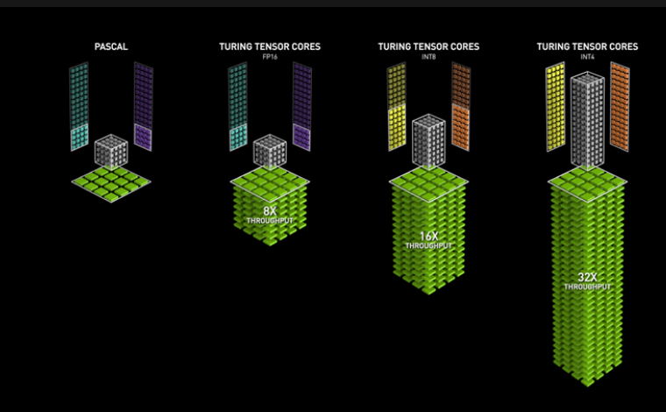
CUDA
Code Path (CPU):
malloc as normal gpu memory
copy to allocated memory via tensor core specific methods
run specific operations for the kernel
Only operations allowed through predefined methods usually for matrix multiplication
Notes:
Uses Tensor Cores embedded onto the GPU instead of a full TPU
4x4x4 matrix multiplication for full FP16 inputs
Output = A * B + C
CUBLAS, cuDNN
Integrated in CUDA as a library where memory needs to be specifically set for the TPU matrix multiplication
Only really used in Tensor Math so limited in CUDA;
Matrices must be limited to multiples of 8 in dimensions
CUDA 9.0
Do not need libraries anymore, part of base cuda code
No need to manually set multiples of 8 anymore however the functions may correct dimensions in the back
Need to allocate special memory for TPU as before

Slide 16
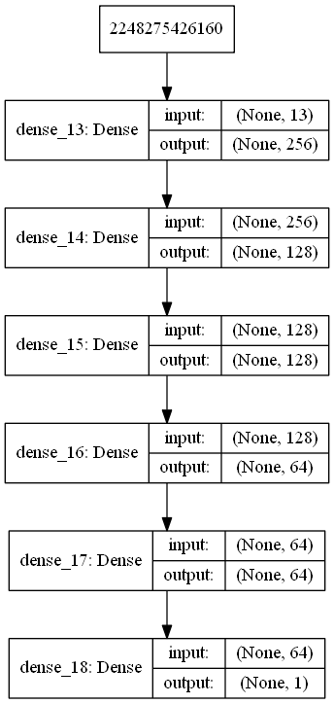
TensorFlow
Can use TensorCores with default Tensorflow functions, but with compact library
Some Unique Functions:
cross_replica_sum
replica
rewrite
Notes:
Functions use a lot of replication due to the nature of deeplearning models
Models want to train multiple versions with random weights and different parameters
cross_replica_sum: sums tensor based on group assignments/parameters such as number of replicas, num groups
replica: builds a graph that runs a replica of a TPU computation
rewrite: Takes in a function as an input and performs a computation on the function
Most of these aren’t usually touched by programmers, instead you would write code in general
*NOTE* Visual representation of graph shown on right, you would construct code to make said graph and tensorflow would use a TPU to run the code, similar to cpu vs gpu code

Slide 17
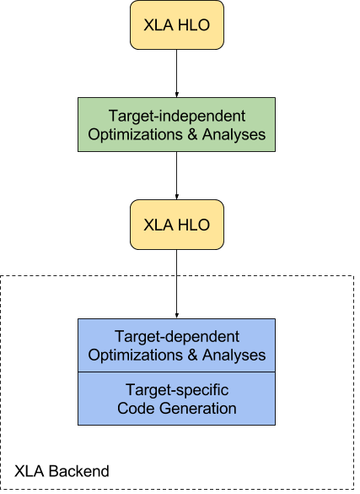
XLA
Target-independent
Fuse operations
Reorder matrix multiplication
Target-dependent
Tile/pad

Slide 18
TPU vs EYERISS?
Memory Hierarchy?
Inter Processing Element communication whereas TPU does not have
Application?
TPU is mainly used for training models whereas Eyeriss is used for inference
Programmability?
TPU is highly programmable compared to Eyeriss
Usability?
TPU is for generic training whereas Eyeriss is for CNN's

Slide 19
Sources
[TPU Architecture]https://ieeexplore.ieee.org/abstract/document/8192463
[TPU Architecture]https://arxiv.org/pdf/1704.04760.pdf
[TPU Architecture]https://cloud.google.com/blog/products/gcp/an-in-depth-look-at-googles-first-tensor-processing-unit-tpu
[Performance] https://storage.googleapis.com/nexttpu/index.html
[Deep Learning and neural nets] https://www.nature.com/articles/nature14539
[TPU Architecture] https://ieeexplore.ieee.org/abstract/document/8358031
[CPU vs GPU vs TPU]https://iq.opengenus.org/cpu-vs-gpu-vs-tpu/
[tensorflow documentation of functions] https://www.tensorflow.org/api_docs/python/tf/compat/v1/tpu?hl=en
[cuda programming of tensor cores] https://devblogs.nvidia.com/programming-tensor-cores-cuda-9/
[XLA documentation] https://www.tensorflow.org/xla/architecture

