Slide 1
BOOM, Rocket SoC Generator, and Chisel Agile Design Flow
Jiayi Cai
Kun Wu
Zeran Zhu

Slide 2
Content
BOOM Core Design
Introduction to Rocket SoC Generator
Chisel Agile Hardware Design Flow

Slide 3
https://content.riscv.org/wp-content/uploads/2017/12/Wed0936-BOOM-v2-An-Open-Source-Out-of-Order-RISC-V-Core-Celio.pdf
Notes:
Hight level overview of the boom pipeline
Fetch unit
Decode and rename
Multiple issue
Execute
Write back

Slide 4
Simplified BOOM Pipeline with Stages
https://docs.boom-core.org/en/latest/sections/intro-overview/boom-pipeline.html
Notes:
Fetch unit differ from lecture
Explicit register renaming, precense of physical register files differ from tomasulo reorder buffer in lecture
* no data in rob, rather maintains register alias table (RAT)
For limited time, we will cover optimizations and design choices in the fetch and rename stage, which differ the most from the pipeline covered in lecture

Slide 5
Fetch
Rocket core i-cache
Handling compressed 16b instructions
Fetch buffer
Fetch packet
Fetch target queue – branch info for updating the predictor

Slide 6
Branch
BTB & Predictor
Branch unit – resolves branch

Slide 7
Notes:
FTQ for updating the backing predictor
Backing predictor has higher accuracy, can force NLP's taken to NT

Slide 8
Pipeline Hazards
Requires ROB unwind and RAT restore
Exceptions:
Rollback
Single-cycle reset
Branches:
Branch mask
Branch tag - assigned at decode
Notes:
The difference between exceptions and branch misprediction is that exception flushes ROB, whereas branch misprediction only requires killing inflight ops with specific branch tags

Slide 9
Simplified BOOM Pipeline with Stages
https://docs.boom-core.org/en/latest/sections/intro-overview/boom-pipeline.html
Notes:
Rob stores stale mapping

Slide 10
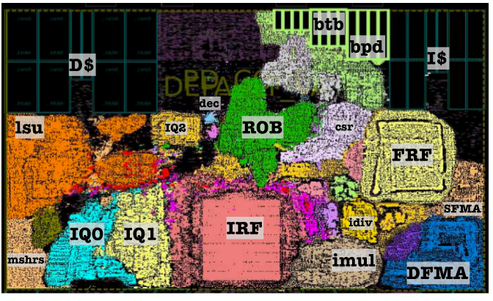
https://docs.boom-core.org/en/latest/sections/intro-overview/boom.html

Slide 11
Content
BOOM Core Design
Introduction to Rocket SoC Generator
Chisel Agile Hardware Design Flow

Slide 12
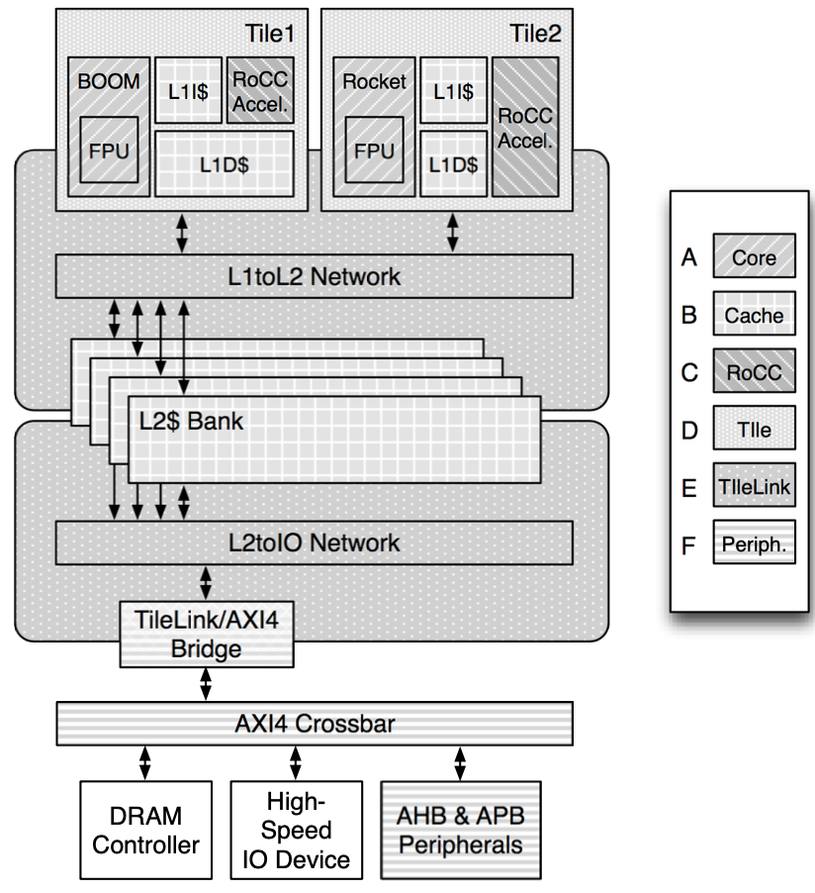
What is the Rocket Chip SoC Generator?
Parameterized SoC generator written in Chisel
Generates Tiles
Core + Private caches
Generates Uncore (outer memory system)
Caches
RoCC (the Rocket Custom Coprocessor interface)
Tile
TileLink
Peripherals
Glues all the pieces together

Slide 13
What can be Configured?
Tile
Instruction width
IFetch width
Use debug
# breakpoints
# Perf. counters
FPU key
Mult. div. key
Use atomics
Caches
# Sets
# Ways
# TLB-entries
# row bits
# id bits
split metadata
ECC code
Replacement policy
Uncore
TileLink config
L1 to L2 config
Broadcast config
Banked L2 config
Bootrom
# Tiles
$block # bytes
Notes:
In general, Rocket Chip is a library of generators that can be parameterized and composed into a wide variety of SoC designs.

Slide 14
Important Interfaces in the Rocket Chip
TileLink
Specific to Rocket Chip
Inter-tile cache coherence network
RoCC (The Rocket Custom Coprocessor interface)
A special interface that helps attach accelerators to Rocket
AXI (Advanced eXtensible Interface)
Open standards specified by ARM
Notes:
The internal bus system uses TileLink, which is specific to RocketChip and connects the tiles, caches and other core components.
The physical bus sytem used within the processor is divided into 4 blocks, each with independent synchronization, data, address, source, size, mask, parameter and opcode signals, implementing two full-duplex paths.

Slide 15
TileLink
Agents
Client: manipulates data in cache blocks
Manager: tracks and controls the access and dataflow of the cache blocks
Channels
Acquire: getting permissions on a cache block and writing back data
Probe: find out if a client holds a certain cache block
Release: response to a probe, returns permissions for a cache block with its data
Grant: provide permissions and data for a cache block or acknowledge a release
Finish: used as a final acknowledgement after receiving a Grant
Notes:
TileLink is the cache coherence protocol on top of the physical bus system that connects different agents who participate in a coherent memory model. Supports MOESI memory model
Each agent is either a client or a manager. An agent can also fit into both categories. For example, the L2 cache will appear as a client to caches farther out (or the memory), while managing its clients the L1 caches.
TileLink specifies 5 basic operations, called channels.
A number of behavioural constraints have to be implemented in the agents to ensure consistent, deadlock-free operation:
If the different channels share the same physical link, Each channel listed must have priority over the channels listed above it (So that Finish has highest priority and is always sent first.
A Manager must wait for transactions on a block to be finished before accepting new requests on that block unless it can merge the results of the different transactions.
A Client cannot release and respond to a Probe if there is still an outstanding voluntary Release on that block

Slide 16
TileLink: Operations
Notes:
an example of TileLink operations: Several Clients are managed by a higher-level Manager which is itself a client to the memory .

Slide 17
TileLink: Operations
Notes:
In the first transaction, client 0 ,which could be a processor core, requests a cache block. As a result, the Manager sends Probe messages to all Clients under its control. If no client hold the requested block, the clients will indicate this in their release response. Then, the manager requests the block from memory. When receiving the Grant with the cache data, the manager forwards it to client 0. On reception, client0 sends a finish message.
If one of the clients holds the requested cache block, It will release its hold of the cache block and return data with its Release message. The Manager now has the data and permissions for the cache block, so it can directly issue a Grant to Client0 without contacting Memory.

Slide 18
TileLink: Operations
Notes:
The second transaction is a voluntary release.
Client0 decides that it no longer needs to hold a cache block under its control and releases it by sending a Release message with the clobbered data to the Manager, which in turn sends a Release to the Memory. The Memory acknowledges the voluntary release by issuing a Grant which the Manager passes to Client0.

Slide 19
RoCC: Rocket Custom Coprocessor
The RoCC accelerators follow a standard instruction format
2 register values can optionally be passed to the accelerator
An optional destination register can also be passed into the accelerator
A function code is passed to the accelerator and can be used to trigger specific operations
The RoCC instruction encoding.
Notes:
In the Rocket coprocessor interface, the Rocket core processes custom Rocket Custom Coprocessor (RoCC) instructions and passes requests to the accelerator.
The RISC-V specification is rather general on creating custom instructions

Slide 20
RoCC: Rocket Custom Coprocessor
The RoCC interface is split into several wires and bundles
cmd
resp
busy
Mem.req
Mem.rsp
Simplified view of RoCC
Notes:
cmd is a decoupled interface that carries the 2 register values along with the entire instruction
resp is a decoupled interface that carries the value to be written into the destination reg
busy signals to the processor that the accelerator is busy
mem.req is a decoupled interface that carries memory requests
mem.resp is a decoupled interface that carries a response to a mem request

Slide 21
Content
BOOM Core Design
Introduction to Rocket SoC Generator
Chisel Agile Hardware Design Flow

Slide 22
What is Chisel?
Hardware description language: Verilog, VHDL.
too low-level
Chisel is a hardware construction language (HCL).
Chisel stands for Constructing Hardware in a Scala Embedded Language

Slide 23
A Finite State Machine Example
Finite state machine is a typical building block that contains both combinational logic and sequential logic.
A finite state machine (Moore’s type)

Slide 24
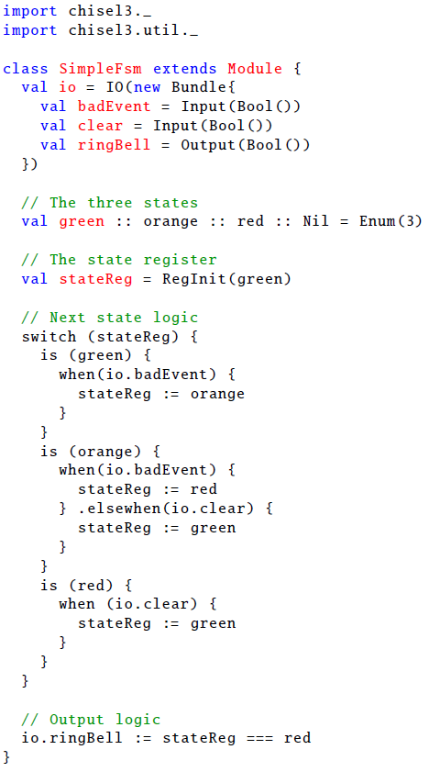
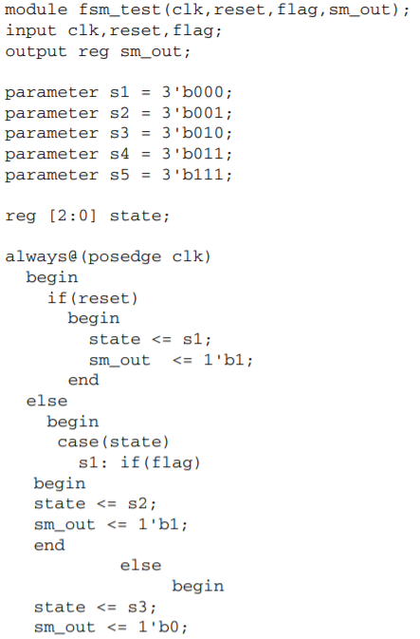
1. Module definition
type checks
2. State register
default clocking and reset logic
3. State transition logic
4. Output logic
5. Hardware constructs primitives
distinct from Scala built-in control flow primitives
when vs. if
switch vs. match

Slide 25
Chisel is a Hardware Construction Language
Hardware constructs + hardware generation. e.g. when vs. if.
Analogously, #if vs. if in C/C++
Gains merits from modern programming language and software development flow
building blocks in standard library, duplicate code elimination, trouble-free connection (<>, Flipped, etc.), strong type checking, etc.
Parameterization: bypass, BTB type, issue width, etc.
Powerful unit test functionality
check signal equality check at certain cycle.
Notes:
Two common mistakes in Verilog
Forgot to specify the variable width
Typo causes implicit variable declaration. The whole module becomes brick.

Slide 26
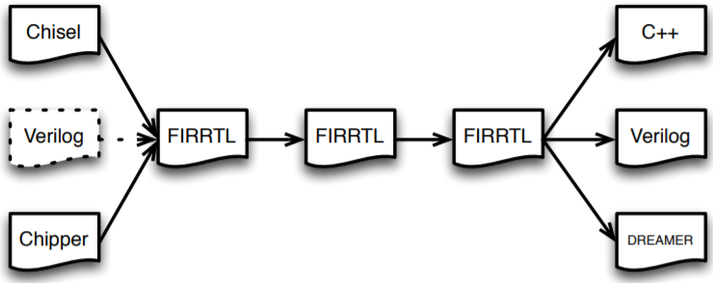
The Chisel Design Flow
Chisel programming describes the data path
and eventually transformed to Verilog RTL (register transfer level).
Better view: The Scala Chisel library enables metaprogramming for FIRRTL.
although FIRRTL stands for Flexible Intermediate Representation for RTL.
An ambitious plan that enables agile hardware development flow
generation, composition (module reusability), transformation (customized optimization passes by FIRRTL compiler), optimization (design space exploration), layering, simulation, realization.
FIRRTL Flow.

Slide 27
Parameterization Allows Fast Design Space Exploration
The example of BOOM development effort.

Slide 28
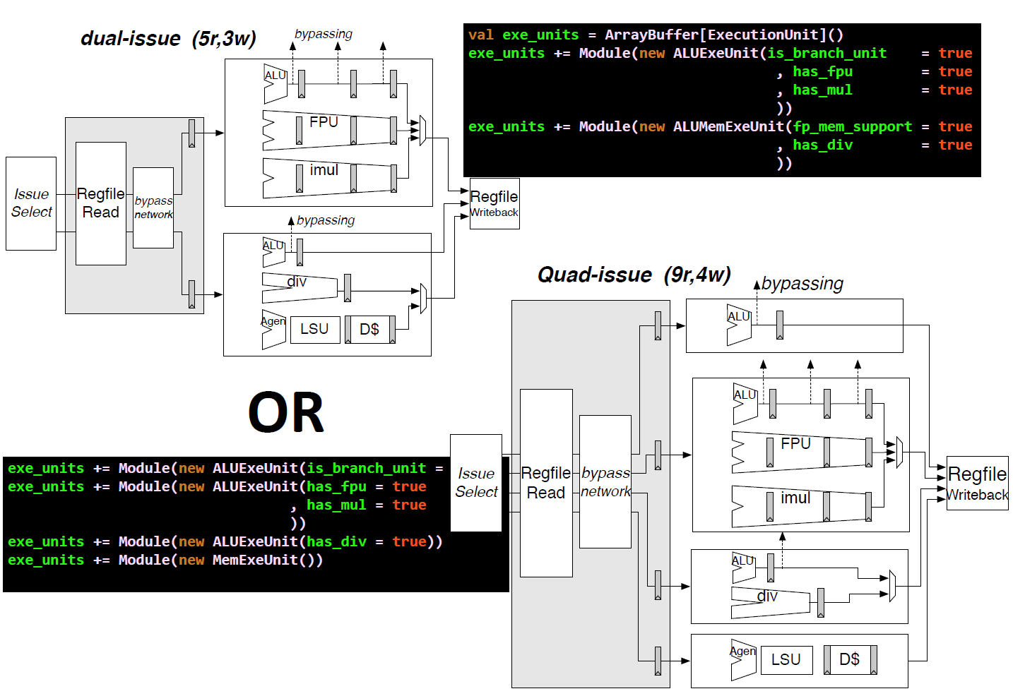

Slide 29
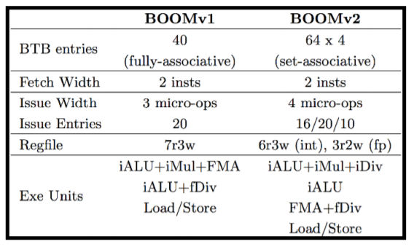
BOOM Agile Development
Two graduate students spent only four months before tape-out.
Targeted at TSMC 28nm HPM (high performance mobile).
The analysis and optimization effort mainly focused on critical path.

Slide 30
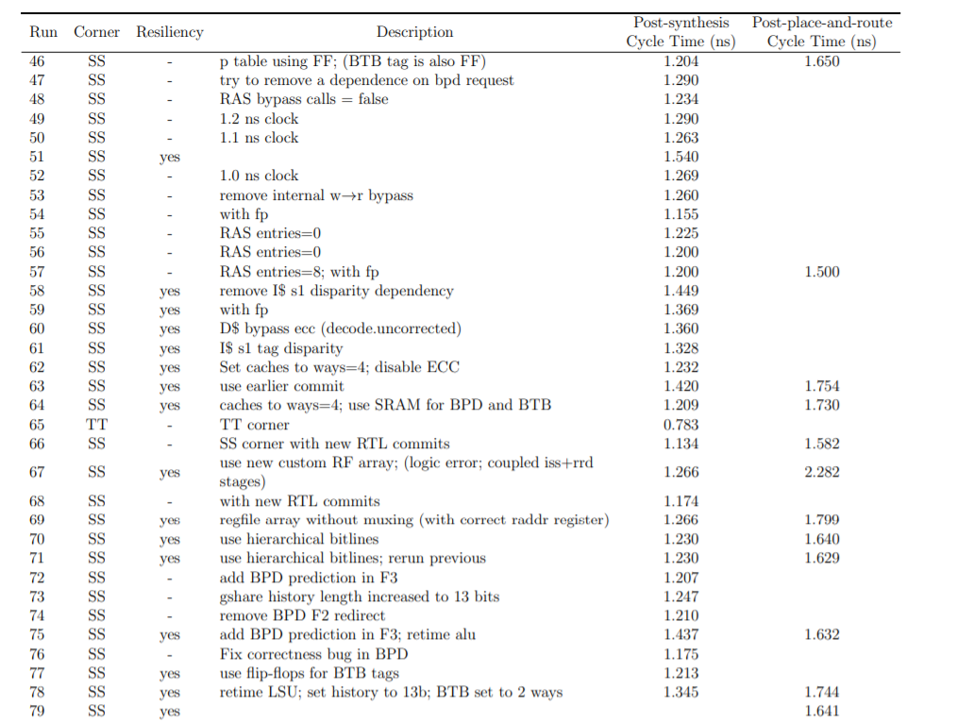
A brief description of major builds. The critical path is the summation of the target clock period and the negative clock skew.

Slide 31
Current Status: Limitations and Prospects
Migration effort from old code base.
Besides the learning curve is steep
Best for design space exploration at the level of data path.
Not specifically designed for FPGA development.
Xilinx coding style
Xilinx primitives, specific memory types that beyond the RTL level
People prefer HLS (high level synthesis) for design space exploration.
Modifying the tools is needed to suit specific design task.
What to expect
The BOOM ecosystem is still evolving. Many useful tools are under development.
Chisel may be applied in open hardware effort. e.g. DARPA Electronics Resurgence Initiative

Slide 32
Reference
[1] Martin Schoeberl 2019. Digital Design with Chisel. (2019). Retrieved December 3, 2019 from https://github.com/schoeberl/chisel-book
[2] Stevo Bailey et al. 2019. Chisel Bootcamp. (2019). Retrieved December 3, 2019 from https://github.com/freechipsproject/chisel-bootcamp
[3] Krste Asanović et al. 2016. The Rocket Chip Generator. Technical Report.
[4] Christopher Celio 2018. A Highly Productive Implementation of an Out-of-Order Processor Generator. Technical Report.
[5] Zihao Yu et al. 2019. Practice of Chip Agile Development: Labeled RISC-V. Journal of Computer Research and Development (2019).
[6] Xilinx 2014. Vivado Design Suite User Guide: Synthesis. Retrieved December 3, 2019 from https://www.xilinx.com/support/documentation/sw_manuals/xilinx2014_1/ug901-vivado-synthesis.pdf
[7] Christopher Celio et al. 2017. BOOM v2: an open-source out-of-order RISC-V core. Technical Report.
[8] Github 2019. The Berkeley Out-of-Order RISC-V Processor. (2019). Retrieved December 3, 2019 from https://github.com/riscv-boom/riscv-boom
[9] UCB 2019. RISCV-BOOM's Documentation. (2019). Retrieved December 3, 2019 from https://docs.boom-core.org/
[10] UCB 2017. Chisel3 Cheat Sheet. (2017). Retrieved December 3, 2019 from https://inst.eecs.berkeley.edu/~cs250/sp17/handouts/chisel-cheatsheet3.pdf
[11] Christopher Celio et al. 2018. BROOM: An open-source out-of-order processor with resilient low-voltage operation in 28nm CMOS. Hot Chips (2018).
[12] Sagar Karandikar et al. 2018. FireSim: FPGA-Accelerated Cycle-Exact Scale-Out System Simulation in the Public Cloud. ISCA (2018).
[13] Tutu Ajayi et al. 2017. Experiences Using the RISC-V Ecosystem to Design an Accelerator-Centric SoC in TSMC 16nm. CARRV (2017).
[14] Jonathan Bachrach et al. 2015. Chisel – Accelerating Hardware Design. (2015). Retrieved December 3, 2019 from https://riscv.org/wp-content/uploads/2015/01/riscv-chisel-tutorial-bootcamp-jan2015.pdf.

Slide 33
Thank you!

Slide 34
Backup Slides

Slide 36
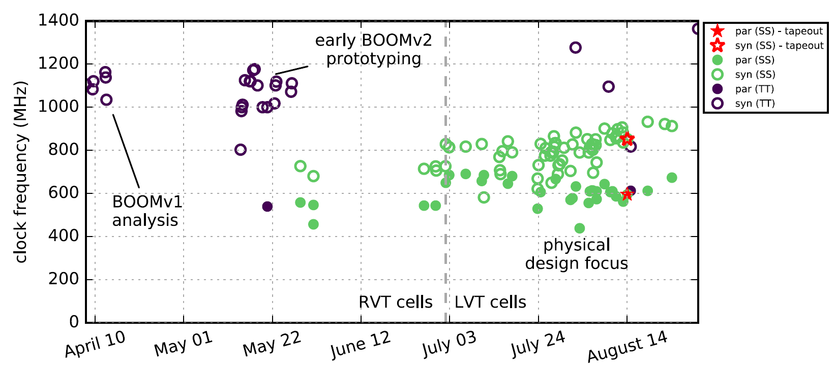
BOOM Agile Development
Many changes have been made to the code base. A lot of versions shown here have violations.
Notes:
LVT:Low voltage threshold
RVT: regular voltage threshold

Slide 37
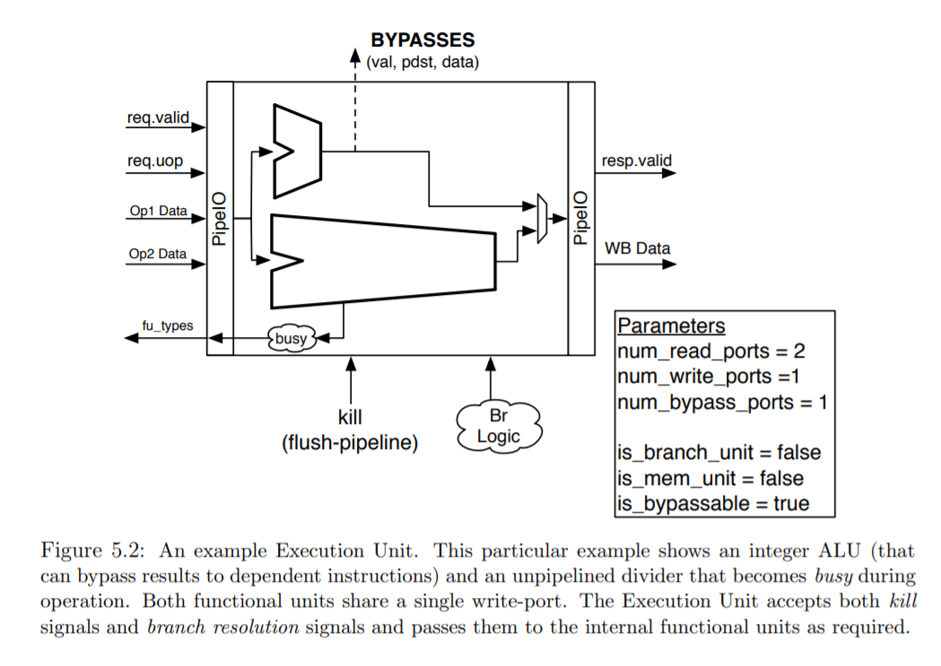

Slide 38
