Slide 1
CS 425 / ECE 428
Distributed Systems
Fall 2026
Aishwarya Ganesan
w/ Ram Kesavan
Lecture 9-10: Key-Value/NoSQL Stores
Ack: Indranil Gupta
All slides © IG

Slide 2
Announcements
HW2 Released, due on Sunday 10/4 in less than 2 weeks (start early, no extensions!)
MP2 is already out, due soon 9/27 (no extensions!)
MP1 grades released (see Piazza post)
HW1 being graded
In class midterm October 8th
  Make sure you’re in class that day!
  There will be two rooms, different buildings (will update on Piazza and course webpage soon)

Slide 3
The Key-value Abstraction
(Business) Key → Value
(twitter.com) tweet id → information about tweet
(amazon.com) item number → information about it
(kayak.com) Flight number → information about flight, e.g., availability
(yourbank.com) Account number → information about it
3

Slide 4
The Key-value Abstraction (2)
It’s a dictionary datastructure.
  Insert, lookup, and delete by key
  E.g., hash table, binary tree
But distributed.
Sound familiar? Remember Distributed Hash tables (DHT) in P2P systems?
It’s not surprising that key-value stores reuse many techniques from DHTs.
4

Slide 5
Isn’t that just a database?
Yes, sort of
Relational Database Management Systems (RDBMSs) have been around for ages
  E.g., MySQL
Schema-based, i.e., structured tables
Each row (data item) in a table has a primary key that is unique within that table
Queried using SQL (Structured Query Language)
Supports joins
5

Slide 6
Relational Database Example
users table
user_id name zipcode blog_url blog_id
101 Alice 12345 alice.net 1
422 Charlie 45783 charlie.com 3
555 Bob 99910 bob.blogspot.com 2
Example SQL queries
SELECT zipcode
FROM users
WHERE name = “Bob”
2. SELECT url
FROM blog
WHERE id = 3
SELECT users.zipcode, blog.num_posts
FROM users JOIN blog
ON users.blog_url = blog.url
users.zipcode | blog.num_posts
12345 | 332
45783 | 7
99910 | 10003
Primary keys
Foreign keys
blog table
id url last_updated num_posts
1 alice.net 5/2/14 332
2 bob.blogspot.com 4/2/13 10003
3 charlie.com 6/15/14 7
6

Slide 7
Mismatch with today’s workloads
Data: Large and unstructured
Lots of random reads and writes
Sometimes write-heavy
Foreign keys rarely needed
Joins infrequent
7

Slide 8
Needs of Today’s Workloads
Speed
Avoid Single point of Failure (SPoF)
Low TCO (Total cost of operation/ownership)
Fewer system administrators
Incremental Scalability
Scale out, not up
  What?
8

Slide 9
Scale out, not Scale up
Scale up = grow your cluster capacity by replacing with more powerful machines
  Traditional approach
  Not cost-effective, as you’re buying above the sweet spot on the price curve
  And you need to replace machines often
Scale out = incrementally grow your cluster capacity by adding more COTS machines (Components Off the Shelf)
  Cheaper
  Over a long duration, phase in a few newer (faster) machines as you phase out a few older machines
  Used by most companies who run datacenters and clouds today
9

Slide 10
Key-value/NoSQL Data Model
NoSQL = “Not Only SQL”
Necessary API operations: get(key) and put(key, value)
  And some extended operations, e.g., “CQL” in Cassandra key-value store
Tables
  “Column families” in Cassandra, “Table” in HBase, “Collection” in MongoDB
  but …
  May be unstructured: May not have schemas
    Some columns may be missing from some rows
  Don’t always support joins or have foreign keys
  Can have index tables, just like RDBMSs
10
Notes:
What reason did the NoSQL database give when it declined the birthday party invite? It said it could not join.

Slide 11
Key-value/NoSQL Data Model
Value
Key
Unstructured
Columns Missing from some Rows
No schema imposed
No foreign keys, joins may not be supported
users table
user_id name zipcode blog_url
101 Alice 12345 alice.net
422 Charlie charlie.com
555 99910 bob.blogspot.com
Value
Key
blog table
id url last_updated num_posts
1 alice.net 5/2/14 332
2 bob.blogspot.com 10003
3 charlie.com 6/15/14
11
Notes:
Why is the NoSQL database a bad building architect? Because its buildings often have missing columns.
Why was the NoSQL query frustrated at the restaurant? Because it had no table.

Slide 12
CS 425 / ECE 428
Distributed Systems
Fall 2026
Aishwarya Ganesan
w/ Ram Kesavan
Lecture 9-10: Key-Value/NoSQL Stores
Ack: Indranil Gupta
All slides © IG

Slide 13
Some history…
Earlier: RDBMS
SQL, ACID transactions, enterprise workloads
Systems: Oracle, DB2, SQL Server, MySQL
~late ‘00s and ‘10s: Rise of NoSQL
Large web companies build distributed stores to handle massive scale
Focus on partitioning, replication, high availability, and simpler data models
Systems: Google Bigtable, Amazon Dynamo, Cassandra, HBase, MongoDB
Today: Converging
SQL databases increasingly support horizontal scale-out (cloud databases)
NoSQL databases increasingly add transactions and richer query capabilities
Systems: Spanner, CockroachDB, distributed PostgreSQL, DynamoDB
13

Slide 14
Agenda
Design of a real key-value store, Cassandra.
Replication
Consistency vs. Availability tradeoff
Quorums
Local storage
HBase, another KV store and Consistency models (subsequent lectures)
14

Slide 15
Cassandra
A distributed key-value store
Intended to run in a datacenter (and also across DCs)
Originally designed at Facebook (influenced by Amazon Dynamo [1])
Open-sourced later, today an Apache project [2]
Widely used in production
  IBM, Adobe, HP, eBay, Ericsson, Symantec, Twitter, Spotify, PBS Kids, Netflix
    Netflix: uses Cassandra to keep track of your current position in the video you’re watching
(Version from 2015)
[1] https://www.allthingsdistributed.com/files/amazon-dynamo-sosp2007.pdf
[2] https://github.com/apache/cassandra
15

Slide 16
Let’s go Inside Cassandra:
Key -> Server Mapping
How do you decide which server(s) a key-value resides on?
16

Slide 17
Why okay to store full list at all nodes in Cassandra but not Chord ?
0
One ring per DC
Say m=7
N112
N16
Routing hops?
(Remember this?)
Primary replica for
key K13
N96
Read/write K13
N32
Key replicated on its r successors
r-replication factor
N80
N45
Client
Coordinator
Backup replicas for
key K13
Cassandra uses a Ring-based DHT but without finger tables
Each node has the full membership list
17

Slide 18
Data Placement Strategies
Replication Strategy: two options:
SimpleStrategy: uses the Partitioner, of which there are two kinds
  RandomPartitioner: Chord-like hash partitioning
  ByteOrderedPartitioner: Assigns ranges of keys to servers.
    Easier for range queries (e.g., Get me all twitter users starting with [a-b])
NetworkTopologyStrategy:
  E.g., Two replicas per DC
  Per DC
    First replica placed according to Partitioner
    Then go clockwise around ring until you hit a different rack
    Cassandra uses a component called snitches to map IPs to racks and DCs
18

Slide 19
Writes
Client sends write to one coordinator node in Cassandra cluster
  Coordinator may be per-key, or per-client, or per-query
    Typically, the successor of key in the ring
Coordinator assigns its current timestamp for the write (or client supplies it)
Per-key Coordinator ensures writes for the key are ordered
Coordinator sends write to all replica nodes responsible for key (let’s call it N from now)
A replica records the write to its local storage – We’ll see later.
When first X replicas respond, coordinator acknowledges client
  X? We’ll see later.
Note that multiple writes to same key K can be in progress at the same time.
19

Slide 20
Writes – Hinted Handoff
Always writable: Hinted Handoff mechanism
  If any replica is down, the coordinator writes to all other replicas
  And keeps the write locally until down replica comes back up.
  Catch up replica after it is up
When all replicas are down, the Coordinator buffers writes (for up to a few hours).
0
N112
N16
N96
N32
N80
N45
20

Slide 21
Reads
K13 → v1,10
Read: Similar to writes
Coordinator can contact X replicas (e.g., in same rack)
    Coordinator sends read to replicas that have responded quickest in past
  Or, send to all N and wait for first X
When X replicas respond, coordinator returns the
latest-timestamped value from among those X
    (X? We’ll see later.)
0
N112
N16
N96
N32
K13 → v0,9
N80
N45
K13 → v1,10
21

Slide 22
Reads – read repair
K13 → v1,10
After X responses, in the background
  Coordinator also fetches value from other replicas
    Checks consistency
    Initiates a read repair if any two values are different
      To install the latest value
This mechanism seeks to eventually bring all replicas up to date
0
N112
N16
N96
v1,10
N32
v1,10
K13 → v1,10
K13 → v0,9
v0,9
N80
v1,10
N45
K13 → v1,10
22

Slide 23
Membership
Any server in cluster could be the coordinator
Every server maintains a full list of all other servers
  updated automatically as servers join, leave, fail
Cassandra uses gossip-based cluster membership
One ring per datacenter
  Per-DC leader elected to coordinate with other DCs
  Election done via Zookeeper, which runs a Paxos (consensus) variant (Paxos: elsewhere in this course)
  Leader tells new nodes what key ranges they are replicas for
23

Slide 24
Failure detection
Use heartbeat-style Failure Detector (uses Φ Accrual detector)
  Adaptively sets timeout based on underlying network behavior
  Entry not deleted on failure (unlike fail-stop model)
  Cassandra uses fail-recover model and so nodes just marked down/up
24

Slide 25
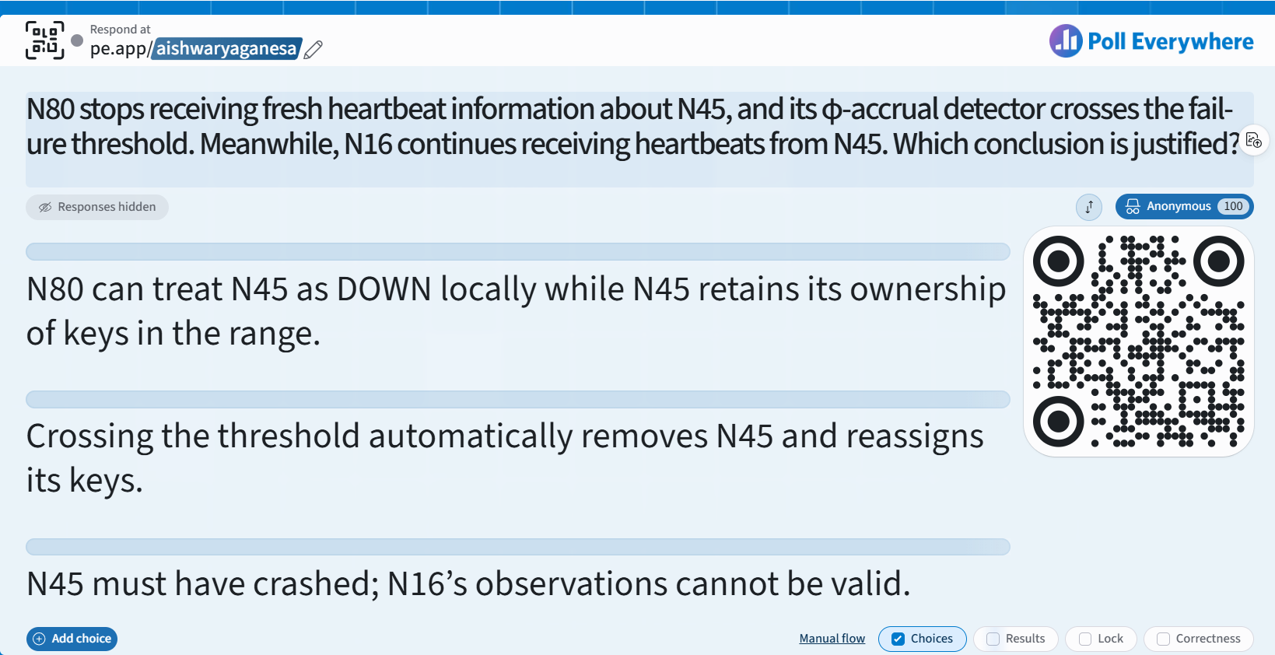

Slide 26
Mystery of “X”: CAP Theorem
Proposed by Eric Brewer (Berkeley)
Subsequently proved by Gilbert and Lynch (NUS and MIT)
In a distributed system you can satisfy at
most 2 out of the 3 guarantees:
  Consistency: all nodes see same data at any time, or reads return latest written value by any client
  Availability: the system allows operations all the time, and operations return quickly
  Partition-tolerance: the system continues to work in spite of network partitions
26

Slide 27
Why is Availability Important?
Availability = Reads/writes complete reliably and quickly.
Measurements have shown that a 500 ms increase in latency for operations at Amazon.com or at Google.com can cause a 20% drop in revenue.
  More recent measurements: Amazon: 100 ms increase → 1% drop in sales. Akamai: 100 ms → 7% drop.
At Amazon, each added millisecond of latency implies a $6M yearly loss.
  More recent measurements: Amazon: 1 s → $1.6 B.
User cognitive drift: If more than a second elapses between clicking and material appearing, the user’s mind is already somewhere else
SLAs (Service Level Agreements) written by providers predominantly deal with latencies faced by clients.
27

Slide 28
Why is Consistency Important?
  Consistency = all nodes see same data at any time, or reads return latest written value by any client.
When you access your bank or investment account via multiple clients (laptop, workstation, phone, tablet), you want the updates done from one client to be visible to other clients.
When thousands of customers are looking to book a flight, all updates from any client (e.g., book a flight) should be accessible by other clients.
28

Slide 29
Why is Partition-Tolerance Important?
  Partitions can happen across datacenters when the Internet gets disconnected
    Internet router outages
    Under-sea cables cut
    DNS not working
  Partitions can also occur within a datacenter, e.g., a rack switch outage
  Still desire system to continue functioning normally under this scenario
29

Slide 30
CAP Theorem Fallout
Since partition-tolerance is essential in today’s cloud computing systems, CAP theorem implies that a system has to choose between consistency and availability
Cassandra
  Eventual (weak) consistency, Availability, Partition-tolerance
Traditional RDBMSs
  Strong consistency over availability under a partition
30

Slide 31

CAP Tradeoff
Starting point for NoSQL Revolution
A distributed storage system can achieve at most two of C, A, and P.
When partition-tolerance is important, you have to choose between consistency and availability
Consistency
HBase, HyperTable,
BigTable, Spanner
RDBMSs
(non-replicated)
Partition-tolerance
Availability
Cassandra, Riak,
Dynamo, Voldemort
31

Slide 32
Eventual Consistency
What mechanisms in Cassandra we saw earlier helps with eventual convergence?
If all writes stop (to a key), then all its values (replicas) will converge eventually.
If writes continue, then system always tries to keep converging.
  Moving “wave” of updated values lagging behind the latest values sent by clients, but always trying to catch up.
May still return stale values to clients (e.g., if many back-to-back writes).
But works well when there a few periods of low writes – system converges quickly.
32
Notes:
0.0004%
4 in a million

Slide 33
RDBMS vs. Key-value stores
While RDBMS provide ACID
  Atomicity
  Consistency
  Isolation
  Durability
Key-value stores like Cassandra provide BASE
  Basically Available Soft-state Eventual Consistency
  Prefers Availability over Consistency
33

Slide 34
Back to Cassandra: Mystery of X
Cassandra has consistency levels
Client is allowed to choose a consistency level for each operation (read/write)
  ANY: any server (may not be replica)
    Fastest: coordinator caches write and replies quickly to client
  ALL: all replicas
    Ensures strong consistency, but slowest
  ONE: at least one replica
    Faster than ALL
  QUORUM: quorum across all replicas in all datacenters (DCs)
    What?
34

Slide 35
Quorums?
In a nutshell:
Quorum = majority
  > 50%
Any two quorums intersect no matter how you select the quorums
  Client 1 does a write in red quorum
  Then client 2 does read in blue quorum
At least one server in blue quorum returns latest write
Quorums faster than ALL, but still ensure strong consistency
A second
quorum
A quorum
A server
Five replicas of a key-value pair
35

Slide 36
Quorums in Detail
Several key-value/NoSQL stores (e.g., Riak and Cassandra) use quorums.
Reads
  Client specifies value of R (≤ N = total number of replicas of that key).
  R = read consistency level.
  Coordinator waits for R replicas to respond before sending result to client (returns the latest-timestamped value)
  In background, coordinator checks for consistency of remaining (N-R) replicas, and initiates read repair if needed.
36

Slide 37
Quorums in Detail (Contd.)
Writes
Client specifies W (≤ N)
  W = write consistency level.
  Coordinator writes new value to W replicas and returns.
    Coordinator blocks until W replicas perform the write
37

Slide 38
Quorums in Detail (Contd.)
Does the system choose consistency or availability upon partitions?
W=N, R=1
W=R=QUORUM
W=R=ANY
R = read replica count, W = write replica count
Two necessary conditions for consistency:
  W+R > N
  W > N/2
Select values based on application
  (W=1, R=1): very few writes and reads
  (W=N, R=1): great for read-heavy workloads
  (W=N/2+1, R=N/2+1): great for write-heavy workloads
  (W=1, R=N):
  great for write-heavy workloads with mostly one client writing per key
38

Slide 39
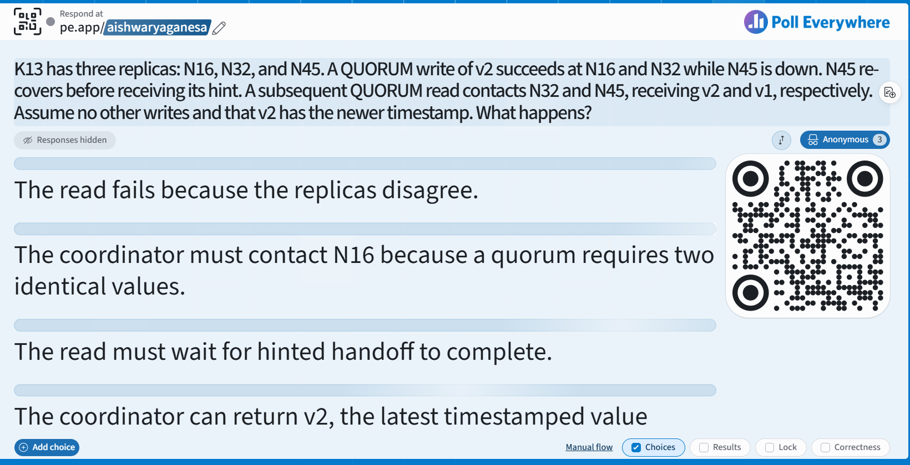

Slide 40
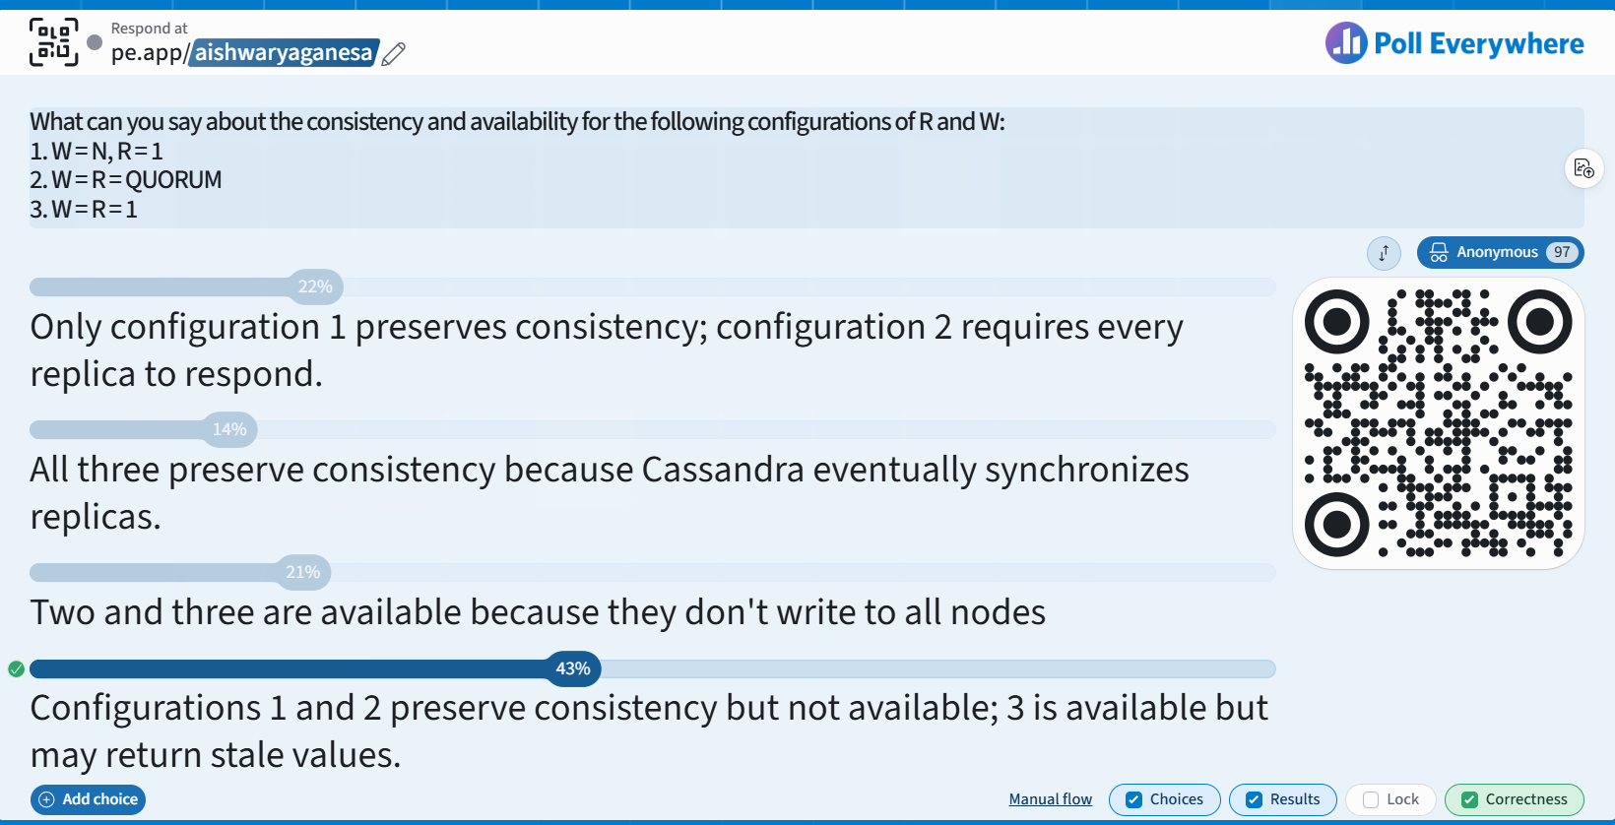

Slide 41
Cassandra Consistency Levels (Contd.)
Client is allowed to choose a consistency level for each operation (read/write)
  ANY: any server (may not be replica)
    Fastest: coordinator may cache write and reply quickly to client
  ALL: all replicas
    Slowest, but ensures strong consistency
  ONE: at least one replica
    Faster than ALL
  QUORUM: quorum across all replicas in all datacenters (DCs)
    Global consistency, but still fast
  LOCAL_QUORUM: quorum in coordinator’s DC
    Faster: only waits for quorum in first DC client contacts
  EACH_QUORUM: quorum in every DC
    Lets each DC do its own quorum: supports hierarchical replies
41

Slide 42
Announcements
(All) HW2 due 10/4 @ 11:59 pm (Sunday!) US Central (hard deadline)
(All) Midterm Thursday (10/8): Written, in class
(4cr) MP2 Demo, Signup, and Submission instructions release on Piazza
  (Due by Fri) [MP Demo Signup Sheet]
  (Due by Sun) [a. MP Submission Form & push MP code to GitHub]
  (Due by Sun 13) [MP Report Submission on Gradescope]
  (On Mon) MP Demos
42

Slide 43
Local storage at a replica – Writes
How slow is a disk seek compared to DRAM?
5x b. 50x
c. 5000x d. 50000x
Need to be lock-free and fast (no reads or disk seeks)
On receiving a write
Log it in disk commit log (for failure recovery)
Writes to a data structure called Log-Structured Merge-tree (LSM)
2. Make changes to appropriate memtables
  Memtable = In-memory representation of multiple key-value pairs
  Cache that can be searched by key
  Write-back cache as opposed to write-through
43
Notes:
What does a photographer use to store their many photos of flowers? … A Bloom filter.

Slide 44
LSM animation – see additional slides

