Slide 1
CS 425 / ECE 428
Distributed Systems
Fall 2026
Aishwarya Ganesan
w/ Ram Kesavan
(Thanks to Indranil Gupta)
Lecture 2: Introduction to Cloud Computing
Many slides © IG

Slide 2

What tools will we use? (2)
For in-class activities:
  https://app.acadly.com/auth/signup/student
  Enter Illinois email address
  Use code: ZHXVAN
  Signup now if you haven’t already!

Slide 3
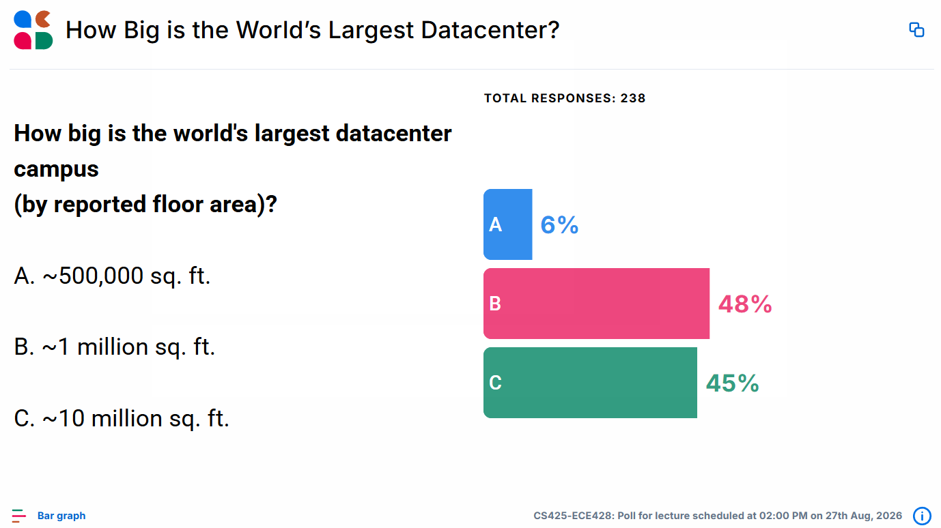

Slide 4
World’s Largest Datacenter?
(2018-2025) China Telecom. 10.7 Million sq. ft.
(2017) “The Citadel” Nevada. 7.2 Million sq. ft.
(2015) In Chicago!
  350 East Cermak, Chicago, 1.1 MILLION sq. ft.
  Shared by many different “carriers”
  Critical to Chicago Mercantile Exchange
See:
  https://datacentremagazine.com/top10/top-10-biggest-data-centres

Slide 5
(There was and is) The Hype!
Forrester in 2010 – Cloud computing will go from $40.7 billion in 2010 to $241 billion in 2020.
Today ^{[1]}
  Market size (2025): USD 943.6 Billion
  Estimated (2026): USD 1.1 Trillion
  CAGR (2026-2033): 16.0%
  Projected (2033): USD 3.34 Trillion
Companies and even Federal/state governments use cloud
[1] Source: Grand View Research

Slide 6
Many Cloud Providers
AWS: Amazon Web Services (28%)
Microsoft Azure (20%)
Google Cloud (15%)
Alibaba, Oracle, IBM, Tencent Cloud etc.
And many many more!
Edge computing
Neo clouds

Slide 7
Two Categories of Clouds
Can be either a (i) public cloud, or (ii) private cloud
Private clouds are accessible only to company employees
Public clouds provide service to any paying customer:
  Amazon S3 (Simple Storage Service): store arbitrary datasets, pay per GB-month stored
    Recently: S3 Standard ≈ 2.3¢ per GB-month; cheaper storage tiers available
  Amazon EC2 (Elastic Compute Cloud): upload and run arbitrary OS images
    from inexpensive CPU VMs to large GPU/AI instances;
    pay per hour, with on-demand, spot, and committed-use options

Slide 8
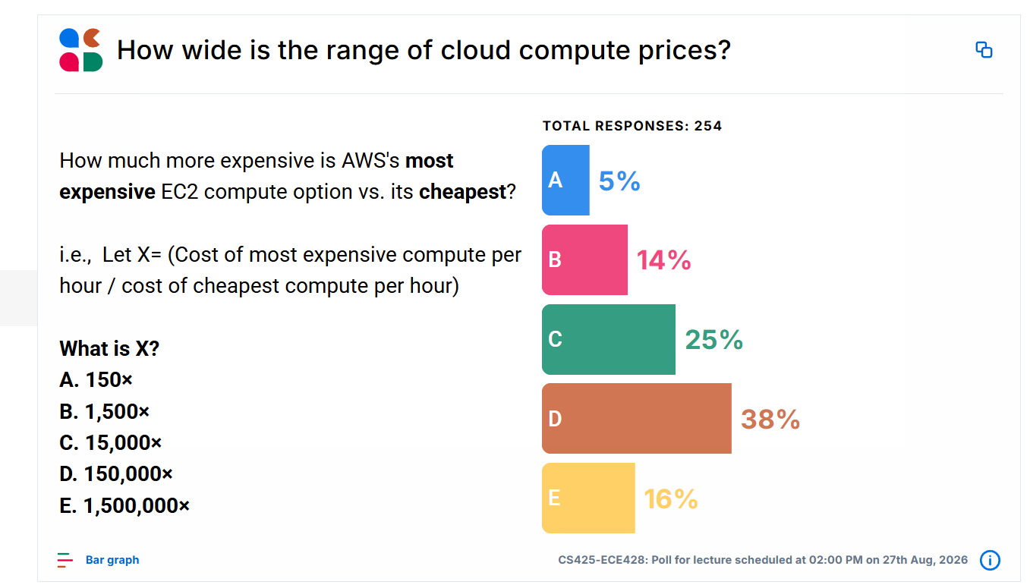

Slide 9
Two Categories of Clouds
Can be either a (i) public cloud, or (ii) private cloud
Private clouds are accessible only to company employees
Public clouds provide service to any paying customer:
  Amazon S3 (Simple Storage Service): store arbitrary datasets, pay per GB-month stored
  Amazon EC2 (Elastic Compute Cloud): upload and run arbitrary OS images
    $0.005/hour for a t3.nano (2 vCPU, 0.5 GiB RAM) –
    $761.904/hour for an ultra server (u-p6e) with 72 B200 GPUs.
  Other clouds: similar pricing ranges as above

Slide 10
Customers Save Time and $$$
(Stories from mid-2010s)
Dave Power, Associate Information Consultant at Eli Lilly and Company: “With AWS, Powers said, a new server can be up and running in three minutes (it used to take Eli Lilly seven and a half weeks to deploy a server internally) and a 64-node Linux cluster can be online in five minutes (compared with three months internally). … It's just shy of instantaneous.”
Ingo Elfering, Vice President of Information Technology Strategy, GlaxoSmithKline: “With Online Services, we are able to reduce our IT operational costs by roughly 30% of what we’re spending”
Jim Swartz, CIO, Sybase: “At Sybase, a private cloud of virtual servers inside its datacenter has saved nearly $US2 million annually since 2006, Swartz says, because the company can share computing power and storage resources across servers.”
100s of startups in Silicon Valley can harness large computing resources without buying their own machines.

Slide 11
But what exactly IS a cloud?

Slide 12

What is a Cloud?
It’s a cluster!
It’s a supercomputer!
It’s a datastore!
All of the above
Cloud = Lots of storage + compute cycles nearby

Slide 13
What is a Cloud?
A single-site cloud (aka “Datacenter”) consists of
  Compute nodes (grouped into racks)
  Switches, connecting the racks
  A network topology, e.g., hierarchical

Slide 14
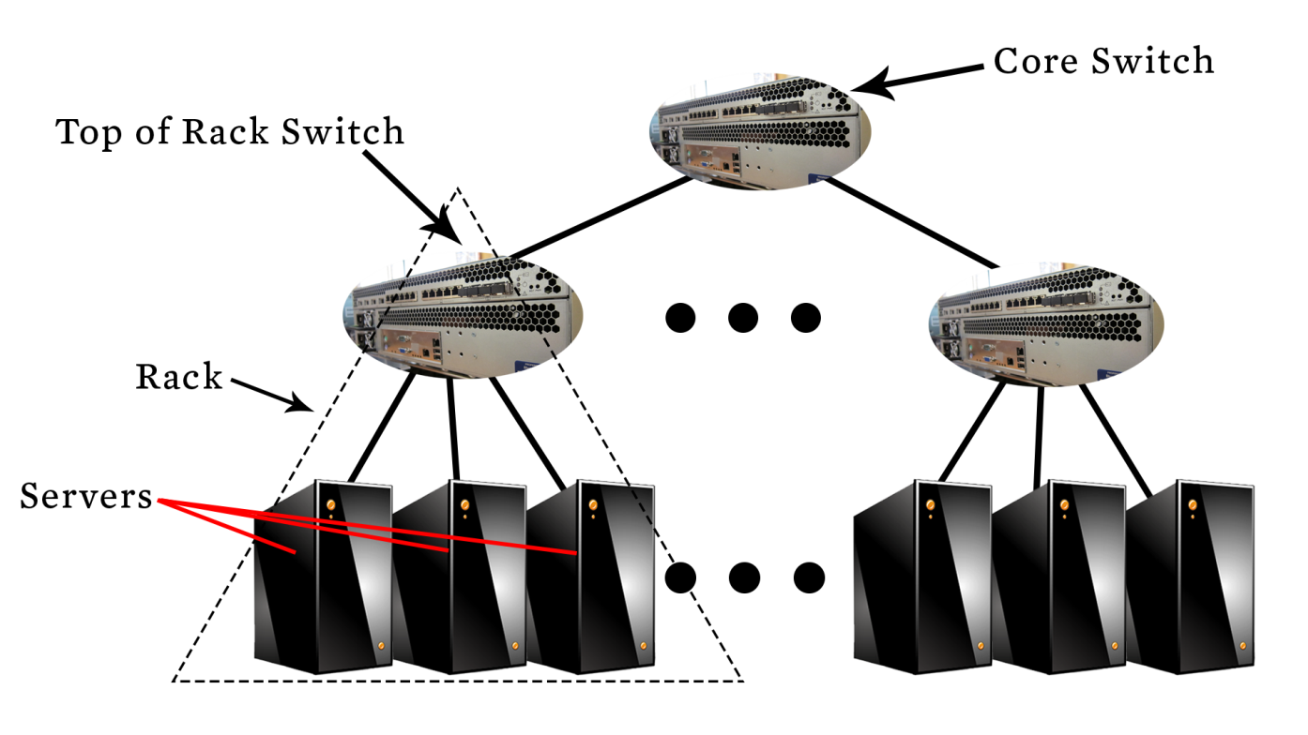
A Sample Cloud Topology
Clos/fat-tree topology

Slide 15
What is a Cloud?
A single-site cloud (aka “Datacenter”) consists of
  Compute nodes (grouped into racks) (2)
  Switches, connecting the racks
  A network topology, e.g., hierarchical
  Storage (backend) nodes connected to the network (3)
  Front-end/load balancers for submitting jobs and receiving client requests (1)
  (1,2,3: Often called “three-tier architecture”)
  Cloud control plane — provisioning, scheduling, monitoring, authentication, etc.
  Software Services

Slide 16
What is a Cloud? (2)
A geographically distributed cloud consists of
  Multiple such sites
  Datacenters typically grouped into Availability Zones (AZs) (e.g., us-east-1a, us-east-1b)
    AZs designed as separate failure domains
  Multiple AZs form a regions (e.g., us-east-1)
  Multiple such regions (e.g., us-east, us-west)
    Connected by high-capacity WAN/backbone networks
  Server → Rack → Datacenter → AZ → Region → Global

Slide 17
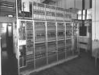

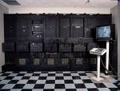


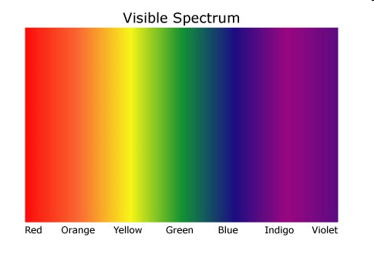
“A Cloudy History of Time”
The first datacenters!
ENIAC, ORDVAC, ILLIAC
Many used vacuum tubes and mechanical relays
Timesharing Companies
& Data Processing Industry
Clouds and datacenters
1940
1950
Clusters
1960
Grids
1970
1980
Data Processing Industry
- 1968: $70 M. 1978: $3.15 Billion
PCs
(not distributed!)
1990
2000
Timesharing Industry (1975):
Honeywell 6000 & 635, IBM 370/168,
Xerox 940 & Sigma 9, DEC PDP-10, UNIVAC 1108
Peer to peer systems
2012

Slide 18
Trends: Technology
Historical doubling Periods – storage: 12 mos, bandwidth: 9 mos, and cpu compute capacity: 18 mos
  These trends did not continue indefinitely
  E.g., 2005 is the end of Dennard/frequency scaling
Then and Now
  Bandwidth
    1985: mostly 56Kbps links nationwide
    Today: Tbps backbone capacity widespread
  Disk capacity
    Today’s PCs have TBs, far more than a 1990 supercomputer

Slide 19
Trends: Users
Then and Now
Biologists:
  1990: were running small single-molecule simulations
  Today: CERN’s Large Hadron Collider producing many PB/year

Slide 20
Four Features New in Today’s Clouds
Massive scale.
On-demand access: Pay-as-you-go, no upfront commitment.
  And anyone can access it
Data-intensive Nature: What was MBs has now become TBs, PBs and XBs.
  Daily logs, forensics, Web data, etc.
  Humans have data numbness: Wikipedia (large) compressed is only about 10 GB!
New Cloud Programming Paradigms: MapReduce/Hadoop, NoSQL/Cassandra/MongoDB and many others.
  High in accessibility and ease of programmability
Combination of one or more of these gives rise to novel and unsolved distributed computing problems in cloud computing.

Slide 21
Announcements
4 cr only: MP Groups Form DUE this week Mon Aug 31st (see course webpage).
  Hard deadline, as Engr-IT will create and assign VMs the day after!
  (Form does NOT automatically “enroll” you in 4cr section—you must do that yourself)
DO NOT
  Change MP groups unless your partner has dropped
  Leave your MP partner hanging: Both MP partners should contribute equally (we will ask!)
All: Please fill out Student Survey (see course webpage).
MP1 due Sep 13th
  VMs being distributed soon (watch Piazza)
  Demos will be Monday Sep 14th (schedule and details will be posted soon on Piazza)
HW1 out today due Sep 20^{th:} Solve problems right after lecture covers topic!
Check Piazza often! It’s where all the announcements are at!

Slide 22
I. Massive Scale
Facebook [GigaOm, 2012]
  30K in 2009 -> 60K in 2010 -> 180K in 2012
Microsoft [NYTimes, 2008]
  150K machines
AWS EC2 [Randy Bias, 2009]
  40K machines
  8 cores/machine
Google [2011, Data Center Knowledge] : 900K (reputed in 2016: 2.5M)
Today: exact server count not publicly disclosed
Estimated to have millions of machines globally
Meta: 125K-H100 GPUs

Slide 23
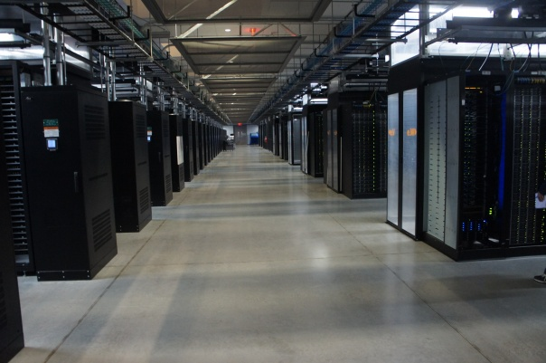
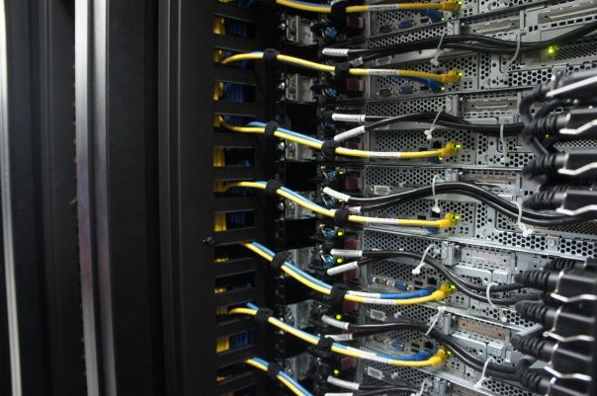
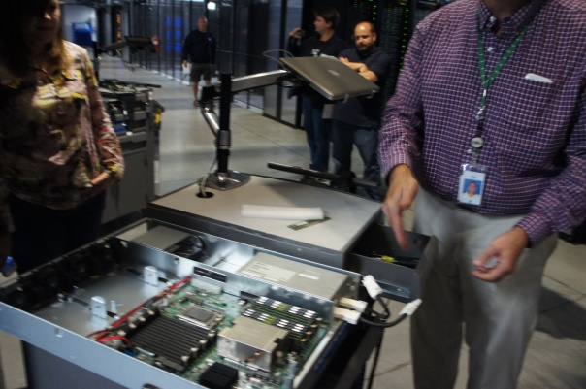
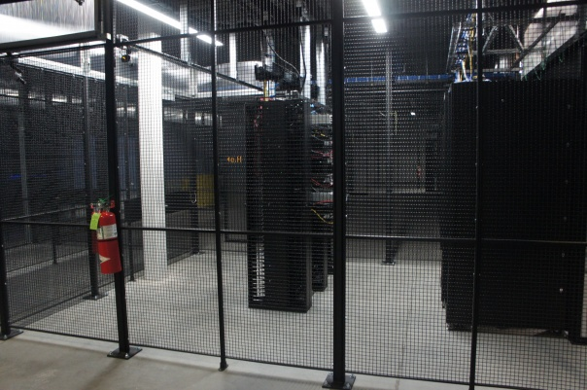
Servers
Front
Back
In
Some highly secure (e.g., financial info)
Notes:
Copyright?

Slide 24
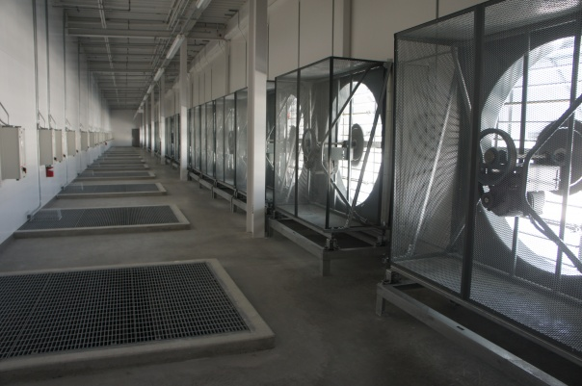
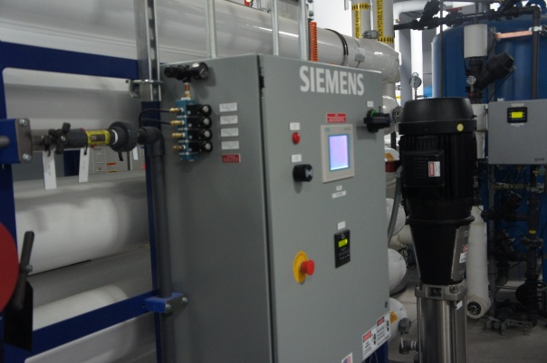
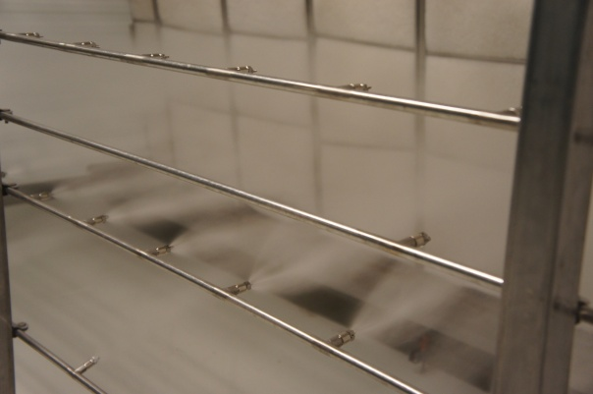
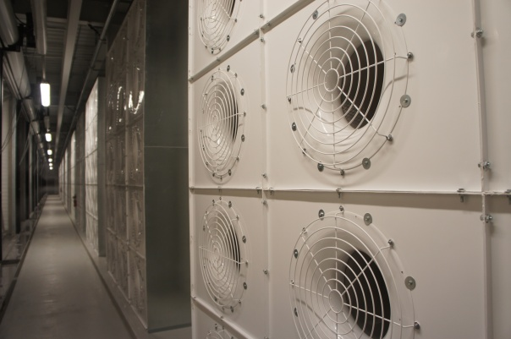
Cooling
Air sucked in from top (also, Bugzappers)
Water purified
Water sprayed into air
15 motors per server bank
Notes:
Copyright?

Slide 25
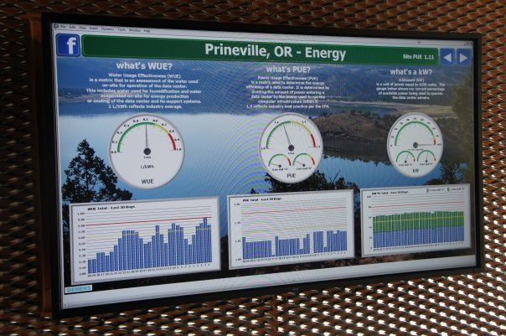
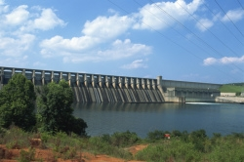
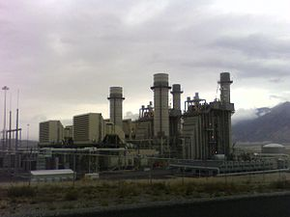
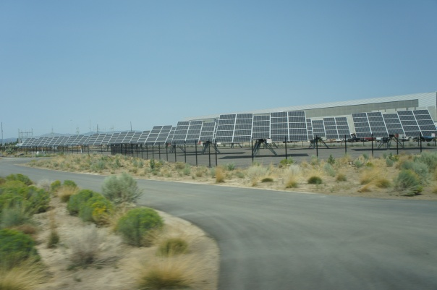
Power
Off-site
On-site
WUE = Annual Water Usage / IT Equipment Energy (L/kWh) – low is good
PUE = Total facility Power / IT Equipment Power – low is good
(e.g., Google~1.1)
Notes:
Copyright?
Power Usage Effectiveness and Water Usage Effectiveness

Slide 26
What does a datacenter look like from inside?
A virtual walk through a datacenter (Facebook Prineville Datacenter, Mid 2010s)
  https://www.youtube.com/watch?v=4A_A-CmrqpQ
Timelapse of a Datacenter Construction on the Inside (Fortune 500 company)
  http://www.youtube.com/watch?v=ujO-xNvXj3g

Slide 27
II. On-demand access: *aaS Classification
On-demand: renting a cab vs. (previously) renting a car, or buying one. E.g.:
  AWS Elastic Compute Cloud (EC2): a few cents to a few $ per CPU hour
  AWS Simple Storage Service (S3): a few cents per GB-month
HaaS: Hardware as a Service
  Barebones hardware machines
  Not always a good idea because of security risks
IaaS: Infrastructure as a Service
  Flexible computing and storage infrastructure.
  Using virtualization or containerization (cgroups, Kubernetes, Dockers, VMs,…).
  Often said to subsume HaaS.
  Ex: Amazon Web Services (AWS: EC2 and S3), Microsoft Azure, Google Cloud.

Slide 28
II. On-demand access: *aaS Classification
PaaS: Platform as a Service
  You get access to flexible computing and storage infrastructure, coupled with a software platform (often tightly coupled)
  Ex: Google’s AppEngine (Python, Java, Go)
SaaS: Software as a Service
  You get access to software services, when you need them.
  Ex: Google docs, MS Office 365 Online
FaaS = Function as a Service
  you upload a function, and cloud provider runs it when triggered
  e.g., AWS Lambda, Azure Functions, etc.
Notes:
Why does Google AppEngine reportedly never fail? … Because it’s always a PAAS.

Slide 29
III. Data-intensive Computing
Computation-Intensive Computing
  Example areas: MPI-based, High-performance computing, Grids
  Typically run on supercomputers (e.g., NCSA Blue Waters)
Data-Intensive
  Typically store data at datacenters
  Use compute nodes nearby
  Compute nodes run computation services
In data-intensive computing, the focus shifts from computation to data:
CPU utilization no longer the most important resource metric,
instead I/O is (disk and/or network)

Slide 30
IV. New Cloud Programming Paradigms
Easy to write and run highly parallel programs in new cloud programming paradigms:
  Google: MapReduce and Sawzall
  Amazon: Elastic MapReduce service (pay-as-you-go)
  Google (MapReduce)
    Indexing: a chain of 24 MapReduce jobs
    ~200K jobs processing 50PB/month (in 2006)
  Yahoo! (Hadoop + Pig)
    WebMap: a chain of several MapReduce jobs
    300 TB of data, 10K cores, many tens of hours (~2008)
  Facebook (Hadoop + Hive)
    ~300TB total, adding 2TB/day (in 2008)
    3K jobs processing 55TB/day
  Similar numbers from other companies, e.g., Yieldex, eharmony.com, etc.
  NoSQL: MySQL is an industry standard, but Cassandra is 2400 times faster!

Slide 31
Two Categories of Clouds
Can be either a (i) public cloud, or (ii) private cloud
Private clouds are accessible only to company employees
Public clouds provide service to any paying customer
You’re starting a new service/company: should you use a public cloud or purchase your own private cloud?

Slide 32
Single site Cloud: to Outsource or Own?
Medium-sized organization: wishes to run a service for M months
  Service requires 128 servers (1024 cores) and 524 TB
  Same as UIUC CCT (Cloud Computing Testbed) cloud site (bought in 2009, now decommissioned)
Outsource (e.g., via AWS): monthly cost
  S3 costs: $0.12 per GB month. EC2 costs: $0.10 per CPU hour (costs from 2009)
  Storage = $ 0.12 X 524 X 1000 ~ $62 K
  Total = Storage + CPUs = $62 K + $0.10 X 1024 X 24 X 30 ~ $136 K
Own: monthly cost
  Storage ~ $349 K / M
  Total ~ $ 1555 K / M + 7.5 K (includes 1 sysadmin / 100 nodes)
    using 0.45:0.4:0.15 split for hardware:power:network and 3 year lifetime of hardware

Slide 33
Single site Cloud: to Outsource or Own?
Breakeven analysis: more preferable to own if:
  ^{- $349 K / M < $62 K (storage)}
  ⁻ $ 1555 K / M + 7.5 K < $136 K (overall)
  ^{Breakeven points}
  ^{M > 5.55 months (storage)}
  ^{M > 12 months (overall)}
^{As a result}
    ^{Startups use clouds a lot}

Slide 34
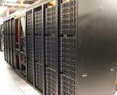

Academic Clouds: Emulab/CloudLab
A community resource open to researchers in academia and industry. Very widely used by researchers everywhere today.
https://www.emulab.net/
A cluster, with currently ~500 servers
Founded and owned by University of Utah (led by Late Prof. Jay Lepreau)
Accessible to researchers with a qualifying grant
Chameleon Cloud: https://www.chameleoncloud.org/
CloudLab: https://www.cloudlab.us/
Build your own cloud on their hardware
All images © Emulab

Slide 35
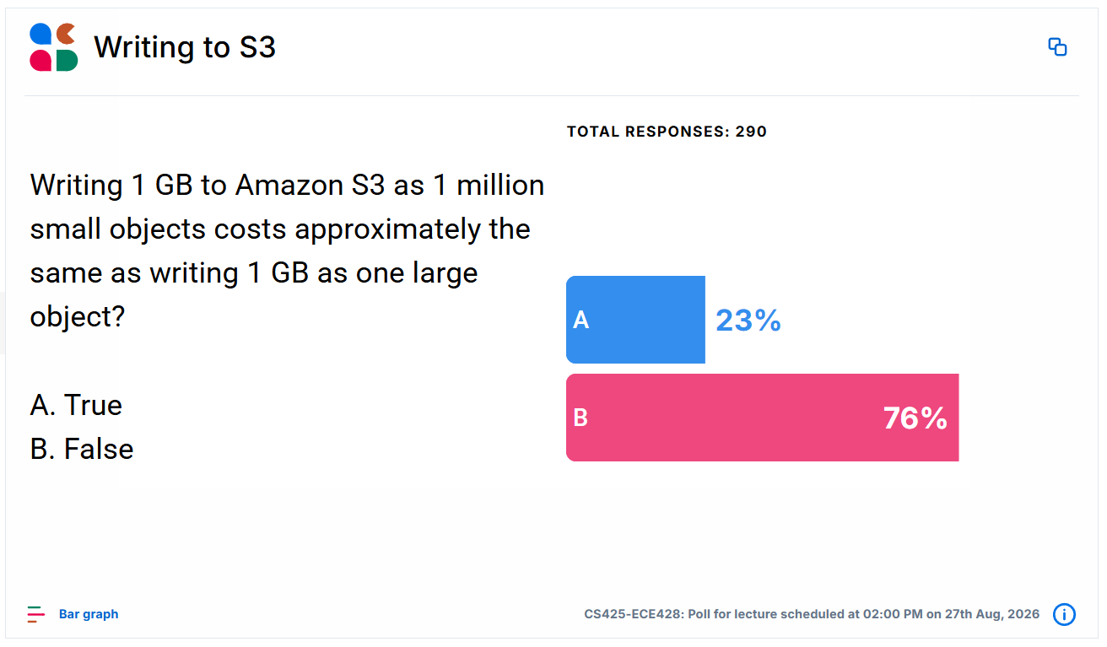

Slide 36
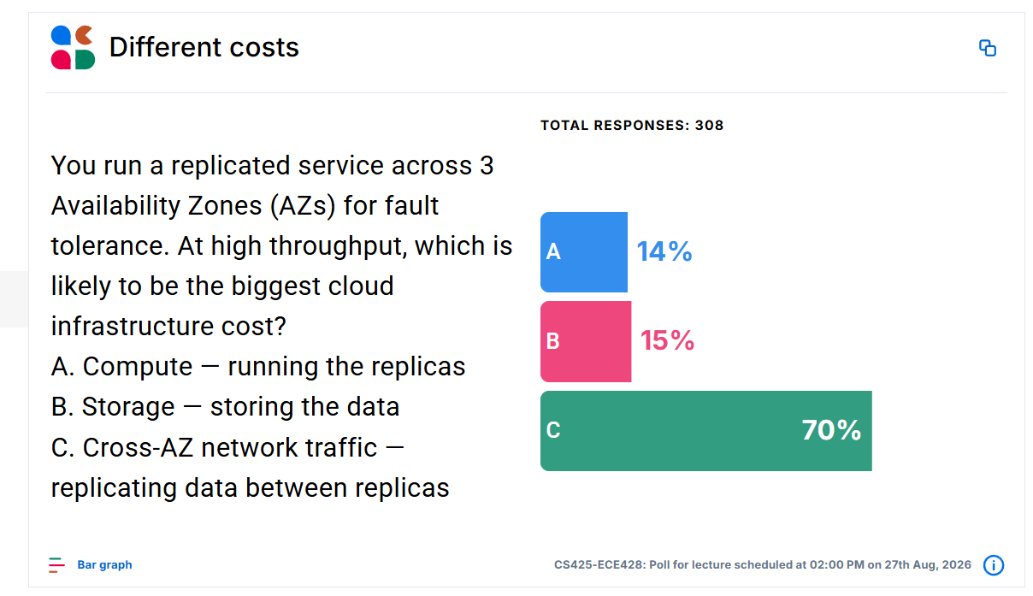

Slide 37
Cloud economics
Dictates system design
Solutions:
  Batch multiple small writes to write to S3
  Use S3 for fault tolerance instead of replicating at the application level
Leads to interesting designs…

Slide 38
Announcements
4 cr only: MP Groups Form DUE this week Mon Aug 31st (see course webpage).
  Hard deadline, as Engr-IT will create and assign VMs the day after!
  (Form does NOT automatically “enroll” you in 4cr section—you still have to do that yourself)
DO NOT
  Change MP groups unless your partner has dropped
  Leave your MP partner hanging: Both MP partners should contribute equally (we will ask!)
All: Please fill out Student Survey (see course webpage).
MP1 due Sep 13th
  VMs being distributed soon (watch Piazza)
  Demos will be Monday Sep 14th (schedule and details will be posted soon on Piazza)
HW1 out today due Sep 20^{th:} Solve problems right after lecture covers topic!
Check Piazza often! It’s where all the announcements are at!

