Slide 1
CS 425 / ECE 428
Distributed Systems
Fall 2026
Aishwarya Ganesan w/ Ram Kesavan
Ack: Indranil Gupta (Indy)
Lecture 17: Leader Election
All slides © IG

Slide 2
Why Election?
Example 1: Your Bank account details are replicated at a few servers, but one of these servers is responsible for receiving all reads and writes, i.e., it is the leader among the replicas
  What if there are two leaders per customer?
  What if servers disagree about who the leader is?
  What if the leader crashes?
    Each of the above scenarios leads to Inconsistency
2

Slide 3
More motivating examples
Example 2: In the sequencer-based algorithm for total ordering of multicasts, the “sequencer” = leader
Example 3: Group of NTP servers: who is the root server?
Other systems that need leader election: Apache Zookeeper, Google’s Chubby, Raft.
Leader is useful for coordination among distributed servers
Can use it solve consensus.
3

Slide 4
Leader Election Problem
In a group of processes, elect a Leader to undertake special tasks
  And let everyone know in the group about this Leader
What happens when a leader fails (crashes)
  Some process detects this (using a Failure Detector!)
  Then what?
Focus of this lecture: Election algorithm. Its goal:
  1. Elect one leader only among the non-faulty processes
  2. All non-faulty processes agree on who is the leader
4

Slide 5
System Model
N processes.
Each process has a unique id.
Messages are eventually delivered.
Failures may occur during the election protocol.
5

Slide 6
Calling for an Election
Any process can call for an election.
A process can call for at most one election at a time.
Multiple processes are allowed to call an election simultaneously.
  All of them together must yield only a single leader
The result of an election should not depend on which process calls for it.
6

Slide 7
Election Problem, Formally
A run of the election algorithm must always guarantee at the end:
  Safety: For all non-faulty processes p: (p’s elected = (q: a particular non-faulty process with the best attribute value) or Null)
  Liveness: For all election runs: (election run terminates)
  & for all non-faulty processes p: p’s elected is not Null
At the end of the election protocol, the non-faulty process with the best (highest) election attribute value is elected.
  Common attribute : leader has highest id
  Other attribute examples: leader has highest IP address, or fastest cpu, or most disk space, or most number of files, etc.
7

Slide 8
First Classical Algorithm: Ring Election
N processes are organized in a logical ring
  Similar to ring in Chord p2p system
  i-th process p_{i} has a communication channel to p_{(i+1) mod N}
  All messages are sent clockwise around the ring.
8
Notes:
Not to be confused with the algorithm a Computer Scientists uses when searching for a husband or wife.
What algorithm does a distributed systems researcher/engineer use when searching for a marriage partner?... A Ring Election.

Slide 9
The Ring
N12
N3
N6
N32
N80
N5
9

Slide 10
The Ring Election Protocol
Any process p_{i} that discovers the old leader has failed initiates an “Election” message that contains p_{i}’s own id:attr. This is the initiator of the election.
When a process p_{i} receives an “Election” message, it compares the attr in the message with its own attr.
  If the arrived attr is greater, p_{i} forwards the message.
  If the arrived attr is smaller and p_{i} has not forwarded an election message earlier, it overwrites the message with its own id:attr, and forwards it.
  If the arrived id:attr matches that of p_{i}, then p_{i}’s attr must be the greatest (why?), and it becomes the new leader.
10

Slide 11
The Ring Election Protocol (2)
Leader process then sends an “Elected” message to its neighbor with its id, announcing the election result
When a process p_{i} receives an “Elected” message, it
  sets its variable elected_{i} ← id of the message.
  forwards the message unless it is the new leader.
11

Slide 12
Ring Election: Example
Initiates the election
N12
N3
Election: 3
N6
N32
N80
N5
Goal: Elect highest id process as leader

Slide 13
Initiates the election
N12
N3
N6
N32
Election: 32
N80
N5
Goal: Elect highest id process as leader

Slide 14
Initiates the election
N12
N3
N6
N32
N80
N5
Election: 32
Goal: Elect highest id process as leader

Slide 15
Initiates the election
N12
N3
N6
N32
Election: 80
N80
N5
Goal: Elect highest id process as leader

Slide 16
Election: 80
Initiates the election
N12
N3
N6
N32
N80
N5
Goal: Elect highest id process as leader

Slide 17
Initiates the election
N12
N3
Election: 80
N6
N32
N80
N5
Goal: Elect highest id process as leader

Slide 18
Initiates the election
N12
N3
N6
N32
N80
N5
Election: 80
Goal: Elect highest id process as leader

Slide 19
Initiates the election
N12
N3
N6
N32
Elected: 80
N80
N5
Goal: Elect highest id process as leader

Slide 20
Initiates the election
N12
N3
Elected: 80
N6
elected = 80
N32
N80
N5
Goal: Elect highest id process as leader

Slide 21
elected = 80
Initiates the election
N12
N3
elected = 80
N6
elected = 80
N32
elected = 80
N80
N5
Elected: 80
elected = 80
Goal: Elect highest id process as leader

Slide 22
elected = 80
Initiates the election
N12
N3
elected = 80
N6
elected = 80
N32
elected = 80
N80
N5
elected = 80
elected = 80
Goal: Elect highest id process as leader
Notes:
What algorithm does a distributed systems researcher/engineer use when searching for a marriage partner?... A Ring Election.

Slide 23
Analysis
Let’s assume no failures occur during the election protocol itself, and there are N processes
How many messages?
Worst case occurs when the initiator is the ring successor of the would-be leader
23
Notes:
What algorithm does a distributed systems researcher/engineer use when searching for a marriage partner?... A Ring Election.

Slide 24
Worst-case
N12
N3
Initiates the election
N6
N32
N80
N5
Goal: Elect highest id process as leader
24

Slide 25
Worst-case Analysis
(N-1) messages for Election message to get from Initiator (N6) to would-be coordinator (N80)
N messages for Election message to circulate around ring without message being changed
N messages for Elected message to circulate around the ring
Message complexity: (3N-1) messages
Completion time: (3N-1) message transmission times
Thus, if there are no failures, election terminates (liveness) and everyone knows about highest-attribute process as leader (safety)
25

Slide 26
Best Case?
Initiator is the would-be leader, i.e., N80 is the initiator
Message complexity: 2N messages
Completion time: 2N message transmission times
26

Slide 27
Multiple Initiators?
Include initiator’s id with all messages
Each process remembers in cache the initiator of each Election/Elected message it receives
(All the time) Each process suppresses Election/Elected messages of any lower-id initiators
Updates cache if receives higher-id initiator’s Election/Elected message
Result is that only the highest-id initiator’s election run completes
What about failures?
27

Slide 28
Effect of Failures
Initiates the election
N12
N3
Elected: 80
N6
elected = 80
N32
Election: 80 will
circulate around
the ring forever
=>
Liveness violated
N80
N5
Crash

Slide 29
Fixing for failures
One option: have predecessor (or successor) of would-be leader N80 detect failure and start a new election run
  May re-initiate election if
    Receives an Election message but times out waiting for an Elected message
    Or after receiving the Elected:80 message
  But what if predecessor also fails?
  And its predecessor also fails? (and so on)
29

Slide 30
Fixing for failures (2)
Use the failure detector
Any process, after receiving Election:80 message, can detect failure of N80 via its own local failure detector
  If so, start a new run of leader election
But failure detectors may not be both complete and accurate
30

Slide 31
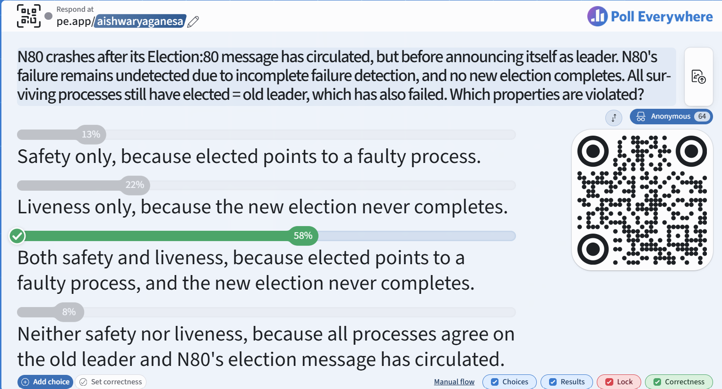
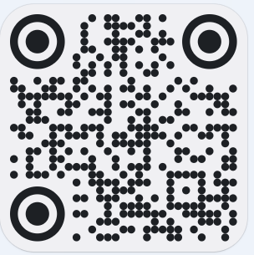
https://pe.app/aishwaryaganesa

Slide 32
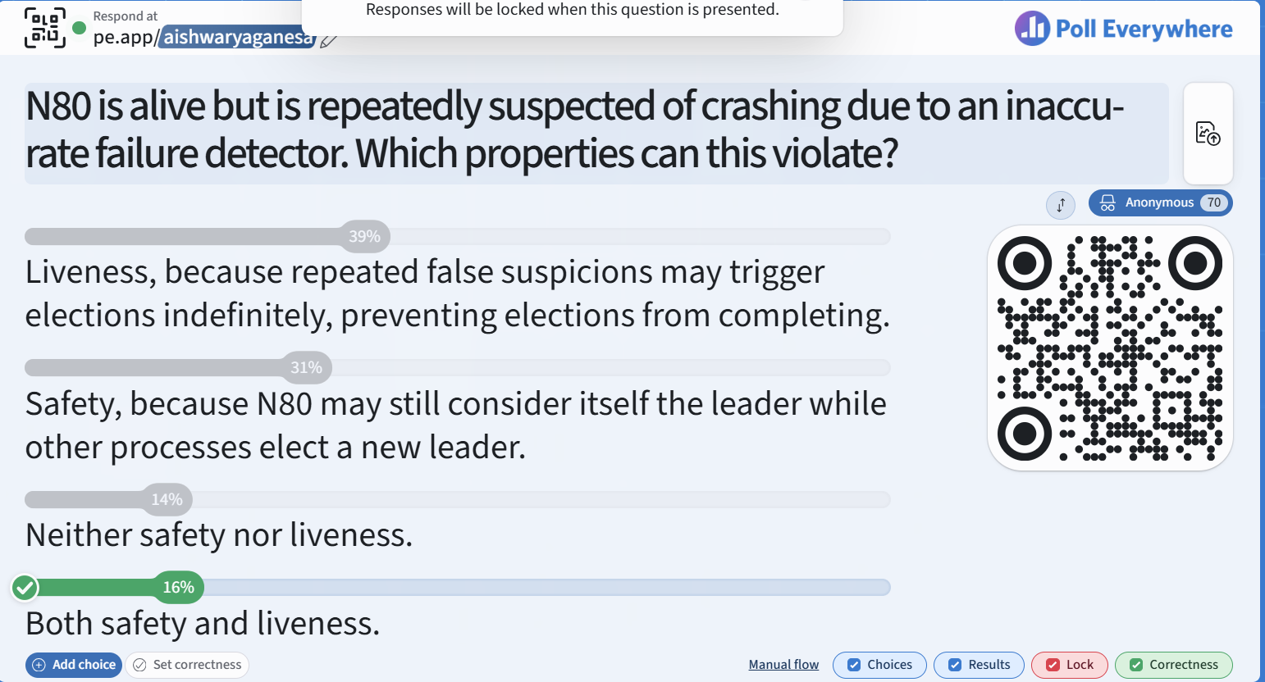

Slide 33
Another Classical Algorithm: Bully Algorithm
All processes know other process’ ids
When a process finds the leader (coordinator) has failed (via the failure detector):
  if it knows its id is the highest
    it elects itself as coordinator, then sends a Coordinator message to all processes with lower identifiers. Election is completed.
  else
    it initiates an election by sending an Election message
    (contd.)
33

Slide 34
Bully Algorithm (2)
  else it initiates an election by sending an Election message
    Sends it to only processes that have a higher id than itself.
    if receives no answer within timeout, calls itself leader and sends Coordinator message to all lower id processes. Election completed.
    if an answer (OK) received however, then there is some non-faulty higher process => so, wait for coordinator message. If none received after another timeout, start a new election run.
A process that receives an Election message replies with OK message, and starts its own leader election (unless already done so)
34

Slide 35
Bully Algorithm: Example
N80
N3
N32
N5
N12
N6
Detects failure
of N80
35

Slide 36
N80
N3
N32
N5
Election
N12
N6
Detects failure
of N80

Slide 37
N80
N3
Election
N32
N5
Election
OK
N12
N6
Waiting…

Slide 38
N80
N3
N32
N5
OK
N12
N6
Waiting…
Waiting…

Slide 39
N80
N3
Times out
waiting for N80’s
response
N32
N5
Coordinator: N32
N12
N6
Election is completed

Slide 40
Failures during Election Run
N80
N3
N32
N5
N12
N6
Waiting…
Waiting…

Slide 41
N80
N3
N32
N5
Election
N12
N6
OK
Times out, starts
new election run
Waiting…

Slide 42
N80
N3
N32
N5
Election
N12
N6
Times out, starts
another new election run

Slide 43
Failures and Timeouts
If failures stop, eventually will elect a leader
How do you set the timeouts?
Based on Worst-case time to complete election
  5 message transmission times if there are no failures during the run:
    Election from lowest id server in group
    Answer (OK) to lowest id server from 2nd highest id process
    Election from 2nd highest id server to highest id
    Timeout for answers (OKs) @ 2nd highest id server
    Coordinator from 2nd highest id server
43

Slide 44
Analysis
Worst-case completion time: 5 message transmission times
  When the process with the lowest id in the system detects the failure.
    (N-1) processes altogether begin elections, each sending messages to processes with higher ids.
    i-th highest id process sends (i-1) election messages
  Number of Election messages
    = N-1 + N-2 + … + 1 = (N-1)*N/2 = O(N²)
Best-case
  Second-highest id detects leader failure
  Sends (N-2) Coordinator messages
  Completion time: 1 message transmission time
44

Slide 45
Impossibility?
Since timeouts built into protocol, in asynchronous system model:
  Protocol may never terminate => Liveness not guaranteed
But satisfies liveness in synchronous system model where
  Worst-case one-way latency can be calculated = worst-case processing time + worst-case message latency
45

Slide 46
Why is Election so Hard?
Because it is related to the consensus problem!
If we could solve election, then we could solve consensus!
  Elect a process, use its id’s last bit as the consensus decision
But since consensus is impossible in asynchronous systems, so is election!
46
Notes:
We have two jokes about distributed systems, but we can’t decide which one to tell.

Slide 47
Can use Consensus to solve Election
One approach
  Each process proposes a value
  Everyone in group reaches consensus on some process Pi’s value
  That lucky Pi is the new leader!
47

Slide 48
Election in Industry
Several systems in industry use Paxos-like approaches for election
  Paxos is a consensus protocol (safe, but eventually live): next lecture
Google’s Chubby system
Apache Zookeeper
48

Slide 49
Election: Summary
Leader election an important component of many cloud computing systems
Classical leader election protocols
  Ring-based
  Bully
But failure-prone
  Paxos-like protocols used by Google Chubby, Apache Zookeeper
49

Slide 50
Announcements
HW3 due Nov 1.
MP3 due Nov 8.
  MP3 clarifications (refresh pdf)
Please fill out post-midterm survey.
Final exams:
  On-campus students: Dec 15th, 7pm--10pm.
  Chicago students: Date: Dec 15th, 4pm--7pm.
  DRES students: Please schedule your exam at the TAC center for Dec 15

Slide 51
Additional slides
Chubby
Zookeeper

Slide 52
Election in Google Chubby
A system for locking
Essential part of Google’s stack
  Many of Google’s internal systems rely on Chubby
  BigTable, Megastore, etc.
Group of replicas
  Need to have a master server elected at all times
Server A
Server B
Server C
Server D
Server E
Reference: http://research.google.com/archive/chubby.html
52

Slide 53
Election in Google Chubby (2)
Group of replicas
  Need to have a master (i.e., leader)
Election protocol
  Potential leader tries to get votes from other servers
  Each server votes for at most one leader
  Server with majority of votes becomes new leader, informs everyone
Server A
Server B
Server C
Server D
Master
Server E
53

Slide 54
Election in Google Chubby (3)
Why safe?
  Essentially, each potential leader tries to reach a quorum
  Since any two quorums intersect, and each server votes at most once, cannot have two leaders elected simultaneously
Why live?
  Only eventually live! Failures may keep happening so that no leader is ever elected
  In practice: elections take a few seconds. Worst-case noticed by Google: 30 s
Server A
Quorum
Server B
Server C
Server D
Master
Server E
54

Slide 55
Election in Google Chubby (4)
After election finishes, other servers promise not to run election again for “a while”
  “While” = time duration called “Master lease”
  Set to a few seconds
Master lease can be renewed by the master as long as it continues to win a majority each time
Lease technique ensures automatic re-election on master failure
Server A
Quorum
Server B
Server C
Server D
Master
Server E
55

Slide 56
Election in Zookeeper
Centralized service for maintaining configuration information
Uses a variant of Paxos called Zab (Zookeeper Atomic Broadcast)
Needs to keep a leader elected at all times
http://zookeeper.apache.org/
56

