Slide 1
CS 425 / ECE 428
Distributed Systems
Fall 2026
Aishwarya Ganesan w/ Ram Kesavan
Ack: Indranil Gupta (Indy)
Lecture 16: Multicast
All slides © IG

Slide 2
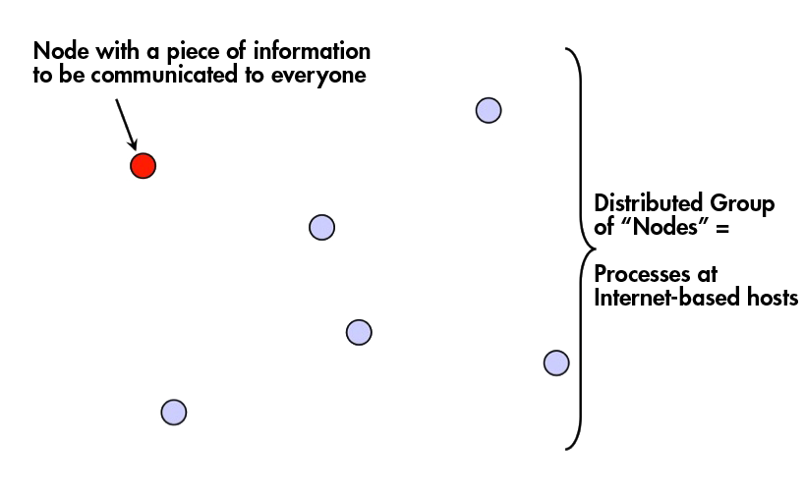
Multicast Problem

Slide 3
Other Communication Forms
Multicast → message sent to a group of processes
Broadcast → message sent to all processes (anywhere)
Unicast → message sent from one sender process to one receiver process

Slide 4
Who Uses Multicast?
A widely-used abstraction by almost all cloud systems
Storage systems like Cassandra or a database
  Replica servers for a key: Writes/reads to the key are multicast within the replica group
  All servers: membership information (e.g., heartbeats) is multicast across all servers in cluster
Online scoreboards (ESPN, French Open, FIFA World Cup)
  Multicast to group of clients interested in the scores
Stock Exchanges
  Group is the set of broker computers
  Groups of computers for High frequency Trading
Air traffic control system
  All controllers need to receive the same updates in the same order

Slide 5
Multicast Ordering
Determines the meaning of “same order” of multicast delivery at different processes in the group
Three popular flavors implemented
by several multicast protocols
  FIFO ordering
  Causal ordering
  Total ordering

Slide 6
“Receive” vs. “Deliver”
Receive: At lower multicast layer receives a message from network
Deliver: Lower multicast layer gives (via upcall) the message to the application
Messages that are received but not delivered are buffered (you will see this in implementation in a few slides)
Note if Pi sends m, Pi also receives m (it is also the part of the multicast group)

Slide 7
1. FIFO ordering
Multicasts from each sender are delivered in the order they are sent, at all receivers
Don’t worry about multicasts from different senders
More formally
  If a correct process issues (sends) multicast(g,m) to group g and then multicast(g,m’), then every correct process that delivers m’ would already have delivered m.

Slide 8
FIFO Ordering: Example
P1
M1:1
M1:2
Time
P2
M3:1
P3
P4
M1:1 and M1:2 should be delivered in that order at each receiver
Order of delivery of M3:1 and M1:2 could be different at different receivers

Slide 9
2. Causal Ordering
Multicasts whose send events are causally related, must be delivered in the same causality-obeying order at all receivers
Formally
  If multicast(g,m) → multicast(g,m’) then any correct process that delivers m’ would already have delivered m.
  (→ is Lamport’s happens-before)

Slide 10
Causal Ordering: Example
P1
M1:1
Time
M2:1
P2
M3:1
M3:2
P3
P4
M1:1 → M3:1, and so should be delivered in that order at each receiver
M3:1 and M2:1 are concurrent and thus ok to be received in different orders at
different receivers
M3:1 → M3:2, and so should be delivered in that order at each receiver

Slide 11
Causal vs. FIFO
Causal Ordering => FIFO Ordering
Why?
  If two multicasts M and M’ are sent by the same process P, and M was sent before M’, then M → M’
  Then a multicast protocol that implements causal ordering will obey FIFO ordering since M → M’
Reverse is not true! FIFO ordering does not imply causal ordering.

Slide 12
Why Causal at All?
Group = set of your friends on a social network
A friend sees your message m, and she posts a response (comment) m’ to it
  If friends receive m’ before m, it wouldn’t make sense
  But if two friends post messages m” and n” concurrently, then they can be seen in any order at receivers
A variety of systems implement causal ordering: Social networks, bulletin boards, comments on websites, etc.

Slide 13
3. Total Ordering
Also known as “Atomic Broadcast”
Unlike FIFO and causal, this does not pay attention to order of multicast sending
Ensures all receivers deliver all multicasts in the same order
Formally
  If a correct process P delivers message m before m’ (independent of the senders), then any other correct process P’ that delivers m’ would already have delivered m.

Slide 14
Total Ordering: Example
P1
M1:1
Time
M2:1
P2
M3:1
M3:2
P3
P4
The order of delivery of multicasts is the same at all processes.
M1:1, then M2:1, then M3:1, then M3:2
May need to delay delivery of some messages

Slide 15
Hybrid Variants
Since FIFO/Causal are orthogonal to Total, can have hybrid ordering protocols too
  FIFO-total hybrid protocol satisfies both FIFO and total orders
  Causal-total hybrid protocol satisfies both Causal and total orders

Slide 16
Implementation?
That was what ordering is
But how do we implement each of these orderings?

Slide 17
FIFO Multicast: Data Structures
Each receiver maintains a per-sender sequence number (integers)
  Processes P1 through PN
  Pi maintains a vector of sequence numbers Pi[1…N] (initially all zeroes)
  Pi[j] is the latest sequence number Pi has delivered from Pj

Slide 18
FIFO Multicast: Updating Rules
Send multicast at process Pj:
  Set Pj[j] = Pj[j] + 1
  Include new Pj[j] in multicast message as its sequence number
Receive multicast: If Pi receives a multicast from Pj with sequence number S in message
  if (S == Pi[j] + 1) then
    deliver message to application
    Set Pi[j] = Pi[j] + 1
  else buffer this multicast until above condition is true

Slide 19
FIFO Ordering: Example
P1
[0,0,0,0]
Time
P2
[0,0,0,0]
P3
[0,0,0,0]
P4
[0,0,0,0]

Slide 20
[1,0,0,0]
[2,0,0,0]
P1
[0,0,0,0]
P1, seq: 1
P1, seq: 2
Time
P2
[0,0,0,0]
[1,0,0,0]
Deliver!
P3
[0,0,0,0]
?
P4
[1,0,0,0]
Deliver!
[0,0,0,0]
FIFO Ordering: Example

Slide 21
[1,0,0,0]
[2,0,0,0]
P1
[0,0,0,0]
P1, seq: 1
P1, seq: 2
Time
P2
[0,0,0,0]
[1,0,0,0]
Deliver!
P3
[0,0,0,0]
[0,0,0,0]
Buffer!
P4
[1,0,0,0]
Deliver this!
Deliver buffered <P1, seq:2>
Update [2,0,0,0]
[1,0,0,0]
Deliver!
[0,0,0,0]
FIFO Ordering: Example

Slide 22
[1,0,0,0]
[2,0,0,0]
P1
[0,0,0,0]
P1, seq: 1
P1, seq: 2
[2,0,0,0]
Deliver!
Time
P2
[0,0,0,0]
[1,0,0,0]
Deliver!
P3
[0,0,0,0]
[0,0,0,0]
Buffer!
P4
[1,0,0,0]
Deliver this!
Deliver buffered <P1, seq:2>
Update [2,0,0,0]
[1,0,0,0]
Deliver!
[0,0,0,0]
FIFO Ordering: Example

Slide 23
[1,0,0,0]
[2,0,0,0]
[2,0,1,0]
Deliver!
P1
[0,0,0,0]
P1, seq: 1
P1, seq: 2
[2,0,0,0]
Deliver!
Time
[2,0,1,0]
Deliver!
P2
[0,0,0,0]
[1,0,0,0]
Deliver!
P3, seq: 1
P3
[0,0,0,0]
[2,0,1,0]
[0,0,0,0]
Buffer!
?
P4
[1,0,0,0]
Deliver this!
Deliver buffered <P1, seq:2>
Update [2,0,0,0]
[1,0,0,0]
Deliver!
[0,0,0,0]
FIFO Ordering: Example

Slide 24
[1,0,0,0]
[2,0,0,0]
[2,0,1,0]
Deliver!
P1
[0,0,0,0]
P1, seq: 1
P1, seq: 2
[2,0,0,0]
Deliver!
Time
[2,0,1,0]
Deliver!
P2
[0,0,0,0]
[1,0,0,0]
Deliver!
[1,0,1,0]
Deliver!
P3, seq: 1
P3
[0,0,0,0]
[2,0,1,0]
[0,0,0,0]
Buffer!
[2,0,1,0]
Deliver!
P4
[1,0,0,0]
Deliver this!
Deliver buffered <P1, seq:2>
Update [2,0,0,0]
[1,0,0,0]
Deliver!
[0,0,0,0]
FIFO Ordering: Example

Slide 25
Total Ordering
Ensures all receivers deliver all multicasts in the same order
Formally
  If a correct process P delivers message m before m’
  then any other correct process P’ that delivers m’ would already have delivered m.
How to implement?

Slide 26
A First Cut Approach
Each sender attaches its current local physical timestamp to every multicast message it sends
Each process delivers messages in increasing order of the message timestamps
  (ties broken using process IDs)

Slide 27
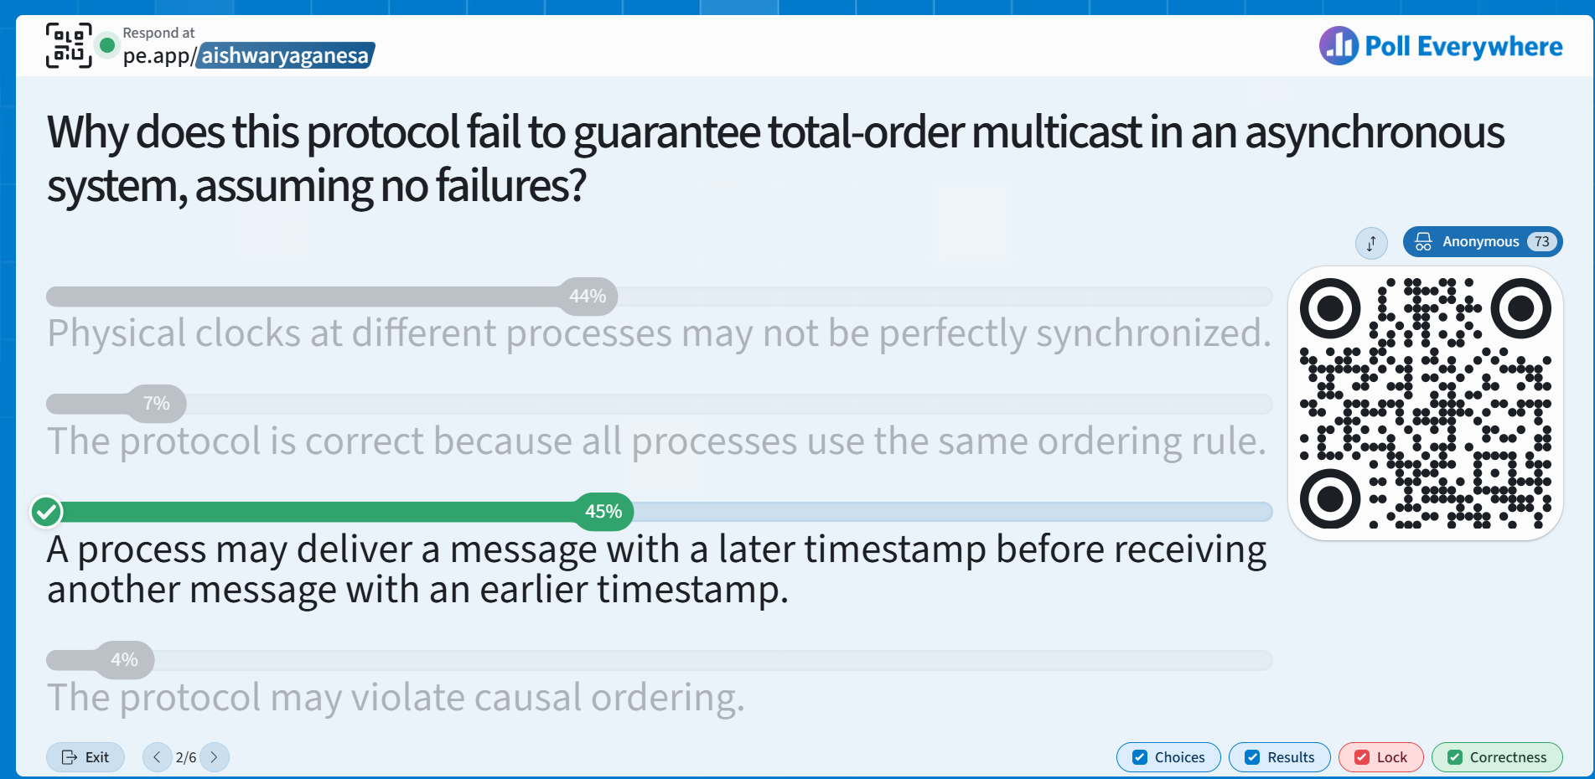
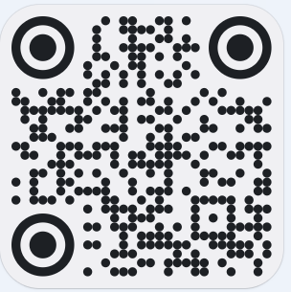
https://pe.app/aishwaryaganesa

Slide 28
Problem with the First Cut Approach
Receiver does not know if a lower timestamped message is in the network
One way to solve this:
  Special process elected as leader or sequencer
  Sequencer assigns contiguous, monotonically increasing sequence numbers (1, 2, 3, …) to messages.
  Process knows to wait for missing timestamp

Slide 29
Sequencer-based Approach
Send multicast at process Pi:
  Send multicast message M to both group and sequencer
Sequencer:
  Maintains a global sequence number S (initially 0)
  When it receives a multicast message M, it sets S = S + 1, and multicasts <M, S>
Receive multicast at process Pi:
  Pi maintains a local sequence number Si (initially 0)
  If Pi receives a multicast M from Pj, it buffers it until it both
    Pi receives <M, S(M)> from sequencer, and
    Si + 1 = S(M) (why is this condition needed?)
    Then deliver message M to application and set Si = Si + 1

Slide 30
Causal Ordering
Multicasts whose send events are causally related, must be delivered in the same causality-obeying order at all receivers
Formally
  If multicast(g,m) → multicast(g,m’)
  then any correct process that delivers m’ would already have delivered m.

Slide 31
Causal Multicast: Datastructures
Each receiver maintains a vector of per-sender sequence numbers (integers)
  Processes P1 through PN
  Pi maintains a vector Pi[1…N] (initially all zeroes)
  Pi[j] is the latest sequence number Pi has delivered from Pj
  Similar to FIFO Multicast, but updating rules are different

Slide 32
Causal Multicast: Updating Rules
Send multicast at process Pj:
  Set Pj[j] = Pj[j] + 1
  Include new entire vector Pj[1…N] in multicast message
Receive multicast at Pi from Pj with vector M[1…N] in message
buffer it until both:
  This message is the next one Pi is expecting from Pj, i.e.,
    M[j] = Pi[j] + 1
  All multicasts, anywhere in group, which happened-before M have been delivered at Pi, i.e.,
    For all k ≠ j: M[k] ≤ Pi[k]
    i.e., Receiver satisfies causality
  When above two conditions satisfied, deliver M to application and set Pi[j] = M[j]

Slide 33
[1,0,0,0]
P1
[0,0,0,0]
Time
[1,0,0,0]
P2
[0,0,0,0]
P3
[0,0,0,0]
P4
[0,0,0,0]
Causal Ordering: Example

Slide 34
[1,0,0,0]
P1
[0,0,0,0]
Time
[1,1,0,0]
P2
[0,0,0,0]
[1,0,0,0]
Deliver!
P3
[0,0,0,0]
P4
[1,0,0,0]
Deliver!
[0,0,0,0]
Causal Ordering: Example

Slide 35
[1,1,0,0]
Deliver!
[1,0,0,0]
P1
[0,0,0,0]
Time
[1,1,0,0]
P2
[0,0,0,0]
[1,0,0,0]
Deliver!
[1,1,0,0]
P3
[0,0,0,0]
Missing 1 from P1
Buffer!
P4
[1,0,0,0]
Deliver!
[0,0,0,0]
Causal Ordering: Example

Slide 36
[1,1,0,0]
Deliver!
[1,0,0,0]
P1
[0,0,0,0]
Time
[1,1,0,0]
P2
[0,0,0,0]
[1,0,0,0]
Deliver!
P3
[0,0,0,0]
Missing 1 from P1
Buffer!
Missing 1 from P1
Buffer!
[1,0,0,1]
P4
[1,0,0,0]
Deliver!
[1,0,0,1]
[0,0,0,0]
Causal Ordering: Example

Slide 37
[1,1,0,0]
Deliver!
Deliver!
Receiver satisfies causality
[1,0,0,0]
P1
[0,0,0,0]
Time
Deliver!
Receiver satisfies causality
[1,1,0,0]
P2
[0,0,0,0]
[1,0,0,0]
Deliver!
Deliver!
P3
[0,0,0,0]
Missing 1 from P1
Buffer!
Missing 1 from P1
Buffer!
Should these 2 messages
from P2 & P4
be delivered in that order
or reversed at P3?
P4
[1,0,0,0]
Deliver!
[1,0,0,1]
Deliver P1’s multicast
Receiver satisfies causality for buffered multicasts
Deliver P2’s buffered multicast
Deliver P4’s buffered multicast
[0,0,0,0]
Causal Ordering: Example

Slide 38
Summary: Multicast Ordering
Ordering of multicasts affects correctness of distributed systems using multicasts
Three popular ways of implementing ordering
  FIFO, Causal, Total
And their implementations
What about reliability of multicasts?
What about failures?

Slide 39
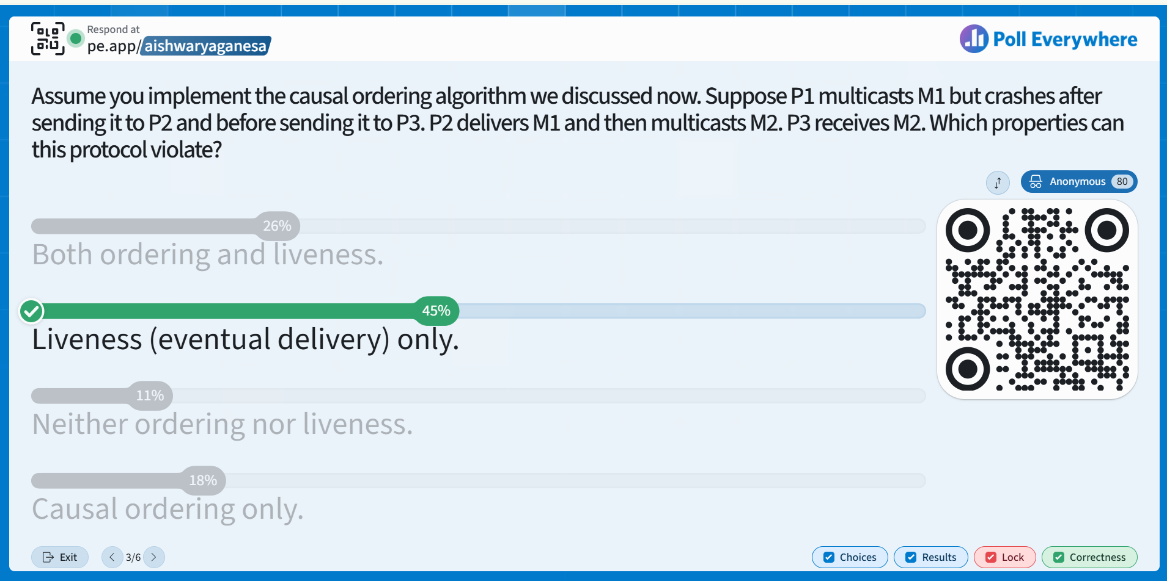
https://pe.app/aishwaryaganesa

Slide 40
Reliable Multicast
Reliable multicast loosely says that every process in the group receives all multicasts
  Reliability is orthogonal to ordering
  Can implement Reliable-FIFO, or Reliable-Causal, or Reliable-Total, or Reliable-Hybrid protocols
What about process failures?

Slide 41
Reliable Multicast (under failures)
Need all correct (i.e., non-faulty) processes to receive/deliver the same set of multicasts as all other correct processes
  Faulty processes stop anyway, so we won’t worry about them

Slide 42
Implementing Reliable Multicast
Assume reliable unicast (e.g., TCP)
First-cut: Sender process (of each multicast M) sequentially sends a reliable unicast message to all group recipients
First-cut protocol does not satisfy reliability
  If sender fails, some correct processes might receive multicast M, while other correct processes might not receive M

Slide 43
REALLY Implementing Reliable Multicast
Trick: Have receivers help the sender
Sender process (of each multicast M) sequentially sends a reliable unicast message to all group recipients
When a receiver receives multicast M, it also sequentially sends M to all the group’s processes

Slide 44
Analysis
Not the most efficient multicast protocol, but reliable
Proof is by contradiction
Assume two correct processes Pi and Pj are so that Pi received a multicast M and Pj did not receive that multicast M
  If Pi is correct, it would have sequentially sent the multicast M to all group members, including Pj, and Pj would have received M
  A contradiction
  Hence our initial assumption must be false
  Hence protocol preserves reliability

Slide 45
Challenges
Membership changes?
  Processes join/leave
  Need a membership protocol
  One approach: View synchrony
  - slides and video links on Course webpage
Using consensus protocols
  Chubby/Raft/Zookeeper etc.
  Later in the course (Raft)

Slide 46
Summary
Multicast an important building block for cloud computing systems
Depending on application need, can implement
  Ordering
  Reliability

Slide 47
Announcements
HW3, MP3 released.
Midterm regrades due soon.
Please fill out post-midterm survey.

Slide 48
CS 425 / ECE 428
Distributed Systems
Fall 2026
Indranil Gupta (Indy)
Lecture 16: Multicast: Virtual Synchrony
All slides © IG

Slide 49
Virtual Synchrony or View Synchrony
Attempts to preserve multicast ordering and reliability in spite of failures
Combines a membership protocol with a multicast protocol
Systems that implemented it (like Isis Systems) have been used in NYSE, French Air Traffic Control System, Swiss Stock Exchange

Slide 50
Views
Each process maintains a membership list
The membership list is called a View
An update to the membership list is called a View Change
  Process join, leave, or failure
Virtual synchrony guarantees that all view changes are delivered in the same order at all correct processes
  If a correct P1 process receives views, say {P1}, {P1, P2, P3}, {P1, P2}, {P1, P2, P4} then
  Any other correct process receives the same sequence of view changes (after it joins the group)
    P2 receives views {P1, P2, P3}, {P1, P2}, {P1, P2, P4}
Views may be delivered at different physical times at processes, but they are delivered in the same order

Slide 51
VSync Multicasts
A multicast M is said to be “delivered in a view V at process Pi” if
  Pi delivers view V, and then sometime before Pi delivers the next view it delivers multicast M
Virtual synchrony ensures that
  The set of multicasts delivered in a given view is the same set at all correct processes that were in that view
    What happens in a View, stays in that View
  The sender of the multicast message (and the send event) also belongs to that view
  If a process Pi does not deliver a multicast M in view V while other processes in the view V delivered M in V, then Pi will be forcibly removed from the next view delivered after V at the other processes

Slide 52
View{P1,P2,P3,P4}
View{P1,P2,P3}
P1
M1
Time
View{P1,P2,P3,P4}
M2
View{P1,P2,P3}
P2
View{P1,P2,P3,P4}
View{P1,P2,P3}
P3
View{P1,P2,P3,P4}
M3
P4
Crash
Satisfies virtual synchrony

Slide 53
View{P1,P2,P3,P4}
View{P1,P2,P3}
P1
M1
Time
View{P1,P2,P3,P4}
M2
View{P1,P2,P3}
P2
View{P1,P2,P3,P4}
View{P1,P2,P3}
P3
View{P1,P2,P3,P4}
M3
P4
Crash
Does not satisfy virtual synchrony

Slide 54
View{P1,P2,P3,P4}
View{P1,P2}
P1
M1
Time
View{P1,P2,P3,P4}
M2
View{P1,P2}
P2
View{P1,P2,P3,P4}
P3
View{P1,P2,P3,P4}
M3
P4
Crash
Satisfies virtual synchrony

Slide 55
View{P1,P2,P3,P4}
View{P1,P2,P3}
P1
M1
Time
View{P1,P2,P3,P4}
M2
View{P1,P2,P3}
P2
View{P1,P2,P3,P4}
View{P1,P2,P3}
P3
View{P1,P2,P3,P4}
M3
P4
Crash
Does not satisfy virtual synchrony

Slide 56
View{P1,P2,P3,P4}
View{P1,P2,P3}
P1
M1
Time
View{P1,P2,P3,P4}
M2 (not delivered at P2)
View{P1,P2,P3}
P2
View{P1,P2,P3,P4}
View{P1,P2,P3}
P3
View{P1,P2,P3,P4}
M3
P4
Crash
Satisfies virtual synchrony

Slide 57
View{P1,P2,P3,P4}
View{P1,P2,P3}
P1
M1
Time
View{P1,P2,P3,P4}
M2
View{P1,P2,P3}
P2
View{P1,P2,P3,P4}
View{P1,P2,P3}
P3
View{P1,P2,P3,P4}
M3
P4
Crash
Does not satisfy virtual synchrony

Slide 58
View{P1,P2,P3,P4}
View{P1,P2,P3}
P1
M1
Time
View{P1,P2,P3,P4}
M2
View{P1,P2,P3}
P2
View{P1,P2,P3,P4}
View{P1,P2,P3}
P3
View{P1,P2,P3,P4}
M3
P4
Crash
Does not satisfy virtual synchrony

Slide 59
View{P1,P2,P3,P4}
View{P1,P2,P3}
P1
M1
Time
View{P1,P2,P3,P4}
M2
View{P1,P2,P3}
P2
View{P1,P2,P3,P4}
View{P1,P2,P3}
P3
View{P1,P2,P3,P4}
M3
P4
Crash
Satisfies virtual synchrony

Slide 60
What about Multicast Ordering?
Again, orthogonal to virtual synchrony
The set of multicasts delivered in a view can be ordered either
  FIFO
  Or Causally
  Or Totally
  Or using a hybrid scheme

Slide 61
About that name
Called “virtual synchrony” since in spite of running on an asynchronous network, it gives the appearance of a synchronous network underneath that obeys the same ordering at all processes
So can this virtually synchronous system be used to implement consensus?
No! VSync groups susceptible to partitioning
  E.g., due to inaccurate failure detections

Slide 62
View{P1,P2,P3,P4}
View{P1}
P1
M1
Time
View{P1,P2,P3,P4}
M2
View{P2, P3}
P2
View{P1,P2,P3,P4}
View{P2,P3}
P3
View{P1,P2,P3,P4}
M3
P4
Crash
Partitioning in View synchronous systems

