Slide 1
CS 425 / ECE 428
Distributed Systems
Fall 2026
Aishwarya Ganesan w/ Ram Kesavan
Ack: Indranil Gupta (Indy)
Lecture 15-A: Impossibility of Consensus
All slides © IG

Slide 2
Announcements
HW3 released – please start early!
MP3 will be released today – start now! (you should already be able to do it based on the lecture material so far)
  Distributed key-value store
Midterm grades will be released today
Midterm solutions will be released today morning (waiting for some last-set of conflict exams)

Slide 3
Agenda
Consensus problem
A solution for synchronous system model
Impossibility result
Solutions for asynchronous system model (how?)
  Paxos, Raft (subsequent lectures)

Slide 4
What is common to all of these?
A group of servers attempting:
Make sure that all of them receive the same updates in the same order as each other
To keep their own local lists where they know about each other, and when anyone leaves or fails, everyone is updated simultaneously
Elect a leader among them, and let everyone in the group know about it
To ensure mutually exclusive (one process at a time only) access to a critical resource like a file
4

Slide 5
What is common to all of these?
A group of servers attempting:
Make sure that all of them receive the same updates in the same order as each other [Reliable Multicast]
To keep their own local lists where they know about each other, and when anyone leaves or fails, everyone is updated simultaneously [Membership/Failure Detection]
Elect a leader among them, and let everyone in the group know about it [Leader Election]
To ensure mutually exclusive (one process at a time only) access to a critical resource like a file [Mutual Exclusion]
5

Slide 6
So what is common?
Let’s call each server a “process” (think of the daemon at each server)
All of these were groups of processes attempting to coordinate with each other and reach agreement on the value of something
  The ordering of messages
  The up/down status of a suspected failed process
  Who the leader is
  Who has access to the critical resource
All of these are related to the Consensus problem
6

Slide 7
What is Consensus?
Formal problem statement
N processes
Each process p has
  input variable xp : initially either 0 or 1
  output variable yp : initially b (can be changed only once)
Consensus problem: design a protocol so that at the end, either:
  All processes set their output variables to 0 (all-0’s)
  Or All processes set their output variables to 1 (all-1’s)
7

Slide 8
What is Consensus? (2)
Every process contributes a value
Goal is to have all processes decide same (some) value
  Decision once made can’t be changed
There might be other constraints
  Validity = if everyone proposes same value, then that’s what’s decided
  Integrity = decided value must have been proposed by some process
  Non-triviality = there is at least one initial system state that leads to each of the all-0’s or all-1’s outcomes
8

Slide 9
Why is it Important?
Many problems in distributed systems are equivalent to (or harder than) consensus!
  Perfect Failure Detection
  Leader election (select exactly one leader, and every alive process knows about it)
  State machine replication: Processes agree on the same sequence of operations.
Consensus is a fundamental building block for fault-tolerant distributed systems.
So, is there a solution to Consensus?
9

Slide 10
Two Different Models of Distributed Systems
Synchronous System Model and Asynchronous System Model
Synchronous Distributed System
  Each message is received within bounded time
  Drift of each process’ local clock has a known bound
  Each step in a process takes lb < time < ub
  E.g., A collection of processors connected by a communication bus, e.g., a Cray supercomputer or a multicore machine
10
Notes:
We have two jokes about distributed systems, but we can’t decide which one to tell.

Slide 11
Asynchronous System Model
Asynchronous Distributed System
  No bounds on process execution
  The drift rate of a clock is arbitrary
  No bounds on message transmission delays
  E.g., The Internet is an asynchronous distributed system, so are ad-hoc and sensor networks
This is a more general (and thus challenging) model than the synchronous system model. A protocol for an asynchronous system will also work for a synchronous system (but not vice-versa)
11

Slide 12
Possible or Not
In the synchronous system model
  Consensus is solvable
In the asynchronous system model
  Consensus is impossible to solve
  Whatever protocol/algorithm you suggest, there is always a worst-case possible execution (with failures and message delays) that prevents the system from reaching consensus
  Powerful result (see the FLP proof)
  Subsequently, safe or probabilistic solutions have become quite popular to consensus or related problems.
12

Slide 13
Let’s Try to Solve Consensus!
Uh, what’s the system model? (assumptions!)
Synchronous system: bounds on
  Message delays
  Upper bound on clock drift rates
  Max time for each process step
  e.g., multiprocessor (common clock across processors)
Processes can fail by stopping (fail-stop or crash failures)
13

Slide 14
Consensus in Synchronous Systems
For a system with at most f processes crashing
  All processes are synchronized and operate in “rounds” of time. Round length >> max transmission delay.
  algorithm proceeds in f+1 rounds (with timeout), using reliable communication to all members.
  Values^{r}_{i}: the set of proposed values known to p_{i} at the beginning of round r.
Round 1
Round 2
Round 3
14

Slide 15
Consensus in Synchronous System
Possible to achieve!
For a system with at most f processes crashing
  All processes are synchronized and operate in “rounds” of time. Round length >> max transmission delay.
  algorithm proceeds in f+1 rounds (with timeout), using reliable communication to all members.
  Values^{r}_{i}: the set of proposed values known to p_{i} at the beginning of round r.
- Initially Values⁰_{i} = {} ; Values¹_{i} = {v_{i}}
for round = 1 to f+1 do
multicast (Values ^{r}_{i} – Values^{r-1}_{i}) // iterate through processes, send each a message
Values ^{r+1}_{i} ← Values^{r}_{i}
for each V_{j} received
Values ^{r+1}_{i} = Values ^{r+1}_{i} ∪ V_{j}
end
end
d_{i} = minimum(Values ^{f+2}_{i}) // consistent minimum based on say, id (not minimum value)
15

Slide 16
Why does the Algorithm work? (Proof)
After f+1 rounds, all non-faulty processes would have received the same set of Values. Proof by contradiction.
Assume that two non-faulty processes, say p_{i} and p_{j} , differ in their final set of values (i.e., after f+1 rounds)
Assume that p_{i} possesses a value v that p_{j} does not possess.
  p_{i} must have received v in the very last round
    Else, p_{i} would have sent v to p_{j} in that last round
  → So, in the last round: a third process, p_{k}, must have sent v to p_{i}, but then crashed before sending v to p_{j}.
  → Similarly, a fourth process sending v in the last-but-one round must have crashed; otherwise, both p_{k} and p_{j} should have received v.
  → Proceeding in this way, we infer at least one (unique) crash in each of the preceding rounds.
  → This means a total of f+1 crashes, while we have assumed at most f crashes can occur => contradiction.
16

Slide 17
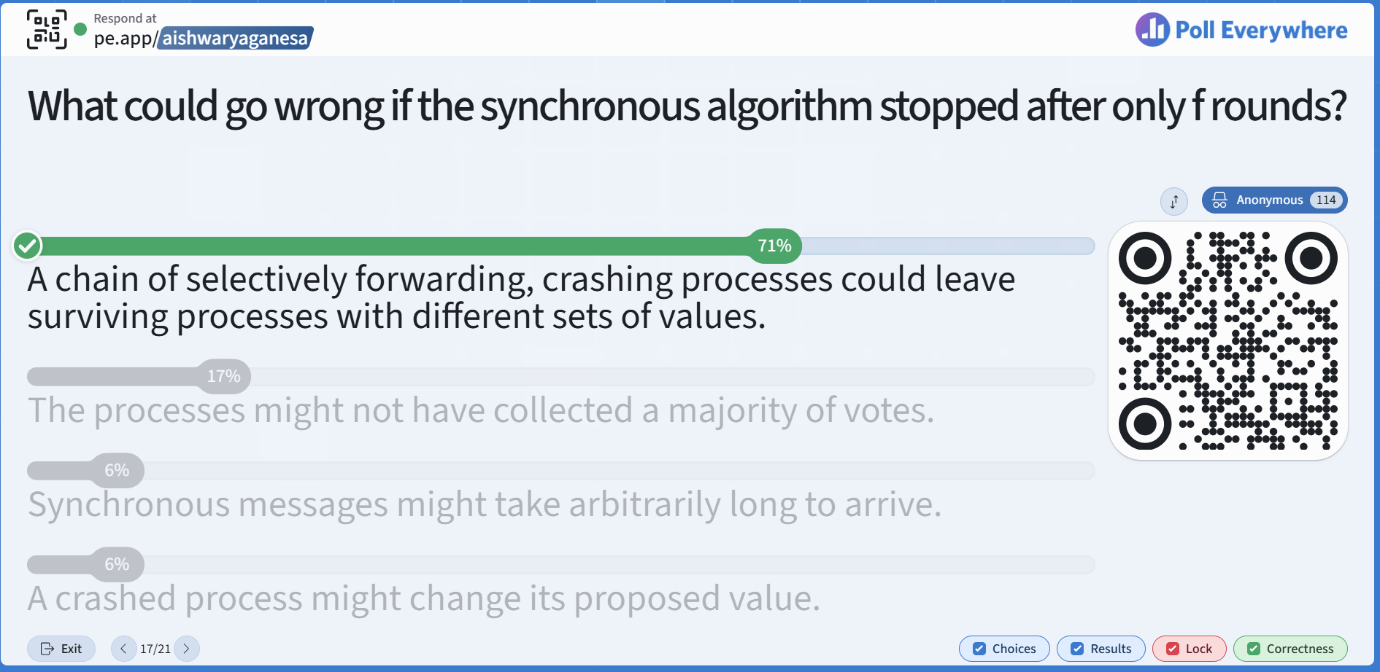

https://pe.app/aishwaryaganesa

Slide 18


Slide 19
Consensus in an Asynchronous System
Impossible to achieve!
Proved in a now-famous result by Fischer, Lynch and Patterson, 1983 (FLP)
“The consensus problem involves an asynchronous system of processes, some of which may be unreliable. The problem is for the reliable processes to agree on a binary value. In this paper, it is shown that every protocol for this problem has the possibility of nontermination, even with only one faulty process”
https://groups.csail.mit.edu/tds/papers/Lynch/jacm85.pdf
19
Notes:
We have two jokes about distributed systems, but we can’t decide which one to tell.

Slide 20
Recall
Asynchronous system: All message delays and processing delays can be arbitrarily long or short.
Consensus:
Each process p has a state
  program counter, registers, stack, local variables
  input register xp : initially either 0 or 1
  output register yp : initially b (undecided)
Consensus Problem: design a protocol so that either
  all processes set their output variables to 0 (all-0’s)
  Or all processes set their output variables to 1 (all-1’s)
  Non-triviality: at least one initial system state leads to each of the above two outcomes
20

Slide 21
Proof Setup
For impossibility proof, OK to consider
more restrictive system model, and
easier problem
  Why is this is ok?
21

Slide 22
Network
p
p’
send(p’,m)
receive(p’)
may return null
Global Message Buffer
“Network”
22

Slide 23
States
State of a process
Configuration=global state. Collection of states, one for each process; alongside state of the global buffer.
Each Event (different from Lamport events) is atomic and consists of three steps
  receipt of a message by a process (say p)
  processing of message (may change recipient’s state)
  sending out of all necessary messages by p
Schedule: sequence of events
23

Slide 24
C
Configuration C
C
Event e’=(p’,m’)
C’
Schedule s=(e’,e’’)
C’’
Event e’’=(p’’,m’’)
C’’
Equivalent
24

Slide 25
Lemma 1
Disjoint schedules are commutative
C
s2
Schedule s1
C’
s1 and s2 involve
disjoint sets of
receiving processes,
and are each applicable
on C
Schedule s2
C’’
s1
25

Slide 26
Easier Consensus Problem
Easier Consensus Problem: some process eventually sets yp to be 0 or 1
Only one process crashes – we’re free to choose which one
26

Slide 27
Easier Consensus Problem
Let config. C have a set of decision values V reachable from it
  If |V| = 2, config. C is bivalent
  If |V| = 1, config. C is 0-valent or 1-valent, as is the case
Bivalent means outcome is unpredictable
27

Slide 28
What the FLP proof shows
There exists an initial configuration that is bivalent
Starting from a bivalent config., there is always another bivalent config. that is reachable
28

Slide 29
Lemma 2
Some initial configuration is bivalent
Suppose all initial configurations were either 0-valent or 1-valent.
If there are N processes, there are 2^{N} possible initial configurations
Place all configurations side-by-side (in a lattice), where adjacent
configurations differ in initial xp value for exactly one process.
1 1 0 1 0 1
There has to be some adjacent pair of
1-valent and 0-valent configs.
29

Slide 30
Lemma 2
Some initial configuration is bivalent
There has to be some adjacent pair of 1-valent and 0-valent configs.
Let the process p, that has a different state across these two configs., be
the process that has crashed (i.e., is silent throughout)
Both initial configs. will lead to the same config. for the same sequence of events
Therefore, both these initial configs. are bivalent when there is such a failure
1 1 0 1 0 1
30
Notes:
Now take these two adjacent initial configurations. We assumed one is 0-valent and the other is 1-valent, and they differ only in process (p_3)’s input.
Let (p_3) crash immediately, before sending any messages. What does that achieve? It hides the only difference between the two configurations from all the other processes.
Every other process starts in exactly the same local state in both cases. If we schedule those processes and deliver their messages in the same order, they behave identically. They have no way to discover whether (p_3)’s input was 0 or 1.
But our assumed consensus protocol must still eventually produce a decision despite this one crash. Because the remaining processes behave identically, that decision must be the same in both executions.
Now we have a contradiction. If they decide 0, then the configuration we called 1-valent can actually lead to a decision of 0. If they decide 1, then the configuration we called 0-valent can actually lead to a decision of 1.
Therefore, our assumption that every initial configuration is univalent must be false. Some initial configuration must be bivalent.
Notice what we proved: the crash lets us expose a contradiction in the assumption that all initial configurations are univalent.

Slide 31
What we’ll show
There exists an initial configuration that is bivalent
Starting from a bivalent config., there is always another bivalent config. that is reachable
31

Slide 32
Lemma 3
Starting from a bivalent config., there is always another bivalent config. that is reachable
32

Slide 33
Lemma 3
A bivalent initial config.
let e=(p,m) be some event
applicable to the initial config.
Let C be the set of configs. reachable
without applying e
33

Slide 34
Lemma 3
A bivalent initial config.
let e=(p,m) be some event
applicable to the initial config.
Let C be the set of configs. reachable
without applying e
e e e e e
Let D be the set of configs.
obtained by applying e to some
config. in C
34

Slide 35
Lemma 3
bivalent
C
[don’t apply
event e=(p,m)]
e e e e e
D
35

Slide 36
Claim. Set D contains a bivalent config.
Proof. By contradiction. That is, suppose D has only 0- and 1- valent states (and no bivalent ones)
There are states D0 and D1 in D, and C0 and C1 in C such that
  D0 is 0-valent, D1 is 1-valent
  D0=C0 foll. by e=(p,m)
  D1=C1 foll. by e=(p,m)
  And C1 = C0 followed by some event e’=(p’,m’)
(why?)
bivalent
C
[don’t apply
event e=(p,m)]
e e e e e
D
36
Notes:
Why D contains at least one i-valent state (for each of i=0,1)
Consider an i-valent state E reachable from the red state.
If E is in C, then E-> e is in D and is an i-valent state in D.
If E is NOT in C, then e was applied during red->E, and so the red-> E path must pass via D. Since D has no bivalent states, E’s ANCESTOR that belongs in D must also be i-valent.

Slide 37
Proof. (contd.)
Case I: p’ is not p
Case II: p’ same as p
C0
e’
e
D0
C1
e’
e
D1
Why? (Lemma 1)
But D0 is then bivalent!
bivalent
C
[don’t apply
event e=(p,m)]
e e e e e
D
37

Slide 38
Proof. (contd.)
Case I: p’ is not p
Case II: p’ same as p
C0
e’
e
C1
e
D0
sch. s
D1
sch. s
sch. s
A
bivalent
e
(e’,e)
E1
E0
C
[don’t apply
event e=(p,m)]
sch. s
finite
deciding run from C0
p takes no steps
e e e e e
D
But A is then bivalent!
38

Slide 39
Lemma 3
Starting from a bivalent config., there is always another bivalent config. that is reachable
39

Slide 40
Putting it all Together
Lemma 2: There exists an initial configuration that is bivalent
Lemma 3: Starting from a bivalent config., there is always another bivalent config. that is reachable
Theorem (Impossibility of Consensus): There is always a run of events in an asynchronous distributed system such that the group of processes never reach consensus (i.e., stays bivalent all the time)
40
Notes:
We have two jokes about distributed systems, but we can’t decide which one to tell.

Slide 41
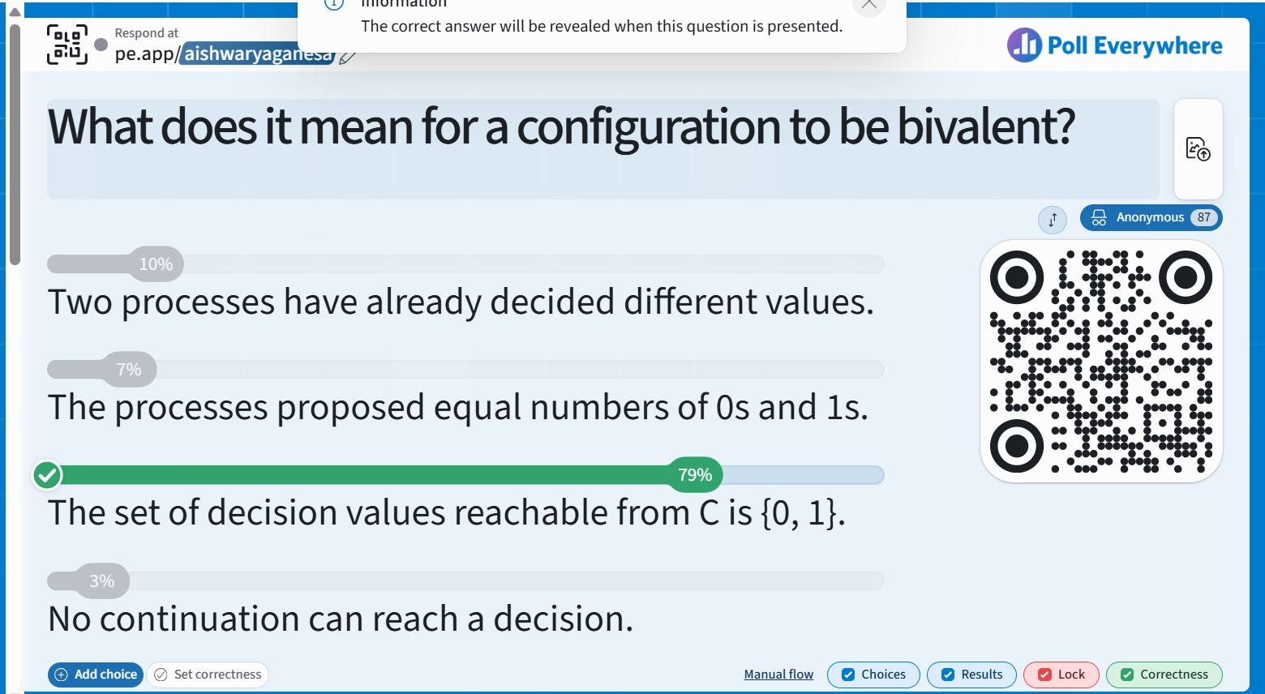

Slide 42
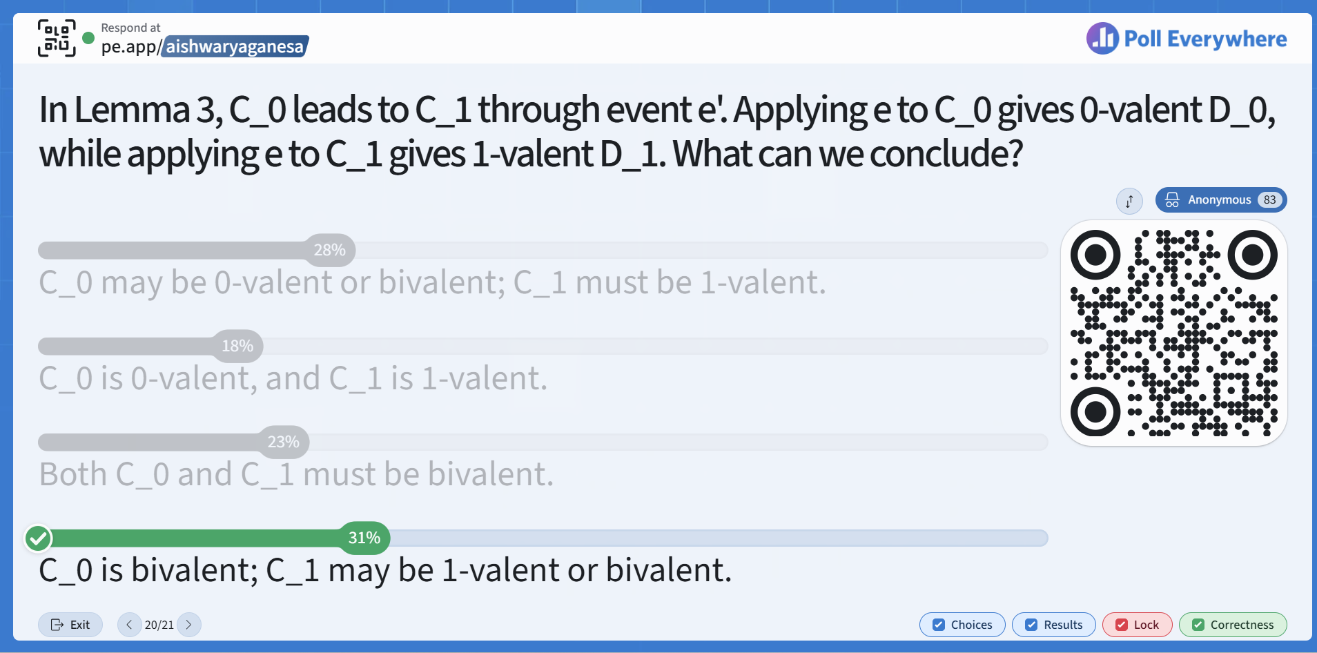

Slide 43
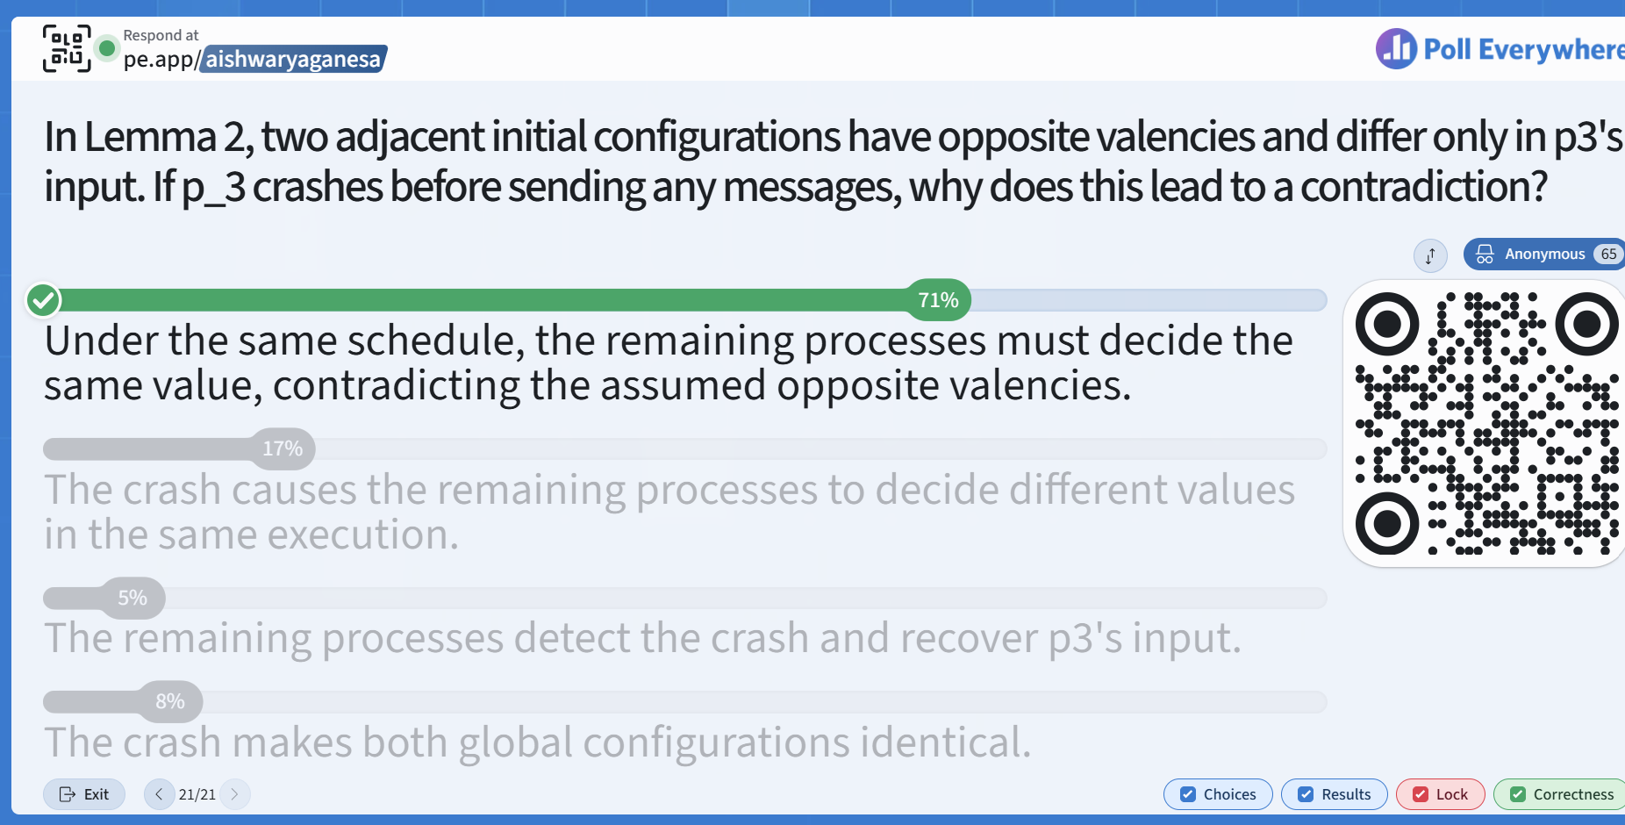

Slide 44
Optional Exercises/Questions to Test your Own Knowledge
Is the consensus problem the same as majority voting? If not, what are the differences?
What is a trivial solution to consensus?
Why is consensus solvable for synchronous systems?.
. A synchronous consensus algorithm with N=5 processes has only 2 rounds, but can have up to 2 failures. Show how this algorithm fails to solve consensus.
Why does the FLP proof treat the network as a giant “buffer”?
What is a commutative schedule?
What is the lattice of states and why is it important in the FLP proof?
How does FLP show that given a bivalent state, one can reach another bivalent state?
In FLP’s last lemma, why is it ok to prevent process p from taking any steps for a while, or event e from occurring for a while?
44

Slide 45
Summary
Consensus Problem
  Agreement in distributed systems
  Solution exists in synchronous system model (e.g., supercomputer)
  Impossible to solve in an asynchronous system (e.g., Internet, Web)
    Key idea: with even one (adversarial) crash-stop process failure, there are always sequences of events for the system to decide any which way
    Holds true regardless of whatever algorithm you choose!
  FLP impossibility proof
One of the most fundamental results in distributed systems
45

Slide 46
Announcements
HW3 released – please start early!
MP3 released today – start now! (you should already be able to do it based on the lecture material so far)
  Distributed key-value store
Midterm grades released
Midterm solutions

