Slide 1
CS 425 / ECE 428
Distributed Systems
Fall 2026
Aishwarya Ganesan & Ram Kesavan
Lecture 12: Time and Ordering
Ack: Indranil Gupta
All slides © IG

Slide 2
Announcements
HW2 due on Sunday 10/4 @11:59 pm US Central
  Solutions will be posted early next week
MP2 is being graded this week
HW1 grades released
In-class midterm Thursday 10/8
  Course webpage specifies the two rooms
  Make sure you’re in correct classroom for the midterm
  Piazza post with more details
  Practice mid-term released

Slide 3
Why Synchronization?
You want to catch a bus at 6.05 pm, but your watch is off by 15 minutes
  What if your watch is Late by 15 minutes?
    You’ll miss the bus!
  What if your watch is Fast by 15 minutes?
    You’ll end up unfairly waiting for a longer time than you intended
Time synchronization is required for both
  Correctness
  Fairness

Slide 4
Synchronization In The Cloud
Cloud airline reservation system
Server A receives a client request to purchase last ticket on flight ABC 123.
Server A timestamps purchase using local clock 9h:15m:32.45s and logs it. Acks the client.
That was the last seat. Server A messages Server B: “flight full.”
B records “Flight ABC 123 full” + its own local clock value (which is 9h:10m:10.11s) into its log.
Server C queries A’s and B’s logs. Is confused that a client purchased a ticket on A after the flight became full at B.
This may lead to further incorrect actions by C
Notes:
On a single machine, there is only 1 clock. All processes on that machine can unambiguously share their timestamps with each other.

Slide 5
Why is it Challenging?
End hosts in Internet-based systems (like clouds)
  Each have their own clocks
  Unlike processors (CPUs) within one server or workstation which share a system clock
Processes in Internet-based systems follow an asynchronous system model
  No bounds on
    Message delays
    Processing delays
  Unlike multi-processor (or parallel) systems which follow a synchronous system model

Slide 6
Some Definitions
An (asynchronous) distributed system comprises many processes
  Each process has a state (values of variables).
  Each process takes actions to change its state, which may be an instruction or a communication action (send, receive).
  An event is the occurrence of an action.
Each process has a local clock – events within a process can be assigned timestamps and thus ordered linearly.
But in a distributed system, we also need to know the time order of events across different processes.

Slide 7
Clock Skew vs. Clock Drift
Each process (running at some end host) has its own clock.
When comparing two clocks at two processes:
  Clock Skew = Relative Difference in clock values of two processes
    Like distance between two vehicles on a road
  Clock Drift = Relative Difference in clock frequencies (rates) of two processes
    Like difference in speeds of two vehicles on the road
A non-zero clock skew implies clocks are not synchronized.
A non-zero clock drift causes skew to increase (eventually).
  If faster vehicle is ahead, it will drift away
  If faster vehicle is behind, it will catch up and then drift away

Slide 8
How often to Synchronize?
Maximum Drift Rate (MDR) of a clock
Absolute MDR is defined relative to Coordinated Universal Time (UTC). UTC is the “correct” time at any point of time.
  MDR of a process depends on the environment.
Max drift rate between two clocks with similar MDR is 2 * MDR
Given a maximum acceptable skew M between any pair of clocks, need to synchronize at least once every: M / (2 * MDR) time units
  Try & prove this
Notes:
M = Maximum *allowed* skew (allowed by application, before application would start to malfunction)
Proof: let 2 clocks start perfectly synchronized at time t0. After time T has passed:
The fastest clock reads: t0 + (1 + MDR)T
The slowest clock reads: t0 + (1 - MDR)T
Absolute worst-case skew between them is = (1 + MDR)T – (1 – MDR)T = 2*MDR*T
But we want M >= 2*MDR*T
So, T <= M/(2*MDR)

Slide 9
External vs Internal Synchronization
Consider a group of processes
External Synchronization
  Each process C(i)’s clock is within a bound D of a well-known clock S external to the group
  |C(i) – S| < D at all times
  External clock may be connected to UTC (Universal Coordinated Time) or an atomic clock
  E.g., Cristian’s algorithm, NTP
Internal Synchronization
  Every pair of processes in group have clocks within bound D
  |C(i) – C(j)| < D at all times and for all processes i, j
  E.g., Berkeley algorithm (not discussed in course)

Slide 10
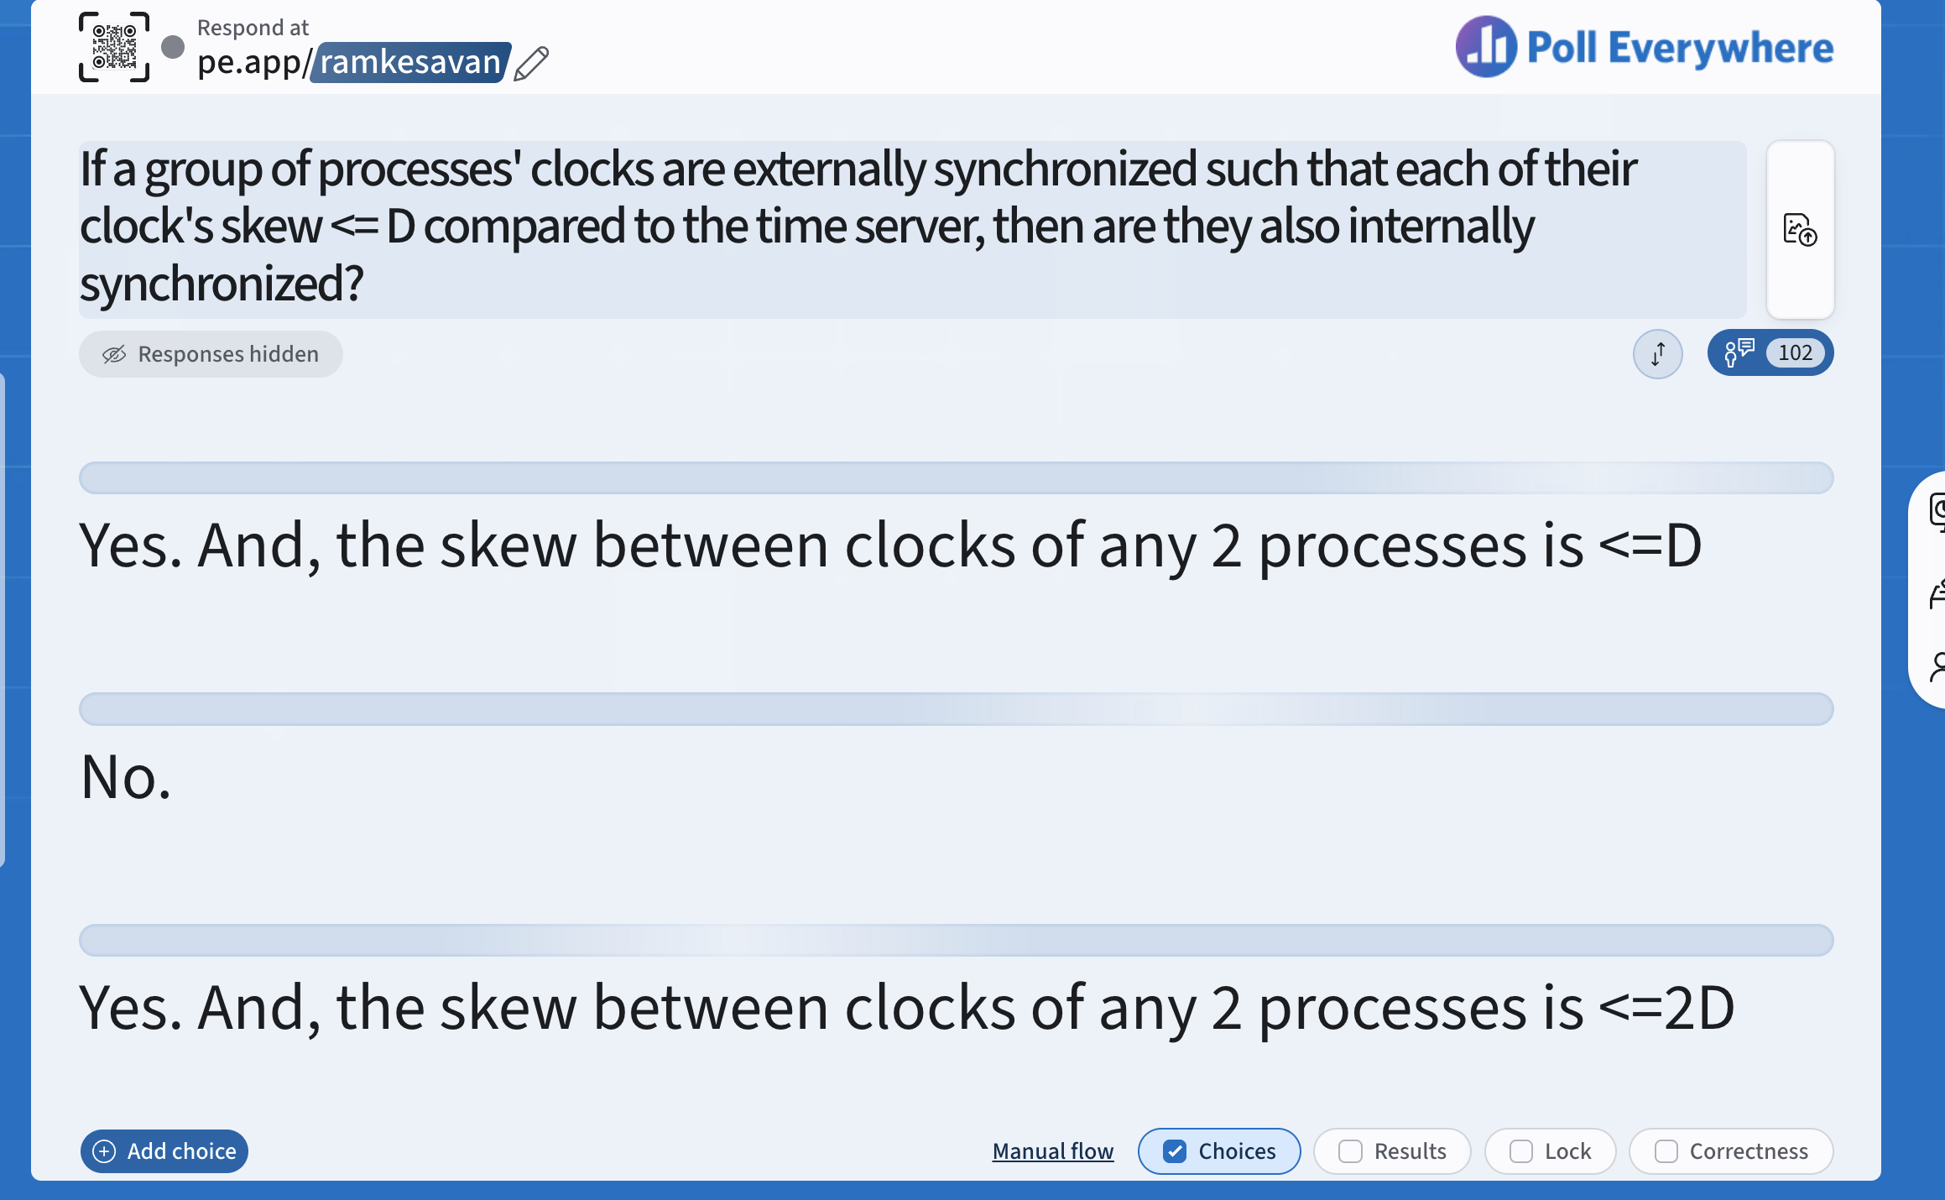
pe.app/ramkesavan
9

Slide 11
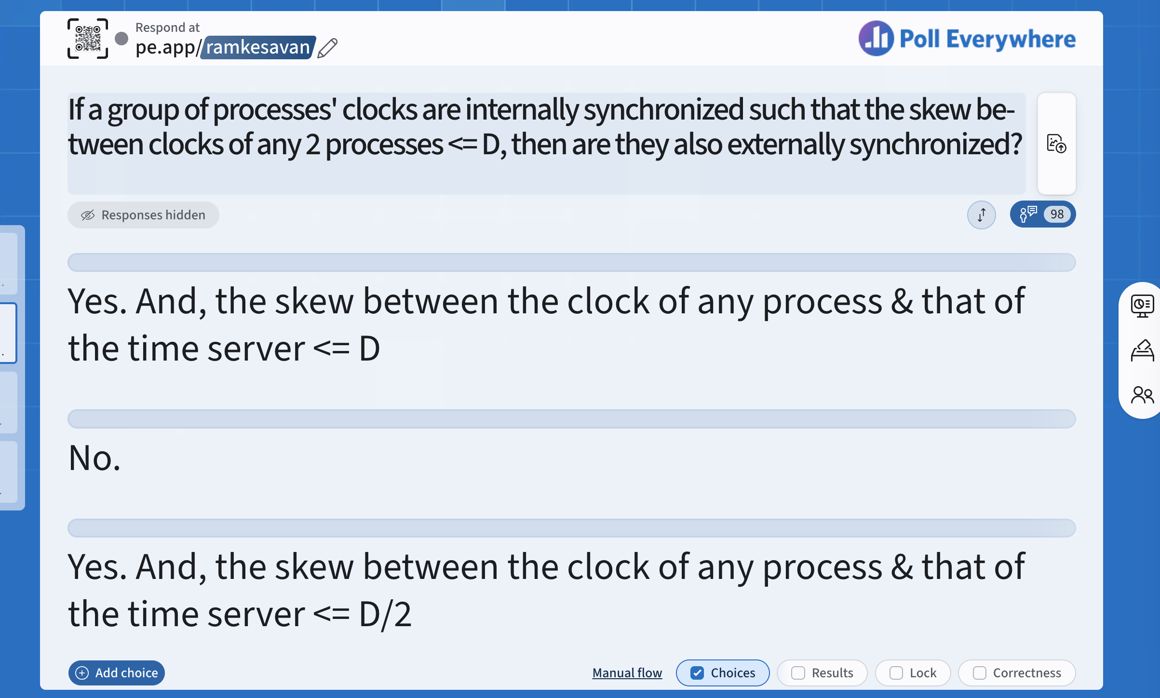
pe.app/ramkesavan
9

Slide 12
External vs Internal Synchronization (2)
External Synchronization with D => Internal Synchronization with 2*D
Internal Synchronization does not imply External Synchronization
  In fact, the entire system may drift away from the external clock S!

Slide 13
Next
Algorithms for Clock Synchronization

Slide 14
Cristian’s Algorithm

Slide 15

Basics
What is the problem with setting clock at P to t?
External time synchronization
All processes P synchronize with a time server S
Set clock to t
Time
P
What’s the time?
Clock = t
S
Server returns its clock t

Slide 16
What’s Wrong
By the time response message is received by P, time has moved ahead
P’s time set to t is inaccurate, which is a function of the latency of the message from S to P
This latency is different and unbounded for each P in the system
Thus, there is no upper bound on the skew between clocks of any two processes in the system

Slide 17
Cristian’s Algorithm
P measures the round-trip-time RTT of message exchange
Set clock to t
Time
P
What’s the time?
Clock = t
S
Server returns its clock t

Slide 18
Cristian’s Algorithm (2)
Why not measure
one-way latency?
P measures the round-trip-time RTT of message exchange
Suppose we know the minimum P → S latency min1
And the minimum S → P latency min2
  min1 and min2 depend on Operating System overhead to buffer messages, TCP time to queue messages, network distance, etc.
RTT
Set clock to t
P
Time
What’s the time?
Clock = t
S
Server returns its clock t

Slide 19
Cristian’s Algorithm (4)
What if min1 and min2 are unknown?
The actual time at P when it receives response is between [t+min2, t+RTT-min1]
P sets its time to halfway through this interval
  To: t + (RTT+min2-min1)/2
  Error is at most (RTT-min2-min1)/2
  Bounded!
RTT
Set clock to t
P
Time
What’s the time?
Here’s the time t!
S
Check local clock to find time t
Notes:
t+min2 because the LATEST time that S could have timestamped the message is if the S->P message took the minimum time min2
T+RTT-min1 because the EARLIEST time that S could have timestamped the message is if the P->S message took the minimum time min1 (and the rest of the time for the message to transit needs to sum up to RTT as that is the ground truth).

Slide 20
Gotchas
Cristian’s algorithm drawbacks
  Allows for clock to be set backwards (may violate ordering of events within the same process)
  Doesn’t scale -- time server can become a bottleneck
Network Time Protocol (NTP)
  Increases or decreases speed of clock
  Uses a hierarchy of time servers
  Used in 95% of installed systems; milli-sec level accuracy over wide networks
Precision Time Protocol (PTP)
  Sub-microsec accuracy on local networks
  Uses hardware clocks on switches and NICs
Notes:
IoT devices use SNTP (Simple NTP)

Slide 21
NTP = Network Time Protocol
NTP Servers organized in a hierarchy (like a tree)
  No bottleneck
Clients talks to leaves of the tree
Each node synchronizes with its parent
Primary servers
Secondary servers
Tertiary servers
client
Notes:
Network Time Protocol is the gold standard for 95% of the use-cases today. Keeps clocks accurate within 10-100ms over the public internet
Precision Time Protocol: for sub-microsecond accuracy. Uses specialized HW timestamps inside network switches and NICs: high-freq trading floors, power grid automation, etc.

Slide 22
NTP Protocol
Message 1 recv time tr1
Message 2 send time ts2
Time
Child
Let’s start protocol
Message 2
ts1,tr2
Message 1
Parent
Message 2 recv time tr2
Message 1 send time ts1

Slide 23
What the Child Does
Child calculates offset between its clock and parent’s clock
Uses ts1, tr1, ts2, tr2
Offset is calculated as
  o = (tr1 – tr2 + ts2 – ts1)/2

Slide 24
Why o = (tr1 - tr2 + ts2 - ts1)/2?
Offset o = (tr1 – tr2 + ts2 – ts1)/2
Let’s calculate the error
Suppose real offset is oreal
  Child is ahead of parent by oreal
  Parent is ahead of child by -oreal
Suppose one-way latency of Message 1 is L1 (L2 for Message 2)
We don’t know L1 or L2!
Then
  tr1 = ts1 + L1 + oreal
  tr2 = ts2 + L2 – oreal
Notes:
“Oreal” in French means Beauty or Halo

Slide 25
Why o = (tr1 - tr2 + ts2 - ts1)/2? (2)
Given
  tr1 = ts1 + L1 + oreal
  tr2 = ts2 + L2 – oreal
Subtracting second equation from the first
  oreal = (tr1 – tr2 + ts2 – ts1)/2 + (L2 – L1)/2
  => oreal = o + (L2 – L1)/2
  => |oreal – o| < |(L2 – L1)/2| < |(L2 + L1)/2|
  Thus, the error is bounded by the round-trip-time

Slide 26
And yet…
We are always left with a non-zero error!
Because
  Message latencies are non-zero & unpredictable
Can we avoid synchronizing clocks altogether, and still be able to order events?

Slide 27
Lamport Timestamps

Slide 28
Ordering Events in a Distributed System
To order events across processes, trying to sync clocks is one approach
What if we instead assigned timestamps to events that were not absolute time?
As long as these timestamps obey causality, that would work
  If an event A causally happens before another event B, then timestamp(A) < timestamp(B)
  Humans use causality all the time
    E.g., I enter a house only after I unlock it
    E.g., You receive a letter only after I send it

Slide 29
Logical (or Lamport) Ordering
Proposed by Leslie Lamport in the 1970s
Used in almost all distributed systems since then
Almost all cloud computing systems use some form of logical ordering of events

Slide 30
Logical (or Lamport) Ordering(2)
Define a logical relation Happens-Before among pairs of events
Happens-Before denoted as →
Three rules
On the same process: a → b, if time(a) < time(b) (using the local clock)
If p1 sends m to p2: send(m) → receive(m)
(Transitivity) If a → b and b → c then a → c
Creates a partial order among events
  Not all events related to each other via →
Notes:
What’s the difference between a blind date and a second date? The first is casual, the second is causal. (this joke is really important)
Why did the chicken cross the road?
Because Lamport asked it to carry a timestamp.
Because it was carrying a Lamport timestamp.

Slide 31
Example
A B C D E
P1
Time
E F G
P2
H I J
P3
Instruction or step
Message

Slide 32
Happens-Before
A B C D E
P1
Time
E F G
P2
H I J
P3
A → B
B → F
A → F
Instruction or step
Message

Slide 33
Happens-Before (2)
F and J?
F and C?
A B C D E
P1
Time
E F G
P2
H I J
P3
H → G
F → J
H → J
C → J
Instruction or step
Message
Notes:
?C -> F?
?H -> C?

Slide 34
In practice: Lamport timestamps
Goal: Assign logical (Lamport) timestamps to events such that they obey causality
Rules
  Each process uses a local counter (clock) which is an integer
    initial value of counter is zero
  A process increments its counter when a send or an instruction happens at it. The counter is assigned to the event as its timestamp.
  A send (message) event carries its timestamp
  For a receive (message) event the counter is updated by
  max(local clock, message timestamp) + 1
Notes:
Timestamps Song: https://www.youtube.com/watch?v=dG2wmdkkeY0
Description: Distributed Systems Timestamps, with a Ukulele.
Lamport and Vector Timestamps are very important concepts in Distributed Systems/Cloud Computing Systems. Here's a Song Mnemonic Tutorial for these timestamps, played with a Ukulele. Lyrics:
Lamport timestamps, they're so easy;
When you send a message, increment your timestamp;
When you receive a message, add 1 to the
Max of what you got and what you have (that's it!).
Vector timestamps, they're even easier;
When you send a message, increment your entry;
When you receive a message, increment your entry;
For the other entries, just take max (that's it!).
(C) Indranil Gupta, March 2016.

Slide 35
Example
P1
Time
P2
P3
Instruction or step
Message

Slide 36
Lamport Timestamps
P1
0
0
0
Time
P2
P3
Instruction or step
Initial counters (clocks)
Message

Slide 37
Lamport Timestamps
P1
0
0
0
ts = 1
Time
P2
Message carries
ts = 1
P3
ts = 1
Instruction or step
Message send
Message

Slide 38
Lamport Timestamps
P1
0
0
0
1
ts = max(local, msg) + 1
= max(0, 1)+1
= 2
Time
P2
Message carries
ts = 1
P3
1
Instruction or step
Message

Slide 39
Lamport Timestamps
P1
0
0
0
1
2
Message carries
ts = 2
Time
P2
2
max(2, 2)+1=3
P3
1
Instruction or step
Message

Slide 40
Lamport Timestamps
Why
Max?
max(3, 4)+1
=5
P1
0
0
0
1
2
3
Time
P2
2
3
4
P3
1
Instruction or step
Message

Slide 41
Lamport Timestamps
P1
0
0
0
1
2
3
5
6
Time
P2
2
3
4
P3
2
7
1
Instruction or step
Message

Slide 42
Obeying Causality
A B C D E
P1
0
0
0
1
2
3
5
6
Time
E’ F G
P2
2
3
4
H I J
P3
2
7
1
A → B :: 1 < 2
B → F :: 2 < 3
A → F :: 1 < 3
Instruction or step
Message

Slide 43
Obeying Causality (2)
A B C D E
P1
0
0
0
1
2
3
5
6
Time
E’ F G
P2
2
3
4
H I J
P3
2
7
1
H → G :: 1 < 4
F → J :: 3 < 7
H → J :: 1 < 7
C → J :: 3 < 7
Instruction or step
Message

Slide 44
Not always implying Causality
A B C D E
P1
0
0
0
1
2
3
5
6
Time
E’ F G
P2
2
3
4
H I J
P3
2
7
1
? C → F ? :: 3 = 3
? H → C ? :: 1 < 3
(C, F) and (H, C) are pairs of concurrent events
Instruction or step
Message
Notes:
Why did the chicken cross the road?
Because Lamport asked it to carry a timestamp.
Because it was carrying a Lamport timestamp.

Slide 45
Concurrent Events
What can you be sure of if
TS(e1)< TS(e2)?
A pair of concurrent events doesn’t have a causal path from one event to another (either way, in the pair)
Lamport timestamps not guaranteed to be ordered or unequal for concurrent events
Ok, since concurrent events are not causally related!
Remember
  E1 → E2 ⇒ timestamp(E1) < timestamp (E2), BUT
  timestamp(E1) < timestamp (E2) ⇒
  {E1 → E2} OR {E1 and E2 concurrent}

Slide 46
Next
Can we have causal or logical timestamps from which we can tell if two events are concurrent or causally related?

Slide 47
Vector Timestamps
Used in key-value stores like Riak, Dynamo
Each process uses a vector of integer clocks
Suppose there are N processes in the group 1…N
Each vector has N elements
Process i maintains vector V_{i}[1…N]
jth element of vector clock at process i, V_{i}[j], is i’s knowledge of latest events at process j
Notes:
Version control systems, such as git, use a directed acyclic graph, which functions conceptually like a vector timestamp, to track parallel development branches, determine causal history, and figure out common ancestors during code merges.

Slide 48
Assigning Vector Timestamps
Each process starts with a vector of all zeros
Incrementing vector clocks
On an instruction or send event at process i, it increments only its ith element of its vector clock
Each message carries the send-event’s vector timestamp V_{message}[1…N]
On receiving a message at process i:
  V_{i}[i] = V_{i}[i] + 1
  V_{i}[j] = max(V_{message}[j], V_{i}[j]) for j ≠ i
Notes:
Timestamps Song: https://www.youtube.com/watch?v=dG2wmdkkeY0
Description: Distributed Systems Timestamps, with a Ukulele.
Lamport and Vector Timestamps are very important concepts in Distributed Systems/Cloud Computing Systems. Here's a Song Mnemonic Tutorial for these timestamps, played with a Ukulele. Lyrics:
Lamport timestamps, they're so easy;
When you send a message, increment your timestamp;
When you receive a message, add 1 to the
Max of what you got and what you have (that's it!).
Vector timestamps, they're even easier;
When you send a message, increment your entry;
When you receive a message, increment your entry;
For the other entries, just take max (that's it!).
(C) Indranil Gupta, March 2016.

Slide 49
Example
A B C D E
P1
Time
E’ F G
P2
H I J
P3
Instruction or step
Message

Slide 50
Vector Timestamps
P1
(0,0,0)
(0,0,0)
(0,0,0)
Time
P2
P3
Initial counters (clocks)

Slide 51
Vector Timestamps
P1
(0,0,0) (1,0,0)
(0,0,0)
Message(0,0,1)
(0,0,0) (0,0,1)
Time
P2
P3

Slide 52
Vector Timestamps
P1
(0,0,0) (1,0,0)
(0,0,0) (0,1,1) = max[(0,x,0),(0,x,1)]
Message(0,0,1)
(0,0,0) (0,0,1)
Time
P2
P3

Slide 53
Vector Timestamps
P1
(0,0,0) (1,0,0) (2,0,0)
Message(2,0,0)
(0,0,0) (0,1,1) (2,2,1)=max[(0,x,1),(2,x,0)]
(0,0,0) (0,0,1)
Time
P2
P3

Slide 54
Vector Timestamps
P1
(0,0,0) (1,0,0) (2,0,0) (3,0,0) (4,3,1) (5,3,1)
(0,0,0) (0,1,1) (2,2,1) (2,3,1)
(0,0,0) (0,0,1) (0,0,2) (5,3,3)
Time
P2
P3

Slide 55
Causally-Related …
VT₁ = VT₂,
iff (if and only if)
VT₁[i] = VT₂[i], for all i = 1, … , N
VT₁ ≤ VT₂,
iff VT₁[i] ≤ VT₂[i], for all i = 1, … , N
Two events are causally related iff
  VT₁ < VT₂, i.e.,
iff VT₁ ≤ VT₂ &
there exists at least one j such that
1 ≤ j ≤ N & VT₁[j] < VT₂ [j]

Slide 56
… or Not Causally-Related
Two events VT₁ and VT₂ are concurrent
iff
NOT (VT₁ ≤ VT₂) AND NOT (VT₂ ≤ VT₁)
We’ll denote this as VT₂ ||| VT₁

Slide 57
Obeying Causality
A B C D E
P1
(0,0,0) (1,0,0) (2,0,0) (3,0,0) (4,3,1) (5,3,1)
(0,0,0) (0,1,1) (2,2,1) (2,3,1)
(0,0,0) (0,0,1) (0,0,2) (5,3,3)
Time
E’ F G
P2
H I J
P3
A → B :: (1,0,0) < (2,0,0)
B → F :: (2,0,0) < (2,2,1)
A → F :: (1,0,0) < (2,2,1)

Slide 58
Obeying Causality (2)
A B C D E
P1
(0,0,0) (1,0,0) (2,0,0) (3,0,0) (4,3,1) (5,3,1)
(0,0,0) (0,1,1) (2,2,1) (2,3,1)
(0,0,0) (0,0,1) (0,0,2) (5,3,3)
Time
E’ F G
P2
H I J
P3
H → G :: (0,0,1) < (2,3,1)
F → J :: (2,2,1) < (5,3,3)
H → J :: (0,0,1) < (5,3,3)
C → J :: (3,0,0) < (5,3,3)

Slide 59
Identifying Concurrent Events
A B C D E
P1
(0,0,0) (1,0,0) (2,0,0) (3,0,0) (4,3,1) (5,3,1)
(0,0,0) (0,1,1) (2,2,1) (2,3,1)
(0,0,0) (0,0,1) (0,0,2) (5,3,3)
Time
E’ F G
P2
H I J
P3
C & F :: (3,0,0) ||| (2,2,1)
H & C :: (0,0,1) ||| (3,0,0)
(C, F) and (H, C) are pairs of concurrent events

Slide 60
Logical Timestamps: Summary
Lamport timestamps
  Integer clocks assigned to events
  Obeys causality
  Cannot distinguish concurrent events
Vector timestamps
  Obey causality
  By using more space, can also identify concurrent events
1. Lamport vs Vector TS:
if TS(A)<TS(B) does A->B?
2. Lamport TS vs Vector TS:
if TS(A)==TS(B), then what can you say about events A and B?

Slide 61
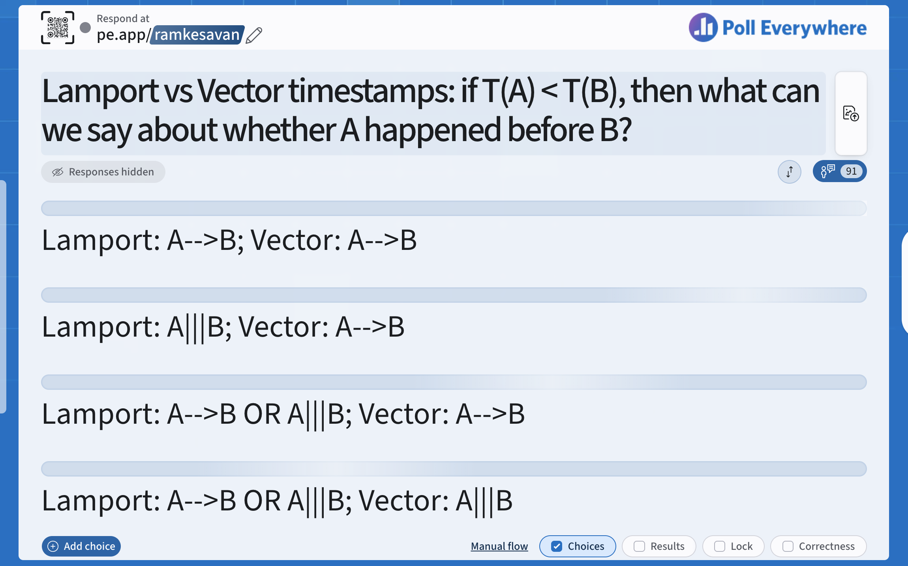
pe.app/ramkesavan
9

Slide 62
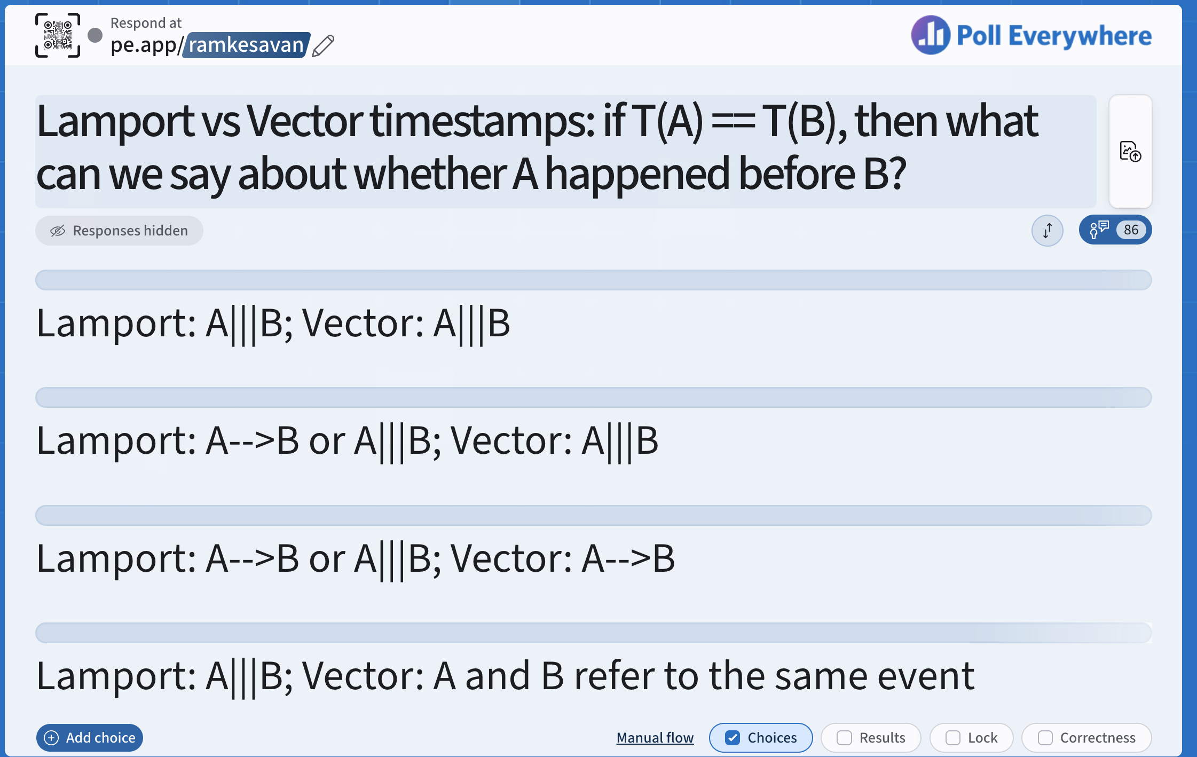
pe.app/ramkesavan
9

Slide 63
Logical Timestamps: Summary
Lamport timestamps
  Integer clocks assigned to events
  Obeys causality
  Cannot distinguish concurrent events
Vector timestamps
  Obey causality
  By using more space, can also identify concurrent events

Slide 64
Time and Ordering: Summary
Clocks are unsynchronized in an asynchronous distributed system
But need to order events, across processes!
Time synchronization
  Cristian’s algorithm
  NTP
  Berkeley algorithm (not in syllabus)
  But error a function of round-trip-time
Can avoid time sync altogether by instead assigning logical timestamps to events

