Slide 1
CS 425 / ECE 428
Distributed Systems
Fall 2026
Aishwarya Ganesan & Ram Kesavan
Lecture 11: KV Stores & Consistency Models
Ack: Indranil Gupta
All slides © IG

Slide 2
Announcements
HW2 due on Sunday 10/4 @11:59 pm US Central
  Solutions will be posted early next week
MP2 is being graded this week
HW1 grades released (see Piazza post)
In-class midterm Thursday 10/8
  Course webpage specifies the two rooms
  Make sure you’re in correct classroom for the midterm
  Piazza post with more details
  Practice mid-term released

Slide 3
Today’s Agenda: Finish up KV stores
Consistency Models
  Consistency vs. Availability tradeoff
    Cassandra: Availability over Consistency
    HBase: Consistency over Availability
Per-replica local storage (LSM-tree)
Start on Time/Ordering
3

Slide 4
Quick Recap: NoSQL & Cassandra
Convergence: scale-out & SQL-like ACID
  Traditional RDBMS: SQL, ACID, enterprise workloads
  Late ‘00s & ‘10s KV-stores: NoSQL, BASE, new workloads
Cassandra: distributed KV-store
  Replication: which replicas hold a key
  Writes & reads; Timestamps
CAP theorem
4
Notes:
ACID: atomicity, consistency, isolation, durability
BASE: basically available soft-state eventual consistency

Slide 5

Quick Recap: CAP Tradeoff
Consistency
A distributed storage system can achieve at most two of C, A, and P.
If partition-tolerance is a must-have, the choice is between consistency and availability
HBase, HyperTable,
BigTable, Spanner
RDBMSs
(non-replicated)
Partition-tolerance
Availability
Cassandra, Riak,
Dynamo, Voldemort
5
Notes:
Cassandra gives us eventual consistency

Slide 6
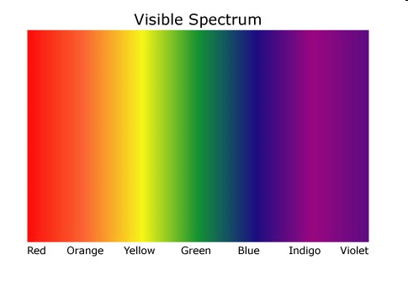
Consistency Spectrum
Weaker consistency
Faster reads and writes
Stronger consistency
Strong
(e.g., Linearizability,
Sequential)
Eventual
(Cassandra)
6
Notes:
We take the right-side edge of the triangle and explore that as a dimension; given that P is non-negotiable.
Fundamentally, it’s performance that’s being traded-off.

Slide 7
Consistency Models
Contract between distributed system and application
Dictates what results the system can return for operations
  Concurrent reads and writes by clients on replicas
  Depending on how operations are performed, guarantees offered by the distributed system differ
  Consistency model dictates what is permissible
System developer: design/optimize system to meet contract
Application developer: understand what contract means for application correctness
clients
system
7

Slide 8
Spectrum Ends: Eventual Consistency
Cassandra offers Eventual Consistency
  originally from Amazon’s Dynamo and LinkedIn’s Voldemort
If writes to a key stop, all replicas of key will converge
Reads might see any previous write
  weak guarantee
More performant – allows concurrent writes
More availability – disconnected operation
Need to resolve conflicts between multiple object versions
  Cassandra – latest timestamp wins
req
resp
C1
W(x=1)
W(x=2)
C2
R(x)=0
C3
R(x)=0
C4
8

Slide 9
Spectrum Ends: Strong Consistency
Linearizability [Herlihy and Wing]
Strong consistency (the C in CAP)
Intuitively, each operation by a client is visible instantaneously to other clients
  instantaneously in real time
All operations are totally ordered in a way that respects real-time order of operations
  if A completes before B begins, A ordered before B
  what if A and B are concurrent?
    order in a way such that total order is a valid sequential one
Appears to be a single machine (one-copy semantics)
Trades off performance and availability
C1
W(x=1)
W(x=2)
C2
R(x)
1
2
C3
R(x)
2
1/2
?
C4
9

Slide 10

Spectrum Ends: Strong Consistency
Models II
Suppose you have another R(x) at C3 after first R(x)=2. What should second R(x) return?
Can both reads, R(y) and R(x), return 0?
Sequential Consistency (Lamport):
  "... the result of any execution is the same as if the operations of all the processors were executed in some sequential order, and the operations of each individual processor appear in this sequence in the order specified by its program."
All operations are totally ordered
  total order respects local order of operations at clients
Sequential vs linearizability?
  sequential is weaker than linearizability (can have stale reads)
  but strong compared to many models
C1
W(x=1)
W(x=2)
C2
R(x)
2
C3
0/1/2
R(x)
?
C4
W(x=1)
1
0
R(y)
C1
W(y=1)
1
Must be 1 and
never 0
R(x)
?
C2
10

Slide 11
Consistency Spectrum
Faster reads and writes
Eventual
Sequential
Linearizable
More consistency
Linearizability is easy to program against, but can lead to low performance/availability
Eventual consistency is performant and leads to high availability, but hard to program against
There are a variety of options in between
9

Slide 12
Causal Consistency
No total order of operations
Avoids many inconsistencies that happen with eventual
Operations must respect partial order based on information flow or causality
  Operations from same client are causally related
  If client C1 does a write and a read at client C2 sees it, then these ops are causally related
  Transitive
W(x=1)
Causality, not messages
C1
R(x)1
W(y=1)
C2
R(x)
may return 0 or 1
R(y)1
R(x)
must
return 1
C3
Eventual
Causal
Sequential
Linearizable
10

Slide 13
Session-based Consistency Models
[Terry et al. 1994]
Does causal imply MR?
Monotonic reads (MR) – intuitively, reads cannot go back in time
if a client issues read R₁ and then R₂, R₂ must at least observe the state as of R₁
Monotonic writes (MW) – if a client issues write W₁ and then W₂, clients must see W₁ before W₂
Read my writes (RMW) – if a client issues W₁ and then R₁, R₁ must see the effects of W₁
MR
Eventual
MW
Causal
Sequential
Linearizable
RMW
11

Slide 14
Question
Consider the following sequence of events. Alice updates a post on social media. Alice calls Bob on his cell phone: “Check my social-media post!”. Bob reads Alice’s timeline. Under which of the consistency models can Bob be guaranteed to see Alice's post?
(a) Linearizability
(b) Read my writes
(c) Sequential consistency
(d) Under (a) and (c)
(e) All of the above

Slide 15
Newer Consistency Models
CRDTs (Commutative Replicated Data Types): Data structures for which commutated writes give same result [INRIA, France]
  E.g., value == int, and only op allowed is +1
  Guaranteed to eventually converge
  Effectively, servers don’t need to worry about consistency and conflict resolution
Red-blue Consistency: Rewrite client transactions to separate ops into red ops vs. blue ops [MPI-SWS Germany and others]
  Blue ops can be executed (commutated) in any order across DCs
  Red ops need to be executed in the same order at each DC
  Composite model: blue ops are eventually consistent and red ops are strongly consistent
13

Slide 16
Newer Consistency Models (Contd.)
Bounded staleness
  Guarantees that data lags at most by K versions or T time units
  User or app can set K or T on reads
Probabilistically Bounded Staleness (PBS)
  expected bounds on staleness with respect to both versions and time
  SLA-style consistency predictions
14

Slide 17
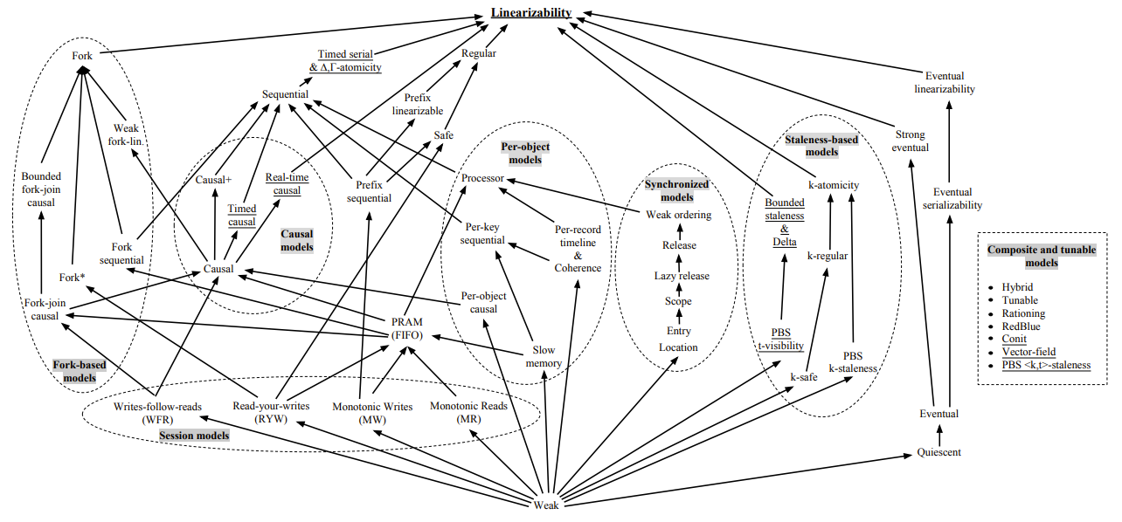
The Consistency Spectrum
[1] Viotti and Vukolic 2016
15

Slide 18
Which Consistency Model should you use?
Use the lowest consistency (to the left) consistency model that is “correct” for your application
  Gets you fastest availability
MR
Eventual
MW
Causal
Sequential
Linearizable
RMW
18

Slide 19
HBase
Google’s BigTable was first “blob-based” storage system
  Yahoo! Open-sourced it → HBase
  Still a major Apache project today
Facebook used HBase internally for a while
API functions
  Get/Put(row)
  Scan(row range, filter) – range queries
  MultiPut
Unlike Cassandra, HBase prefers consistency (over availability)
Watch Video in course webpage
19

Slide 20
pe.app/ramkesavan
9

Slide 21
Local Storage at Each Replica
Different ways of storing data: Big topic of file systems (423/523/598)
Storage write performance: random vs sequential
Historically, cloud-scale file systems have evolved into:
  Append-only files, immutable once they’re “closed”
  Files are deleted eventually
But workloads insert/modify/delete keys randomly across the key space
Need data structure that can absorb random writes to keys
  Log structured merge tree (LSM-tree)
21

Slide 22
Log Structured Merge-tree (LSM-tree)
On receiving a write
Record it on a write-ahead-log, aka WAL (for failure recovery)
Update Memtable
  In-memory data structure to store many key-value pairs
  Easily searched by key
  Write-back cache (as opposed to write-through)
Eventually written to persistent storage
  After which the log can be discarded
  As new files with a specific format (e.g. SSTables)
Used by many distributed systems: Cassandra, Hbase, Spanner, etc.
22

Slide 23
LSM animation – see additional slides

Slide 24
Writes at a replica node
What’s written to storage?
Whenever Memtable is full or old → flush to disk
Data File: An SSTable (Sorted String Table) – list of key-value pairs, sorted by key
  Other formats too
Each data file is immutable (once created, they don’t change)
Includes
  Indexes: key → location in data file
  Bloom filter (for efficient search) – next slide
24
Notes:
What does a photographer use to store their many photos of flowers? … A Bloom filter.

Slide 25
Bloom Filter
Compact way of representing a set of items
Checking for existence in set is cheap
Some probability of false positives: an item not in set may check true as being in set
Never false negatives
Large Bit Map
0
1
On insert, set all hashed bits.
On check-if-present,
return true if all hashed bits set.
False positives
False positive rate low
m=4 hash functions
100 items
3200 bits
FP rate = 0.02%
2
3
Hash1
Key-K
Hash2
.
.
69
Hashm
111
25
127
Notes:
What does a photographer use to store their many photos of flowers? … A Bloom filter.
Approximate Membership Query (AMQ) data structures,

Slide 26
Compaction
Data file (SSTables) accumulate over time:
Consumes storage
Many of the values of keys are stale; newer values have been written since
  Another level of complexity: <key, value, timestamp>
  System may want to retain some timestamped values
Compaction merges data files: fewer values per key
  Run periodically and locally at each server
26

Slide 27
Reads at a Replica
What if the false positive rate of Bloom filter is too high?
  Read consults Memtables first
  And then data files: from L0, L1, …until Ln
    Check if SSTable key range intersects
    If yes, check Bloom filter
      If no, repeat with the next level SSTable
    If yes, search Index to get position in SSTable
      If no, repeat with the next level SSTable (false +ve)
      If yes, read actual KV pair from SSTable
  Read may specify a timestamp:
    Youngest value of <key> before <timestamp>
27

Slide 28
Deletes
Delete: don’t delete item right away
Add a tombstone to the log and Memtable
  <Key:Tombstone:timestamp>
Eventually, when compaction merges values and encounters the tombstone it can delete the key
28

Slide 29
CS 425 / ECE 428
Distributed Systems
Fall 2026
HBase
All slides © IG

Slide 30
HBase
Google’s BigTable was first “blob-based” storage system
Yahoo! Open-sourced it → HBase
Major Apache project today
Facebook uses HBase internally
API functions
  Get/Put(row)
  Scan(row range, filter) – range queries
  MultiPut
Unlike Cassandra, HBase prefers consistency (over availability)
(Version of 2014)
30

Slide 31
HBase Architecture
Small group of servers running
Zab, a consensus protocol (Paxos-like)
Client
HMaster
Zookeeper
HRegionServer
HRegionServer
HLog
Hregion
Store
Store
MemStore
MemStore
StoreFile
StoreFile
StoreFile
StoreFile
. . .
. . .
…
. . .
…
HFile
HFile
HFile
HFile
HDFS
31

Slide 32
HBase Storage hierarchy
HBase Table
  Split it into multiple regions: replicated across servers
    ColumnFamily = subset of columns with similar query patterns
    One Store per combination of ColumnFamily + region
      Memstore for each Store: in-memory updates to Store; flushed to disk when full
        StoreFiles for each store for each region: where the data lives
        - HFile
HFile
  SSTable from Google’s BigTable
32

Slide 33
HFile
Data … Data … Metadata, file info, indices, and trailer
Magic (Key, value) (Key, value) … (Key, value)
Key Value Row Row Col Family Col Family Col Timestamp Key Value
length length length length Qualifier type
SSN:000-01-2345
Demographic
Information
Ethnicity
HBase Key
33

Slide 34
Strong Consistency: HBase Write-Ahead Log
Store
Client
HRegion
MemStore
2. (k1)
StoreFile
StoreFile
.
.
.
…
(k1, k2, k3, k4)
HFile
HFile
(k1, k2)
.
.
.
HRegionServer
Log flush
HRegion
(k3, k4)
1. (k1)
Store
MemStore
StoreFile
StoreFile
…
HFile
HFile
HLog
Write to HLog before writing to MemStore
Helps recover from failure by replaying Hlog.
34
Notes:
Hlog is an in-memory file, which is flushed periodically to disk. Hlog is a write-ahead log.

Slide 35
Log Replay
After recovery from failure, or upon bootup (HRegionServer/HMaster)
  Replay any stale logs (use timestamps to find out where the database is w.r.t. the logs)
  Replay: add edits to the MemStore
35

Slide 36
Cross-Datacenter Replication
Single “Leader” (“Master”) cluster
Other “Follower” (“Slave”) clusters replicate the same tables
Leader cluster synchronously sends HLogs over to follower clusters
Coordination among clusters is via Zookeeper
Zookeeper can be used like a file system to store control information
1. /hbase/replication/state
2. /hbase/replication/peers/<peer cluster number>
3. /hbase/replication/rs/<hlog>
36

