Slide 1
CS 425 / ECE 428
Distributed Systems
Fall 2026
Aishwarya Ganesan & Ram Kesavan
(Thanks to Indranil Gupta)
Lecture 1: Welcome, and Introduction
Aug 25, 2026
web: courses.engr.illinois.edu/cs425/

Slide 2
Course Staff
Instructors:
  (Aishwarya Ganesan): 3120 Siebel Center
  (Ram Kesavan): 3126 Siebel Center
  Office Hours Every Tue and Thu right after class until 4 pm – see website
TAs: (see course website for OH)
  Nishant Sheik (Lead TA)
    TAs for On-campus Students: Wei Zhang, Rafid Murshed, Tianyi Zhong, Weidong Wang, TBD
  Xinying Zheng (lead TA for MCS Coursera, and Deputy Lead TA)
    TAs for MCS Online Students: Parham Chavoshian, Soham Chakraborty, TBD
  All students (on-campus, Chicago, & Coursera) can access all TAs
More about course logistics later in this lecture…

Slide 3
What This Course is Really About
Distributed Systems
How to design algorithms for them
How to design these systems
How they work in real life
How to build real distributed systems
Notes:
Distributed Algos are very different from the algorithms that you’ve studied thus far.

Slide 4
Computer Science in the time of AI
Should I bother writing or debugging my MP code?
AI is a capability multiplier:
  But, 0 x 1000 = 0; if your understanding of concepts, systems, and algorithms is zero, then you’ll produce zero!
  AI is creating a bigger gulf between a highly capable + experienced engineer and the rest!
Prompts express intent, but true engineering is about trade-offs, performance, maintenance, and architectural taste.
If anything, knowing the fundamentals is even more important than before
  Requires deep engagement with the material
  Best gained by writing, reading, and debugging code
My recommendation: write and debug your MPs to better learn the fundamentals
  Use this time to learn. Learning on-the-job will be difficult—there’ll be no time
Notes:
I talk with ex-colleagues in the tech industry. They’re all senior to super-senior engineers with 20+ years of experience who are now more productive than they’ve ever been…they are thrilled because they can prototype & benchmark difficult solutions over a weekend with AI now. Previously, they would need a 2-3 weeks of time from a small team of junior devs to get that same information.
If the code breaks production, causes a security breach, or introduces technical debt, "the AI wrote it" is not an acceptable excuse. Engineers own every line they commit.

Slide 5
Definition
Define the Term Distributed System

Slide 6
What is an Operating System?

Slide 7
FOLDOC definition
(FOLDOC = Free On-Line Dictionary of Computing)
Operating System - The low-level software which handles peripheral hardware, schedules tasks, allocates storage, and presents a default interface to the user when no application program is running.

Slide 8
Can you name some examples of
Distributed Systems?

Slide 9
Can you name some examples of
Distributed Systems?
Client-Server (NFS)
The Web & the internet
IoT (Internet of Things) networks
DNS
Gnutella, BitTorrent, Blockchain (peer to peer overlay network)
“Cloud” service, from AWS, Microsoft Azure, Google Cloud, etc.
Datacenter, e.g., NCSA, a Google/AWS datacenter

Slide 10
What is a Distributed System?

Slide 11
How does Leslie Lamport define Distributed System?
(Leslie Lamport is considered by many to be the most prominent Distributed System Researcher)
“A distributed system is one in which the failure of a computer you didn't even know existed can render your own computer unusable.”
Notes:
Latex,

Slide 12
FOLDOC definition
A collection of (probably heterogeneous) automata whose distribution is transparent to the user so that the system appears as one local machine. This is in contrast to a network, where the user is aware that there are several machines, and their location, storage replication, load balancing and functionality is not transparent. Distributed systems usually use some kind of client-server organization.
Notes:
1. Alan Turing (Imitation Game): first used ”automaton” to describe the theoretical predecessor of the modern computer; later John von Neumann proposed Automata Theory
2. “Transparent”: means the opposite in English! ☺
Eg of the web: one site is up and another is down---CNN is down but ESPN is not.
P2P/blockchain don’t have client-server.

Slide 13
Textbook definitions
A distributed system is a collection of independent computers that appear to the users of the system as a single computer.
[Andrew Tanenbaum]
A distributed system is several computers doing something together. Thus, a distributed system has three primary characteristics: multiple computers, interconnections, and shared state.
[Michael Schroeder]
Notes:
Contradictions:
uh, doesn’t each computer need to know about a few other computers in the system (somewhere deep down there in the RAM)?
If computers don’t exchange any information and make no progress, would this count as a distributed system?

Slide 14
Unsatisfactory
Why are these definitions short?
Why do these definitions look inadequate to us?
Because we are interested in the insides of a distributed system
  Design and implementation
  Maintenance
  Algorithmics (“protocols” or “distributed algorithms”)
Notes:
We want to write a definition as a builder of a distributed system; not as a consumer.

Slide 15
A working definition for us
A distributed system is a collection of entities, each of which is autonomous, programmable, asynchronous and failure-prone, and which communicate through an unreliable communication medium.
Entity=a process on a device (PC, PDA/mobile device)
Communication Medium=Wired or wireless network
Our interest in distributed systems involves
  design and implementation, maintenance, algorithmics
Notes:
Designers and programmers interested in : algorithmics, maintenance.
(informal definition, for us programmers of distributed systems)
Clien—server model isn’t required. Ok: peer to peer systems

Slide 16
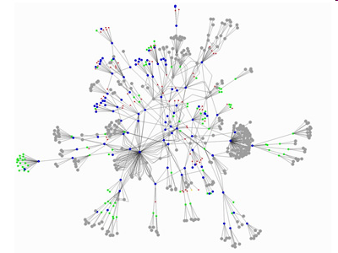
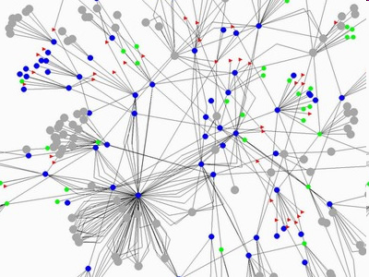
Gnutella Peer to Peer System
What are the “entities”
(nodes)?
What is the
communication medium
(links)?
Source: GnuMap Project

Slide 17
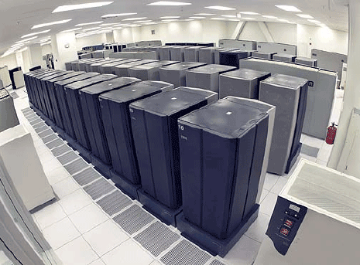
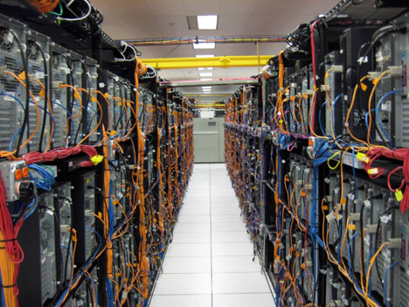
Datacenter
What are the “entities”
(nodes)?
What is the
communication medium
(links)?
Notes:
If you get a chance to tour the inside of a data center, grab it.

Slide 18
The Internet: A Refresher
Underlies many distributed systems
A vast interconnected collection of computer networks of many types
Intranets – subnetworks operated by companies and organizations
Intranets contain LANs (local area networks)
WAN – wide area networks, consists of subnets (intranets, LANs, etc.)
ISPs – Internet Service Providers. Companies that provide modem links and other types of connections to users
Intranets (actually the ISPs’ core routers) are linked by backbones – network links of large bandwidth, such as satellite connections, fiber optic cables, and other high-bandwidth circuits
UC2B, Google Fiber (MAN = Metropolitan Area Networks)
Notes:
Note: A distributed system may span a LAN, or intranet, or WAN, or the entire internet.
We talk about the internet because the most interesting/complex distributed systems span the internet.

Slide 19
An Intranet & a distributed system
Running over this Intranet is a distributed file system
prevents unauthorized messages from leaving/entering;
implemented by filtering incoming and outgoing messages
via firewall “rules” (configurable)
Notes:
Pic does not show mobile clients that come/go from these buildings.

Slide 20
Networking Stacks
Application
layer protocol
smtp [RFC 821]
telnet [RFC 854]
http [RFC 2068]
ftp [RFC 959]
proprietary
(e.g. RealNetworks)
NFS
proprietary
(e.g., Skype)
Underlying
transport protocol
TCP
TCP
TCP
TCP
TCP or UDP
TCP or UDP
typically UDP
Application
e-mail
remote terminal access
Web
file transfer
streaming multimedia
remote file server
internet telephony
Distributed System Protocols!
Networking Protocols
TCP=Transmission Control Protocol
UDP=User Datagram Protocol
(Implemented via sockets)

Slide 21
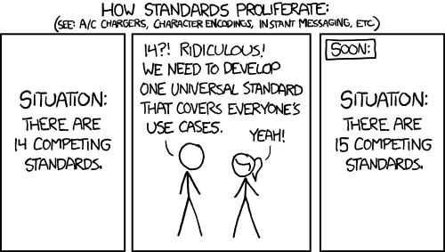
The History of internet Standards
Source: http://xkcd.com/927/

Slide 22
The Heart of the World Wide Web: the HTTP Standard
HTTP: hypertext transfer protocol
WWW’s application layer protocol
client/server model
  client: browser that requests, receives, and “displays” WWW objects
  server: WWW server, which is hosting the website, sends objects in response to requests
http1.0: RFC 1945
http1.1: RFC 2068
  Leverages same connection to download images, scripts, etc.
http request
PC running
Chrome
http response
http request
Server
Running
Apache
Web
server
http response
Mac running
Safari

Slide 23
The HTTP Protocol: More
http: TCP transport service:
client initiates a TCP connection (creates socket) to server, port 80
server accepts the TCP connection from client
http messages (application-layer protocol messages) exchanged between browser (http client) and WWW server (http server)
TCP connection closed
http is “stateless”
server maintains no information about past client requests
Why?
Protocols that maintain session “state” are complex!
past history (state) must be maintained and updated.
if server/client crashes, their views of “state” may be inconsistent, and hence must be reconciled.
RESTful protocols are stateless.

Slide 24
Does our Working Definition work for the http
Web?
A distributed system is a collection of entities, each of which is autonomous, programmable, asynchronous and failure-prone, and that communicate through an unreliable communication medium.
Entity=a process on a device (PC, PDA)
Communication Medium=Wired or wireless network
Our interest in distributed systems involves
  design and implementation, maintenance, study, algorithmics

Slide 25
Important Distributed Systems Issues
No global clock; no single global notion of the correct time
  (asynchrony)
Unpredictable failures of components (failure-prone, unreliable)
  Fail-stop failures (or sometimes recover after failing)
  Lack of response may be due to either failure of a network component, network path being down, or a computer crash – challenging
Highly variable bandwidth: from 16Kbps (slow modems) to Gbps (Internet2) to Tbps (in between DCs of same big company)
Possibly large and variable latency: few ms to several seconds
Large numbers of hosts: 2 to several million

Slide 26
Many Interesting Design Problems
Real distributed systems
  Cloud Computing, Peer to peer systems, Hadoop, key-value stores/NoSQL, distributed file systems, graph processing, stream processing, machine learning …
Classical Problems (Distributed algorithms)
  Failure detection, Asynchrony, Snapshots, Multicast, Consensus, Mutual Exclusion, Election, …
Concurrency
  RPCs, Concurrency Control, Replication Control, Paxos, Raft…
Security
  ACLs, Capabilities, …
Others…

Slide 27
Typical Distributed Systems Design Goals
Heterogeneity – can the system handle a large variety of types of machines and devices?
Robustness – is the system resilient to host crashes and failures, and to the network dropping messages?
Availability – are data+services always there for clients?
Transparency – can the system hide its internal workings from the users? (warning: term means the opposite of what the name implies!)
Concurrency – can the server handle multiple clients simultaneously?
Efficiency – is the service fast enough? Does it utilize 100% of all resources?
Scalability – can it handle 100 million nodes without degrading service? (nodes=clients and/or servers) How about 6 B? More?
Security – can the system withstand hacker attacks?
Openness – is the system extensible?

Slide 28
“Important” Issues
If you’re already complaining that the list of topics we’ve discussed so far has been perplexing…
  You’re right!
  It was meant to be (perplexing)
The Goal for the Rest of the Course: see enough examples and learn enough concepts so these topics and issues will make sense
  We will revisit many of these slides in the very last lecture!

Slide 29
“Concepts”?
Which of the following inventions do you think is the most important?
  Car
  Wheel
  Bicycle
“What lies beneath?” Concepts!

Slide 30
How will We Learn?
All this information is contained in handout on course website: “Syllabus/Course Information Sheet/”
Web: courses.engr.illinois.edu/cs425/
Lectures
  In-class activities (incl. quizzes)
  Mediaspace recordings for review
Textbook, Recommended but not Required
  Colouris, Dollimore, Kindberg and Blair (5th edition). CDK Textbook
  If you use a different or older version, be sure to check problem numbers, etc.
  Textbook is a great source of practice problems for the exams (midterm and final)

Slide 31
How will We Learn? (2)
This information is in “Syllabus” handout on course website (read carefully!)
Web: courses.engr.illinois.edu/cs425/
Homeworks (HWs)
Machine Programming Assignments (MPs)
Exams/quizzes

Slide 32
How will We Learn? (2)
This information is in “Syllabus” handout on course website (read carefully!)
Web: courses.engr.illinois.edu/cs425/
Homeworks (HWs)
  Four in total, two before midterm (early-Oct) and two after
  About 2-3 weeks per homework
  Solutions need to be typed, figures can be hand-drawn
  Best 3/4 policy
Machine Programming Assignments(MPs)
Exams/quizzes

Slide 33
How will We Learn? (2)
This information is in “Syllabus” handout on course website (read carefully!)
Web: courses.engr.illinois.edu/cs425/
Homeworks (HWs)
Machine Programming Assignments(MPs)
  Only for 4credit on-campus/Chicago (others welcome to try; no VMs/grading/extra credit)
  You will be building a distributed (surprise!) processing system in stages
  Four in total, two before midterm and two after
  Demo dates set on website: please be in town on those days (no excuses for interviews, travel.)
  No LLM/coding agents for MP1 and MP2
    For MP3/MP4, we plan to allow but strict guidelines on how (e.g., you will submit traces)
    In-person demos will include questions about your code
Exams/quizzes

Slide 34
How will We Learn? (2)
This information is in “Syllabus” handout on course website (read carefully!)
Web: courses.engr.illinois.edu/cs425/
Homeworks (HWs)
Machine Programming Assignments(MPs)
Exams/quizzes
  Midterm in class (Oct 8th)
  Final in person (date decided by campus)
  In-class quizzes/activities
    Score is ignored but your participation will be recorded
    5 points in your final grade

Slide 35
What will the schedule look like?
Web: courses.engr.illinois.edu/cs425/
Check schedule on web
Tentative:
  Lectures
Final:
  HW due dates
  MP demos (in-person)
  Midterm in class (Oct 8th)
TBA
  Final (campus sets the date)

Slide 36
What assistance is available to you?
Lectures
  Lecture slides will be placed online at course website
    “Tentative” version before lecture
    “Final” version after lecture
    Ask questions during and after lecture
Asking Questions outside lectures:
In order of preference:
  Piazza: Your first stop for all questions (see if your question has already been asked)
    We will try to ensure that every question is answered within 24 hours of posting (during weekdays).
    Students can answer other students' Qs, but to do so respectfully
    Do not post solutions or code on Piazza – that’ll immediately earn you a zero on the HW/MP.
  Office Hours (posted on course website): Every weekday has multiple office hours scheduled, including evenings.
  Email staff mailing list (don’t email individual instructor/TA except for private issues)

Slide 37
What tools will we use?
All links are posted on website. Signup by today!
Gradescope: You one-stop shop to submit all HWs and all MP reports
Piazza: Your first stop for all questions and important announcements
Canvas: We will post all your final HW, MP, and exam grades here
(4cr students)
  Google Apps: For MP group signups, MP(1-4) demo signups, MP(1-4) repo link submissions
  GitHub: For MP code repositories
  MP group signup link posted
  Others will be posted as we progress…

Slide 38
What tools will we use? (2)
New this year…
For in-class activities: Acadly
  https://app.acadly.com/auth/signup/student
  Enter Illinois email address
  Use code: ZHXVAN
  Signup by next class

Slide 39
Course Prerequisites
Credit or concurrent enrollment in one of CS 240/241/340/341,
or ECE 391,
or equivalent OS/networking course
(latter need instructor permission)
Please fill survey by 9/1: https://forms.illinois.edu/chooseAuth/165568737

Slide 40
Individual vs. Group Work
Homeworks
  Individual work only. All work must be your own.
MPs
  In groups of 2
  Within group: Can discuss everything.
  Outside group (e.g., on Piazza): can only discuss concepts and question (but not solution)
For both HWs and MPs
  You can discuss with others (and course staff) lecture concepts and the HW/MP question/spec itself, but you cannot discuss solutions or even ideas.
  You cannot copy solutions/code or look at someone else’s solutions: we check with Moss, etc.
  No use of AI permitted (you will get wrong solutions, and you won’t know it)
First violation: zero on HW/MP. Second violation: F in course. (Both have happened in the past!)

Slide 41
Course Staff
Instructors:
  (Aishwarya Ganesan): 3120 Siebel Center
  (Ram Kesavan): 3126 Siebel Center
  Office Hours Every Tue and Thu right after class until 4 pm – see website
TAs: (see course website for OH)
  Nishant Sheik (Lead TA)
    TAs for On-campus Students: Wei Zhang, Rafid Murshed, Tianyi Zhong, TBD
  Xinying Zheng (lead TA for MCS Coursera, and Deputy Lead TA)
    TAs for MCS Online Students: Parham Chavoshian, Soham Chakraborty, TBD
  All students (on-campus & MCS Coursera) can access all TAs

Slide 42
Speaking of HWs and MPs
MPs (4 cr only):
  MP demos in-person (not online), and the demo dates are posted to website. So please plan ahead!
  MP1 has been released
  Must form groups and let us know your group by Monday 8/31 @ 5 pm.
    If you don’t meet this deadline, you won’t get VMs to do your MP!
    Submit form and not e-mail (see course website for instructions)
  You can start on MP1 right away (don’t need lectures for it)
HWs:
  HW1 releases this Thursday
Don’t worry – you have time, but start early! Start now
  Due in about 2-3 weeks
  MP1 due 9/13 (demos on 9/14)
  HW1 will be due 9/20 after we release it this Thursday

Slide 43
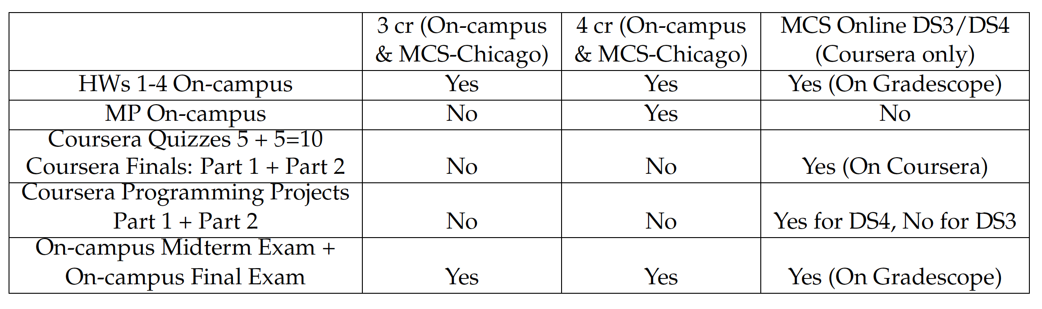
3 cr vs 4 cr vs MCS Coursera
+ Pop-up in-class Quizzes for on-campus

Slide 44
Wrap-Up
(Reading for today’s lecture: Relevant parts of Chapter 1)
All students:
  Go to course website https://courses.engr.illinois.edu/cs425/
  Todos:
    (All) Sign up for Piazza, Gradescope, Acadly by today!
    (4 cr) Form MP group by this week and respond to MP group survey. You can use Piazza “Search for Teammates”, or just hang around after class today.
    (All) Fill out Student Survey sheet by this week
  Not yet registered?
    We cannot allow “double booking” with CS425 and another class at same time
    No waitlist, continue to do all the HWs, (MPs if 4 cr).
    Usually we get everyone in by end of September (no guarantees though!).

