Slide 1
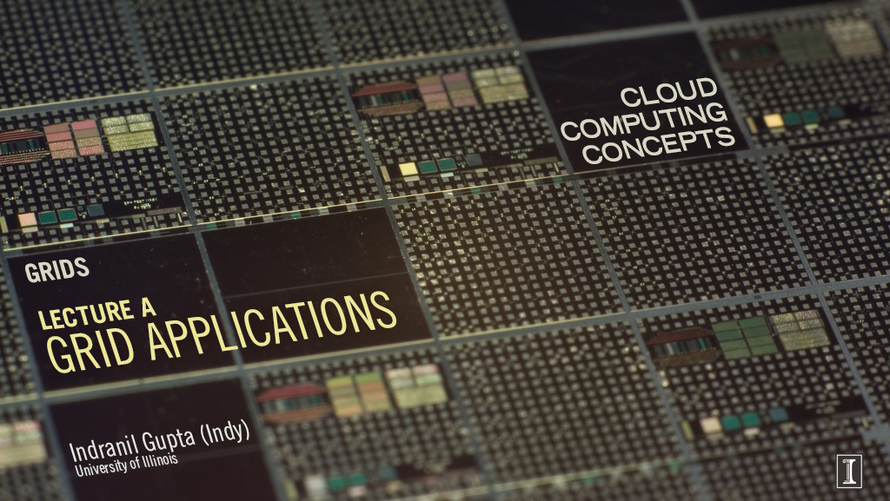

Slide 2
Example: Rapid Atmospheric Modeling System, ColoState U
Hurricane Georges, 17 days in Sept 1998
  “RAMS modeled the mesoscale convective complex that dropped so much rain, in good agreement with recorded data”
  Used 5 km spacing instead of the usual 10 km
  Ran on 256+ processors
Computation-intenstive computing (or HPC = High Performance Computing)
Can one run such a program without access to a supercomputer?

Slide 3
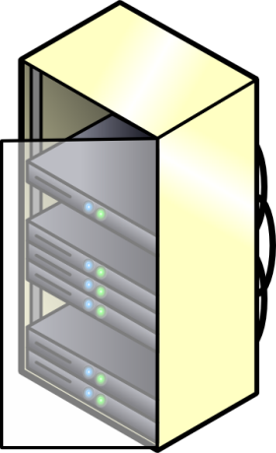
Distributed Computing Resources
Wisconsin
NCSA
MIT

Slide 4

An Application Coded by a Physicist/Biologist/Meterologist
Job 0
Output files of Job 0
Input to Job 2
Job 1
Job 2
Jobs 1 and 2 can be concurrent
Job 3
Output files of Job 2
Input to Job 3

Slide 5
An Application Coded by a Physicist/Biologist/Meterologist
Output files of Job 0
Input to Job 2
Several GBs
May take several hours/days
4 stages of a job
  Init
  Stage in
  Execute
  Stage out
  Publish
Computation Intensive,
so Massively Parallel
Job 2
Output files of Job 2
Input to Job 3

Slide 6
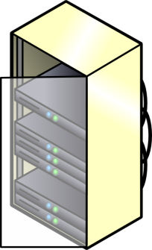
Next: Scheduling Problem
Wisconsin
Job 0
Job 1
Job 2
Allocation? Scheduling?
Job 3
NCSA
MIT

Slide 7


Slide 8
Scheduling Problem
Wisconsin
Job 0
Job 1
Job 2
Allocation? Scheduling?
Job 3
NCSA
MIT

Slide 9
2-level Scheduling Infrastructure
Wisconsin
Job 0
HTCondor Protocol
Job 1
Job 2
Job 3
Globus Protocol
NCSA
MIT
Some other Intra-site Protocol
9

Slide 10
Intra-site Protocol
HTCondor Protocol
Wisconsin
Job 3
Job 0
Internal Allocation & Scheduling
Monitoring
Distribution and Publishing of Files

Slide 11
Condor (now HTCondor)
High-throughput computing system from U. Wisconsin Madison
Belongs to a class of Cycle-scavenging systems
Such systems
Run on a lot of workstations
When workstation is free, ask site’s central server (or Globus) for tasks
If user hits a keystroke or mouse click, stop task
  Either kill task or ask server to reschedule task
Can also run on dedicated machines

Slide 12
Inter-site Protocol
Wisconsin
Job 3
Job 0
Internal structure of different
sites may be
transparent (invisible) to Globus
Globus Protocol
Job 1
NCSA
MIT
Job 2
External Allocation & Scheduling
Stage in & Stage out of Files

Slide 13
Globus
Globus Alliance involves universities, national US research labs, and some companies
Standardized several things, especially software tools
Separately, but related: Open Grid Forum
Globus Alliance has developed the Globus Toolkit
  http://toolkit.globus.org/toolkit/

Slide 14
Globus Toolkit
Open-source
Consists of several components
  GridFTP: Wide-area transfer of bulk data
  GRAM5 (Grid Resource Allocation Manager): submit, locate, cancel, and manage jobs
    Not a scheduler
    Globus communicates with the schedulers in intra-site protocols like HTCondor or Portable Batch System (PBS)
  RLS (Replica Location Service): Naming service that translates from a file/dir name to a target location (or another file/dir name)
  Libraries like XIO to provide a standard API for all Grid IO functionalities
  Grid Security Infrastructure (GSI)

Slide 15
Security Issues
Important in Grids because they are federated, i.e., no single entity controls the entire infrastructure
Single sign-on: collective job set should require once-only user authentication
Mapping to local security mechanisms: some sites use Kerberos, others using Unix
Delegation: credentials to access resources inherited by subcomputations, e.g., job 0 to job 1
Community authorization: e.g., third-party authentication
These are also important in clouds, but less so because clouds are typically run under a central control
In clouds the focus is on failures, scale, on-demand nature

Slide 16
Summary
Grid computing focuses on computation-intensive computing (HPC)
Though often federated, architecture and key concepts have a lot in common with that of clouds
Are Grids/HPC converging towards clouds?
  E.g., Compare OpenStack and Globus

