Slide 1
Byzantine Fault Tolerance
CS 425: Distributed Systems
Fall 2010
Presented By: Imranul Hoque

Slide 2
Reading List
L. Lamport, R. Shostak, M. Pease, “The Byzantine Generals Problem,” ACM ToPLaS 1982.
M. Castro and B. Liskov, “Practical Byzantine Fault Tolerance,” OSDI 1999.

Slide 3
Problem
Computer systems provide crucial services
Computer systems fail
  Crash-stop failure
  Crash-recovery failure
  Byzantine failure
Example: natural disaster, malicious attack, hardware failure, software bug, etc.
Need highly available service
Replicate to increase availability

Slide 4

Byzantine Generals Problem
All loyal generals decide upon the same plan
A small number of traitors can’t cause the loyal generals to adopt a bad plan
Attack
Attack/Retreat
Attack
Retreat
Attack/Retreat
Solvable if more than two-third of the generals are loyal

Slide 5
Practical Byzantine Fault Tolerance
Before PBFT: BFT was considered too impractical in practice
Practical replication algorithm
  Weak assumption (BFT, asynchronous)
  Good performance
Implementation
  BFT: A generic replication toolkit
  BFS: A replicated file system
Performance evaluation
Byzantine Fault Tolerance in Asynchronous Environment

Slide 6

Challenges
Request A
Request B
Client
Client

Slide 7
Challenges
Client
Client
1: Request A
2: Request B
Notes:
Operations are deterministic
Replicas start in the same state

Slide 8
State Machine Replication
Client
Client
How to assign sequence number to requests?
1: Request A
1: Request A
1: Request A
1: Request A
2: Request B
2: Request B
2: Request B
2: Request B

Slide 9
Primary Backup Mechanism
Client
Client
What if the primary is faulty?
Agreeing on sequence number
Agreeing on changing the primary (view change)
1: Request A
2: Request B
View 0

Slide 10
Agreement
Certificate: set of messages from a quorum
Algorithm steps are justified by certificates
Quorums have at least 2f + 1 replicas
Quorum A
Quorum B
Quorums intersect in at least one correct replica

Slide 11
Algorithm Components
Normal case operation
View changes
Garbage collection
State transfer
Recovery
All have to be designed to work together

Slide 12
Normal Case Operation
Three phase algorithm:
  PRE-PREPARE picks order of requests
  PREPARE ensures order within views
  COMMIT ensures order across views
Replicas remember messages in log
Messages are authenticated
  {.}_{σk} denotes a message sent by k
Quadratic message exchange

Slide 13
Pre-prepare Phase
Request: m
{PRE-PREPARE, v, n, m}_{σ0}
Primary: Replica 0
Replica 1
Replica 2
Fail
Replica 3

Slide 14
Prepare Phase
Request: m
PRE-PREPARE
Primary: Replica 0
Replica 1
Replica 2
Fail
Replica 3
Accepted PRE-PREPARE

Slide 15
Prepare Phase
Request: m
PRE-PREPARE
Primary: Replica 0
{PREPARE, v, n, D(m), 1}_{σ1}
Replica 1
Replica 2
Fail
Replica 3
Accepted PRE-PREPARE

Slide 16
Prepare Phase
Request: m
Collect PRE-PREPARE + 2f matching PREPARE
PRE-PREPARE
Primary: Replica 0
{PREPARE, v, n, D(m), 1}_{σ1}
Replica 1
Replica 2
Fail
Replica 3
Accepted PRE-PREPARE

Slide 17
Commit Phase
Request: m
PRE-PREPARE
PREPARE
Primary: Replica 0
Replica 1
{COMMIT, v, n, D(m)}_{σ2}
Replica 2
Fail
Replica 3

Slide 18
Commit Phase (2)
Request: m
Collect 2f+1 matching COMMIT: execute and reply
PRE-PREPARE
PREPARE
COMMIT
Primary: Replica 0
Replica 1
Replica 2
Fail
Replica 3

Slide 19
View Change
Provide liveness when primary fails
  Timeouts trigger view changes
  Select new primary (= view number mod 3f+1)
Brief protocol
  Replicas send VIEW-CHANGE message along with the requests they prepared so far
  New primary collects 2f+1 VIEW-CHANGE messages
  Constructs information about committed requests in previous views

Slide 20
View Change Safety
Goal: No two different committed request with same sequence number across views
Quorum for Committed Certificate (m, v, n)
View Change
Quorum
At least one correct replica has
Prepared Certificate (m, v, n)

Slide 21
Recovery
Corrective measure for faulty replicas
  Proactive and frequent recovery
  All replicas can fail if at most f fail in a window
System administrator performs recovery, or
Automatic recovery from network attacks
  Secure co-processor
  Read-only memory
  Watchdog timer
Clients will not get reply if more than f replicas are recovering

Slide 22
Sketch of Recovery Protocol
Save state
Reboot with correct code and restore state
  Replica has correct code without losing state
Change keys for incoming messages
  Prevent attacker from impersonating others
Send recovery request r
  Others change incoming keys when r execute
Check state and fetch out-of-date or corrupt items
  Replica has correct up-to-date state

Slide 23
Optimizations
Replying with digest
Separate request transmission
Request batching
Optimistic execution

Slide 24
Performance
Andrew benchmark
  Andrew100 and Andrew500
4 machines: 600 MHz, Pentium III
3 Systems
  BFS: based on BFT
  NO-REP: BFS without replication
  NFS: NFS-V2 implementation in Linux
No experiment with faulty replicas
Scalability issue: only 4 & 7 replicas

Slide 25
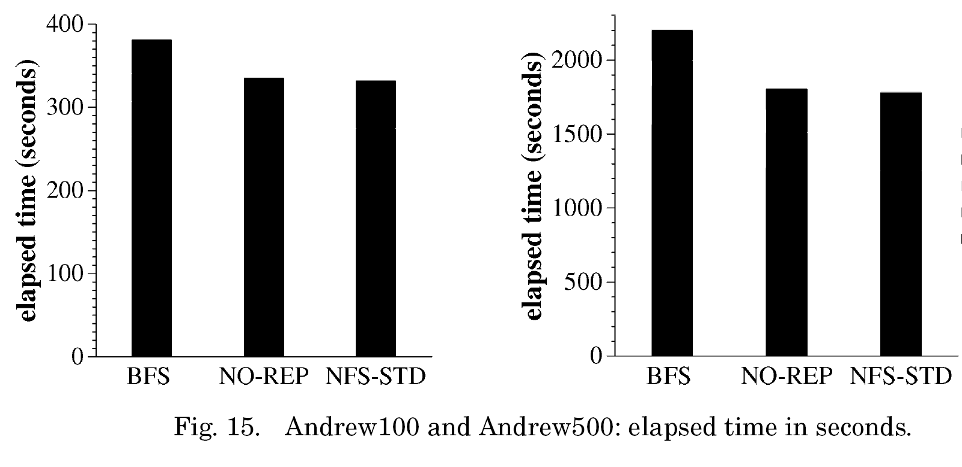
Benchmark Results (w/o PR)
Without view change and faulty replica!
Notes:
Although they have some data on view change time – that’s artificial view change!

Slide 26
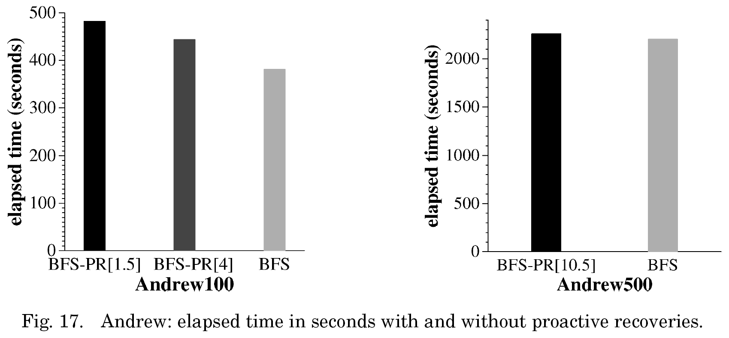
Benchmark Results (with PR)
Recovery Period
Recovery is staggered!

Slide 27
Related Works

Slide 28
Questions?

