Slide 1
Programming Languages and Compilers (CS 421)
William Mansky
http://courses.engr.illinois.edu/cs421/
Based in part on slides by Mattox Beckman, as updated by Vikram Adve, Gul Agha, Elsa Gunter, and Dennis Griffith

Slide 2
Untyped λ-Calculus
Only three kinds of expressions:
  Variables: x, y, z, w, …
  Abstraction: λ x. e
  Application: e₁ e₂
  What if we want something more complicated? bools? ints? ADTs?

Slide 3
Representing Data Structures (Enums)
Suppose τ is an enumeration type with n constructors: C₁, …, C_{n} (no arguments)
Represent each term as an abstraction:
C_{i} → λ x₁ … x_{n}. x_{i}
Idea: take as arguments what to return in each case (as in match statement), and return the case for the i'th constructor
Functional (“extensional”) description of the enumeration

Slide 4
How to Represent Booleans
bool = True | False
True → λ x₁ x₂. x₁ ≡_{α} λ x. λ y. x
False → λ x₁ x₂. x₂ ≡_{α} λ x. λ y. y
Notes:
λ x₁ … x_{n}. e means λ x₁. … λx_{n}. e
  application is left-associative

Slide 5
Functions over Enumeration Types
Write a “match” function
match e with C₁ -> x₁
| …
| C_{n} -> x_{n}
→ λ x₁ … x_{n} e. e x₁…x_{n}
Idea: take as arguments what to do in each case and a case, and return the result of applying that case

Slide 6
Functions over Enumeration Types
type τ = C₁ | … | C_{n}
match e with C₁ -> x₁
| …
| C_{n} -> x_{n}
match_{τ} = λ x₁ … x_{n} e. e x₁…x_{n}
e = expression (single constructor)
x_{i} is returned if e = C_{i}

Slide 7
match for Booleans
bool = True | False
True → λ x₁ x₂. x₁ ≡_{α} λ x y. x
False → λ x₁ x₂. x₂ ≡_{α} λ x y. y
match_{bool} = ?

Slide 8
match for Booleans
bool = True | False
True → λ x₁ x₂. x₁ ≡_{α} λ x y. x
False → λ x₁ x₂. x₂ ≡_{α} λ x y. y
match_{bool} = λ x₁ x₂ e. e x₁ x₂
≡_{α} λ x y b. b x y

Slide 9
How to Write Functions over Booleans
if b then x₁ else x₂ =
match b with True -> x₁ | False -> x₂ →
match_{bool} x₁ x₂ b =
(λ x₁ x₂ b . b x₁ x₂ ) x₁ x₂ b = b x₁ x₂
if_then_else
≡ λ b x₁ x₂. (match_{bool} x₁ x₂ b)
= λ b x₁ x₂. (λ x₁ x₂ b . b x₁ x₂ ) x₁ x₂ b
= λ b x₁ x₂. b x₁ x₂

Slide 10
Encoded Boolean Function
not b
= match b with True -> False | False -> True
→ (match_{bool}) False True b
= (λ x₁ x₂ b . b x₁ x₂) (λ x y. y) (λ x y. x) b
= b (λ x y. y) (λ x y. x) (“b False True”)
not ≡ λ b. b (λ x y. y) (λ x y. x)
How about and, or?

Slide 11
and or

Slide 12
Representing Data Structures (Unions)
Suppose τ is a type with n constructors: type τ = C₁ t₁₁ … t_{1k} | … | C_{n} t_{n1} … t_{nm}
Represent each term as an abstraction:
C_{i} t_{i1} … t_{ij} → λ x₁ … x_{n}. x_{i} t_{i1} … t_{ij}
C_{i} → λ t_{i1} … t_{ij} x₁ … x_{n}. x_{i} t_{i1} … t_{ij}
Idea: you need to give each constructor its arguments first; then it acts like an enumeration

Slide 13
How to Represent Pairs
Pair has one constructor (comma) that takes two arguments
type (α,β)pair = (,) α β
(a , b) → λ x. x a b
(,) → λ a b x. x a b

Slide 14
Functions over Union Types
Write a “match” function
match e with C₁ y₁ … y_{m1} -> f₁ y₁ … y_{m1}
| …
| C_{n} y₁ … y_{mn} -> f_{n} y₁ … y_{mn}
match_{τ} → λ f₁ … f_{n} e. e f₁…f_{n}
Idea: take as arguments a function for each case and a case, and return the result of applying that case, i.e., applying the appropriate function to the data of the case

Slide 15
Functions over Pairs
match_{pair =} λ f p. p f
fst p = match p with (x,y) -> x
fst → λ p. match_{pair} (λ x y. x)
= (λ f p. p f) (λ x y. x) = λ p. p (λ x y. x)
snd → λ p. p (λ x y. y)
fst (a, b) → ?

Slide 16
Functions over Pairs
match_{pair =} λ f p. p f
fst p = match p with (x,y) -> x
fst → λ p. match_{pair} (λ x y. x)
= (λ f p. p f) (λ x y. x) = λ p. p (λ x y. x)
snd → λ p. p (λ x y. y)
fst (a, b) → (λ p. p (λ x y. x)) (λ x. x a b)

Slide 17
Functions over Pairs
match_{pair =} λ f p. p f
fst p = match p with (x,y) -> x
fst → λ p. match_{pair} (λ x y. x)
= (λ f p. p f) (λ x y. x) = λ p. p (λ x y. x)
snd → λ p. p (λ x y. y)
fst (a, b) → (λ p. p (λ x y. x)) (λ x. x a b) =
(λ x. x a b) (λ x y. x) = (λ x y. x) a b = a

Slide 18
Representing Data Structures (Recursion)
Suppose τ is a type with n constructors:
type τ = C₁ t₁₁ … t_{1k} | … | C_{n} t_{n1} … t_{nm}
Suppose t_{ih} = τ (i.e. is recursive)
In place of a value t_{ih} have a function to compute the recursive value r_{ih} x₁ … x_{n}
C_{i} t_{i1} … r_{ih} …t_{ij} → λ x₁ … x_{n}. x_{i} t_{i1} … (r_{ih} x₁ … x_{n}) … t_{ij}
C_{i} → λ t_{i1} … r_{ih} … t_{ij} x₁ … x_{n}. x_{i} t_{i1} … (r_{ih} x₁ … x_{n}) … t_{ij}

Slide 19
How to Represent Natural Numbers
nat → Suc nat | 0
Suc → λ n f x. f (n f x)
Suc n → λ f x. f (n f x)
0 → λ f x. x
This representation is called Church Numerals

Slide 20
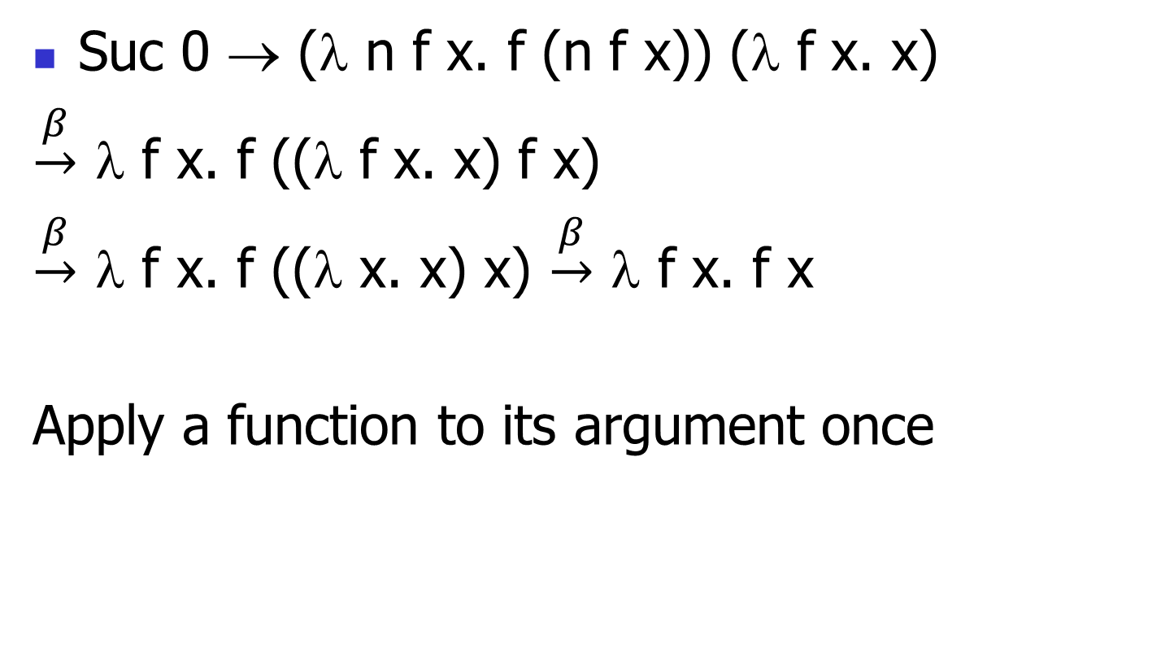
Some Church Numerals
Suc 0 → (λ n f x. f (n f x)) (λ f x. x)
$\underset{→}{β}$ λ f x. f ((λ f x. x) f x)
$\underset{→}{β}$ λ f x. f ((λ x. x) x) $\underset{→}{β}$ λ f x. f x
Apply a function to its argument once

Slide 21
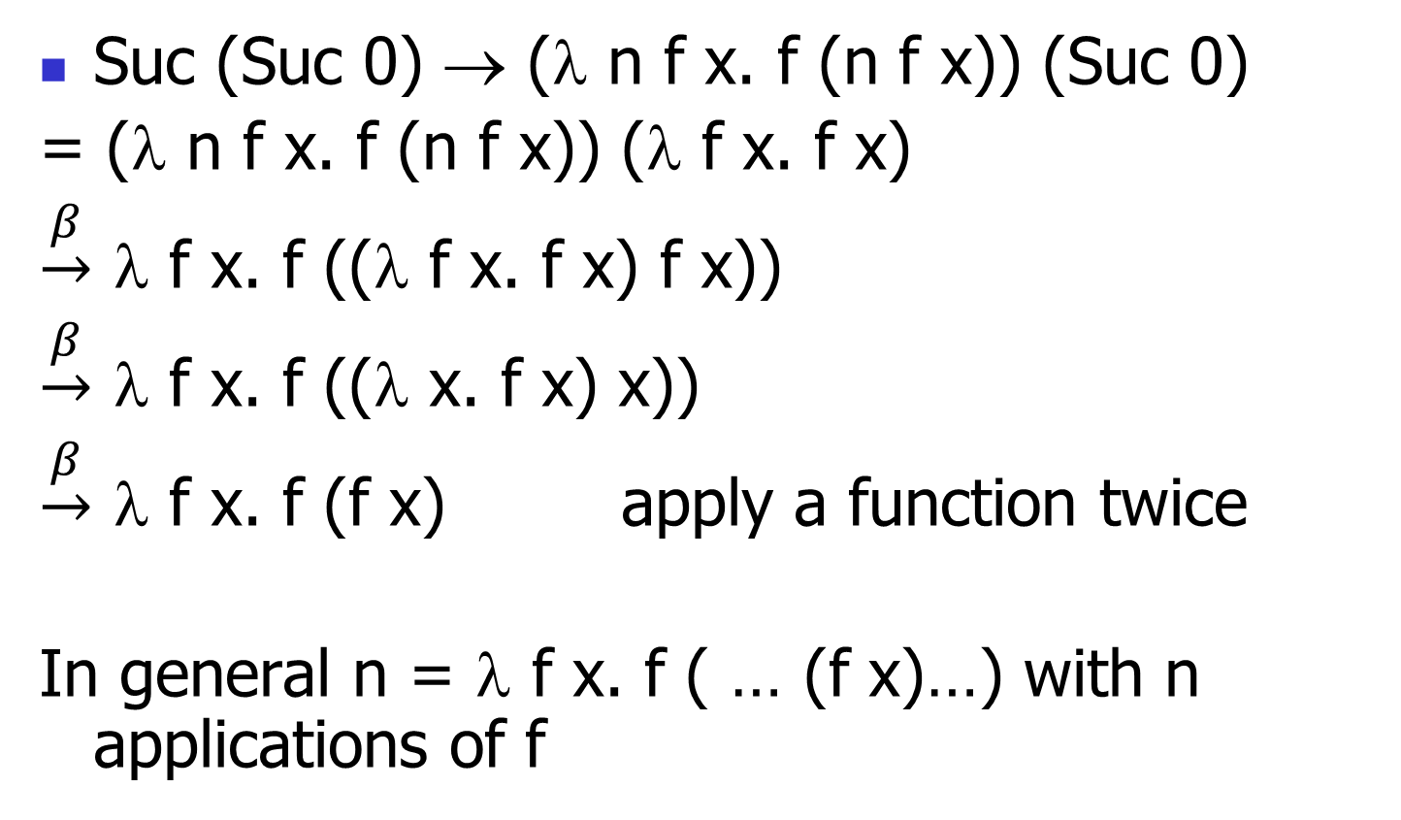
Some Church Numerals
Suc (Suc 0) → (λ n f x. f (n f x)) (Suc 0)
= (λ n f x. f (n f x)) (λ f x. f x)
$\underset{→}{β}$ λ f x. f ((λ f x. f x) f x))
$\underset{→}{β}$ λ f x. f ((λ x. f x) x))
$\underset{→}{β}$ λ f x. f (f x) apply a function twice
In general n = λ f x. f ( … (f x)…) with n applications of f

Slide 22
Primitive Recursive Functions
Write a “fold” function
fold f₁ … f_{n} = match e
with C₁ y₁ … y_{m1} -> f₁ y₁ … y_{m1}
| …
| C_{i} y₁ … r_{ij} …y_{in} -> f_{n} y₁ … (fold f₁ … f_{n} r_{ij}) … y_{mn}
| …
| C_{n} y₁ … y_{mn} -> f_{n} y₁ … y_{mn}
fold_{τ} → λ f₁ … f_{n} e. e f₁ … f_{n}
match in non-recursive case a simple version of fold

Slide 23
Primitive Recursion over Nat
fold f z n =
match n with 0 -> z
| Suc m -> f (fold f z m)
fold → λ f z n. n f z
is_zero n → fold (λ r. False) True n

Slide 24
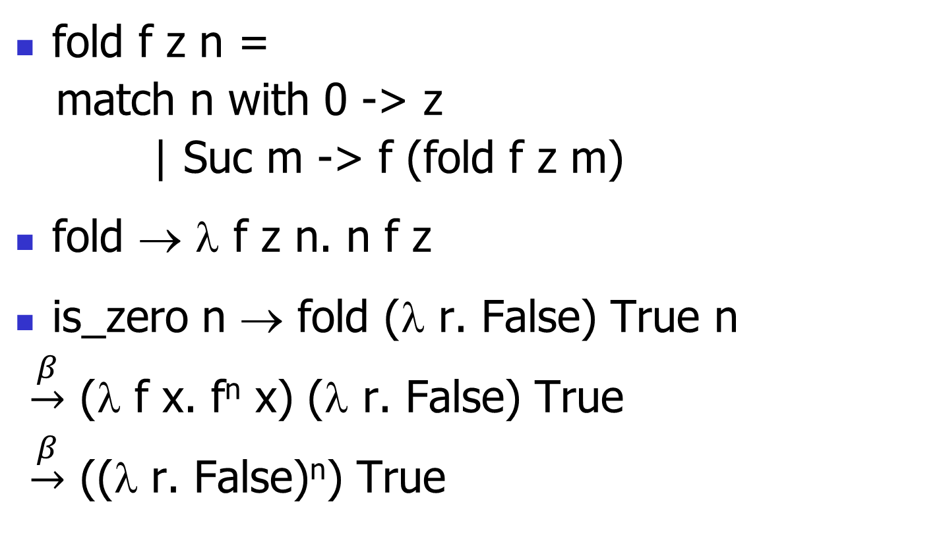
Primitive Recursion over Nat
fold f z n =
match n with 0 -> z
| Suc m -> f (fold f z m)
fold → λ f z n. n f z
is_zero n → fold (λ r. False) True n
$\underset{→}{β}$ (λ f x. f^{n} x) (λ r. False) True
$\underset{→}{β}$ ((λ r. False)^{n}) True

Slide 25
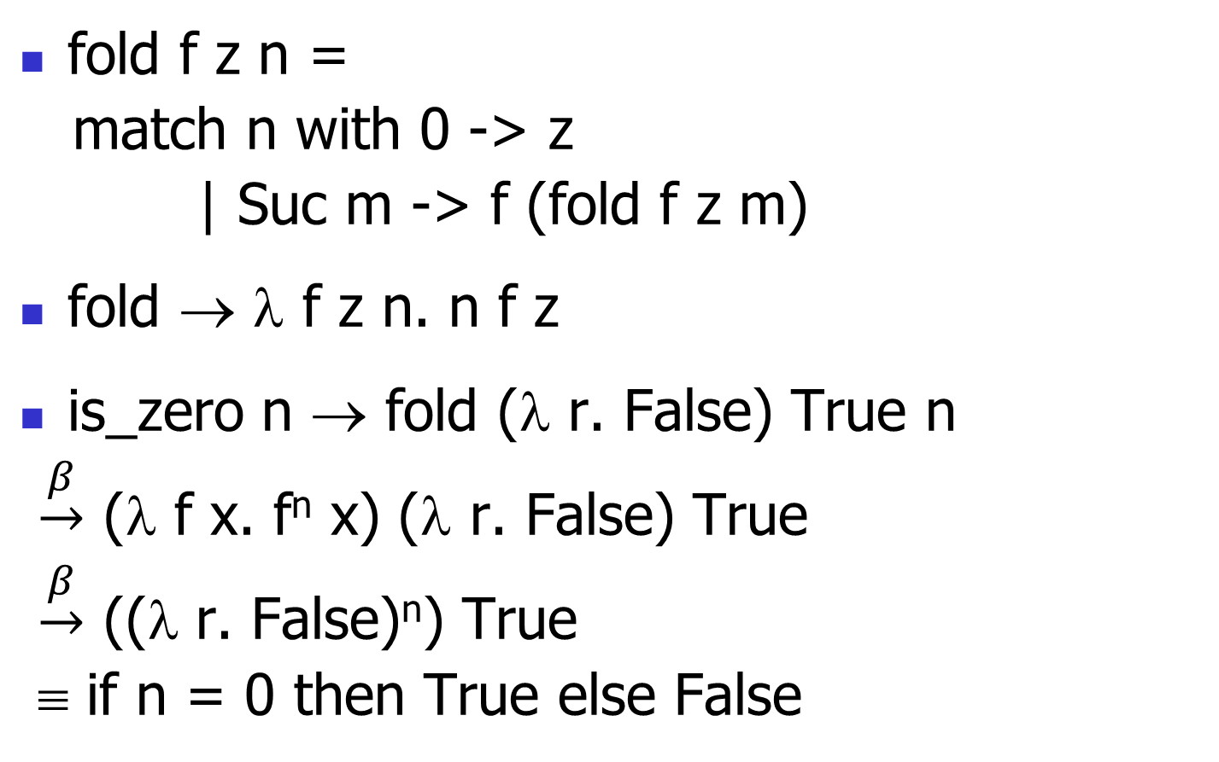
Primitive Recursion over Nat
fold f z n =
match n with 0 -> z
| Suc m -> f (fold f z m)
fold → λ f z n. n f z
is_zero n → fold (λ r. False) True n
$\underset{→}{β}$ (λ f x. f^{n} x) (λ r. False) True
$\underset{→}{β}$ ((λ r. False)^{n}) True
≡ if n = 0 then True else False

Slide 26
Adding Church Numerals
n → λ f x. f^{n} x and m → λ f x. f^{m} x
n + m → λ f x. f ^{(n+m)} x
= λ f x. f^{n} (f^{m} x) = λ f x. n f (m f x)
+ → λ n m f x. n f (m f x)
Subtraction is harder

Slide 27
Multiplying Church Numerals
n → λ f x. f^{n} x and m → λ f x. f^{m} x
n ∗ m → λ f x. (f^{n∗m}) x = λ f x. (f^{m})^{n} x = λ f x. n (m f) x
∗ → λ n m f x. n (m f) x

Slide 28
Predecessor
let pred_aux n =
match n with 0 -> (0,0)
| Suc m
-> (Suc(fst(pred_aux m)), fst(pred_aux m))
= fold (λ r. (Suc(fst r), fst r)) (0,0) n
pred → λ n. snd (pred_aux n) =
λ n. snd (fold (λ r.(Suc(fst r), fst r)) (0,0) n)

Slide 29
Recursion
Want a λ-term Y such that for all terms R we have Y R = R (Y R)
Y needs to have replication to “remember” a copy of R
Y = λ y. (λ x. y(x x)) (λ x. y(x x))
Y R = (λ x. R(x x)) (λ x. R(x x))
= R ((λ x. R(x x)) (λ x. R(x x)))
Note: requires lazy evaluation
Called the Y-combinator

Slide 30
Factorial
Let F = λ f n. if n = 0 then 1 else n * f (n – 1)
Y F 3 = F (Y F) 3
= if 3 = 0 then 1 else 3 * ((Y F)(3 – 1))
= 3 * (Y F) 2 = 3 * (F(Y F) 2)
= 3 * (if 2 = 0 then 1 else 2 * (Y F)(2 – 1))
= 3 * (2 * (Y F)(1)) = 3 * (2 * (F(Y F) 1)) = …
= 3 * 2 * 1 * (if 0 = 0 then 1 else 0 * (Y F)(0 – 1))
= 3 * 2 * 1 * 1 = 6

Slide 31
Y in OCaml
Y is type-incorrect, but we can define its behavior using let rec:
# let rec y f = f (y f);;
val y : ('a -> 'a) -> 'a = <fun>
# let mk_fact =
fun f n -> if n = 0 then 1 else n * f(n-1);;
val mk_fact : (int -> int) -> int -> int = <fun>
# y mk_fact;;
Stack overflow during evaluation (looping recursion?).

Slide 32
Eager Eval Y in Ocaml
# let rec y f x = f (y f) x;;
val y : (('a -> 'b) -> 'a -> 'b) -> 'a -> 'b = <fun>
# y mk_fact;;
- : int -> int = <fun>
# y mk_fact 5;;
- : int = 120
Use recursion to get recursion

Slide 33
Some Other Combinators
For your general exposure
I = λ x . x
K = λ x. λ y. x
K* = λ x. λ y. y
S = λ x. λ y. λ z. x z (y z)

