Slide 1
Programming Languages and Compilers (CS 421)
William Mansky
http://courses.engr.illinois.edu/cs421/
Based in part on slides by Mattox Beckman, as updated by Vikram Adve, Gul Agha, Elsa Gunter, and Dennis Griffith

Slide 2
Lambda Calculus
Aims to capture the essence of functions, function applications, and evaluation
λ-calculus is a theory of computation
Programs may be viewed as functions from input (initial state and input values) to output (resulting state and output values)
λ-calculus makes this precise, and provides rules for working with functions in general
Can be typed or untyped, but we’ll focus on untyped

Slide 3
Lambda Calculus: Motivation
Typed and untyped λ-calculus used for theoretical study of (sequential) programming languages
Programming languages can be thought of as λ-calculus + predefined constructs, constants, types, syntactic sugar (denotational semantics)
OCaml is close to the λ-calculus:
fun x -> exp ≡ λ x. exp
let x = e₁ in e₂ ≡ (λ x. e₂) e₁

Slide 4
Untyped λ-calculus
Only three kinds of expressions:
  Variables: x, y, z, w, …
  Abstraction: λ x. e
  (Function creation, as fun x -> e)
  Application: e₁ e₂

Slide 5
Untyped λ-calculus Grammar
Formal BNF Grammar:
  <expression> ::= <variable>
  | <abstraction>
  | <application>
  | (<expression>)
  <abstraction>
  ::= λ<variable>.<expression>
  <application>
  ::= <expression> <expression>

Slide 6
Example
Which variables are which?
(λ x. λ y. y (λ x. x y) x) x

Slide 7
Example
Which variables are which?
(λ x. y λ y. y (λ x. x y) x) x

Slide 8
Working with Variables
Occurrence: a location of a subterm (variable or complex term) in a term
Variable binding: λ x. e is a binding of x to e
Bound occurrence: all occurrences of x in λ x. e
Free occurrence: one that is not bound
Scope of binding: in λ x. e, all occurrences in e not in a subterm of the form λ x. e’ (same x) are in scope of that binding of x
Free variables: all variables with free occurrences in a term

Slide 9
Untyped λ-calculus
How do you compute with the λ-calculus?
Roughly speaking, by substitution:
(λ x. e₁) e₂ ⇒ e₁ [e₂ / x]
Modulo subtleties to avoid free variable capture

Slide 10
Semantics of Substitution
x [e / x] = e
y [e / x] = y if y ≠ x
(e₁ e₂) [e / x] = ((e₁ [e / x] ) (e₂ [e / x] ))
(λ x. f) [e / x] = (λ x. f)
(λ y. f) [e / x] = λ y. (f [e / x] )
if y ≠ x and y is not a free variable in e

Slide 11
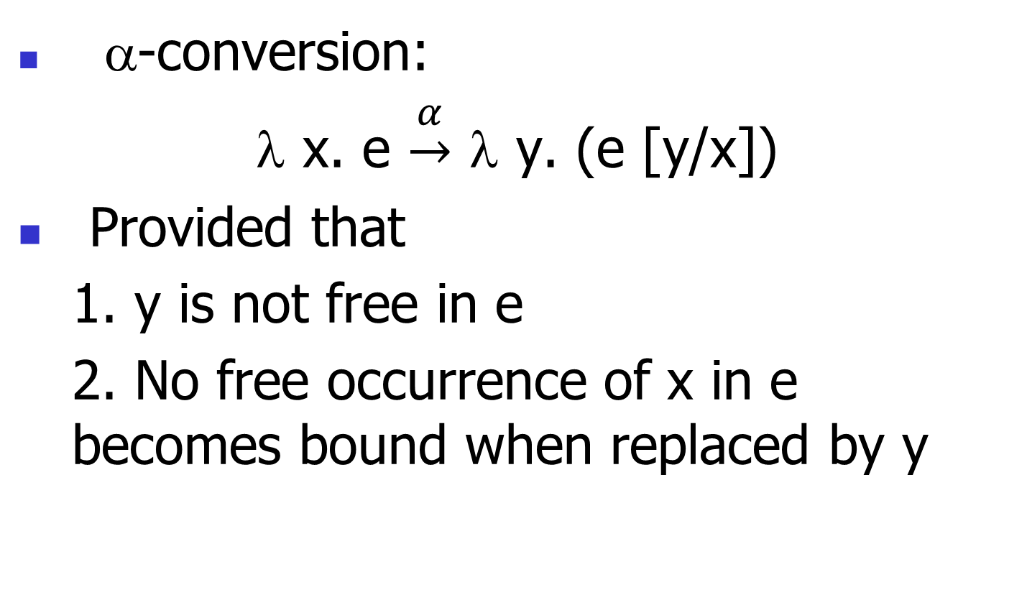
Changing Names
α-conversion:
λ x. e $\underset{→}{α}$ λ y. (e [y/x])
Provided that
  1. y is not free in e
  2. No free occurrence of x in e becomes bound when replaced by y

Slide 12
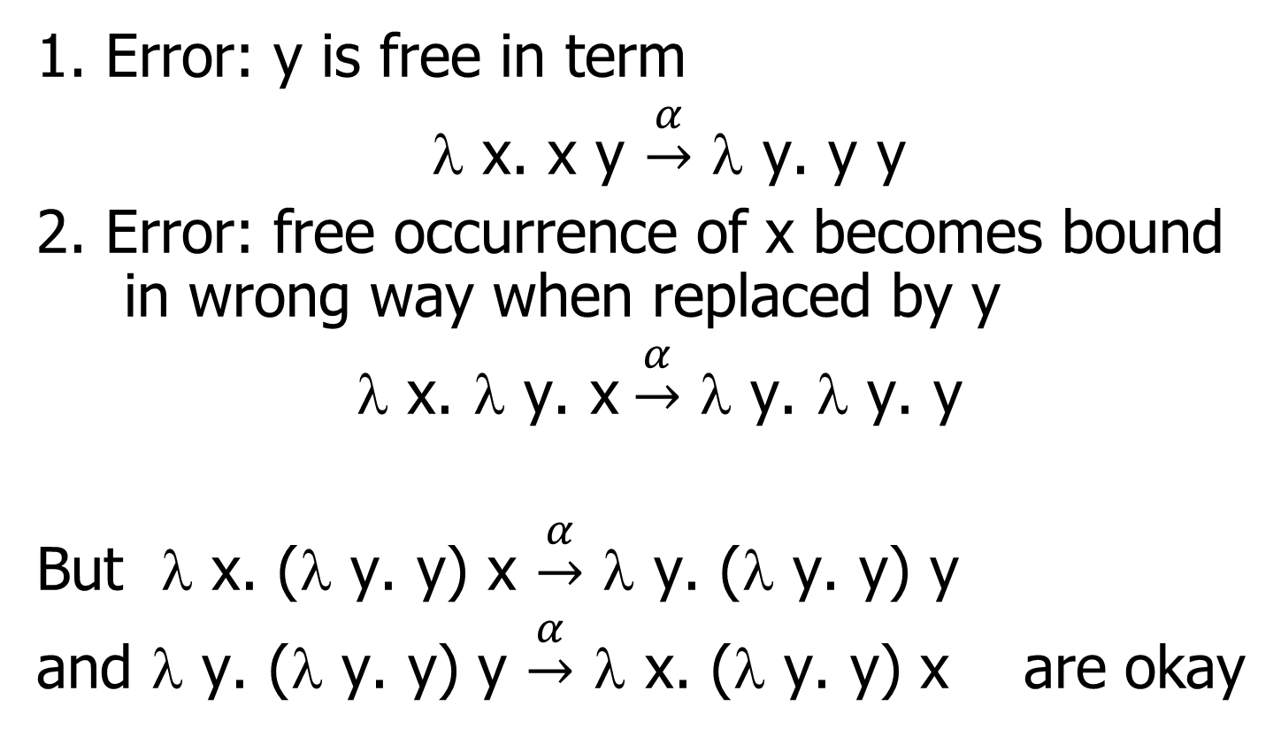
α-conversion Failure
1. Error: y is free in term
λ x. x y $\underset{→}{α}$ λ y. y y
2. Error: free occurrence of x becomes bound in wrong way when replaced by y
λ x. λ y. x$\underset{→}{α}$ λ y. λ y. y
But λ x. (λ y. y) x $\underset{→}{α}$ λ y. (λ y. y) y
and λ y. (λ y. y) y $\underset{→}{α}$ λ x. (λ y. y) x are okay

Slide 13
Congruence
Let ~ be a relation on lambda terms. ~ is a congruence if
~ is an equivalence relation (reflexive, symmetric, transitive)
If e₁ ~ e₂ then
  (e e₁) ~ (e e₂) and (e₁ e) ~ (e₂ e)
  λ x. e₁ ~ λ x. e₂
Congruent terms are “functionally the same” in some way

Slide 14
α-equivalence
α-equivalence is the smallest congruence containing α-conversion
  i.e., two terms are α-equivalent if they can be α-converted into the same term
We usually treat α-equivalent terms as equal

Slide 15
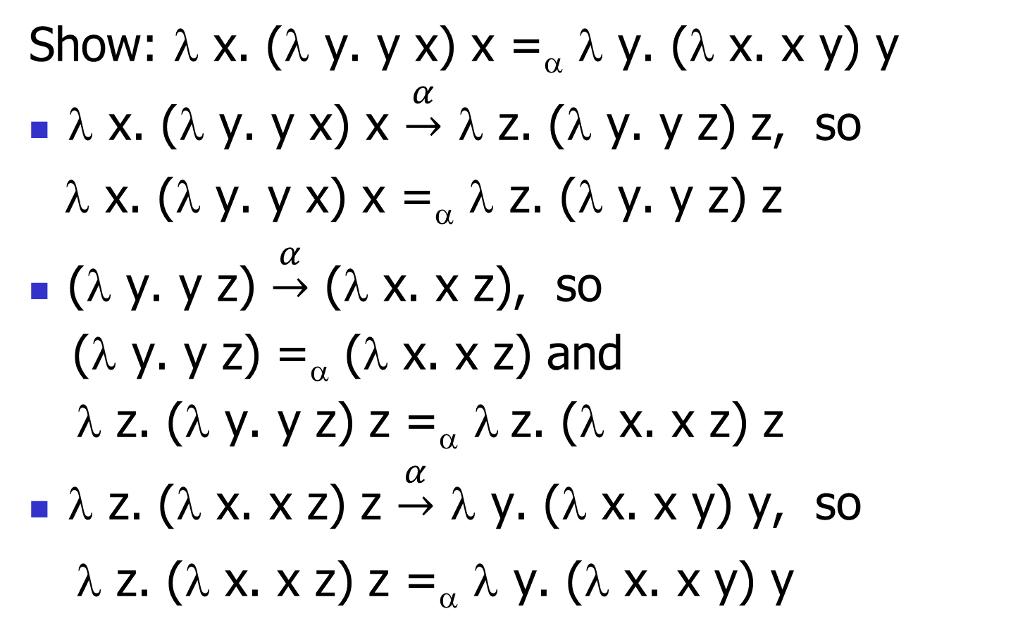
Proving α-equivalence
Show: λ x. (λ y. y x) x =_{α} λ y. (λ x. x y) y
λ x. (λ y. y x) x $\underset{→}{α}$ λ z. (λ y. y z) z, so
λ x. (λ y. y x) x =_{α} λ z. (λ y. y z) z
(λ y. y z) $\underset{→}{α}$ (λ x. x z), so
(λ y. y z) =_{α} (λ x. x z) and
λ z. (λ y. y z) z =_{α} λ z. (λ x. x z) z
λ z. (λ x. x z) z $\underset{→}{α}$ λ y. (λ x. x y) y, so
λ z. (λ x. x z) z =_{α} λ y. (λ x. x y) y

Slide 16
Semantics of Substitution
x [e / x] = e
y [e / x] = y if y ≠ x
(e₁ e₂) [e / x] = ((e₁ [e / x] ) (e₂ [e / x] ))
(λ x. f) [e / x] = (λ x. f)
(λ y. f) [e / x] = λ y. (f [e / x] )
if y ≠ x and y is not a free variable in e
α-convert here if necessary!

Slide 17
Substitution Example
(λ y. y z) [(λ x. x y) / z] = ?

Slide 18
Substitution Example
(λ y. y z) [(λ x. x y) / z] = ?
Problems?
  y free in the residue

Slide 19
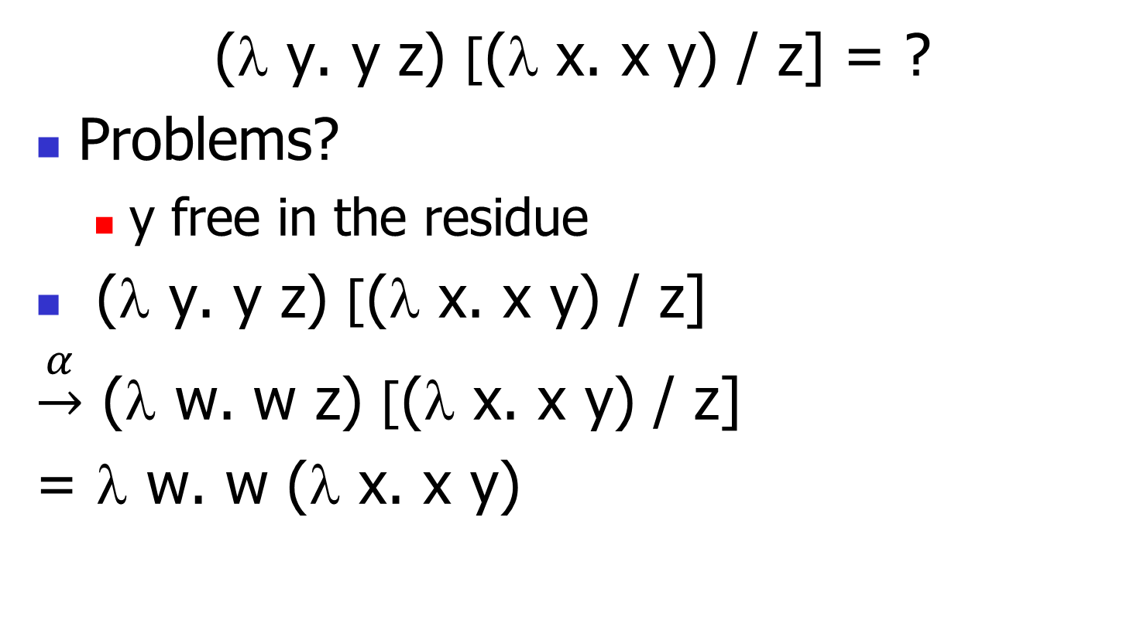
Substitution Example
(λ y. y z) [(λ x. x y) / z] = ?
Problems?
  y free in the residue
(λ y. y z) [(λ x. x y) / z]
$\underset{→}{α}$ (λ w. w z) [(λ x. x y) / z]
= λ w. w (λ x. x y)

Slide 20
Substitution Example
Only replace free occurrences
(λ y. y z (λ z. z)) [(λ x. x) / z] = ?

Slide 21
Substitution Example
Only replace free occurrences
(λ y. y z (λ z. z)) [(λ x. x) / z] =
λ y. y (λ x. x) (λ z. z)
Not
λ y. y (λ x. x) (λ z. (λ x. x))

Slide 22
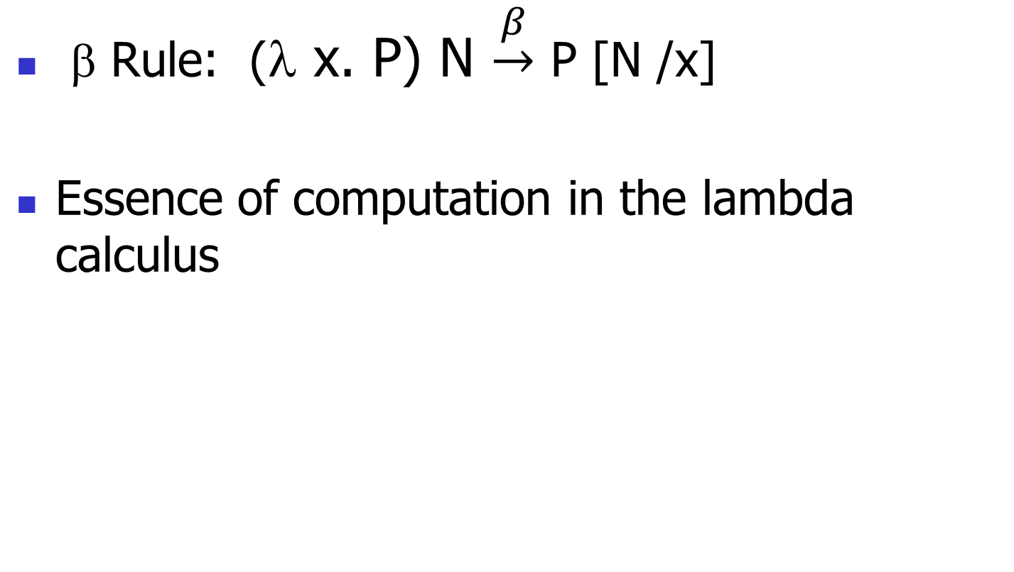
β reduction
β Rule: (λ x. P) N $\underset{→}{β}$ P [N /x]
Essence of computation in the lambda calculus

Slide 23
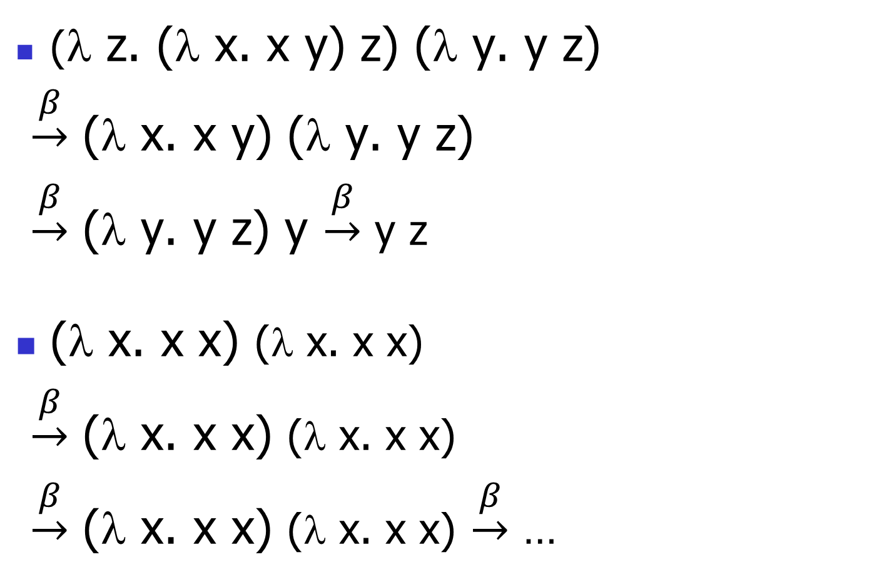
Example
(λ z. (λ x. x y) z) (λ y. y z)
$\underset{→}{β}$ (λ x. x y) (λ y. y z)
$\underset{→}{β}$ (λ y. y z) y $\underset{→}{β}$ y z
(λ x. x x) (λ x. x x)
$\underset{→}{β}$ (λ x. x x) (λ x. x x)
$\underset{→}{β}$ (λ x. x x) (λ x. x x) $\underset{→}{β}$ …

Slide 24
αβ-equivalence
αβ-equivalence is the smallest congruence containing α-equivalence and β-reduction
A term is in normal form if no subterm is α-equivalent to a term that can be β-reduced
Theorem (Church-Rosser): if e₁ and e₂ are αβ-equivalent and both are normal forms, then they are α-equivalent
  So each term has a unique fully reduced form, up to α-equivalence

Slide 25
Order of Evaluation
Order of evaluation matters!
  Not all terms reduce to normal forms
  Not all reduction strategies will produce a normal form if one exists
Two main strategies: eager and lazy
Reflected in functional languages (OCaml is eager, Haskell is lazy)

Slide 26
Lazy Evaluation
Reduce the left side of an application first
β-reduce when left side is an abstraction (function)
Don’t evaluate the right side unless we have to!
When there are multiple applications, go top-down and left-to-right

Slide 27
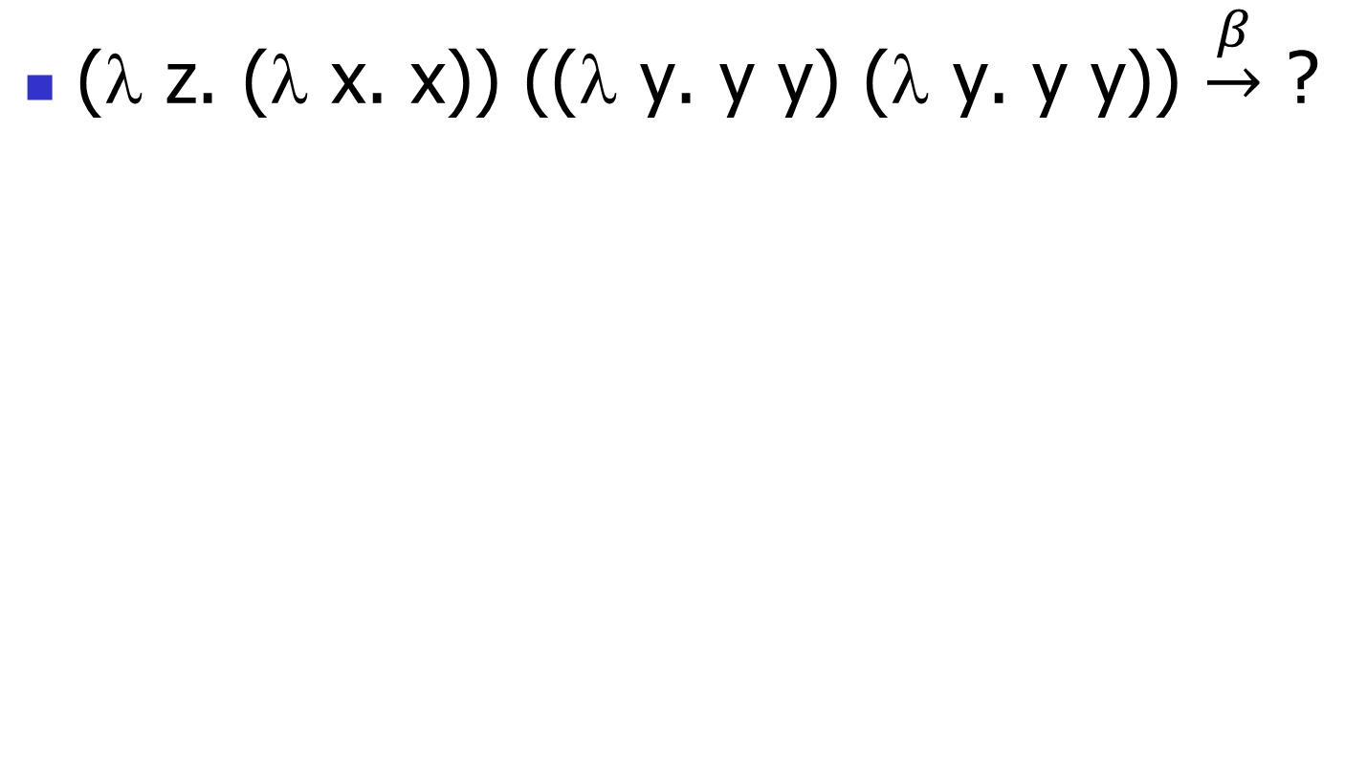
Lazy Example
(λ z. (λ x. x)) ((λ y. y y) (λ y. y y)) $\underset{→}{β}$ ?

Slide 28
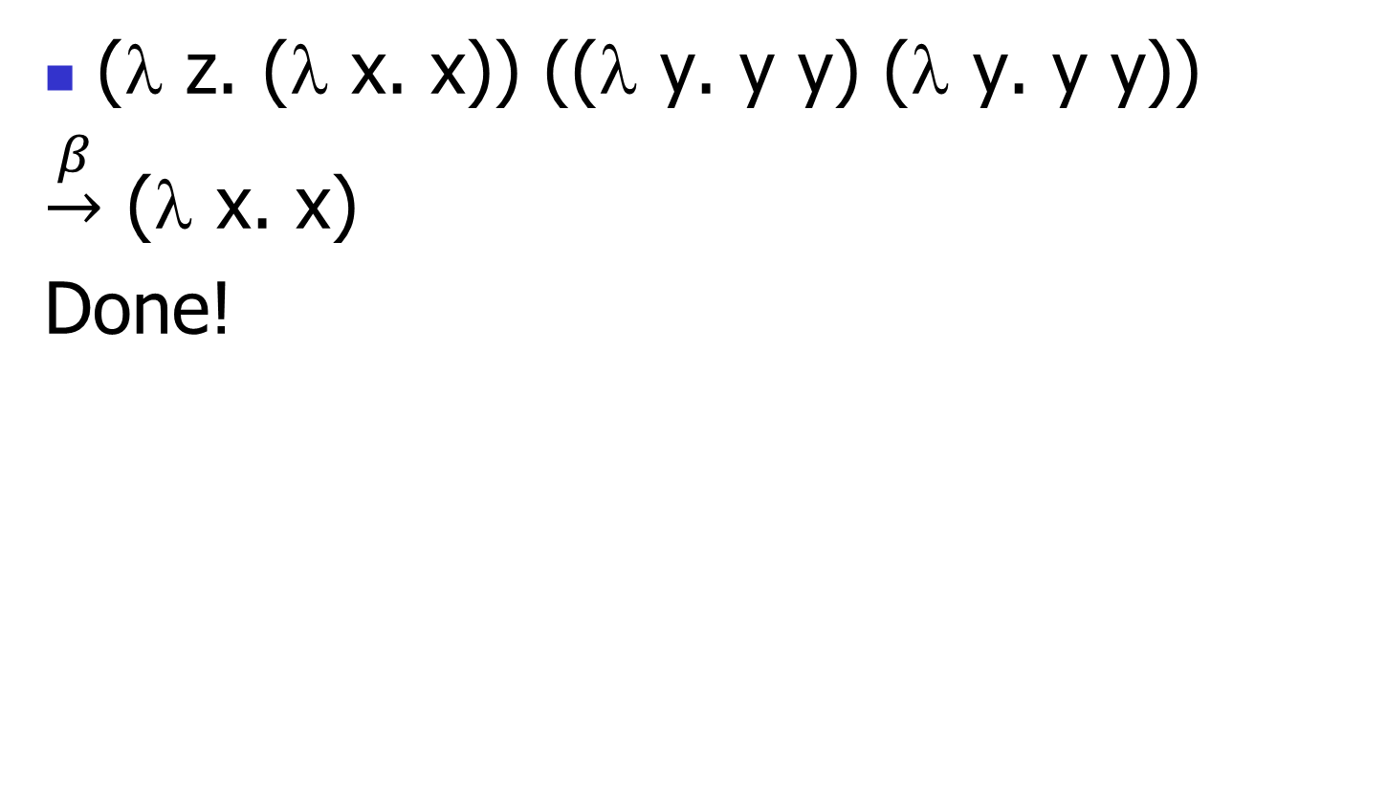
Lazy Example
(λ z. (λ x. x)) ((λ y. y y) (λ y. y y))
$\underset{→}{β}$ (λ x. x)
Done!

Slide 29
Eager Evaluation
Reduce the left side of an application first
Then reduce the right side
β-reduce when left side is an abstraction (function) and right side cannot be reduced (eagerly) any further
  Might not be a normal form!
When there are multiple applications, go top-down and left-to-right
Evaluate everything we can

Slide 30
Eager Example
(λ z. (λ x. x)) ((λ y. y y) (λ y. y y)) $\underset{→}{β}$ ?

Slide 31
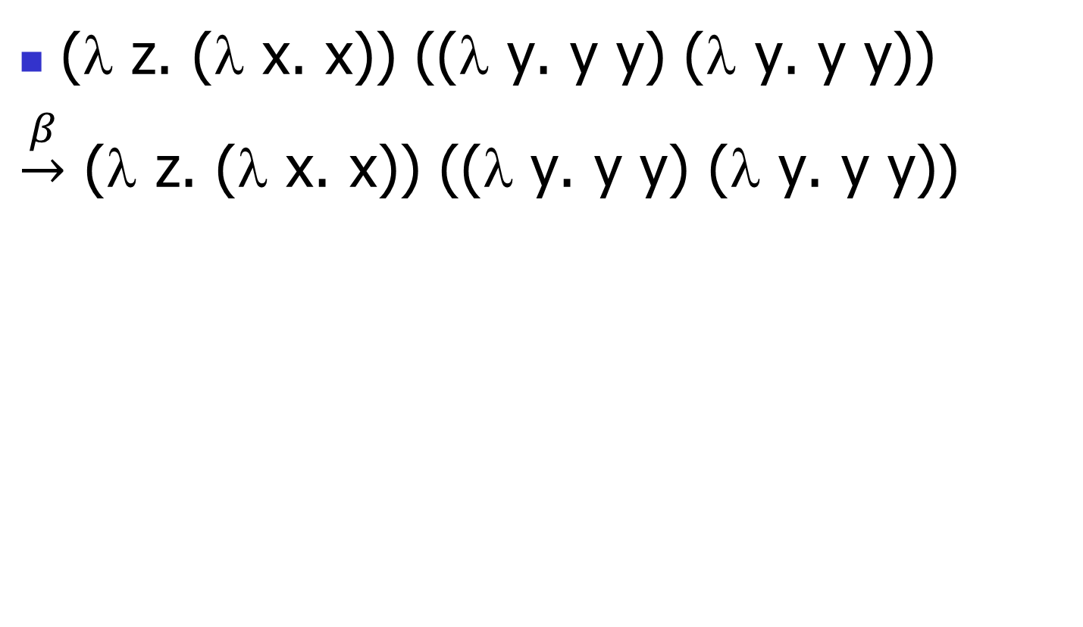
Eager Example
(λ z. (λ x. x)) ((λ y. y y) (λ y. y y))
$\underset{→}{β}$ (λ z. (λ x. x)) ((λ y. y y) (λ y. y y))

Slide 32
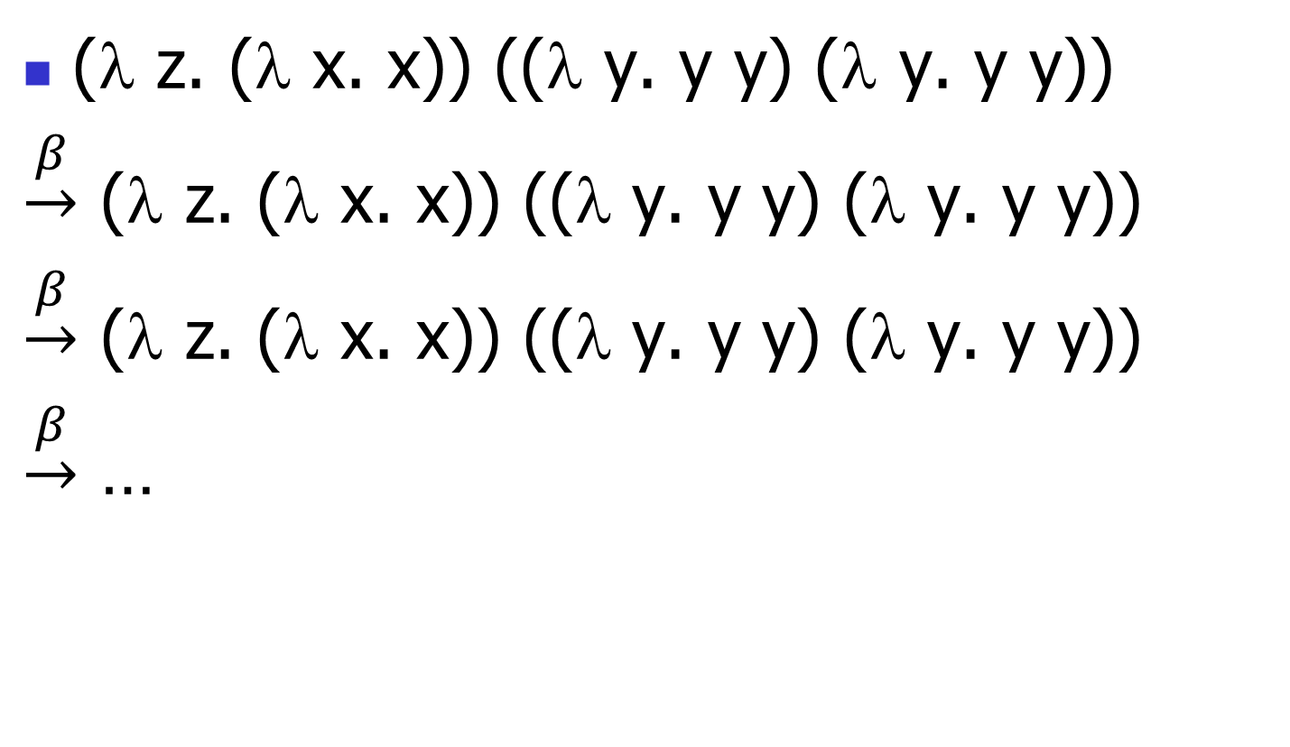
Eager Example
(λ z. (λ x. x)) ((λ y. y y) (λ y. y y))
$\underset{→}{β}$ (λ z. (λ x. x)) ((λ y. y y) (λ y. y y))
$\underset{→}{β}$ (λ z. (λ x. x)) ((λ y. y y) (λ y. y y))
$\underset{→}{β}$ …

Slide 33
Operational Semantics for λ-calculus
E → E’’
E E’ → E’’ E’
Application (version 1 - Lazy Evaluation)
(λ x . E ) E’ → E [E’ / x]
Application (version 2 - Eager Evaluation)
E’ → E’’
(λ x . E ) E’ → (λ x . E ) E’’
(λ x . E ) V → E [V / x]
where V is a variable or abstraction

Slide 34
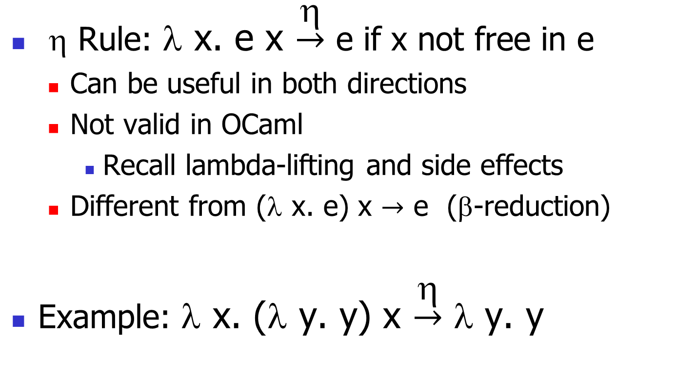
η (Eta) Reduction
η Rule: λ x. e x $\underset{→}{η}$ e if x not free in e
  Can be useful in both directions
  Not valid in OCaml
    Recall lambda-lifting and side effects
  Different from (λ x. e) x $→$ e (β-reduction)
Example: λ x. (λ y. y) x $\underset{→}{η}$ λ y. y

Slide 35
Expressiveness
Untyped λ-calculus is Turing Complete
  Can express any sequential computation
Tricky parts:
  How to express basic data: booleans, integers, etc?
  How to express recursion?
  Constants, if_then_else, etc., are conveniences; can be added as syntactic sugar

Slide 36
Typed vs. Untyped λ-calculus
The pure λ-calculus has no notion of type: (f f) is a legal expression
Types restrict which applications are valid
Types are not syntactic sugar! They disallow some terms/executions
Simply typed λ-calculus is less powerful than the untyped λ-calculus: NOT Turing Complete (no recursion)

