Slide 1
Programming Languages and Compilers (CS 421)
William Mansky
http://courses.engr.illinois.edu/cs421/
Based in part on slides by Mattox Beckman, as updated by Vikram Adve, Gul Agha, Elsa Gunter, and Dennis Griffith

Slide 2
Parsing Programs
Parsing is the process of tracing or constructing a parse tree for a given input string
Process usually broken into two phases:
  Lexer: generating tokens from string or character stream
  Parser: generating parse tree from token list or stream

Slide 3
Example BNF Grammar
<exp> ::= <factor>
  | <factor> + <factor>
  <factor> ::= <bin>
  | <bin> * <exp>
  <bin> ::= 0 | 1

Slide 4
Example Parse Tree
1 * 1 + 0: <exp>
<factor>
<bin> * <exp>
1 <factor> + <factor>
<bin> <bin>
1 0
Fringe of tree is string generated by grammar

Slide 5
Recursive Descent Parsing
Algorithm for constructing parse trees given BNF grammar
Builds parse tree top-down, always builds leftmost derivation (LL – left-to-right scanning, leftmost derivation)
One subprogram/function to parse each nonterminal
Each nonterminal in right-hand side of a rule corresponds to a recursive call to the associated subprogram

Slide 6
Recursive Descent Parsing
Each subprogram must be able to decide on a production by looking at the left-most character in the string to be parsed
  May do so directly, or indirectly by calling another parsing subprogram
  Cannot be built from left-recursive grammars
  Sometimes can modify grammar to suit

Slide 7
Sample Grammar
<expr> ::= <term> | <term> + <expr>
| <term> - <expr>
<term> ::= <factor> | <factor> * <term>
| <factor> / <term>
<factor> ::= <id> | ( <expr> )

Slide 8
Tokens as OCaml Types
+ - * / ( ) <id>
Becomes an OCaml datatype
type token =
Id_token of string
| Left_parenthesis | Right_parenthesis
| Times_token | Divide_token
| Plus_token | Minus_token

Slide 9
Parse Trees as Datatypes
<expr> ::= <term>
| <term> + <expr>
| <term> – <expr>
type expr =
Term_as_Expr of term
| Plus_Expr of (term * expr)
| Minus_Expr of (term * expr)

Slide 10
Parse Trees as Datatypes
<term> ::= <factor>
| <factor> * <term>
| <factor> / <term>
and term =
Factor_as_Term of factor
| Mult_Term of (factor * term)
| Div_Term of (factor * term)

Slide 11
Parse Trees as Datatypes
<factor> ::= <id> | ( <expr> )
and factor =
Id_as_Factor of string
| Parenthesized_Expr_as_Factor of expr

Slide 12
Parsing Lists of Tokens
For recursive descent, three mutually recursive functions:
  expr : token list -> (expr * token list)
  term : token list -> (term * token list)
  factor : token list -> (factor * token list)
Each parses what it can and gives back parse and remaining tokens

Slide 13
Parse Trees as Datatypes
<expr> ::= <term>
| <term> + <expr>
| <term> – <expr>
type expr =
Term_as_Expr of term
| Plus_Expr of (term * expr)
| Minus_Expr of (term * expr)

Slide 14
Parsing an Expression
<expr> ::= <term> [( + | – ) <expr>]
let rec expr tokens =
match term tokens
with (term_parse, more_tokens) ->
match more_tokens
with (Plus_token :: rest) -> …
| (Minus_token :: rest) -> …
| _ -> …

Slide 15
Parsing an Expression
<expr> ::= <term> [( + | – ) <expr>]
let rec expr tokens =
match term tokens
with (term_parse, more_tokens) ->
match more_tokens
with (Plus_token :: rest) -> …
| (Minus_token :: rest) -> …
| _ -> …

Slide 16
Parsing an Expression
<expr> ::= <term> [( + | – ) <expr>]
let rec expr tokens =
match term tokens
with (term_parse, more_tokens) ->
match more_tokens
with (Plus_token :: rest) -> …
| (Minus_token :: rest) -> …
| _ -> …

Slide 17
Parsing an Expression
<expr> ::= <term> [( + | – ) <expr>]
let rec expr tokens =
match term tokens
with (term_parse, more_tokens) ->
match more_tokens
with (Plus_token :: rest) -> …
| (Minus_token :: rest) -> …
| _ -> …

Slide 18
Parsing a Plus-Expression
<expr> ::= <term> + <expr>
let rec expr tokens =
… match more_tokens
with (Plus_token :: rest) ->
match expr rest
with (expr_parse, tokens_after_expr) ->
(Plus_Expr (term_parse , expr_parse),
tokens_after_expr))
| …

Slide 19
Parsing a Plus-Expression
<expr> ::= <term> + <expr>
let rec expr tokens =
… match more_tokens
with (Plus_token :: rest) ->
match expr rest
with (expr_parse, tokens_after_expr) ->
(Plus_Expr (term_parse , expr_parse),
tokens_after_expr))
| …

Slide 20
Parsing a Plus-Expression
<expr> ::= <term> + <expr>
let rec expr tokens =
… match more_tokens
with (Plus_token :: rest) ->
match expr rest
with (expr_parse, tokens_after_expr) ->
(Plus_Expr (term_parse , expr_parse),
tokens_after_expr))
| …

Slide 21
Parsing a Plus-Expression
<expr> ::= <term> + <expr>
let rec expr tokens =
… match more_tokens
with (Plus_token :: rest) ->
match expr rest
with (expr_parse, tokens_after_expr) ->
(Plus_Expr (term_parse , expr_parse),
tokens_after_expr))
| …

Slide 22
Parsing a Minus-Expression
<expr> ::= <term> – <expr>
let rec expr tokens =
… match more_tokens …
| (Minus_token :: rest) ->
match expr rest
with (expr_parse, tokens_after_expr) ->
(Minus_Expr (term_parse , expr_parse),
tokens_after_expr))
| …

Slide 23
Parsing an Expression as a Term
<expr> ::= <term>
let rec expr tokens =
… match more_tokens …
| _ -> (Term_as_Expr term_parse, more_tokens)

Slide 24
Parsing an Expression
<expr> ::= <term> [( + | – ) <expr>]
let rec expr tokens =
match term tokens
with (term_parse, more_tokens) ->
match more_tokens
with (Plus_token :: rest) -> …
| (Minus_token :: rest) -> …
| _ -> …
and term tokens = … (* defined similarly *)

Slide 25
Parsing Factor as Id
<factor> ::= <id> | ( <expr> )
and factor tokens =
match tokens
with (Id_token id_name::more_tokens) ->
(Id_as_Factor id_name, more_tokens)
| …

Slide 26
Parsing Factor as Parenthesized Expr
<factor> ::= <id> | ( <expr> )
and factor tokens =
match tokens …
| (Left_parenthesis :: more_tokens) ->
(match expr more_tokens
with (expr_parse, more) ->
match more with Right_parenthesis :: rest ->
(Parenthesized_Expr_as_Factor expr_parse, rest)

Slide 27
Parsing Factor as Parenthesized Expr
<factor> ::= <id> | ( <expr> )
and factor tokens =
match tokens …
| (Left_parenthesis :: more_tokens) ->
(match expr more_tokens
with (expr_parse, more) ->
match more with Right_parenthesis :: rest ->
(Parenthesized_Expr_as_Factor expr_parse, rest)

Slide 28
Error Cases
What if no matching right parenthesis?
| _ -> raise (Failure "No matching rparen") ))
What if no leading id or left parenthesis?
| _ -> raise (Failure "No id or lparen" ));;

Slide 29
( a + b ) * c – d
expr [Left_parenthesis; Id_token "a"; Plus_token; Id_token "b";
Right_parenthesis; Times_token; Id_token "c"; Minus_token; Id_token "d"];;

Slide 30
( a + b ) * c – d
- : expr * token list =
(Minus_Expr
(Mult_Term
(Parenthesized_Expr_as_Factor
(Plus_Expr
(Factor_as_Term (Id_as_Factor "a"),
Term_as_Expr (Factor_as_Term (Id_as_Factor "b")))),
Factor_as_Term (Id_as_Factor "c")),
Term_as_Expr (Factor_as_Term (Id_as_Factor "d"))),
[])

Slide 31
( a + b ) * c – d
<expr>
<term> – <expr>
  <factor> * <term> <term>
  ( <expr> ) <factor> <factor>
  <term> + <expr> <id> <id>
  <factor> <term> c d
  <id> <factor>
  a <id>
  b

Slide 32
a + b * c – d
# expr [Id_token "a"; Plus_token; Id_token "b"; Times_token; Id_token "c"; Minus_token;
Id_token "d"];;
- : expr * token list =
(Plus_Expr
(Factor_as_Term (Id_as_Factor "a"),
Minus_Expr
(Mult_Term (Id_as_Factor "b", Factor_as_Term (Id_as_Factor "c")),
Term_as_Expr (Factor_as_Term (Id_as_Factor "d")))),
[])

Slide 33
a + b * c – d
<expr>
<term> + <expr>
<factor> < term> – <expr>
<id> <factor> * <term> <term>
a <id> <factor> <factor>
b <id> <id>
c d

Slide 34
( a + b * c – d
# expr [Left_parenthesis; Id_token "a"; Plus_token; Id_token "b"; Times_token; Id_token "c"; Minus_token; Id_token "d"];;
Exception: Failure "No matching rparen".
Can’t parse because we ran out of tokens before seeing a ')'

Slide 35
a + b ) * c - d *)
expr [Id_token "a"; Plus_token; Id_token "b"; Right_parenthesis; Times_token; Id_token "c"; Minus_token; Id_token "d"];;
- : expr * token list =
(Plus_Expr
(Factor_as_Term (Id_as_Factor "a"),
Term_as_Expr (Factor_as_Term (Id_as_Factor "b"))),
[Right_parenthesis; Times_token; Id_token "c"; Minus_token; Id_token "d"])

Slide 36
Parsing Whole String
Q: Does the whole string parse?
A: Check whether returned tokens are empty
let parse tokens =
match expr tokens
with (expr_parse, []) -> expr_parse
| _ -> raise (Failure “No parse");;
Fixes <expr> as start symbol

Slide 37
Streams in Place of Lists
More realistically, might not want to create entire list of tokens before parsing
We want to generate one token at a time and use it to make one step in parsing
Use (token * (unit -> token)) or (token * (unit -> token option)) in place of token list

Slide 38
Problems for Recursive-Descent Parsing
Left Recursion:
A ::= Aw
translates to a subroutine that loops forever
Indirect Left Recursion:
A ::= Bw
B ::= Av
causes the same problem

Slide 39
Problems for Recursive-Descent Parsing
Parser must always be able to choose next action based only the very next token
Pairwise Disjointness Test: Can we always determine which rule (in the non-extended BNF) to choose based on just the first token?

Slide 40
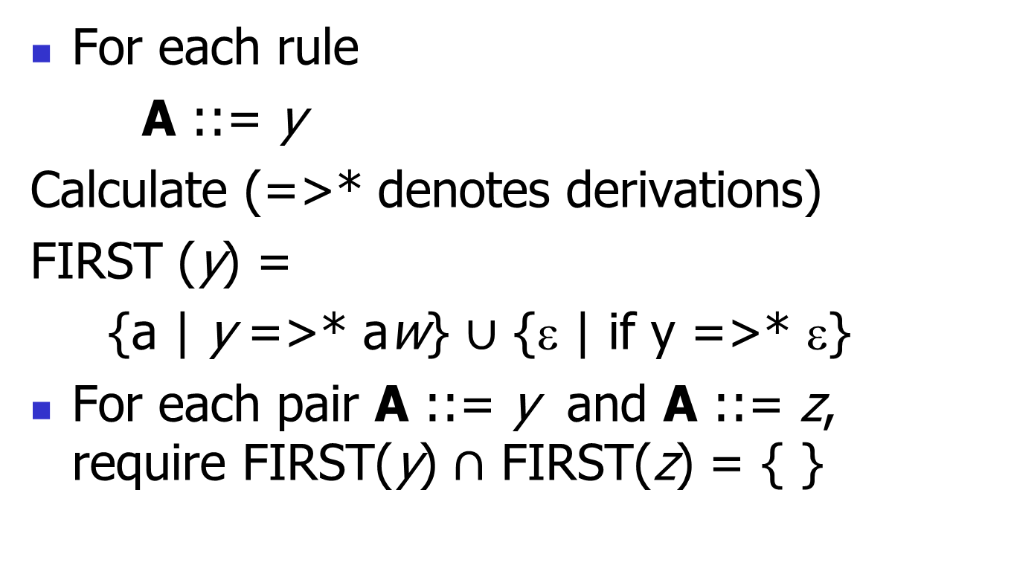
Pairwise Disjointness Test
For each rule
    A ::= y
Calculate (=>* denotes derivations)
FIRST (y) =
{a | y =>* aw} $∪$ {ε | if y =>* ε}
For each pair A ::= y and A ::= z, require FIRST(y) $∩$ FIRST(z) = { }

Slide 41
Example
Grammar:
<S> ::= <A> a <B> b
<A> ::= <A> b | b
<B> ::= a <B> | a
FIRST (<A> b) = {b}
FIRST (b) = {b}
Rules for <A> not pairwise disjoint

Slide 42
Eliminating Left Recursion
Rewrite grammar to shift left recursion to right recursion
  Changes associativity
Given
<expr> ::= <expr> + <term> and
<expr> ::= <term>
Add new non-terminal <e> and replace above rules with
<expr> ::= <term><e>
<e> ::= + <term><e> | ε

Slide 43
Factoring Grammar
Test too strong: Can’t handle
<expr> ::= <term> [ ( + | – ) <expr>]
Answer: Add new non-terminal and replace above rules by
  <expr> ::= <term><e>
  <e> ::= + <term><e>
  <e> ::= – <term><e>
  <e> ::= ε
Delay decision point

Slide 44
Example
Both <A> and <B> have problems:
<S> ::= <A> a <B> b
<A> ::= <A> b | b
<B> ::= a <B> | a
Transform grammar to:
<S> ::= <A> a <B> b
<A> ::= b<A1>
<A1> ::= b<A1> | ε
<B> ::= a<B1>
<B1> ::= a<B1> | ε

