Slide 1
Programming Languages and Compilers (CS 421)
William Mansky
http://courses.engr.illinois.edu/cs421/
Based in part on slides by Mattox Beckman, as updated by Vikram Adve, Gul Agha, Elsa Gunter, and Dennis Griffith

Slide 2
Format of Type Judgments
A type judgment has the form
Γ Ⱶ exp : τ
Γ is a typing environment
  Supplies the types of variables and functions
  Γ is a list of the form [ x : σ , . . . ]
exp is a program expression
τ is a type to be assigned to exp
Ⱶ pronounced “turnstile” or “entails”

Slide 3
Axioms - Constants
Ⱶ n : int (assuming n is an integer constant)
Ⱶ true : bool Ⱶ false : bool
These rules are true with any typing environment
n is a meta-variable

Slide 4
Simple Rules - Arithmetic
Primitive operators ( ⊕ ∈ { +, -, *, …}):
Γ Ⱶ e₁ : int Γ Ⱶ e₂ : int
Γ Ⱶ e₁ ⊕ e₂ : int
Relations ( ˜ ∈ { < , > , =, <=, >= }):
Γ Ⱶ e₁ : int Γ Ⱶ e₂ : int
Γ Ⱶ e₁ ˜ e₂ :bool

Slide 5
(Monomorphic) Let and Let Rec
let rule:
Γ Ⱶ e₁ : τ₁ [x : τ₁ ] + Γ Ⱶ e₂ : τ₂
Γ Ⱶ (let x = e₁ in e₂ ) : τ₂
let rec rule:
[x : τ₁ ] + Γ Ⱶ e₁ : τ₁ [x : τ₁ ] + Γ Ⱶ e₂ : τ₂
Γ Ⱶ (let rec x = e₁ in e₂ ) : τ₂

Slide 6
Remaining Problems
The above system can’t handle polymorphism as in OCAML
No type variables in type language (only meta-variable in the logic)
Would need:
  Object level type variables and some kind of type quantification
  let and let rec rules to introduce polymorphism
  Explicit rule to eliminate (instantiate) polymorphism

Slide 7
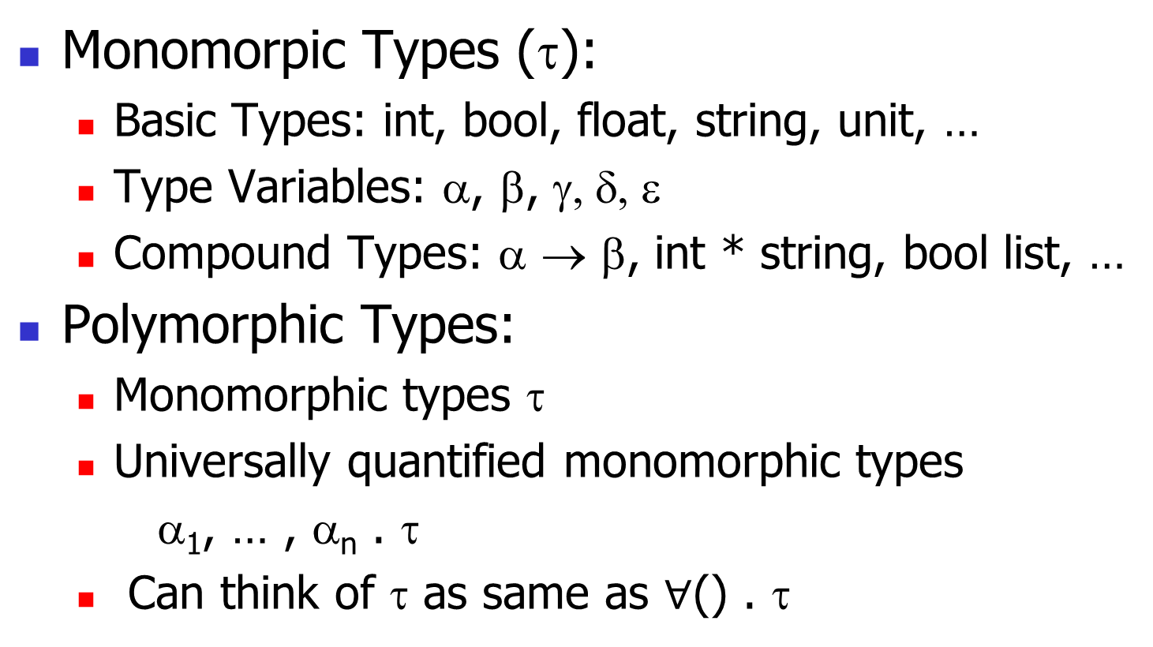
Support for Polymorphic Types
Monomorpic Types (τ):
  Basic Types: int, bool, float, string, unit, …
  Type Variables: α, β, γ, δ, ε
  Compound Types: α → β, int * string, bool list, …
Polymorphic Types:
  Monomorphic types τ
  Universally quantified monomorphic types
  α₁, … , α_{n} . τ
  Can think of τ as same as $∀$() . τ
A

Slide 8
Support for Polymorphic Types
Typing Environment Γ supplies (possibly polymorphic) types for variables
Free variables of monomorphic type are type variables that occur in it
  Write FreeVars(τ)
Free variables of polymorphic type removes variables that are universally quantified
  FreeVars( α₁, … , α_{n} . τ) = FreeVars(τ) – {α₁, … , α_{n} }
FreeVars(Γ) = all FreeVars of types in range of Γ
A

Slide 9
Monomorphic to Polymorphic
Given:
  type environment Γ
  monomorphic type τ
  τ shares type variables with Γ
Want most polymorphic type for τ that doesn’t break sharing type variables with Γ
Recall ‘a vs. ‘_a
Gen(τ, Γ) = α₁, … , α_{n} . τ where
{α₁, … , α_{n}} = freeVars(τ) – freeVars(Γ)
A

Slide 10
Polymorphic Typing Rules
A type judgment has the form
Γ Ⱶ exp : τ
  Γ uses polymorphic types
  τ still monomorphic
Most rules stay same (except use more general typing environments)
Rules that change:
  Variables
  Let and Let Rec
  Allow polymorphic constants

Slide 11
Monomorphic Let and Let Rec
let rule:
Γ Ⱶ e₁ : τ₁ [x : τ₁ ] + Γ Ⱶ e₂ : τ₂
Γ Ⱶ (let x = e₁ in e₂ ) : τ₂
let rec rule:
[x : τ₁ ] + Γ Ⱶ e₁ : τ₁ [x : τ₁ ] + Γ Ⱶ e₂ : τ₂
Γ Ⱶ (let rec x = e₁ in e₂ ) : τ₂

Slide 12
Polymorphic Let and Let Rec
let rule:
Γ Ⱶ e₁ : τ₁ [x : Gen(τ₁,Γ)] + Γ Ⱶ e₂ : τ₂
Γ Ⱶ (let x = e₁ in e₂ ) : τ₂
let rec rule:
[x : τ₁] + Γ Ⱶ e₁ : τ₁ [x : Gen(τ₁,Γ)] + Γ Ⱶ e₂ : τ₂
Γ Ⱶ (let rec x = e₁ in e₂ ) : τ₂

Slide 13
Polymorphic Variables (Identifiers)
Variable axiom:
Γ Ⱶ x : ϕ(τ) if Γ(x) = α₁, … , α_{n} . τ
Where ϕ replaces all occurrences of
α₁, … , α_{n} by monotypes τ₁, … , τ_{n}
Note: Monomorphic rule special case:
Γ Ⱶ x : τ if Γ(x) = τ
Constants treated same way
A

Slide 14
Fun Rule Stays the Same
fun rule:
[x : τ₁ ] + Γ Ⱶ e : τ₂
Γ Ⱶ fun x -> e : τ₁ → τ₂
Types τ₁, τ₂ monomorphic
Function argument must always be used at same type in function body

Slide 15
Polymorphic Example
Assume additional constants:
hd: α. α list -> α
tl: α. α list -> α list
is_empty : α. α list -> bool
:: : α. α -> α list -> α list
[] : α. α list
A
A
A
A
A

Slide 16
Polymorphic Example
Show:
?
{} Ⱶ let rec length =
fun l -> if is_empty l then 0
else 1 + length (tl l)
in length ((::) 2 []) + length((::) true []) : int

Slide 17
Polymorphic Example: Let Rec Rule
Show: (1) (2)
{length: α list -> int} {length: α. α list -> int}
Ⱶ fun l -> … Ⱶ length ((::) 2 []) +
: α list -> int length((::) true []) : int
{} Ⱶ let rec length =
fun l -> if is_empty l then 0
else 1 + length (tl l)
in length ((::) 2 []) + length((::) true []) : int
A

Slide 18
Polymorphic Example (1)
Show:
?
{length: α list -> int} Ⱶ
fun l -> if is_empty l then 0
else 1 + length (tl l) : α list -> int

Slide 19
Polymorphic Example (1): Fun Rule
Show: (3)
{length: α list -> int, l: α list } Ⱶ
if is_empty l then 0
else length (hd l) + length (tl l) : int
{length: α list -> int} Ⱶ
fun l -> if is_empty l then 0
else 1 + length (tl l) : α list -> int

Slide 20
Polymorphic Example (3)
Let Γ = {length: α list -> int, l: α list }
Show
?
Γ Ⱶ if is_empty l then 0
else 1 + length (tl l) : int

Slide 21
Polymorphic Example (3):IfThenElse
Let Γ = {length: α list -> int, l: α list }
Show
(4) (5) (6)
Γ Ⱶ is_empty l Γ Ⱶ 0:int Γ Ⱶ 1 +
: bool length (tl l) : int
Γ Ⱶ if is_empty l then 0
else 1 + length (tl l) : int

Slide 22
Polymorphic Example (4)
Let Γ = {length: α list -> int, l: α list }
Show
?
Γ Ⱶ is_empty l : bool

Slide 23
Polymorphic Example (4):Application
Let Γ = {length: α list -> int, l: α list }
Show
? ?
Γ Ⱶ is_empty : α list -> bool Γ Ⱶ l : α list
Γ Ⱶ is_empty l : bool

Slide 24
Polymorphic Example (4)
Let Γ = {length: α list -> int, l: α list }
Show
By Const since α list -> bool is
instance of α. α list -> bool
Γ Ⱶ is_empty : α list -> bool Γ Ⱶ l : α list
Γ Ⱶ is_empty l : bool
A

Slide 25
Polymorphic Example (4)
Let Γ = {length: α list -> int, l: α list }
Show
By Const since α list -> bool is By Variable
instance of α. α list -> bool Γ(l) = α list
Γ Ⱶ is_empty : α list -> bool Γ Ⱶ l : α list
Γ Ⱶ is_empty l : bool
This finishes (4)
A

Slide 26
Polymorphic Example (5):Const
Let Γ = {length: α list -> int, l: α list }
Show
By Const Rule
Γ Ⱶ 0:int

Slide 27
Polymorphic Example (6):Arith Op
Let Γ = {length: α list -> int, l: α list }
Show
By Variable
Γ Ⱶ length (7)
By Const : α list -> int Γ Ⱶ (tl l) : α list
Γ Ⱶ 1 : int Γ Ⱶ length (tl l) : int
Γ Ⱶ 1 + length (tl l) : int

Slide 28
Polymorphic Example (7):App Rule
Let Γ = {length: α list -> int, l: α list }
Show
By Const By Variable
Γ Ⱶ tl : α list -> α list Γ Ⱶ l : α list
Γ Ⱶ (tl l) : α list
By Const since α list -> α list is instance of
α. α list -> α list
A

Slide 29
Polymorphic Example: (2) by ArithOp
Let Γ’ = {length: α. α list -> int}
Show:
(8) (9)
Γ’ Ⱶ Γ’ Ⱶ
length ((::) 2 []) : int length((::) true []) : int
{length: α. α list -> int} Ⱶ
length ((::) 2 []) + length((::) true []) : int
A

Slide 30
Polymorphic Example: (8)AppRule
Let Γ’ = {length: α. α list -> int}
Show:
Γ’ Ⱶ length: int list -> int Γ’ Ⱶ ((::) 2 []): int list
Γ’ Ⱶ length ((::) 2 []) : int
A

Slide 31
Polymorphic Example: (8)AppRule
Let Γ’ = {length: α. α list -> int}
Show:
By Var since int list -> int is instance of
α. α list -> int
(10)
Γ’ Ⱶ length: int list -> int Γ’ Ⱶ ((::) 2 []): int list
Γ’ Ⱶ length ((::) 2 []) : int
A
A

Slide 32
Polymorphic Example: (10)AppRule
Let Γ’ = {length: α. α list -> int}
Show:
By Const since int list is instance of
α. α list
(11)
Γ’ Ⱶ ((::) 2) : int list -> int list Γ’ Ⱶ [] : int list
Γ’ Ⱶ ((::) 2 []) : int list
A
A

Slide 33
Polymorphic Example: (11)AppRule
Let Γ’ = {length: α. α list -> int}
Show:
By Const since int -> int list -> int list
is instance of
α. α -> α list -> α list By Const
Γ’ Ⱶ (::) : int -> int list -> int list Γ’ Ⱶ 2 : int
Γ’ Ⱶ ((::) 2) : int list -> int list
A
A

Slide 34
Polymorphic Example: (9)AppRule
Let Γ’ = {length: α. α list -> int}
Show:
Γ’ Ⱶ Γ’ Ⱶ
length : bool list -> int ((::) true []) : bool list
Γ’ Ⱶ length ((::) true []) : int
A

Slide 35
Polymorphic Example: (9)AppRule
Let Γ’ = {length: α. α list -> int}
Show:
By Var since bool list -> int is instance of
α. α list -> int
(12)
Γ’ Ⱶ Γ’ Ⱶ
length : bool list ->int ((::) true []) : bool list
Γ’ Ⱶ length ((::) true []) : int
A
A

Slide 36
Polymorphic Example: (12)AppRule
Let Γ’ = {length: α. α list -> int}
Show:
By Const since bool list is instance of
(13) α. α list
Γ’ Ⱶ ((::) true)
: bool list -> bool list Γ’ Ⱶ [] : bool list
Γ’ Ⱶ ((::) true []) : bool list
A
A

Slide 37
Polymorphic Example: (13)AppRule
Let Γ’ = {length: α. α list -> int}
Show:
By Const since bool -> bool list -> bool list
is instance of α. α -> α list -> α list
Γ’ Ⱶ (::) By Const
: bool -> bool list -> bool list Γ’ Ⱶ true : bool
Γ’ |- ((::) true) : bool list -> bool list
A
A

Slide 38
Polymorphic Example: QED!
{} Ⱶ let rec length =
fun l -> if is_empty l then 0
else 1 + length (tl l)
in length ((::) 2 []) + length((::) true []) : int

