Slide 1
Programming Languages and Compilers (CS 421) #3: Closures, evaluation of function applications, order of evaluation #4: Evaluation and Application rules using symbolic rewriting
Madhusudan Parthasarathy (madhu)
3112 Siebel Center madhu@illinois.edu
https://courses.engr.illinois.edu/cs421/fa2018/CS421D
Based on slides by Elsa Gunter, who made these slides mostly, in part borrowing from slides by Mattox Beckman, as updated by Vikram Adve and Gul Agha

Slide 2
Logistics
ML 1
Started today. Must be taken by Thursday.
Schedule and take it if you haven’t already!
Many tries (but finitely many tries).
Idea: Test that you are indeed the person doing your homework!
Practice ML1
Does NOT count against your grade
Prepares you for ML1. Take as many instances of it as you can.
WA 1
Make sure you do one question (has a sequence of subquestions)
And after you are shown the score (“14/16”, etc.), press the GRADE button

Slide 3
RECAP OF LAST LECTURE

Slide 4
Order of Evaluation
Evaluating (f e1)
Evaluate e1 first
Then evaluate f on the value of e1

Slide 5
Booleans (aka Truth Values) Order of Evaluation
# true;;
- : bool = true
# false;;
- : bool = false
// ρ₇ = {c → 4, test → 3.7, a → 1, b → 5}
# if b > a then 25 else 0;;
- : int = 25

Slide 6
Booleans and Short-Circuit Evaluation
# 3 > 1 && 4 > 6;;
- : bool = false
# 3 > 1 || 4 > 6;;
- : bool = true
# (print_string "Hi\n"; 3 > 1) || 4 > 6;;
Hi
- : bool = true
# 3 > 1 || (print_string "Bye\n"; 4 > 6);;
- : bool = true
# not (4 > 6);;
- : bool = true

Slide 7
Functions as arguments and functions as return values

Slide 8
Partial application of functions
let add_three x y z = x + y + z;;
# let h = add_three 5 4;;
val h : int -> int = <fun>
# h 3;;
- : int = 12
# h 7;;
- : int = 16

Slide 9
Functions as arguments
# let thrice f x = f (f (f x));;
val thrice : ('a -> 'a) -> 'a -> 'a = <fun>
# let g = thrice plus_two;;
val g : int -> int = <fun>
# g 4;;
- : int = 10
# thrice (fun s -> "Hi! " ^ s) "Good-bye!";;
- : string = "Hi! Hi! Hi! Good-bye!"

Slide 10
Tuples as Values
// ρ₇ = {c → 4, test → 3.7,
a → 1, b → 5}
# let s = (5,"hi",3.2);;
val s : int * string * float = (5, "hi", 3.2)
// ρ₈ = {s → (5, "hi", 3.2),
c → 4, test → 3.7,
a → 1, b → 5}
a ➔ 1
b ➔ 5
test ➔ 3.7
c ➔ 4
a ➔ 1
b ➔ 5
test ➔ 3.7
c ➔ 4
s ➔ (5, ”hi”, 3.2)

Slide 11
Pattern Matching with Tuples
/ ρ₈ = {s → (5, "hi", 3.2),
c → 4, test → 3.7,
a → 1, b → 5}
# let (a,b,c) = s;; (* (a,b,c) is a pattern *)
val a : int = 5
val b : string = "hi"
val c : float = 3.2
# let x = 2, 9.3;; (* tuples don't require parens in Ocaml *)
val x : int * float = (2, 9.3)
a ➔ 1
b ➔ 5
test ➔ 3.7
c ➔ 4
s ➔ (5, ”hi”, 3.2)
b ➔ “hi”
a ➔ 5
test ➔ 3.7
s ➔ (5, ”hi”, 3.2)
c ➔ 3.2
a ➔ 5
b ➔ “hi”
test ➔ 3.7
s ➔ (5, ”hi”, 3.2)
c ➔ 3.2
x ➔ (2, 9.3)

Slide 12
Nested Tuples
# (*Tuples can be nested *)
let d = ((1,4,62),("bye",15),73.95);;
val d : (int * int * int) * (string * int) * float =
((1, 4, 62), ("bye", 15), 73.95)
# (*Patterns can be nested *)
let (p,(st,_),_) = d;; (* _ matches all, binds nothing *)
val p : int * int * int = (1, 4, 62)
val st : string = "bye"

Slide 13
Save the Environment!
A closure is a pair of an environment and an association of a sequence of variables (the input variables) with an expression (the function body), written:
f → < (v1,…,vn) → exp, ρ_{f} >
Where ρ_{f} is the environment in effect when f is defined (if f is a simple function)

Slide 14
Functions on tuples
# let plus_pair (n,m) = n + m;;
val plus_pair : int * int -> int = <fun>
# plus_pair (3,4);;
- : int = 7
# let double x = (x,x);;
val double : 'a -> 'a * 'a = <fun>
# double 3;;
- : int * int = (3, 3)
# double "hi";;
- : string * string = ("hi", "hi")

Slide 15
Match Expressions
# let triple_to_pair triple =
match triple
with (0, x, y) -> (x, y)
| (x, 0, y) -> (x, y)
| (x, y, _) -> (x, y);;
val triple_to_pair : int * int * int -> int * int = <fun>
Each clause: pattern on left, expression on right
Each x, y has scope of only its clause
Use first matching clause

Slide 16
Closure for plus_pair
Assume ρ_{plus_pair} was the environment just before plus_pair defined
Closure for plus_pair:
<(n,m) → n + m, ρ_{plus_pair}>
Environment just after plus_pair defined:
{plus_pair → <(n,m) → n + m, ρ_{plus_pair} >} + ρ_{plus_pair}

Slide 17
Match Expressions
# let triple_to_pair triple =
match triple
with (0, x, y) -> (x, y)
| (x, 0, y) -> (x, y)
| (x, y, _) -> (x, y);;
val triple_to_pair : int * int * int -> int * int = <fun>
Each clause: pattern on left, expression on right
Each x, y has scope of only its clause
Use first matching clause

Slide 18
Closure for plus_pair
Assume ρ_{plus_pair} was the environment just before plus_pair defined
Closure for plus_pair:
<(n,m) → n + m, ρ_{plus_pair}>
Environment just after plus_pair defined:
{plus_pair → <(n,m) → n + m, ρ_{plus_pair} >} + ρ_{plus_pair}

Slide 19
Functions as arguments
# let thrice f x = f (f (f x));;
val thrice : ('a -> 'a) -> 'a -> 'a = <fun>
# let g = thrice plus_two;;
val g : int -> int = <fun>
# g 4;;
- : int = 10
# thrice (fun s -> "Hi! " ^ s) "Good-bye!";;
- : string = "Hi! Hi! Hi! Good-bye!"

Slide 20
Functions on tuples
# let plus_pair (n,m) = n + m;;
val plus_pair : int * int -> int = <fun>
# plus_pair (3,4);;
- : int = 7
# let double x = (x,x);;
val double : 'a -> 'a * 'a = <fun>
# double 3;;
- : int * int = (3, 3)
# double "hi";;
- : string * string = ("hi", "hi")

Slide 21
Recall closures: Closure for plus_pair
Assume ρ_{plus_pair} was the environment just before plus_pair defined
Closure for plus_pair:
<(n,m) → n + m, ρ_{plus_pair}>
Environment just after plus_pair defined:
{plus_pair → <(n,m) → n + m, ρ_{plus_pair} >} + ρ_{plus_pair}

Slide 22
Functions with more than one argument
# let add_three x y z = x + y + z;;
val add_three : int -> int -> int -> int = <fun>
# let t = add_three 6 3 2;;
val t : int = 11
# let add_three =
fun x -> (fun y -> (fun z -> x + y + z));;
val add_three : int -> int -> int -> int = <fun>
Again, first syntactic sugar for second

Slide 23
Curried vs Uncurried
Recall
val add_three : int -> int -> int -> int = <fun>
How does it differ from
# let add_triple (u,v,w) = u + v + w;;
val add_triple : int * int * int -> int = <fun>
add_three is curried;
add_triple is uncurried

Slide 24
Curried vs Uncurried
# add_triple (6,3,2);;
- : int = 11
# add_triple 5 4;;
Characters 0-10:
add_triple 5 4;;
^^^^^^^^^^
This function is applied to too many arguments,
maybe you forgot a `;'

Slide 25
Partial application of functions
let add_three x y z = x + y + z;;
# let h = add_three 5 4;;
val h : int -> int = <fun>
# h 3;;
- : int = 12
# h 7;;
: int = 16
Partial application also called sectioning

Slide 26
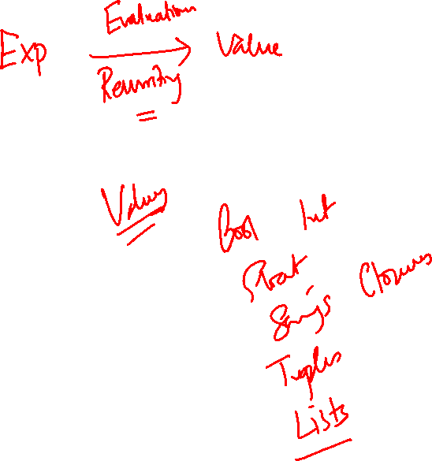
Evaluation
How exactly do we evaluate expressions to values?

Slide 27
Recall: let plus_x = fun x => y + x
X ➔ 12
…
let x = 12
let plus_x = fun y => y + x
let x = 7
X ➔ 12 … plus_x ➔
y → y + x
X ➔ 12
…
plus_x ➔
…
x ➔7
y → y + x
X ➔ 12
…

Slide 28
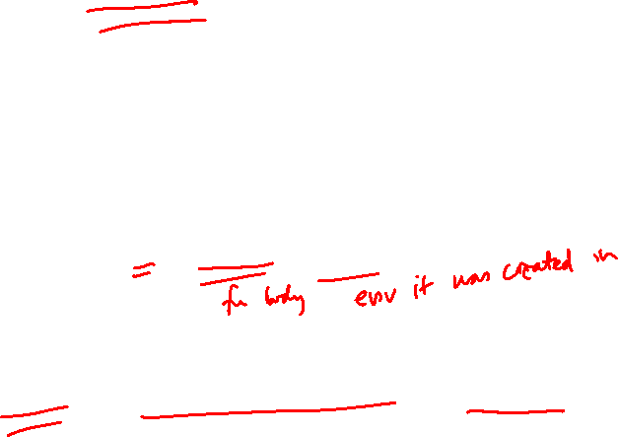
Recall closures: closure for plus_x
When plus_x was defined, had environment:
ρ_{plus_x =} {…, x → 12, …}
Recall: let plus_x y = y + x
is really let plus_x = fun y -> y + x
Closure for fun y -> y + x:
<y → y + x, ρ_{plus_x} >
Environment just after plus_x defined:
{plus_x → <y → y + x, ρ_{plus_x} >} + ρ_{plus_x}

Slide 29
Evaluating declarations
Evaluation uses an environment ρ
To evaluate a (simple) declaration let x = e
Evaluate expression e in ρ to value v
Update ρ with x v: {x → v} + ρ
Update: ρ₁+ ρ₂ has all the bindings in ρ₁ and all those in ρ₂ that are not rebound in ρ₁
{x → 2, y → 3, a → “hi”} + {y → 100, b → 6}
= {x → 2, y → 3, a → “hi”, b → 6}

Slide 30
Evaluating expressions
Evaluation uses an environment ρ
A constant evaluates to itself
To evaluate an variable, look it up in ρ (ρ(v))
To evaluate uses of +, _ , etc, eval args, then do operation
Function expression evaluates to its closure
To evaluate a local dec: let x = e1 in e2
Eval e1 to v, eval e2 using {x → v} + ρ
More generally, let pattern = e1 in e2

Slide 31
Evaluating expressions
To evaluate if e1 then e2 else e3 under an environment ρ
Eval e1 using ρ
If it evaluates to true, then eval e2 using ρ.
Else, (i.e., it evaluates to false), then eval e3 using ρ.
To evaluate match e with p1 -> e1 | p2 -> e2… | pn -> en in env ρ
Evaluate e to v. If v matches p1, then eval e1, else
if v matches p2, then eval e2, else …
if v matches pn then eval en (all evaluations using environment

Slide 32
Evaluation of Application with Closures
Given application expression f(e₁,…,e_{n}) in env ρ, where f is an identifier
In environment ρ, evaluate left term to closure, c = <(x₁,…,x_{n}) → b, ρ>
(x₁,…,x_{n}) variables in (first) argument
Evaluate (e₁,…,e_{n}) to value (v₁,…,v_{n}) using ρ
Update the environment ρ to
ρ’ = {x₁ → v₁,…, x_{n} →v_{n}}+ ρ
Evaluate body b in environment ρ’

Slide 33
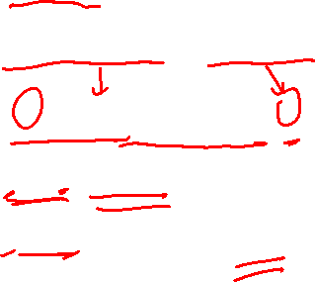
Evaluation of Application of plus_x;;
Have environment: ρ = {plus_x → <y → y + x, ρ_{plus_x} >, … , y → 3, …}
where ρ_{plus_x} = {x → 12, … , y → 24, …}
Eval (plus_x y, ρ) rewrites to
App (Eval(plus_x, ρ) , Eval(y, ρ)) rewrites to
App (<y → y + x, ρ_{plus_x} >, 3) rewrites to
Eval (y + x, {y → 3} +ρ_{plus_x} ) rewrites to
Eval (3 + 12 , ρ_{plus_x} ) = 15

Slide 34
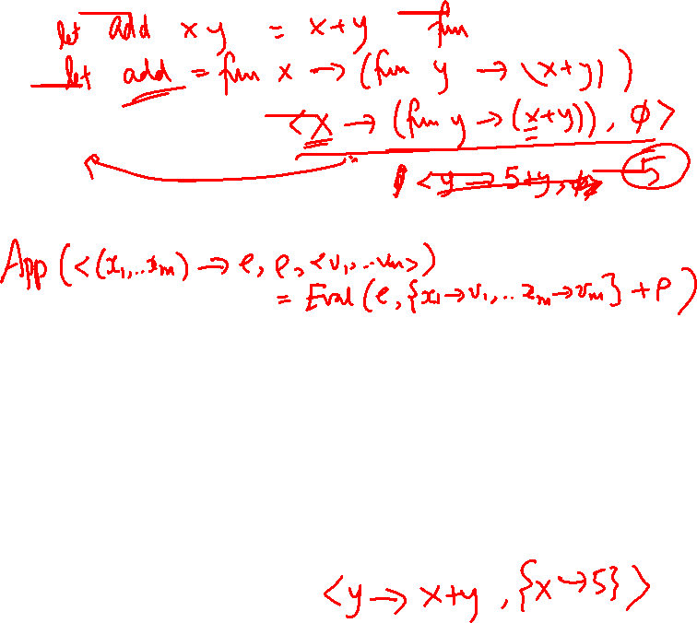
App
App (closure, value)
$$App\left( <x →e, ρ>, v\right) =Eval (e, \left\{x →v\right\}+ρ)$$
Note:
App(closure, value) is independent of any external env as “value” has no variables to look up in external env
The closure (or value, which in turn can be a closure) may have
local environments that define variables it uses.
So when applying a function, we “shut off the rest of the world” and application depends only on the given closure and value.
Eval and App and mutually recursively defined. Eval calls App, App calls Eval.

Slide 35
Closure question
If we start in an empty environment, and we execute:
let f = fun n -> n + 5;;
(* 0 *)
let pair_map g (n,m) = (g n, g m);;
let f = pair_map f;;
let a = f (4,6);;
What is the environment at (* 0 *)?

Slide 36
Answer
let f = fun n -> n + 5;;
ρ₀ = {f → <n → n + 5, { }>}

Slide 37
Closure question
If we start in an empty environment, and we execute:
let f = fun => n + 5;;
let pair_map g (n,m) = (g n, g m);;
(* 1 *)
let f = pair_map f;;
let a = f (4,6);;
What is the environment at (* 1 *)?

Slide 38
Answer
ρ₀ = {f → <n → n + 5, { }>}
let pair_map g (n,m) = (g n, g m);;
ρ₁ = { pair_map →
<g → fun (n,m) -> (g n, g m), {f → <n → n + 5, { }>}>, f → <n → n + 5, { }> }
I.e.
ρ₁ = {pair_map →
<g → fun (n,m) -> (g n, g m), ρ₀ >,
f → <n → n + 5, { }>}

Slide 39
Closure question
If we start in an empty environment, and we execute:
let f = fun => n + 5;;
let pair_map g (n,m) = (g n, g m);;
let f = pair_map f;;
(* 2 *)
let a = f (4,6);;
What is the environment at (* 2 *)?

Slide 40
Evaluate pair_map f
ρ₀ = {f → <n → n + 5, { }>}
ρ₁ = {pair_map →<g→fun (n,m) -> (g n, g m), ρ₀>,
f→<n → n + 5, { }>}
let f = pair_map f;;

Slide 41
Evaluate pair_map f
ρ₀ = {f → <n → n + 5, { }>}
ρ₁ = {pair_map →<g→fun (n,m) -> (g n, g m), ρ₀>,
f→<n → n + 5, { }>}
Eval(pair_map f, ρ₁) =
9/6/2018
41

Slide 42
Evaluate pair_map f
ρ₀ = {f → <n → n + 5, { }>}
ρ₁ = {pair_map →<g→fun (n,m) -> (g n, g m), ρ₀>,
f→<n → n + 5, { }>}
Eval(pair_map f, ρ₁)
= App(Eval (pair_map, ρ₁), Eval(f, ρ₁))
= App (<g→fun (n,m) -> (g n, g m), ρ₀>, <n → n + 5, { }>)
=
9/6/2018
42

Slide 43
Evaluate pair_map f
ρ₀ = {f → <n → n + 5, { }>}
ρ₁ = {pair_map →<g→fun (n,m) -> (g n, g m), ρ₀>,
f→<n → n + 5, { }>}
Eval(pair_map f, ρ₁)
= App (<g→fun (n,m) -> (g n, g m), ρ₀>, <n → n + 5, { }>)
= Eval (fun (n,m)->(g n, g m), {g→<n→n + 5, { }>}+ρ₀)
= <(n,m) →(g n, g m), {g→<n→n + 5, { }>}+ρ₀>
= <(n,m) →(g n, g m), {g→<n→n + 5, { }>,
f→<n→n + 5, { }>}
9/6/2018
43

Slide 44
Answer
ρ₁ = {pair_map →
<g → fun (n,m) -> (g n, g m),{f → <n → n + 5, { }>}>,
f → <n → n + 5, { }>}
let f = pair_map f;;
ρ₂ = {f → <(n,m) →(g n, g m),
{g → <n → n + 5, { }>,
f → <n → n + 5, { }>}>,
pair_map → <g → fun (n,m) -> (g n, g m),
{f → <n → n + 5, { }>}>}

Slide 45
Closure question
9/6/2018
45
If we start in an empty environment, and we execute:
let f = fun n -> n + 5;;
let pair_map g (n,m) = (g n, g m);;
let f = pair_map f;;
let a = f (4,6);;
(* 3 *)
What is the environment at (* 3 *)?
Notes:
45

Slide 46
Final Evalution?
9/6/2018
46
ρ₂ = {f → <(n,m) →(g n, g m),
{g → <n → n + 5, { }>,
f → <n → n + 5, { }>}>,
pair_map → <g → fun (n,m) -> (g n, g m),
{f → <n → n + 5, { }>}>}
let a = f (4,6);;

Slide 47
Evaluate f (4,6);;
9/6/2018
47
ρ₂ = {f → <(n,m) →(g n, g m),
{g → <n → n + 5, { }>,
f → <n → n + 5, { }>}>,
pair_map → <g → fun (n,m) -> (g n, g m),
{f → <n → n + 5, { }>}>}
Eval(f (4,6), ρ₂) =
App( Eval(f, ρ₂), Eval( (4,6), ρ₂) )

Slide 48
Evaluate f (4,6);;
48
ρ₂ = {f → <(n,m) →(g n, g m),
{g → <n → n + 5, { }>,
f → <n → n + 5, { }>}>,
pair_map → <g → fun (n,m) -> (g n, g m),
{f → <n → n + 5, { }>}>}
Eval(f (4,6), ρ₂) = = App( Eval(f, ρ₂), Eval( (4,6), ρ₂) )
= App(<(n,m) →(g n, g m), {g → <n → n + 5, { }>,
f → <n → n + 5, { }>}>,
(4,6)) =

Slide 49
Evaluate f (4,6);;
App(<(n,m) →(g n, g m), {g → <n → n + 5, { }>,
f → <n → n + 5, { }>}>,
(4,6))
= Eval((g n, g m), ρ₇)
where ρ₇ ₌ {n → 4, m → 6} +
{g → <n → n + 5, { }>,
f → <n → n + 5, { }>}
=
49

Slide 50
Evaluate f (4,6);;
App(<(n,m) →(g n, g m), {g → <n → n + 5, { }>,
f → <n → n + 5, { }>}>,
(4,6))
= Eval((g n, g m), ρ₇)
where ρ₇ ₌ {n → 4, m → 6} +
{g → <n → n + 5, { }>,
f → <n → n + 5, { }>}
= (Eval (g n, ρ₇), Eval (g m, ρ₇))
= (App (Eval (g, ρ₇), Eval (n, ρ₇))),
App (Eval (g, ρ₇), Eval (m, ρ₇))) )
= (App(<n → n + 5, { }>, 4), App (<n → n + 5, { }>, 6))
= …
50

Slide 51
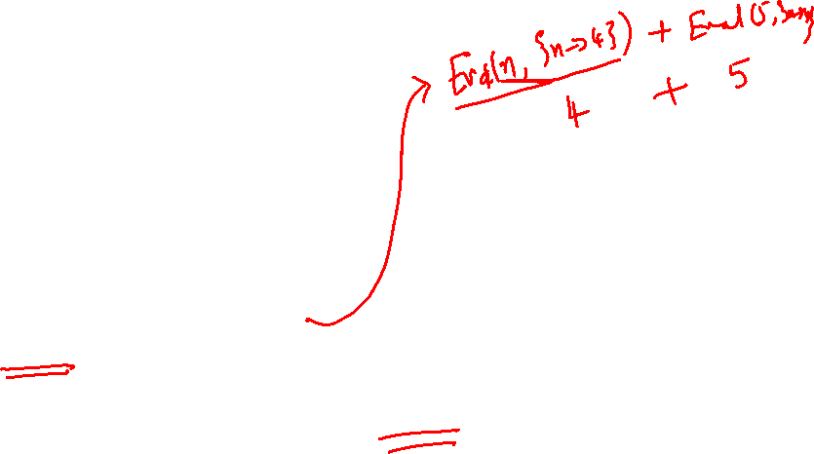
Evaluate f (4,6);;
9/10/2018
51
(App(<n → n + 5, { }>, 4),
App (<n → n + 5, { }>, 6)) =
(Eval(n + 5, {n → 4} + { }),
Eval(n + 5, {n → 6} + { })) =
(Eval(4 + 5, {n → 4} + { }),
Eval(6 + 5, {n → 6} + { })) = (9, 11)

Slide 52
A small subset of Ocaml
Syntax for expressions.
op is a primitive operator (like +, +., or ^)
$p_{i}$ is a pattern
let x = e in e’ is synonymous to let (x) = e in e’
No recursion; no lists; no free algebraic datatypes
No pattern matching in let statements
52

Slide 53
Values and evaluation
Values: a subset of expressions and closures
Evaluation
Partial-functions from expressions to values. Evaluation of an expression may be undefined if
evaluation of it does not halt, or expression is ill-formed
or calls a primitive operation that’s not defined on a value, etc.
53

Slide 54
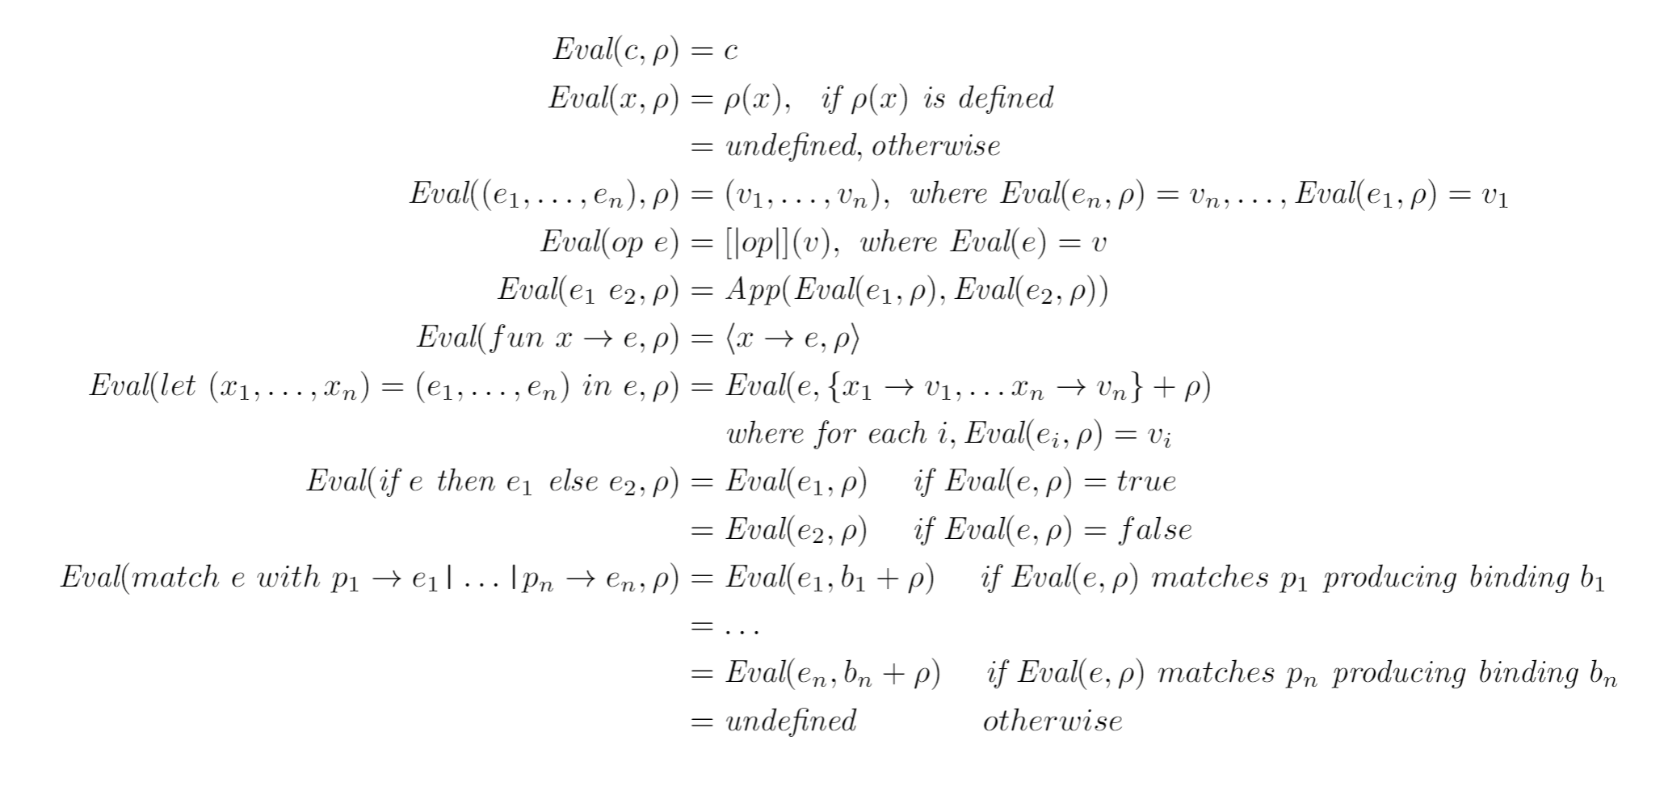
Rules of evaluation
54

Slide 55
Functions as arguments
# let thrice f x = f (f (f x));;
val thrice : ('a -> 'a) -> 'a -> 'a = <fun>
# let g = thrice plus_two;;
val g : int -> int = <fun>
# g 4;;
- : int = 10
# thrice (fun s -> "Hi! " ^ s) "Good-bye!";;
- : string = "Hi! Hi! Hi! Good-bye!"

Slide 56
Higher Order Functions
A function is higher-order if it takes a function as an argument or returns one as a result
Example:
# let compose f g = fun x -> f (g x);;
val compose : ('a -> 'b) -> ('c -> 'a) -> 'c -> 'b = <fun>
The type ('a -> 'b) -> ('c -> 'a) -> 'c -> 'b is a higher order type because of ('a -> 'b) and ('c -> 'a) and -> 'c -> 'b

Slide 57
Thrice
Recall:
# let thrice f x = f (f (f x));;
val thrice : ('a -> 'a) -> 'a -> 'a = <fun>
How do you write thrice with compose?

Slide 58
Thrice
Recall:
# let thrice f x = f (f (f x));;
val thrice : ('a -> 'a) -> 'a -> 'a = <fun>
How do you write thrice with compose?
# let thrice f = compose f (compose f f);;
val thrice : ('a -> 'a) -> 'a -> 'a = <fun>
Is this the only way?

Slide 59
Lambda lifting
You must remember the rules for evaluation when you use partial application
# let add_two =
(let two = (print_string "test\n"; 2) in
(fun x -> x + two));;
test
val add_two : int -> int = <fun>
# let add2 =
fun x -> (let two = (print_string "test\n"; 2) in (x+two));;
val add2 : int -> int = <fun>

Slide 60
Lambda Lifting
# thrice add_two 5;;
- : int = 11
# thrice add2 5;;
test
test
test
- : int = 11
Lambda lifting delayed the evaluation of the argument to (+) until the second argument was supplied

Slide 61
Match Expressions
# let triple_to_pair triple =
match triple
with (0, x, y) -> (x, y)
| (x, 0, y) -> (x, y)
| (x, y, _) -> (x, y);;
val triple_to_pair : int * int * int -> int * int = <fun>
Each clause: pattern on left, expression on right
Each x, y has scope of only its clause
Use first matching clause

