Slide 1

CS 420/CSE 402/ECE 492
Introduction to Parallel Programming for Scientists and Engineers
Fall 2012
Department of Computer Science
University of Illinois at Urbana-Champaign

Slide 2
Topics covered
Parallel algorithms
Parallel programing languages
Parallel programming techniques focusing on tuning programs for performance.
The course will build on your knowledge of algorithms, data structures, and programming. This is an advanced course in Computer Science.

Slide 3
Why parallel programming for scientists and engineers ?
Science and engineering computations are often lengthy.
Parallel machines have more computational power than their sequential counterparts.
Faster computing → Faster science/design
If fixed resources: Better science/engineering
Yesterday: Top of the line machines were parallel
Today: Parallelism is the norm for all classes of machines, from mobile devices to the fastest machines.

Slide 4
CS420/CSE402/ECE492
Developed to fill a need in the computational sciences and engineering program.
CS majors can also benefit from this course. However, there is a parallel programming course for CS majors that will be offered in the Spring semester.

Slide 5
Course organization
Course website: https://agora.cs.illinois.edu/display/cs420fa10/Home
Instructor: David Padua
4227 SC
padua@uiuc.edu
3-4223
Office Hours: Wednesdays 1:30-2:30 pm
TA: Osman Sarrod
sarood1@illinois.edu
Grading: 6 Machine Problems(MPs) 40%
Homeworks Not graded
Midterm (Wednesday, October 10) 30%
Final (Comprehensive, 8 am Friday, December 14) 30%
Graduate students registered for 4 credits must complete additional work (associated with each MP).

Slide 6
MPs
Several programing models
Common language will be C with extensions.
Target machines will (tentatively) be those in the Intel(R) Manycore Testing Lab.

Slide 7
MP Plan
MP# | Assign Date | Due Date | Grade Date
MP1 | 9/7 | 9/17 | 10/1
MP2 | 9/17 | 9/26 | 10/8
MP3 | 9/26 | 10/5 | 10/19
MP4 | 10/10 | 10/19 | 11/2
MP5 | 10/19 | 11/2 | 11/16
MP6 | 11/2 | 11/12 | 12/3
MP7 | 11/12 | 11/30 | 12/12

Slide 8

Textbook
G. Hager and G. Wellein. Introduction to High Performance Computing for Scientists and Engineers.
CRC Press

Slide 9
Specific topics covered
Introduction
Scalar optimizations
Memory optimizations
Vector algorithms
Vector programming in SSE
Shared-memory programming in OpenMP
Distributed memory programming in MPI
Miscellaneous topics (if time allows)
  Compilers and parallelism
  Performance monitoring
  Debugging

Slide 10
Parallel computing

Slide 11
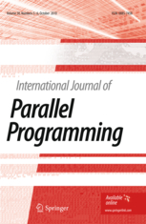









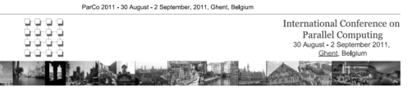

An active subdiscipline
The history of computing is intertwined with parallelism.
Parallelism has become an extremely active discipline within Computer Science.

Slide 12
What makes parallelism so important ?
One reason is its impact on performance
  For a long time, the technology of high-end machines
  Today the most important driver of performance for all classes of machines

Slide 13
Parallelism in hardware
Parallelism is pervasive. It appears at all levels
  Within a processor
    Basic operations
    Multiple functional units
    Pipelining
    SIMD
  Multiprocessors
Multiplicative effect on performance

Slide 14
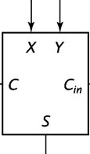

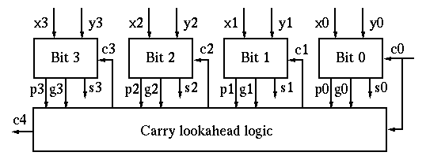
Parallelism in hardware (Adders)
Adders could be serial
Parallel
Or highly parallel

Slide 15
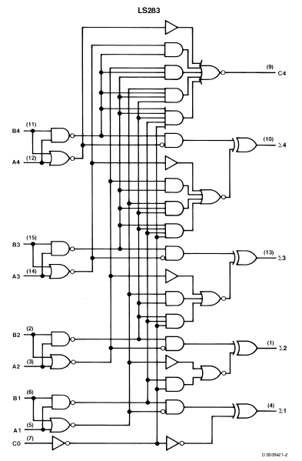
Carry lookahead logic

Slide 16
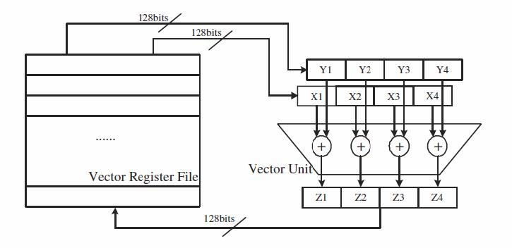
Parallelism in hardware
(Scalar vs SIMD array operations)
ldv vr1, addr1
ldv vr2, addr2
addv vr3, vr1, vr2
stv vr3, addr3
n
times
ld r1, addr1
ld r2, addr2
add r3, r1, r2
st r3, addr3
for (i=0; i<n; i++)
c[i] = a[i] + b[i];
n/4
times
32 bits
32 bits
Y1
X1
Register File
+
…
Z1
32 bits

Slide 17
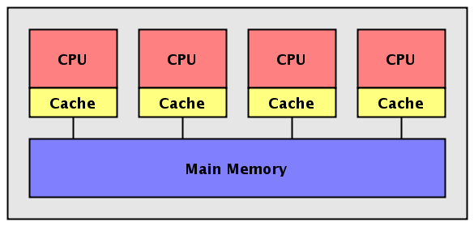
Parallelism in hardware (Multiprocessors)
Multiprocessing is the characteristic that is most evident in clients and high-end machines.

Slide 18
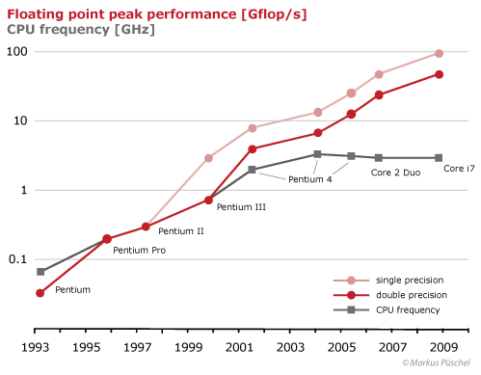
Clients: Intel microprocessor performance
Knights Ferry
MIC co-processor
(Graph from Markus Püschel, ETH)

Slide 19
High-end machines: Top 500 number 1

Slide 20
Research/development in parallelism
Produced impressive achievements in hardware and software
Numerous challenges
Hardware:
  Machine design,
  Heterogeneity,
  Power
Applications
Software:
  Determinacy,
  Portability across machine classes,
  Automatic optimization

Slide 21
Issues in applications

Slide 22
Applications at the high-end
Numerous applications have been developed in a wide range of areas.
  Science
  Engineering
  Search engines
  Experimental AI
Tuning for performance requires expertise.
Although additional computing power is expected to help advances in science and engineering, it is not that simple:

Slide 23
More computational power is only part of the story
“increase in computing power will need to be accompanied by changes in code architecture to improve the scalability, … and by the recalibration of model physics and overall forecast performance in response to increased spatial resolution” *
“…there will be an increased need to work toward balanced systems with components that are relatively similar in their parallelizability and scalability”.*
Parallelism is an enabling technology but much more is needed.
*National Research Council: The potential impact of high-end capability computing on four illustrative fields of science and engineering. 2008

Slide 24


Applications for clients / mobile devices
A few cores can be justified to support execution of multiple applications.
But beyond that, … What app will drive the need for increased parallelism ?
New machines will improve performance by adding cores. Therefore, in the new business model: software scalability needed to make new machines desirable.
Need app that must be executed locally and requires increasing amounts of computation.
Today, many applications ship computations to servers (e.g. Apple’s Siri). Is that the future. Will bandwidth limitations force local computations ?

Slide 25
Issues in libraries

Slide 26
Library routines
Easy access to parallelism. Already available in some libraries (e.g. Intel’s MKL).
Same conventional programming style. Parallel programs would look identical to today’s programs with parallelism encapsulated in library routines.
But, …
  Libraries not always easy to use (Data structures). Hence not always used.
  Locality across invocations an issue.
  In fact, composability for performance not effective today

Slide 27
Implicit parallelism

Slide 28
Objective:
Compiling conventional code
Since the Illiac IV times
“The ILLIAC IV Fortran compiler's Parallelism Analyzer and Synthesizer (mnemonicized as the Paralyzer) detects computations in Fortran DO loops which can be performed in parallel.” (*)
(*) David L. Presberg. 1975. The Paralyzer: Ivtran's Parallelism Analyzer and Synthesizer. In Proceedings of the
Conference on Programming Languages and Compilers for Parallel and Vector Machines. ACM, New York, NY, USA, 9-16.

Slide 29
Benefits
Same conventional programming style. Parallel programs would look identical to today’s programs with parallelism extracted by the compiler.
Machine independence.
Compiler optimizes program.
Additional benefit: legacy codes
Much work in this area in the past 40 years, mainly at Universities.
Pioneered at Illinois in the 1970s

Slide 30
The technology
Dependence analysis is the foundation.
It computes relations between statement instances
These relations are used to transform programs
  for locality (tiling),
  parallelism (vectorization, parallelization),
  communication (message aggregation),
  reliability (automatic checkpoints),
  power …

Slide 31
The technology
Example of use of dependence
Consider the loop
for (i=1; i<n; i++) {
for (j=1; j<n; j++) {
a[i][j]=a[i][j-1]+a[i-1][j];
}}
Notes:
nested loop, with a single statement S1
Each line corresponds to a statement instace of the j iteration.

Slide 32
The technology
Example of use of dependence
Compute dependences (part 1)
for (i=1; i<n; i++) {
for (j=1; j<n; j++) {
a[i][j]=a[i][j-1]+a[i-1][j];
}}
i=1
i=2
j=1
a[1][1] = a[1][0] + a[0][1]
a[1][2] = a[1][1] + a[0][2]
a[1][3] = a[1][2] + a[0][3]
a[1][4] = a[1][3] + a[0][4]
a[2][1] = a[2][0] + a[1][1]
a[2][2] = a[2][1] + a[1][2]
a[2][3] = a[2][2] + a[1][3]
a[2][4] = a[2][3] + a[1][4]
j=2
j=3
j=4
Notes:
nested loop, with a single statement S1
Each line corresponds to a statement instace of the j iteration.

Slide 33
The technology
Example of use of dependence
Compute dependences (part 2)
for (i=1; i<n; i++) {
for (j=1; j<n; j++) {
a[i][j]=a[i][j-1]+a[i-1][j];
}}
i=1
i=2
j=1
a[1][1] = a[1][0] + a[0][1]
a[1][2] = a[1][1] + a[0][2]
a[1][3] = a[1][2] + a[0][3]
a[1][4] = a[1][3] + a[0][4]
a[2][1] = a[2][0] + a[1][1]
a[2][2] = a[2][1] + a[1][2]
a[2][3] = a[2][2] + a[1][3]
a[2][4] = a[2][3] + a[1][4]
j=2
j=3
j=4
Notes:
nested loop, with a single statement S1
Each line corresponds to a statement instace of the j iteration.

Slide 34
The technology
Example of use of dependence
for (i=1; i<n; i++) {
for (j=1; j<n; j++) {
a[i][j]=a[i][j-1]+a[i-1][j];
}}
i
1
2
3
4
…
1,1
1
2
or
j
3
4
Notes:
nested loop, with a single statement S1
Each line corresponds to a statement instace of the j iteration.

Slide 35
The technology
Example of use of dependence3.
Find parallelism
for (i=1; i<n; i++) {
for (j=1; j<n; j++) {
a[i][j]=a[i][j-1]+a[i-1][j];
}}
Notes:
nested loop, with a single statement S1
Each line corresponds to a statement instace of the j iteration.

Slide 36
The technology
Example of use of dependence
Transform the code
for (i=1; i<n; i++) {
for (j=1; j<n; j++) {
a[i][j]=a[i][j-1]+a[i-1][j];
}}
for k=4; k<2*n; k++) forall (i=max(2,k-n):min(n,k-2)) a[i][k-i]=...
Notes:
nested loop, with a single statement S1
Each line corresponds to a statement instace of the j iteration.

Slide 37
How well does it work ?
Depends on three factors:
The accuracy of the dependence analysis
The set of transformations available to the compiler
The sequence of transformations

Slide 38
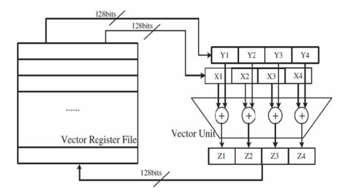
How well does it work ?
Our focus here is on vectorization
Vectorization important:
  Vector extensions are of great importance. Easy parallelism. Will continue to evolve
    SSE
    AltiVec
  Longest experience
  Most widely used. All compilers has a vectorization pass (parallelization less popular)
  Easier than parallelization/localization
  Best way to access vector extensions in a portable manner
    Alternatives: assembly language or machine-specific macros

Slide 39
How well does it work ?
Vectorizers - 2005
G. Ren, P. Wu, and D. Padua: An Empirical Study on the Vectorization of Multimedia Applications for Multimedia Extensions. IPDPS 2005

Slide 40
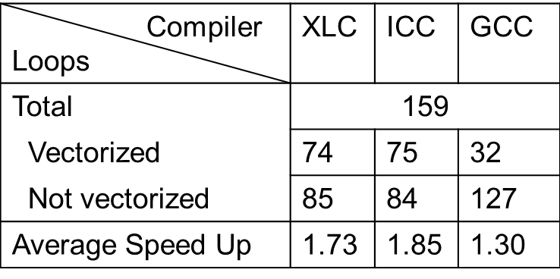
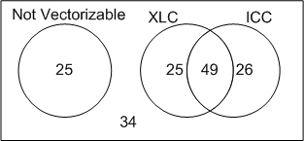
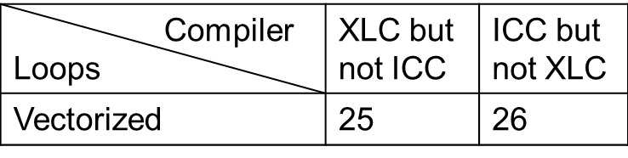
How well does it work ?
Vectorizers - 2010
S. Maleki, Y. Gao, T. Wong, M. Garzarán, and D. Padua. An Evaluation of Vectorizing Compilers.
International Conference on Parallel Architecture and Compilation Techniques. PACT 2011.

Slide 41
Going forward
It is a great success story. Practically all compilers today have a vectorization pass (and a parallelization pass)
But… Research in this are stopped a few years back. Although all compilers do vectorization and it is a very desirable property.
Some researchers thought that the problem was impossible to solve.
However, work has not been as extensive nor as long as work done in AI for chess of question answering.
No doubt that significant advances are possible.

Slide 42

What next ?
3-10-2011
Inventor, futurist predicts dawn of total artificial intelligence
Brooklyn, New York (VBS.TV) -- ...Computers will be able to improve their own source codes ... in ways we puny humans could never conceive.

Slide 43
Explicit parallelism

Slide 44



Accomplishments of the last decades in programming notation
Much has been accomplished
Widely used parallel programming notations
  Distributed memory (SPMD/MPI) and
  Shared memory (pthreads/OpenMP/TBB/Cilk/ArBB).

Slide 45
Languages
OpenMP constitutes an important advance, but its most important contribution was to unify the syntax of the 1980s (Cray, Sequent, Alliant, Convex, IBM,…).
MPI has been extraordinarily effective.
Both have mainly been used for numerical computing. Both are widely considered as “low level”.

Slide 46
The future
Higher level notations
Libraries are a higher level solution, but perhaps too high-level.
Want something at a lower level that can be used to program in parallel.
The solution is to use abstractions.

Slide 47
Array operations in MATLAB
An example of abstractions are array operations.
They are not only appropriate for parallelism, but also to better represent computations.
In fact, the first uses of array operations does not seem to be related to parallelism. E.g. Iverson’s APL (ca. 1960). Array operations are also powerful higher level abstractions for sequential computing
Today, MATLAB is a good example of language extensions for vector operations

Slide 48
Array operations in MATLAB
Matrix addition in scalar mode
for i=1:m,
for j=1:l,
c(i,j)= a(i,j) + b(i,j);
end
end
Matrix addition in array notation
c = a + b;

