Slide 1
CS 414 – Multimedia Systems Design Lecture 40 – P2P Streaming (Part 4)
Klara Nahrstedt

Slide 2
Administrative
MP3 deadline Saturday May 3, 5pm
Demonstrations of MP3, May 5, 5-7pm
Groups should sign up as follows:
Top four groups will be decided Monday, May 5 in the evening (via email, also posted on the newsgroup/class website) - these groups will compete in front of the Google judges on Tuesday, May 6

Slide 3
Administrative
Competition of final four groups on Tuesday 5-7pm in 216/218 SC
Google company – judging competition (and TA/Instructor)
The top four groups should prepare 3-4 power-point slides to present
Intro Slide – name of your system and your names (1 slide)
System Design – overall architecture (1 slide)
Features of Your System - interface (1 slide)
Features of Your System – other features (1 slide)

Slide 4
Administrative
Homework 2 is posted
Deadline May 7, Wednesday midnight 11:59pm
Peer Evaluations – due Friday, May 9, midnight
Peer Evaluation Form and Explanation - available on the class website
Submit your Peer Evaluation to klara@illinois.edu
Note: if you do not submit your peer evaluations, you get 0 for self-evaluation and 100% for your group mates.
¼ Unit projects – due Friday, May 9 midnight (if you need more time, arrange deadline with instructor)

Slide 5
Final Exam
May 15, 1:30-4:30pm in 216 SC
More information on Wednesday about final exam format/review session

Slide 6
Outline
P2P Streaming for IPTV
Example PPLive
Voice over IP
Example Lync, MSF

Slide 7
P2P Applications
Many P2P applications since the 1990s
File sharing
Napster, Gnutella, KaZaa, BitTorrent
Internet telephony
Skype, VoIP
Internet television
PPLive, CoolStreaming

Slide 8
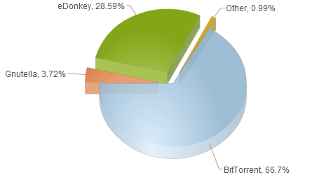
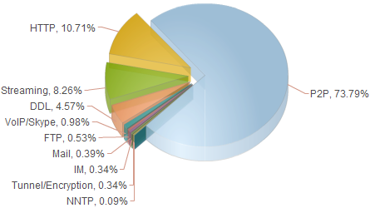
Traffic Distribution (2007)
Source: http://liquidculture.wordpress.com/2008/03/14/the-absolute-majority-of-all-internet-traffic-is-p2p-file-sharing/

Slide 9
Mixed News 2014 on P2P
Some companies are moving away from P2P, some are deploying P2P
Spotify (music company) is phasing out P2P streaming
Netflix considers P2P streaming to beat bandwidth crunch

Slide 10
PPLive – P2P Application

Slide 11
Case Study: PPLive
Very popular P2P IPTV application
From Huazhong U. of Science and Technology, China
Free for viewers
Over 100,000 simultaneous viewers and 500,00 viewers daily (and increasing)
100s of channels
Windows Media Video and Real Video format

Slide 12
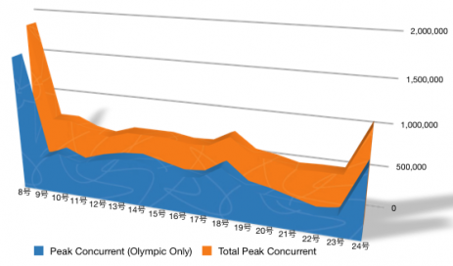
PPLive Current Viewers during Olympics 2008

Slide 13
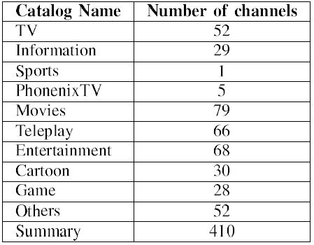
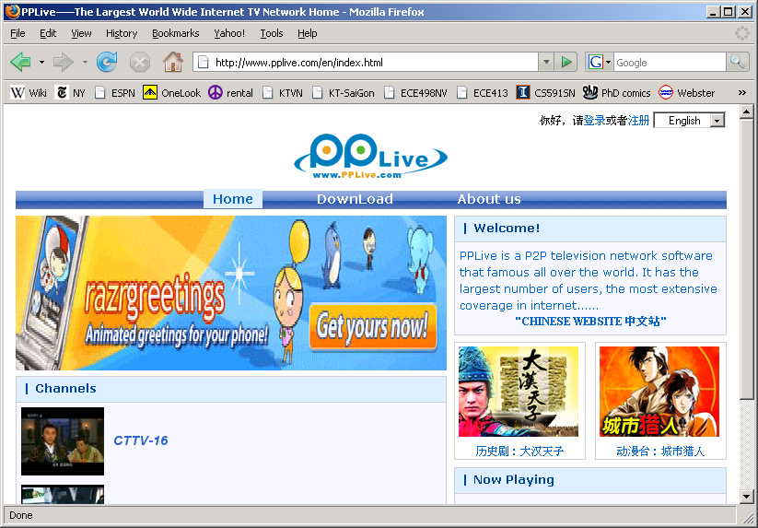
PPLive Overview

Slide 14
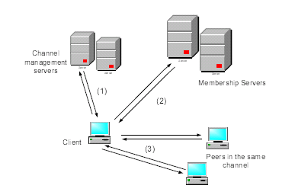
PPLive Design Characteristics
Gossip-based protocols
Peer management
Channel discovery
TCP used for signaling
Data-driven p2p streaming
TCP used for video streaming
Peer client contacts multiple active peers to download media content of the channel
Cached contents can be uploaded from a client peer to other peers watching the same channel
Received video chunks are reassembled in order and buffered in queue of PPLive TV Engine (local streaming)

Slide 15
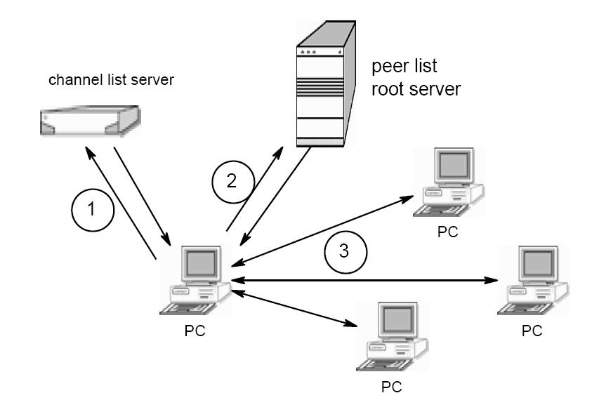
PPLive Architecture
Contact channel server for available channels
Retrieve list of peers watching selected channel
Find active peers on channel to share video chunks
Source: “Insights into PPLive: A Measurement
Study of a Large-Scale P2P IPTV System” by Hei et al.

Slide 16
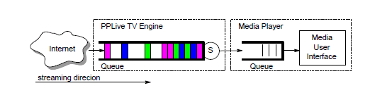
P2P Streaming Process
TV Engine – responsible for
downloading video chunks from PPLive network
streaming downloaded video to local media player

Slide 17
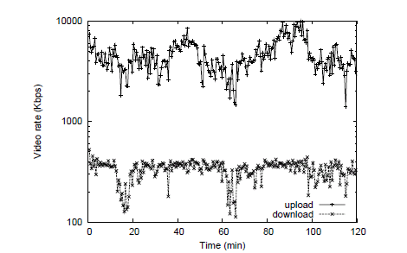
Download and Upload Video Rate over Time at CCTV3 Campus

Slide 18
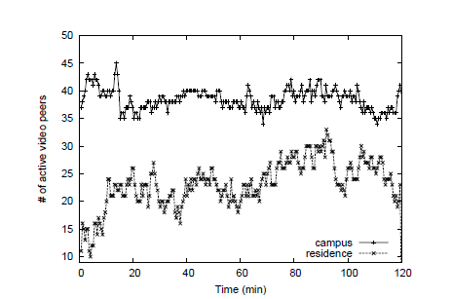
Evolution of active video peer connections on CCTV3 Network

Slide 19
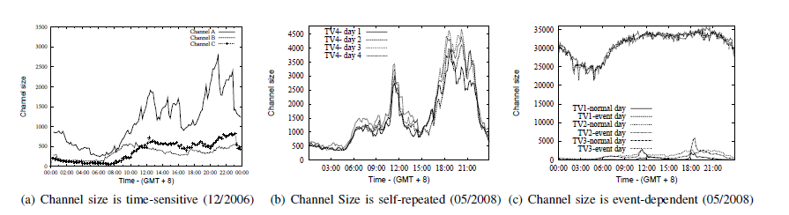
PPLive Channel Size Analysis

Slide 20
Background
Large-scale video broadcast over Internet (Internet TV such as PPLIve, YouTube)
Real-time video streaming
Need to support large numbers of viewers
AOL Live 8 broadcast peaked at 175,000 (July 2005)
CBS NCAA broadcast peaked at 268,000 (March 2006)
NBC Olympic Games in 2008 served total 75.5 million streams
BBC served almost 40 million streams of Olympic Games 2008 (http://newteevee.com/2008/08/28/final-tally-olympics-web-and-p2p-numbers/)
Very high data rate
TV quality video encoded with MPEG-4 would require 1.5 Tbps aggregate capacity for 100 million viewers
NFL Superbowl 2007 had 93 million viewers in the U.S. (Nielsen Media Research)

Slide 21
Voice over IP
Voice over IP via Telecom IP Networks (this lecture)
Peer-to-Peer Internet Voice Distribution (next lecture)

Slide 22
Voice over IP (VoIP)
VoIP – transport of voice over IP-based networks
Complexity ranges from
Hobbyists using Internet to get free phone calls on peer-to-peer basis to
Full scale PSTN (Public-Switched Telephone Network) replacement networks
VoIP must address
Types of end user terminals - IP phones, PC clients
Quality of Service – ensure agreed quality
Security risks must be clearly identified
Last mile bandwidth – which affects codec, packetization period and where to use compression to best meet service goals
Signaling protocol must support service set required

Slide 23
Next Generation VoIP Network (MSF – Multi-service Switching Forum Example)

Slide 24
MSF VoIP
Access Services Signaling protocol and network service signaling protocol: SIP
Use RTP packets for telephony events
Transport DTMF(Dual-tone multi-frequency signaling) tones out of band using the signaling protocol such as SIP
Quality of Service (Delay, Jitter, Packet loss)
Use RSVP, DiffServ, MPLS, even ATM
RTP is used for media traffic

Slide 25
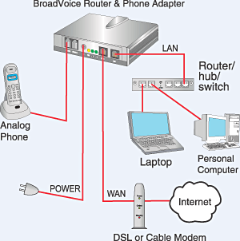
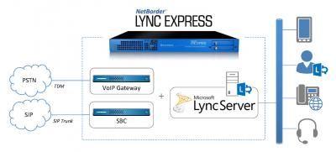
Voice over IP in Residential Areas (e.g., Microsoft Lync)

Slide 26
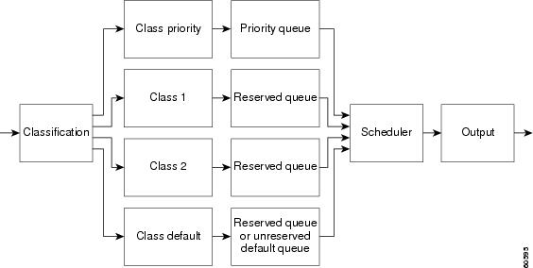
VoIP Issues - QoS (Low Latency Queuing)

Slide 27
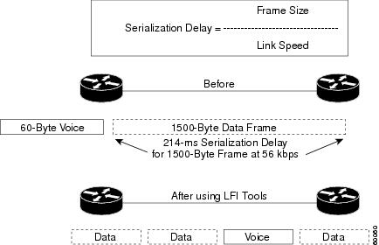
VoIP Issues - Fragmentation and Interleaving in VoIP
http://www.cisco.com/c/en/us/td/docs/ios/solutions_docs/qos_solutions/QoSVoIP/QoSVoIP.html#wp1034022

Slide 28
Conclusion
P2P Video Streaming
IPTV
P2PTV
Voice over Internet
Traditional VoIP over IP-based telephone network with P reservation, IP QoS, …(Vonage, Lync)
New VoIP over P2P network using P2P streaming mechanisms (next Lecture)

