Slide 1
CS 414 – Multimedia Systems Design Lecture 39 – P2P Streaming (Part 3)
Klara Nahrstedt

Slide 2
Administrative
MP3 deadline Saturday May 3, 5pm
If you have bonus days (max 2 days) – you can deliver MP3 by May 5, 5pm
Demonstrations of MP3, May 5, 5-7pm
Top four groups will be decided Monday, May 5 at 7pm (via email, also posted on the newsgroup/classwebsite) - these groups will compete in front of the judges on Tuesday, May 6
Google Competition of MP3, May 6, 5-7pm and 7-8pm pizza and drinks with prizes from Google. (Rooms will be advertised).

Slide 3
Administrative
Homework 2 is posted today
Deadline May 7, Wednesday midnight 11:59pm
Peer Evaluations – due Friday, May 9, midnight
Peer Evaluation Form and Explanation - available on the class website
Submit your Peer Evaluation to klara@illinois.edu
Note: if you do not submit your peer evaluations, you get 0 for self-evaluation and 100% for your group mates.
¼ Unit projects – due Friday, May 9 midnight (if you need more time, arrange deadline with instructor)

Slide 4
Outline
True On-Demand P2P Streaming
PPLive

Slide 5
P2P Streaming (We have discussed streaming of a movie at the same time )
Common arrangements to multicast the stream
Single Tree
Multiple Tree
Mesh-based
All nodes are usually interested in the stream
They all have to deal with node dynamism (join/leave/fail/capacity-changes)

Slide 6
Mesh-based streaming
Basic idea
Report to peers the packets that you have
Ask peers for the packets that you are missing
Adjust connections depending on in/out bandwidth
(mesh uses MDC)
Description 0/1/2
Description 0/1/2
Description 0
Description 1,2
(Nodes are randomly connected to their peers, instead of statically)
Description 0,1,2
Description 1

Slide 7
Content delivery
(Levels determined by hops to source)
Description 0
Description 2
Description 1
1
2
3
4
5
6
7
8
9
10
11
12
13
14
15
16
17
(1) Diffusion Phase ( ) (2) Swarming Phase ( )

Slide 8
Diffusion Phase
Have segment 0
Segment 1
Segment 0
…
2₂
4₀
3₀
2₀
1₀
Send me
Segment 0
…
1₂
…
3
4₂
3₂
2₂
1₂
(during period 0)
As a new segment (set of packets) of length L becomes available at source every L seconds
Level 1 nodes pull data units from source, then level 2 pulls from level 1, etc.
Recall that reporting and pulling are performed periodically
3
Have segment 0
2₂
1₂
Send me
Segment 0
9
(during period 1)
(drawings follow previous example)

Slide 9
Swarming Phase
1₀
2
2₀
2₁
7
1₁
9
1₁
2₁
10
11
12
13
14
15
16
17
2₀
1₀
2₁
1₁
At the end of the diffusion all nodes have at least one data unit of the segment
Pull missing data units from (swarm-parent) peers located at same or lower level
Can node 9 pull new data units from node 16?
Node 9 cannot pull data in a single swarm interval
(drawings follow previous example)

Slide 10
Comments on Single Tree/Multi-tree/Mesh Overlay P2P vs IP Multicast
Gatech
Stan1
Stanford
Source:
Purdue
Stan2
Dumb Network
Berk1
Overlay Tree
Berkeley
Stan1
Berk2
Gatech
Stan2
Purdue
Berk1
Berk2
Source: Sanjay Rao’s lecture from Purdue

Slide 11
Overlay Performance
Even a well-designed overlay cannot be as efficient as IP Mulitcast
But performance penalty can be kept low
Trade-off some performance for other benefits
Duplicate Packets:
Bandwidth Wastage
Gatech
Stanford
Dumb Network
Increased Delay
Berkeley
Source: Sanjay Rao’s lecture from Purdue

Slide 12
P2P Streaming (Demand the same movie at different times)
Create true-on-demand P2P streaming service (demand movie any time)
Few Rules:
All peers have connection to the source of the movie
Each peer should keep track of which peer has what chunks and where to find the next chunk
From neighboring peer
From source

Slide 13
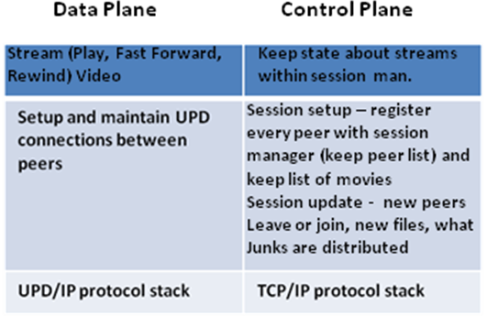
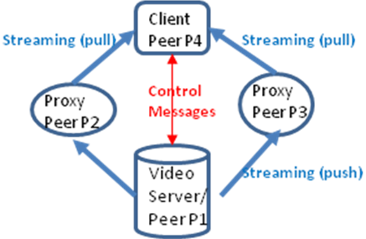
Example Design of an on-demand P2P Streaming Service

Slide 14
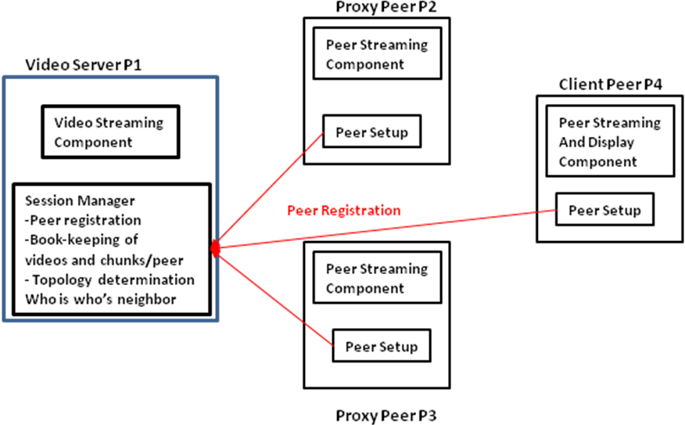
Example of on-demand P2P streaming service
Centralized chunk management
Chunk manager will reside on video server P1
For P2P streaming need to consider
Buffer sizes at each peer
Frame rate of movie (video)
Chunk size
Demand time of each peer for movie
Which peer has which chunks

Slide 15
Example: P2P on-demand streaming protocol
Consider when P2, P3, P4 start to PLAY the same movie M1:
At time t= 0, start one peer (e.g., P2) to play a movie M1, i.e., this peer will start to cache chunks from the server (assume you have 40 seconds buffer size at each peer). The server as part of the chunk management should keep a table specifying that peer P2 has ‘what’ chunks.
At t = 5 seconds, second peer joins (e.g., P3) and requests to play movie M1. P3 goes to the server P1 and requests the name of the peers who have chunks to play movie M1. Server P1 returns to P3 information about P2 and the chunks that peer P2 already received from server P1.
Peer P3 starts to request/pull chunks from the peer P2, and peer P3 plays the movie M1 as well as peer P2 plays the movie M1 (ahead of peer P3). P3 should inform the server P1 at regular intervals (e.g., every 2 seconds) what chunks it has.

Slide 16
Example (2)
At t = 20 seconds, peer P4 requests to play movie M1. P4 goes to the server P1 and requests the names of peers who have chunks to play movie M1. Server P1 should return that peer P2 has chunks F1-FF and peer P3 has chunks K1-KK.
Peer P4 starts to request/pull chunks from peers P2 and P3 to play movie M1. If a chunk exists in both P2 and P3, P4 MUST request the chunk from either P2 or P3 at random. P4 should inform server P1 at regular intervals what chunks it has.
At this point all peers P2, P3, P4 should play the movie M1 but movie M1 on peer P2 should be ahead of movie M1 on peers P3 and movie M1 on peer P3 should be ahead of movie M1 on peer P4.

Slide 17
P2P Applications
Many P2P applications since the 1990s
File sharing
Napster, Gnutella, KaZaa, BitTorrent
Internet telephony
Skype
Internet television
PPLive, CoolStreaming

Slide 18
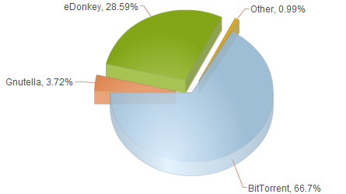
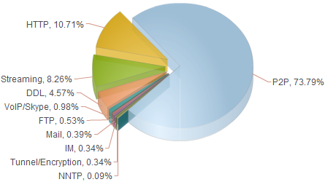
Traffic Distribution (2007)
Source: http://liquidculture.wordpress.com/2008/03/14/the-absolute-majority-of-all-internet-traffic-is-p2p-file-sharing/

Slide 19
Some News 2014 on P2P
Some companies are moving away from P2P, some are deploying P2P
Spotify (music company) is phasing out P2P streaming
Netflix considers P2P streaming to beat bandwidth crunch

Slide 20
PPLive – P2P Application

Slide 21
Case Study: PPLive
Very popular P2P IPTV application
From Huazhong U. of Science and Technology, China
Free for viewers
Over 100,000 simultaneous viewers and 500,00 viewers daily (and increasing)
100s of channels
Windows Media Video and Real Video format

Slide 22
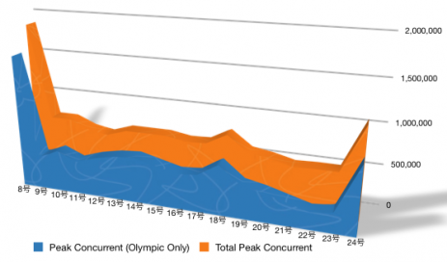
PPLive Current Viewers during Olympics 2008

Slide 23
PPLive Overview

Slide 24
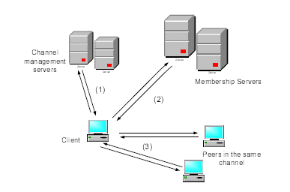
PPLive Design Characteristics
Gossip-based protocols
Peer management
Channel discovery
TCP used for signaling
Data-driven p2p streaming
TCP used for video streaming
Peer client contacts multiple active peers to download media content of the channel
Cached contents can be uploaded from a client peer to other peers watching the same channel
Received video chunks are reassembled in order and buffered in queue of PPLive TV Engine (local streaming)

Slide 25
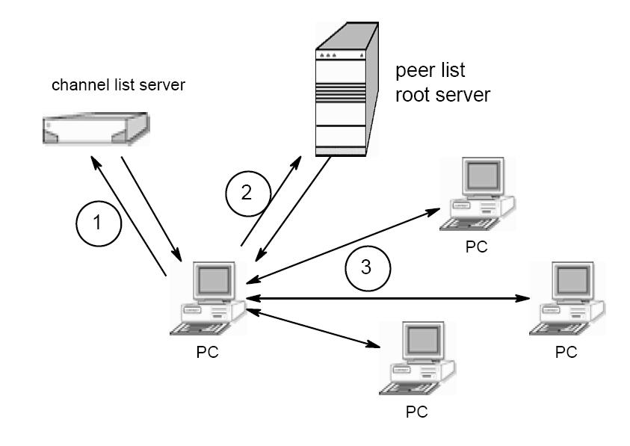
PPLive Architecture
Contact channel server for available channels
Retrieve list of peers watching selected channel
Find active peers on channel to share video chunks
Source: “Insights into PPLive: A Measurement
Study of a Large-Scale P2P IPTV System” by Hei et al.

Slide 26
P2P Streaming Process
TV Engine – responsible for
downloading video chunks from PPLive network
streaming downloaded video to local media player

Slide 27
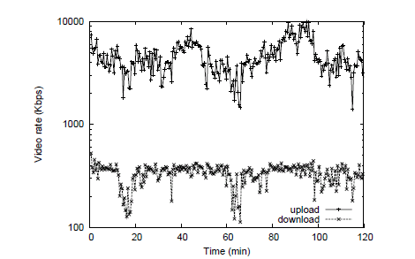
Download and Upload Video Rate over Time at CCTV3 Campus

Slide 28
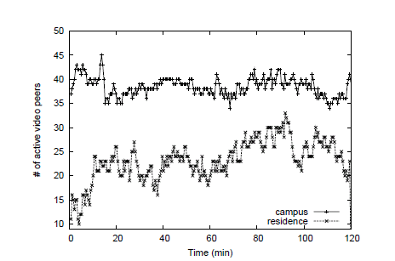
Evolution of active video peer connections on CCTV3 Network

Slide 29
PPLive Channel Size Analysis

Slide 30
Background
Large-scale video broadcast over Internet (Internet TV such as PPLIve, YouTube)
Real-time video streaming
Need to support large numbers of viewers
AOL Live 8 broadcast peaked at 175,000 (July 2005)
CBS NCAA broadcast peaked at 268,000 (March 2006)
NBC Olympic Games in 2008 served total 75.5 million streams
BBC served almost 40 million streams of Olympic Games 2008 (http://newteevee.com/2008/08/28/final-tally-olympics-web-and-p2p-numbers/)
Very high data rate
TV quality video encoded with MPEG-4 would require 1.5 Tbps aggregate capacity for 100 million viewers
NFL Superbowl 2007 had 93 million viewers in the U.S. (Nielsen Media Research)

Slide 31
Conclusion
Couple of Lessons Learned
Structure of PPLive overlay is close to random
PPLive peers slightly peer to have closer neighbors and peers can attend simultaneous overlays
Improves streaming quality
Geometrically distributed session lenghts of nodes can be used to accurately model node arrival and departure
Major differences between PPLive overlays and P2P file-sharing overlays!!!

Slide 32
Reading
“Opportunities and Challenges of Peer-to-Peer Internet Video Broadcast” by Liu et al.
“Insights into PPLive: A Measurement Study of a Large-Scale P2P IPTV System” by Hei et al.
“Mapping the PPLive Network: Studying the Impacts of Media Streaming on P2P Overlays” by Vu et al.
Some lecture material borrowed from the following sources
Sanjay Rao’s lecture on P2P multicast in his ECE 695B course at Purdue
“Insights into PPLive: A Measurement Study of a Large-Scale P2P IPTV System” by Hei et al.
“Mapping the PPLive Network: Studying the Impacts of Media Streaming on P2P Overlays” by Vu et al.

