Slide 1
Filesystems
Based on slides by Matt Welsh, Harvard

Slide 2
Announcements
MP8 due tomorrow night
Finals approaching, know your times and conflicts
Ours: Friday May 11, 1:30 – 4:30 pm
Review material similar to midterm released by Friday
Topic outline
Practice final exam
Review sessions
Vote on Piazza for times that work for you
Do this by midnight Tuesday; results announced Wed.
Honors section demos
Vote on Piazza for times that work for you
Do this by Wednesday

Slide 3
Filesystems
A filesystem provides a high-level application access to disk
As well as CD, DVD, tape, floppy, etc...
Masks the details of low-level sector-based I/O operations
Provides structured access to data (files and directories)
Caches recently-accessed data in memory
Hierarchical filesystems: Most common type
Organized as a tree of directories and files
Byte-oriented vs. record-oriented files
UNIX, Windows, etc. all provide byte-oriented file access
May read and write files a byte at a time
Many older OS's provided only record-oriented files
File composed of a set of records; may only read and write a record at a time
Versioning filesystems
Keep track of older versions of files
e.g., VMS filesystem: Could refer to specific file versions:foo.txt;1, foo.txt;2

Slide 4
Filesystem Operations
Filesystems provide a standard interface to files and directories:
Create a file or directory
Delete a file or directory
Open a file or directory – allows subsequent access
Read, write, append to file contents
Add or remove directory entries
Close a file or directory – terminates access
What other features do filesystems provide?
Accounting and quotas – prevent your classmates from hogging the disks
Backup – some filesystems have a “$HOME/.backup” containing automatic snapshots
Indexing and search capabilities
File versioning
Encryption
Automatic compression of infrequently-used files
Should this functionality be part of the filesystem or built on top?
Classic OS community debate: Where is the best place to put functionality?

Slide 5
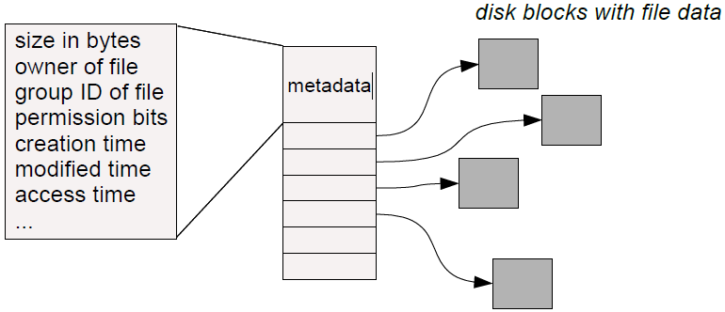
Basic Filesystem Structures
Every file and directory is represented by an inode
Stands for “index node”
Contains two kinds of information:
1) Metadata describing the file's owner, access rights, etc.
2) Location of the file's blocks on disk

Slide 6
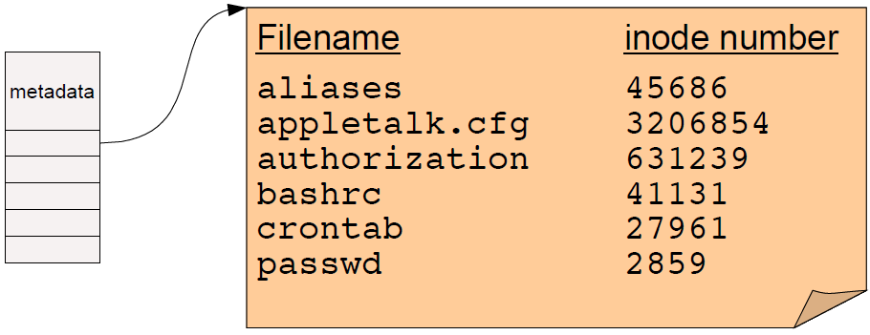
Directories
A directory is a special kind of file that contains a list of (filename, inode number) pairs
These are the contents of the directory “file data” itself – NOT the directory's inode!
Filenames (in UNIX) are not stored in the inode at all!
Two open questions:
How do we find the root directory (“ / “ on UNIX systems)?
How do we get from an inode number to the location of the inode on disk?

Slide 7
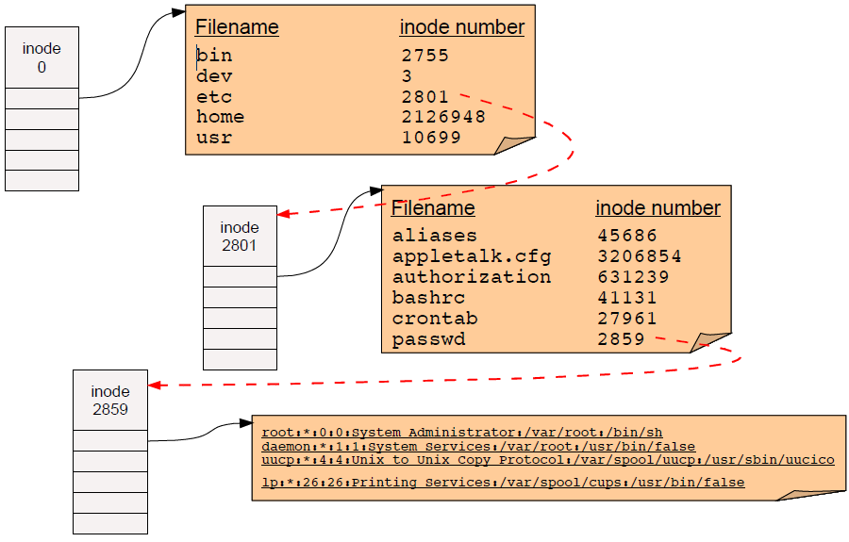
Pathname resolution
To look up a pathname “/etc/passwd”, start at root directory and walk down chain of inodes...

Slide 8
Locating inodes on disk
All right, so directories tell us the inode number of a file.
How the heck do we find the inode itself on disk?
Basic idea: Top part of filesystem contains all of the inodes!
inode number is just the “index” of the inode
Easy to compute the block address of a given inode:
block_addr(inode_num) = block_offset_of_first_inode + (inode_num * inode_size)
This implies that a filesystem has a fixed number of potential inodes
This number is generally set when the filesystem is created
The superblock stores important metadata on filesystem layout, list of free blocks, etc.

Slide 9
Stupid directory tricks
Directories map filenames to inode numbers. What does this imply?
We can create multiple pointers to the same inode in different directories
Or even the same directory with different filenames
In UNIX this is called a “hard link” and can be done using “ln”
bash$ ls -i /home/foo
287663 /home/foo (This is the inode number of “foo”)
bash$ ln /home/foo /tmp/foo
bash$ ls -i /home/foo /tmp/foo
287663 /home/foo
287663 /tmp/foo
“/home/foo” and “/tmp/foo” now refer to the same file on disk
Not a copy! You will always see identical data no matter which filename you use to read or write the file.
Note: This is not the same as a “symbolic link”, which only links one filename to another.

Slide 10
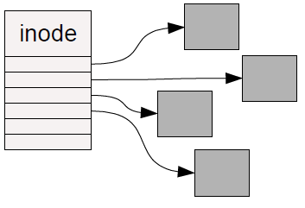
How should we organize blocks on a disk?
Very simple policy: A file consists of linked blocks
inode points to the first block of the file
Each block points to the next block in the file (just a linked list on disk)
What are the advantages and disadvantages??
Indexed files
inode contains a list of block numbers containing the file
Array is allocated when the file is created
What are the advantages and disadvantages??

Slide 11
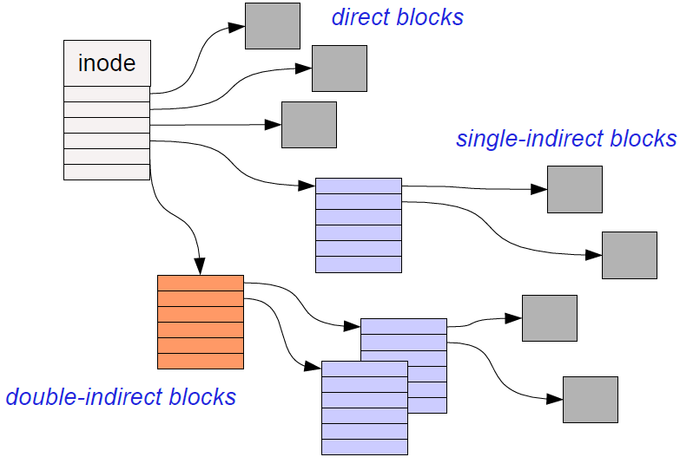
Multilevel indexed files
inode contains a list of 10-15 direct block pointers
First few blocks of file can be referred to by the inode itself
inode also contains a pointer to a single indirect, double indirect, and triple indirect blocks
Allows file to grow to be incredibly large!!!

Slide 12
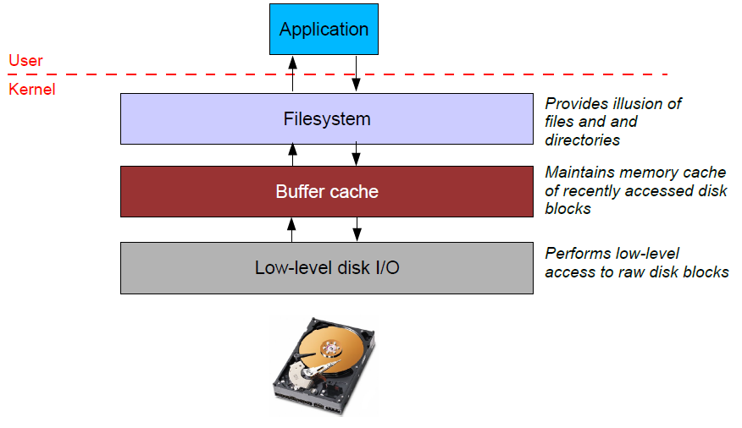
File system caching
Most filesystems cache significant amounts of disk in memory
e.g., Linux tries to use all “free” physical memory as a giant cache
Avoids huge overhead for going to disk for every I/O

Slide 13
Caching issues
Where should the cache go?
Below the filesystem layer: Cache individual disk blocks
Above the filesystem layer: Cache entire files and directories
Which is better??

Slide 14
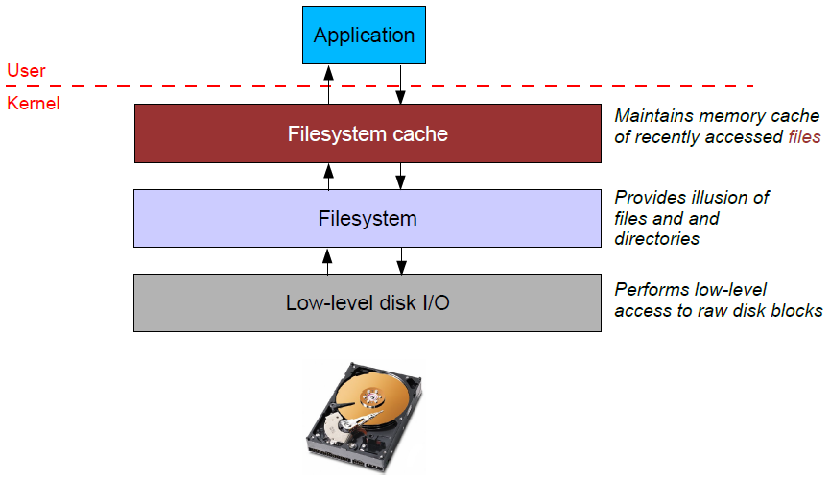
Caching issues
Where should the cache go?
Below the filesystem layer: Cache individual disk blocks
Above the filesystem layer: Cache entire files and directories
Which is better??

Slide 15
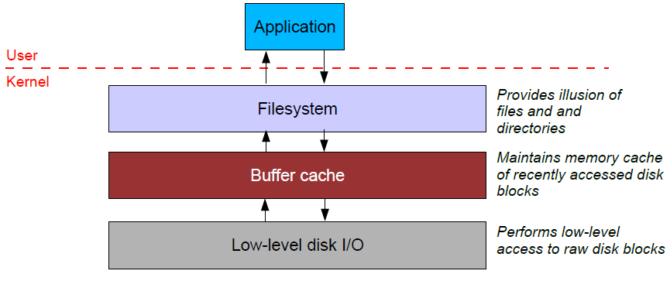
Caching issues (2)
Reliability issues
What happens when you write to the cache but the system crashes?
What if you update some of the blocks on disk but not others?
Example: Update the inode on disk but not the data blocks?
Write-through cache: All writes immediately sent to disk
Write-back cache: Cache writes stored in memory until evicted (then written to disk)
Which is better for performance? For reliability?

Slide 16
Caching issues (2)
“Syncing” a filesystem writes back any dirty cache blocks to disk
UNIX “sync” command achieves this.
Can also use fsync() system call to sync any blocks for a given file.
Warning – not all UNIX systems guarantee that after sync returns that the data has really been written to the disk!
This is also complicated by memory caching on the disk itself.
Crash recovery
If system crashes before sync occurs, “fsck” checks the filesystem for errors
Example: an inode pointing to a block that is marked as free in the free block list
Another example: An inode with no directory entry pointing to it
These usually get linked into a “lost+found” directory
inode does not contain the filename so need the sysadmin to look at the file dataand guess where it might belong!

Slide 17
Caching and fsync() example
Running the copy example from last time,
How fast is it the first time, vs. the second time you copy the same file?
What happens if we fsync() after each iteration?
Notes:
Add fsync() after each iteration through the loop. How much slower?

Slide 18
Caching issues (3)
Read ahead
Recall: Seek time dominates overhead of disk I/O
So, would ideally like to read multiple blocks into memory when you have a cache miss
Amortize the cost of the seek for multiple reads
Useful if file data is laid out in contiguous blocks on disk
Especially if the application is performing sequential access to the file

Slide 19
Making filesystems resilient: RAID

Slide 20
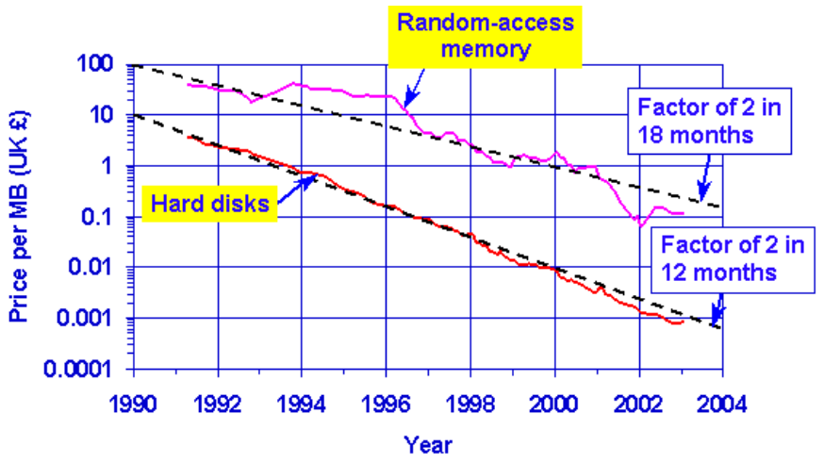
RAID Motivation
Speed of disks not matching other components
Moore’s law: CPU speed doubles every 18 months
SRAM speeds increasing by 40-100% a year
In contrast, disk seek time only improving 7% a year
Although greater density leads to improved transfer times once seek is done
Emergence of PCs starting to drive down costs of disks
(This is 1988 after all)
PC-class disks were smaller, cheaper, and only marginally slower

Slide 21
RAID Motivation
Basic idea: Build I/O systems as arrays of cheap disks
Allow data to be striped across multiple disks
Means you can read/write multiple disks in parallel – greatly improve performance
Problem: disks are extremely unreliable
Mean Time to Failure (MTTF)
MTTF (disk array) = MTTF (single disk) / # disks
Adding more disks means that failures happen more frequently..
An array of 100 disks with an MTTF of 30,000 hours = just under 2 weeks for the array’s MTTF!

Slide 22
Increasing reliability
Idea: Replicate data across multiple disks
When a disk fails, lost information can be regenerated from the redundant data
Simplest form: Mirroring (also called “RAID 1”)
All data is mirrored across two disks
Advantages:
Reads are faster, since both disks can be read in parallel
Higher reliability (of course)
Disadvantages:
Writes are slightly slower, since OS must wait for both disks to do write
Doubles the cost of the storage system!

Slide 23
RAID 3
Rather than mirroring, use parity codes
Given N bits {b₁, b₂, ..., b_{N}}, the parity bit P is the bit {0,1} that yields an even number of “1” bits in the set {b₁, b₂, ..., b_{N}, P}
Idea: If any bit in {b₁, b₂, ..., b_{N}} is lost, can use the remaining bits (plus P) to recover it.
Where to store the parity codes?
Add an extra “check disk” that stores parity bits for the data stored on the rest of the N disks
Advantages:
If a single disk fails, can easily recompute the lost data from the parity code
Can use one parity disk for several data disks (reduces cost)
Disadvantages:
Each write to a block must update the corresponding parity block as well

Slide 24
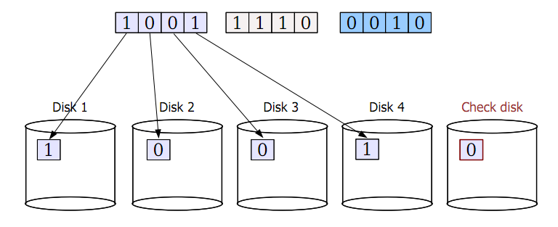
RAID 3 example

Slide 25
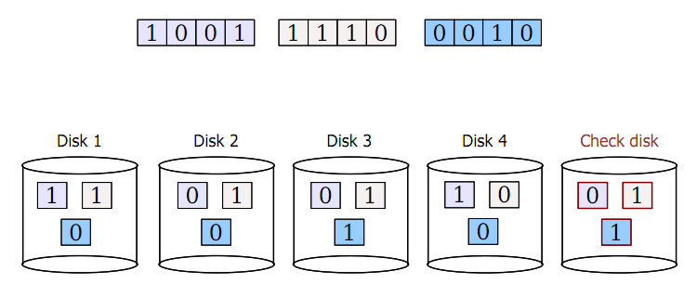
RAID 3 example

Slide 26
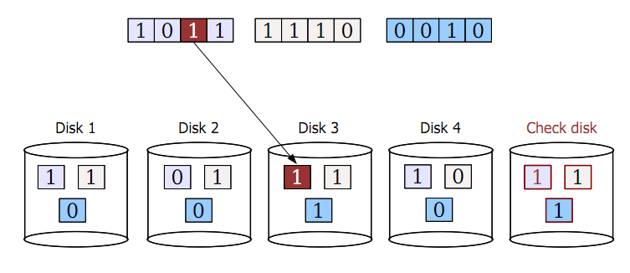
RAID 3 example

Slide 27
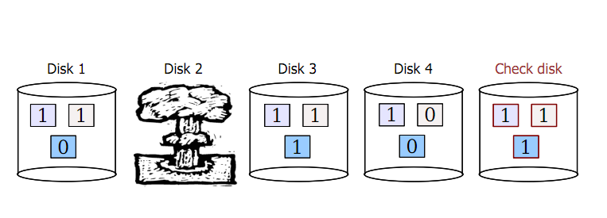
RAID 3 example

Slide 28
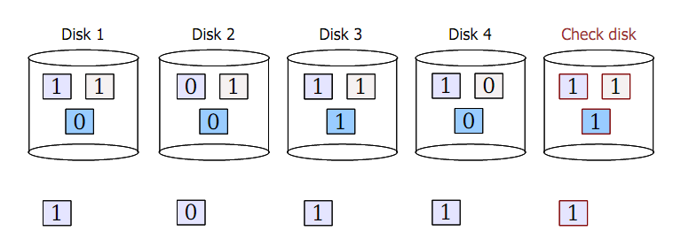
RAID 3 example
1. Read back data from other disks
2. Recalculate lost data from parity code
3. Rebuild data on lost disk

Slide 29
RAID 3 issues
Terminology
MTTF = mean time to failure
MTTR = mean time to repair
What is the MTTF of RAID?
Both RAID 1 and RAID 3 tolerate the failure of a single disk
As long as a second disk does not die while we are repairing the first failure, we are in good shape!
So, what is the probability of a second disk failure?
P(2nd failure) ≈ MTTR / (MTTF of one disk / # disks -1)
Assumes independent, exponential failure rates; see Patterson RAID paper for derivation
10 disks, MTTF (disk) = 1000 days, MTTR = 1 day
P(2nd failure) ≈ 1 day / ( 1000 / 9 ) = 0.009
What is the performance of RAID 3?
Check disk must be updated each time there is a write
Problem: The check disk is then a performance bottleneck
Only a single read/write can be done at once on the whole system!

Slide 30
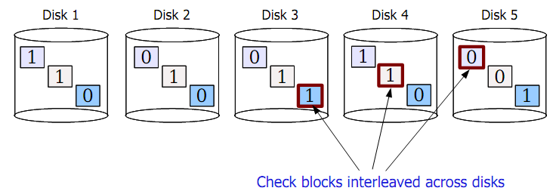
RAID 5
Another approach: Interleaved check blocks (“RAID 5”)
Rotate the assignment of data blocks and check blocks across disks
Avoids the bottleneck of a single disk for storing check data
Allows multiple reads/writes to occur in parallel (since different disks affected)

Slide 31
Reliable distributed storage
Today, giant data stores distributed across 100s of thousands of disks across the world
e.g., your mail on gmail
“You know you have a large storage system when you get paged at 1 AM because you only have a few petabytes of storage left.”
– a “note from the trenches” at Google
Notes:
Source of quote: http://goo.gl/LwFIy

Slide 32
Reliable distributed storage
Issues
Failure is the common case
Google reports 2-10% of disks fail per year
Now multiply that by 60,000+ disks in a single warehouse...
Must survive failure of not just a disk, but a rack of servers or a whole data center
Solutions
Simple redundancy (2 or 3 copies of each file)
e.g., Google GFS (2001)
More efficient redundancy (analogous to RAID 3++)
e.g., Google Colossus filesystem (~2010): customizable replication including Reed-Solomon codes with 1.5x redundancy
More interesting tidbits: http://goo.gl/LwFIy

Slide 33
Bonus: Atomic write failures in RAID (not on exam)

Slide 34
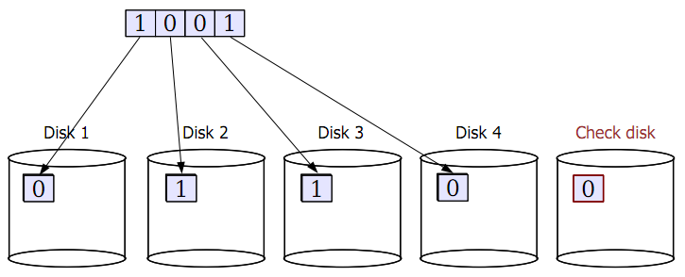
Atomic Write Failure
Many applications perform “update in place”
They change a file on disk by overwriting it with a new version
What happens with RAID?

Slide 35
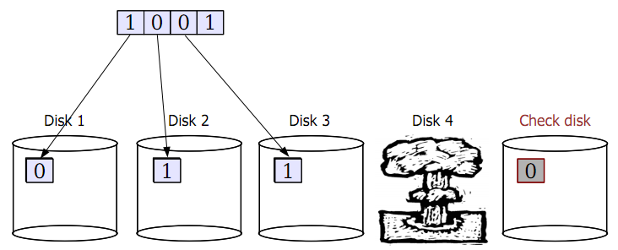
Atomic Write Failure
But is the complete write to all disks really atomic?
Generally, no!

Slide 36
Atomic Write Failure
But is the complete write to all disks really atomic?
Generally, no!
What does this mean?
Data can be left in an inconsistent state across the different disks!
Really hard to recover from this.
Problem: Most applications assume the storage system has atomic write semantics.
Possible fixes?
Use a journaling filesystem-like approach: Record changes to data objects transactionally.
Requires extensive changes to filesystem sitting on top of the RAID.
Battery-backed write cache:
RAID controller remembers all writes in a battery-backed cache
When recovery occurs, flush all writes out to the physical disks
Doesn't solve the problem in general but gives you some insurance.

Slide 37
Bonus: Modern Filesystem techniques (not on exam)

Slide 38
Modern Filesystem Tricks
Extents
Pre-allocation
Delayed allocation (Block remapping)
Colocating inodes and directories
Soft metadata updates
Journaling
These tricks are used by many modern filesystems
E.g., ext3 and ext4

Slide 39
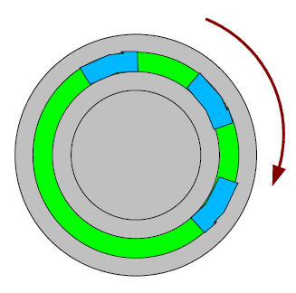
Extent-based transfers
One idea: a gap between sectors on a track
Try to take advantage of rotational latency for performing next read or write operation
Problem: Hurts performance for multi-sector I/O!
Cannot achieve the full transfer rate of the disk for large, contiguous reads or writes.
Possible fix: Just get rid of the gap between sectors
Problem: “Dropped rotation” between consecutive reads or writes: have to wait for next sector to come around under the heads.
Hybrid approach - “extents” [McVoy, USENIX'91]
Group blocks into “extents” or clusters of contiguous blocks
Try to do all I/O on extents rather than individual blocks
To avoid wasting I/O bandwidth, only do this when FS detects sequential access
Kind of like just increasing the block size...

Slide 40
Block remapping
Problem: Block numbers are allocated when they are first written
FS maintains a free list of blocks and simply picks the first block off the list
No guarantee that these blocks will be contiguous for a large write!
A single file may end up with blocks scattered across the disk
Why can't we maintain the free list in some sorted order?
Problem: Interleaved writes to multiple files may end up causing each file to be discontiguous.

Slide 41
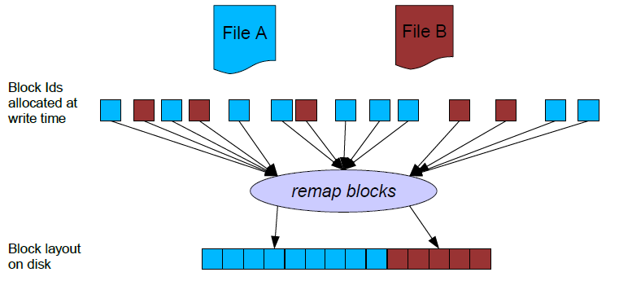
Block remapping
Idea: Delay determination of block address until cache is flushed
Hope that multiple block writes will accumulate in the cache
Can remap the block addresses for each file's writes to a contiguous set
This is kind of a hack, introduced “underneath” the FFS block allocation layer.
Meant fewer changes to the rest of the FFS code.
Sometimes building real systems means making these kinds of tradeoffs!

Slide 42
Colocating inodes and directories
Problem: Reading small files is slow. Why?
What happens when you try to read all files in a directory (e.g., “ls -l” or “grep foo *”) ?
Must first read directory.
Then read inode for each file.
Then read data pointed to by inode.
Solution: Embed the inodes in the directory itself!
Recall: Directory just a set of <name, inode #> values
Why not stuff inode contents in the directory file itself?
Problem #2: Must still seek to read contents of each file in the directory.
Solution: Pack all files in a directory in a contiguous set of blocks.

Slide 43
Synchronous metadata updates
Problem: Some updates to metadata require synchronous writes
Means the data has to “hit the disk” before anything else can be done.
Example #1: Creating a file
Must write the new file's inode to disk before the corresponding directory entry.
Why???
Example #2: Deleting a file
Must clear out the directory entry before marking the inode as “free”
Why???

Slide 44
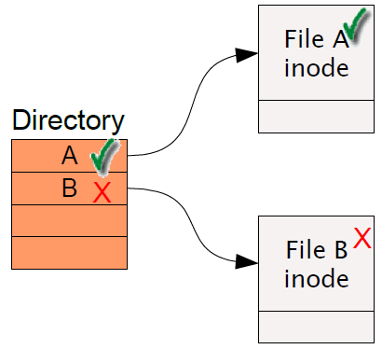
Synchronous metadata updates
Problem: Some updates to metadata require synchronous writes
Means the data has to “hit the disk” before anything else can be done.
Example #1: Creating a file
Must write the new file's inode to disk before the corresponding directory entry.
Why???
Example #2: Deleting a file
Must clear out the directory entry before marking the inode as “free”
Why???

Slide 45
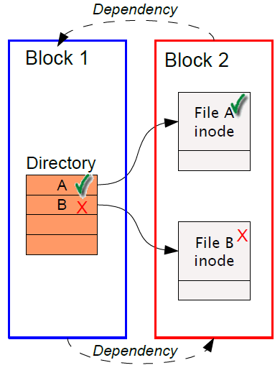
Synchronous metadata updates
Say that ...
1) Both inodes are in the same disk block.
2) Both the file create and file delete have happened in the cache, but neither has hit the disk yet.
Given this, what order are we allowed to write the disk blocks out?
We have a cyclic dependency here!!! Arggghhhh ....

Slide 46
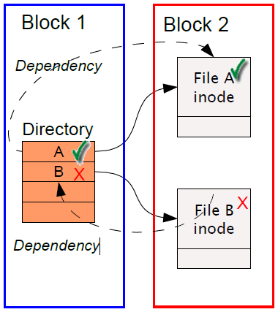
Solution: Soft Updates
Idea: Keep track of dependencies on a finer granularity
Rather than at a block level, do this at a “data structure level”
Example: Track dependencies on individual inodes or directory entries.

Slide 47
Soft Updates - Example
How to break the cyclic dependency?
“Roll back” one of the changes before writing the data out to disk!
When flushing inode block (Block 2) to disk...
Undo the file delete operation (as if it never happened!)
Write out the inode block (Block 2) – still contains B!
Then write out the directory block (Block 1) – still contains entry for B!
Then redo the file delete operation ... can now proceed.

Slide 48
Log-structured Fileystems (LFS)
Around '91, two trends in disk technology were emerging:
Disk bandwidth was increasing rapidly (over 40% a year)
Seek latency not improving much at all
Machines had increasingly large main memories
Large buffer caches absorb a large fraction of read I/Os
Can use for writes as well!
Coalesce several small writes into one larger write
Some lingering problems with earlier filesystems...
Writing to file metadata (inodes) was required to be synchronous
Couldn't buffer metadata writes in memory
Lots of small writes to file metadata means lots of seeks!
LFS takes advantage of both to increase FS performance
Started as a grad-school research project at Berkeley
Mendel Rosenblum and John Ousterhout

Slide 49
LFS: The basic idea
Treat the entire disk as one big append-only log for writes!
Don't try to lay out blocks on disk in some predetermined order
Whenever a file write occurs, append it to the end of the log
Whenever file metadata changes, append it to the end of the log
Collect pending writes in memory and stream out in one big write
Maximizes disk bandwidth
No “extra” seeks required (only those to move the end of the log)
When do writes to the actual disk happen?
When a user calls sync() -- synchronize data on disk for whole filesystem
When a user calls fsync() -- synchronize data on disk for one file
When OS needs to reclaim dirty buffer cache pages
Note that this can often be avoided, eg., by preferring clean pages
Sounds simple ...
But lots of hairy details to deal with!

Slide 50
LFS Example
Just append every new write that happens to the end of the log
Writing a block in the middle of the file just appends that block to the end of the log

Slide 51
LFS and inodes
How do you locate file data?
Sequential scan of the log is probably a bad idea ...
Solution: Write the inodes to the tail of the log! (just like regular data)

Slide 52
LFS and inodes
How do you locate file data?
Sequential scan of the log is probably a bad idea ...
Solution: Use FFS-style inodes!

Slide 53
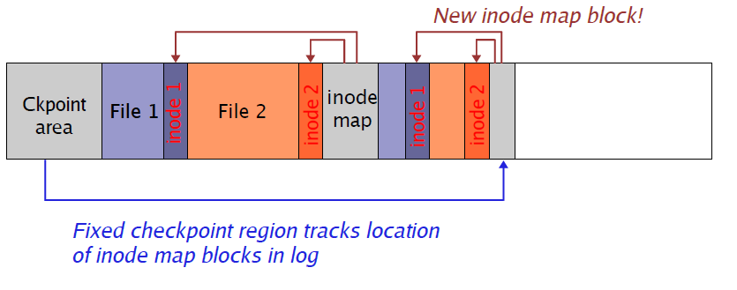
inode map (this is getting fun)
Well, now, how do you find the inodes??
Could also be anywhere in the log!
Solution: inode maps
Maps “file number” to the location of its inode in the log
Note that inode map is also written to the log!!!!
Cache inode maps in memory for performance

Slide 54
Reading from LFS
But wait ... now file data is scattered all over the disk!
Seems to obviate all of the benefits of grouping data on common cylinders
Basic assumption: Buffer cache will handle most read traffic
Or at least, reads will happen to data roughly in the order in which it was written
Take advantage of huge system memories to cache the heck out of the FS!

Slide 55
Log cleaner
With LFS, eventually the disk will fill up!
Need some way to reclaim “dead space”
What constitutes “dead space?”
Deleted files
File blocks that have been “overwritten”
Solution: Periodic “log cleaning”
Scan the log and look for deleted or overwritten blocks
Effectively, clear out stale log entries
Copy live data to the end of the log
The rest of the log (at the beginning) can now be reused!

Slide 56
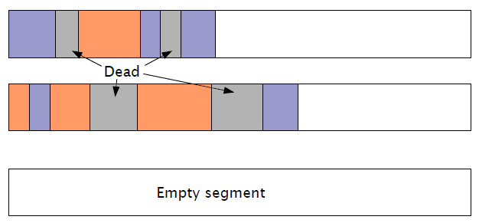
Log cleaning example
LFS cleaner breaks log into segments
Each segment is scanned by the cleaner
Live blocks from a segment are copied into a new segment
The entire scanned segment can then be reclaimed

Slide 57
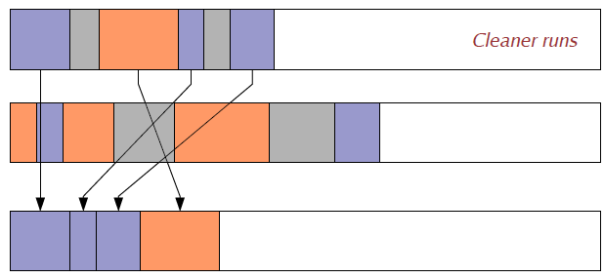
Log cleaning example
LFS cleaner breaks log into segments
Each segment is scanned by the cleaner
Live blocks from a segment are copied into a new segment
The entire scanned segment can then be reclaimed

Slide 58
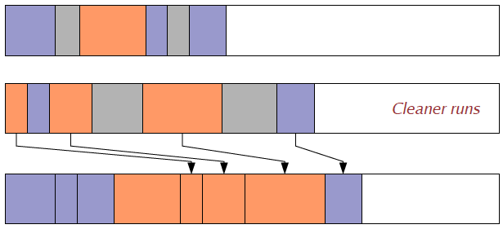
Log cleaning example
LFS cleaner breaks log into segments
Each segment is scanned by the cleaner
Live blocks from a segment are copied into a new segment
The entire scanned segment can then be reclaimed

Slide 59
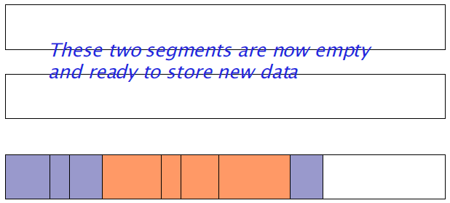
Log cleaning example
LFS cleaner breaks log into segments
Each segment is scanned by the cleaner
Live blocks from a segment are copied into a new segment
The entire scanned segment can then be reclaimed

Slide 60
Properties of LFS
Advantages
High write throughput
Few in-place writes
Some kinds of storage media have limited write/erase cycles per location (e.g., flash memory, CD-RW)
LFS prolongs life of media through write-leveling
Disadvantages
Increases file fragmentation, can harm performance on systems with high seek times
Less throughputs on flash memory, where write fragmentation has much less of an impact on write throughput
“Lies, damn lies, and benchmarks”
It is very difficult to come up with definitive benchmarks proving that one system is better than another
Can always find a scenario where one system design outperforms another

Slide 61
Filesystem corruption
What happens when you are making changes to a filesystem and the system crashes?
Example: Modifying block 5 of a large directory, adding lots of new file entries
System crashes while the block is being written
The new files are “lost!”
System runs fsck program on reboot
Scans through the entire filesystem and locates corrupted inodes and directories
Can typically find the bad directory, but may not be able to repair it!
The directory could have been left in any state during the write
fsck can take a very long time on large filesystems
And, no guarantees that it fixes the problems anyway

Slide 62
Journaling filesystems
Ensure that changes to the filesystem are made atomically
That is, a group of changes are made all together, or not at all
Example: creating a new file
Need to write both the inode for the new file and the directory entry “together”
Otherwise, if a crash happens between the two writes, either..
1) Directory points to a file that does not exist
2) Or, file is on disk but not included in any directory

Slide 63
Journaling filesystems
Goal: Make updates to filesystems appear to be atomic
The directory either looks exactly as it did before the file was created
Or the directory looks exactly as it did after the file was created
Cannot leave an FS entity (data block, inode, directory, etc.) in an intermediate state!
Idea: Maintain a log of all changes to the filesystem
Log contains information on any operations performed to the filesystem state
e.g., “Directory 2841 had inodes 404, 407, and 408 added to it”
To make a filesystem change:
1. Write an intent-to-commit record to the log
2. Write the appropriate changes to the log
Do not modify the filesystem data directly!!!
3. Write a commit record to the log
This is very similar to the notion of database transactions

Slide 64
Journaling FS Recovery
What happens when the system crashes?
Filesystem data has not actually been modified, just the log!
So, the FS itself reflects only what happened before the crash
Periodically synchronize the log with the filesystem data
Called a checkpoint
Ensures that the FS data reflects all of the changes in the log
No need to scan the entire filesystem after a crash...
Only need to look at the log entries since the last checkpoint!
For each log entry, see if the commit record is there
If not, consider the changes incomplete, and don't try to make them

Slide 65
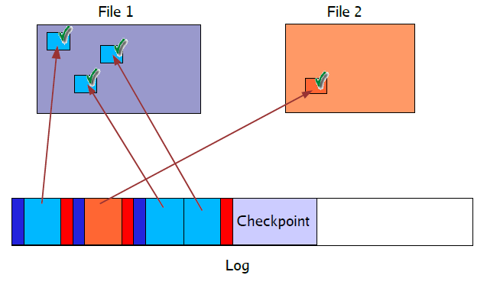
Journaling FS Example

Slide 66
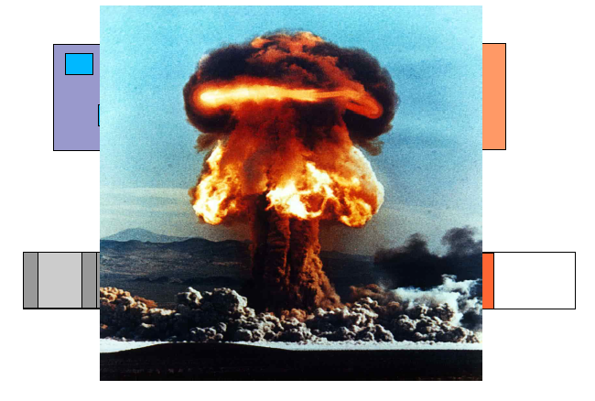
Journaling FS Example

Slide 67
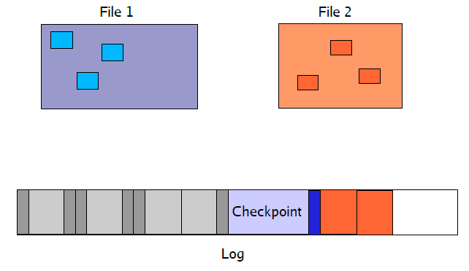
Journaling FS Example
Filesystem reflects changes up to last checkpoint
Fsck scans changelog from last checkpoint forward
Doesn't find a commit record ... changes are simply ignored

Slide 68
Bonus: NFS

Slide 69
More recent filesystems
How can we share filesystems over a network?
NFS, SAN, NAS, Hadoop
How can we make a filesystem resilient to failures?
RAID (covered in earlier slides)
Notes:
TODO: HadoopFS

Slide 70
Networked File System (NFS)
NFS allows a system to access files over a network
One of many distributed file systems
Extremely successful and widely used
You use NFS on all your shared files in the lab machines

Slide 71
Networked File System (NFS)
Development of LANs made it really attractive to provide shared file systems to all machines on a network
Login to any machine and see the same set of files
Install software on a single server that all machines can run
Let users collaborate on shared set of files (before CVS)
Why might this be hard to do?
Clients and servers might be running different OS
Clients and servers might be using different CPU architecture with differing byte ordering (endianess)
Client or server might crash independently of each other
Must be easy to recover from crashes
Potentially very large number of client machines on a network
Different users might be trying to modify a shared file at the same time
Transparency: Allow user programs to access remote files just like local files
No special libraries, recompilation, etc.

Slide 72
NFS Overview
NFS was developed by Sun Microsystems in the mid-80s
Networked machines at the time were predominantly UNIX-based workstations
Various vendors: Sun, DEC, IBM, etc.
Different CPU architectures and OS implementations
But, all used UNIX filesystem structure and semantics
NFS is based on Remote Procedure Call (RPC)
Allows a client machine to invoke a function on a server machine, over a network
Client sends a message with the function arguments
Server replies with a message with the return value.
External Data Representation (XDR) to represent data types
Canonical network representation for ints, longs, byte arrays, etc.
Clients and servers must translate parameters and return values of RPC calls into XDR before shipping on the network
Otherwise, a little-endian machine and a big-endian machine would disagree on what is meant by the stream of bytes “fe 07 89 da” interpreted as an “int”

Slide 73
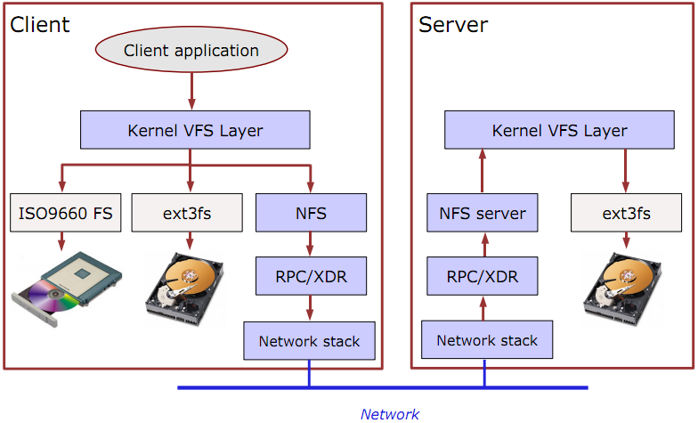
NFS Design

Slide 74
Stateless Protocol
The NFS protocol is stateless
The server maintains no information about individual clients!
This means that NFS does not support any notion of “opening” or “closing” files
Each client simply issues read and write requests specifying the file, offset in the file, and the requested size
Advantages:
Server doesn't need to keep track of open/close status of files
Server doesn't need to keep track of “file offset” for each client's open files
Clients do this themselves
Server doesn't have to do anything to recover from a crash!
Clients simply retry NFS operations until the server comes back up
Disadvantages:
Server doesn't keep track of concurrent access to same file
Multiple clients might be modifying a file at the same time
NFS does not provide any consistency guarantees!!!
However, there is a separate locking protocol – discussed later

Slide 75
NFS Protocol Overview
mount() returns filehandle for root of filesystem
Actually a separate protocol from NFS...
lookup(dir-handle, filename) returns filehandle, attribs
Returns unique file handle for a given file
File handle used in subsequent read/write/etc. calls
create(dir-handle, filename, attributes) returns filehandle
remove(dir-handle, filename) returns status
getattr(filehandle) returns attribs
Returns attributes of the file, e.g., permissions, owner, group ID, size, access time, last-modified time
setattr(filehandle, attribs) returns attribs
read(filehandle, offset, size) returns attribs, data
write(filehandle, offset, count, data) returns attribs

Slide 76
NFS Caching
NFS clients are responsible for caching recently-accessed data
Remember: the server is stateless!
The NFS protocol does not require that clients cache data ...
But, it provides support allowing a range of client-side caching techniques
This is accomplished through the getattr() call
Returns size, permissions, and last-modified time of file
This can tell a client whether a file has changed since it last read it
Read/write calls also return attributes so client can tell if object was modified since the last getattr() call
How often should the client use getattr()?
Whenever the file is accessed?
Could lead to a lot of getattr calls!
Only if the file has not been accessed for some time?
e.g., If the file has not been accessed in 30 sec?
Different OSs implement this differently!

Slide 77
NFS Locking
NFS does not prevent multiple clients from modifying a file simultaneously
Clearly, this can be a Bad Thing for some applications...
Solution: Network Lock Manager (NLM) protocol
Works alongside NFS to provide file locking
NFS itself does not know anything about locks
Clients have to use NLM “voluntarily” to avoid stomping on each other
NLM has to be stateful
Why?

Slide 78
NLM Protocol
NLM server has to keep track of locks held by clients
If the NLM server crashes...
All locks are released!
BUT ... clients can reestablish locks during a “grace period” after the server recovers
No new locks are granted during the grace period
Server has to remember which locks were previously held by clients
If an NLM client crashes...
The server is notified when the client recovers and releases all of its locks
What happens if a client crashes and does not come back up for a while?
Servers and clients must be notified when they crash and recover
This is done with the simple “Network Status Monitor” (NSM) protocol
Essentially, send a notification to the other host when you reboot

Slide 79
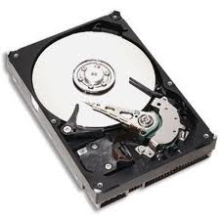
NLM Example
Client A
“lock file foo, offset 0 len 512”
“lock granted”
Server
“lock file foo, offset 0 len 512”
Client B
Client A,
foo[0…512]
“denied!”

Slide 80
NLM Example
Client A
Server
Client B
Client A,
foo[0…512]

Slide 81
NLM Example
Client A
Server
Restart notification
Client B
Client A,
foo[0…512]

Slide 82
NLM Example
Client A
“relock file foo, offset 0 len 512”
“lock granted”
Server
check
Client B
Client A,
foo[0…512]

