Slide 1
I/O and Filesystems
Based on slides by Matt Welsh, Harvard

Slide 2
Announcements
Exam review postponed till special session after last class
Research talk today: Darko Kirovski, Microsoft Research
“Making optical media impossible to counterfeit”
2405 SC, 4:00 p.m.

Slide 3
Part 1: Disks

Slide 4
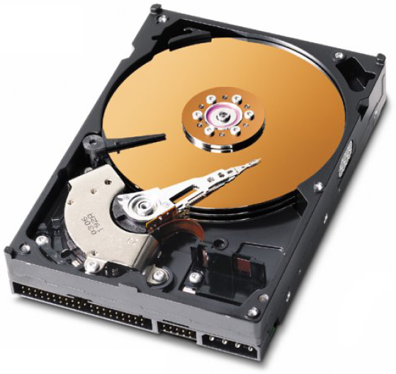
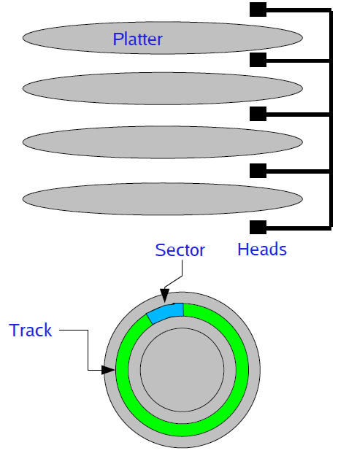
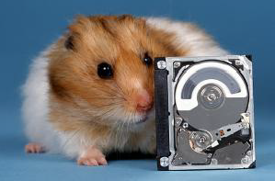
A Disk Primer (Review)
Disks consist of one or more platters divided into tracks
  Each platter may have one or two heads that perform read/write operations
  Each track consists of multiple sectors
  The set of sectors across all platters is a cylinder
Notes:
http://www.youtube.com/watch?v=9eMWG3fwiEU

Slide 5
Disks: messy & slow (Review)
Low-level interface for reading and writing sectors
  Generally allow OS to read/write an entire sector at a time
  No notion of “files” or “directories” – just raw sectors
  So, what do you do if you need to write a single byte to a file?
  Disk may have numerous bad blocks – OS may need to mask this from filesystem
Access times are still very slow
  Disk seek times are around 10 ms
    Although raw throughput has increased dramatically
  Compare to several nanosec to access main memory
  Requires careful scheduling of I/O requests

Slide 6
Disk I/O Scheduling
Given multiple outstanding I/O requests, what order to issue them?
FIFO: Just schedule each I/O in the order it arrives
  What's wrong with this? Potentially lots of seek time!
SSTF: Shortest seek time first
  Issue I/O with the nearest cylinder to the current one
  Favors middle tracks: Head rarely moves to edges of disk
SCAN (or Elevator) Algorithm:
  Head has a current direction and current cylinder
  Sort I/Os according to the track # in the current direction of the head
  If no more I/Os in the current direction, reverse direction
CSCAN Algorithm:
  Always move in one direction, “wrap around” to beginning of disk when moving off the end
  Idea: Reduce variance in seek times, avoid discriminating against the highest and lowest tracks

Slide 7
SCAN example
Current track
Direction

Slide 8
SCAN example
Current track
Direction

Slide 9
SCAN example
Current track
Direction

Slide 10
SCAN example
Current track
Direction

Slide 11
SCAN example
Current track
Direction

Slide 12
SCAN example
Current track
Direction

Slide 13
SCAN example
Current track
Direction

Slide 14
SCAN example
Current track
Direction

Slide 15
SCAN example
Current track
Direction

Slide 16
SCAN example
Current track
Direction

Slide 17
SCAN example
Current track
Direction
What is the overhead of the SCAN algorithm?
  Count the total amount of seek time to service all I/O requests
    I.e., count total number of track changes
  In this case, 12 tracks in --> direction
  15 tracks for long seek back
  5 tracks in <-- direction
    Total: 12+15+5 = 32 tracks

Slide 18
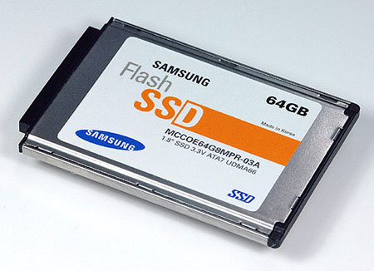
What about flash?
Non-volatile, solid state storage
  No moving parts!
  Fast access times (about 0.1 msec)
  Can read and write individual bytes at a time
Limitations
  Block erasure: However, must erase a whole “block” before writing to it
  Read disturb: Reads can cause cells near the read cell to change
    Solution: Periodically re-write blocks
  Limited number of erase/write cycles
    Most flash on the market today can withstand up to 1 million erase/write cycles
    Flash Translation Layer (FTL): writes to a different cell each time to wear-level device, cache to avoid excessive writes
How does this affect how we design filesystems???
Notes:
Todo: more slides on flash

Slide 19
Part 2: I/O

Slide 20
Input and Output
A computer’s job is to process data
  Computation (CPU, cache, and memory)
  Move data into and out of a system (between I/O devices and memory)
Challenges with I/O devices
  Different categories: storage, networking, displays, etc.
  Large number of device drivers to support
  Device drivers run in kernel mode and can crash systems
Goals of the OS
  Provide a generic, consistent, convenient and reliable way to
  access I/O devices
  As device-independent as possible
  Don’t hurt the performance capability of the I/O system too much

Slide 21
How does the CPU talk to devices?
Device controller: Circuit that enables devices to talk to the peripheral bus
Host adapter: Circuit that enables the computer to talk to the peripheral bus
Bus: Wires that transfer data between components inside computer
Device controller allows OS to specify simpler instructions to access data
Example: a disk controller
  Translates “access sector 23” to “move head reader 1.672725272 cm from edge of platter”
  Disk controller “advertises” disk parameters to OS, hides internal disk geometry
  Most modern hard drives have disk controller embedded as a chip on the physical device

Slide 22
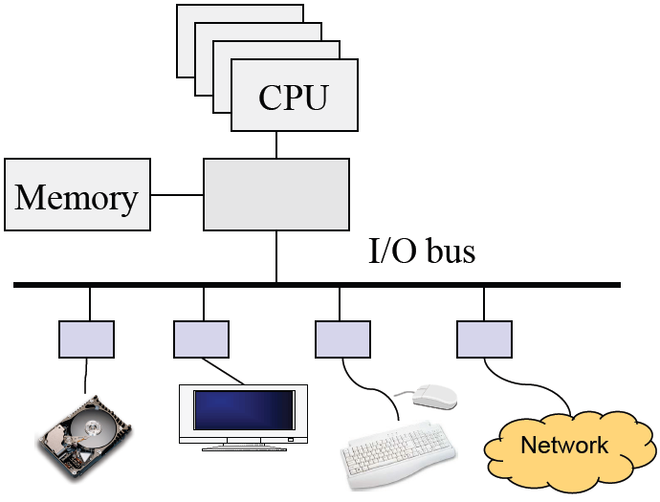
Review: Computer Architecture
Compute hardware
  CPU and caches
  Chipset
  Memory
I/O Hardware
  I/O bus or interconnect
  I/O controller or adaptor
  I/O device
Two types of I/O
  Programmed I/O (PIO)
    CPU does the work of moving data
  Direct Memory Access (DMA)
    CPU offloads the work of moving data to DMA controller

Slide 23
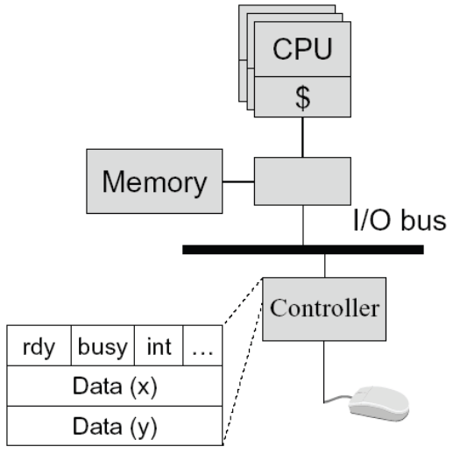
Programmed Input Device
Device controller
  Status register
    ready: tells if the host is done
    busy: tells if the controller is done
    int: interrupt
    …
  Data registers
A simple mouse design
  When moved, put (X, Y) in mouse’s device controller’s data registers
  Interrupt CPU
Input on an interrupt
  CPU saves state of currently-executing program
  Reads values in X, Y registers
  Sets ready bit
  Wakes up a process/thread or execute a piece of code to handle interrupt

Slide 24
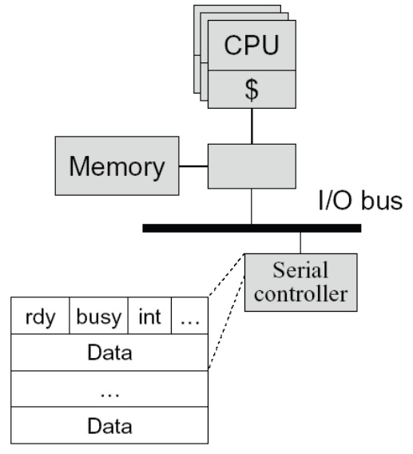
Programmed Output Device
Device
  Status registers (ready, busy, … )
  Data registers
Example
  A serial output device
Perform an output
  CPU: Poll the busy bit
  Writes the data to data register(s)
  Set ready bit
  Controller sets busy bit and transfers data
  Controller clears the busy bit
Notes:
Wait until ready bit is clear

Slide 25
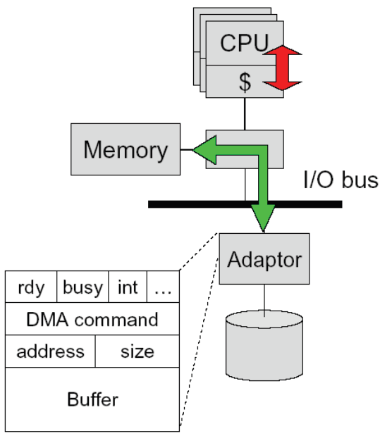
Direct Memory Access (DMA)
DMA controller or adaptor
  Status register (ready, busy, interrupt, …)
  DMA command register
  DMA register (address, size)
  DMA buffer
Host CPU initiates DMA
  Device driver call (kernel mode)
  Wait until DMA device is free
  Initiate a DMA transaction
  (command, memory address, size)
  Block
Controller performs DMA
  DMA data to device (size--; address++)
  Interrupt on completion (size == 0)
Interrupt handler (on completion)
  Wakeup the blocked process

Slide 26
Memory-mapped I/O
Use the same address bus to address both memory and I/O devices
  The memory and registers of I/O devices are mapped to address values
  Allows same CPU instructions to be used with regular memory and devices
I/O devices, memory controller, monitor address bus
  Each responds to addresses they own
Orthogonal to DMA
  May be used with, or without, DMA

Slide 27
Polling- vs. Interrupt-driven I/O
Polling
  CPU issues I/O command
  CPU directly writes instructions into device’s registers
  CPU busy waits for completion
Interrupt-driven I/O
  CPU issues I/O command
  CPU directly writes instructions into device’s registers
  CPU continues operation until interrupt
Direct Memory Access (DMA)
  Typically done with Interrupt-driven I/O
  CPU asks DMA controller to perform device-to-memory transfer
  DMA issues I/O command and transfers new item into memory
  CPU module is interrupted after completion
Which is better, polling or interrupt-driven I/O?

Slide 28
Polling- vs. Interrupt-driven I/O
Polling
  Expensive for large transfers
  Better for small, dedicated systems with infrequent I/O
Interrupt-driven
  Overcomes CPU busy waiting
  I/O module interrupts when ready: event driven

Slide 29
How Interrupts are implemented
CPU hardware has an interrupt report line that the CPU tests after executing every instruction
  If a(ny) device raises an interrupt by setting interrupt report line
    CPU catches the interrupt and saves the state of current running process into PCB
    CPU dispatches/starts the interrupt handler
    Interrupt handler determines cause, services the device and clears the interrupt report line
Other uses of interrupts: exceptions
  Division by zero, wrong address
  System calls (software interrupts/signals, trap)
  Virtual memory paging

Slide 30
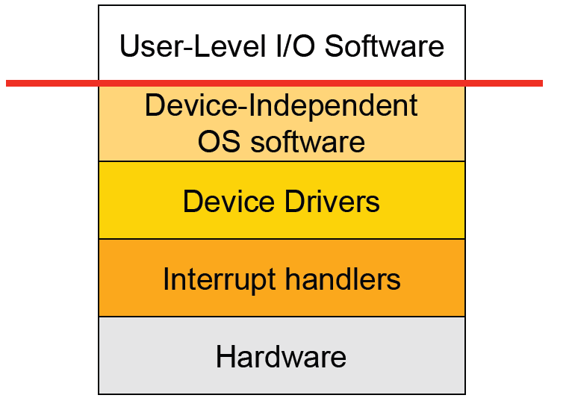
I/O Software Stack

Slide 31
Interrupt Handling
Save context (registers that hw hasn’t saved, PSW etc)
Mask interrupts if needed
Set up a context for interrupt service
Set up a stack for interrupt service
Acknowledge interrupt controller, perhaps enable it
Save entire context to PCB
Run the interrupt service
Unmask interrupts if needed
Possibly change the priority of the process
Run the scheduler
Then OS will set up context for next process, load registers and PSW, start running process …

Slide 32
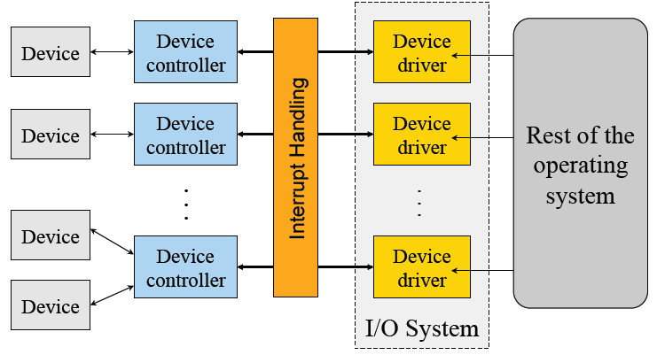
Device Drivers
Manage the complexity and differences among specific types of devices (disk vs. mouse, different types of disks …)
Each handles one type of device or small class of them (eg SCSI)

Slide 33
Typical Device Driver Design
Operating system and driver communication
  Commands and data between OS and device drivers
Driver and hardware communication
  Commands and data between driver and hardware
Driver responsibilities
  Initialize devices
  Interpreting commands from OS
  Schedule multiple outstanding requests
  Manage data transfers
  Accept and process interrupts
  Maintain the integrity of driver and kernel data structures

Slide 34
Device Driver Behavior
Check input parameters for validity, and translate them to device specific language
Check if device is free (wait or block if not)
Issue commands to control device
  Write them into device controller’s registers
  Check after each if device is ready for next (wait or block if not)
Block or wait for controller to finish work
Check for errors, and pass data to device-independent software
Return status information
Process next queued request, or block waiting for next
Challenges:
  Must be reentrant (can be called by an interrupt while running)
  Handle hot-pluggable devices and device removal while running
  Complex and many of them; bugs in them can crash system

Slide 35
Types of I/O Devices
Block devices
  Organize data in fixed-size blocks
  Transfers are in units of blocks
  Blocks have addresses and data are therefore addressable
  E.g. hard disks, USB disks, CD-ROMs
Character devices
  Delivers or accepts a stream of characters, no block structure
  Not addressable, no seeks
  Can read from stream or write to stream
  Printers, network interfaces, terminals
Like everything, not a perfect classification
  E.g. tape drives have blocks but not randomly accessed
  Clocks are I/O devices that just generate interrupts

Slide 36
User-level interfaces: syscalls
Character device interface
  read( deviceNumber, bufferAddr, size )
    Reads “size” bytes from a byte stream device to “bufferAddr”
  write( deviceNumber, bufferAddr, size )
    Write “size” bytes from “bufferAddr” to a byte stream device
Block device interface
  read( deviceNumber, deviceAddr, bufferAddr )
    Transfer a block of data from “deviceAddr” to “bufferAddr”
  write( deviceNumber, deviceAddr, bufferAddr )
    Transfer a block of data from “bufferAddr” to “deviceAddr”
  seek( deviceNumber, deviceAddress )
    Move the head to the correct position
    Usually not necessary

Slide 37
Sync vs Asynchronous I/O
Synchronous I/O
  read() or write() will block a user process until its completion
  OS overlaps synchronous I/O with another process
Asynchronous I/O
  read() or write() will not block a user process
    returns -1, sets error code EAGAIN or EWOULDBLOCK
  user process can do other things before I/O completion
  can determine if device is ready with select() / poll()
  Make asynchronous with O_NONBLOCK option on open() or later via fcntl()

Slide 38
Example: Blocked Read
A process issues a read call which executes a system call
System call code checks for correctness
If it needs to perform I/O, it will issues a device driver call
Device driver allocates a buffer for read and schedules I/O
Controller performs DMA data transfer
Block the current process and schedule a ready process
Device generates an interrupt on completion
Interrupt handler stores any data and notifies completion
Move data from kernel buffer to user buffer
Wakeup blocked process (make it ready)
User process continues when it is scheduled to run

Slide 39
Does I/O overhead matter?
Many steps involved in transmitting data
How much can this overhead slow us down?
Experiment: copy.c

Slide 40
Part 2: Filesystems

Slide 41
Filesystems
A filesystem provides a high-level application access to disk
    As well as CD, DVD, tape, floppy, etc...
  Masks the details of low-level sector-based I/O operations
  Provides structured access to data (files and directories)
  Caches recently-accessed data in memory
Hierarchical filesystems: Most common type
  Organized as a tree of directories and files
Byte-oriented vs. record-oriented files
  UNIX, Windows, etc. all provide byte-oriented file access
    May read and write files a byte at a time
  Many older OS's provided only record-oriented files
    File composed of a set of records; may only read and write a record at a time
Versioning filesystems
  Keep track of older versions of files
  e.g., VMS filesystem: Could refer to specific file versions:foo.txt;1, foo.txt;2

Slide 42
Filesystem Operations
Filesystems provide a standard interface to files and directories:
  Create a file or directory
  Delete a file or directory
  Open a file or directory – allows subsequent access
  Read, write, append to file contents
  Add or remove directory entries
  Close a file or directory – terminates access
What other features do filesystems provide?
  Accounting and quotas – prevent your classmates from hogging the disks
  Backup – some filesystems have a “$HOME/.backup” containing automatic snapshots
  Indexing and search capabilities
  File versioning
  Encryption
  Automatic compression of infrequently-used files
Should this functionality be part of the filesystem or built on top?
Classic OS community debate: Where is the best place to put functionality?

Slide 43
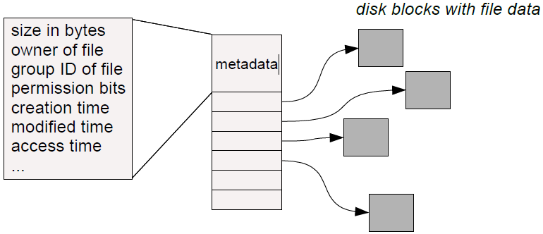
Basic Filesystem Structures
Every file and directory is represented by an inode
  Stands for “index node”
Contains two kinds of information:
  1) Metadata describing the file's owner, access rights, etc.
  2) Location of the file's blocks on disk

Slide 44
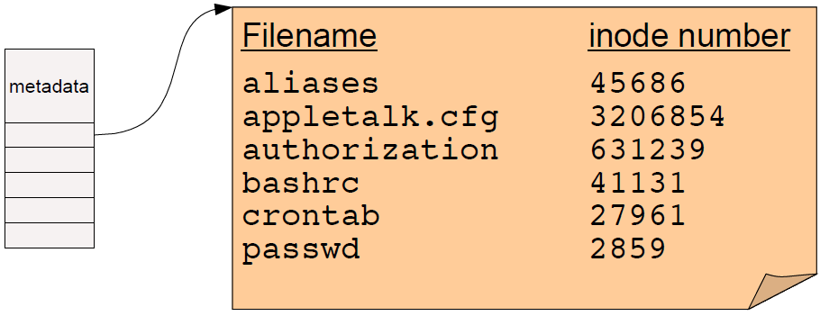
Directories
A directory is a special kind of file that contains a list of (filename, inode number) pairs
  These are the contents of the directory “file data” itself – NOT the directory's inode!
  Filenames (in UNIX) are not stored in the inode at all!
Two open questions:
  How do we find the root directory (“ / “ on UNIX systems)?
  How do we get from an inode number to the location of the inode on disk?

Slide 45
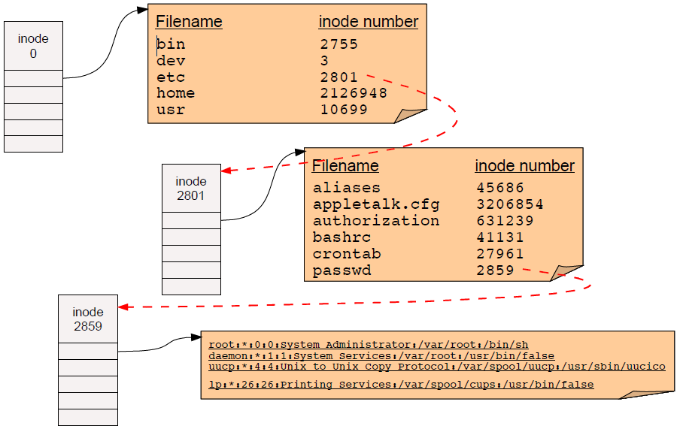
Pathname resolution
To look up a pathname “/etc/passwd”, start at root directory and walk down chain of inodes...

Slide 46
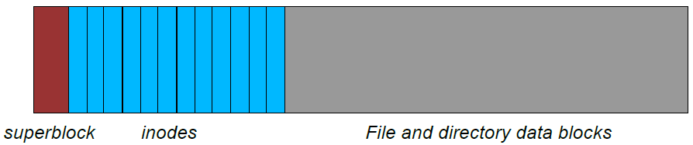
Locating inodes on disk
All right, so directories tell us the inode number of a file.
  How the heck do we find the inode itself on disk?
Basic idea: Top part of filesystem contains all of the inodes!
  inode number is just the “index” of the inode
  Easy to compute the block address of a given inode:
    block_addr(inode_num) = block_offset_of_first_inode + (inode_num * inode_size)
  This implies that a filesystem has a fixed number of potential inodes
    This number is generally set when the filesystem is created
  The superblock stores important metadata on filesystem layout, list of free blocks, etc.

Slide 47
Stupid directory tricks
Directories map filenames to inode numbers. What does this imply?
We can create multiple pointers to the same inode in different directories
  Or even the same directory with different filenames
In UNIX this is called a “hard link” and can be done using “ln”
    bash$ ls -i /home/foo
    287663 /home/foo (This is the inode number of “foo”)
    bash$ ln /home/foo /tmp/foo
    bash$ ls -i /home/foo /tmp/foo
    287663 /home/foo
    287663 /tmp/foo
  “/home/foo” and “/tmp/foo” now refer to the same file on disk
    Not a copy! You will always see identical data no matter which filename you use to read or write the file.
  Note: This is not the same as a “symbolic link”, which only links one filename to another.

Slide 48
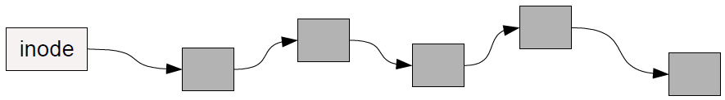
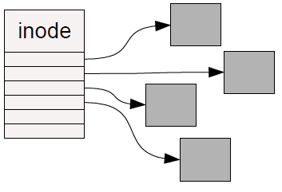
How should we organize blocks on a disk?
Very simple policy: A file consists of linked blocks
  inode points to the first block of the file
  Each block points to the next block in the file (just a linked list on disk)
    What are the advantages and disadvantages??
Indexed files
  inode contains a list of block numbers containing the file
  Array is allocated when the file is created
    What are the advantages and disadvantages??

Slide 49
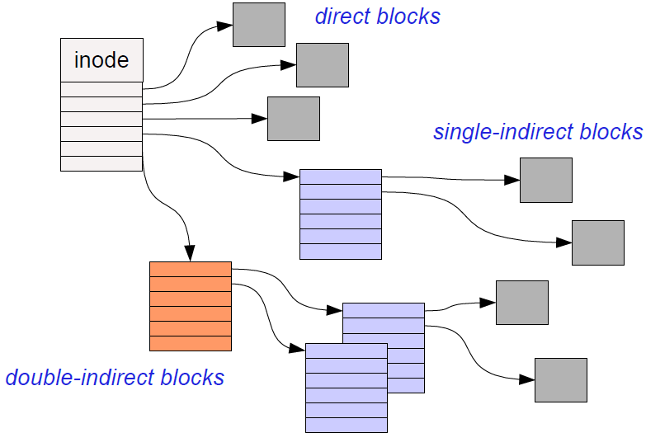
Multilevel indexed files
inode contains a list of 10-15 direct block pointers
  First few blocks of file can be referred to by the inode itself
inode also contains a pointer to a single indirect, double indirect, and triple indirect blocks
  Allows file to grow to be incredibly large!!!

Slide 50
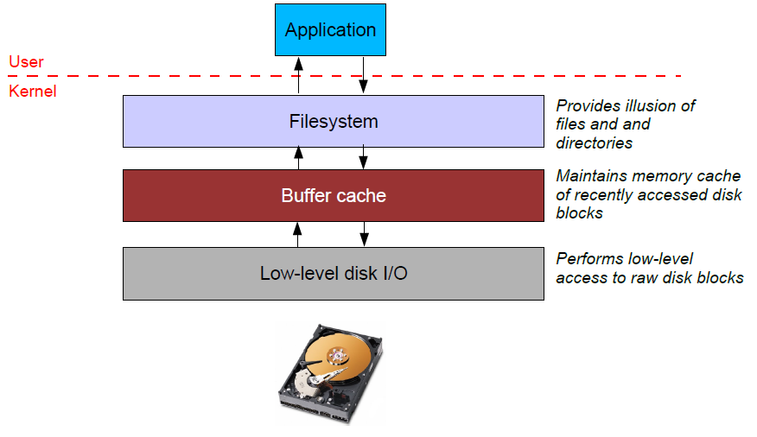
File system caching
Most filesystems cache significant amounts of disk in memory
  e.g., Linux tries to use all “free” physical memory as a giant cache
  Avoids huge overhead for going to disk for every I/O

Slide 51
Caching issues
Where should the cache go?
  Below the filesystem layer: Cache individual disk blocks
  Above the filesystem layer: Cache entire files and directories
  Which is better??

Slide 52
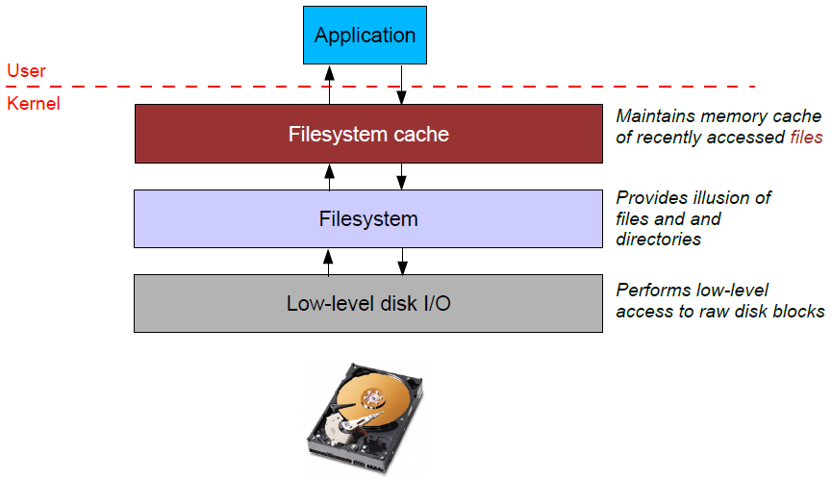
Caching issues
Where should the cache go?
  Below the filesystem layer: Cache individual disk blocks
  Above the filesystem layer: Cache entire files and directories
  Which is better??

Slide 53
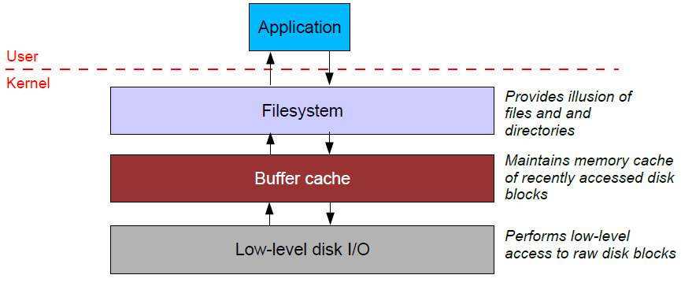
Caching issues (2)
Reliability issues
  What happens when you write to the cache but the system crashes?
  What if you update some of the blocks on disk but not others?
    Example: Update the inode on disk but not the data blocks?
  Write-through cache: All writes immediately sent to disk
  Write-back cache: Cache writes stored in memory until evicted (then written to disk)
    Which is better for performance? For reliability?

Slide 54
Caching issues (2)
“Syncing” a filesystem writes back any dirty cache blocks to disk
  UNIX “sync” command achieves this.
  Can also use fsync() system call to sync any blocks for a given file.
    Warning – not all UNIX systems guarantee that after sync returns that the data has really been written to the disk!
    This is also complicated by memory caching on the disk itself.
Crash recovery
  If system crashes before sync occurs, “fsck” checks the filesystem for errors
  Example: an inode pointing to a block that is marked as free in the free block list
  Another example: An inode with no directory entry pointing to it
    These usually get linked into a “lost+found” directory
    inode does not contain the filename so need the sysadmin to look at the file dataand guess where it might belong!

Slide 55
Caching issues (3)
Read ahead
  Recall: Seek time dominates overhead of disk I/O
  So, would ideally like to read multiple blocks into memory when you have a cache miss
    Amortize the cost of the seek for multiple reads
  Useful if file data is laid out in contiguous blocks on disk
    Especially if the application is performing sequential access to the file

