Slide 1
Deadlock Solutions
CS 241
March 28, 2012
University of Illinois

Slide 2

Announcements
Office hours today: 3-4 and 5-6
In between: Talk by Tom Wenisch
  Energy efficiency in warehouse-scale computers
  4pm, in 3405 SC
Midterm exams: you may look at them through the end of this week
  An extension of our one-week policy
  Drop by office hours today (3-4 and 5-6) or schedule appointment
Notes:
One reason we limit the timespan of regrades for the midterm is consistency. If we return to look at a problem months later, we are much more likely to give a certain mistake a different number of points (either more or less) than others students with the same answer received.

Slide 3
Deadlock: definition
There exists a cycle of processes such that each process cannot proceed until the next process takes some specific action.
Result: all processes in the cycle are stuck!
Notes:
This is slightly broader than the definition in the book. Page 348 uses circular wait as the definition of deadlock, but circular wait is defined in terms of holding resources rather than the (somewhat more general) waiting for events.
Last time we saw the Dining Philosophers Problem as an example of deadlock, along with some code. But guess what: Deadlock can happen in the real world too.

Slide 4




Deadlock in the real world
Which way should I go?

Slide 5
Deadlock in the real world
I can almost get across
Drat!
GRIDLOCK!

Slide 6
Deadlock: One-lane Bridge
Traffic only in one direction
Each section of a bridge can be viewed as a resource
What can happen?

Slide 7
Deadlock: One-lane Bridge
Traffic only in one direction
Each section of a bridge can be viewed as a resource
Deadlock
  Resolved if cars back up (preempt resources and rollback)
  Several cars may have to be backed up

Slide 8
Deadlock: One-lane Bridge
Traffic only in one direction
Each section of a bridge can be viewed as a resource
Deadlock
  Resolved if cars back up (preempt resources and rollback)
  Several cars may have to be backed up
But, starvation is possible
  e.g., if the rule is that Westbound cars always go first when present

Slide 9
Deadlock: One-lane Bridge
I always have to back up!
Deadlock vs. Starvation
  Starvation = Indefinitely postponed
    Delayed repeatedly over a long period of time while the attention of the system is given to other processes
    Logically, the process may proceed but the system never gives it the CPU (unfortunate scheduling)
  Deadlock = no hope
    All processes blocked; scheduling change won’t help

Slide 10
Deadlock solutions
Prevention
  Design system so that deadlock is impossible
Avoidance
  Steer around deadlock with smart scheduling
Detection & recovery
  Check for deadlock periodically
  Recover by killing a deadlocked processes and releasing its resources
Do nothing
  Prevention, avoidance and detection/recovery are expensive
  If deadlock is rare, is it worth the overhead?
  Manual intervention (kill processes, reboot) if needed

Slide 11
Deadlock Prevention

Slide 12
Aside: Necessary Conditions for Deadlock
Mutual exclusion
  Processes claim exclusive control of the resources they require
Hold-and-wait (a.k.a. wait-for) condition
  Processes hold resources already allocated to them while waiting for additional resources
No preemption condition
  Resources cannot be removed from the processes holding them until used to completion
Circular wait condition
  A circular chain of processes exists in which each process holds one or more resources that are requested by the next process in the chain
Notes:
These are the traditional four conditions for deadlock. Traditionally, we could break any one of these to prevent deadlock.
However, this way of thinking about deadlock is quite confused. For example, it suggests that if you choose to break one condition, the other three might still be true but deadlock is prevented. That suggestion is false. Suppose we choose to break hold-and-wait, for example; this also must break circular wait. In fact, circular wait is the definition of deadlock. By preventing any one of these, we prevent circular wait, and there are various other ways of preventing circular wait as well.
So we will think about it in a different way.

Slide 13
Deadlock prevention
Goal 1: devise resource allocation rules which make circular wait impossible
  Resources include mutex locks, semaphores, pages of memory, ...
  ...but you can think about just mutex locks for now
Goal 2: make sure useful behavior is still possible!
  The rules will necessarily be conservative
    Rule out some behavior that would not cause deadlock
  But they shouldn’t be to be too conservative
    We still need to get useful work done

Slide 14
Rule #1: No Mutual Exclusion
For deadlock to happen: processes must claim exclusive control of the resources they require
How to break it?

Slide 15
Rule #1: No Mutual Exclusion
For deadlock to happen: processes must claim exclusive control of the resources they require
How to break it?
  Non-exclusive access only
    Read-only access
  Battle won!
    War lost
    Very bad at Goal #2
Notes:
This severely violates our Goal #2.

Slide 16
Rule #2: Allow preemption
A lock can be taken away from current owner
  Let it go: If a process holding some resources is denied a further request, that process must release its original resources
  Or take it all away: OS preempts current resource owner, gives resource to new process/thread requesting it
Breaks circular wait
  ...because we don’t have to wait
Reasonable strategy sometimes
  e.g. if resource is memory: “preempt” = page to disk
Not so convenient for synchronization resources
  e.g., locks in multithreaded application
  What if current owner is in the middle of a critical section updating pointers? Data structures might be left in inconsistent state!
Notes:
On the very last bullet: We can potentially do something. We can save periodic snapshots of an applications’s state. These are called checkpoints. If we have to preempt it, we roll back to the last saved checkpoint, so that any inconsistency while the process was within its critical section is not relevant.
But that is only possible across processes. Harder to roll back a thread. And checkpoints and rollbacks have high overhead.

Slide 17
Rule #3: No hold and wait
When waiting for a resource, must not hold others
  So, process can only have one resource locked
  Or, it must request all resources at the beginning
  Or, before asking for more: give up everything you have and request it all at one time
Breaks circular wait
  In resource allocation diagram: process with an outgoing link must have no incoming links
  Therefore, cannot have a loop!
Notes:
Fix me: add figure showing resource allocation diagram

Slide 18
Rule #3: No hold and wait
Breaks circular wait
  In resource allocation diagram: process with an outgoing link must have no incoming links
  Therefore, cannot have a loop!
Q: Which of these request links would be disallowed?
Process
request
Resource
ownership
Notes:
This resource allocation diagram shows a deadlocked state. Among the request edges (blue), which of these requests would the processes not have been able to make according to the “No hold and wait” rule?

Slide 19
Rule #3: No hold and wait
Breaks circular wait
  In resource allocation diagram: process with an outgoing link must have no incoming links
  Therefore, cannot have a loop!
A: Legal links are...
Process
request
Resource
ownership
Notes:
As you can see, many edges are disallowed. This gives us some intuition that Rule #3 is pretty conservative.

Slide 20
Rule #3: No hold and wait
Very constraining (bad job on Goal #2)
  Better than Rules #1 and #2, but...
  Often need more than one resource
  Hard to predict at the begining what resources you’ll need
  Releasing and re-requesting is inefficient, complicates programming, might lead to starvation

Slide 21
Rule #4: request resources in order
Must request resources in increasing order
  Impose ordering on resources (any ordering will do)
  If holding resource i, can only request resources > i
Much less constraining (decent job on Goal #2)
  Strictly easier to satisfy than “No hold and wait”: If we can request all resources at once, then we can request them in increasing order
  But now, we don’t need to request them all at once
  Can pick the arbitrary ordering for convenience to the application
  Still might be inconvenient at times
But why is it guaranteed to preclude circular wait?

Slide 22




Dining Philosophers solution with unnumbered resources
Back to the trivial broken “solution”...
# define N 5
void philosopher (int i) {
while (TRUE) {
think();
take_fork(i);
take_fork((i+1)%N);
eat(); /* yummy */
put_fork(i);
put_fork((i+1)%N);
}
}

Slide 23
Dining Philosophers solution with unnumbered resources
Back to the trivial broken “solution”...
# define N 5
void philosopher (int i) {
while (TRUE) {
think();
take_fork(i);
take_fork((i+1)%N);
eat(); /* yummy */
put_fork(i);
put_fork((i+1)%N);
}
}

Slide 24
Dining Philosophers solution with unnumbered resources
Back to the trivial broken “solution”...
# define N 5
void philosopher (int i) {
while (TRUE) {
think();
take_fork(i);
take_fork((i+1)%N);
eat(); /* yummy */
put_fork(i);
put_fork((i+1)%N);
}
}

Slide 25
Dining Philosophers solution with numbered resources
Instead, number resources
First request lower numbered fork
# define N 5
void philosopher (int i) {
while (TRUE) {
think();
take_fork(LOWER(i));
take_fork(HIGHER(i));
eat(); /* yummy */
put_fork(LOWER(i));
put_fork(HIGHER(i));
}
}
1
5
2
4
3

Slide 26
Dining Philosophers solution with numbered resources
Instead, number resources...
Then request higher numbered fork
# define N 5
void philosopher (int i) {
while (TRUE) {
think();
take_fork(LOWER(i));
take_fork(HIGHER(i));
eat(); /* yummy */
put_fork(LOWER(i));
put_fork(HIGHER(i));
}
}
1
5
2
4
3

Slide 27
Dining Philosophers solution with numbered resources
Instead, number resources...
Then request higher numbered fork
# define N 5
void philosopher (int i) {
while (TRUE) {
think();
take_fork(LOWER(i));
take_fork(HIGHER(i));
eat(); /* yummy */
put_fork(LOWER(i));
put_fork(HIGHER(i));
}
}
1
5
2
4
3

Slide 28
Dining Philosophers solution with numbered resources
Instead, number resources...
One philosopher can eat!
# define N 5
void philosopher (int i) {
while (TRUE) {
think();
take_fork(LOWER(i));
take_fork(HIGHER(i));
eat(); /* yummy */
put_fork(LOWER(i));
put_fork(HIGHER(i));
}
}
1
5
2
4
3

Slide 29
Ordered resource requests prevent deadlock
Without numbering
Cycle!

Slide 30
Ordered resource requests prevent deadlock
With numbering
4
3
8
7
Contradiction:
Must have requested 3 first!

Slide 31
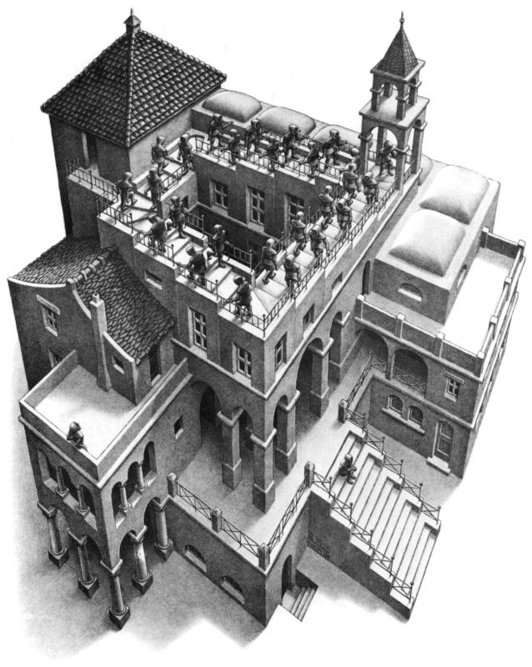
Proof by M.C. Escher

Slide 32
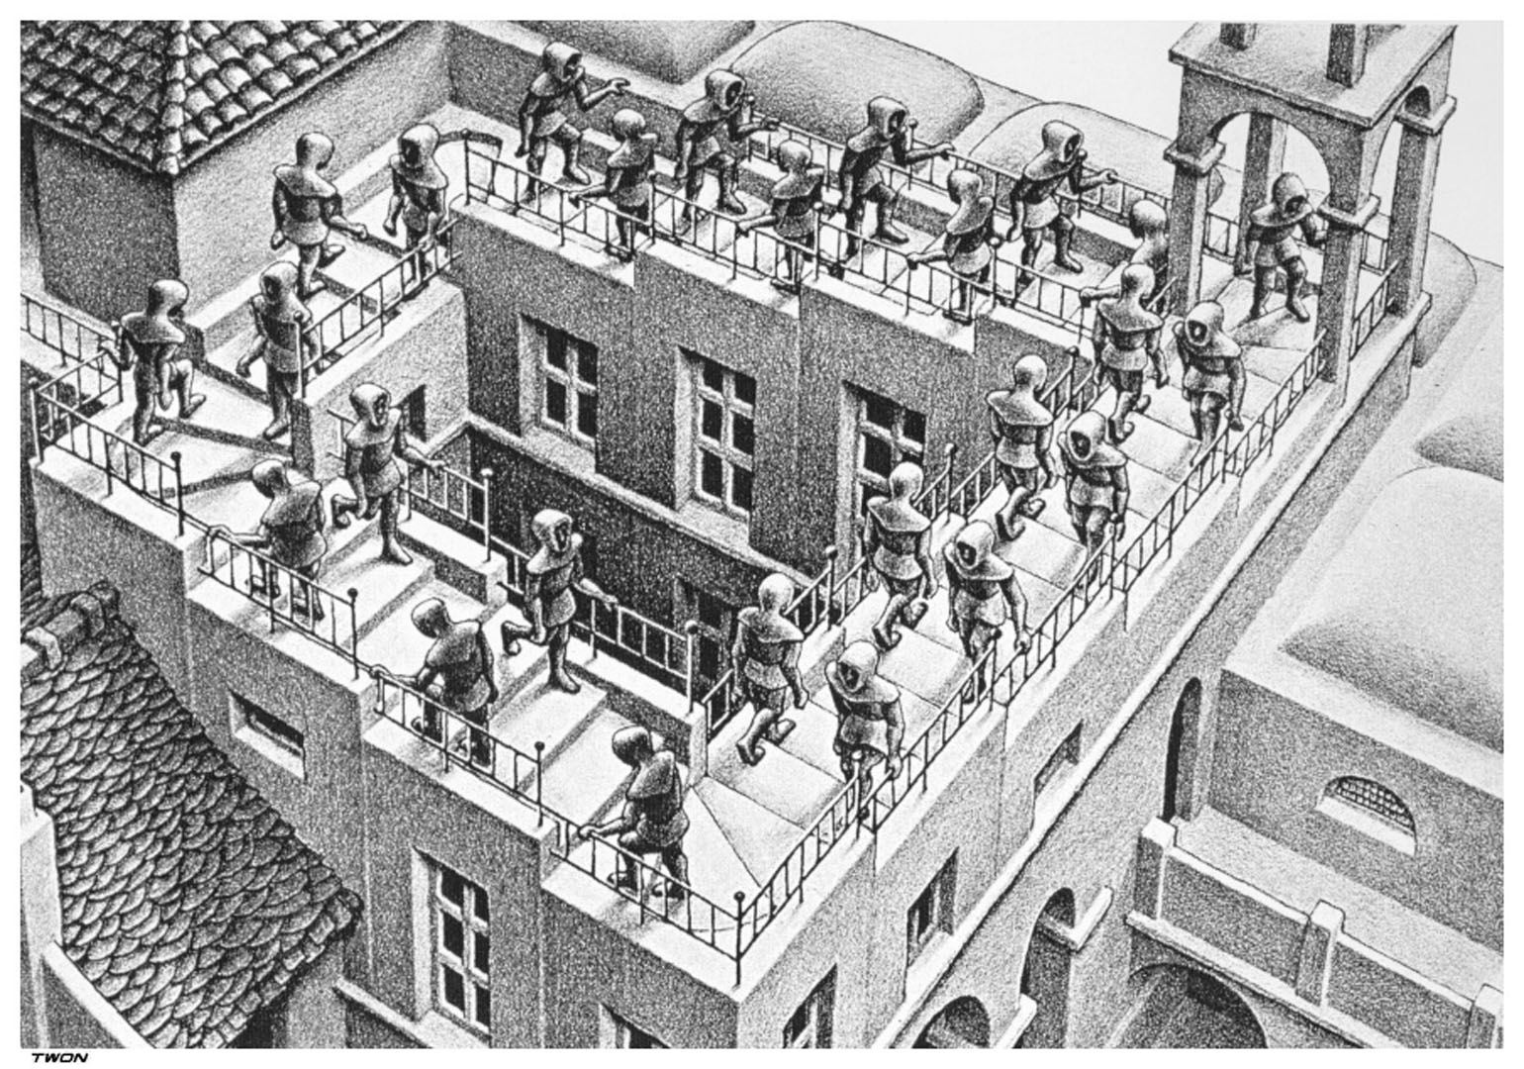

Slide 33
Are we always in trouble without ordering resources?
No, not always:
Ordered resource requests are sufficient to avoid deadlock, but not necessary
Convenient, but may be conservative
4
3
8
7

Slide 34
Q: What’s the rule of the road?
What’s the law? Does it resemble one of the rules we saw?
I can almost get across
Drat!
Notes:
See question on SurveyMonkey (linked off web page)

Slide 35
Summary
Deadlock prevention
  Imposes rules on what system can do
  These rules are conservative
  Most useful technique: ordered resources
  Application can do it; no special OS support
Next: dealing with deadlocks other ways
  Avoidance
  Detection & recovery

