Slide 1
Input/Output: Organization, Disk Performance, and RAID

Slide 2
An example I/O performance question:
How long does it take to rip a CD? Why?

Slide 3
I/O Device Examples and Speeds
I/O Speed: bytes transferred per second (from keyboard to Gigabit LAN: 7 orders of magnitude)
Device Behavior Partner Data Rate (KB/s)
Keyboard Input Human 0.01
Mouse Input Human 0.02
Audio Output Human 100.00
Magnetic Disk Storage Machine 10,000.00
Wireless Network I or O Machine 10,000.00
Graphics Display Output Human 30,000.00
Wired LAN Network I or O Machine 125,000.00
Bandwidth to GPU & Memory >1,000,000.00
Notes:
Here are some examples of the various I/O devices you are probably familiar with.
Notice that most I/O devices that has human as their partner usually has relatively low peak data rates because human in general are slow relatively to the computer system.
The exceptions are the laser printer and the graphic displays.
Laser printer requires a high data rate because it takes a lot of bits to describe high resolution image you like to print by the laser writer.
The graphic display requires a high data rate because as I will show you later in today’s lecture, all the color objects we see in the real world and taken for granted is very hard to replicate on a graphic display.
Let’s take a closer look at one of the most popular storage device, magnetic disks.
+2 = 28 min. (Y:08)

Slide 4
The Hardware (the motherboard)
CPU socket
Serial,
parallel,
and USB
ports
Memory slots
IDE drive
connectors
(Back)
(Front)
graphics card slot
PCI slots

Slide 5
How is it all connected? (Hierarchy!)
CPU
Memory
North Bridge
chip
Graphics
port
Video
card
PCI bus
South Bridge
chip
PCI slots
Networking
Sound card
Disk controller
Serial, parallel
and USB ports
Hard disks
CD-ROM

Slide 6
How does the data flow when you rip?
CPU
Memory
North Bridge
chip
Graphics
port
Video
card
PCI bus
South Bridge
chip
PCI slots
Networking
Sound card
Disk controller
Serial, parallel
and USB ports
Hard disks
CD-ROM

Slide 7
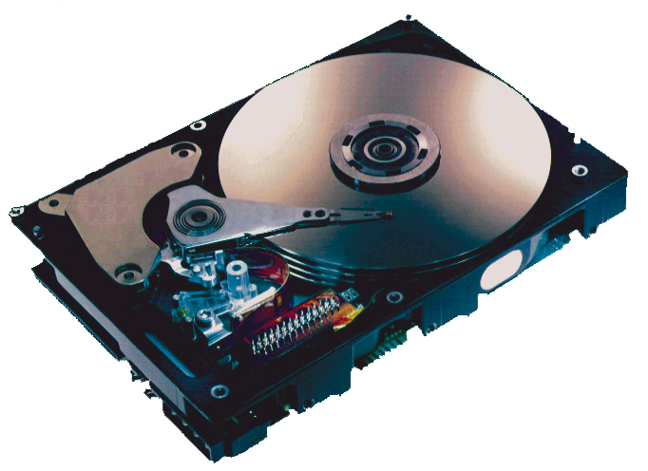
What’s Inside A Disk Drive?
Spindle
Arm
Platters
Actuator
Electronics
(including a
processor
and memory!)
SCSI
connector
Image courtesy of Seagate Technology

Slide 8
Disk Geometry
Disks consist of platters, each with two surfaces.
Each surface consists of concentric rings called tracks.
Each track consists of sectors separated by gaps.
Tracks
Surface
Track k
Gaps
Spindle
Sectors

Slide 9
Disk Geometry (Muliple-Platter View)
Aligned tracks form a cylinder.
Cylinder k
Surface 0
Platter 0
Surface 1
Surface 2
Platter 1
Surface 3
Surface 4
Platter 2
Surface 5
Spindle

Slide 10
Disk Capacity
Capacity: maximum number of bits that can be stored.
Vendors express capacity in units of gigabytes (GB), where 1 GB = 10⁹ Bytes.
Capacity is determined by these technology factors:
Recording density (bits/in): number of bits that can be squeezed into a 1 inch segment of a track.
Track density (tracks/in): number of tracks that can be squeezed into a 1 inch radial segment.
Areal density (bits/in2): product of recording and track density.

Slide 11
Computing Disk Capacity
Capacity = (# bytes/sector) x (avg. # sectors/track) x
(# tracks/surface) x (# surfaces/platter) x
(# platters/disk)
Example:
512 bytes/sector
300 sectors/track (on average)
20,000 tracks/surface
2 surfaces/platter
5 platters/disk
Capacity = 512 x 300 x 20000 x 2 x 5
= 30,720,000,000
= 30.72 GB

Slide 12
Disk Operation (Single-Platter View)
The disk surface
spins at a fixed
rotational rate
The read/write head
is attached to the end
of the arm and flies over
the disk surface on
a thin cushion of air.
spindle
spindle
spindle
spindle
spindle
By moving radially, the arm can position the read/write head over any track.

Slide 13
Disk Operation (Multi-Platter View)
Read/write heads
move in unison
from cylinder to cylinder
Arm
Spindle

Slide 14
Disk Structure - top view of single platter
Surface organized into tracks
Tracks divided into sectors
Notes:
Goal:
Show the inefficeincy of current disk requests.
Conveyed Ideas:
Rotational latency is wasted time that can be used to service tasks
Background Information:
None.
Slide Background:
None.
Kill text and arrows

Slide 15
Disk Access
Head in position above a track
Notes:
Goal:
Show the inefficeincy of current disk requests.
Conveyed Ideas:
Rotational latency is wasted time that can be used to service tasks
Background Information:
None.
Slide Background:
None.
Kill text and arrows

Slide 16
Disk Access
Rotation is counter-clockwise
Notes:
Goal:
Show the inefficeincy of current disk requests.
Conveyed Ideas:
Rotational latency is wasted time that can be used to service tasks
Background Information:
None.
Slide Background:
None.
Kill text and arrows

Slide 17
Disk Access – Read
About to read blue sector
Notes:
Goal:
Show the inefficeincy of current disk requests.
Conveyed Ideas:
Rotational latency is wasted time that can be used to service tasks
Background Information:
None.
Slide Background:
None.
Kill text and arrows

Slide 18
Disk Access – Read
After BLUE read
After reading blue sector
Notes:
Goal:
Show the inefficeincy of current disk requests.
Conveyed Ideas:
Rotational latency is wasted time that can be used to service tasks
Background Information:
None.
Slide Background:
None.
Kill text and arrows

Slide 19
Disk Access – Read
After BLUE read
Red request scheduled next
Notes:
Goal:
Show the inefficeincy of current disk requests.
Conveyed Ideas:
Rotational latency is wasted time that can be used to service tasks
Background Information:
None.
Slide Background:
None.
Kill text and arrows

Slide 20
Disk Access – Seek
After BLUE read
Seek for RED
Seek to red’s track
Notes:
Goal:
Show the inefficeincy of current disk requests.
Conveyed Ideas:
Rotational latency is wasted time that can be used to service tasks
Background Information:
None.
Slide Background:
None.
Kill text and arrows

Slide 21
Disk Access – Rotational Latency
After BLUE read
Seek for RED
Rotational latency
Wait for red sector to rotate around
Notes:
Goal:
Show the inefficeincy of current disk requests.
Conveyed Ideas:
Rotational latency is wasted time that can be used to service tasks
Background Information:
None.
Slide Background:
None.
Kill text and arrows

Slide 22
Disk Access – Read
After BLUE read
Seek for RED
Rotational latency
After RED read
Complete read of red
Notes:
Goal:
Show the inefficeincy of current disk requests.
Conveyed Ideas:
Rotational latency is wasted time that can be used to service tasks
Background Information:
None.
Slide Background:
None.
Kill text and arrows

Slide 23
Disk Access – Service Time Components
After BLUE read
Seek for RED
Rotational latency
After RED read
Data transfer
Seek
Rotational
latency
Data transfer
Notes:
Goal:
Show the inefficeincy of current disk requests.
Conveyed Ideas:
Rotational latency is wasted time that can be used to service tasks
Background Information:
None.
Slide Background:
None.
Kill text and arrows

Slide 24
Disk Access Time
Average time to access some target sector approximated by :
Taccess = Tavg seek + Tavg rotation + Tavg transfer
Seek time (Tavg seek)
Time to position heads over cylinder containing target sector.
Typical Tavg seek is 3—9 ms
Rotational latency (Tavg rotation)
Time waiting for first bit of target sector to pass under r/w head.
Tavg rotation = 1/2 x 1/RPMs x 60 sec/1 min
Typical Tavg rotation = 7200 RPMs
Transfer time (Tavg transfer)
Time to read the bits in the target sector.
Tavg transfer = 1/RPM x 1/(avg # sectors/track) x 60 secs/1 min.

Slide 25
Disk Access Time Example
Given:
Rotational rate = 6,000 RPM
Average seek time = 3 ms.
Avg # sectors/track = 400.
Time to access a random sector:
Tavg rotation =
Tavg transfer =
Taccess =
Important points:
Access time dominated by seek time and rotational latency.
First bit in a sector is the most expensive, the rest are free.
SRAM access time is about 4 ns/doubleword, DRAM about 60 ns
Disk is about 40,000 times slower than SRAM,
2,500 times slower then DRAM.

Slide 26
Disk Access Time Example
Given:
Rotational rate = 6,000 RPM
Average seek time = 9 ms.
Avg # sectors/track = 400.
Time to access a random sector:
Tavg rotation = 1/2 x (60 secs/6000 RPM) x 1000 ms/sec = 5 ms.
Tavg transfer = 60/6000 RPM x 1/400 secs/track x 1000 ms/sec = 0.025 ms
Taccess = 3 ms + 5 ms + 0.025 ms = 8.25ms
Important points:
Access time dominated by seek time and rotational latency.
First bit in a sector is the most expensive, the rest are free.
SRAM access time is about 4 ns/doubleword, DRAM about 60 ns
Disk is about 40,000 times slower than SRAM,
2,500 times slower then DRAM.

Slide 27
Disk Access Time Example, cont.
Given:
Rotational rate = 6,000 RPM
Average seek time = 3 ms.
Avg # sectors/track = 400.
Time to access 40 consecutive sectors: (20KB file = 40 sectors)
Tavg rotation =
Tavg transfer =
Taccess =
Time to read a whole track: (200KB file = 390 sectors)
Taccess =
Important points:
Try to lay out files contiguously for high bandwidth reading/writing!

Slide 28
Another piece of data.

Slide 29
Recording Zones:
Modern disks partition tracks into disjoint subsets called recording zones
Each track in a zone has the same number of sectors, determined by the circumference of innermost track.
Each zone has a different number of sectors/track
Outside tracks have more sectors
Same rotation speed
Higher MB/sec

Slide 30
Logical Disk Blocks
Modern disks present a simpler abstract view of the complex sector geometry:
The set of available sectors is modeled as a sequence of b-sized logical blocks (0, 1, 2, ...)
Mapping between logical blocks and actual (physical) sectors
Maintained by hardware/firmware device called disk controller.
Converts requests for logical blocks into (surface,track,sector) triples.
Allows controller to set aside spare cylinders for each zone.
Accounts for the difference in “formatted capacity” and “maximum capacity”.

Slide 31
Solid State Disks (SSDs)
I/O bus
Requests to read and
write logical disk blocks
Solid State Disk (SSD)
Flash
translation layer
Flash memory
Block 0
Block B-1
…
…
…
Page 0
Page 1
Page P-1
Page 0
Page 1
Page P-1
Pages: 512KB to 4KB, Blocks: 32 to 128 pages
Data read/written in units of pages.
Page can be written only after its block has been erased
A block wears out after 100,000 repeated writes.

Slide 32
SSD Performance Characteristics
Sequential read tput 250 MB/s Sequential write tput 170 MB/s
Random read tput 140 MB/s Random write tput 14 MB/s
Rand read access 30 us Random write access 300 us
Why are random writes so slow?
Erasing a block is slow (around 1 ms)
Write to a page triggers a copy of all useful pages in the block
Find an used block (new block) and erase it
Write the page into the new block
Copy other pages from old block to the new block

Slide 33
SSD Tradeoffs vs Rotating Disks
Advantages
No moving parts → faster, less power, more rugged
Disadvantages
Have the potential to wear out
Mitigated by “wear leveling logic” in flash translation layer
E.g. Intel X25 guarantees 1 petabyte (10¹⁵ bytes) of random writes before they wear out
In 2010, about 100 times more expensive per byte
Applications
MP3 players, smart phones, laptops
Beginning to appear in desktops and servers

Slide 34
Storage Trends
SRAM
Metric 1980 1985 1990 1995 2000 2005 2010 2010:1980
$/MB 19,200 2,900 320 256 100 75 60 320
access (ns) 300 150 35 15 3 2 1.5 200
DRAM
Metric 1980 1985 1990 1995 2000 2005 2010 2010:1980
$/MB 8,000 880 100 30 1 0.1 0.06 130,000
access (ns) 375 200 100 70 60 50 40 9
typical size (MB) 0.064 0.256 4 16 64 2,000 8,000 125,000
Disk
Metric 1980 1985 1990 1995 2000 2005 2010 2010:1980
$/MB 500 100 8 0.30 0.01 0.005 0.0003 1,600,000
access (ms) 87 75 28 10 8 4 3 29
typical size (MB) 1 10 160 1,000 20,000 160,000 1,500,000 1,500,000

Slide 35
RAID : Redundant Array of Inexpensive Disks
Problem: Disks fail -> total data loss
Improving reliability of a disk is expensive.
Cheaper just to buy a few extra disks.
Idea: ECC for your disks
Files are “striped” across multiple disks
Redundancy yields high data availability
Disks will still fail
Contents reconstructed from data redundantly stored in the array
⇒ Capacity penalty to store redundant info
⇒ Bandwidth penalty to update redundant info
A multi-billion industry 80% non-PC disks sold in RAIDs

Slide 36
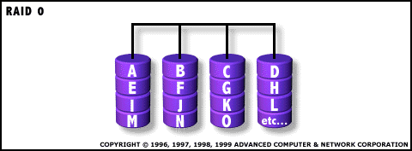
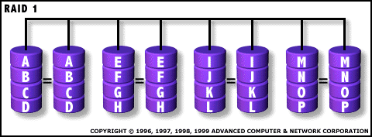
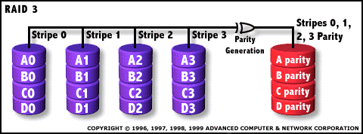
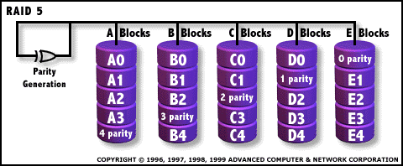
Common RAID configurations
RAID 0 No redundancy, Fast access
RAID 1
Mirror Data, most expensive sol’n
RAID 3/4
Parity drive protects against 1 failure
RAID 5
Rotated parity across all drives

Slide 37
Summary
I/O devices are much slower than processors.
Engineered to be accessible, but to not slow down computation
Spindle-based devices:
Access time = seek time + rotational delay + transfer time
Lay files out contiguously!
RAID: Redundant Array of Inexpensive Disks
Achieve reliable storage, but not by making reliable disks
Use redundancy (e.g., parity) to reconstruct lost disk

