Slide 1
Induction
http://www.picshag.com/recursive-painting.html
Discrete Structures (CS 173)
Madhusudan Parthasarathy, University of Illinois

Slide 2
Last lecture: graphs and 2-way bounds
Terminology for graph connectivity
Walk, path, cycle, acyclic, closed, Euler circuit, distance, diameter, connected components
Graph coloring and how to apply it
How to use two-way bounding in a variety of settings

Slide 3
Two-way bounding: set equality
Claim: For any integer $k$, $A=\{3ik+5jk:i, j are integers\}$ is equal to $B=\{multiples of k\}$.

Slide 4
This lecture (and next): Induction
What is induction
Examples

Slide 5
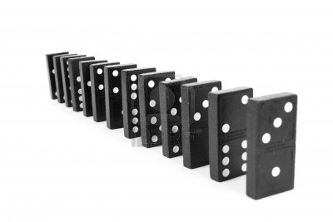
Does domino n fall?

Slide 6
Does domino n fall?
Suppose domino k falls. Then domino k+1 falls.
$$fall\left(k\right)→fall(k+1)$$

Slide 7
Does domino n fall?
Suppose domino k falls. Then domino k+1 falls.
$$fall\left(k\right)→fall(k+1)$$
The first domino falls
$$fall\left(1\right)=T$$

Slide 8
Induction
Inductive hypothesis: Suppose domino k falls.
Inductive conclusion: Domino k+1 falls.
Base case: The first domino falls.

Slide 9
Simple math example
Claim: $\sum_{i=1}^{n}{i=\frac{n(n+1)}{2}}$ for all natural integers $n$.

Slide 10

Basic structure of induction proof
Claim: $P\left(n\right) for all n=0, 1, 2, 3…$
Inductive step: $k. P\left(k\right)→P(k+1)$
$k. P\left(0\right), P\left(1\right), …P\left(k\right)→P(k+1)$
$$k. ( ∀0≤i≤k. P\left(i\right) )→P(k+1)$$
Base case: $P(0)$ is true.
Weak Induction
Inductive conclusion
Inductive hypothesis
Strong Induction
Inductive conclusion
Inductive hypothesis

Slide 11
Another math example
Claim: For $n=2, 3, 4,…$, $\sum_{i=2}^{n}{i2^{i}=\left(n−1\right)2^{n+1}.}$

Slide 12
Number theory example
Claim: For any natural integer $n$, $n^{3}−n$ is divisible by $3$.

Slide 13
Geometrical example
Claim: For any positive integer $n$, a $2^{n}×2^{n}$ checkerboard with one corner square removed can be tiled using right triminos.
right trimino
$$2^{1}×2^{1}$$
$$2^{2}×2^{2}$$

Slide 14
Things to remember
Induction requires demonstrating a base case and an inductive step
Inductive step usually involves showing that $P\left(k\right)→P\left(k+1\right)$ or $P\left(all n up to k\right)→P(k+1)$
Typically, this requires writing $P(k+1)$ in terms of $P\left(k\right)$

Slide 15
Next class
Induction with graphs, stamps, and games

