Slide 1
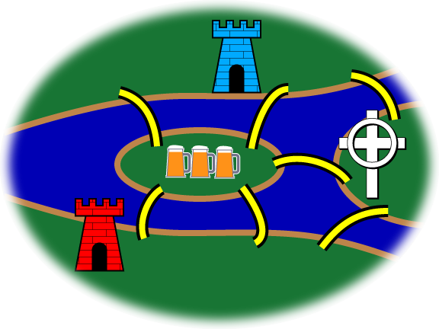
Graphs and 2-Way Bounding
http://en.wikipedia.org/wiki/File:7_bridgesID.png
Discrete Structures (CS 173)
Madhusudan Parthasarathy, University of Illinois

Slide 2
Last Lecture: Graphs
How to represent graphs?
What are the properties of a graph?
Degrees, special types
When are two graphs isomorphic, having the same structure?

Slide 3
Isomorphism example
e
3
2
b
a
1
d
4
c
5
overhead

Slide 4
Today’s lecture
Subgraphs
How do we characterize connectivity and walks in graphs?
What is graph coloring and what is it good for?
What are bipartite graphs and why are they important?
Methods and applications for 2-way bounding

Slide 5
Subgraphs

Slide 6
Subgraphs and isomorphisms

Slide 7
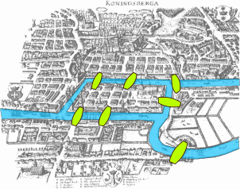
Bridges of Konigsberg
Possible to cross all bridges exactly one and end up where you started?
First theorem of graph theory!
Image source: http://en.wikipedia.org/wiki/File:Konigsberg_bridges.png
Notes:
Add picture

Slide 8
Terminology of walks
walk: sequence of connected nodes/edges
closed walk: start and end point are the same
path: walk with no node used more than once
b
c
f
a
d
e
overhead

Slide 9
Terminology of walks
cycle: closed walk with 3+ nodes, no nodes except the first/last used more than once
acyclic: graph without cycles
Euler circuit: closed walk that uses each edge exactly once
b
c
f
a
d
e
overhead

Slide 10
Bridges of Konigsberg
Possible to cross all bridges exactly one and end up where you started?
overhead
Notes:
Solution: Rewrite as a 4 node graph. All nodes must have even degree to have a Euler circuit, so no.

Slide 12
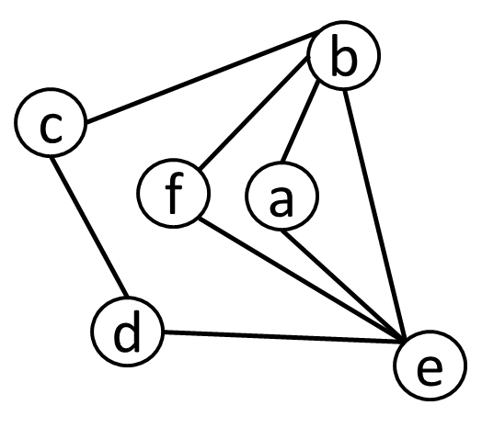
More connectivity terminology
The distance of two nodes is the minimum number of edges that forms a walk from one node to the other.
The diameter of a graph is the maximum distance between any two nodes in a graph.
Notes:
Application to finding image regions

Slide 13
More connectivity terminology
A graph is connected if there is a walk between any two nodes.
A connected component is a subset of nodes that are connected to each other but not connected to any other nodes.
overhead
Notes:
Application to finding image regions

Slide 14
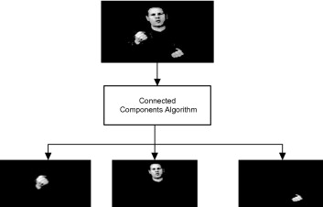
Connected components application
Many applications for finding connected pixels corresponding to boundaries or regions

Slide 15
Coloring
graph coloring: a labeling of nodes such that no two adjacent nodes have the same label
chromatic number: the minimum number of labels required for a coloring
cycles, wheels, complete, grid
overhead
Notes:
Examples of coloring various graphs, explain applications

Slide 16
Applications of coloring
Making a map
How many exam variations to make so that neighbors have different copies?
overhead
Notes:
Examples of coloring various graphs, explain applications

Slide 17
Applications of coloring
Choosing a wardrobe
overhead
Notes:
Examples of coloring various graphs, explain applications

Slide 18
Bipartite graphs
$G=\left(V, E\right)$ is bipartite if we can split $V$ into two non-overlapping sets $V1$ and $V2$, such that all edges connect $vi∈V1$ and $vj∈V2$
All graphs that can be two-colored are bipartite.
Complete bipartite graph $Km,n$:$\left|V1\right|=m$, $\left|V2\right|=n$ , all nodes in $V1$ have edges to all nodes in $V2$
overhead

Slide 19
Application: bipartite graph matching
The National Residency Matching Program
Med students give their preferences for residency jobs
Residency locations give their preferences for Med students
Solve for the maximum matching
overhead
Notes:
Dance partners, edge matching in computer vision

Slide 20
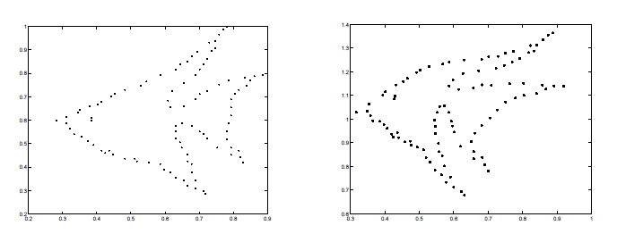
Application: bipartite graph matching
Computer vision
Get soft correspondence between points, with a cost of matching each point on left to each point on right
Find the “match” with the lowest cost (find a subset of edges that do not share an endpoint)
Notes:
Dance partners, edge matching in computer vision

Slide 21
Two-way bounding: graph coloring
What is the chromatic number?

Slide 22
Two-way bounding: marker making
How many 3x3” crosses can be cut out of a 12x15” sheet of paper?
overhead
Notes:
Lots of applications

Slide 24
Two-way bounding: set equality
Claim: For any integer $k$, $A=\{3ik+5jk:i, j are integers\}$ is equal to $B=\{multiples of k\}$.

Slide 25
Things to remember
Terminology for graph connectivity
Walk, path, cycle, acyclic, closed, Euler circuit, distance, diameter, connected components
Graph coloring and how to apply it
How to use two-way bounding in a variety of settings

Slide 26
Next class
Induction

