Slide 1
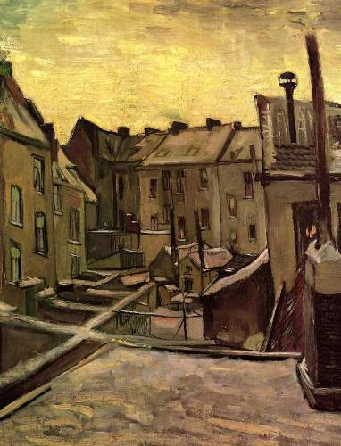
Graphs and Isomorphisms
Backyards of Old Houses in Antwerp in the Snow
Van Gogh
Discrete Structures (CS 173)
Madhusudan Parthasarathy, University of Illinois

Slide 2
Administrative
How was the exam?
Midterm graded by Friday next week (hopefully)
Remember: homework this week and discussions this week continue…

Slide 3
Proof with one-to-one
Let A, B be subsets of reals.
Claim: Any strictly increasing function from A to B is one-to-one.
Definition: $f:A→B$is one-to-one iff $∀x,y∈A, (x≠y)→(f\left(x\right)≠f\left(y\right))$
Definition: $f:A→B, f(x)$ is strictly increasing iff $∀x,y∈A, (x<y)→(f\left(x\right)<f\left(y\right))$
overhead
Notes:
Note that second case is often more useful

Slide 4
Permutations
Ordered selection
Suppose I have 6 gems, and you get to choose 1. How many different combinations of gems can you choose?
Suppose I have $n$ gems and want to put them in a row from left to right. How many different ways can I arrange them?
Suppose I have 6 gems and want to put three of them in a row from left to right. How many different ways can I arrange them?
Unordered selection
Suppose I have 6 gems, and you get to choose 2. How many different combinations of gems can you choose?
Suppose I have $n$ gems, and you choose $k≤n$. How many combinations?

Slide 5
Permutations
Suppose $f:A→B$ with $\left|A\right|=k$ and $\left|B\right|=n$. How many different one-to-one functions can I create? $P(n,k)$
How many ways can I rearrange the letters in “nan”?
How many ways can I rearrange the letters in “yellowbelly”?

Slide 6
Graphs
How to represent graphs?
What are the properties of a graph?
Degrees, special types
When are two graphs isomorphic, having the same structure?

Slide 7
Fastest path from Chicago to Bloomington?

Slide 8
Fastest path from Chicago to Bloomington?

Slide 9
Fastest path from Chicago to Bloomington?
start
2
1
3
end
4

Slide 10
Fastest path from Chicago to Bloomington?
start
C
2
1
20
30
4
15
1
2
120
35
3
110
4
60
90
end
B
3

Slide 11
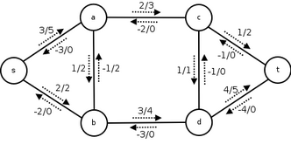
Other applications of graphs
Modeling the flow of a network
Traffic, water in pipes, bandwidth in computer networks, etc.

Slide 12
Basics of graphs
Graph = (V, E)
Terminology: vertex/node, edge, neighbor/adjacent, directed vs. undirected, simple graph, degree of a node
overhead

Slide 14
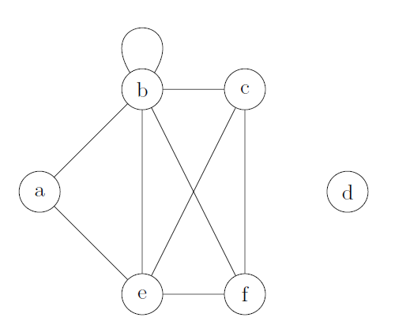
Degrees and handshaking theorem
Loops count twice
overhead

Slide 15
Types of graphs
$Kn$: complete graph with $n$ nodes
How many edges does each type have?
overhead

Slide 16
Types of graphs
$Cn$: cycle graph with $n$ nodes
$Wn$: wheel graph with $n+1$ nodes
How many edges does each type have?
overhead

Slide 17
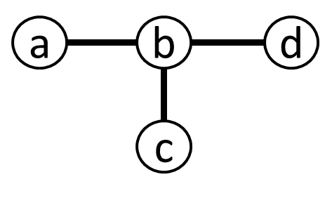
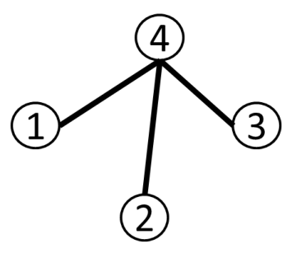
Isomorphism
An isomorphism from $G1=(V1,E1)$ to $G2=(V2,E2)$ is a bijection $f:V1→V2$ such that any pair of nodes $a$ and $b$ are joined by an edge iff $f(a)$ and $f\left(b\right)$ are joined by an edge
Two graphs are isomorphic if there is an isomorphism between them
overhead

Slide 18
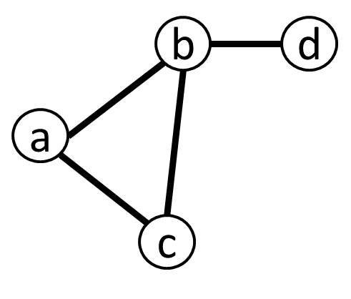
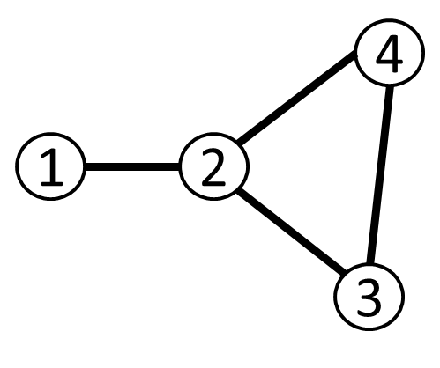
Isomorphism examples
An isomorphism from $G1=(V1,E1)$ to $G2=(V2,E2)$ is a bijection $f:V1→V2$ such that any pair of nodes $a$ and $b$ are joined by an edge iff $f(a)$ and $f\left(b\right)$ are joined by an edge
overhead

Slide 19
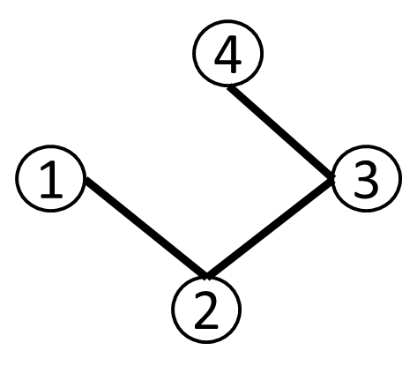
Isomorphism examples
An isomorphism from $G1=(V1,E1)$ to $G2=(V2,E2)$ is a bijection $f:V1→V2$ such that any pair of nodes $a$ and $b$ are joined by an edge iff $f(a)$ and $f\left(b\right)$ are joined by an edge
overhead

Slide 20
Requirements for graphs to be isomorphic
overhead
Notes:
Draw graph with different number of nodes, different number of edges, nodes with differing degrees, different subgraphs

Slide 21
Requirements for two graphs to be isomorphic
Same number of nodes and edges
Same number of nodes of degree $k$
Every subgraph in the first must have a matching subgraph in the second

Slide 22
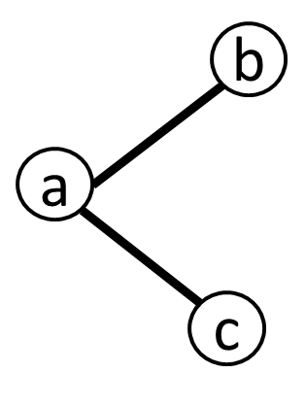
Automorphism: an isomorphism from a graph to itself
Automorphisms identify symmetries in the graph
How many different automorphisms?
$$C4$$
$$C6$$
overhead

Slide 23
Small graphs without non-trivial automorphism?
overhead

Slide 24
Isomorphism is an equivalence relation: reflexive, symmetric, and transitive

Slide 25
Things to remember
A graph is defined by a set of nodes and a set of edges that connect them
Be able to identify types of graphs and degrees of nodes
Be able to identify isomorphisms (or lack thereof) between graphs

Slide 26
Next week: more graphs and induction

