Slide 1
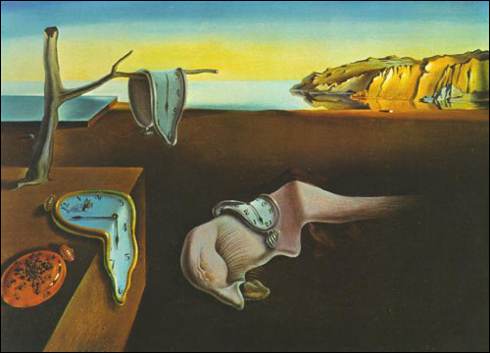
Congruence and Sets
Dali - “The Persistence of Memory”
Discrete Structures (CS 173)
Madhusudan Parthasarathy, University of Illinois

Slide 2
Review of Last Class
Counting, natural numbers, and integers
Representation of numbers: unary, Roman, decimal, binary
Divisibility: a| b iff b =ma for some integer m
Prime numbers and composite numbers
GCD and LCM
$gcd⁡(a,b)$ is the largest integer that divides both $a$ and $b$ $\text{lcm}(a,b)$ is the smallest integer that both $a$ and $b$ divide
Euclidean algorithm for computing gcd
p and q are relatively prime if they have no common prime factors.
i.e., gcd(p.q) = 1

Slide 3
Goals of this lecture
Introduce the concept of congruence mod k
$$3≡15 (\text{mod} 12)$$
Be able to perform modulus arithmetic
Rationals
Reals

Slide 4
Applications of congruence
bitwise operations
error checking
computing 2D coordinates in images
encryption
telling time
etc.

Slide 5
Congruence mod k
Two integers are congruent mod k if they differ by an integer multiple of k
Definition: If $k$ is any positive integer, two integers $a$ and $b$ are congruent mod k iff $k$ divides $(a−b)$
$$a≡b \left(mod k\right) ↔ k | (a−b)$$

Slide 6
Examples of congruent mod k
overhead

Slide 10
Modulus addition proof
Claim: For any integers $a, b, c, d, k$ with $k>0$, if $a≡b (mod k)$ and $c≡d (mod k)$ then $\left(a+c\right)≡(b+d) (mod k)$
Definition: $a≡b \left(mod k\right) ↔ k | (a−b)$
overhead

Slide 12
Modulus multiplication proof
Claim: For any integers $a, b, c, d, k$ with $k>0$, if $a≡b (mod k)$ and $c≡d (mod k)$ then $ac≡bd (mod k)$
Definition: $a≡b \left(mod k\right) ↔ k | (a−b)$
overhead

Slide 13
Equivalence classes with modulus
The equivalence class of integer $x$ (written $[x]$) is the set of all integers congruent to $x (\text{mod} k)$
In (mod 7), $\left[3\right]=\{…,−11, −4, 3, 10, 17, …\}$
In (mod 5), $\left[3\right]=\{…, −7, −2, 3, 8, 13, …\}$
In $Z5$, $\left[3\right]=\left[8\right]=[−2]$

Slide 14
Modulus arithmetic
$$\left[x\right]+\left[y\right]=[x+y]$$
$$\left[x\right]∗\left[y\right]=[x∗y]$$
overhead

Slide 15
RSA Key Generation
Creating the public and private keys for encryption/decryption
Choose two prime numbers $p$ and $q$
$n=pq$
$k=(p−1)(q−1)$
Choose an integer $e$ such that $e≤k$ and $e$ is relatively prime with $k$
Solve for $de≡1\left(\text{mod} k\right)$ (e.g., with extended Euclidean algorithm)
Using the keys
Public key: $n, e$
Private key: $d$
Encryption
Turn message into an integer $m$
Coded message $c≡m^{e}(\text{mod} n)$
Decryption
Original message $m≡c^{d}(\text{mod} n)$

Slide 16
Rationals

Slide 17
Reals

Slide 18
Another congruence proof
Claim: If $n$ is odd, then $n^{2}≡1 (mod 8)$
Definition: $a≡b \left(mod k\right) ↔ k | (a−b)$
overhead

Slide 19
Sets
Topics: lists, set builders, tuples vs. sets, equivalence, cardinality, subsets and supersets
overhead

Slide 20
Things to remember
Concept of congruence mod k, it’s definition in terms of divide, and equivalence classes
Many applications in CS
The key to modular arithmetic is keeping numbers small
Concept of sets and set equivalence

Slide 21
Thank you
Next week: sets and relations

