Slide 1
Number Theory: Factors and Primes
01/29/13
Boats of Saintes-Maries
Van Gogh
Discrete Structures (CS 173)
Madhusudan Parthasarathy, University of Illinois

Slide 2
Counting, numbers, 1-1 correspondence

Slide 3
Representation of numbers
Unary
Roman
Positional number systems: Decimal, binary

Slide 4
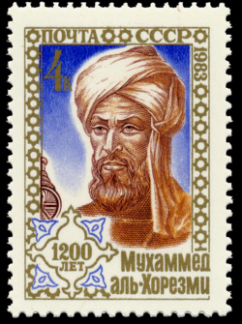
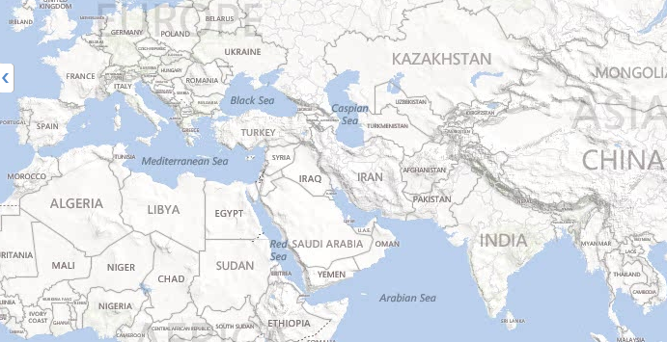
ALGORITHMS
al-Khwārizmī : Persian mathematician,
astronomer
“On the calculation with Hindu numerals”; 825 AD decimal positional number system
ZERO (500 AD)

Slide 5
Natural numbers and integers
Natural numbers: $ℕ=\left\{0, 1, 2, …\right\}$
closed under addition and multiplication
Integers: $ℤ=\left\{0, −1,1,−2,2,…\right\}$
closed under addition, subtraction, multiplication (but not “division”)

Slide 6
Divisibility
Suppose $a$ and $b$ are integers.
Then $a$ divides $b$ iff $b=an$ for some integer $n$.
Example: $5 | 55$ because $55=5∗11$
“$a$ divides $b$” $≡$ “$a | b$”
$a$ is a factor or divisor of $b$
$b$ is a multiple of $a$

Slide 7
Examples of divisibility
($a | b$) $↔$ ($b=an)$, for some integers $n$
Which of these holds?
4 | 12 11 | -11
4 | 4 -22 | 11
4 | 6 7 | -15
12 | 4 4 | -16
6 | 0
0 | 6

Slide 8
Proof with divisibility
Claim: For any integers $a,b,c$, if $a|b$ and b$|c$, then $a|c$.
Definition: integer $a$ divides integer $b$ iff $b=an$ for some integer $n$
Notes:
Assume a|b and b|c.
Then b=an and c=bm
So c=bn=amn.
So a|c.

Slide 9
Proof with divisibility
Claim: For any integers $a,x,y,b,c$, if $a|x$ and $a|y$, then $a|bx+cy$.
Definition: integer $a$ divides integer $b$ iff $b=an$ for some integer $n$
Notes:
Let a|x and a|y.
Then x=an and y=am
So bx+cy=abn+acm = a(bn+cm).
Hence a| (bx+cy).

Slide 10
Prime numbers
Definition: an integer $q≥2$ is prime if the only positive factors of $q$ are $1$ and $q$.
Definition: an integer $q≥2$ is composite if it is not prime.
Primality is in P! [AKS02]
Fundamental Theorem of Arithmetic
(aka unique factorization theorem)
Every integer $≥2$ can be written as the product of one or more prime factors. Except for the order in which you write the factors, this prime factorization is unique.
600=2*3*4*5*5

Slide 11
GCD
Greatest common divisor (GCD) for natural numbers a and b: $gcd⁡(a,b)$ is the largest number that divides both $a$ and $b$
max { n | n ∈ N, n | a and n | b}.
Defined only if { n | n ∈ N, n | a and n | b} has a maximum.
So defined iff at least one of a and b is non-zero.
Product of shared factors of $a$ and $b$
Relatively prime: $a$ and $b$ are relatively prime if they share no common factors, so that $\gcd\left(a,b\right)=1$

Slide 12
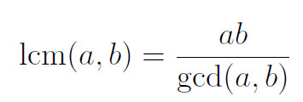
LCM
Least common multiplier (LCM): $\text{lcm}\left(a,b\right)$ is the smallest number that both $a$ and $b$ divide
lcm(a,b) = min{ p | p ∈ N, p >0, a|p and b|p }.
lcm(0,b)=lcm(a,0)=0 by definition.

Slide 13
Factor examples
gcd(5, 15) =
gcd(0, k) =
gcd(8, 12) =
gcd(8*m, 12*m) =
lcm(120, 15) =
lcm (6, 8) =
Which of these are relatively prime?
6 and 8?
5 and 21?
6 and 33?
3 and 33?
Any two prime numbers?

Slide 14
Computing the gcd
Naïve algorithm: factor a and b and compute gcd… but no one knows how to factor fast!
E.g., if $a=31$ and $b=5$, $q=6$ and $r=1$

Slide 15
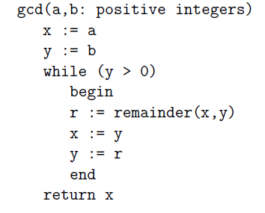
Euclidean algorithm for computing gcd
$\text{remainder}\left(a,b\right)$ is the remainder when $a$ is divided by $b$
$$gcd⁡(969,102)$$
x
y
$$r\text{=}\text{remainder}\left(x,y\right)$$

Slide 16
Euclidean algorithm for computing gcd
$\text{remainder}\left(a,b\right)$ is the remainder when $a$ is divided by $b$
$$gcd⁡(3289,1111)$$
x
y
$$r\text{=}\text{remainder}\left(x,y\right)$$

Slide 17
Recursive Euclidean Algorithm

Slide 18
But why does Euclidean algorithm work?
Euclidean algorithm works iff $\gcd\left(a,b\right)=\gcd\left(b,r\right)$, where $r=\text{remainder}(a,b)$

Slide 19
Proof of Euclidean algorithm
Claim: For any integers $a, b, q, r$, with $b>0$, if $a=bq+r$ then $\gcd\left(a,b\right)=gcd⁡(b,r)$.

Slide 20
Next class
More number theory: congruences
Rationals and reals

